Slide 1
LAY ASIDE…
Text: Heb. 12:1; Js. 1:21; I Pet. 2:1
Notes:
By Nathan L Morrison for Sunday 09/10/17
All Scripture given is from NASB unless otherwise stated
For further study or if questions, Call: 804-277-1983, or Visit: www.courthousechurchofchrist.com
Sermon idea from Mark Posey

Slide 2
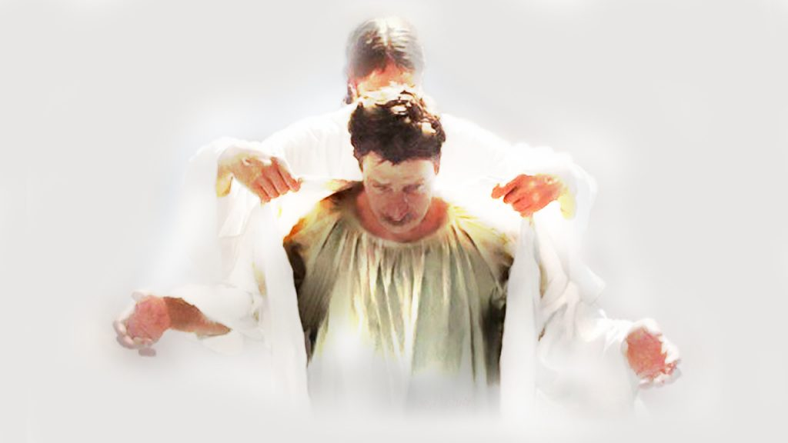
Intro
There are things we are told to “put on”…
Col. 3:12-14 (“Put on” = G1746 enduō: “to envelope in, clothe with”)
12. So, as those who have been chosen of God, holy and beloved, put on a heart of compassion, kindness, humility, gentleness and patience;
13. bearing with one another, and forgiving each other, whoever has a complaint against anyone; just as the Lord forgave you, so also should you.
14. Beyond all these things put on love, which is the perfect bond of unity.
Compassion
Kindness
Humility
Gentleness
Patience
Forgiveness
Love

Slide 3
Intro
While there are things we are told to “put on,” there are also things saints are told to “Lay Aside” (take off)…

Slide 4
Lay Aside…
Heb. 12:1-2
1. Therefore, since we have so great a cloud of witnesses surrounding us, let us also LAY ASIDE every encumbrance and the sin which so easily entangles us, and let us run with endurance the race that is set before us,
2. fixing our eyes on Jesus, the author and perfecter of faith, who for the joy set before Him endured the cross, despising the shame, and has sat down at the right hand of the throne of God.
Lay Aside
Strong’s: Greek apotithēmi [ap-ot-eeth'-ay-mee] (G659):
From G575 and G5087; to put away (literally or figuratively): - cast off, lay apart (aside, down), put away (off).
Thayer on apotithēmi (G659):
Verb; “to put off or aside or away”
Notes:
Emphasis in Scripture mine!

Slide 5
Lay Aside…
Every weight and sin – Heb. 12:1
Weight: ogkos [ong'-kos] (G3591):
A mass (as bending or bulging by its load), that is, burden (hindrance): - weight (Strong’s)
Occurring only here, and translated “weight” (KJV) or “encumbrance” (NASB), refers to “bulk, an encumbrance” (Thomas 3591).
BDAG defines it as “(1) material that is ponderously large, bulk; (2) that which hinders one from doing something, weight, burden, impediment, a figurative extension of 1.”
Heb. 12:1 can thus be rendered “setting aside everything that serves as a hindrance”
Sin: hamartia [ham-ar-tee’-ah] (G266):
From G264; sin (properly abstract): - offence, sin (-ful). (Strong’s)
Thayer: Identical to G264; “to miss the mark; to err, be mistaken”
Notes:
BDAG: Bauer–Danker–Arndt–Gingrich (BDAG) or sometimes the Bauer-Danker Lexicon, a Greek-English Lexicon. (https://en.wikipedia.org/wiki/Bauer%27s_Lexicon)

Slide 6
Lay Aside…
Every weight and sin – Heb. 12:1
Weight of Worry:
Lay aside the weight of worry (anxiousness) – Mt. 6:25-34
While worry is not inherently sinful, it can cause unfruitfulness (Mt. 13:22: Worry of the world; Lk. 10:38-42: Martha worried & bothered by so many things she missed out on what really mattered!)
Worry is burdensome (II Cor. 11:28; Col. 2:1-2)
“Be anxious for nothing…” (Phil. 4:6)
Cast your anxiety on Jesus, for He cares for you (I Pet. 5:7)

Slide 7
Lay Aside…
Every weight and sin – Heb. 12:1
Weight of Worry – Mt. 6:25-34; 13:22; Lk. 10:38-42; II Cor. 11:28; Col. 2:1-2
Weight of Worldliness – I Jn. 2:15-17:
Lust of the flesh (King David and Bathsheba – II Sam. 11) – Eph. 5:3; Col. 3:5 – David suffered consequences (II Sam. 12:7-15; Eph. 4:22; Ps. 32:1-5)
Lust of the eyes (covetousness & greed = idolatry – Col. 3:5) – I Tim. 6:7-10, 17-19: The pursuit of wealth has brought men of faith to ruin & destruction! Let us pursue treasure that never fades away! (I Pet. 1:4)
Pride of life – Scriptures say a lot about the consequences of pride! (James 4:6-10)
(Prov. 8:13; 11:2; 14:16; 15:25; 16:5, 18‐19; 21:24; 28:25; 30:11‐14)

Slide 8
Lay Aside…
James 1:21
21. Therefore, PUTTING ASIDE all filthiness and all that remains of wickedness, in humility receive the word implanted, which is able to save your souls.
Wickedness – James 1:21
Kakia [kak-ee’-ah] (G2549) – Strong’s:
From G2556; badness, that is, (subjectively) depravity, or (actively) malignity, or (passively) trouble: - evil, malice (maliciousness), naughtiness, wickedness.
Thayer also calls it “wickedness and depravity” & “wickedness that is not ashamed to break laws”
Rom. 1:29: Called “evil”
Eph. 4:31; Col. 3:8: Called “Malice”
Notes:
Emphasis in Scripture mine!

Slide 9
Lay Aside…
I Pet. 2:1
1. Therefore, PUTTING ASIDE all malice and all deceit and hypocrisy and envy and all slander,
All Malice – I Pet. 2:1
Kakia [kak-ee’-ah] (G2549) – Strong’s:
From G2556; badness, that is, (subjectively) depravity, or (actively) malignity, or (passively) trouble: - evil, malice (maliciousness), naughtiness, wickedness
James 1:21: Called “wickedness”
Rom. 1:29: Called “evil”–Fall of society when full of evil
Eph. 4:31; Col. 3:8: Called “Malice”
Notes:
Emphasis in Scripture mine!

Slide 10
Lay Aside…
I Pet. 2:1
1. Therefore, PUTTING ASIDE all malice and all deceit and hypocrisy and envy and all slander,
All Malice – I Pet. 2:1
All Deceit – I Pet. 2:1
Dolos [dol’-os] (G1388) – Strong’s:
From dellō (an obsolete primary probably meaning to decoy; compare G1185); a trick (bait), that is, (figuratively) wile: - craft, deceit, guile, subtilty.
Mark 7:20-23: Jesus said “deceit” is product of “evil thought”
John 1:47: Jesus said of Nathanael, “Behold, an Israelite indeed, in whom there is no deceit!”
Rom. 1:29: Society’s downfall is when men are full of “evil & deceit” as well as many other evil things!
I Pet. 2:22: Jesus had no “deceit” in Him – we are to be the same (I Pet. 3:10) – “laying aside falsehood” (Eph. 4:25)
Notes:
Emphasis in Scripture mine!

Slide 11
Lay Aside…
I Pet. 2:1
1. Therefore, PUTTING ASIDE all malice and all deceit and hypocrisy and envy and all slander,
All Malice – I Pet. 2:1
All Deceit – I Pet. 2:1
All Hypocrisy – I Pet. 2:1
Hupokrisis [hoop-ok'-ree-sis] (G5272) – Strong’s:
From G5271; acting under a feigned part; that is, (figuratively) deceit (“hypocrisy”): - condemnation, dissimulation, hypocrisy.
Mt. 23:28: Jesus called the religious leaders “full of hypocrisy and lawlessness”
Gal. 2:13: Peter’s hypocrisy led other Jewish believers along with Barnabas into committing “hypocrisy”
I Tim. 4:1-3: Paul warned Timothy some would fall away from the faith due to the “hypocrisy” of false teachers!
Notes:
Emphasis in Scripture mine!

Slide 12
Lay Aside…
I Pet. 2:1
1. Therefore, PUTTING ASIDE all malice and all deceit and hypocrisy and envy and all slander,
All Malice – I Pet. 2:1
All Deceit – I Pet. 2:1
All Hypocrisy – I Pet. 2:1
All Envy – I Pet. 2:1
Pthonos [fthon’-os] (G5355) – Strong’s:
Probably akin to the base of G5351; ill will (as detraction), that is, jealousy (spite): - envy.
Mt. 27:18; Mk. 15:10: Pilate knew Jews handed over Jesus out of “envy”
Rom. 1:29: Society’s downfall is when men are full of “evil, deceit, and envy” and other wicked things!
Gal. 5:21: “Envying” is a deed of the flesh!
Notes:
Emphasis in Scripture mine!

Slide 13
Lay Aside…
I Pet. 2:1
1. Therefore, PUTTING ASIDE all malice and all deceit and hypocrisy and envy and all slander,
All Malice – I Pet. 2:1
All Deceit – I Pet. 2:1
All Hypocrisy – I Pet. 2:1
All Envy – I Pet. 2:1
All Slander – I Pet. 2:1
Katalalia [kat-al-al-ee’-ah] (G2636) – Strong’s:
From G2637; defamation: - backbiting, evil speaking.
II Cor. 12:20-21: Paul was worried about the state of the Corinthian congregation when he saw them again, that there would be “strife, jealousy, angry tempers, disputes, slanders, gossip, arrogance, disturbances” and people who had not repented of their sins (impurity, immorality and sensuality – Gal. 5:19-21: Deeds of the flesh)
Notes:
Emphasis in Scripture mine!

Slide 14
Lay Aside…
Only when we “lay aside” every weight and sin can we truly run the race in such a way to win!
(I Cor. 9:24; Heb. 12:1; II Tim. 4:7)

Slide 15
Conclusion
After we…
We Must…
Lay aside the hindrances of sin and put on
Christ’s character and virtues from God!

Slide 16
“What Must I Do To Be Saved?”
Hear The Gospel (Jn. 5:24; Rom. 10:17)
Believe In Christ (Jn. 3:16-18; Jn. 8:24)
Repent Of Sins (Lk. 13:35; Acts 2:38)
Confess Christ (Mt. 10:32; Rom. 10:10)
Be Baptized (Mk. 16:16; Acts 22:16)
Remain Faithful (Jn. 8:31; Rev. 2:10)
For The Erring Child of God:
Repent (Acts 8:22), Confess (I Jn. 1:9),
Pray (Acts 8:22)

