Slide 1
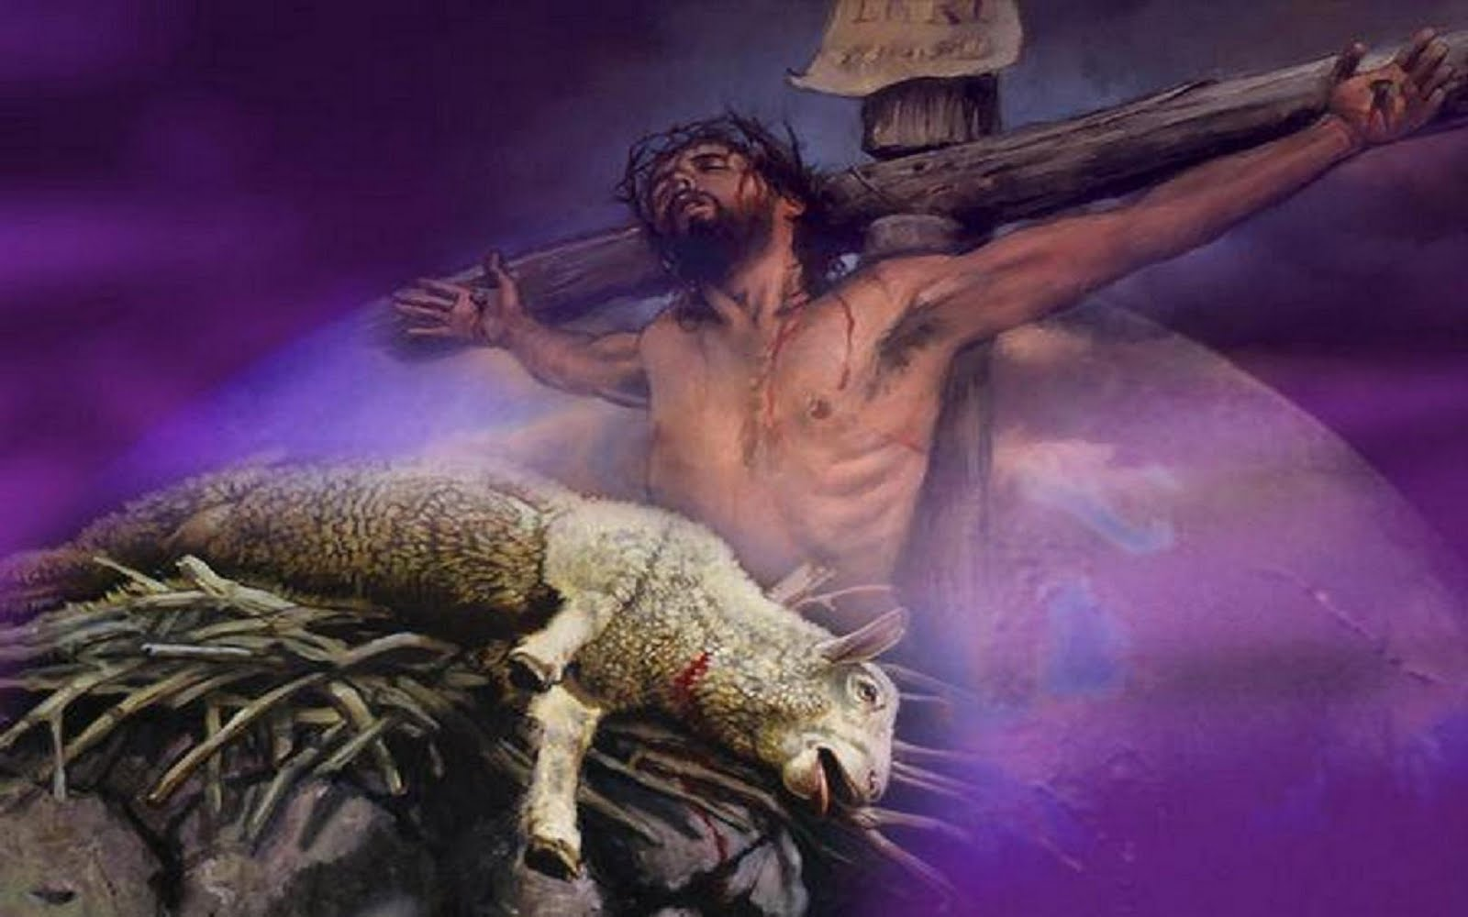
“God Will Provide The Lamb” Text: Gen. 22:8; Heb. 9:22-28
Notes:
By Nathan L Morrison
All Scripture given is from NASB unless otherwise stated
For further study or if questions, Call: 804-277-1983, or Visit: www.courthousechurchofchrist.com

Slide 2
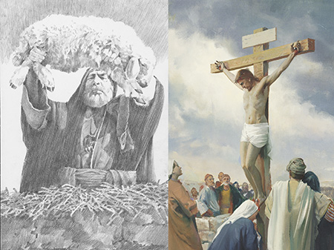
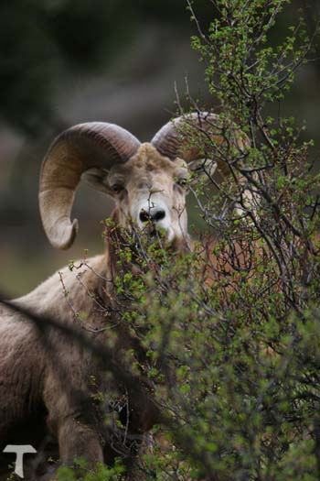
Intro
Gen. 22:8
8. Abraham said, "God will provide for Himself the lamb for the burnt offering, my son." So the two of them walked on together.
In Gen. 22, Abraham can be seen as a “type” of God:
He was willing to give up his “only son,” through whom all the nations of the earth would be blessed!
Gal. 3:6-29: Christ is fulfillment of that promise made to Abraham (Gal. 3:14, 29; 4:4).
Jn. 3:16; I Jn. 4:9: God “gave” (“sent”) His “only begotten Son” to redeem the world!

Slide 3
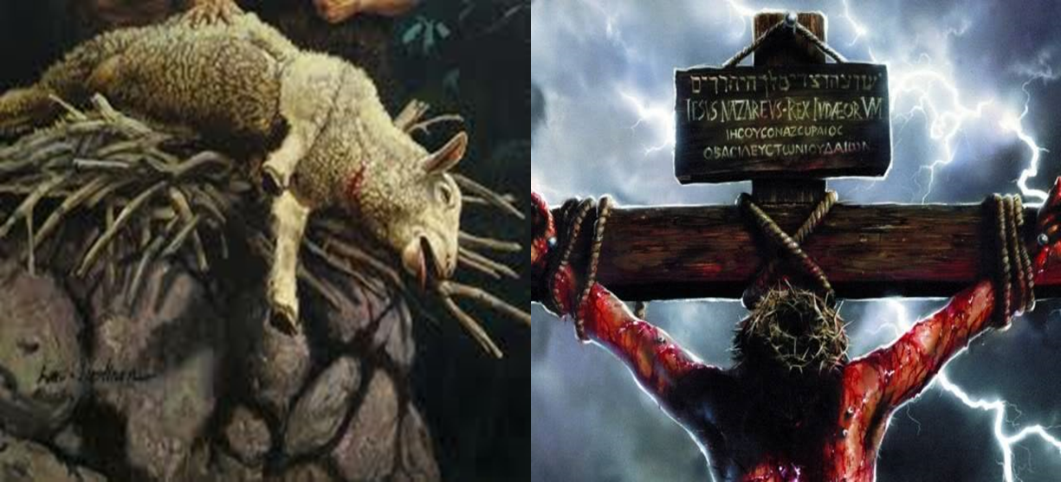
Intro
Why did God need to provide the Lamb? (for sins):
Man’s need for Jesus (the Lamb of God) is seen throughout history in man’s failure to do what is right!
Heb. 9:22-28: “Without shedding of blood there is no forgiveness” (9:22).
Blood of animals could not remove sin – Heb. 10:4
Heb. 10:10-14: Jesus, Lamb of God, the “sacrifice for sins for all time.”
Jn. 1:29
29. The next day he saw Jesus coming to him and said, "Behold, the Lamb of God who takes away the sin of the world!
History shows man’s
need for “the Lamb of
God who takes away
the sin of the world!”

Slide 4
Adam & Eve
Blessings:
Were first created beings.
Were given the right to name all the animals (Gen. 2:19-20).
In a place to suit all their needs.
Given two rules:
To “cultivate it and keep it” (Gen. 2:15).
Not to eat “from the tree of the knowledge of good & evil” (Gen. 2:16-17).
You would think they had it made!

Slide 5
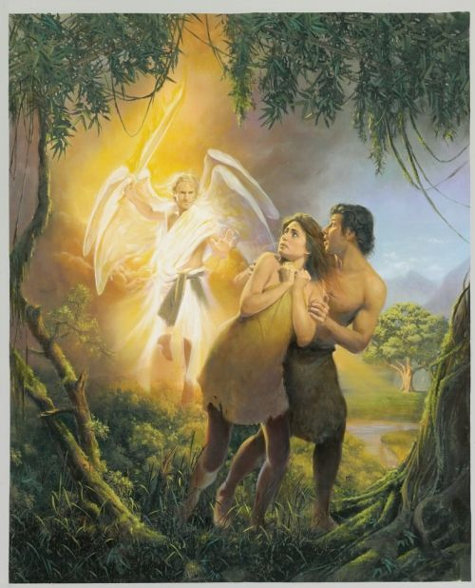
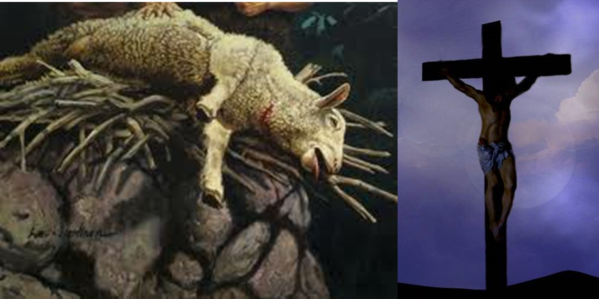
Adam & Eve
Actions:
Gen. 3:1-6: They both ate of the “forbidden fruit” (3:6).
Gen. 3:16-19, 24: God gave to woman pain in childbirth; man was forced to work to eat, and God drove them out of the garden.
The first human beings failed God’s
commands and fell from His grace:
The Lamb of sacrifice was needed!

Slide 6
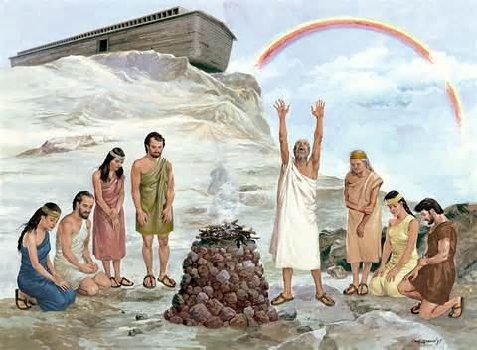
Noah and Mankind After the Flood
Blessings:
Despite the wickedness in the world (Gen. 6:5-7), Noah found grace (favor) in the eyes of the Lord – Gen. 6:8
Gen. 6:13-21: God gave Noah the means of salvation, to build a boat, and made a promise to deliver him and his family.
Gen. 6:22: Noah did all that was commanded him.
Gen. 9:11-16: God made a covenant (promise) to Noah and to all the earth to never again destroy it with a flood, and sealed it with His “bow” in the clouds.
You would think they had it made! (Fresh Start!)

Slide 7
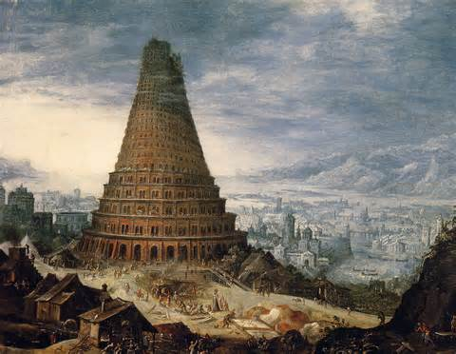
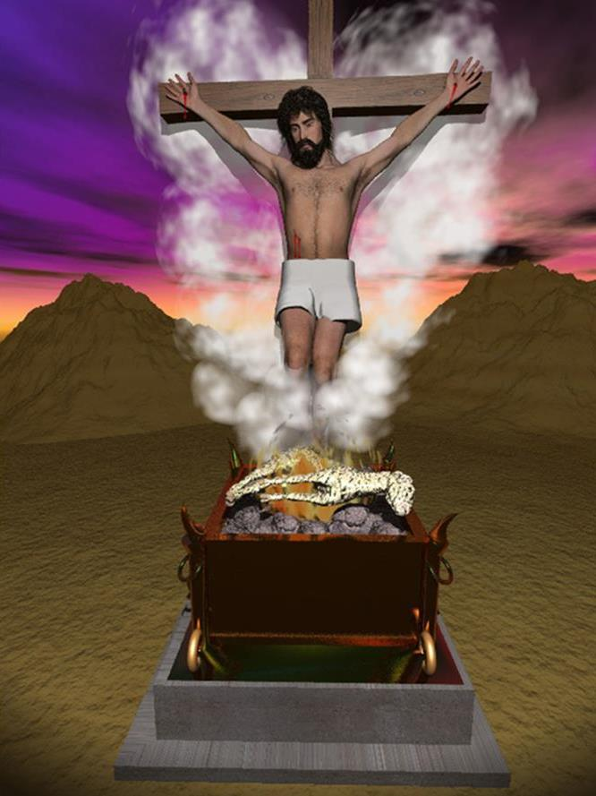
Noah and Mankind After the Flood
Actions:
Gen. 9:1: God commanded them to fill the earth.
Gen. 11:1-9: The people all stayed together in one place, and had decided to build a tower into heaven!
God forced them to disperse and “confused” their languages.
Man (with a fresh start) still didn’t attain
God’s righteousness, but failed His
commands:
The Lamb of sacrifice was needed!

Slide 8
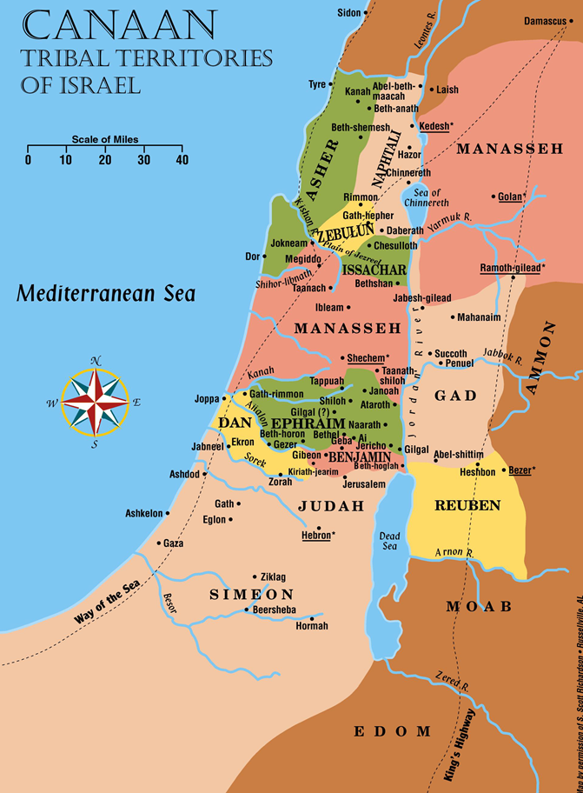
Israel
Blessings:
Gen. 12:2-3; 15:13-14: God made a promise with Abraham, to make a nation from his descendants.
Ex. 3:7-10: God told Moses the time for deliverance of Israel was at hand.
Given the statutes and laws of God to know how to please Him!
Deut. 26:16-17: They accepted them and made a covenant with God to keep them!
Taken from slavery and made a great nation!
Deut. 26:18-19: Special above all other
nations of the earth.
They were given privileges and
blessings beyond any other nation!

Slide 9
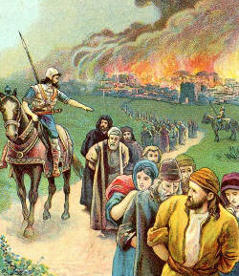
Israel
Actions:
II Chr. 36:15-16: They rejected God till “there was no remedy.”
Neh. 9:13-17: Nehemiah summed up their attitudes toward God…
“But they and our fathers acted proudly, hardened their necks, and did not heed Your commandments.” (Neh. 9:16)
Mt. 23:29-32, 37: Jesus said of Israel: “Jerusalem, Jerusalem, who kills the prophets and stones those who are sent to her!”
Having the Law of God, Israel as a nation
failed to keep her covenant with God:
The Lamb of sacrifice was needed!

Slide 10
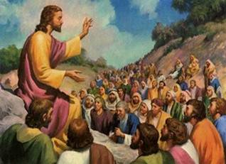
Israel in Jesus’ Day
Blessings:
Saw the coming of the Messiah (Christ), the fulfillment of the promise of God to bless all nations (Gen. 12:3).
Non-Jews saw it and rejoiced! (Mt. 2:1-2: Magi from the east)
They saw Scripture fulfilled in their hearing (Lk. 4:21).
They met and reasoned with the Son of God in the flesh!
Surely they would have taken the chance to do it right!

Slide 11
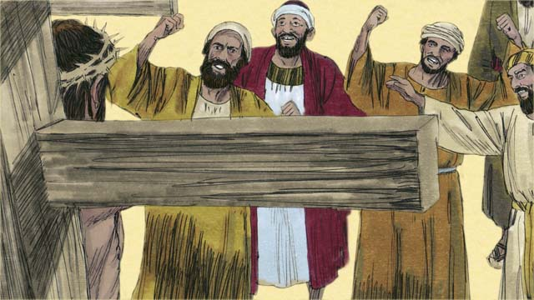
Israel in Jesus’ Day
Actions:
Mt. 16:1; 22:15: They tested Christ, trying to trap Him in His words.
Mt. 23: They were called hypocrites and the sons of their forefathers! (Jn. 8:44: Sons of the devil!)
Mt. 21:43: Jesus said the kingdom was removed from them!
Mt. 26-27: They delivered Him to the Romans to be crucified.
Acts 7:51-53: Though they had God’s divine law they did not recognize the “Big Picture” of redemption and murdered the Christ!
People physically able to see and touch the Lord, who saw His miracles (Jn. 12:9-11), put to death the Son of God! (Acts 2:23, 36)
Having Christ in their midst,
the Jews chose their traditions
over God’s laws and did not
obey the Son of God:
The Lamb of sacrifice was needed!

Slide 12
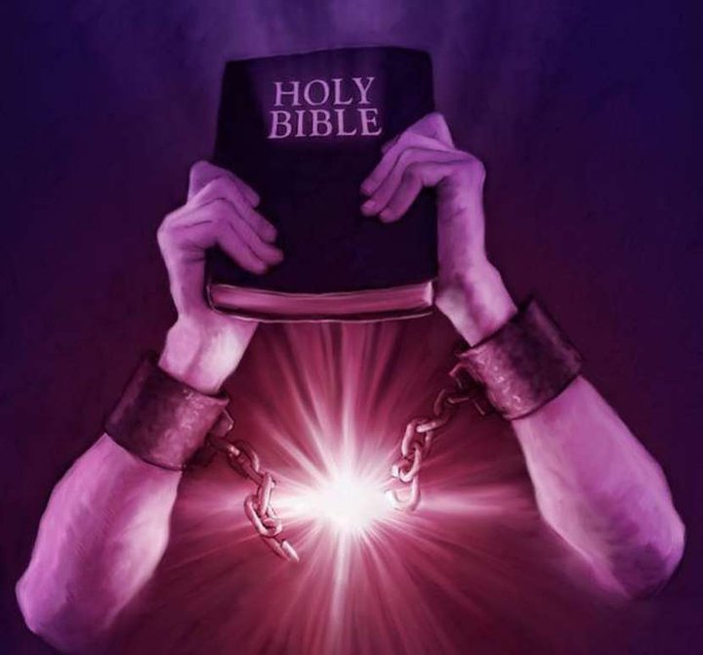
Mankind Today
Blessings:
Made Free from sin in Christ – Jn. 8:36; Gal. 5:1
Able to be adopted into God’s family, made fellow heirs with Christ – Rom 8
The completed Scriptures – Jude 3
History since creation in hindsight (20/20)!
With the completed word of God, you would think we had
it made!

Slide 13
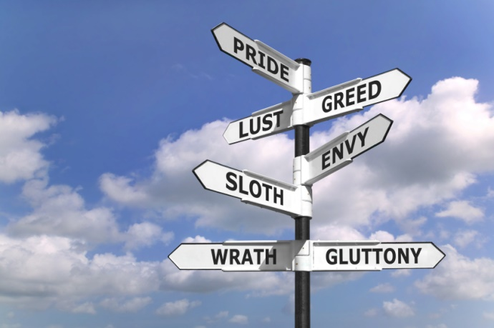
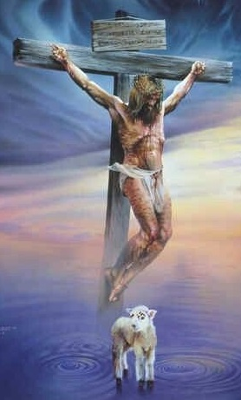
Mankind Today
Actions:
Rom. 2:16; 14:12: We will give account for our deeds (II Cor. 5:10).
We will not be able to “ride the faith” of another.
Man seeks to remove God from education; and teaches evolution.
Societies the world over teach the world will flood (Global Warming) despite the covenant God made with man (Gen. 9:11-16).
People claim to be religious and pervert the word of God to their own ends.
Immorality of every kind is not only advertised but also celebrated!
Man today is making same mistakes
as Israel did, rejecting God and His
commandments:
The Lamb of sacrifice is needed!

Slide 14
Conclusion
Because of the failings of man God had prepared the Lamb before man’s creation!
Eph. 1:3-7 (NKJ)
3. Blessed be the God and Father of our Lord Jesus Christ, who has blessed us with every spiritual blessing in the heavenly places in Christ,
4. just as He chose us in Him before the foundation of the world, that we should be holy and without blame before Him in love,
5. having predestined us to adoption as sons by Jesus Christ to Himself, according to the good pleasure of His will,
6. to the praise of the glory of His grace, by which He made us accepted in the Beloved.
7. In Him we have redemption through His blood, the forgiveness of sins, according to the riches of His grace

Slide 15
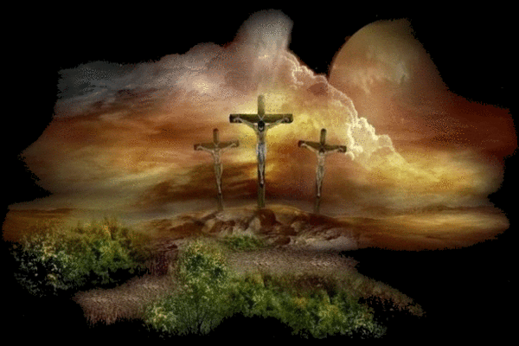
Conclusion
Because of the failings of man God had prepared the Lamb before man’s creation! (Eph. 1:7)
Rom. 4:23-25 (NKJ)
23. Now it was not written for his sake alone that it was imputed to him,
24. but also for us. It shall be imputed to us who believe in Him who raised up Jesus our Lord from the dead,
25. who was delivered up because of our offenses, and was raised because of our justification.
Rom. 5:8: Jesus loved us (Jn. 15:13)

Slide 16
Conclusion
“Why did God need to provide the Lamb?”
Man has always needed forgiveness, thus, man needs Christ, the Lamb of God!
Hebrews 9:26-28
Jesus “would have needed to suffer often since the foundation of the world.”
Christ’s blood was necessary for sin, and because of man’s failings since the “foundation of the world” He was sacrificed “once to bear the sins of many.”
Christ “will appear a second time for salvation without reference to sin.”
He sacrificed Himself once for sin; when He returns it will be for judgment (II Cor. 5:10; II Thess. 1:7-9)

Slide 17
Conclusion
God provided the Lamb of Ultimate Sacrifice
(“for sins for all time” – Heb. 10:12) and His blood washes
sin away! (Acts 22:16; Eph. 1:7; NKJ: Rev. 1:5)
Acts 22:16
16. 'Now why do you delay? Get up and be baptized, and wash away your sins, calling on His name.'
Eph. 1:7 (NKJ)
7. In Him we have redemption through His blood, the forgiveness of sins, according to the riches of His grace

Slide 18
Conclusion
God provided the Lamb of Ultimate Sacrifice
(“for sins for all time” – Heb. 10:12) and His blood washes
sin away! (Acts 22:16; Eph. 1:7; NKJ: Rev. 1:5)
Rev. 1:5 (NKJ)
5. and from Jesus Christ, the faithful witness, the firstborn from the dead, and the ruler over the kings of the earth. To Him who loved us and washed us from our sins in His own blood,

Slide 19
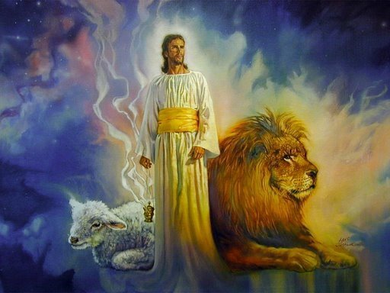
Conclusion
Man has failed in keeping the
commands of God throughout time!
What will be our part?
Will we stand out like Noah? Like Abraham? Like Moses? Like David? Like the apostles?
Will we be counted among the wicked on whom will fall God’s wrath? (Eph. 5:6)
Will we see our need for Christ and obey Him to the “salvation of our souls?”
(I Pet. 1:9; Heb. 5:8-9)
God has provided the Lamb of sacrifice,
let us obey Him, having our sins washed
away, and live with Him forever!

Slide 20
“What Must I Do To Be Saved?”
Hear The Gospel (Jn. 5:24; Rom. 10:17)
Believe In Christ (Jn. 3:16-18; Jn. 8:24)
Repent Of Sins (Lk. 13:35; Acts 2:38)
Confess Christ (Mt. 10:32; Rom. 10:10)
Be Baptized (Mk. 16:16; Acts 22:16)
Remain Faithful (Jn. 8:31; Rev. 2:10)
For The Erring Child of God:
Repent (Acts 8:22), Confess (I Jn. 1:9),
Pray (Acts 8:22)

