Slide 1
Christ: The Indestructible Seed
Text: Gen. 3:15
Gen. 3:15
Notes:
By Nathan L Morrison for Sunday 09/03/17
All Scripture given is from NASB unless otherwise stated
For further study or if questions, Call: 804-277-1983, or Visit: www.courthousechurchofchrist.com

Slide 2
Intro
It is easy to look at the wickedness and evil in the world
and wonder how good can triumph?
Justice system faulty with its prejudices and limitation of science.
Agencies who seek to destroy moral codes set forth by the word of God.
People standing for what is morally right condemned for “hate speech” & other crimes.
Truly the world has become what Isaiah warned about: those who call evil good, and good evil (Is. 5:20)
The word of God holds the clues we need to see that the
struggle for good and evil is already won, it is up to the
good to just persevere to the victory celebration!
Satan has lost but wants to drag into
defeat with him all that he can!

Slide 3
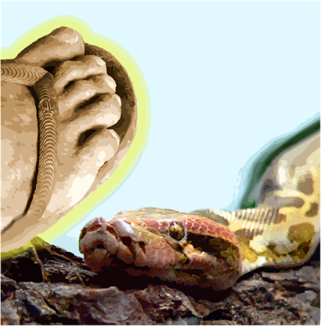
Intro
Gen. 3:15
15. And I will put enmity Between you and the woman, And between your seed and her seed; He shall bruise you on the head, And you shall bruise him on the heel."
Satan’s drive is to discredit God
Gen. 3:1-6: Satan deceived Eve into thinking God’s promise of “death” for disobedience was invalid
Gen. 3:15: God made the promise of His Son as Savior of men from their sin, and told the age-old struggle of good vs. evil: Christ vs. Satan
Since then, Satan has tried to
discredit God by making
that promise invalid, and failed!

Slide 4
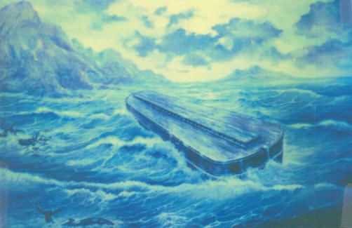
Satan Tries to Destroy the Seed of All Mankind
Gen. 6:8
8. But Noah found favor in the eyes of the LORD.
The days of Noah
The promise of a “Seed” of woman could come from anyone!
Gen. 6:5-7: The corruption of Satan on the earth was so great God was going to destroy mankind!
If Satan had succeeded in corrupting all of the world till God destroyed it all, His promise would be invalid.
Gen. 6:8: “But Noah found favor in the eyes of the LORD.”
Noah and his family (8 persons total – I Pet. 3:20) were saved from the wrath of God (Heb. 11:7).
Satan failed!

Slide 5
Satan Tries to Destroy the Seed of Abraham
Ex. 1:17
17. But the midwives feared God, and did not do as the king of Egypt had commanded them, but let the boys live.
Seed of Abraham
Gen. 12:3: God promised through Abraham’s seed the nations of earth would be blessed.
The promise of the seed of Abraham was narrowed down from all the families of the earth! (Gen. 3:15)
Satan had a target: Abraham’s family
Bondage & death to males
Ex. 1:15-16: The sons of Israel (seed of Abraham) were in Egypt and under bondage, and now their newborn sons were ordered to be killed.
If Satan was successful, no male heir to promise of “seed of Abraham.”
Ex. 1:17: The midwives “feared God” and would not obey the king!
Satan tried again! (Ex. 1:22: all newborn sons thrown into Nile)
Ex. 2:1-9: Moses was hid away and adopted by Pharaoh’s daughter!
Satan failed!

Slide 6
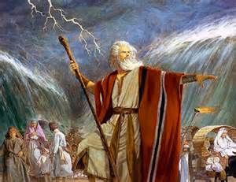
Satan Tries to Destroy the Seed of Abraham
Ex. 14:13
13. But Moses said to the people, "Do not fear! Stand by and see the salvation of the LORD which He will accomplish for you today; for the Egyptians whom you have seen today, you will never see them again forever.
Red Sea Deliverance
Ex. 14:9-10: Pharaoh chased the Israelites to the Red Sea, no escape.
Satan was trying to destroy the “Seed!”
Ex. 14:13: God saved them with the parting of the Red Sea and drowned the Egyptian army chasing them (14:21-31).
Not just a blow to Egypt, but to Satan!
Satan failed!

Slide 7
Satan Tries to Destroy the Seed of David
Seed of David
The “Seed” could come from any of the 12 tribes of Israel, until...
II Sam. 7:12-16: Promise of the “Seed” would come from house of Judah (Gen. 49:8-12), specifically, from the line of David! (Is. 11:1; Jer. 33:15)
The people had a specific promise, but now Satan had a specific target!
If Satan could destroy the family of David, God’s promise would be invalid!

Slide 8
Satan Tries to Destroy the Seed of David
II Kings 11:2-3 (Athaliah’s daughter, Joash’s aunt)
2. But Jehosheba, the daughter of King Joram, sister of Ahaziah, took Joash the son of Ahaziah and stole him from among the king's sons who were being put to death, and placed him and his nurse in the bedroom. So they hid him from Athaliah, and he was not put to death.
Athaliah kills royal seed!
Satan tried numerous times to destroy the house of David…
II Kings 11:1: Athaliah (daughter of Ahab) killed all royal offspring (her own children and grandchildren).
For seven years it appeared to have worked! (II Kings 11:4)
II Kings 11:2-3: All but one: Joash was saved! Line of David preserved (11:12-16)!
Satan failed!

Slide 9
Satan Tries to Destroy the Seed of David
Haman seeks to do Satan’s work
During the exile, there was no king over Judah, but line of David was unbroken, and Satan didn’t rest just because they were in exile.
Esther 3:13: Haman’s plan was total annihilation of the Jews
If this plan was successful, line of David would be destroyed, promise nullified!
Haman was an Agagite (Est. 3:1), a descendant of the kings of the Amalekites (Agag was a royal title).
The Lord had declared perpetual war against Amalek (Ex. 17:15-16).
The Book of Esther relates the last recorded battle in that war! (Wouldn’t have happened if Saul obeyed God – I Sam. 15)
Possible explanation: Mordecai was of the tribe of Benjamin (Est. 2:5), the tribe of king Saul, who fought the Amalekites and was charged with their complete destruction (I Sam. 15), and here he refuses to bow to an Amalekite!

Slide 10
Satan Tries to Destroy the Seed of David
Esther 9:20-22
20. Then Mordecai recorded these events, and he sent letters to all the Jews who were in all the provinces of King Ahasuerus, both near and far,
21. obliging them to celebrate the fourteenth day of the month Adar, and the fifteenth day of the same month, annually,
22. because on those days the Jews rid themselves of their enemies, and it was a month which was turned for them from sorrow into gladness and from mourning into a holiday; that they should make them days of feasting and rejoicing and sending portions of food to one another and gifts to the poor.
The Jews fight back!
Esther 8-9: The Jews were given the authority to defend their lives against any and all that attacked them (Esther 8:11-12; 9:16, 20-22)
Satan failed!

Slide 11
Satan Tries to Destroy Jesus Christ: the “Seed” of Woman
Mt. 2:13, 16
13. Now when they had gone, behold, an angel of the Lord appeared to Joseph in a dream and said, "Get up! Take the Child and His mother and flee to Egypt, and remain there until I tell you; for Herod is going to search for the Child to destroy Him."
16. Then when Herod saw that he had been tricked by the magi, he became very enraged, and sent and slew all the male children who were in Bethlehem and all its vicinity, from two years old and under, according to the time which he had determined from the magi.
Herod attempts to kill Jesus as a baby
Angels pronounced the birth of Jesus (Lk. 2:8-15).
Wise men from the east came looking for the baby born “King of the Jews” (Mt. 2:1-2).
Mt. 2:13, 16: Herod sought to destroy Jesus
If he could destroy Him while a child, God would be discredited

Slide 12
Satan Tries to Destroy Jesus Christ: the “Seed” of Woman
Mt. 2:13-15
13. Now when they had gone, behold, an angel of the Lord appeared to Joseph in a dream and said, "Get up! Take the Child and His mother and flee to Egypt, and remain there until I tell you; for Herod is going to search for the Child to destroy Him."
14. So Joseph got up and took the Child and His mother while it was still night, and left for Egypt.
15. He remained there until the death of Herod. This was to fulfill what had been spoken by the Lord through the prophet: "OUT OF EGYPT I CALLED MY SON."
Go warned Joseph
Mt. 2:13-15: God warned Joseph to flee with his family into Egypt!
Satan failed!

Slide 13
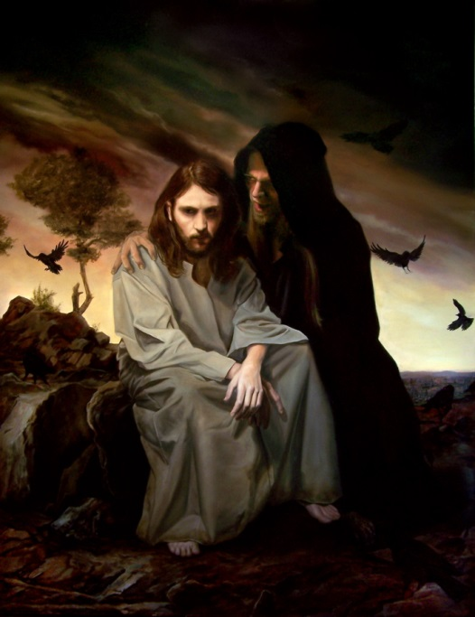
Satan Tries to Destroy Jesus Christ: the “Seed” of Woman
Mt. 4:10-11
10. Then Jesus said to him, "Go, Satan! For it is written, 'YOU SHALL WORSHIP THE LORD YOUR GOD, AND SERVE HIM ONLY.'"
11. Then the devil left Him; and behold, angels came and began to minister to Him.
Satan tempts Jesus
Mt. 4:1-11: Satan tempted Jesus, to get Him to give in to fleshly desires, to give in to temptation of power, and to worship him (I Jn. 2:16).
Mt. 4:10-11: Jesus resisted him and told him to “Go!”
Satan failed!

Slide 14
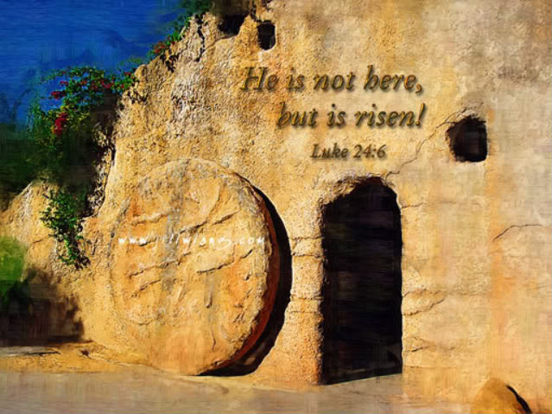
Satan Tries to Destroy Jesus Christ: the “Seed” of Woman
Lk. 24:5-6
5. and as the women were terrified and bowed their faces to the ground, the men said to them, "Why do you seek the living One among the dead?
6. "He is not here, but He has risen. Remember how He spoke to you while He was still in Galilee,
Jesus crucified
Lk. 23:33, 46: He “breathed His last.”
How Satan must have rejoiced!
Until….
Lk. 24:1-7: “Why seek the living among the dead?” He had risen!
Satan failed!

Slide 15
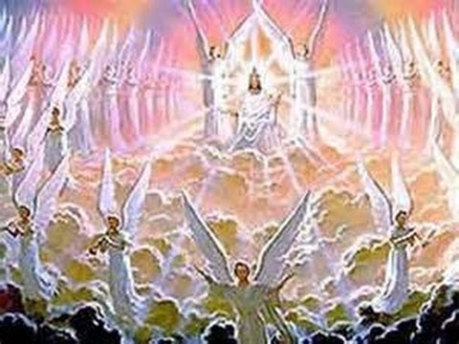
Satan Tries to Destroy Jesus Christ: the “Seed” of Woman
Rev. 12:1-5
1. A great sign appeared in heaven: a woman clothed with the sun, and the moon under her feet, and on her head a crown of twelve stars;
2. and she was with child; and she cried out, being in labor and in pain to give birth.
3. Then another sign appeared in heaven: and behold, a great red dragon having seven heads and ten horns, and on his heads were seven diadems.
4. And his tail swept away a third of the stars of heaven and threw them to the earth. And the dragon stood before the woman who was about to give birth, so that when she gave birth he might devour her child.
5. And she gave birth to a son, a male child, who is to rule all the nations with a rod of iron; and her child was caught up to God and to His throne.

Slide 16
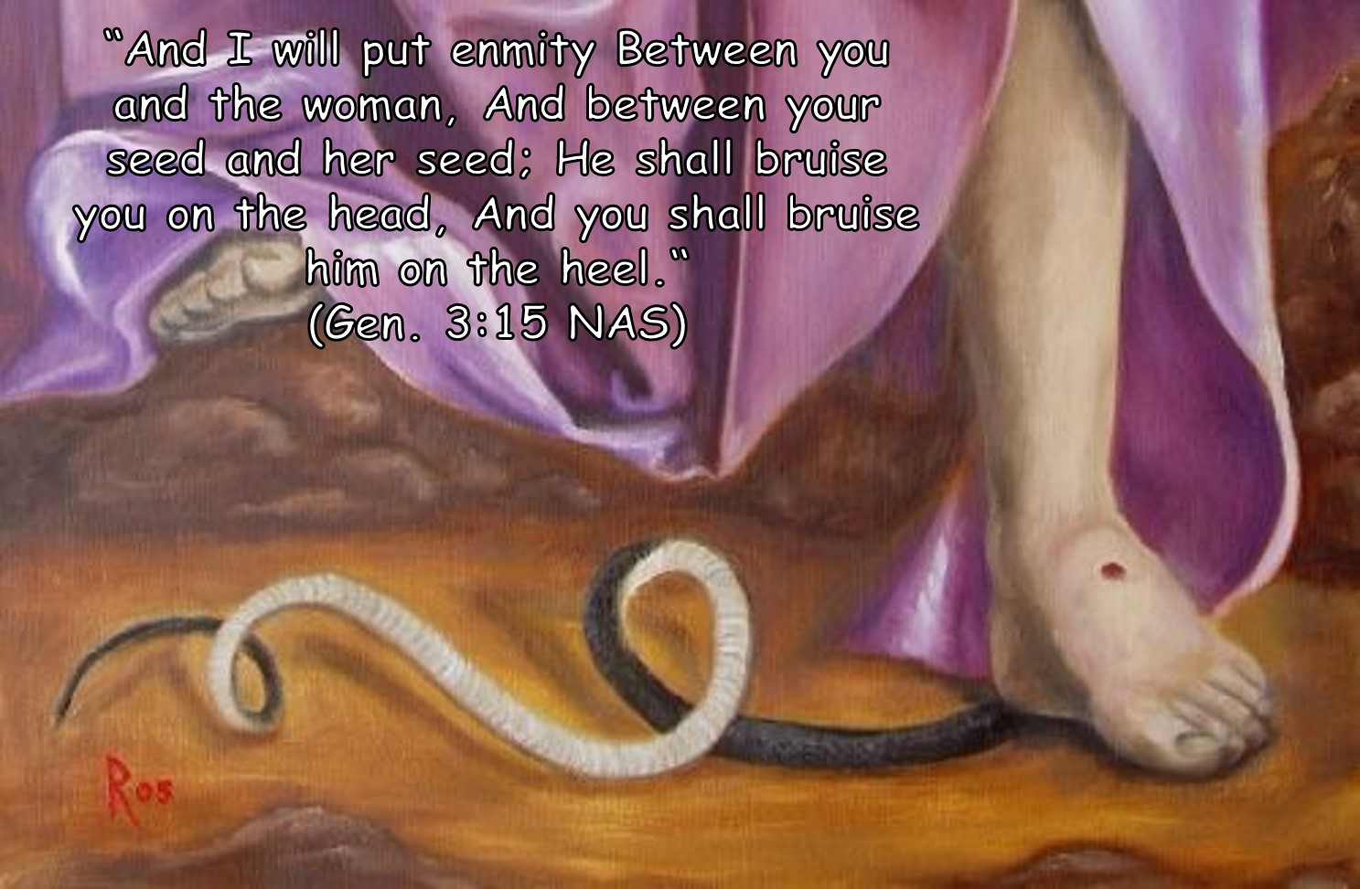
Satan Tries to Destroy Jesus Christ: the “Seed” of Woman
Satan always fails!
Rev. 12:1-5: The picture here is of the eternal struggle of Satan trying to destroy the “Seed” (Ps. 2:9) and failing!
God’s promises can be trusted no matter how bleak
things seem to be:
Satan failed!

Slide 17
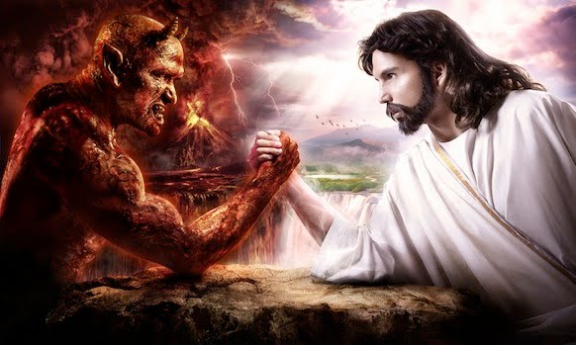
The Power of God’s Promises
Jesus (line of David) sits on the throne of David at right
hand of God – Acts 2:29-36; Col. 3:1; Heb. 12:2
Promise to Abraham fulfilled in Christ – Gal. 3:6-14; 4:4
Jesus defeated Satan and his power of death –
Heb. 2:14-15
The victory is won, saints must
remain faithful till death!
(Rev. 2:10)

Slide 18
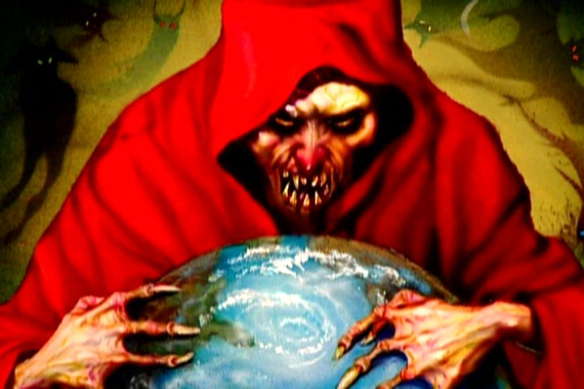
Conclusion
Satan tried to destroy the Seed!
The “seed” of all mankind!
The “seed” of Abraham!
The “seed” of David!
Christ: The “Seed” of woman!
God’s promises do not fail: The Seed was indestructible
because God promised it
It cannot be thwarted – Satan tried numerous times!

Slide 19
Conclusion
Satan has not given up!
I Pet. 5:8: He failed to destroy or corrupt the Seed, so goes after His followers.
Don’t let him succeed in corrupting you for destruction!
I Pet. 5:8
8. Be of sober spirit, be on the alert. Your adversary, the devil, prowls around like a roaring lion, seeking someone to devour.

Slide 20
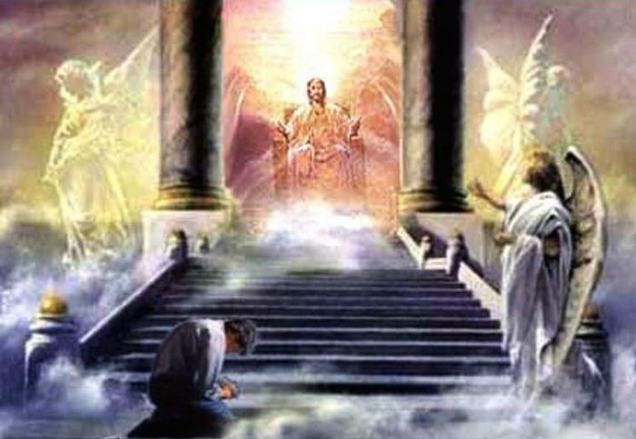
Conclusion
Good has already won:
the world will recognize it one day!
Rom. 14:11-12
11. For it is written, "AS I LIVE, SAYS THE LORD, EVERY KNEE SHALL BOW TO ME, AND EVERY TONGUE SHALL GIVE PRAISE TO GOD."
12. So then each one of us will give an account of himself to God.

Slide 21
Conclusion
Have you obeyed the word of Christ,
the “Indestructible Seed?”
Give your life to obedience to God’s word, knowing His promises are sure and steadfast!

Slide 22
“What Must I Do To Be Saved?”
Hear The Gospel (Jn. 5:24; Rom. 10:17)
Believe In Christ (Jn. 3:16-18; Jn. 8:24)
Repent Of Sins (Lk. 13:35; Acts 2:38)
Confess Christ (Mt. 10:32; Rom. 10:10)
Be Baptized (Mk. 16:16; Acts 22:16)
Remain Faithful (Jn. 8:31; Rev. 2:10)
For The Erring Child of God:
Repent (Acts 8:22), Confess (I Jn. 1:9),
Pray (Acts 8:22)

