Slide 1
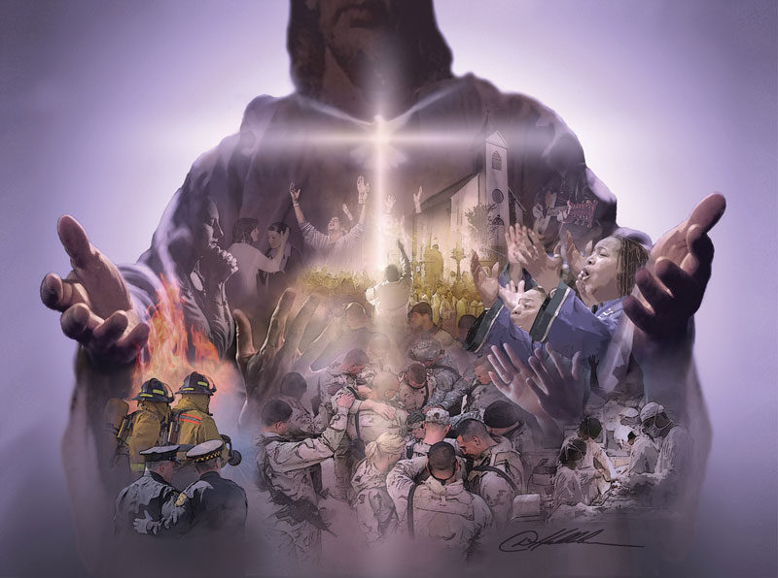
The Importance Of The Church
Text:
Ephesians 1:22-23
Notes:
By Nathan L Morrison for Sunday February 4, 2024
All Scripture given is from NASB unless otherwise stated
For further study, or if questions, please Call: 804-277-1983 or Visit www.courthousechurchofchrist.com
Response to April, 2012 Newsweek article, “Christianity In Crisis” by Andrew Sullivan, 04//02/12
https://www.newsweek.com/andrew-sullivan-christianity-crisis-64025
Logo art provided by www.vecteezy.com

Slide 2
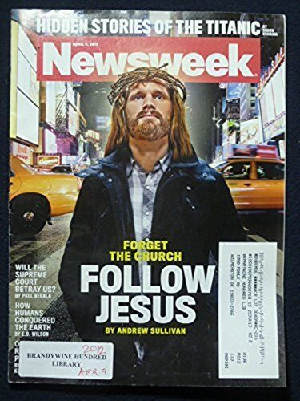
Intro
April 2nd, 2012 Newsweek Cover said, “Forget the Church, Follow Jesus!”!
The church is corrupt and bogged down with unimportant things.
Christianity is just about following Jesus’ words in the Sermon on the Mount.
Anything outside the Sermon on the Mount is (in the words of Thomas Jefferson), “Religious Manure.”
The church is unimportant to Christianity!
Notes:
Sources:
• Response to April, 2012 Newsweek article, “Christianity In Crisis” by Andrew Sullivan, 04//02/12
• https://www.newsweek.com/andrew-sullivan-christianity-crisis-64025

Slide 3
Intro
The Church and Christ cannot be separated – Christ is the Savior of the body (Ephesians 5:23)
The church is the “Called Out” (II Corinthians 6:14-18): Called out of the world! (Ephesians 2:1-3)
The church is bought by the blood of Christ! (Acts 20:28; I Peter 1:18-19)
The church is made up of sanctified and cleansed members! (Ephesians 5:23-27)
Notes:
Reminder: This lists the points from the last lesson! (02/04/2024: Can We Follow Jesus But Forget The Church?”)

Slide 4
Intro
God’s word-pictures paint a portrait of the importance of the church!

Slide 5
The Body of Christ
The body of Christ – Ephesians 1:22-23
To forget the church is like saying,
“I like you, but I can’t stand your body”

Slide 6
The Body of Christ
The church is not:
The physical body of Christ. (Romans 12:4-5)
The glorified body in which He ascended to Heaven. (Acts 1:9)
The church is the “body of Christ,” which is made of saints (I Corinthians 1:2):
Romans 12:4-5: The body of Christ is made up of individual members with different functions (I Corinthians 12:13-14)

Slide 7
The Body of Christ
Blessings in the body:
Ephesians 1:23: The “fullness of God!” (II Peter 1:2-3: Contains all we need for life!)
Ephesians 2:16: Reconciliation to God.
Colossians 1:18-23: The reconciled ones are those who live “holy and blameless” and “continue in the faith firmly established and steadfast.”
Ephesians 5:23: Salvation is in the body. “He Himself being the Savior of the body.”

Slide 8
The Body of Christ
The church is the body of Christ; must be a member to be saved (No other church can)!

Slide 9
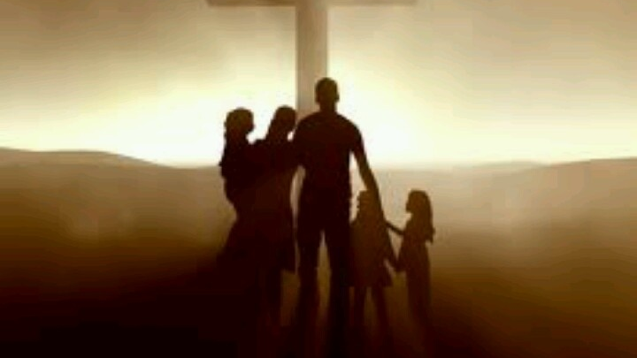
The Family of God
The family of God – Ephesians 2:19
To forget the church is like saying,
“I like you, but I want to remain an orphan”

Slide 10
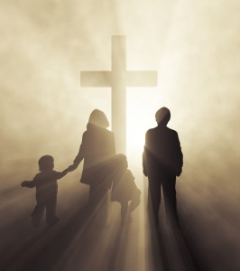
The Family of God
I Timothy 3:15: God’s “house” identifies His family
Romans 8:14-17: God’s children are in His family
The family metaphor emphasizes:
The closeness of God and His people.
God’s love and concern for His children.
The honor involved in church membership (Members are children of God).
Ephesians 5:7-13: The responsibility to live as a child of God.

Slide 11
The Family of God
Two figures are used to show the means of entrance into God’s family:
I Peter 1:22-23: A new birth (Baptism: John 3:3-5; I Corinthians 12:13-14; Galatians 3:27)
Ephesians 1:5: Adopted by God as His children (Romans 8:15-16)

Slide 12
The Family of God
By obedience to the gospel we are all members of the family of God!

Slide 13
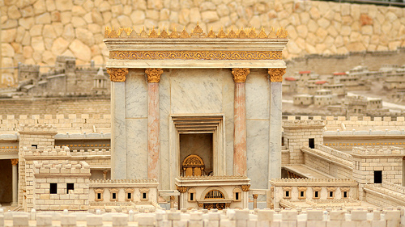
The Temple of God
The temple of God – Ephesians 2:21-22
To forget the church is like saying,
“I like you, but want to worship apart from you”

Slide 14
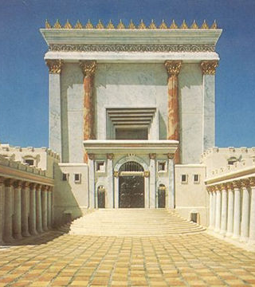
The Temple of God
The description of the church as God’s Temple would impress both Jew and Gentile
Would impress the Ephesians because Diana’s temple was located in Ephesus. (Acts 19: Paul upset the silversmiths who made images of her)
Would impress the Jews of the first century because the temple was the center of their law/worship
Ephesians 3:10-11: The temple reflects the wisdom of the Designer
I Peter 2:4-5, 9: Not only is it the Temple of God, its members are holy priests.

Slide 15
The Temple of God
The description of the church as the Temple of God gives a beautiful portrait of what church members are to be on the outside as well as the inside
I Corinthians 3:16-17: As the Temple was holy, so are we to be!
I Corinthians 6:19-20: Being the Temple of God we are to glorify God in our bodies.
The temple of God was beautiful inside and out. Saints are to be beautiful inside and out!
Can we do that in any practice that is ungodly or unholy?

Slide 16
The Temple of God
The church is the Temple of God, therefore it must glorify God!

Slide 17
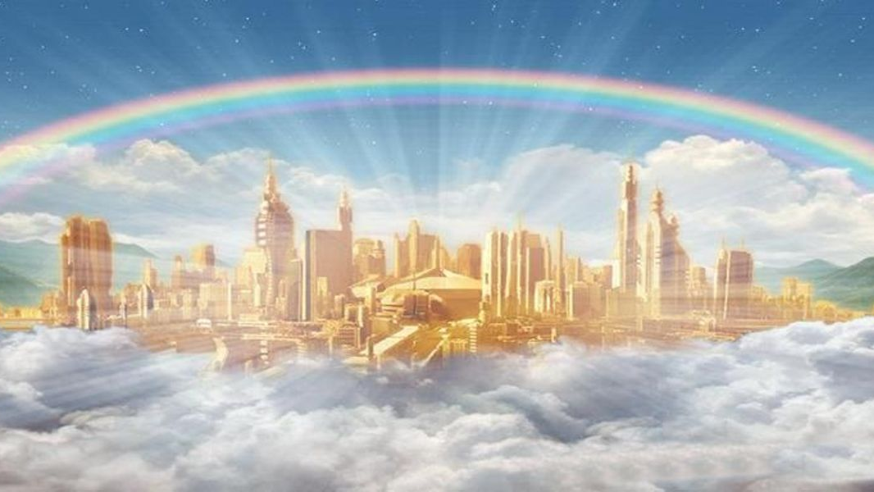
The Kingdom of Christ & God
The kingdom of Christ and God – Ephesians 5:5
To forget the church is like saying,
“I like you, but don’t want to be a citizen with you”

Slide 18
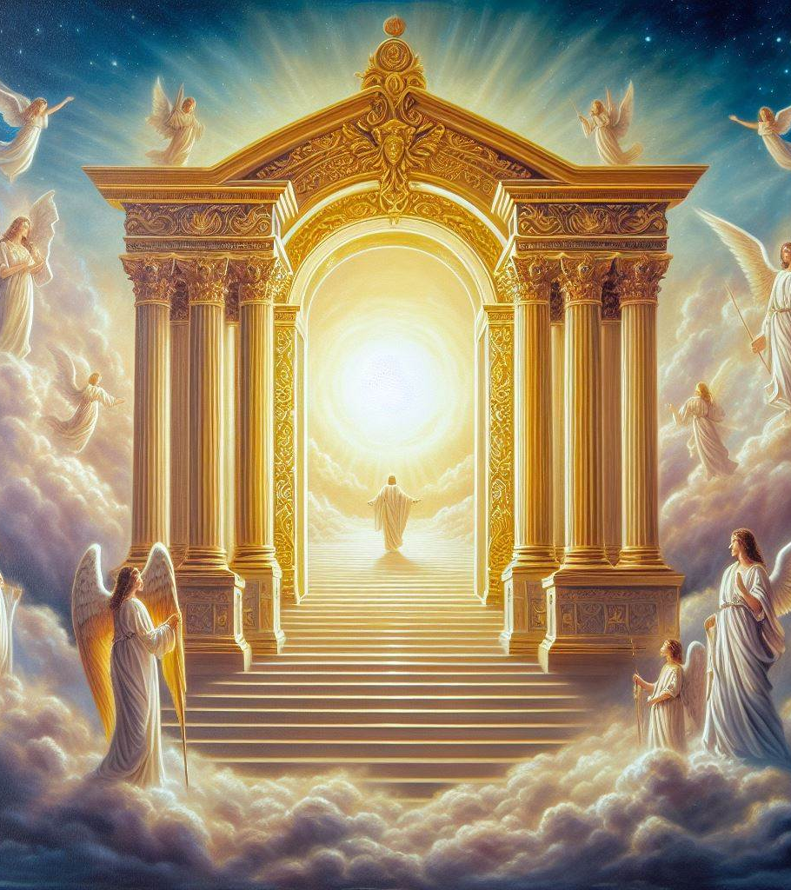
The Kingdom of Christ & God
Matthew 16:18-19: The Lord identified the church as His kingdom
Mark 9:1: He predicted the coming of His church (kingdom) in power
Not a physical kingdom, but a spiritual one! (John 18:36; Ephesians 2:19)
Colossians 1:13-14: Saints at Colossae had been translated “into the kingdom of God’s Son
The kingdom was in place and is now open for all! (Ephesians 2; 3:4-7)
Ephesians 2:19: Saints are citizens in the kingdom of God!

Slide 19
The Kingdom of Christ & God
There are three essentials for a kingdom:
A king — Christ is the king (Matthew 27:11; John 18:37; I Timothy 6:15)
A law – His will, the New Testament is the law of the kingdom of Christ (II Peter 1:2-3; II John 9)
Subjects – The church is made up of people who recognize the Lordship of Christ (Ephesians 1:22-23; 5:23-24; Philippians 3:20; Colossians 1:18)

Slide 20
The Kingdom of Christ & God
We are citizens of His eternal kingdom!
(Daniel 2:44; Philippians 3:20)

Slide 21
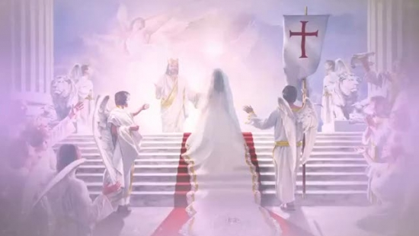
The Bride of Christ
The bride of Christ – Ephesians 5:23-32; Revelation 19:7-9
To forget the church is like saying,
“I like you, but I hate your wife”

Slide 22
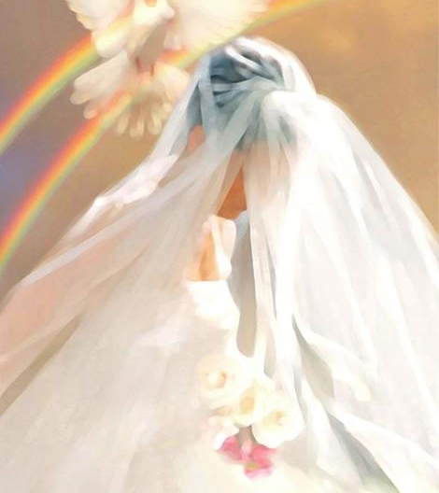
The Bride of Christ
Ephesians 5:22-23: The Lord is the Head and the Savior of the body
Ephesians 5:22, 24: But as the church is subject to Christ, so also wives ought to be to their husbands in everything. (Understand through the marriage relationship – 5:32)
Ephesians 5:25: Husbands, love your wives, just as Christ also loved the church and gave Himself up for her…
Ephesians 5:26-27: Christ died that the church might exist (Bought it – Acts 20:28)
5:28: So husbands are to love their wives as their own bodies.
To love them as Christ loved the church and gave Himself up for her.

Slide 23
The Bride of Christ
James 4:4: Unfaithfulness to Christ is spiritual adultery
This includes adding to or taking away from His word (Revelation 22:18-19)!
John 14:2-3: One day the Groom will come for His bride! (Revelation 19:7-9)

Slide 24
The Bride of Christ
The church will one day be reunited with her Savior; must be found holy and blameless!

Slide 25
Conclusion
Ephesians 3:5-6: The church breaks cultural & ethnic barriers to welcome all in!
Ephesians 5:25: The church was important enough for Jesus to die for it
God used word-pictures to paint a portrait of the church for man to see its importance
Body of Christ
Household of God
Temple of God
Kingdom of Christ & God
Bride of Christ

Slide 26
Conclusion
The church is important to God and to man!
One cannot follow Jesus and forget the church – they are inseparable!

Slide 27
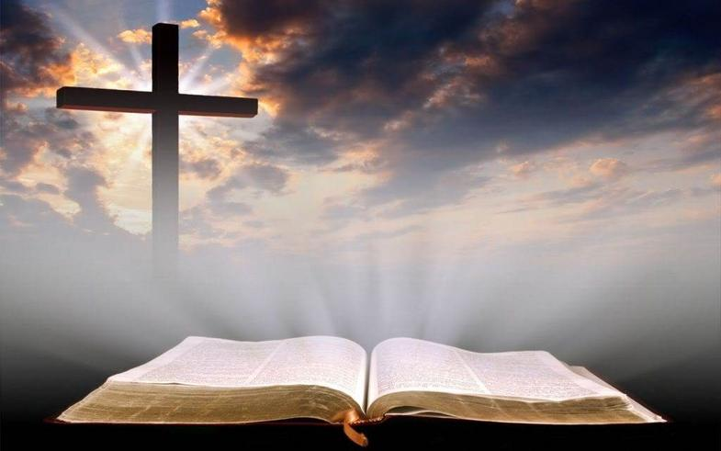
Conclusion
It is important and essential to salvation to be a member of the church Jesus built and died to save!

Slide 28
“What Must I Do To Be Saved?”
Hear The Gospel (John 5:24; Romans 10:17)
Believe In Christ (John 3:16-18; John 8:24)
Repent Of Sins (Luke 13:3-5; Acts 2:38)
Confess Christ (Matthew 10:32; Romans 10:10)
Be Baptized (Mark 16:16; Acts 22:16)
Remain Faithful (John 8:31; Revelation 2:10)
For The Erring Saint:
Repent (Acts 8:22), Confess (I John 1:9),
Pray (Acts 8:22)

