Slide 1
Teach The Good News!
Text:
II Timothy 2:24-26
Notes:
By Nathan L Morrison for Sunday January 28, 2024
All Scripture given is from NASB unless otherwise stated
For further study, or if questions, please Call: 804-277-1983 or Visit www.courthousechurchofchrist.com
Logo art provided by www.vecteezy.com

Slide 2
Intro
What do you do when you hear good news?

Slide 3
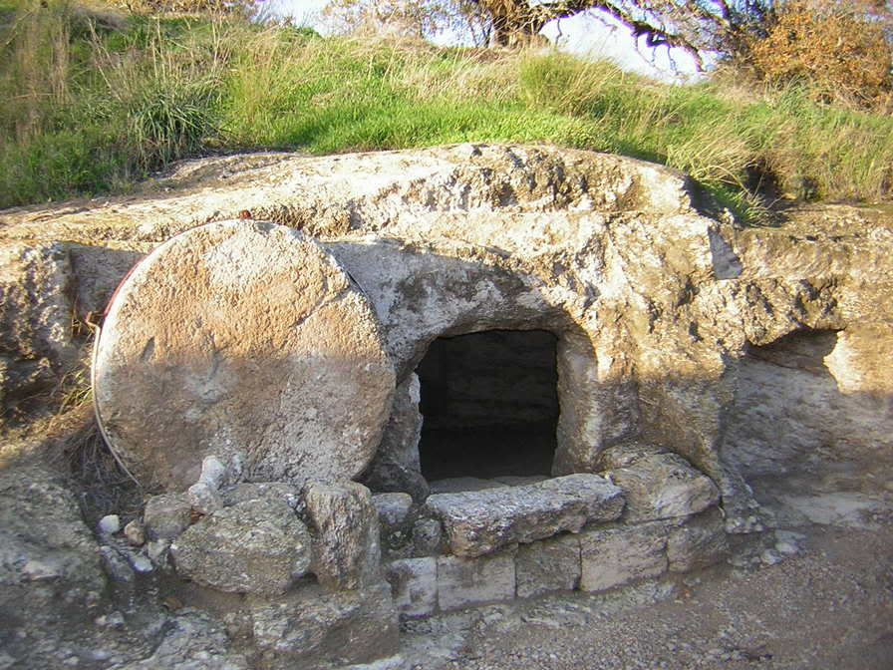
Intro
The good news spreading from Jerusalem was that Jesus was alive (Luke 24:13-27)
“He is not here, but He has risen. Remember how He spoke to you while He was still in Galilee” (Luke 24:6)
Jesus sent His disciples into all the world to preach the good news (Mark 16:15-16)
Paul said he preached the good news of Jesus’ death, burial, and resurrection to the Corinthian saints, and they were saved by the gospel (I Corinthians 15:1-11)

Slide 4
Intro
We need to share the good news that Jesus died for our sins and raised Himself from the dead and invites those who obey Him to live with Him forever!

Slide 5
Intro
Saints are to teach the good news that brings salvation to all men, using approaches that suit the need or style of the teacher!

Slide 6
Teach the Gospel
I Peter 2:9
II Timothy 2:15
II Timothy 2:24-26

Slide 7
Intro
II Timothy 2:24-26
24. The Lord's bond-servant must not be quarrelsome, but be kind to all, able to teach, patient when wronged,
25. with gentleness correcting those who are in opposition, if perhaps God may grant them repentance leading to the knowledge of the truth,
26. and they may come to their senses and escape from the snare of the devil, having been held captive by him to do his will.

Slide 8
Intro
I Peter 3:15
15. but sanctify Christ as Lord in your hearts, always being ready to make a defense to everyone who asks you to give an account for the hope that is in you, yet with gentleness and reverence

Slide 9
Teach the Gospel
I Peter 2:9
II Timothy 2:15
II Timothy 2:24-26
I Peter 3:15
Paul says all saints are to be “able to teach” and Peter says all saints are “always” to be ready to give a defense (that is an answer) for the hope within us

Slide 10
Teach the Gospel
I Peter 2:9
II Timothy 2:15
II Timothy 2:24-26
I Peter 3:15
The church will only grow if all members are doing what they can to teach the gospel!

Slide 11
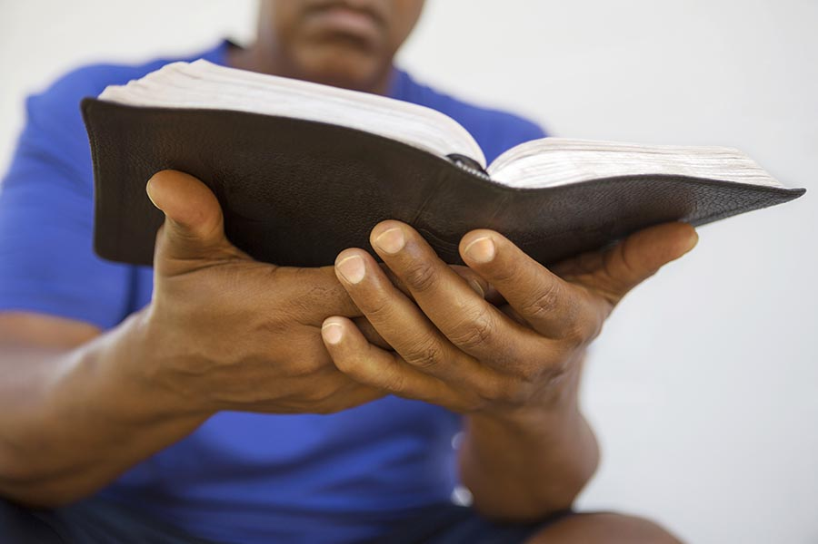
Daily Living
Be an example of Christ’s teachings
Matthew 5:13-16: Be salt and light, live in such a way as to bring glory to God!
Others ought to observe your godly conduct!

Slide 12
Daily Living
Does your life, your marriage, your work ethic, and your parenting exemplify Christ’s word in your speech and conduct?
Colossians 3:17: “Whatever you do in word or deed, do all in the name of the Lord Jesus, giving thanks through Him to God the Father.”
As people ask you about your life’s choices, take those opportunities to teach the good news!
An old adage: “Your life may be the only sermon someone hears. Make it a good one.”

Slide 13
Daily Living
Be an example of Christ’s teachings
Does your life, your marriage, your work ethic, and your parenting exemplify Christ’s word in your speech and conduct?
In being godly servants of the Lord, we may use the opportunities in everyday living to teach the gospel!

Slide 14
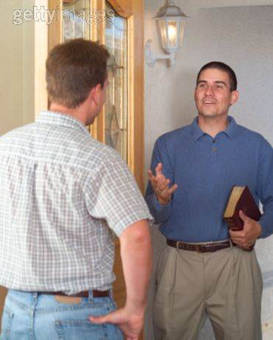
The Right Approaches
There is no “right way” to teach the good news – You must find the approach that suits you as well as the situation
Some respond in obedience to the gospel out of fear, love, guilt, confrontation, reasoning and persuasion, a question, or by exmple and influence! (etc.)
Be the example of godliness and righteousness in your life, and as you teach, be yourself that you might have the maximum spiritual effect!

Slide 15
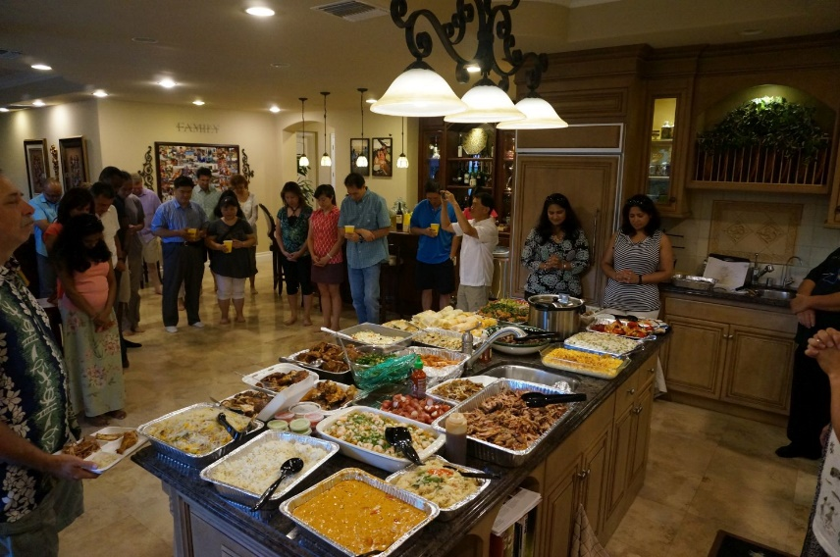
Matthew’s Invitational Approach
Luke 5:27-29, 30-32 (Mt. 9:9-13)
Matthew (Levi) invited Jesus and His disciples to his house for “a big reception” and invited many of his tax collector friends.
This was a great way for his friends to meet Jesus.
Tax collectors and sinners were eating with Jesus, which bothered the religious leaders (Luke 5:30-32), who complained to Jesus’ disciples.
Jesus pointed out that the ones who need healing are the sick!

Slide 16
Matthew’s Invitational Approach
Perhaps you have friends or family that you want them to meet godly influences and could invite them to Christian get-togethers!
You can use our Invitation Cards to invite friends, family, and neighbors to Bible studies or services, or invite them to check out our website!

Slide 17
Matthew’s Invitational Approach
Perhaps you have friends or family that you want them to meet godly influences and could invite them to Christian get-togethers!
You can use our Invitation Cards to invite friends, family, and neighbors to Bible studies or services, or invite them to check out our website!
Perhaps you have friends or relatives that need to meet Jesus and just need an invitation!

Slide 18
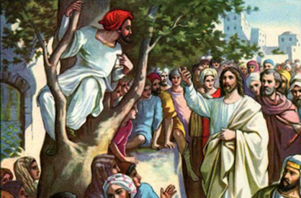
Jesus’ Personal Approach
Luke 19:1-10
Jesus stopped in the middle of a crowd that was following Him to look up into a tree and speak to Zacchaeus, a short tax collector who climbed into a Sycamore tree to see Jesus as He passed by, and told him to come down as Jesus desired to spend time with him!
Jesus taking time to bring him from the curiosity stage by investing his personal attention to the man led the tax collector to change his life.
Jesus said He came to “seek and save the lost” (Luke 19:10)

Slide 19
Jesus’ Personal Approach
Luke 19:1-10
Perhaps you know someone interested in spiritual matters, and maybe they just need someone to give them personal attention so they might meet Jesus!

Slide 20
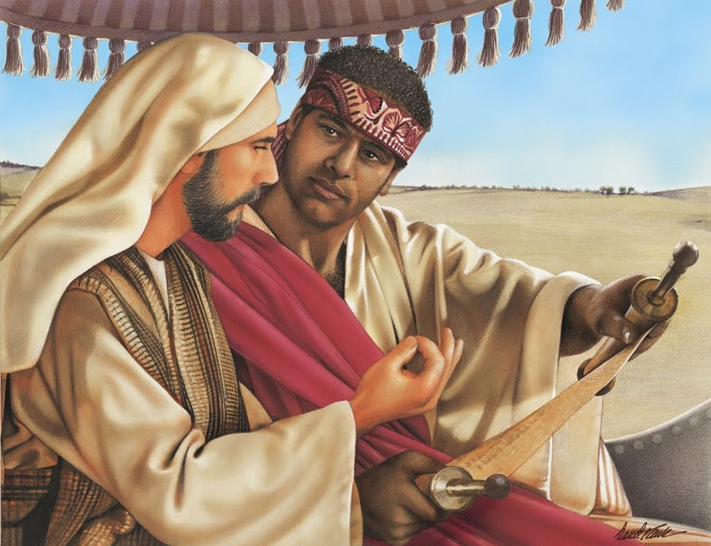
Philip’s Conversational Approach
Acts 8:26-40
Sent by an angel, Philip overheard the Ethiopian Eunuch, Treasurer for the Queen of Ethiopia, reading from Isaiah 53 as his chariot passed by.
He asked, “Do you understand what you are reading?”
He was invited up into the chariot and starting where he was at (in Isaiah 53) he preached to him Jesus!
This resulted in the man stopping the chariot to be baptized, and he went away rejoicing!
It started with a conversational question!

Slide 21
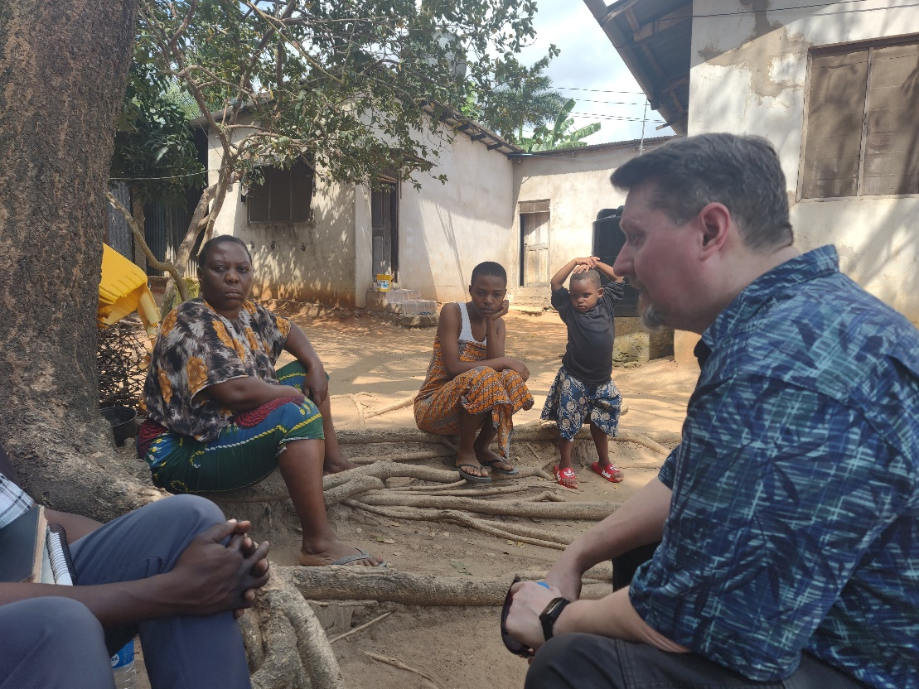
Philip’s Conversational Approach
Acts 8:26-40
Encounter in Mbezi, TZ
Perhaps you could start a conversation with a simple question like Philip did, or start where they are at (their understanding) and preach to them Jesus!
Notes:
Image: 09/13/2023 in Mbezi, Tanzania. Nate talked to and studied the true church vs Lutheranism with Elipendo (Woman sitting under the tree). Her name means "God is Love.”

Slide 22
Tabitha’s Service Approach
Acts 9:36-43
YLT: “…this woman was full of good works and kind acts that she was doing.”
NIV: “she was always doing good and helping the poor”
Tabitha (Dorcas in Greek) of Joppa died and the saints there sent for Peter in nearby Lydda.
When Peter came the widows that were gathered there were crying and showing him all the clothing Tabitha made for them while she was still alive!
Acts of kindness can go a long way to demonstrate the love of Jesus! (James 2:15-17; I John 3:17-18)

Slide 23
Tabitha’s Service Approach
Acts 9:36-43
Memorial Service for a Kind woman
Perhaps there are people in your life you can serve in some way to show them the love of God and bring them to Jesus!

Slide 24
The Right Approaches
Matthew’s Invitational Approach
Jesus’ Personal Approach
Philip’s Conversational Approach
Tabitha’s Service Approach
People respond in many ways, and you can find the approach to teaching that best suits you and the need!

Slide 25
Conclusion
We need to have the mindset that all people matter to God and are worthy of our time, love and concern! (II Timothy 2:24-26)
With that mindset we ought not to “judge a book by its cover” in our approach to teaching people, and that we might do away with our own bias, prejudices, and false image that the church is for perfect people!

Slide 26
Conclusion
Jesus said He came to heal the sick and save the lost (Luke 5:31; 19:10)
The blood of Jesus was shed to forgive the sins of a repentant sinner (Acts 10:34-35; Ephesians 1:7)

Slide 27
Conclusion
Hopefully, these approach styles will give us all ideas on how to be more effective in reaching the lost of the world, by starting on those in our own circle of influence!

Slide 28
“What Must I Do To Be Saved?”
Hear The Gospel (John 5:24; Romans 10:17)
Believe In Christ (John 3:16-18; John 8:24)
Repent Of Sins (Luke 13:3-5; Acts 2:38)
Confess Christ (Matthew 10:32; Romans 10:10)
Be Baptized (Mark 16:16; Acts 22:16)
Remain Faithful (John 8:31; Revelation 2:10)
For The Erring Saint:
Repent (Acts 8:22), Confess (I John 1:9),
Pray (Acts 8:22)

