Slide 1
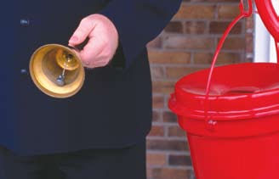
For Conscience' Sake
Soldiers Of Christ or The Salvation Army?
Text:
I Corinthians 10:25-26
Notes:
By Nathan L Morrison for Sunday December 3, 2023
All Scripture given is from NASB unless otherwise stated
For further study, or if questions, please Call: 804-277-1983 or Visit www.courthousechurchofchrist.com
Adapted from an article by Marc W Gibson in Truth Magazine, August 2008, “Taking a Look at the Salvation Army”

Slide 2
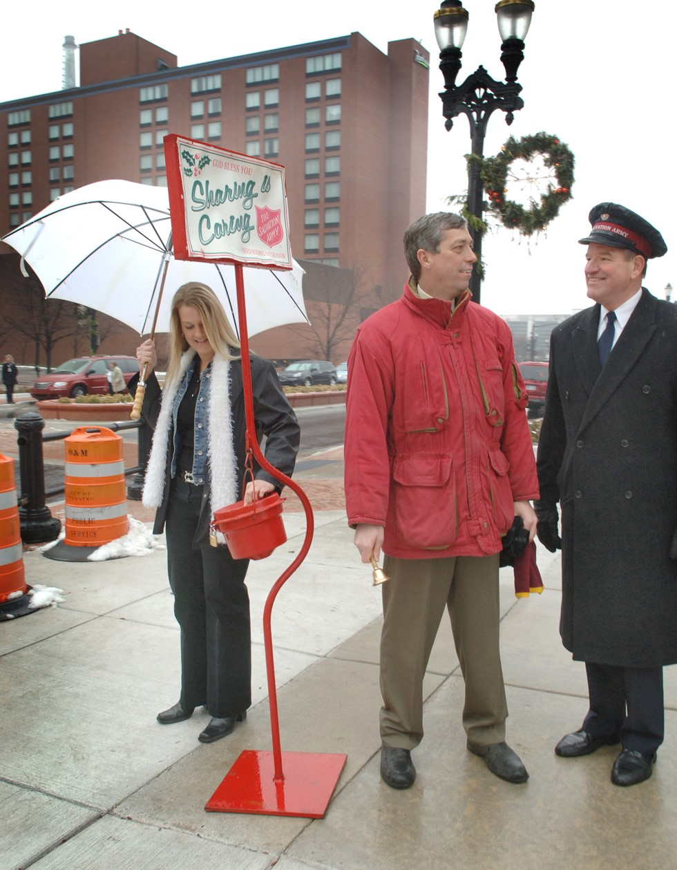
Intro
It’s that time of year where the familiar sights and sounds around department stores include Salvation Army Bell Ringers and donation buckets!
Do you give or walk away?
Appear concerned for the needy, or appear cold?
Do you give a little, a lot, do you feel guilty afterward?

Slide 3
Intro
Is it just another charity or is it much more?
Some are asking, “Should I support The Salvation Army by putting money in their buckets to help the needy?”
Be careful about asking questions that you may not want the answer to!

Slide 4
Intro
I Corinthians 10:25-32: Meats sacrificed to idols
Buy meats in the market and eat it, just don’t ask where it is from for “for conscience’ sake”
You get invited to eat dinner at a friend’s house who is an unbeliever. They serve meat. Eat it. Don’t ask where it came from “for conscience’ sake”
But…they tell you it is meat sacrificed to idols…Paul says for that person’s conscience don’t eat it.
For conscience’ sake we are to be careful. Don’t ask questions, but if we know, we have to make a judgment call!

Slide 5
Intro
A good conscience comes from doing the right things, which have been learned
James 4:17: Therefore, to one who knows the right thing to do and does not do it, to him it is sin.
I Timothy 1:5: Paul commanded Timothy to teach the Ephesians to love from a pure heart, to have a good conscience, and a sincere faith.
When shopping, we have to make judgment calls “for conscience’ sake.”
I John 4:1: Beloved, do not believe every spirit, but test the spirits to see whether they are from God, because many false prophets have gone out into the world

Slide 6
Intro
Examining The Salvation Army does not mean we should not care or want to help the needy, but to understand the proper way to do it as the church, and as individuals!

Slide 7
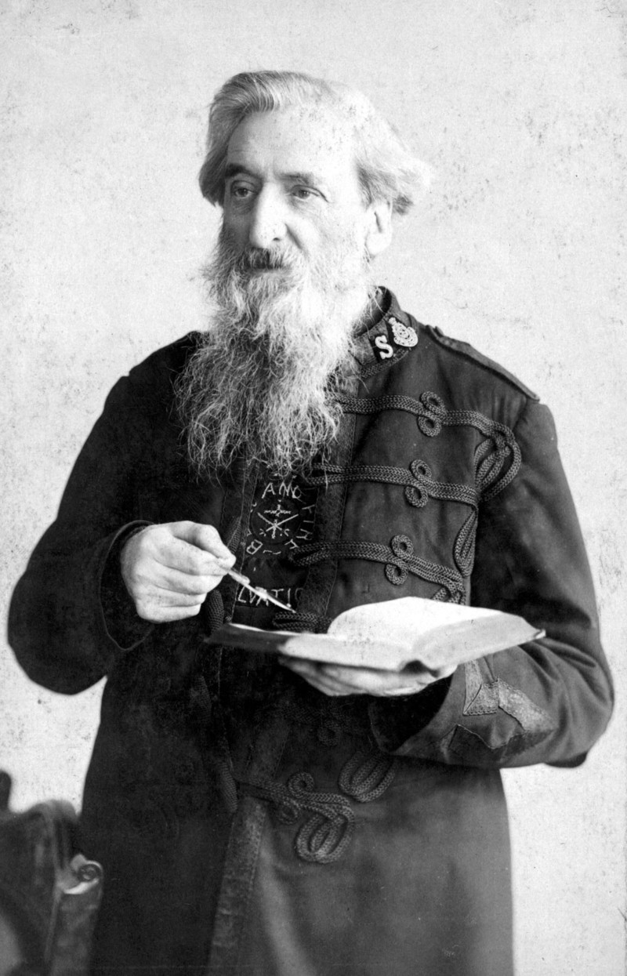
The Salvation Army: Background
The Salvation Army was started by William Booth
Born in Nottingham, England in 1829.
Joined the Methodist Church and became a preacher in 1846.
In 1862, he left and in 1865 started the East London Christian Mission.
In 1878 it was changed to “The Salvation Army” & he became its 1st General, Headquartered in London, UK.
His wife Catherine became known as “The Mother of the Army.”
In 1880, its work was launched in the U.S. and now can be found in all fifty states.
Today it is found in over 112 countries, and operates many evangelical centers as well as social institutions all over the world.
Members are called “Salvationist” and “Soldier.”
Notes:
The Salvation Army: Background
The Salvation Army was started by William Booth.
Born in Nottingham, England in 1829.
Joined the Methodist Church and became a preacher in 1846.
In 1862, he left to evangelize to the poor, and in 1865 started the East London Christian Mission.
In 1878 it was changed to “The Salvation Army.”
His wife Catherine became known as “The Mother of the Army.”
In 1880, its work was launched in the U.S. and now can be found in all fifty states.
Today it is found in over 112 countries, and operates many evangelical centers as well as social institutions all over the world.
A member is called a “Salvationist” and a “Soldier.”
Its headquarters are in London, England.

Slide 8
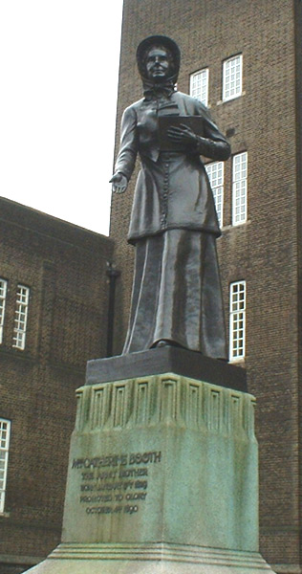
The Salvation Army: Background
Charity? Church? Or, Both?
Its own definition:
Catherine Booth (co-founder) was also a preacher and advocated for women to serve as preachers and leaders and said this in her 1859 pamphlet Female Ministry,
“Neither are we diverse from the Churches in the great fundamental doctrines of Christianity.”
Notes:
The Salvation Army: Background
The Salvation Army was started by William Booth.
Charity? Church? Or, Both? Its own definition:
The Salvation Army is both a charity and social services organization; and a denomination of the Christian religion.
I didn’t know The Salvation Army was a denominational church until 2002.
I had shopped there and donated to the Bell Ringers.
Then I moved to Alaska in 2002.
I delivered medical supplies and was driving through a city called Homer when I saw a building with the familiar red shield emblem but it said, “The Salvation Army Chapel.”
When I went home I researched it and could no longer shop or give “for conscience’ sake.”
Catherine Booth (co-founder) was also a preacher and advocated for women to serve as preachers and leaders and said this in her 1859 pamphlet Female Ministry, “Neither are we diverse from the Churches in the great fundamental doctrines of Christianity.” (https://www.britannica.com/biography/Catherine-Booth)
General Clarence Wiseman (10th General, 1974-1977) wrote in his 1978 book, The Salvation Army: A Church and a Denomination, “The Army is a church and, in the sense that it is a distinct body of Christians, a denomination among denominations.” (Wiseman, C. D. (1978). The Salvation Army: A Church and a Denomination. London: Hodder and Stoughton.)

Slide 9
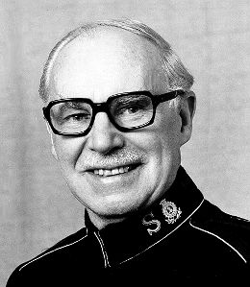
The Salvation Army: Background
Charity? Church? Or, Both? Its own definition:
General Clarence Wiseman (10th General, 1974-1977) wrote in his 1978 book, The Salvation Army: A Church and a Denomination,
“The Army is a church and, in the sense that it is a distinct body of Christians, a denomination among denominations.”
Notes:
The Salvation Army: Background
The Salvation Army was started by William Booth.
Charity? Church? Or, Both? Its own definition:
The Salvation Army is both a charity and social services organization; and a denomination of the Christian religion.
I didn’t know The Salvation Army was a denominational church until 2002.
I had shopped there and donated to the Bell Ringers.
Then I moved to Alaska in 2002.
I delivered medical supplies and was driving through a city called Homer when I saw a building with the familiar red shield emblem but it said, “The Salvation Army Chapel.”
When I went home I researched it and could no longer shop or give “for conscience’ sake.”
Catherine Booth (co-founder) was also a preacher and advocated for women to serve as preachers and leaders and said this in her 1859 pamphlet Female Ministry, “Neither are we diverse from the Churches in the great fundamental doctrines of Christianity.” (https://www.britannica.com/biography/Catherine-Booth)
General Clarence Wiseman (10th General, 1974-1977) wrote in his 1978 book, The Salvation Army: A Church and a Denomination, “The Army is a church and, in the sense that it is a distinct body of Christians, a denomination among denominations.” (Wiseman, C. D. (1978). The Salvation Army: A Church and a Denomination. London: Hodder and Stoughton.)

Slide 10
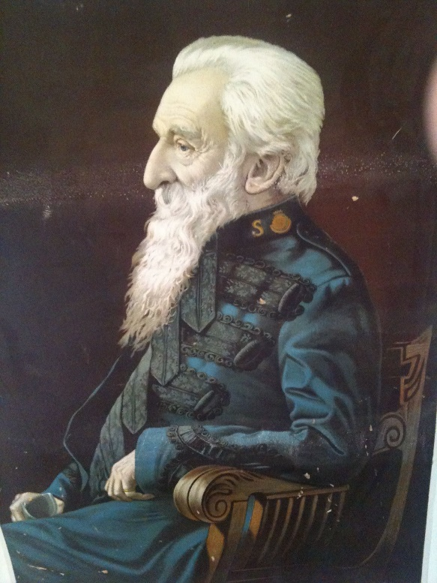
The Salvation Army: Background
Its own objectives:
The advancement of the Christian religion promulgated in the religious doctrines, which are professed, believed & taught by the Army &, pursuant there to, the advancement of education, the relief of poverty & other charitable objects beneficial to society or the community of mankind as a whole.” (Royal Charter of The Salvation Army, which was granted by Queen Victoria in 1878)
Notes:
The Salvation Army: Background
The Salvation Army was started by William Booth.
Charity? Church? Or, Both? Its own definition:
Its own objectives:
“The advancement of the Christian religion promulgated in the religious doctrines, which are professed, believed & taught by the Army &, pursuant there to, the advancement of education, the relief of poverty & other charitable objects beneficial to society or the community of mankind as a whole.” (This quote is from the Royal Charter of The Salvation Army, which was granted by Queen Victoria in 1878; https://salvationarmy.ca/about-us/mission-vision-and-values/)

Slide 11
The Salvation Army: Background
Problems:
The Salvation Army is a religious denomination that happens to specialize in benevolent work.
But it has the same problems other denominations have:
It was started by men (we know who founded it and the date).
It is organized by men.
It follows the doctrines and traditions of men.
It was founded more than 1800 years too late for it to be the church Jesus died to build and to save, which was established on the Day of Pentecost (Acts 2)!
The Salvation Army has no connection to the church that belongs to Jesus Christ!
Notes:
The Salvation Army: Background
The Salvation Army was started by William Booth.
Charity? Church? Or, Both? Its own definition:
Its own objectives:
Problems:
The Salvation Army is a religious denomination that happens to specialize in benevolent work.
But it has the same problems other denominations have:
It was started by men (we know who founded it and the date).
It is organized by men.
It follows the doctrines and traditions of men.
It was founded more than 1800 years too late for it to be the church Jesus died to build and to save, which was established on the Day of Pentecost (Acts 2)!
The Salvation Army has no connection to the church that belongs to Jesus Christ!

Slide 12
The Salvation Army: Background
The Salvation Army is more than a charitable organization: it is a church and therefore needs to be examined!

Slide 13
The Salvation Army: Beliefs
The Salvation Army uses a “creed book” called “The Salvation Army Handbook of Doctrine”
It contains 11 “Articles of Faith”, which it says are “in accord with the truths contained in the ancient Christian creeds known as the Apostle’s Creed and the Nicene Creed” (Mixed Seed!)
Two things commanded in the New Testament not found in their “Articles of Faith”:
Baptism (Mark 16:16)
The Lord’s Supper (Matthew 26:26-29; I Corinthians 11:23-26)
Article of Faith #5 affirms they believe in “Original Sin”
A general benevolent society to the whole world
Where is the Biblical authority?
As individuals we are to do good to all men (Galatians 6:10)
The church is authorized to give benevolence to the needy saints, not to the needy of the world! (Acts 4:32-37; Romans 15:26-27; I Corinthians 16:1-2).
The church can give benevolence to “widows indeed” (I Timothy 5:16).
Notes:
The Salvation Army: Background
The Salvation Army: Beliefs
As a “denomination of denominations, they must have a belief system. The Salvation Army uses a “creed book” called “The Salvation Army Handbook of Doctrine.” (available as a free .pdf @ https://www.salvationarmy.org/doctrine/handbookdoctrine)
It contains 11 “Articles of Faith”, which it says are “in accord with the truths contained in the ancient Christian creeds known as the Apostle’s Creed and the Nicene Creed.”
Their teaching, both private and public, is to “conform” to these Articles of Faith.
So, they have a human creed book based on other human creeds!
To be a member of the Salvation Army, you need something extra, something in addition to the Bible, because it is not found in the Bible!
Mixed Seed!
Two things commanded in the Bible not found in their “Articles of Faith.”
Baptism and the Lord’s Supper (Communion).
The Booths (William & Catherine) believed that many Christians had come to seek salvation through ritual rather than reliance on God.
Therefore, they did not include them in the Army's form of worship.
When baptism is administered they affirm it is not for salvation.
This contradicts Jesus in Mark 16:16.
Jesus instituted the Lord’s Supper (Matthew 26:26-29; I Corinthians 11:23-26).
They don’t feel it is important and they don’t observe it. Therefore, they do not “proclaim the Lord's death until He comes” (I Corinthians 11:26).
In their Article of Faith #5, it says, “…all men have become sinners, totally depraved and as such are justly exposed to the wrath of God.”
The erroneous doctrine of “original sin”
Ezekiel 18:20: Scriptures teach the guilt of the father is not passed to the son.
A general benevolent society to the whole world:
Where is the Biblical authority?
Helping the poor of the world is a good work, but not a work God authorized as part of the work of His church.
Good works won’t get us into Heaven (Matthew 7:21-23).
As individuals we are to do good to all men (Galatians 6:10), but the church is only to do what God authorizes it to do.
Benevolence to the needy saints, not to the needy of the world! (Acts 4:32-37; Romans 15:26-27; I Corinthians 16:1-2).
Benevolence to widows indeed (I Timothy 5:16).
Other areas of false doctrine:
Direct operation of the Holy Spirit – Ephesians 3:1-5; I Corinthians 2:7-16 (Word of God)
Use of mechanical instruments (They have their own band) – Ephesians 5:19
They appoint women preachers – I Corinthians 14:34; I Timothy 2:12-14
They raise money by soliciting the general public – I Corinthians 16:1-2
They lack respect for God’s authority – we cannot do whatever we think is a “good work” and fund it with church money!
We can do good in the way God authorized it to be done!
We need to respect God’s authority and reject the doctrines of men!

Slide 14
The Salvation Army: Beliefs
Other areas of false doctrine:
Direct operation of the Holy Spirit – Ephesians 3:1-5; I Corinthians 2:7-16 (Word of God)
Use of mechanical instruments (They have their own band) – Ephesians 5:19
They appoint women preachers – I Corinthians 14:34; I Timothy 2:12-14
They raise money by soliciting the general public – I Corinthians 16:1-2
They lack respect for God’s authority – we cannot do whatever we think is a “good work” and fund it with church money
Notes:
The Salvation Army: Background
The Salvation Army: Beliefs
As a “denomination of denominations, they must have a belief system. The Salvation Army uses a “creed book” called “The Salvation Army Handbook of Doctrine.” (available as a free .pdf @ https://www.salvationarmy.org/doctrine/handbookdoctrine)
It contains 11 “Articles of Faith”, which it says are “in accord with the truths contained in the ancient Christian creeds known as the Apostle’s Creed and the Nicene Creed.”
Their teaching, both private and public, is to “conform” to these Articles of Faith.
So, they have a human creed book based on other human creeds!
To be a member of the Salvation Army, you need something extra, something in addition to the Bible, because it is not found in the Bible!
Mixed Seed!
Two things commanded in the Bible not found in their “Articles of Faith.”
Baptism and the Lord’s Supper (Communion).
The Booths (William & Catherine) believed that many Christians had come to seek salvation through ritual rather than reliance on God.
Therefore, they did not include them in the Army's form of worship.
When baptism is administered they affirm it is not for salvation.
This contradicts Jesus in Mark 16:16.
Jesus instituted the Lord’s Supper (Matthew 26:26-29; I Corinthians 11:23-26).
They don’t feel it is important and they don’t observe it. Therefore, they do not “proclaim the Lord's death until He comes” (I Corinthians 11:26).
In their Article of Faith #5, it says, “…all men have become sinners, totally depraved and as such are justly exposed to the wrath of God.”
The erroneous doctrine of “original sin”
Ezekiel 18:20: Scriptures teach the guilt of the father is not passed to the son.
A general benevolent society to the whole world:
Where is the Biblical authority?
Helping the poor of the world is a good work, but not a work God authorized as part of the work of His church.
Good works won’t get us into Heaven (Matthew 7:21-23).
As individuals we are to do good to all men (Galatians 6:10), but the church is only to do what God authorizes it to do.
Benevolence to the needy saints, not to the needy of the world! (Acts 4:32-37; Romans 15:26-27; I Corinthians 16:1-2).
Benevolence to widows indeed (I Timothy 5:16).
Other areas of false doctrine:
Direct operation of the Holy Spirit – Ephesians 3:1-5; I Corinthians 2:7-16 (Word of God)
Use of mechanical instruments (They have their own band) – Ephesians 5:19
They appoint women preachers – I Corinthians 14:34; I Timothy 2:12-14
They raise money by soliciting the general public – I Corinthians 16:1-2
They lack respect for God’s authority – we cannot do whatever we think is a “good work” and fund it with church money!
We can do good in the way God authorized it to be done!
We need to respect God’s authority and reject the doctrines of men!

Slide 15
The Salvation Army: Beliefs
We need to respect God’s authority and reject the doctrines of men!

Slide 16
The Salvation Army: Organization
Organization of the Salvation Army includes:
International General
Chief of Staff
Captains
Majors
Lieutenants
Soldiers
Adherents
Notes:
The Salvation Army: Background
The Salvation Army: Beliefs
The Salvation Army: Organization
Organization of the Salvation Army includes:
International General
Chief of Staff
Captains
Majors
Lieutenants
Soldiers
Adherents
U.S. divided into 4 territories, each with its own Territorial Commander who receives orders from the Salvation Army's International Headquarters in London.
Spouses share the same title – up to just a few years ago, officers in the church could only marry other officers.
The General’s spouse is given the rank of “Commissioner.”
Soldiers & officers wear a uniform tailored to the country they are in.
Soldiers: those who sign a document stating they will adhere to creed.
Adherents: attend regularly but have not signed the document and thus do not wear a uniform (also volunteers).
Officers are given new “Marching Orders” every 2-5 years and reassigned to different posts, sometimes moving great distances.
Where is the Biblical authority? (I Peter 4:11: Speak as the utterances of God!)
The Lord’s church is made up of:
Elders – I Timothy 3:1-7; 5:17-18; Titus 1:5-9
Deacons – I Timothy 3:8-13
Preachers (Evangelists) – Ephesians 4:11; II Timothy 4:5
Teachers – I Timothy 4:11; II Timothy 2:2; Hebrews 5:12-14
Members (Saints) – Romans 1:7; 12:4-5; I Corinthians 1:2
Members called “Soldiers” (II Timothy 2:3) & our “uniform” is a spiritual one, made up of the full Armor of God (Ephesians 6:10-18).
It is that simple; no “officers” or “marching orders,” and no “uniforms!”
When man rejects God’s authority, God will reject that man! (Matthew 7:21-23)

Slide 17
The Salvation Army: Organization
Where is the Biblical authority?
(I Peter 4:11: Speak as the utterances of God!)
The Lord’s church is made up of:
Elders – I Timothy 3:1-7; 5:17-18; Titus 1:5-9
Deacons – I Timothy 3:8-13
Preachers (Evangelists) – Ephesians 4:11; II Timothy 4:5
Teachers – I Timothy 4:11; II Timothy 2:2; Hebrews 5:12-14
Members (Saints) – Romans 1:7; 12:4-5; I Corinthians 1:2
Members called “Soldiers” (II Timothy 2:3) & our “uniform” is a spiritual one, made up of the full Armor of God (Ephesians 6:10-18)
Notes:
The Salvation Army: Background
The Salvation Army: Beliefs
The Salvation Army: Organization
Organization of the Salvation Army includes:
International General
Chief of Staff
Captains
Majors
Lieutenants
Soldiers
Adherents
U.S. divided into 4 territories, each with its own Territorial Commander who receives orders from the Salvation Army's International Headquarters in London.
Spouses share the same title – up to just a few years ago, officers in the church could only marry other officers.
The General’s spouse is given the rank of “Commissioner.”
Soldiers & officers wear a uniform tailored to the country they are in.
Soldiers: those who sign a document stating they will adhere to creed.
Adherents: attend regularly but have not signed the document and thus do not wear a uniform (also volunteers).
Officers are given new “Marching Orders” every 2-5 years and reassigned to different posts, sometimes moving great distances.
Where is the Biblical authority? (I Peter 4:11: Speak as the utterances of God!)
The Lord’s church is made up of:
Elders – I Timothy 3:1-7; 5:17-18; Titus 1:5-9
Deacons – I Timothy 3:8-13
Preachers (Evangelists) – Ephesians 4:11; II Timothy 4:5
Teachers – I Timothy 4:11; II Timothy 2:2; Hebrews 5:12-14
Members (Saints) – Romans 1:7; 12:4-5; I Corinthians 1:2
Members called “Soldiers” (II Timothy 2:3) & our “uniform” is a spiritual one, made up of the full Armor of God (Ephesians 6:10-18).
It is that simple; no “officers” or “marching orders,” and no “uniforms!”
When man rejects God’s authority, God will reject that man! (Matthew 7:21-23)

Slide 18
The Salvation Army: Beliefs
When man rejects God’s authority, God will reject that man!
(Matthew 7:21-23)

Slide 19
The Salvation Army: Benevolence
Most of the world recognizes The Salvation Army for their charity work:
Disaster Relief
Thrift Shops and Donation Buckets
Adult Rehabilitation Centers (ARCs) & Work Therapy
Their website confirms thrift store provides:
Quality products at bargain prices.
Funds for ARCs and participants’ Work Therapy
To buy from their thrift stores or to put money in their buckets is to support their church and does not fall into the category of “don’t ask for conscience’s sake.”
Notes:
The Salvation Army: Background
The Salvation Army: Beliefs
The Salvation Army: Organization
The Salvation Army: Benevolence
Alluded to earlier, but what most of the world recognizes The Salvation Army for is their charity work (I didn’t even know they were a church until 21 years ago!).
They claim to spread Christianity in all their work, because they use the Bible in all their programs.
Disaster Relief
Starting in 1900, they have been responding to disasters.
They participate financially, and in supporting roles, including the 9-11 attacks, and even Hurricane Katrina.
They act as Chaplains, offer prayer services, and even hand out cold drinks, and food.
Thrift Shops and Donation Buckets
They sell mostly donated items (100% profit).
Thrift stores provide 100% of the revenue to run the Adult Rehabilitation Centers known as ARCs. (www.salvationarmyusa.org)
Website confirms thrift store provides:
Quality products at bargain prices.
Funds for ARCs and participants’ Work Therapy.
“Plus, your purchase directly funds The Salvation Army ARCs. That means that the bargains you find for yourself also helps others by reclaiming lives and healing families.”
To buy from their thrift stores or to put money in their buckets is to support their church and does not fall into the category of “don’t ask for conscience’s sake.” (Like giving money to “Sponsoring Church”)
I Corinthians 10:25: Paul was saying to shop without asking where the meat came from (and thus who it supported).
We can apply this today in not wanting to know where companies spend their money in support of things.
Others apply this to The Salvation Army Thrift Stores – Can’t apply since their name on the door takes away all doubt!
Personal Story about the United Way:
Worked for Key Bank long ago. They wanted 100% participation in supporting The United Way.
Made it mandatory to listen to an hour long spiel by representatives.
They said you can donate and earmark your contribution to the charity of your choice.
They supported things I wanted no part in so that option was swaying me to donate and play along with the company directive.
Until…I noticed each charity they support had a monetary cap on it. Someone also noticed and asked what happens to the money they earmark but the cap has been met?
The Reps said then they redirect that money to where they feel it is needed best.
I wouldn’t donate because they couldn’t guarantee me that my donation would 100% go to where I wanted it to go.
I was dragged into two different managers’ meetings with the Reps and they plead with me to just put a dime ($.010) in the envelope and it would count towards the company’s 100% directive.
When the Reps repeatedly could not 100% guarantee me that my dime wouldn’t support an organization that my conscience cannot support I wouldn’t donate. We lost the 100% compliance and I became a pariah to management.
But…“for conscience’ sake” I couldn’t do it.
The Salvation Army website lists so many different social programs that they fund that they are too numerous to list.
Many of them are “good works” and belong in the charity work category.
But in all of these things they say their priority is to teach their version of the Scriptures, thus the “Salvation” part of their name is speaking spiritual as well as physical.
A “good work” outside of God’s authority becomes a detriment to one’s soul!

Slide 20
The Salvation Army: Benevolence
Most of the world recognizes The Salvation Army for their charity work:
Disaster Relief
Thrift Shops and Donation Buckets
ARCs
Work Therapy
In all of these things they say their priority is to teach their version of the Scriptures, thus the “Salvation” part of their name is speaking spiritual as well as physical
Notes:
The Salvation Army: Background
The Salvation Army: Beliefs
The Salvation Army: Organization
The Salvation Army: Benevolence
Alluded to earlier, but what most of the world recognizes The Salvation Army for is their charity work (I didn’t even know they were a church until 21 years ago!).
They claim to spread Christianity in all their work, because they use the Bible in all their programs.
Disaster Relief
Starting in 1900, they have been responding to disasters.
They participate financially, and in supporting roles, including the 9-11 attacks, and even Hurricane Katrina.
They act as Chaplains, offer prayer services, and even hand out cold drinks, and food.
Thrift Shops and Donation Buckets
They sell mostly donated items (100% profit).
Thrift stores provide 100% of the revenue to run the Adult Rehabilitation Centers known as ARCs. (www.salvationarmyusa.org)
Website confirms thrift store provides:
Quality products at bargain prices.
Funds for ARCs and participants’ Work Therapy.
“Plus, your purchase directly funds The Salvation Army ARCs. That means that the bargains you find for yourself also helps others by reclaiming lives and healing families.”
To buy from their thrift stores or to put money in their buckets is to support their church and does not fall into the category of “don’t ask for conscience’s sake.” (Like giving money to “Sponsoring Church”)
I Corinthians 10:25: Paul was saying to shop without asking where the meat came from (and thus who it supported).
We can apply this today in not wanting to know where companies spend their money in support of things.
Others apply this to The Salvation Army Thrift Stores – Can’t apply since their name on the door takes away all doubt!
Personal Story about the United Way:
Worked for Key Bank long ago. They wanted 100% participation in supporting The United Way.
Made it mandatory to listen to an hour long spiel by representatives.
They said you can donate and earmark your contribution to the charity of your choice.
They supported things I wanted no part in so that option was swaying me to donate and play along with the company directive.
Until…I noticed each charity they support had a monetary cap on it. Someone also noticed and asked what happens to the money they earmark but the cap has been met?
The Reps said then they redirect that money to where they feel it is needed best.
I wouldn’t donate because they couldn’t guarantee me that my donation would 100% go to where I wanted it to go.
I was dragged into two different managers’ meetings with the Reps and they plead with me to just put a dime ($.010) in the envelope and it would count towards the company’s 100% directive.
When the Reps repeatedly could not 100% guarantee me that my dime wouldn’t support an organization that my conscience cannot support I wouldn’t donate. We lost the 100% compliance and I became a pariah to management.
But…“for conscience’ sake” I couldn’t do it.
The Salvation Army website lists so many different social programs that they fund that they are too numerous to list.
Many of them are “good works” and belong in the charity work category.
But in all of these things they say their priority is to teach their version of the Scriptures, thus the “Salvation” part of their name is speaking spiritual as well as physical.
A “good work” outside of God’s authority becomes a detriment to one’s soul!

Slide 21
The Salvation Army: Beliefs
A “good work” outside of God’s authority becomes a detriment to one’s soul!

Slide 22
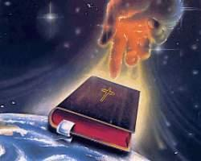
CONCLUSION
While reaching out to the poor and needy is a good work, we need not create a human religious denomination to accomplish the task
Many private and public services are available that Christians can individually give to so that they can participate in that work.
There are many that we can give to that are not affiliated with a church or religious organization (such as Goodwill, which also uses funds for Work Therapy and Work Training Programs).

Slide 23
CONCLUSION
We cannot, and must not, support any organization that would teach and uphold false doctrines that will cause men to lose their souls (in all they do, they evangelize – false doctrines, the creeds of men!)
The end of helping the poor does not justify the unauthorized support of the human religious denomination known as The Salvation Army!

Slide 24
CONCLUSION
“For conscience’ sake,” both for ours and those who observe us, let us be careful in who, what, and how we support the needy!

Slide 25
“What Must I Do To Be Saved?”
Hear The Gospel (John 5:24; Romans 10:17)
Believe In Christ (John 3:16-18; John 8:24)
Repent Of Sins (Luke 13:3-5; Acts 2:38)
Confess Christ (Matthew 10:32; Romans 10:10)
Be Baptized (Mark 16:16; Acts 22:16)
Remain Faithful (John 8:31; Revelation 2:10)
For The Erring Saint:
Repent (Acts 8:22), Confess (I John 1:9),
Pray (Acts 8:22)

