Slide 1
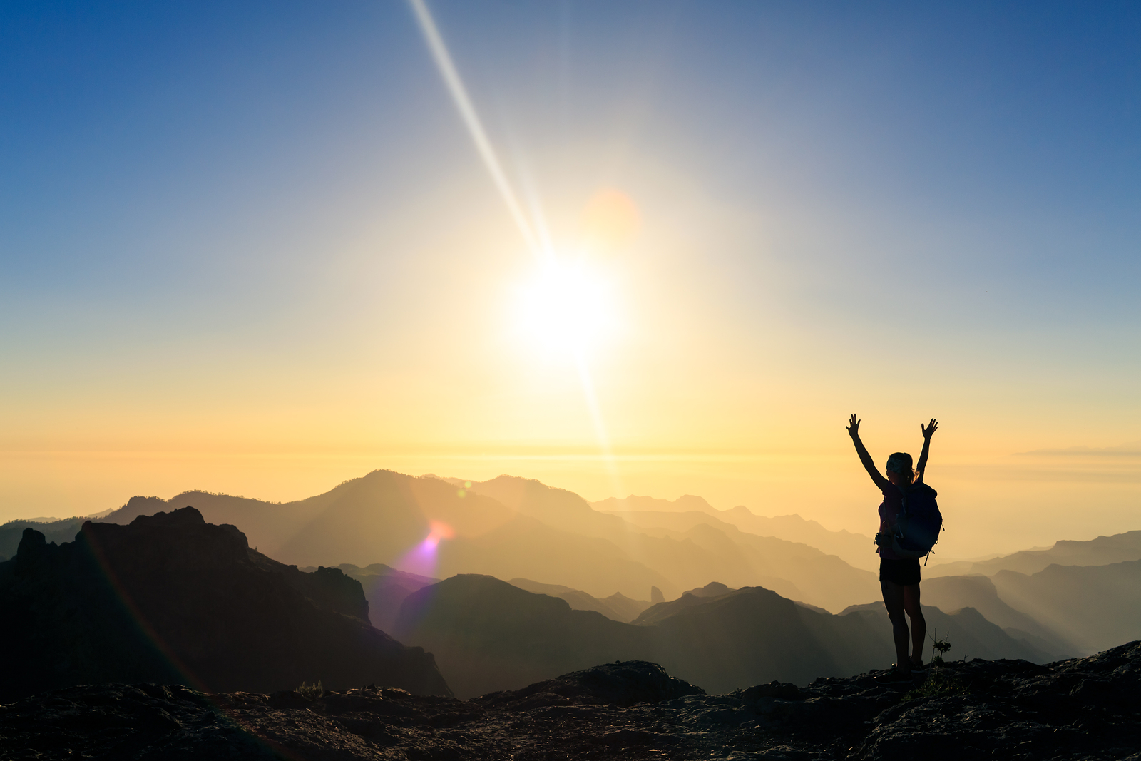
I Love The Lord
Text:
Psalm 116
Notes:
By Nathan L Morrison for Sunday November 26, 2023
All Scripture given is from NASB unless otherwise stated
For further study, or if questions, please Call: 804-277-1983 or Visit www.courthousechurchofchrist.com
Adapted from a lesson by Alan Smith

Slide 2
Intro
Saints are to give thanks to God for all things at all times!
I Thessalonians 5:18: “…in everything give thanks; for this is God's will for you in Christ Jesus.”
Ephesians 5:18-21: “And do not get drunk with wine, for that is dissipation, but be filled with the Spirit, speaking to one another in psalms and hymns and spiritual songs, singing and making melody with your heart to the Lord; always giving thanks for all things in the name of our Lord Jesus Christ to God, even the Father; and be subject to one another in the fear of Christ.”

Slide 3
Intro
This gratitude that we are to feel for all things at all times is not an attitude of “What can I get out of it?” but of genuine thanks to God!
Pagans: Appeasement (“What can I get out of it?”)
Christianity: Gratitude (“Thank you for what I have”)
Appeasement looks forward to what I may get in the future – Is self-centered
Gratitude says Thanks for what I have been given – Is God-centered

Slide 4
Intro
Psalm 116
Psalm 116 was one of six psalms that the Jews sang every year at the Passover meal (Still do today)
First, they sing Psalms 113, 114, and 115. Then they eat!
They remember what God has done for them then they then sing Psalm 116: “I love the Lord.”
Psalm 116 actually has two parts: 1st Part tells of the Psalmists love for God because of His blessings; 2nd Part says how the Psalmists responds to God’s blessings.

Slide 5
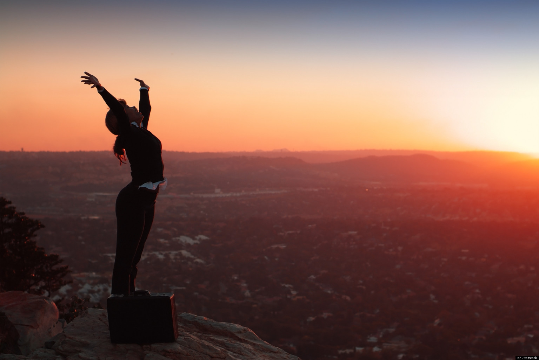
Intro
Let the Psalmist remind us to “give thanks” to the Lord and recount the reasons we love Him!

Slide 6
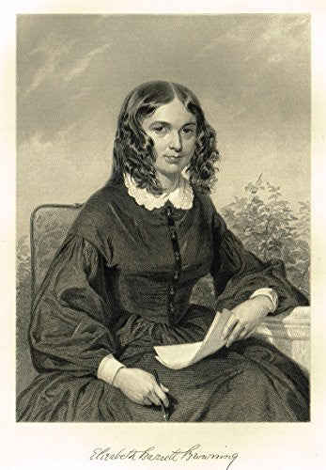
The Psalmist Counts the Ways
Psalm 116 begins with the words “I love the Lord because…”
Elizabeth Barrett (1806-1861), suffered a spinal injury at the age of 15 which left her a semi-invalid.
There was a man whom she loved very deeply and eventually married — Robert Browning.
Her love for him was beautifully expressed in her work “Sonnets From the Portuguese” (1845)
“How do I love thee? Let me count the ways…”
Notes:
The Psalmist Counts the Ways
Psalm 116 begins with the words “I love the Lord because…”
In the 19th century, there was a young English girl, Elizabeth Barrett (1806-1861), who suffered a spinal injury at the age of 15 which left her a semi-invalid for many years afterward.
There was a man whom she loved very deeply and eventually married — Robert Browning.
Her love for him was beautifully expressed in her work “Sonnets From the Portuguese” (1845)
Now, that title may not sound familiar to you, but I think that the words which she wrote will sound familiar, “How do I love thee? Let me count the ways…”
Then she went on to describe the depth of her love for her husband. https://englishhistory.net/poets/elizabeth-barrett-browning/
That’s what the Psalmist does here. Why does he love the Lord? Let him (and us) count the ways!

Slide 7
The Psalmist Counts the Ways
That’s what the Psalmist does here.
Why does he love the Lord? Let him (and us) count the ways!

Slide 8
I Love The Lord, Because…
Because God heard him (Psalm 116:1-2) -- “I love the LORD, because He hears My voice and my supplications. Because He has inclined His ear to me, Therefore I shall call upon Him as long as I live.”
He’s saying, “When I speak, God listens. God pays attention to what I have to say.”
God He hears our voice. He inclines His ear to our prayers (I Peter 3:12; I John 5:14-15)
Giving thanks to God should begin with the realization that God has heard our many prayers, and God has answered those prayers!

Slide 9
I Love The Lord, Because…
Because God rescued him (Psalm 116:3-6, 8) -- “The cords of death encompassed me And the terrors of Sheol came upon me; I found distress and sorrow. Then I called upon the name of the LORD: ‘O LORD, I beseech You, save my life!’ Gracious is the LORD, and righteous; Yes, our God is compassionate. The LORD preserves the simple; I was brought low, and He saved me.…. For You have rescued my soul from death, My eyes from tears, My feet from stumbling.”
Whoever the Psalmist is, he remembers the problems that he’s had in the past.
He did what most of us would do under similar circumstances — he prayed to God.
God delivered him. Just like He did the Israelites in Egypt (Exodus 3:7-8)
The Psalmist realizes that God did the same thing for him.

Slide 10
I Love The Lord, Because…
Because God had richly blessed him (Psalm 116:7) -- “Return to your rest, O my soul, For the LORD has dealt bountifully with you.”
God has “dealt bountifully.” The idea is that God has piled gift after gift upon us.
Ephesians 3:20: “Far more abundantly.”
I Kings 3-11: King Solomon, the richest man in all the world ($530 million per year)

Slide 11
I Love The Lord, Because…
More blessed than King Solomon…
He never had electricity in his home, or running water.
He didn’t own an air conditioner.
He never used a flushing toilet or took a hot shower (without someone constantly refreshing and pouring over him).
He never drove in an automobile, nor traveled across the world in an airplane.
He may have never tasted a banana or a home-baked chocolate chip cookie.
When Solomon got a cold, he couldn’t run down to the store and pick up a bottle of Nyquil to help him sleep better.
Jesus said of Solomon’s splendor and clothing, “And why are you worried about clothing? Observe how the lilies of the field grow; they do not toil nor do they spin, yet I say to you that not even Solomon in all his glory clothed himself like one of these” (Matthew 6:28-29).
Notes:
We read in I Kings 3-11 about King Solomon, the richest man in all the world.
Solomon had an annual income of about $530 million dollars a year.
We hear that and we think, “Wouldn’t that be nice! I wish I had what Solomon did.”
But, for all the gold Solomon collected, he never had electricity in his home, or running water.
He didn’t own an air conditioner.
He never used a flushing toilet or took a hot shower (without someone constantly refreshing and pouring over him).
He never drove in an automobile, nor traveled across the world in an airplane.
He may have never tasted a banana or a home-baked chocolate chip cookie.
When Solomon got a cold, he couldn’t run down to the store and pick up a bottle of Nyquil to help him sleep better.
In almost every way I can think of, I have more luxuries surrounding me, things which I consider very ordinary, than Solomon the richest man in the world ever even dreamed of having!
Jesus said of Solomon’s splendor and clothing, “And why are you worried about clothing? Observe how the lilies of the field grow; they do not toil nor do they spin, yet I say to you that not even Solomon in all his glory clothed himself like one of these” (Matthew 6:28-29).

Slide 12
The Psalmist Counts the Ways
When we consider the many blessings that we have, we should be driven to our knees in thanksgiving: “Count your many blessings, name them one by one!”

Slide 13
The Psalmist’s Response to God
Expressing thanks (Psalm 116:12-13, 17) -- “What shall I render to the LORD For all His benefits toward me? I shall lift up the cup of salvation And call upon the name of the LORD… To You I shall offer a sacrifice of thanksgiving, And call upon the name of the LORD.”
The Psalmist simply can’t contain his desire to express his thanks to God.

Slide 14
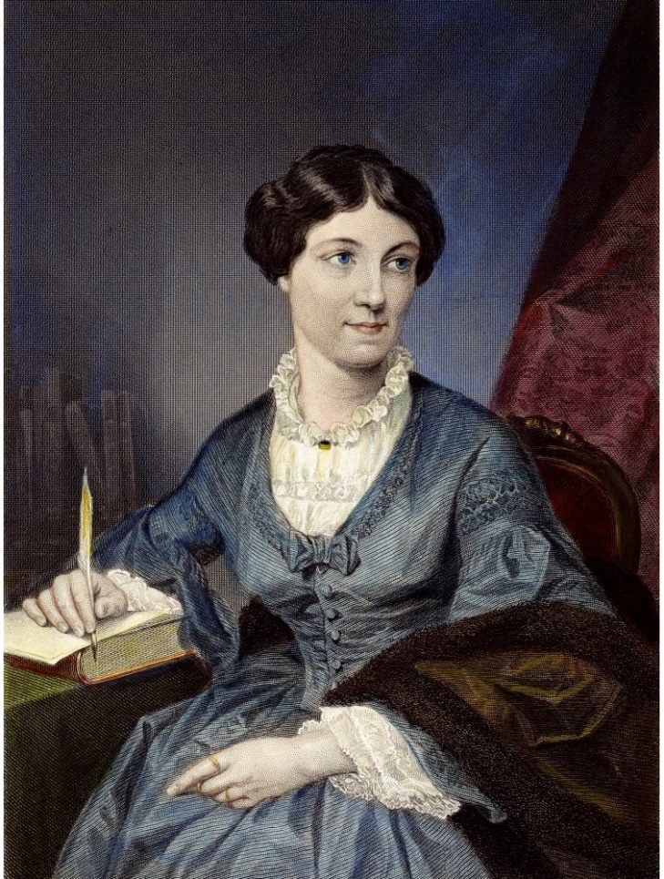
The Psalmist’s Response to God
Harriet Martineau (1802-1876) was a self-proclaimed atheist
Nineteenth Century Questions (1897) by James Freeman Clarke, a minister and friend of Harriet, recounts a conversation he had with Martineau in 1855, when they were both visiting Niagara Falls. He writes...
We were standing together on the bridge which crosses the rapids above the Falls. It was a bright October morning. The sun shone on the brilliant foliage of the trees, and on the swift current of the river. The air was full of life and exhilaration. I said to her, “This is a glorious day.” She replied, “Yes, it is a day to make one grateful.” I said, “To whom are you grateful?” She answered, “To the Power which has caused this beauty and this joy.”
Notes:
Harriet Martineau (1802-1876) was a self-proclaimed atheist who rejected the idea of a personal God, but she also acknowledged the existence of a natural order and a moral law that governed the universe.
James Freeman Clarke was a Unitarian minister and friend of Martineau, who wrote a biography of her in 1877, a year after her death. In his book, Nineteenth Century Questions (1897), he recounts a conversation he had with Martineau in 1855, when they were both visiting Niagara Falls. He writes:
“We were standing together on the bridge which crosses the rapids above the Falls. It was a bright October morning. The sun shone on the brilliant foliage of the trees, and on the swift current of the river. The air was full of life and exhilaration. I said to her, “This is a glorious day.” She replied, “Yes, it is a day to make one grateful.” I said, “To whom are you grateful?” She answered, “To the Power which has caused this beauty and this joy.” p. 282.

Slide 15
The Psalmist’s Response to God
Expressing thanks (Psalm 116:12-13, 17) -- “What shall I render to the LORD For all His benefits toward me? I shall lift up the cup of salvation And call upon the name of the LORD… To You I shall offer a sacrifice of thanksgiving, And call upon the name of the LORD.”
The Psalmist simply can’t contain his desire to express his thanks to God.
People who give a vague “Thanks” remind us of the ten lepers who were healed (Luke 17:11-19)
Ephesians 5:20: “always giving thanks for all things in the name of our Lord Jesus Christ to God, even the Father.”
As we mature in our faith, we learn to thank God for the good and the bad!

Slide 16
The Psalmist’s Response to God
Dedicating his life to God (Psalms 116:14, 18-19) -- “I shall pay my vows to the LORD, Oh may it be in the presence of all His people... I shall pay my vows to the LORD, Oh may it be in the presence of all His people, In the courts of the LORD'S house, In the midst of you, O Jerusalem. Praise the LORD!”
Thanksgiving requires a person to fulfill his responsibility to God.
Mark 12:30: Give to God Heart, Mind, Soul, and Strength!
“Attitude of Gratitude”
I Corinthians 6:19-20: “You are not your own…” “you were bought with a price…” “Glorify God in your body!”
Thanksgiving isn’t complete unless it leads to “thanksLIVING!”

Slide 17
The Psalmist’s Response to God
It’s not enough to merely offer the praise of our lips – there ought to also be the praise of our lives!

Slide 18
Conclusion
When things are going good it is easy to forget to be thankful to God, and easy to think we did that.
When things are going bad it is easy to forget to be thankful to God, because we are focused on ourselves!
It is hard to give thanks if we are focused on “Self” and given over to grumbling and complaining
Philippians 2:14:
“Do all things without grumbling or disputing”

Slide 19
Conclusion
This week, whenever you feel tempted to complain or grumble about something, instead of complaining, thank God.
Find something positive about that situation or day and praise God and give Him thanks.
It will change your life!
Week-long NO Complaining Challenge

Slide 20
Conclusion
The key word there is “always”
Not just on Thanksgiving Not just on Sundays
Every day
God is good (All the time)
All the time (God is good)
Ephesians 5:20:
“always giving thanks for all things in the name of our Lord Jesus Christ to God, even the Father”

Slide 21
Conclusion
Psalm 116 reminds us of the fact that thanksgiving to God is important for each and every one of us!
Day by day, may we remember how richly God has blessed each of us, and may we daily express our thanks to Him for His goodness, and may we in response dedicate our lives to the One who gave His all for us!

Slide 22
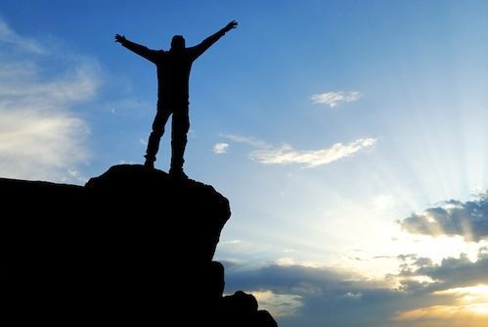
Conclusion
Let us, like the Psalmist, say, “I love the Lord. Let me count the ways!”

Slide 23
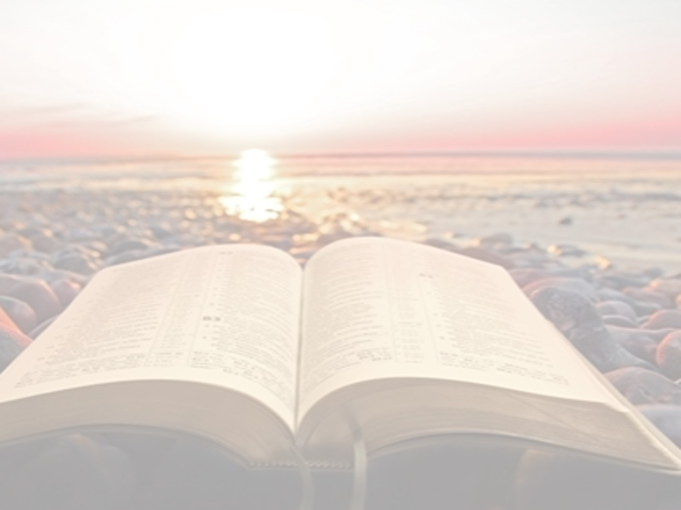
“What Must I Do To Be Saved?”
Hear The Gospel (John 5:24; Romans 10:17)
Believe In Christ (John 3:16-18; John 8:24)
Repent Of Sins (Luke 13:3-5; Acts 2:38)
Confess Christ (Matthew 10:32; Romans 10:10)
Be Baptized (Mark 16:16; Acts 22:16)
Remain Faithful (John 8:31; Revelation 2:10)
For The Erring Saint:
Repent (Acts 8:22), Confess (I John 1:9),
Pray (Acts 8:22)

