Slide 1
“We Need Preachers, NOT Missionaries”
Mission Report: Tanzania 2023
Notes:
By Nathan L Morrison for Sunday 10/08/2023
All Scripture given is from NASB unless otherwise stated
For further study or if questions, Call: 804-277-1983, or Visit: www.courthousechurchofchrist.com
I bring back Greetings from the churches of Christ at Mbezi, Tabata, Chanika, Kizuiani, Mwanambya, and Kigugi.
I went bearing your greetings as well!
I thank you, the brethren here at Courthouse, for supporting Becky and I and helping to fund this overseas trip!
I couldn’t have gone without your love and support!

Slide 2
Intro
Acts 15:36
After some days Paul said to Barnabas, "Let us return and visit the brethren in every city in which we proclaimed the word of the Lord, and see how they are."
Notes:
Act 14:26 From there they sailed to Antioch, from which they had been commended to the grace of God for the work that they had accomplished.
Act 14:27 When they had arrived and gathered the church together, they began to report all things that God had done with them and how He had opened a door of faith to the Gentiles.
Act 14:28 And they spent a long time with the disciples.
Paul and Barnabas concluded their 1st Missionary Journey by returning to Antioch (where they had started from) and reported to the whole church what God had done through them!
Then after the Jerusalem Council in Acts 15 Paul and Barnabas wanted to go and strengthen the congregations they had started in each of those cities (Acts 15:36).
After the fight over John Mark, they split up and Paul took Silas.
Our mission to Tanzania was like Paul and Silas’ on Paul’s 2nd Missionary Journey: To check on established congregations and strengthen and encourage them!
We met with multiple congregations and with preachers for study and Q&A

Slide 3
Intro
Richmond, VA Travelers, Tanzania Bound:
Nathan Morrison
Becky Morrison
Chad Brewer (from Happy Hill CoC)
Notes:
After canceled flights to get out of Richmond Thursday September 7th, we finally were off when we flew out of Dulles on Friday, September 8th!
Chad Brewer from the Happy Hill congregation flew with us!

Slide 4
Notes:
From Friday morning September 8th through Saturday afternoon September 9th the three of us flew from WA DC (Dulles International Airport) to Dubai, where we barely made our connecting flight (They were on “Final Boarding Call”) to Tanzania. All in all, it was about a 30 hour trip!
But we made it safely!
Praise God!

Slide 5
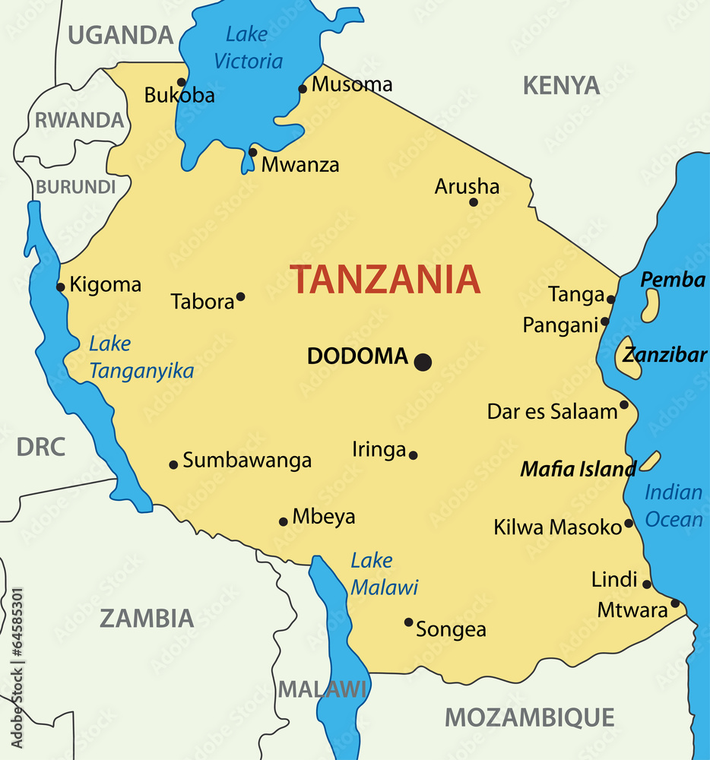
Notes:
Saturday September 9, 2023: We landed on Africa’s Eastern Coast in Tanzania around 2 PM in Dar es Salaam and had to make our way through their Customs.

Slide 6
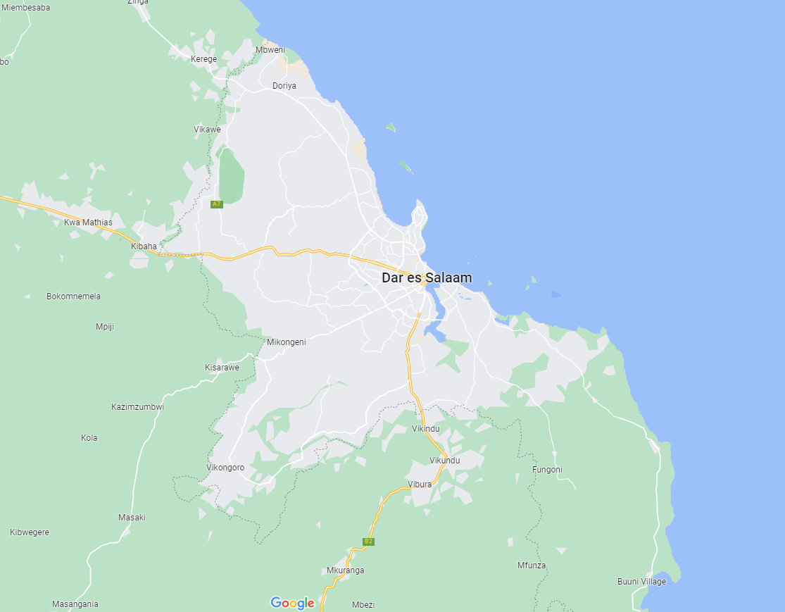
Mbezi
Notes:
A driver was waiting for us at the Dar es Salaam Airport and he drove us to our hotel on the Indian Ocean, Mbezi. We would work with the brethren there for four days from Sunday September 10 – Wednesday September 13.

Slide 7
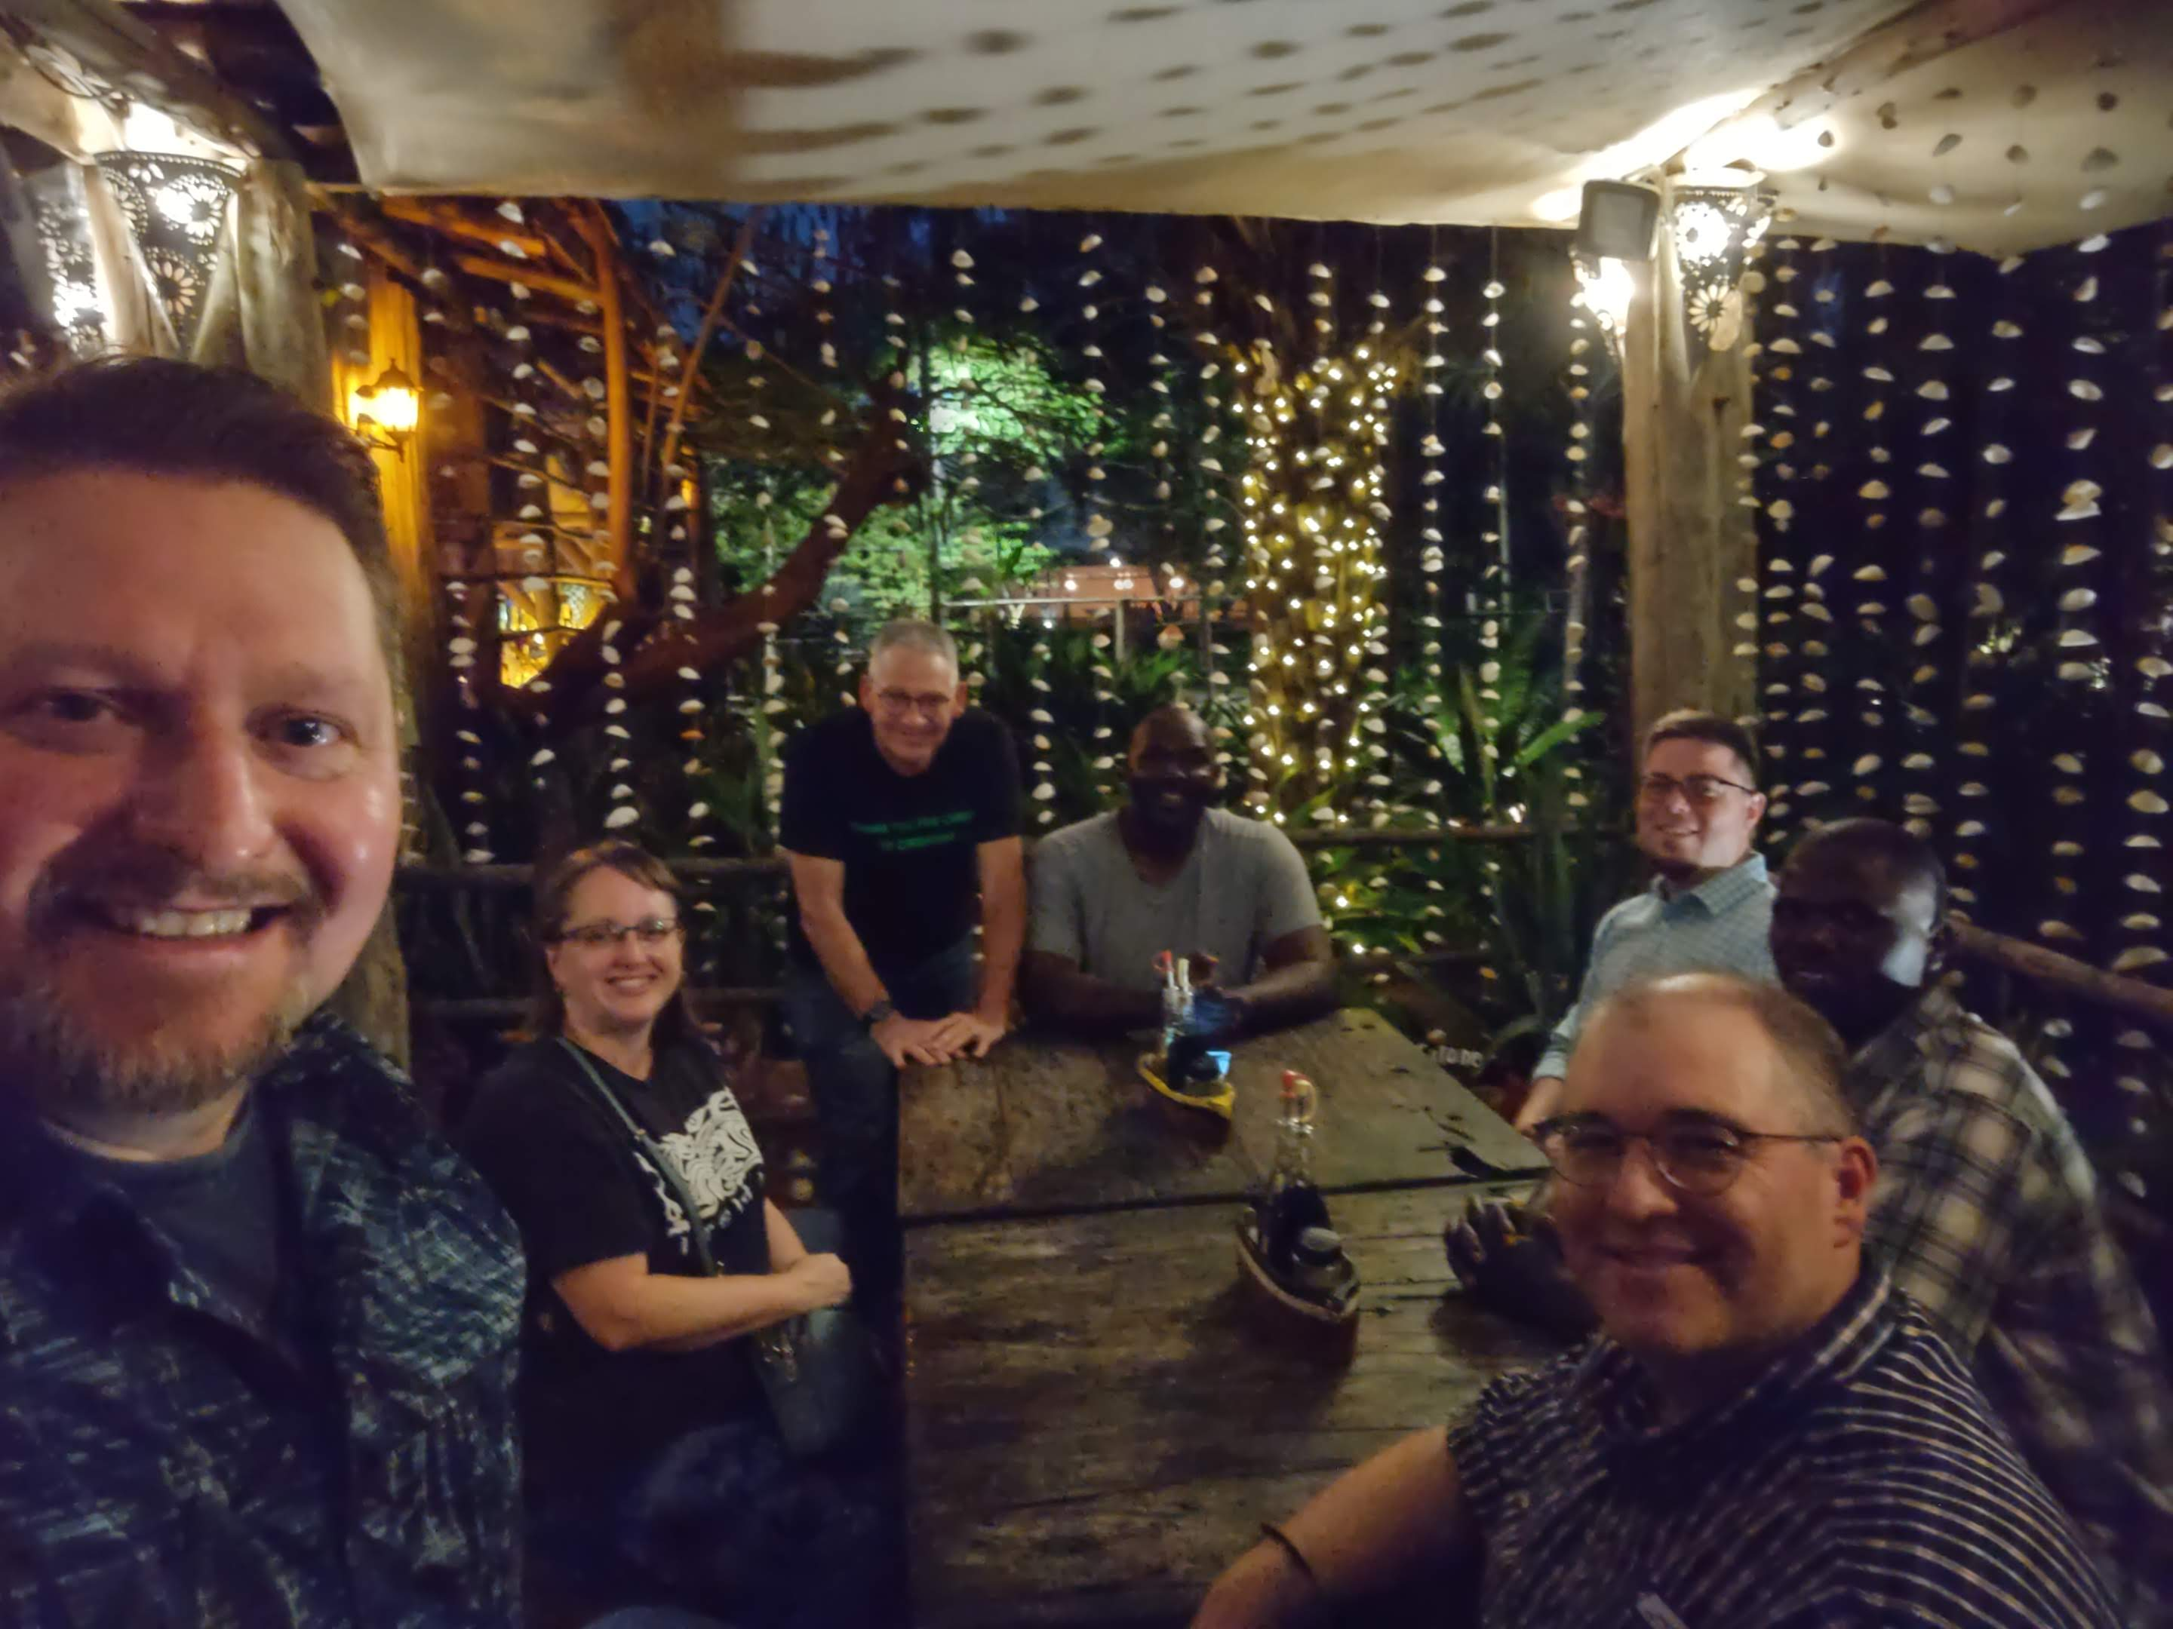
Intro
US Group (MZUNGUS):
Andrew Roberts (Tampa, FL)
Chad Brewer (Richmond, VA)
Ed Smith (Paris, TN)
Nathan Morrison (Richmond, VA)
Becky Morrison (Richmond, VA)
Nate
Ed
Zuberi
Chad
Becky
Charles
Translators:
Charles Mwakalonge (Tunduru, TZ)
Zuberi Mwakyami (Mwanambya, TZ)
Andrew
Notes:
That night, Saturday the 9th, we stayed at our hotel on the coast and despite being tired we met up with the rest of our group who had also traveled to Mbezi!
US Group (MZUNGUS!):
Andrew Roberts (Tampa, FL) – this was his 3rd time to Tanzania
Chad Brewer (Richmond, VA) – this was his 2nd time to Tanzania
Ed Smith (Paris, TN) – this was his 6th time to Tanzania
Nathan Morrison (Richmond, VA) – this was his 2nd time to Tanzania
Becky Morrison (Richmond, VA) – this was her 1st time to Tanzania
Translators:
Charles Mwakalonge (Tunduru, TZ) – We worked with him last year in Iringa. He traveled by bus for 12 hours to meet us in Mbezi!
Zuberi Mwakyami (Mwanambya, TZ)
Our mission was to encourage saints and preachers to continue their work, to strengthen families, to be autonomous and independent from preacher training/Bible schools and American money.

Slide 8
Mbezi
Tabata
Kizuiani
Kingugi
Chanika
Mwanambaya
Notes:
I bring back Greetings from the churches of Christ at Mbezi, Tabata, Chanika, Kizuiani, Mwanambya, and Kigugi.
I went bearing your greetings as well!
I thank you, the brethren here at Courthouse, for supporting Becky and I and helping to fund this overseas trip!
I couldn’t have gone without your love and support!
While we stayed on the coast, a driver came every morning and drove us to the Mbezi church of Christ building. We would work with the brethren there for four days from Sunday September 10 – Wednesday September 13.
We left Mbezi on Thursday the 14th and we visited and taught the brethren at Tabata
Friday the 15th we visited and taught the brethren at Chanika
Saturday the 16th we visited and taught the brethren at Kizuiani
Sunday the 17th we visited and taught the brethren at Mwanambya
Monday the 18th we visited and taught the brethren at Kingugi

Slide 9
Our TIMELINE
Sept 10 - Worship & Classes
Church of Christ Mbezi
Sept 19 - House Visits
Brother Godwin Dihigo’s house
Sept 14 - Classes
Church of Christ Tabata
Sept 16 - Classes
Church of Christ Kizuiani
Sept 12 - Adult Classes
Church of Christ Mbezi
Sept 20 - Visit with Brethren
Sept 17- Worship & Classes
Church of Christ Mwanambaya
Sept 19- House Visits
Brother Moshe’s House
Sept. 11- Children’s Classes
Church of Christ Mbezi
Sept 13- House to house
CoC Mbezi
Sept 15- Classes
Church of Christ Chanika
Sept 18- Classes
Church of Christ Kingugi
Notes:
Timeline:
Mbezi for four days from Sunday September 10 – Wednesday September 13: Family Workshop. All classes and lessons geared towards the family; roles of husbands and wives, children, parents
Sunday the 10th we assembled with them and taught classes during and after services. Me, Andrew, Chad and Ed taught the men and the husbands while Becky taught the women.
Monday the 11th was mostly about the children! Classes for young single men on what to look for in a wife taught by Andrew, and the same for women looking for husbands taught by Becky.
Tuesday the 12th Nate taught the men/husbands while Becky taught the women/wives.
Wednesday the 13th we were split into three teams and went “Street Preaching” where we touched base with some people who had signed up for their correspondence course as well as any others who would talk with us. I was able to sit and study the One Church with a lady who said she was Lutheran but couldn’t find “Lutherans” in her Bible. She said she would go to hear more that following Sunday at the Mbezi congregation.
We left Mbezi on Thursday the 14th and we visited and taught the brethren at Tabata, a new congregation in Dar since last year and one that none of us had been to before. We were again split into classes for men and women, which Becky taught!
Friday the 15th we visited and taught the brethren at Chanika. They also split us into men and women’s classes, which Becky taught with her translator Sherida Hongora.
Saturday the 16th we visited and taught the brethren at Kizuiani. They also split us into men and women’s classes, which Becky taught with her translator Sherida Hongora. Happiness Deusi was baptized that day by Ed.
Sunday the 17th we visited and taught the brethren at Mwanambya. We were there for services, which we took part in, and then Becky taught the women. While that was happening Ed taught the young men, and a few of us walked nearly an hour to the crocodile and snake infested river to baptize Zuberi’s son, Ambwene. We didn’t see any crocs or snakes.
Monday the 18th we visited and taught the brethren at Kingugi. We were all together for the classes here. Later during the pictures beign taken, Becky was called, “Mama Mzungu” and all the ladies wanted a picture with her!
Tuesday the 19th we were invited to conduct home Bible studies at two different houses. The first was at brother Godwin Dihigo’s house. He is the preacher at Kizuiani. The next was at brother Innocent Moshe’s house. He is an elder at the Mbagala congregation, a group we didn’t get to visit this trip. He extended an invitation to us for next time!
Wednesday was a type of “day off” although it didn’t feel like it. We said farewell to Ed. Then we did some shopping and spent the afternoon and early evening with brother Zuberi’s family at his house in Mwanambya.

Slide 10
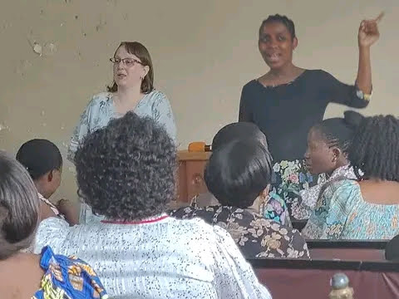
Challenges
Preaching and teaching through a translator
Language barrier: not just in speech but in idioms, comparisons, and examples
Everywhere we went we stuck out and drew notice
Couldn’t drink the water
Everything had to be well cooked
Had to have bottled water with us at all times
For me, personally, had to avoid cumin (allergic) in an Indian cuisine-influenced area (No scares this time!)
Had to try to avoid mosquito bites! (taking anti-malaria pills)
Most places didn’t have “Western” amenities and creature comforts we were used to.
Foreign government and thus, a foreign police force.
But we went to preach and teach because there was a need!
Notes:
Images: Nate with our Translator, Charles Mwakalonge from Tunduru & Becky with her Translator, Seline Edward from Mbezi
Some obstacles to overcome:
Preaching and teaching through a translator
Everywhere we went we stuck out and drew notice
Language barrier: not just in speech but in idioms, comparisons, and examples (IE: in Iringa the people didn’t know what a tornado was. Had to say cyclone and include the speeds of the winds to gain the effect. Andrew found that out!)
Couldn’t drink the water
Everything had to be well cooked
Had to have bottled water with us at all times
For me, personally, had to avoid cumin (allergic) in an Indian cuisine-influenced area (Had a scare! Ordered what we thought was chicken tenders on a stick but was chicken organs, undercooked but heavily seasoned)
Had to try to avoid mosquito bites! (taking anti-malaria pills)
Most places didn’t have “Western” amenities and creature comforts we were used to. (IE: Most places the bathroom was a hole in the ground with a squeegee, a bucket of water and a scooper)
Foreign government and thus, a foreign police force. It was odd to see police forces everywhere carrying AK-47’s, some in their hands. If you photographed them or took video you could be fined or imprisoned.
But we went to preach and teach because there was a need!

Slide 11
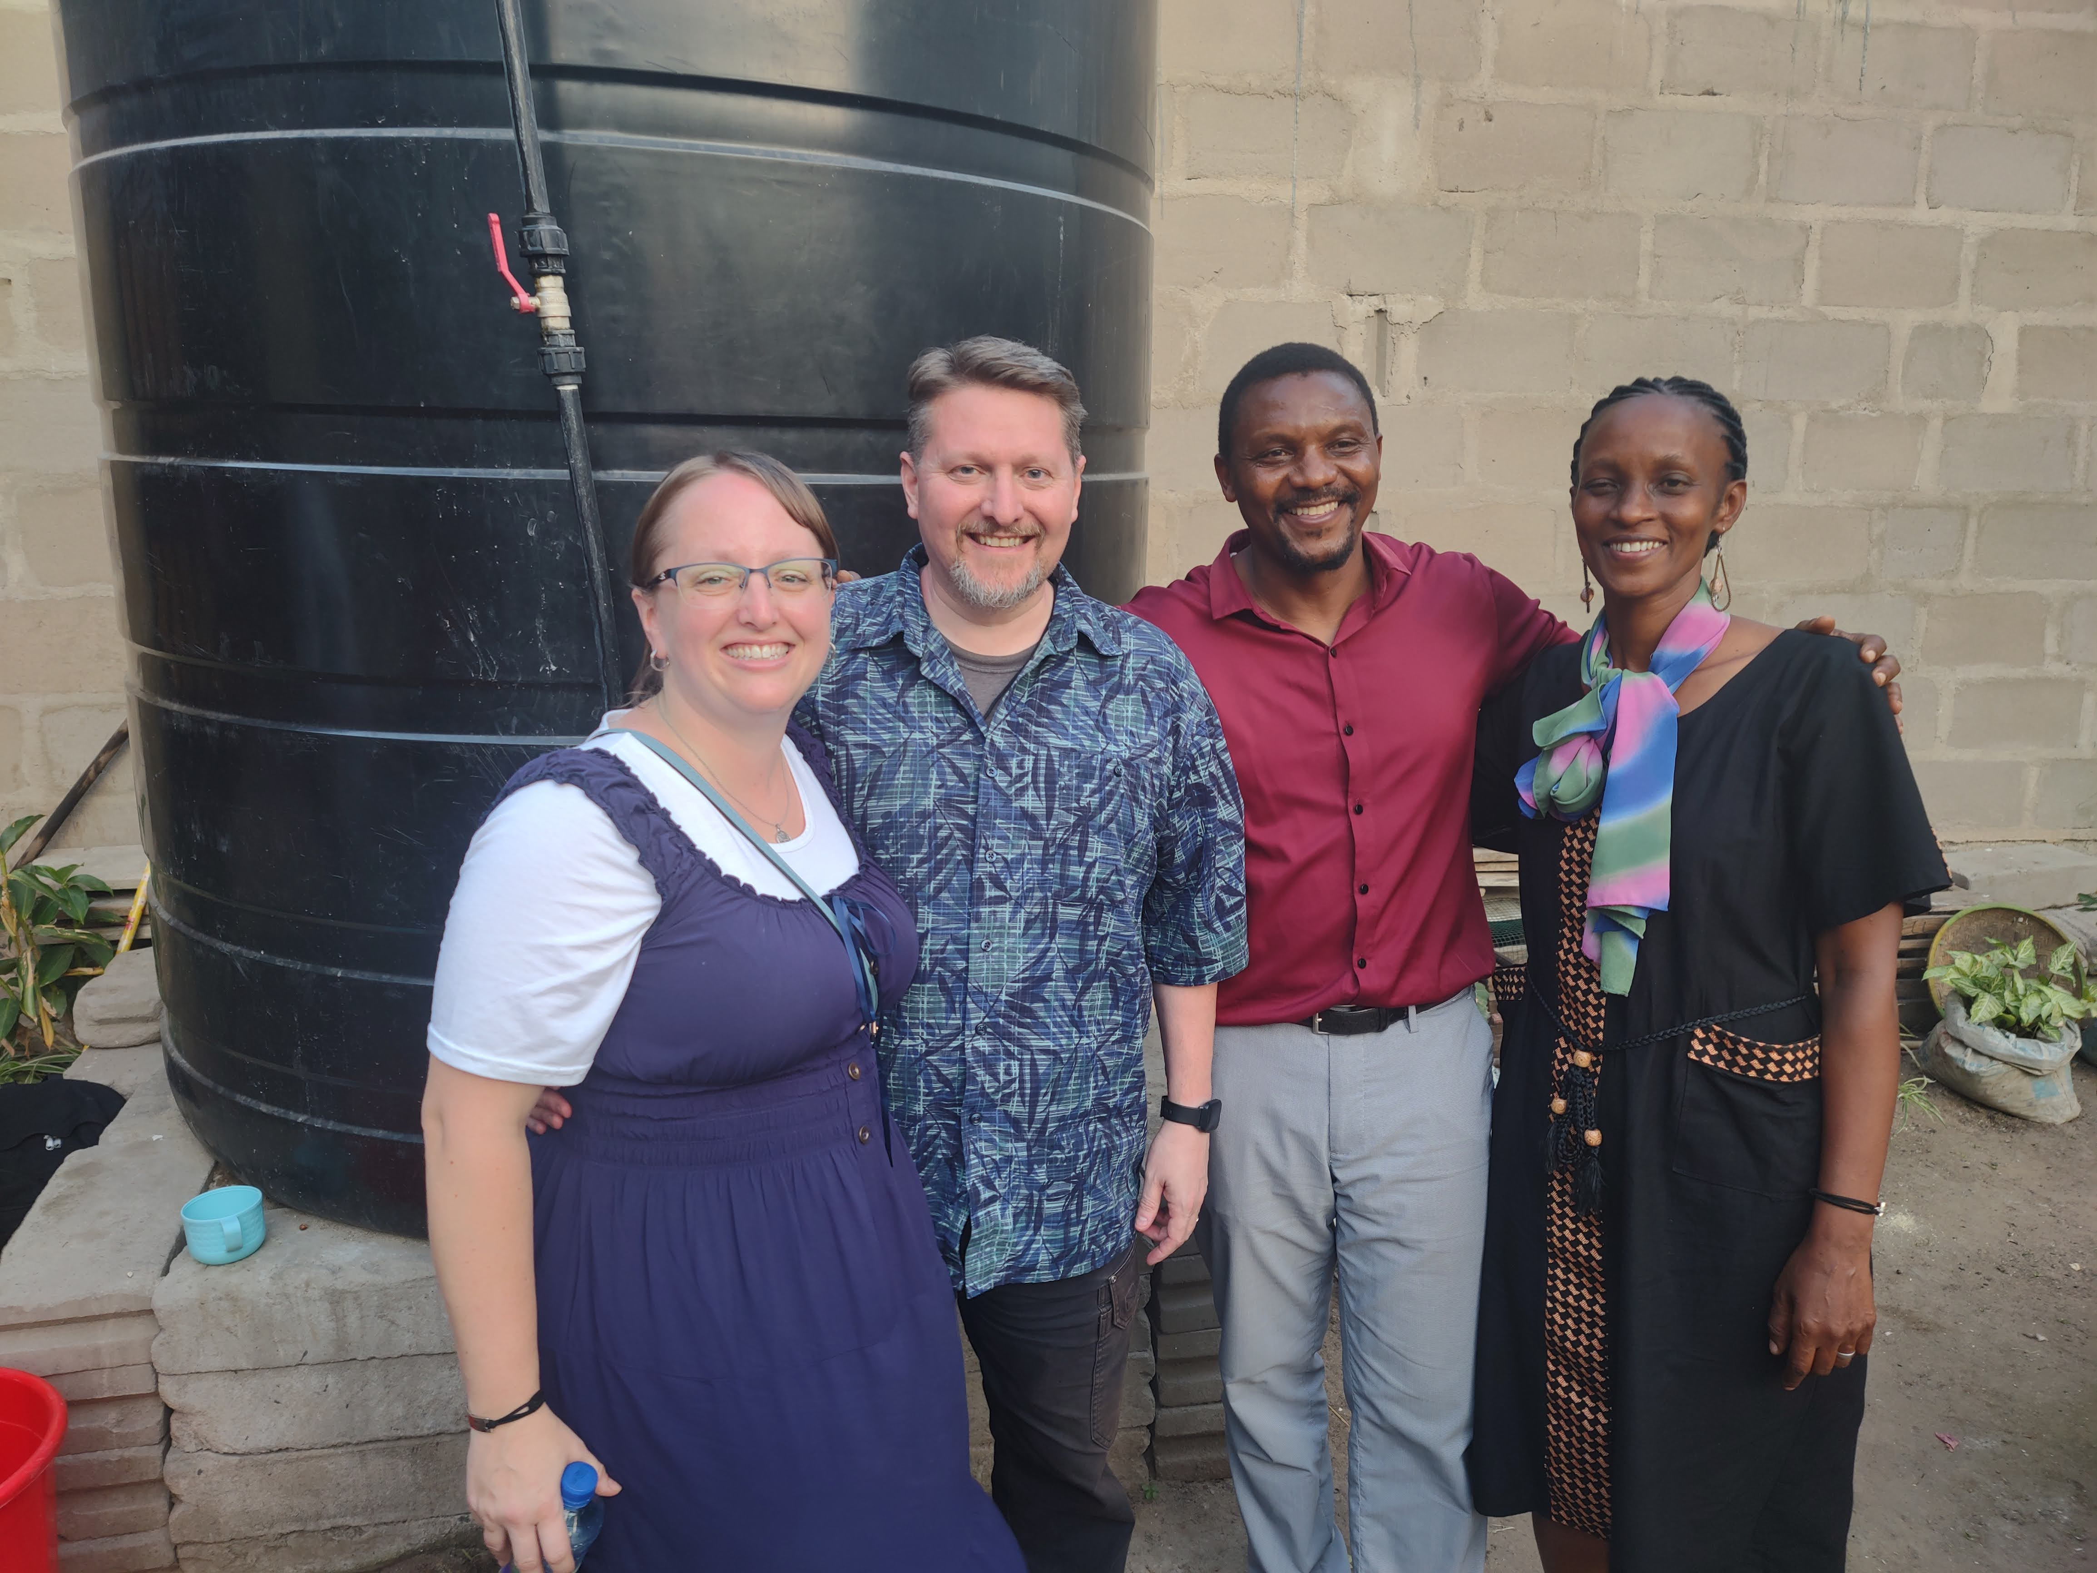
The Need
Family Workshop at Mbezi for four days
Lessons for husbands and wives
Lessons for singles looking for husbands and wives
Lessons for children to honor their parents
Lessons for parents to raise godly children
The roles of husbands: Love and Honor their wives as Jesus loved the church; To be servant-leaders in the home patterned after Jesus
The roles of wives: Learning to Love & Respect their husbands; to be the Helpers God wants them to be
MDR: What the Scriptures teach about the covenant of marriage, how God hates divorce, and who can remarry in the eyes of God
They had lots of questions!
Notes:
Images: Nate & Becky with Elisante Edward and his wife, Seline, Becky’s translator, with their daughter, Julianna Grace. Nate & Becky with Alex and Ellie.
The Need:
Family Workshop at Mbezi for four days (That Sunday there were 157 people!)
Lessons for husbands and wives
Lessons for singles looking for husbands and wives
Lessons for children to honor their parents (That Sunday there were 56 children!)
Lessons for parents to raise godly children
The roles of husbands: Love and Honor their wives as Jesus loved the church; To be servant-leaders in the home patterned after Jesus
The roles of wives: Learning to Love & Respect their husbands; to be the Helpers God wants them to be
MDR: What the Scriptures teach about the covenant of marriage, how God hates divorce, and who can remarry in the eyes of God
They had lots of questions!
Some questions:
Translation issue with I Peter 3:7. The Swahili word for “understanding” means “clever.” This has led to Tanzanian Christian husbands thinking they have to live with their wives in a deceitful and trickery way. Example: Hiding how much money they make, how they choose to spend it, etc…
Both men and women said they had problems with their spouse hiding money, having separate bank accounts, and that it is worse since women started working. Wives get income and hide it and think the husband is charged by God to provide for the family, so the wife can spend her money however she sees fit.
Questions came up as to what defined a marriage. Culturally, marriage can happen a couple different ways and marriage certificates are not required.
If the “Bride Price” is paid then the couple is married. Some congregations help raise the money to pay the fee for the certificate from the government so there is no question. Others will go to the family and ask if the “Bride Price” was paid and if the family says that they were married then the question is settled.
If a couple live together for 6 months then the government considers them married. If such a couple become Christians, or if in error and they turn back, the congregation will help them get a certificate, if they didn’t already have one.
Some try to use a loophole of saying they didn’t have a certificate so they weren’t really married and they end up in several relationships.
One of our takeaways was people are people wherever you go! Husbands and wives deal with the same pressures and strains and blessings no matter what country you are in.

Slide 12
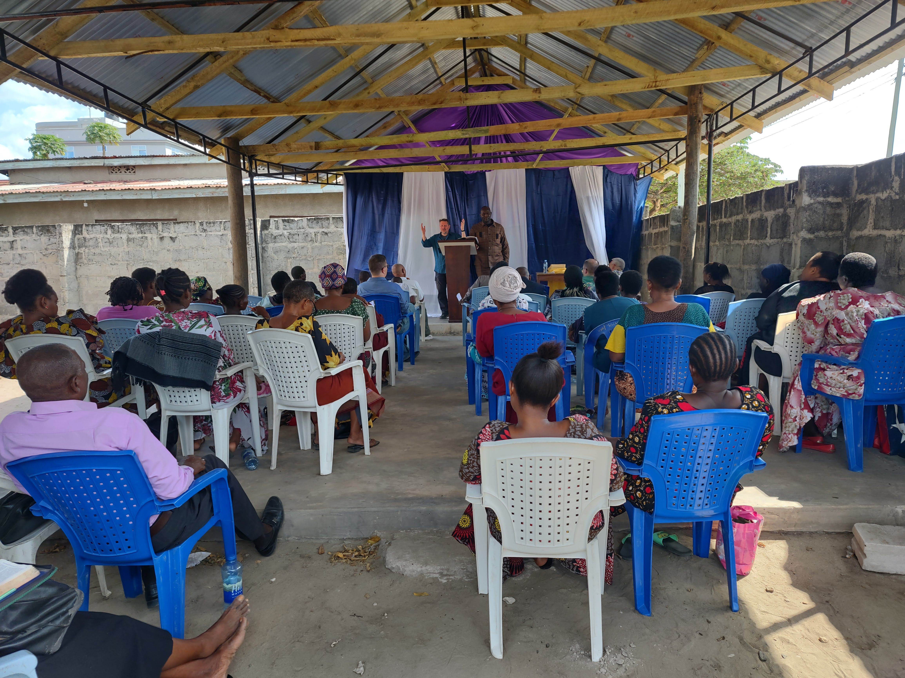
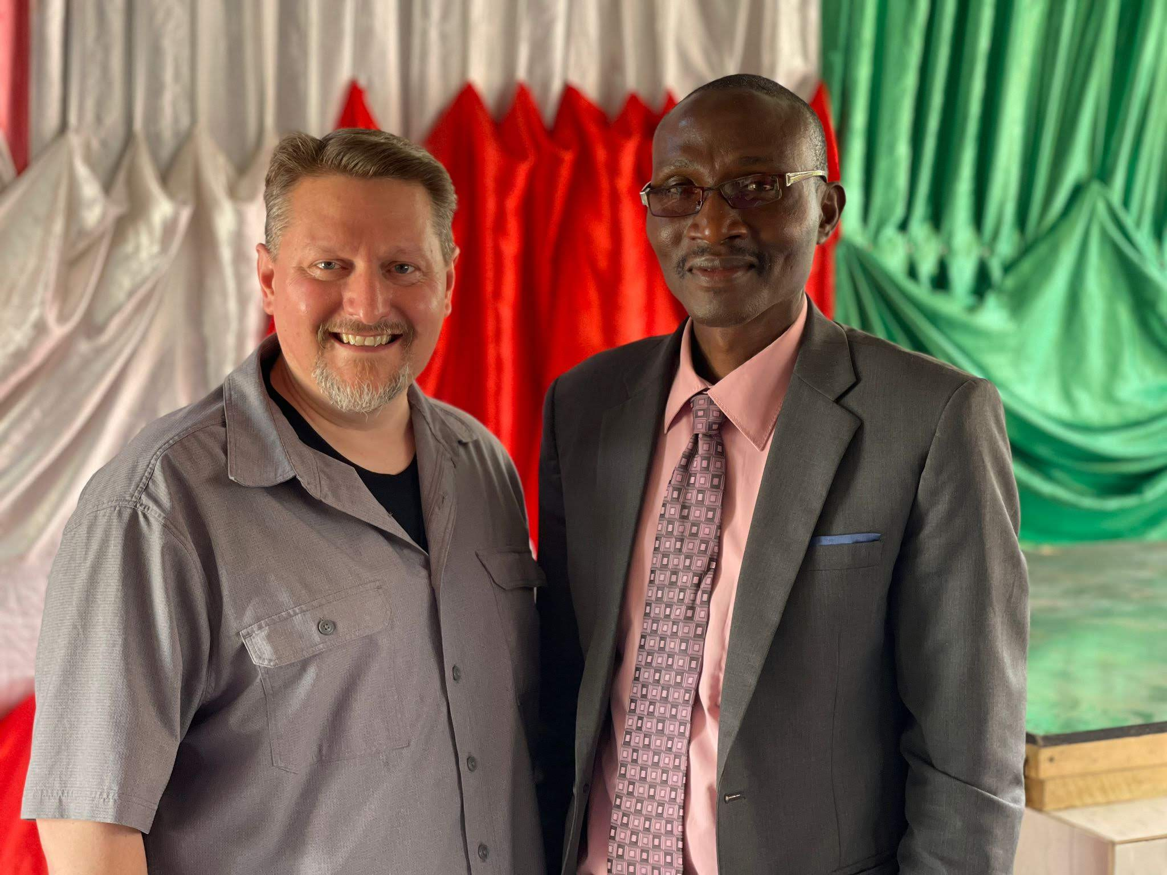
The Need
Preacher Training Schools give money to support preachers (with strings). As soon as you don’t “obey” their standards or staff the support is cut off.
Churches became dependent on “American money.”
Churches became used to NOT supporting the preacher because someone or something else was taking care of that, or accepting money for buildings.
Congregations & preachers felt adrift and alone.
Churches needed to be taught how to be autonomous and independent.
Churches needed to be taught how to support themselves and their preachers!
Older preachers weren’t teaching or training other preachers!
Churches and preachers needed encouragement and to study what the Bible says on these things.
Notes:
Images: Nate teaching at the Tabata congregation with Zuberi translating & Nate with Hansen, the preacher at Chanika
The Need:
Preacher Training Schools give money to support preachers (with strings). As soon as you don’t “obey” their standards or staff the support is cut off.
Churches became dependent on “American money.”
Churches became used to NOT supporting the preacher because someone or something else was taking care of that, or accepting money for buildings.
Congregations & preachers felt adrift and alone.
Churches needed to be taught how to be autonomous and independent.
Churches needed to be taught how to support themselves and their preachers!
Older preachers weren’t teaching or training other preachers!
Churches and preachers needed encouragement and to study what the Bible says on these things.
These problems existed at the Mbezi group as well and we were invited to return in the future to address these concerns, though they expressed gratitude for the Family Workshop.

Slide 13
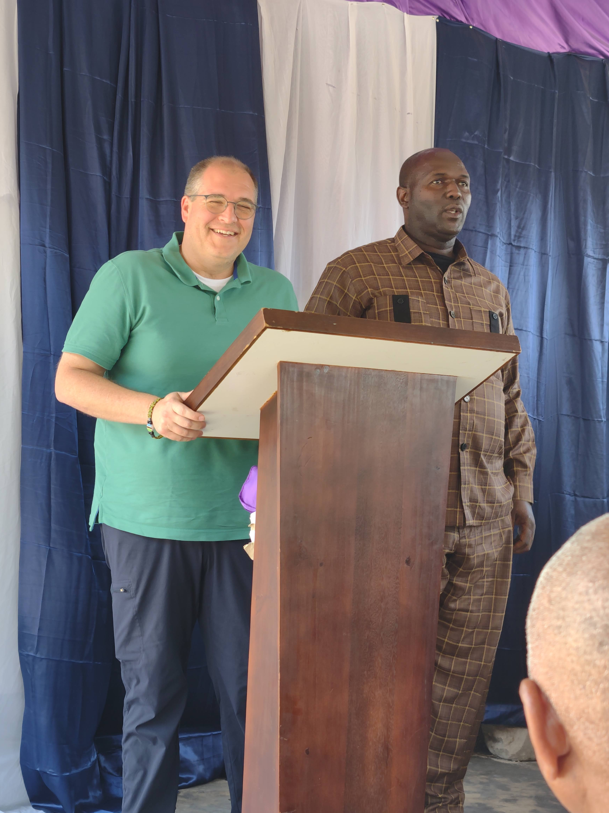
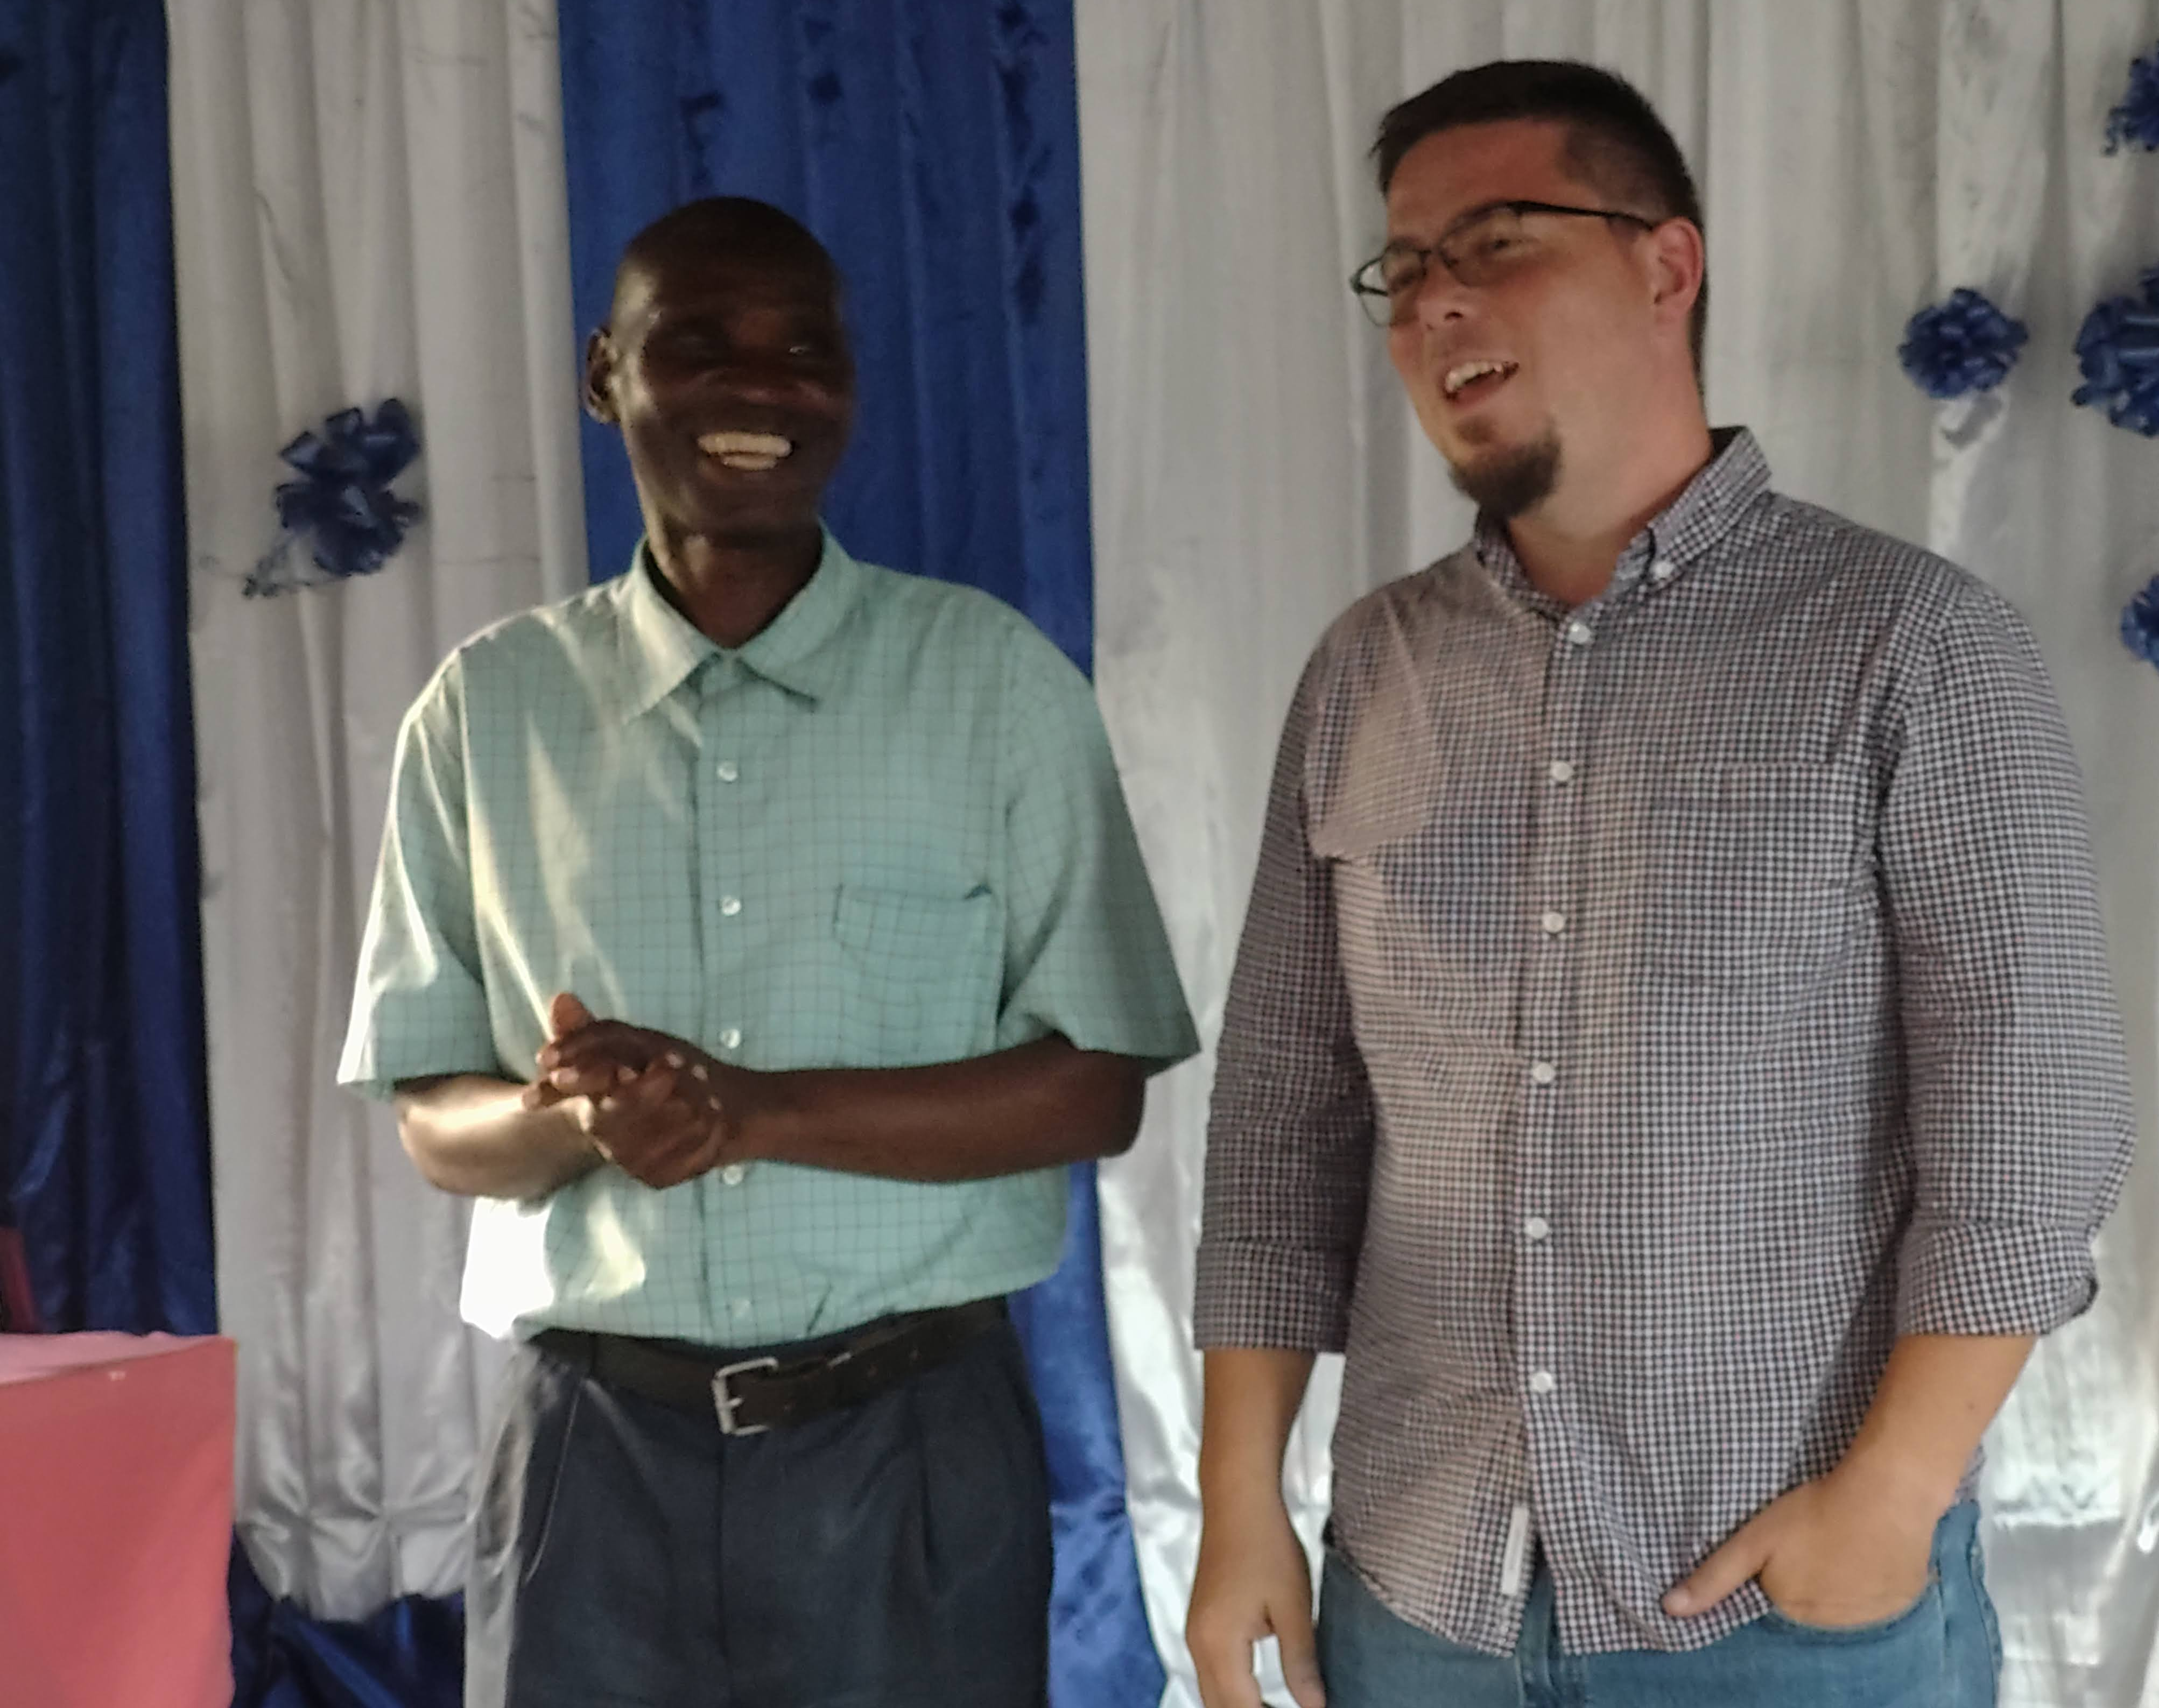
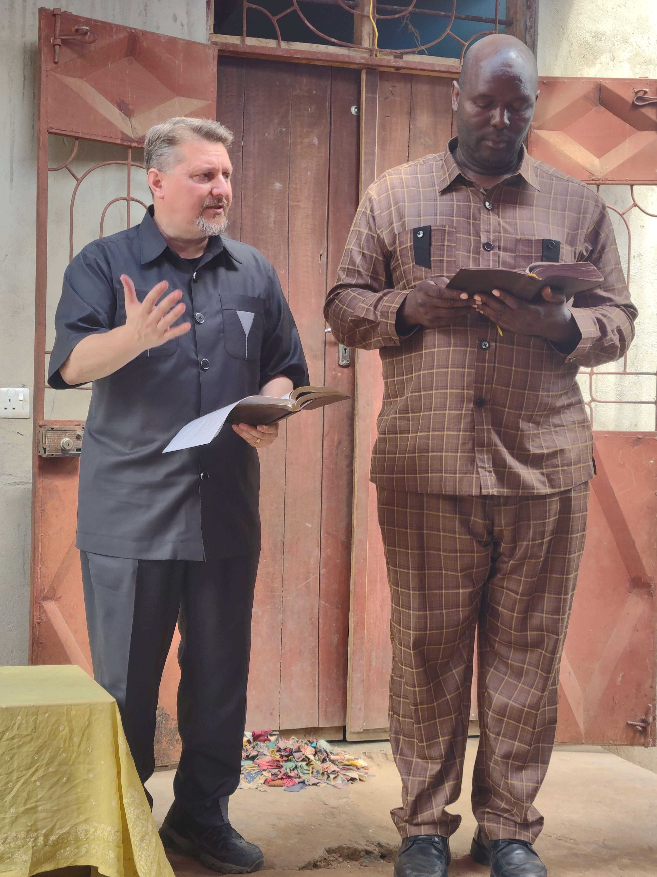
The Need
“We need preachers, not missionaries!”
So much damage has been done by American missionaries.
Some go for a month and preach two days then takes a select few Tanzanian men to a hotel. He doesn’t enjoy their culture but subjects them to his culture!
Some spend the night at casinos with their translator and come to preach drunk. In one case, his translator helped keep him standing and vouched for his integrity.
35 missionaries held a seminar and someone asked to be baptized. All 35 men said they didn’t bring a change of clothes and so asked that man to wait a day so they could bring clothes to get wet the next day! “Oh, Why Not tomorrow?”
Missionaries sit by themselves and don’t mingle with the people, don’t eat the food, don’t go to members’ houses, and don’t teach in-depth studies.
Notes:
Images: Clockwise from the top Left: Andrew preaching at Tabata with Zuberi translating, Chad preaching at Kingugi with Esau translating, Ed preaching at Mbezi with Charles translating, Nate preaching at Mwanambya with Zuberi translating
The Need:
“We need preachers, not missionaries!”
So much damage has been done by American missionaries.
Some go for a month and preach two days then takes a select few Tanzanian men to a hotel. He doesn’t enjoy their culture but subjects them to his culture!
Some spend the night at casinos with their translator and come to preach drunk. In one case, his translator helped keep him standing and vouched for his integrity.
35 missionaries held a seminar and someone asked to be baptized. All 35 men said they didn’t bring a change of clothes and so asked that man to wait a day so they could bring clothes to get wet the next day! “Oh, Why Not tomorrow?”
Missionaries sit by themselves and don’t mingle with the people, don’t eat the food, don’t go to members’ houses, and don’t teach in-depth studies.

Slide 14
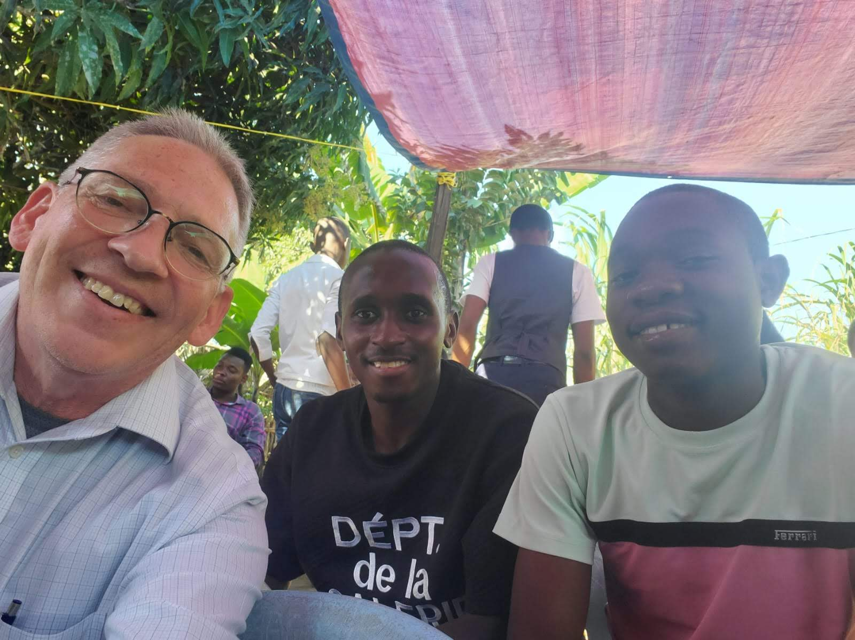
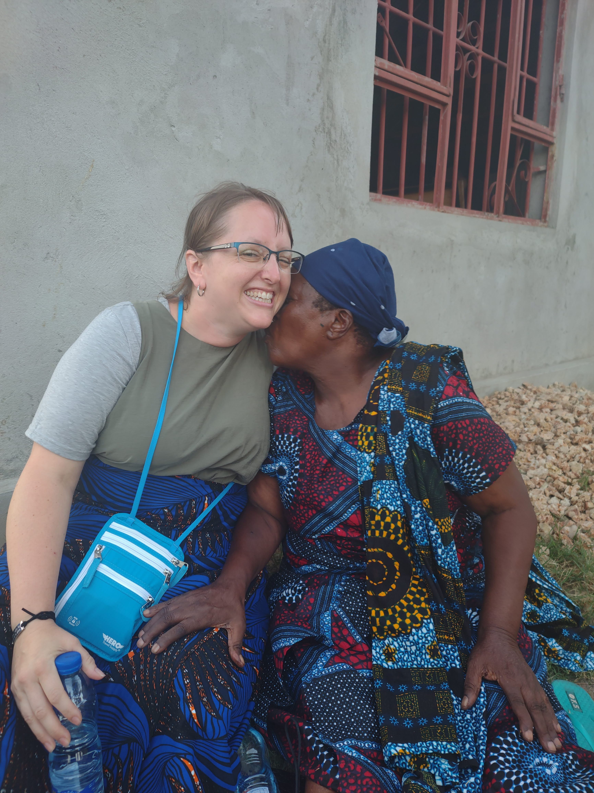
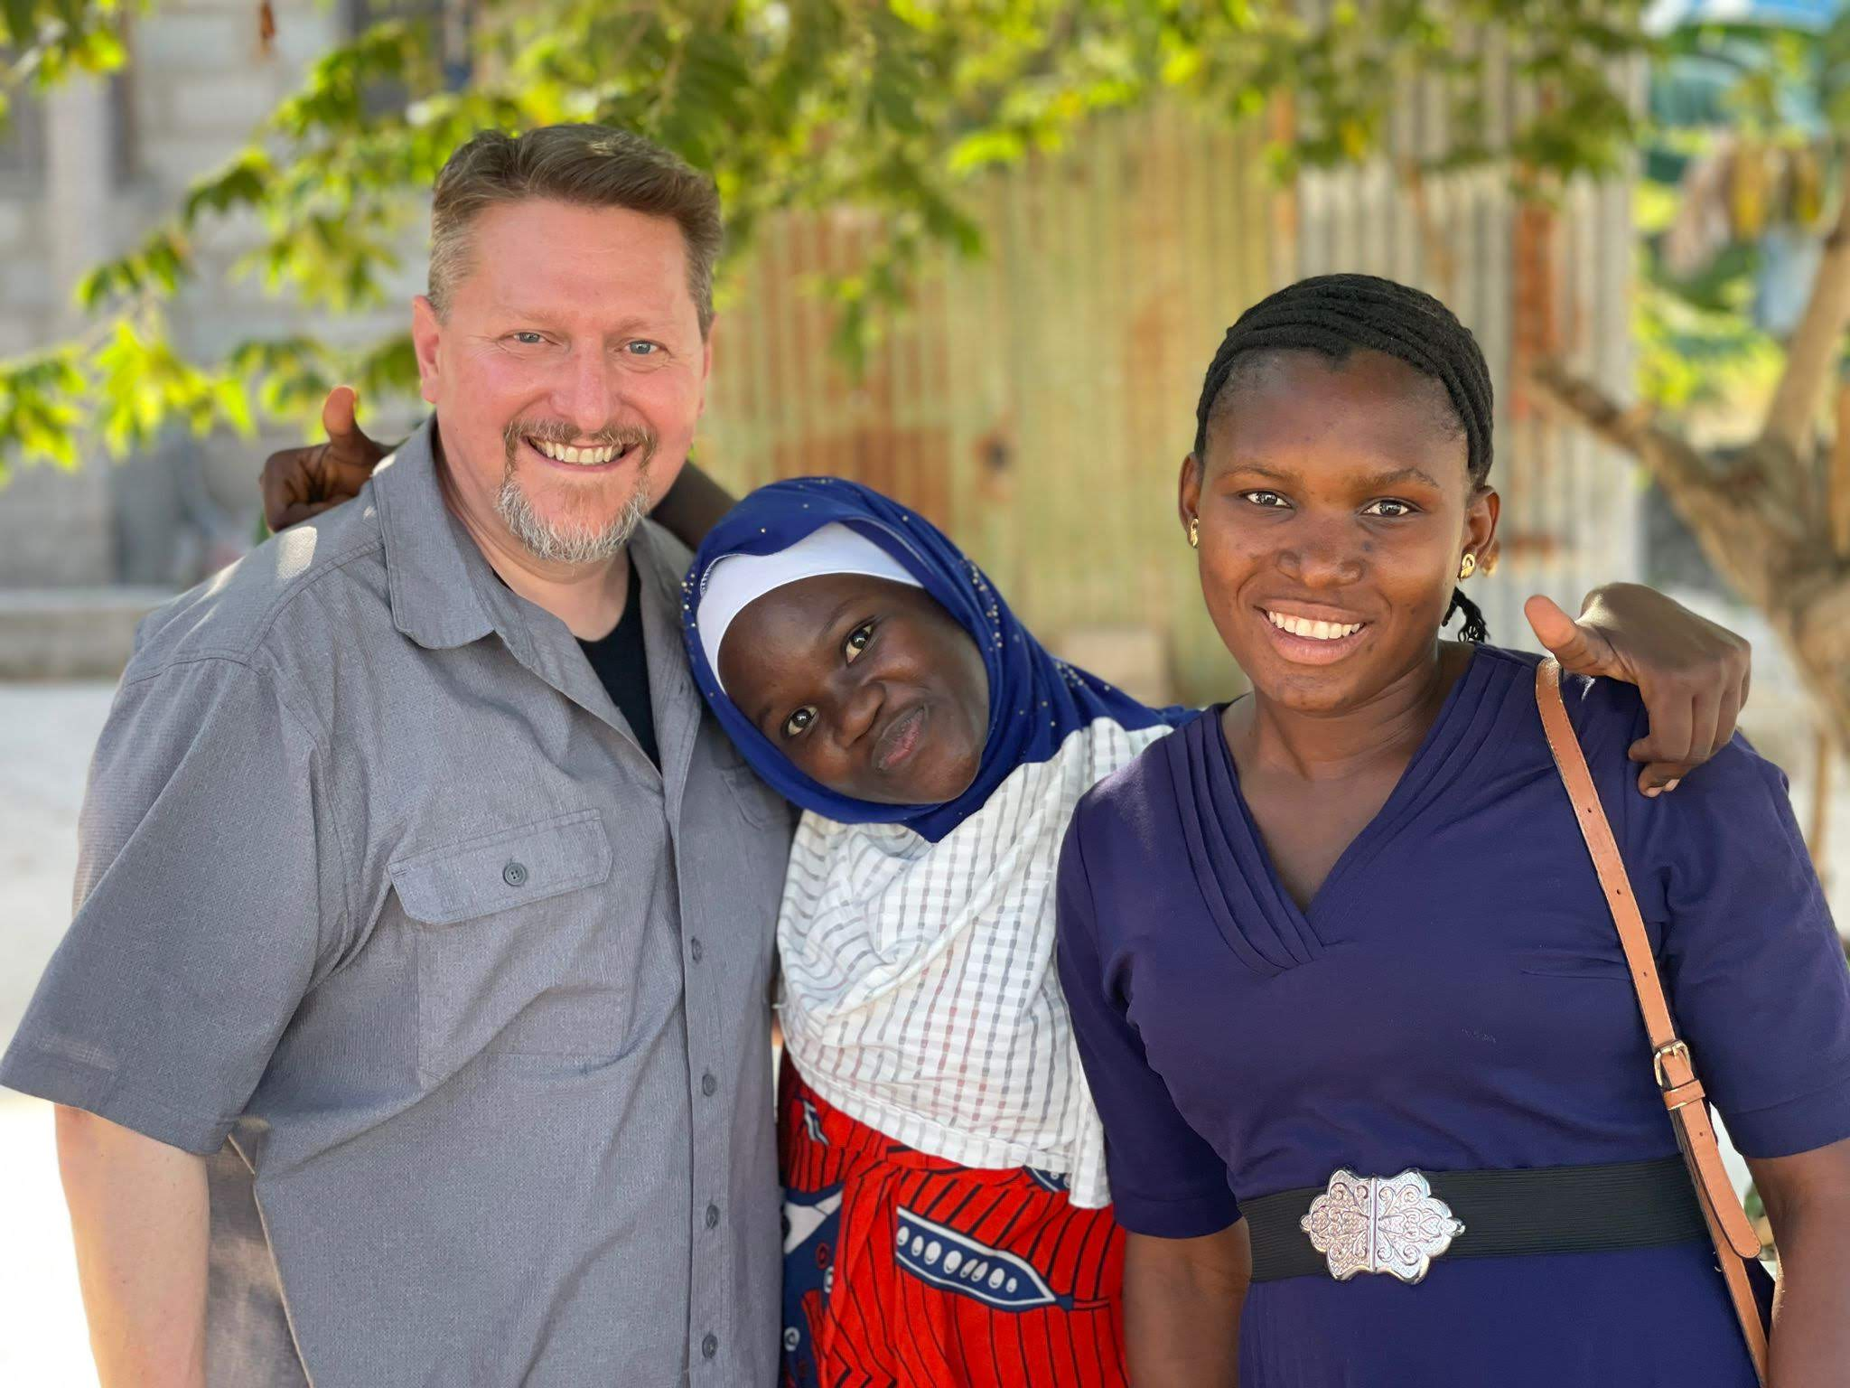
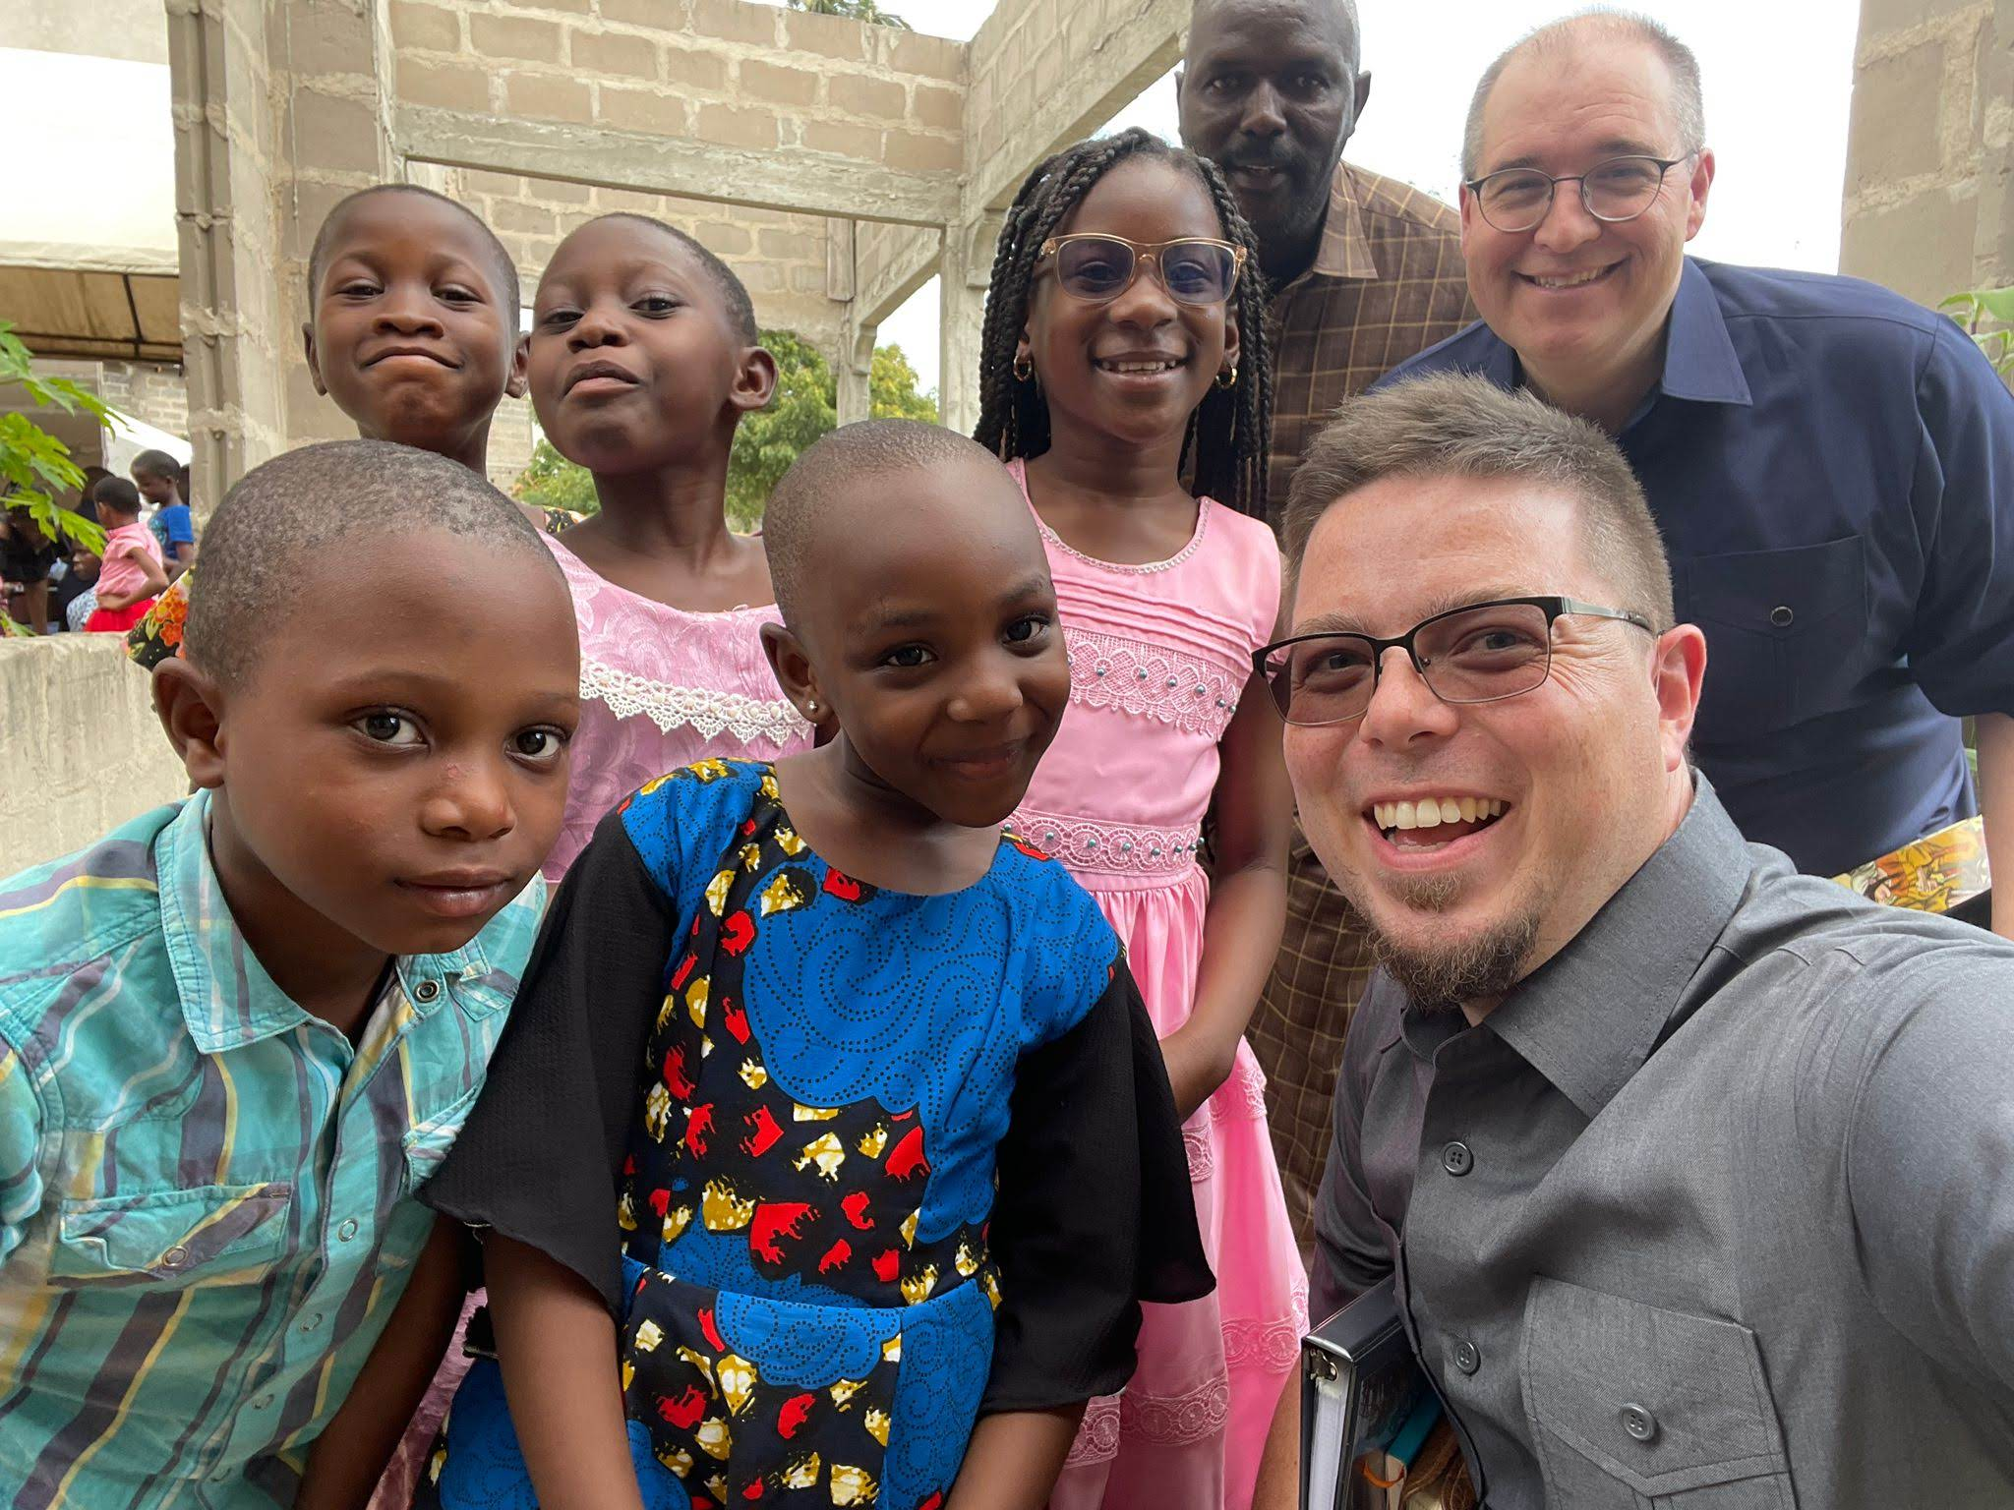
The Mission
The people!
To encourage the brethren
To strengthen their families
To study with them
To teach on church authority, to teach them to be independent
To teach and train them NOT to be “Americanized” or dependent on American money.
To study the biblical way to train preachers and how to support them.
To encourage and equip the local preachers to carry out their work so the churches in the area can thrive on their own.
To visit with them, eat with them, and study with them in their homes.
To value them. They are the reason we traveled so far!
Notes:
Images: From the top Left: Ed with some of the young men who asked for a class at Mwanambya, Becky at Kingugi, where they called her “Mama Mzungu, with Bibi, who wanted a picture with her and then kissed her! Nate with Stella (the one in blue) and her friend at Chanika, Andrew and Chad with Zuberi and some of the children at Mbezi.
The Mission:
The people!
To encourage the brethren (they are not alone).
To strengthen their families: for as the family goes, so goes the church!
To study with them and teach on church autonomy and how to become independent.
To teach and train them NOT to be “Americanized” or dependent on American money.
To study the biblical way to train preachers and how to support them.
To encourage and equip the local preachers to carry out their work so the churches in the area can thrive on their own.
To visit with them, eat with them, and study with them in their homes.
To value them. They are the reason we traveled so far!
The brethren there have noticed the differences in our group and some congregations we haven’t been to have extended invites to our group for future trips!
The saints there showed us love and encouraged us as well! They kept us well-fed and watered. I think I gained 10 pounds there!

Slide 15
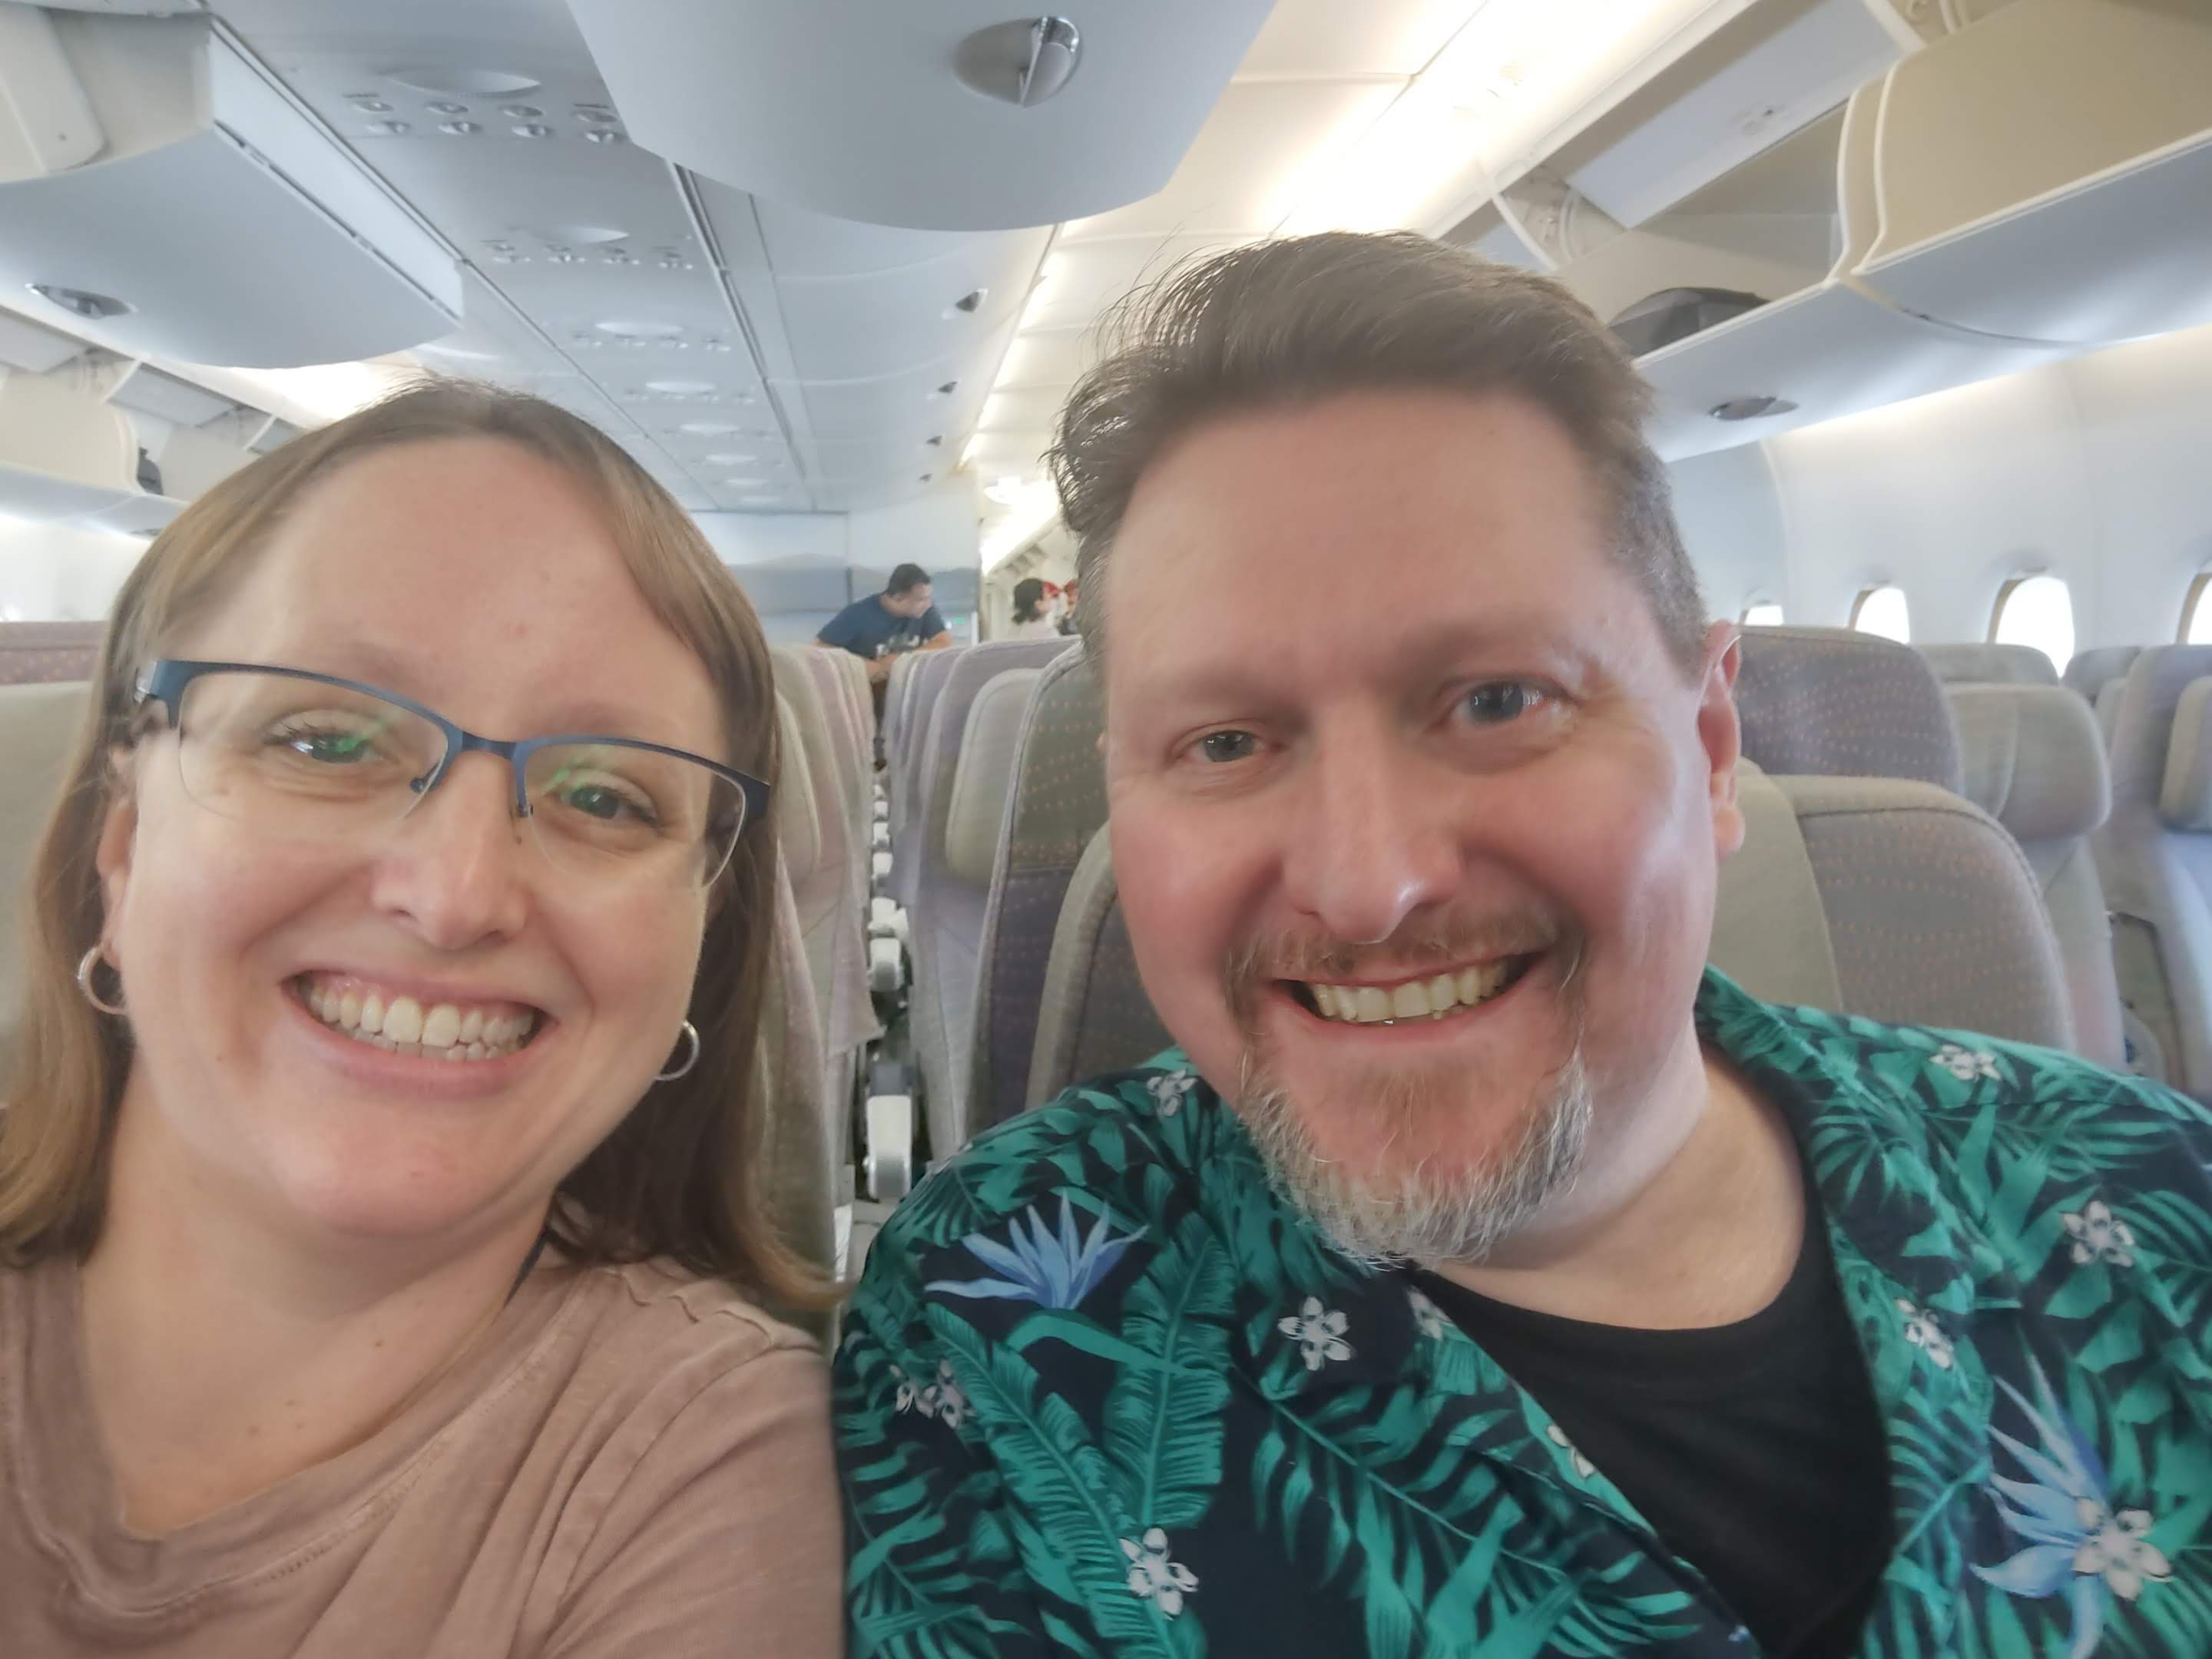
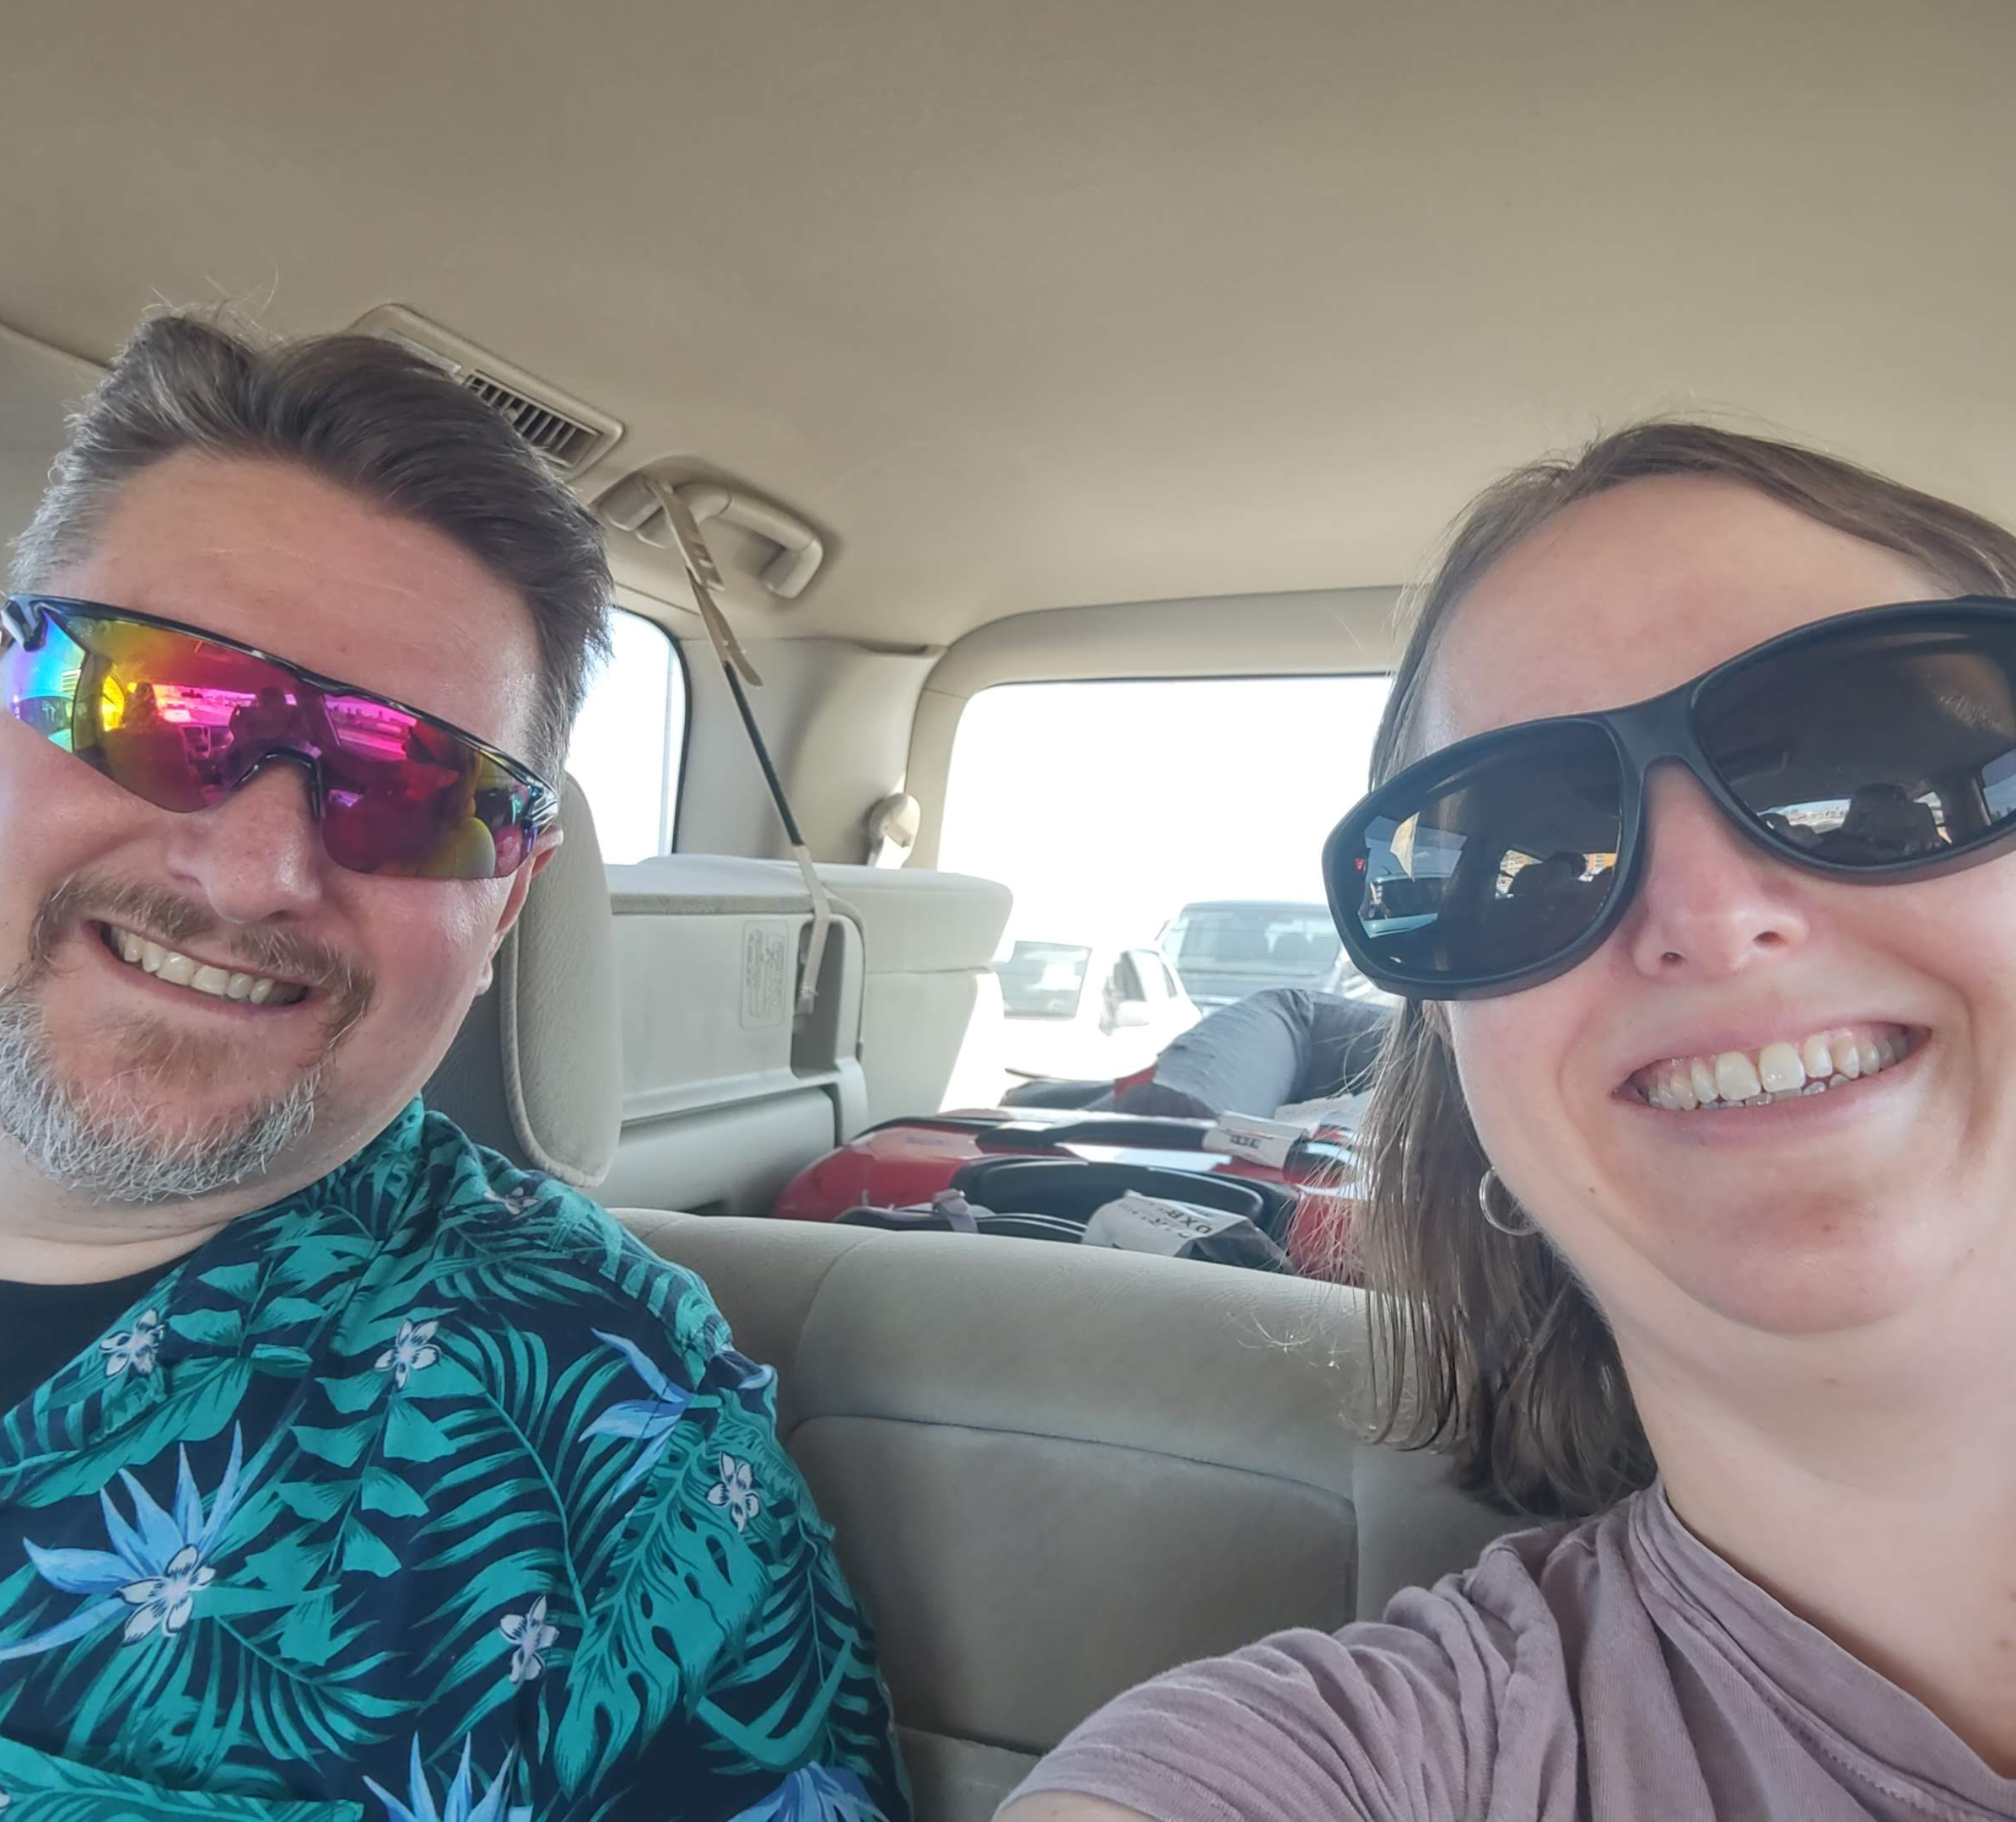
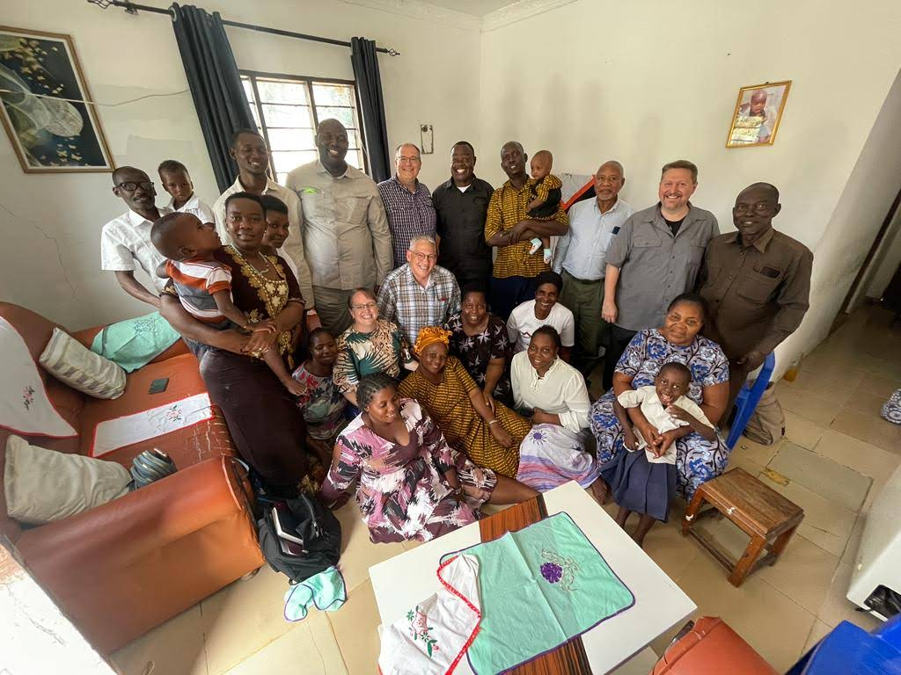
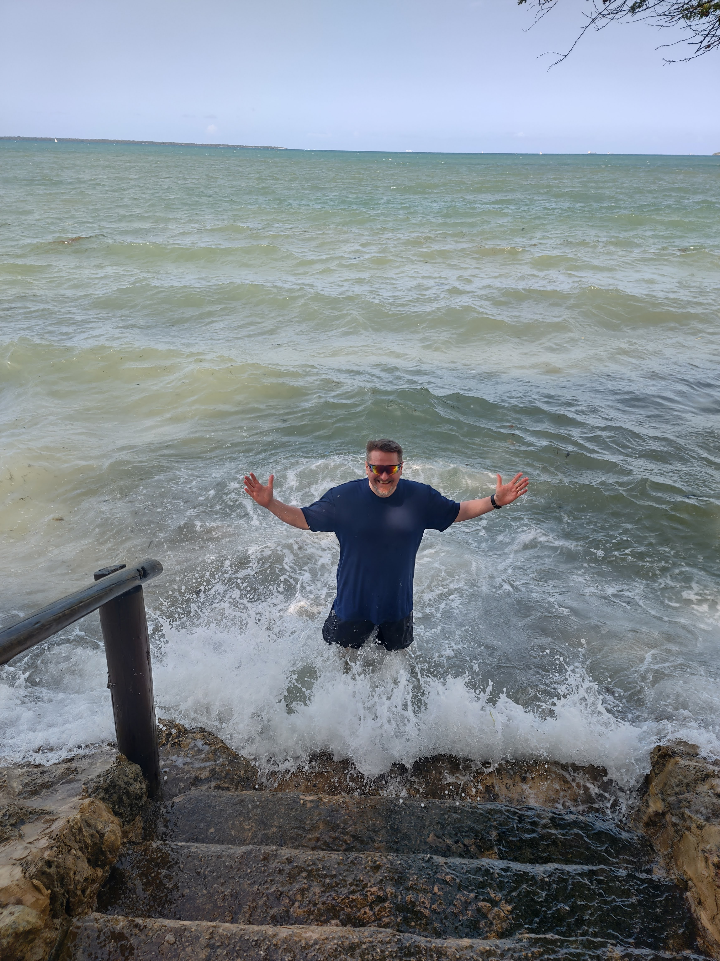
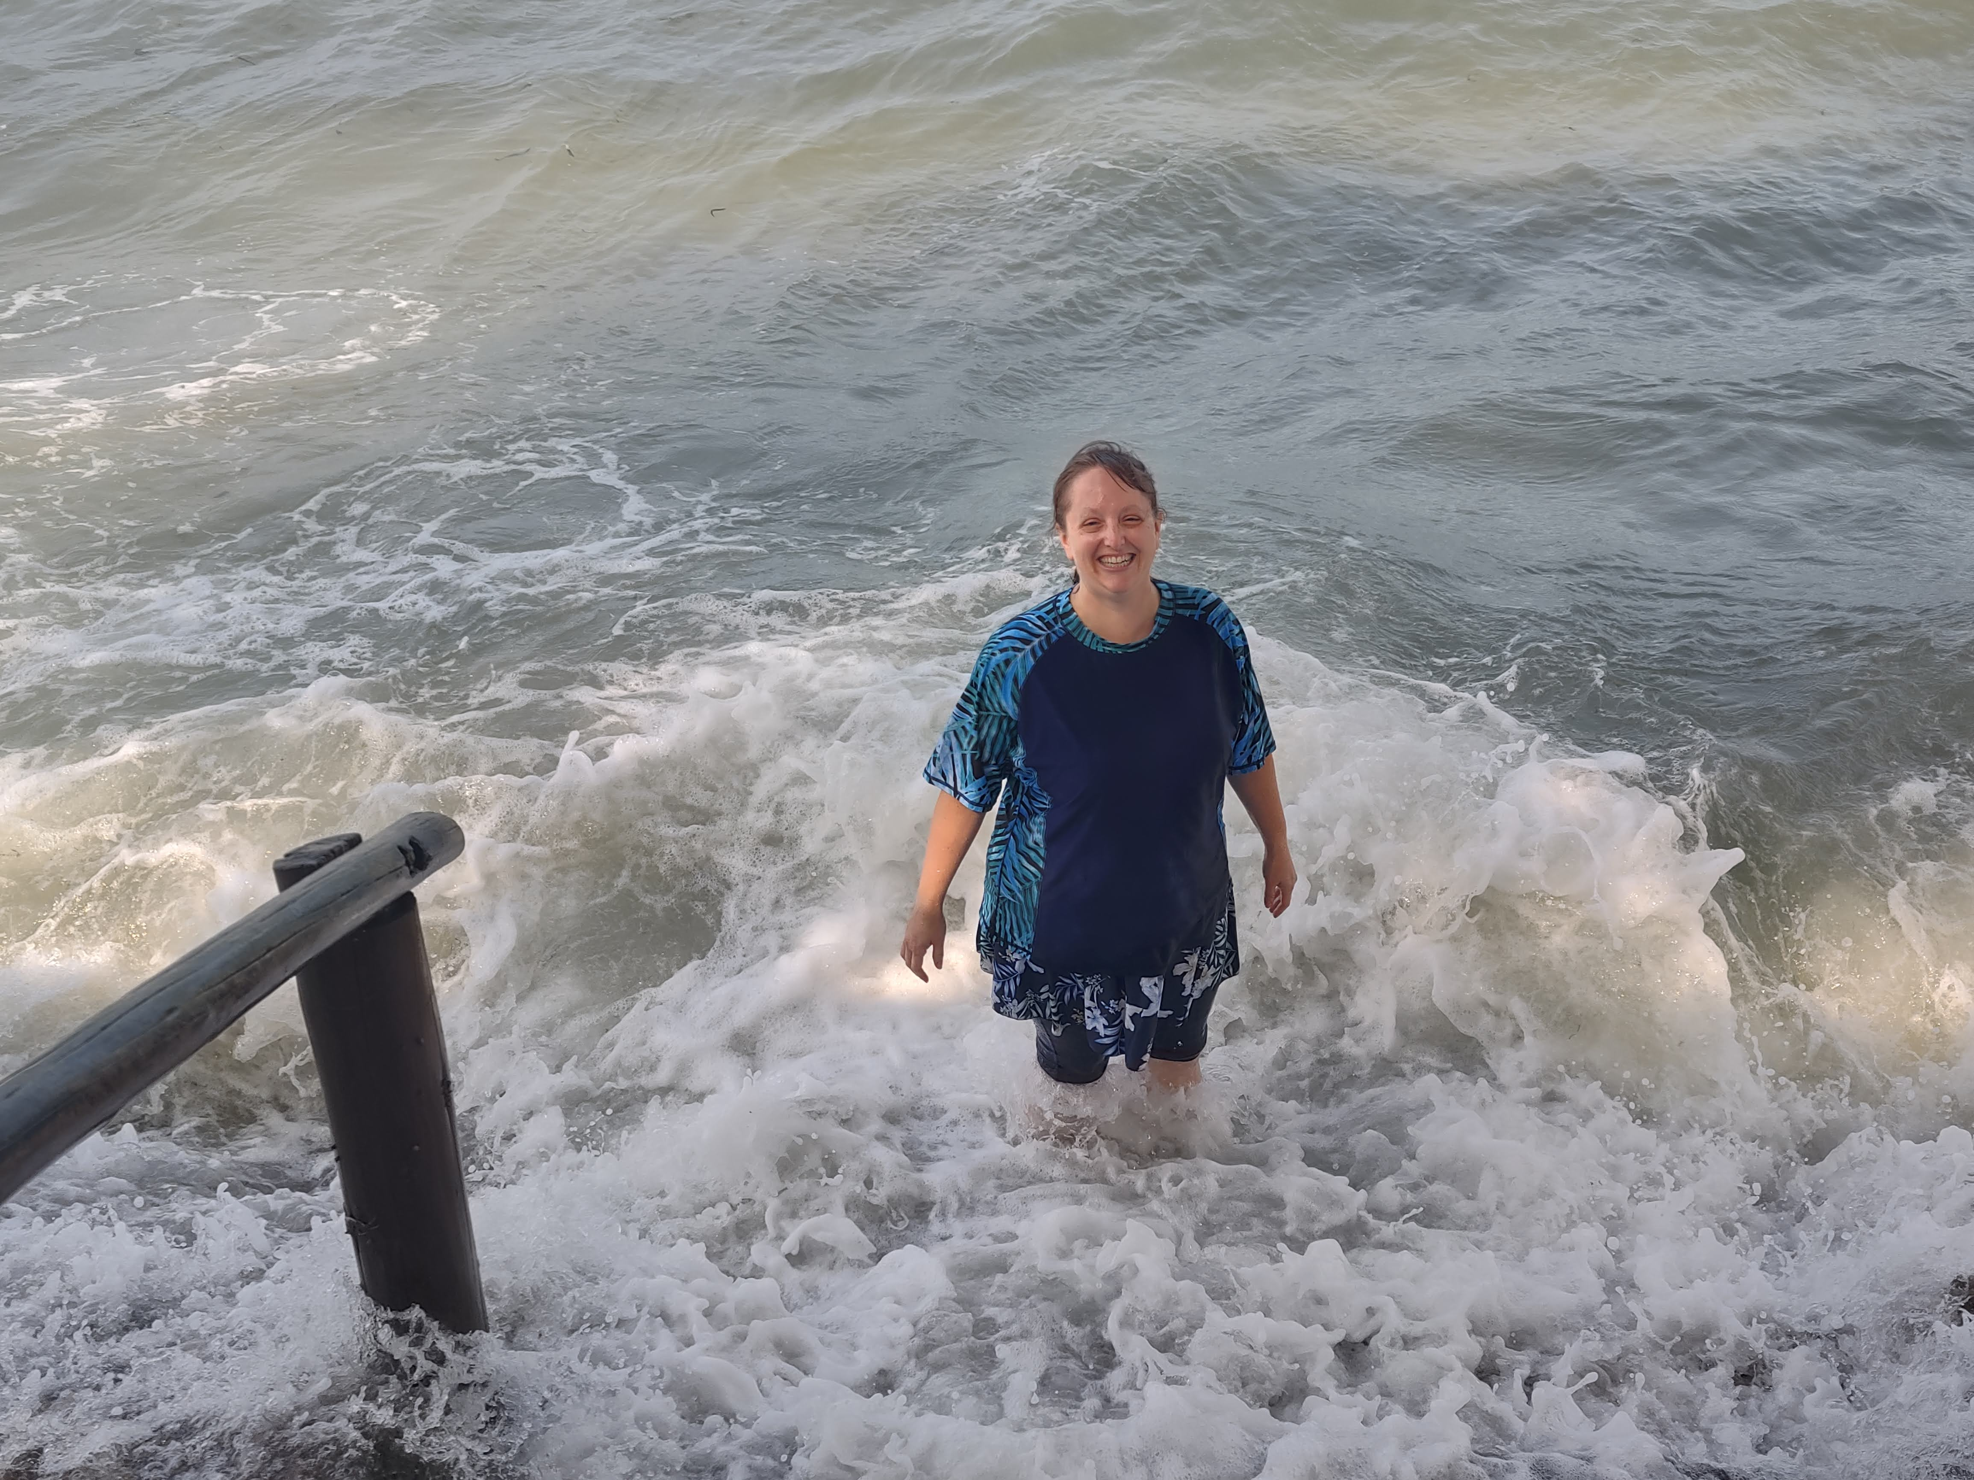
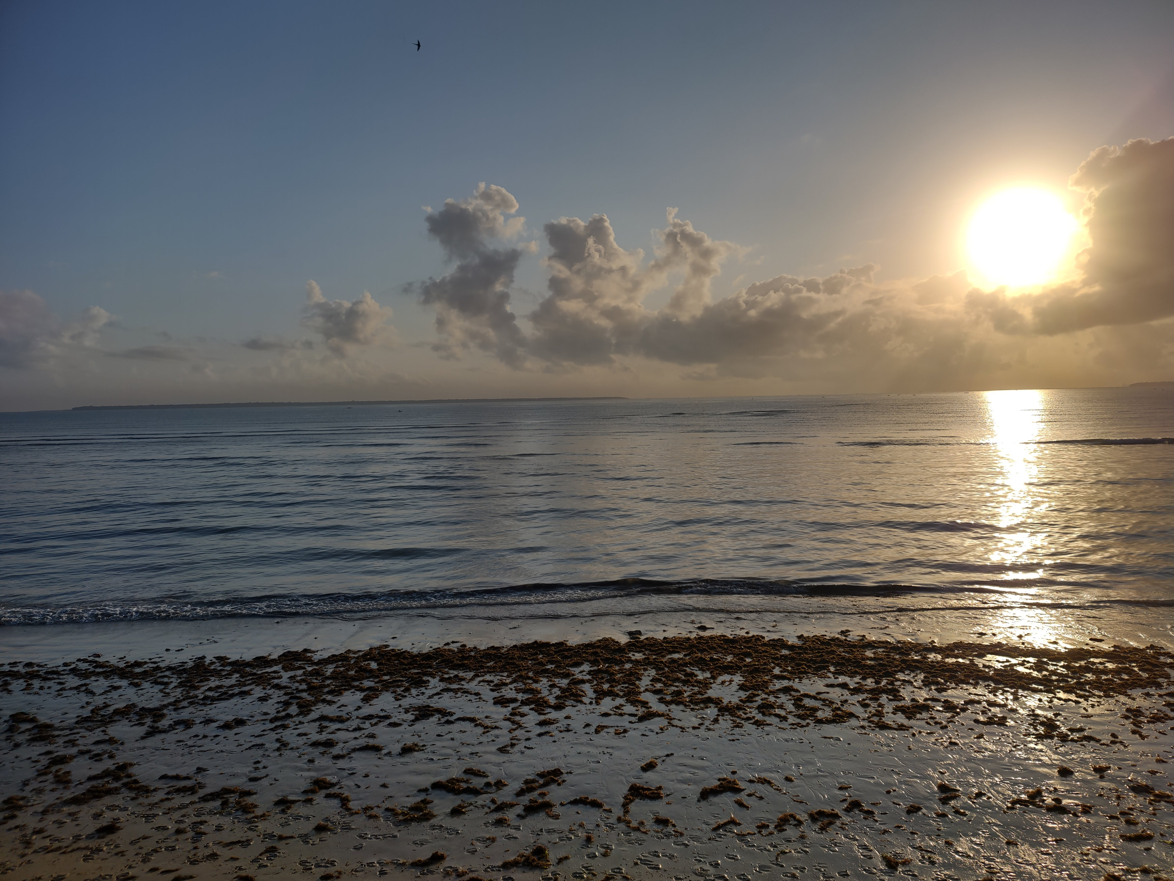
Highlights
Going with Becky
Indian Ocean
Notes:
Images: Clockwise from the top Left: Nate and Becky on plane, in car from airport to Mbezi, Becky in Indian Ocean, Nate in Indian Ocean, The Indian Ocean at sunrise taken by Chad, Group shot at brother Dihigo’s house: the ladies all wanted to be next to Becky, “Mama Mzungu”
Highlights:
Getting to go with Becky was a highlight for me!
Words fail to express the gratitude for the brethren here who made that possible through your generosity!
She learned a little Swahili in the year since my last trip and everywhere we went us guys knew she was the rockstar!
Everyone was impressed with her. She was called, “Mama Mzungu” and the ladies wanted pictures with her.
The word went out that a woman came with us and more women came to these meetings than we saw the whole time last year. The group at Chanika told us a Mzungu woman had never visited there before!
It was special for me, for our group, and for the brethren we went to encourage.

Slide 16
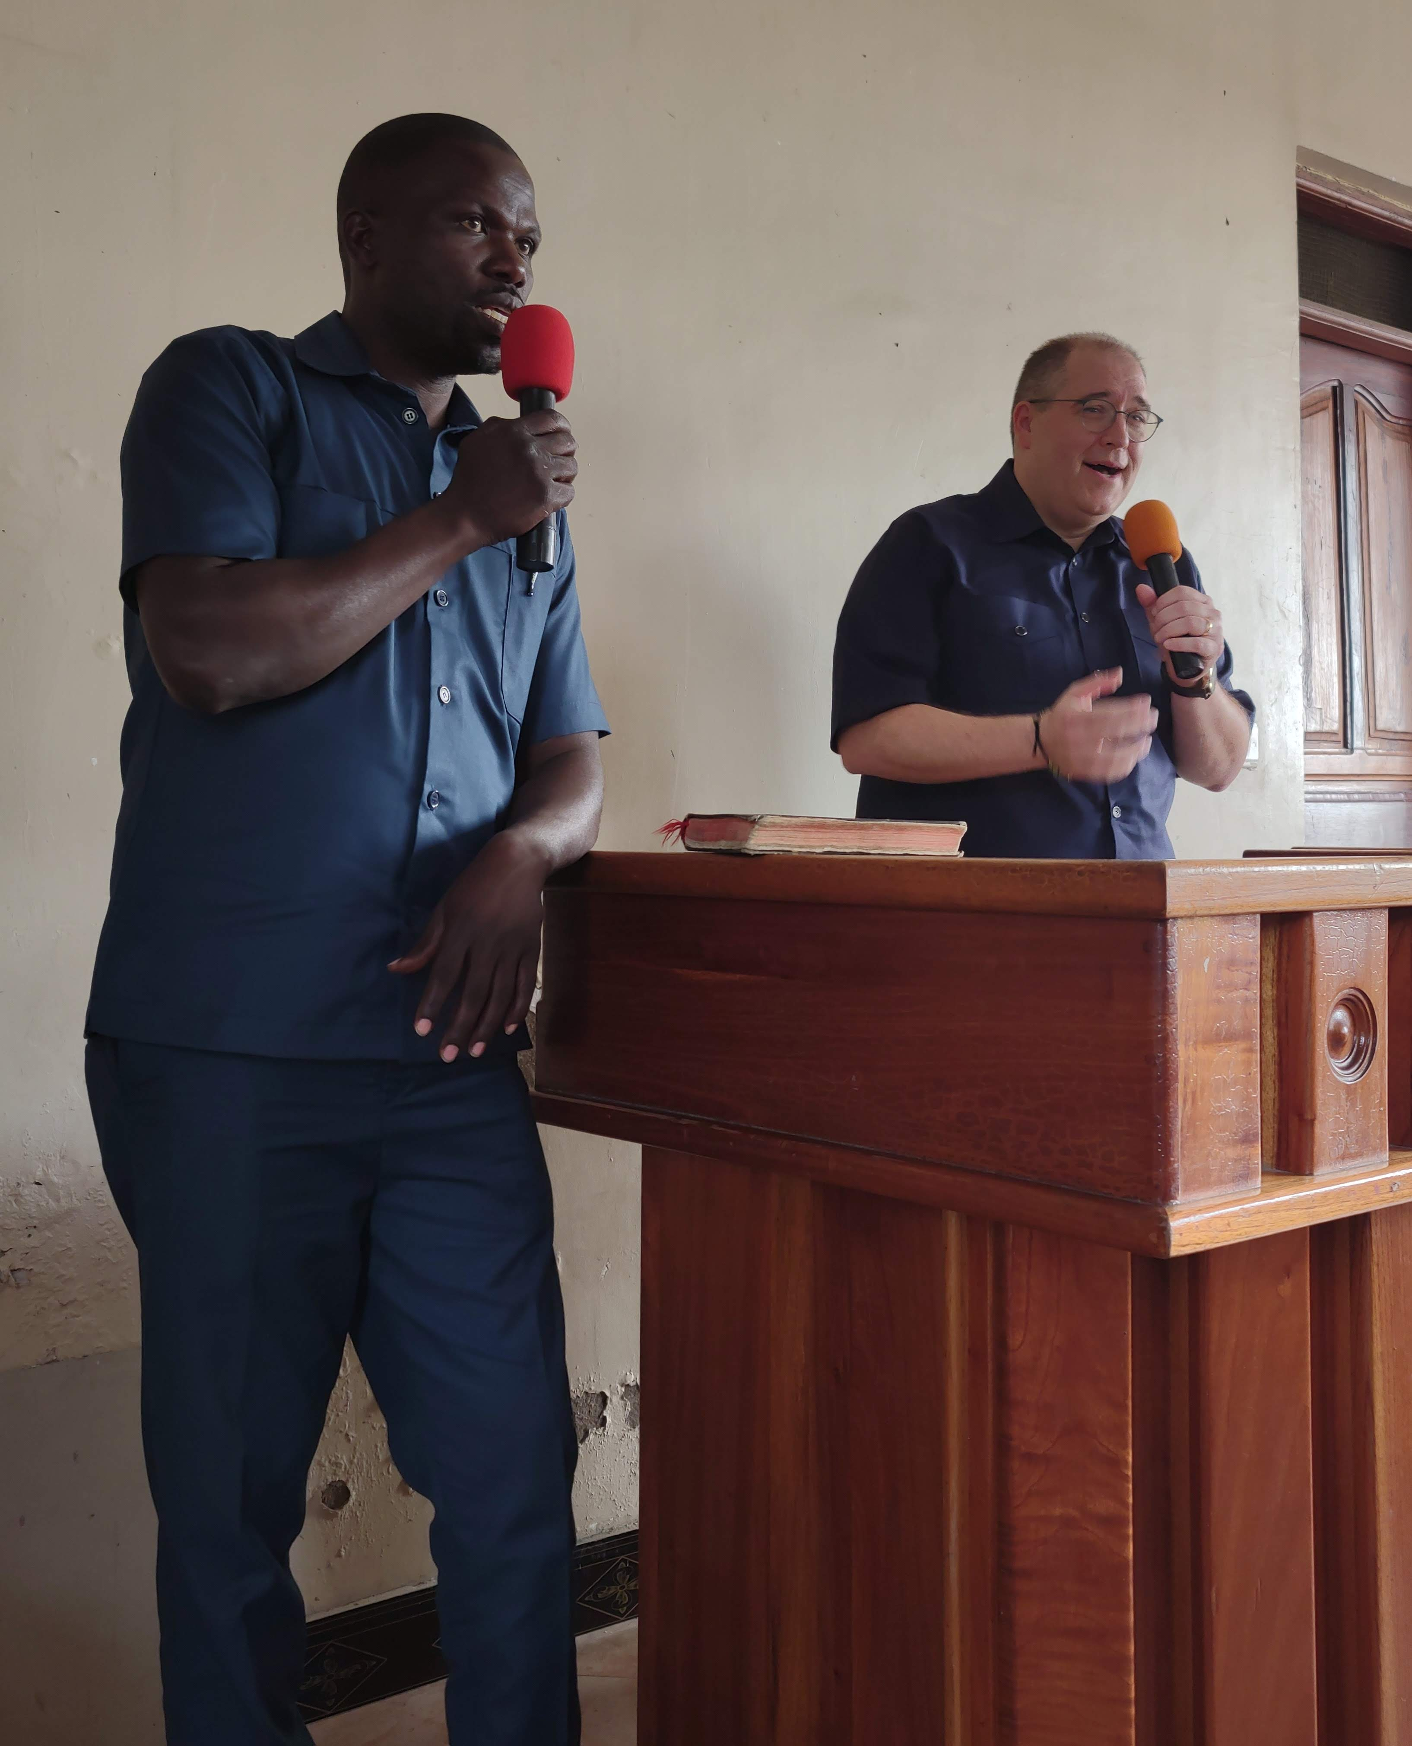
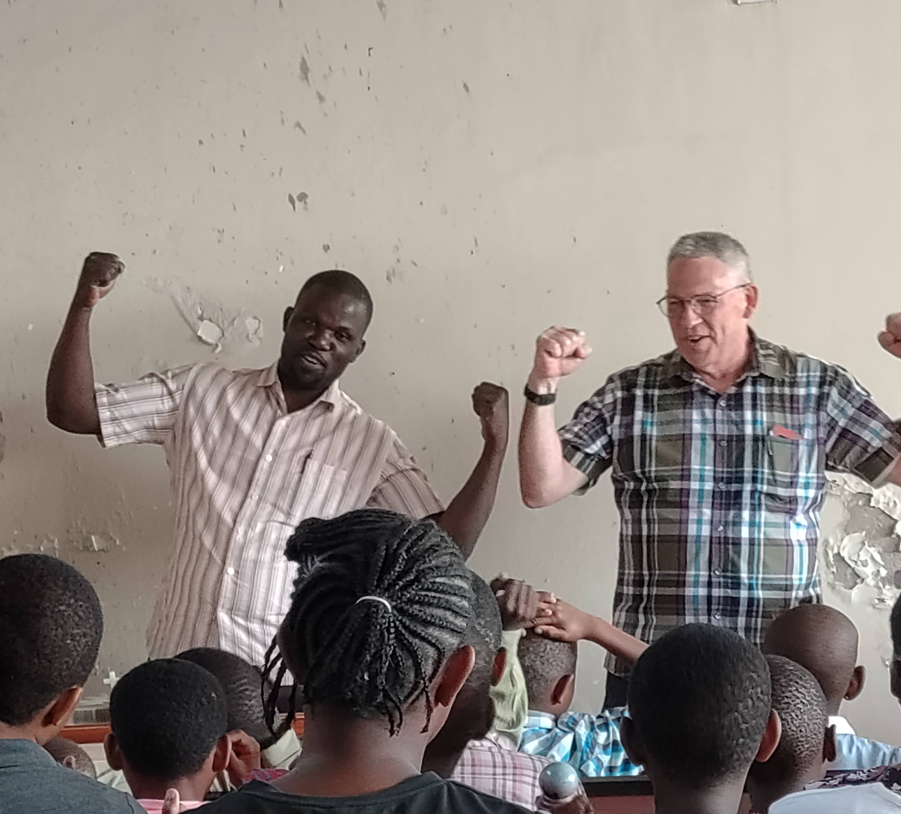
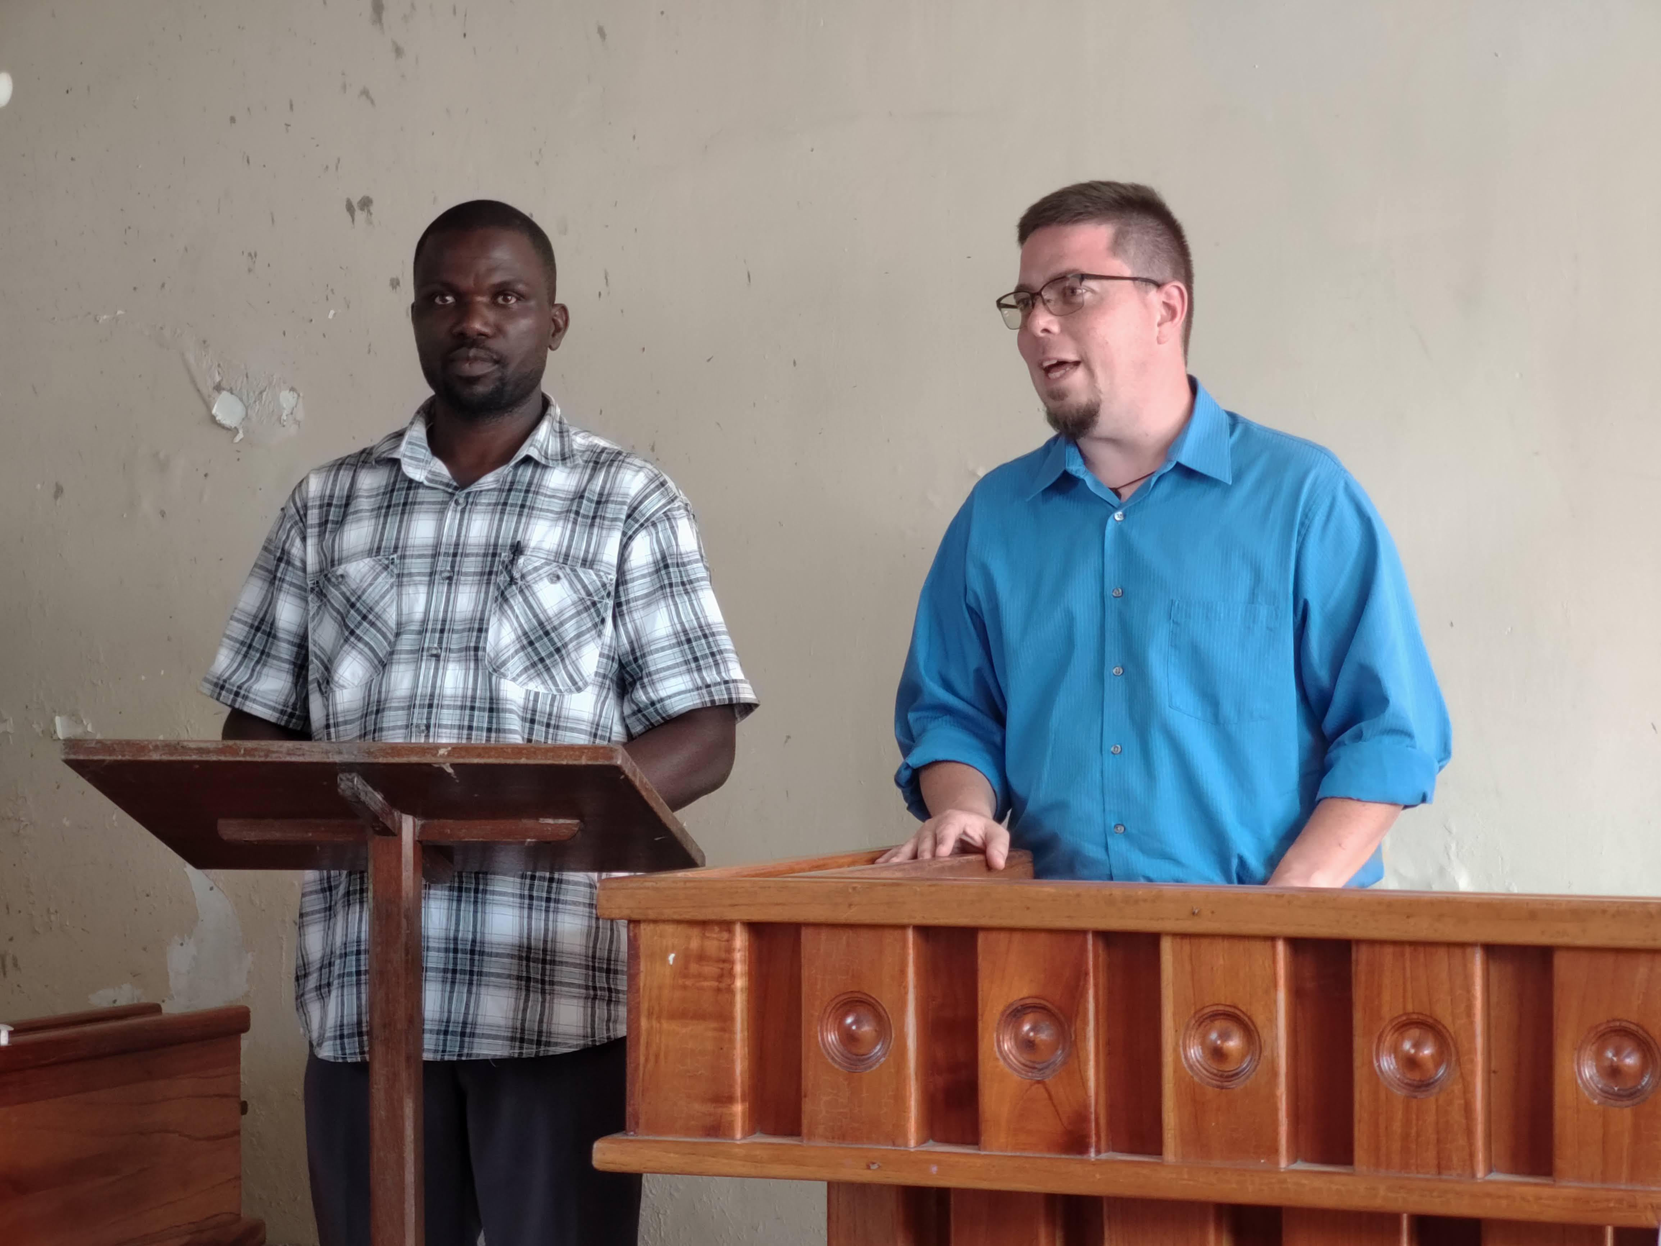
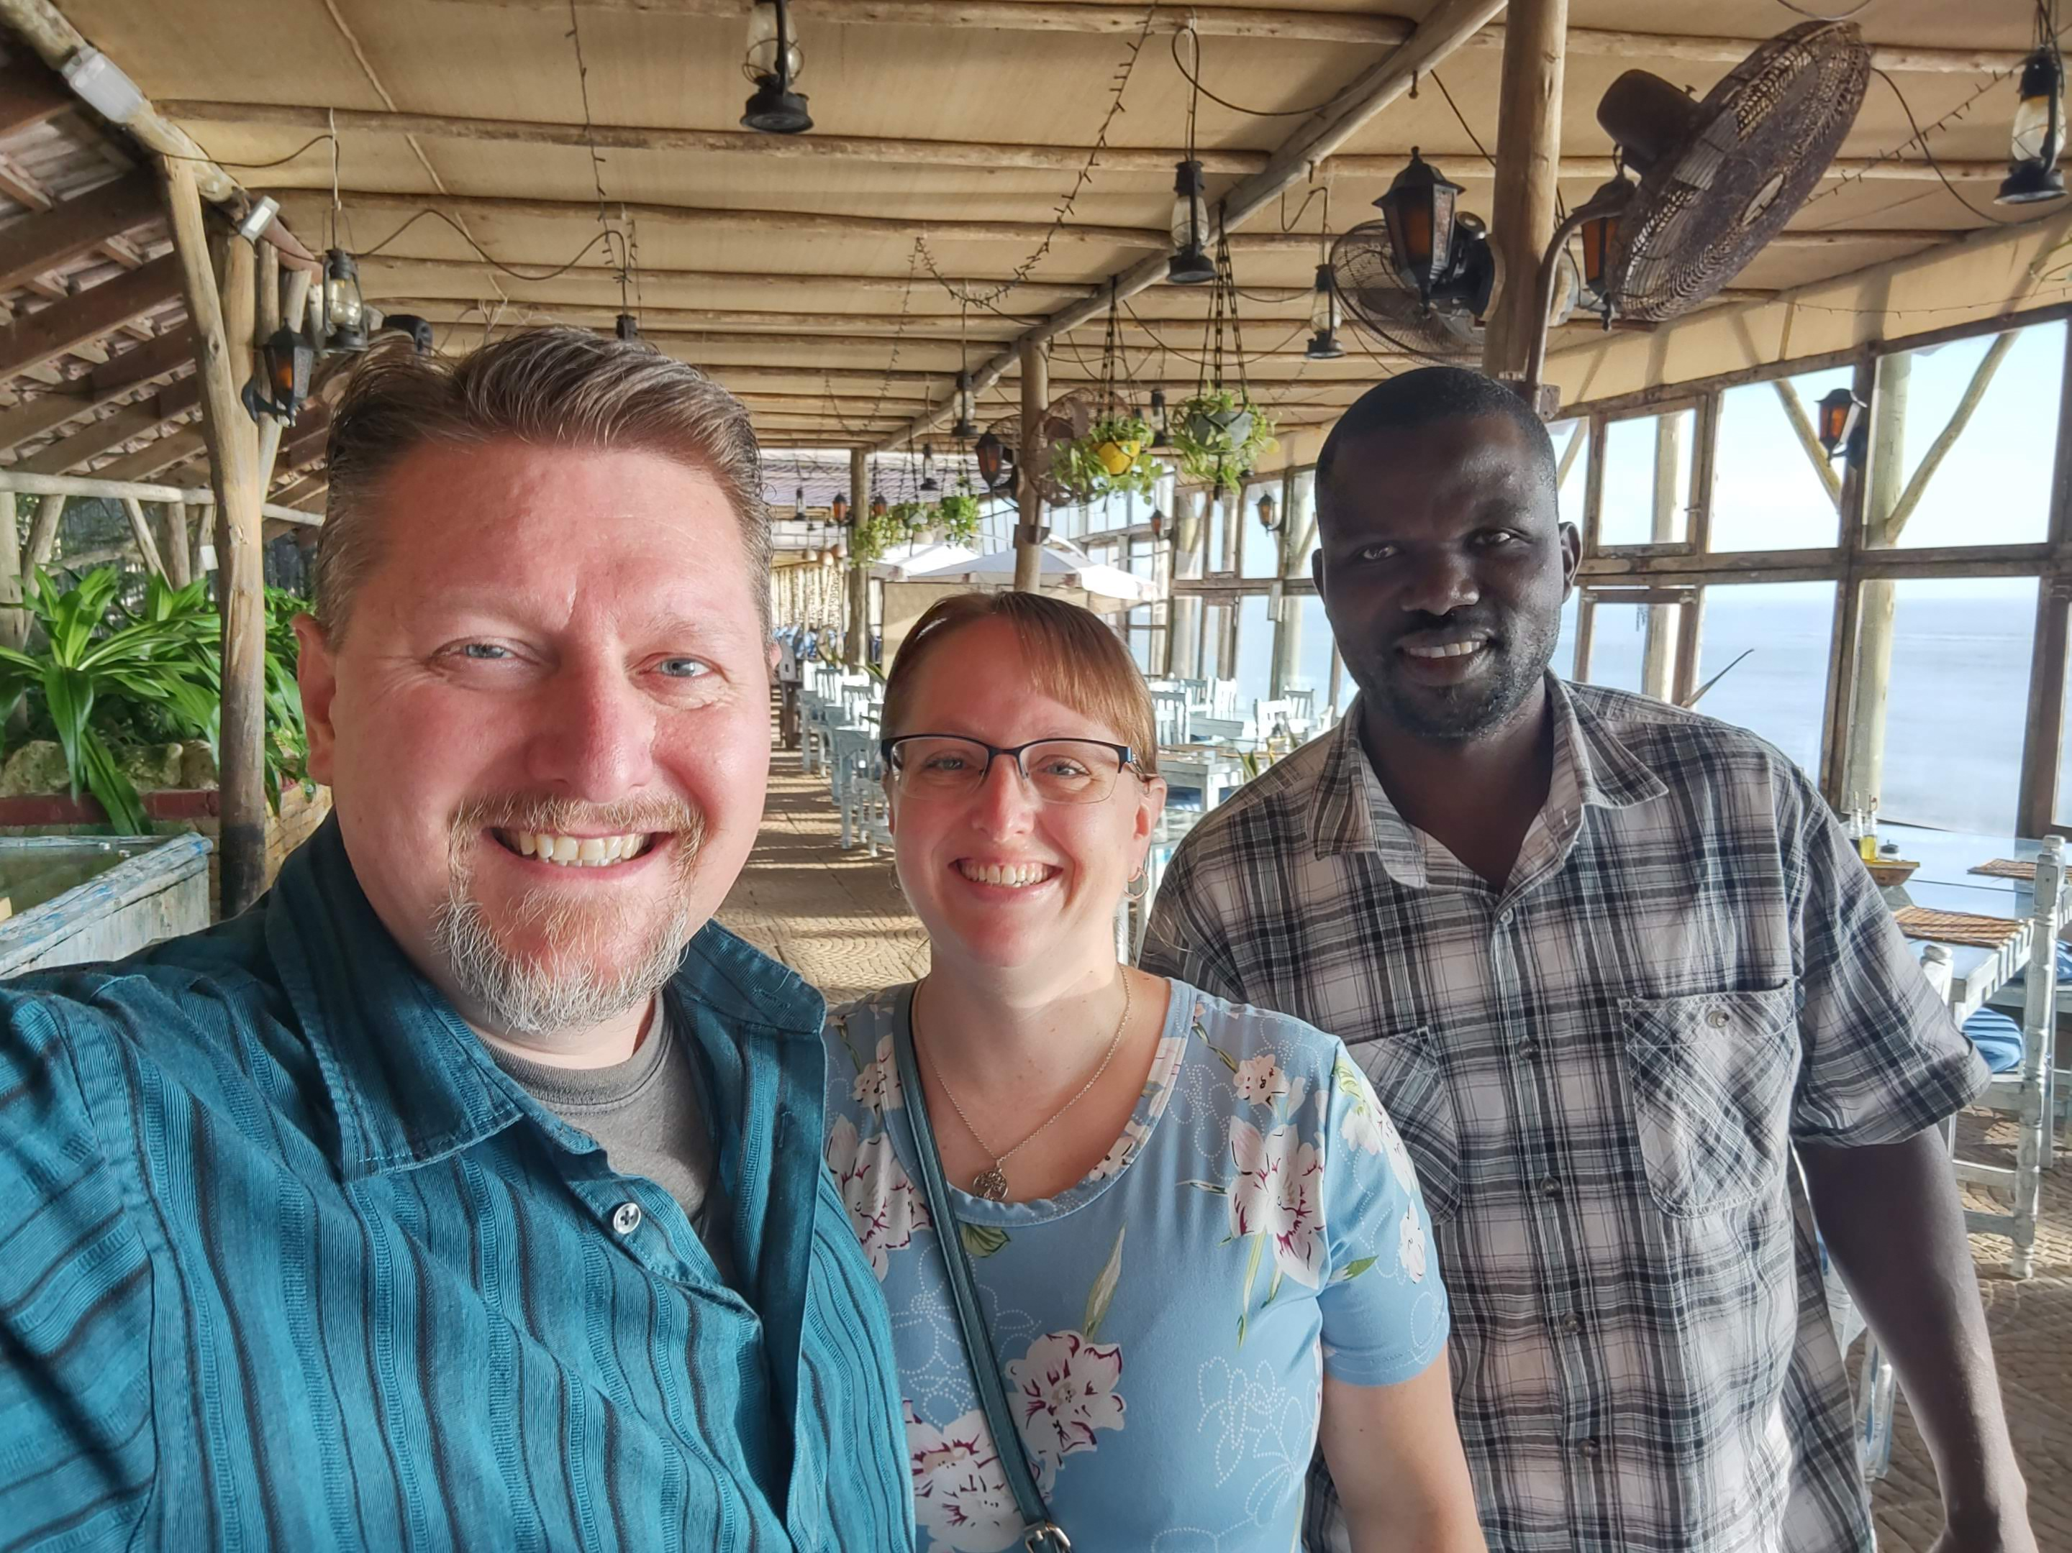
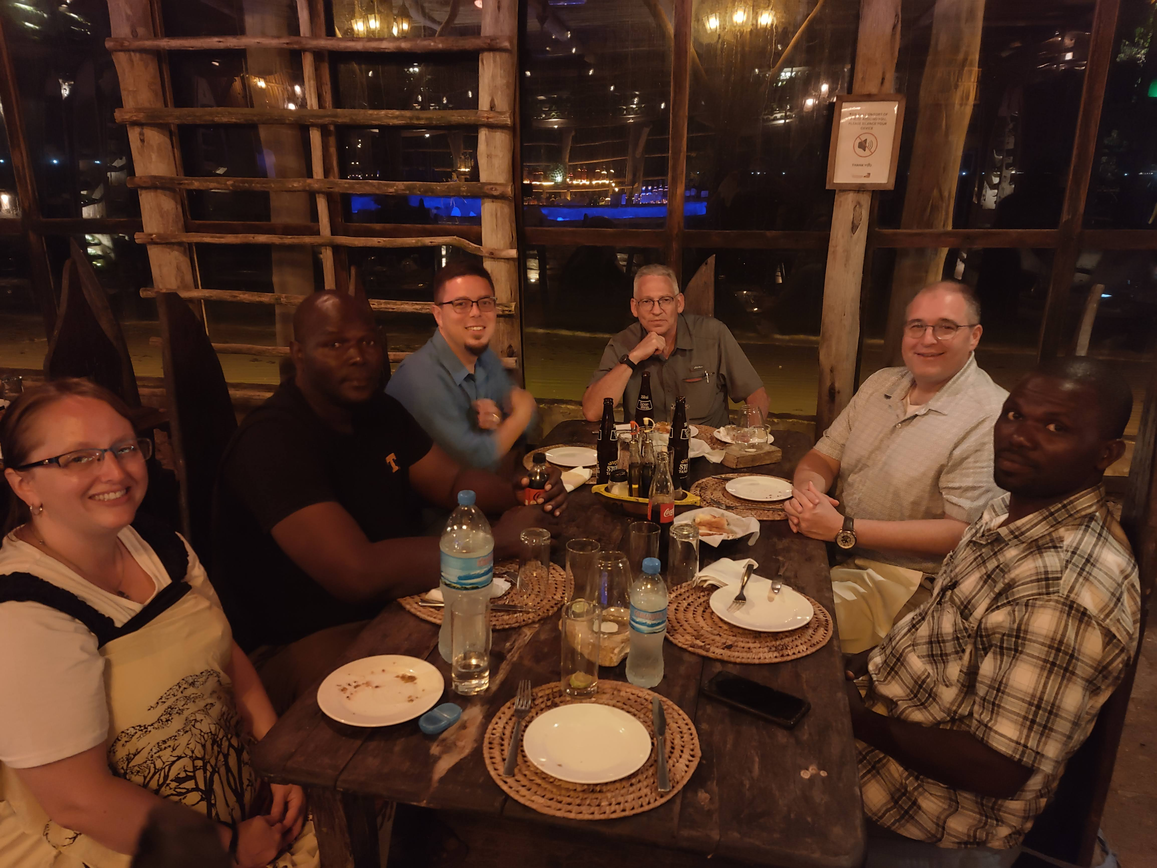
Highlights
Charles!
Notes:
Images: Clockwise from the top Left: Charles translating for Andrew, Charles and Ed teaching the children at Mbezi a new song, All of us at dinner a our hotel Mediterraneo in Mbezi, Nate, Becky & Charles on our last morning in Mbezi, Charles translating for Chad.
Highlights:
Getting to work with Charles Mwakalonge again!
We met him last year in Iringa. He was the preacher at Kilolo but moved to start a new work in Tunduru.
He started a Cashew Tree Farm to supplement his income. Our congregation sent him a one-time benevolent gift to get started. He sent his “Thanks” back to the brethren here!
We enjoyed working with him as a translator last year that we asked him to translate for us in Mbezi.
He traveled 12 hours by bus to meet us there and work with us for four days!
He is an amazing translator: He uses our inflections and gets into it as you can see with his translating for Ed (Top Right)

Slide 17
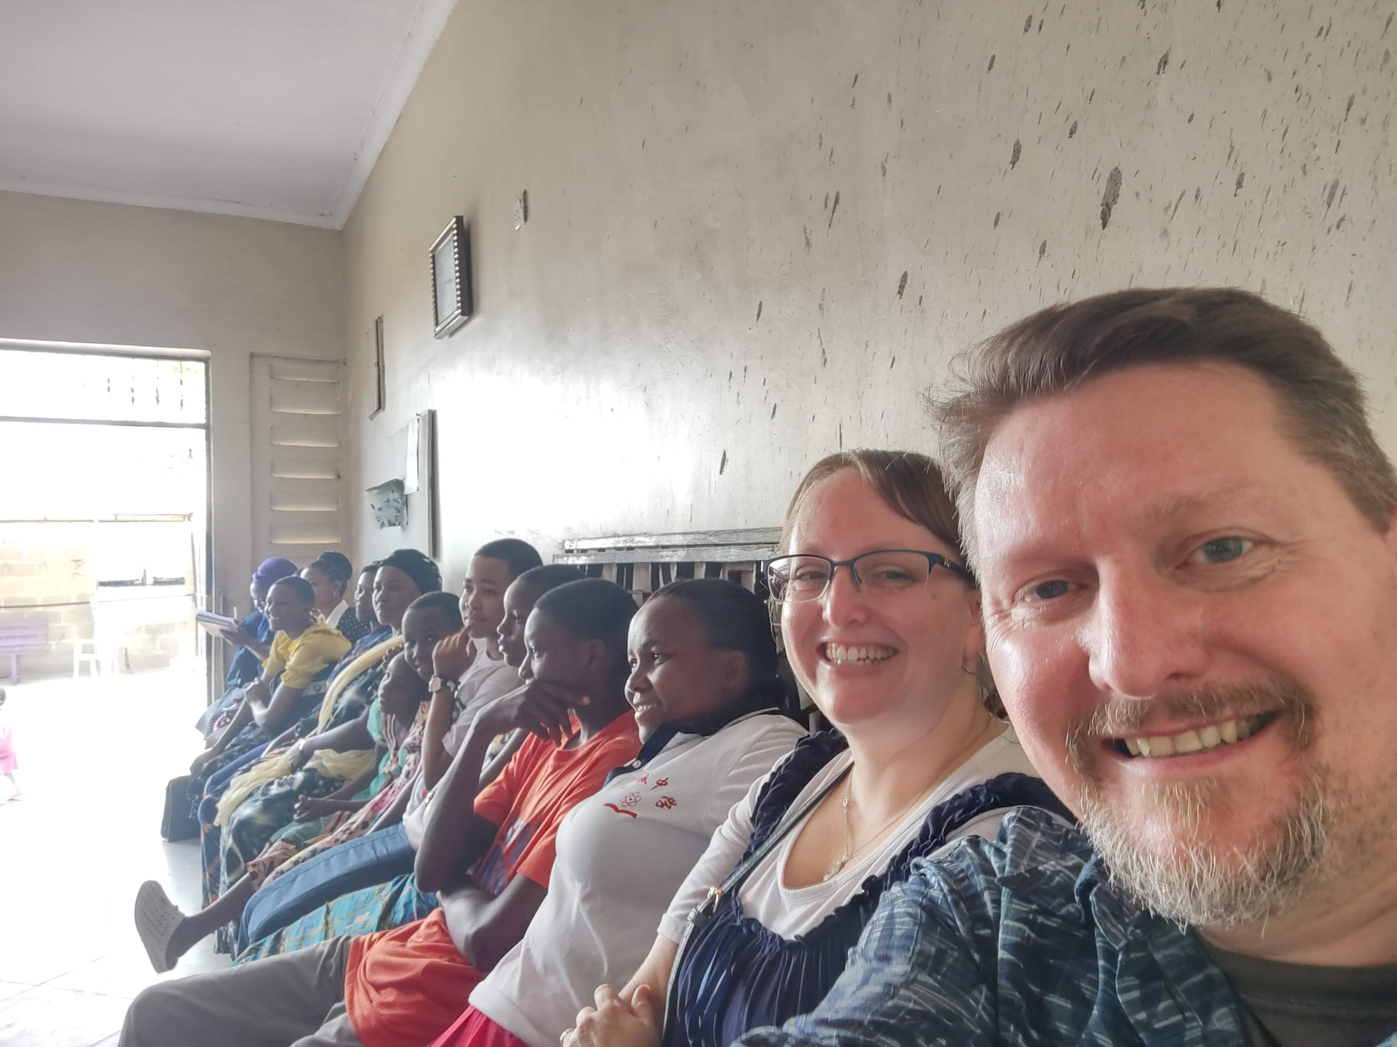
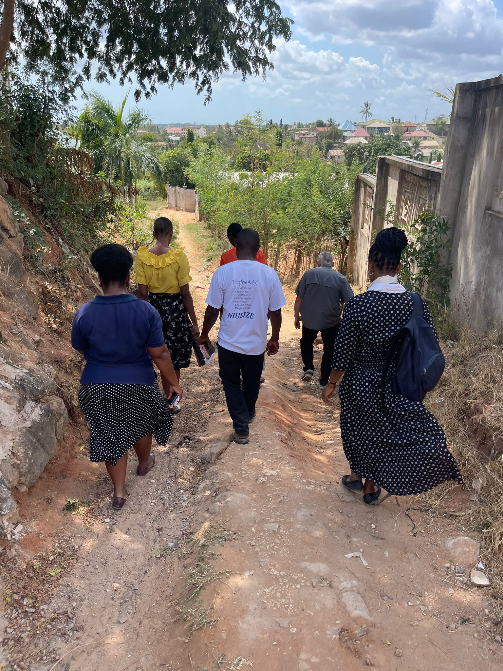
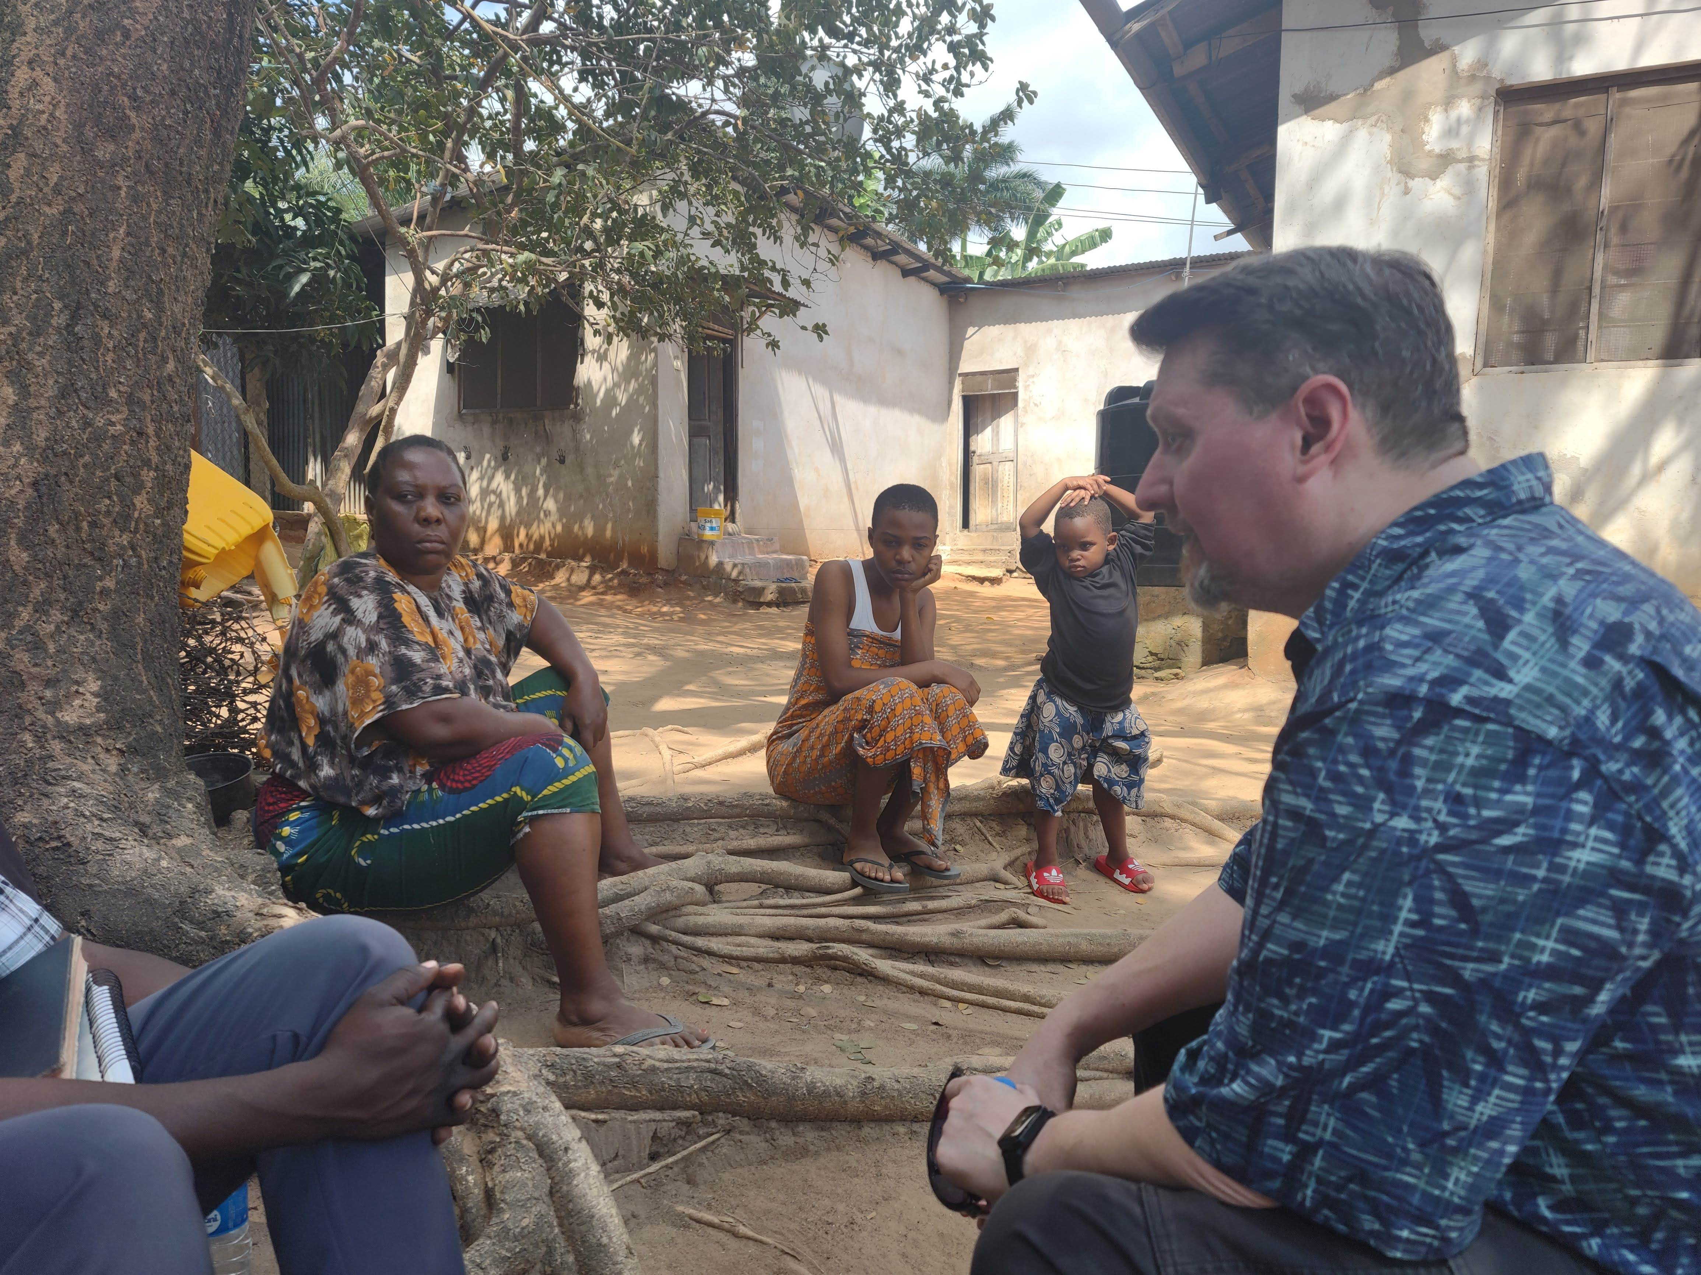
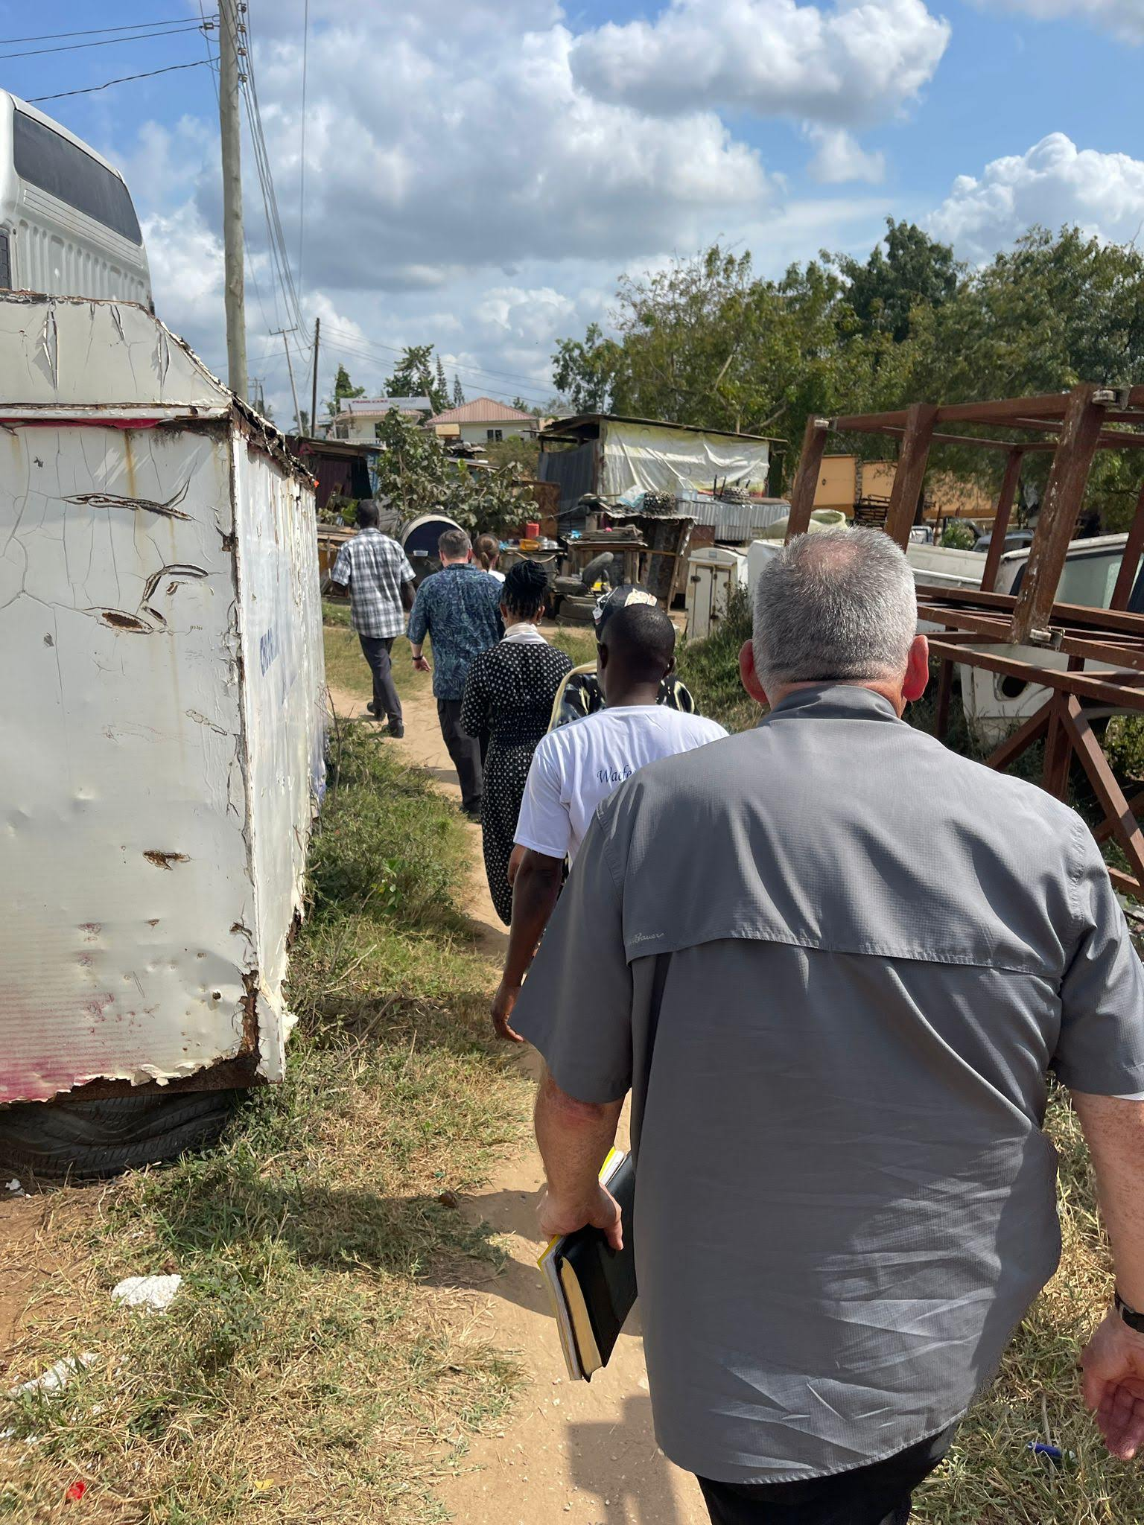
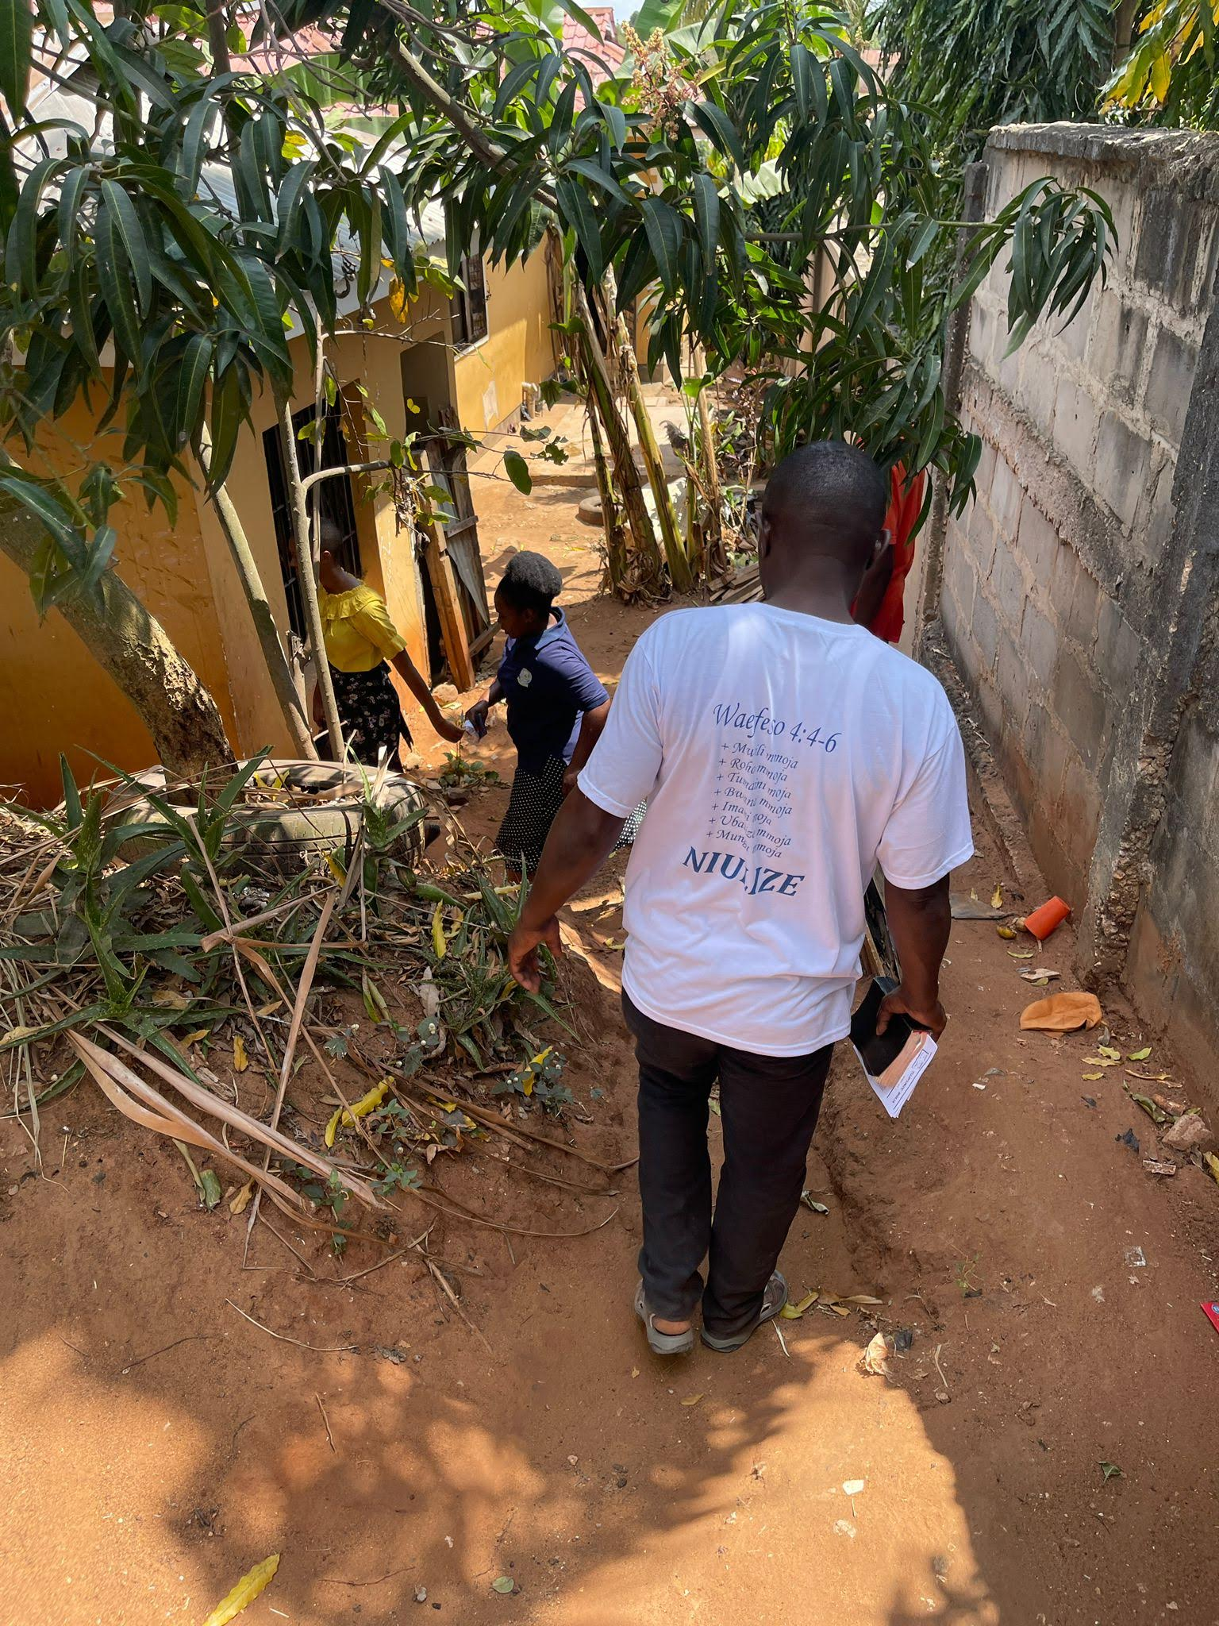
Highlights
Street Preaching
Notes:
Images: Clockwise from the top Left: Nate & Becky with some of the women who will go with us “Street Preaching,” three pictures of two of our groups walking until we split from each other, Nate sitting in the yard and teaching Elipendo under her tree.
Highlights:
Street Preaching:
Three Teams went out into the Community
Group of 8: Led by Steven consisted of: Charles, Nate & Becky, Rehema, Deborah, Brightness, Vin
The first group we met with was four ladies working in their yard. They invited us in to briefly talk and to meet us. We gave them brochures and invited them to Wed PM Bible Class and Sunday services. One of the young ladies pointed at Nate and said she would consider coming to Bible Class if he gave her his watch. She laughed and said it was a joke!
We were invited into the yard of Elipendo, whose name means “God is love.”
She gave us stools to sit on as her guests while she sat on the tree root.
She said she was Lutheran and wanted to know about the true church that members from Mbezi had told her about previously.
She said she reads her Bible and has not seen the name “Luther” or “Lutheran” in the Scriptures so we studied the One church from Ephesians 4:4-6 vs Lutheranism.
After the study she said she would come to visit the Mbezi congregation on Sunday.
Chad and Ed went with Eustach
Andrew and Zuberi went with Denis

Slide 18
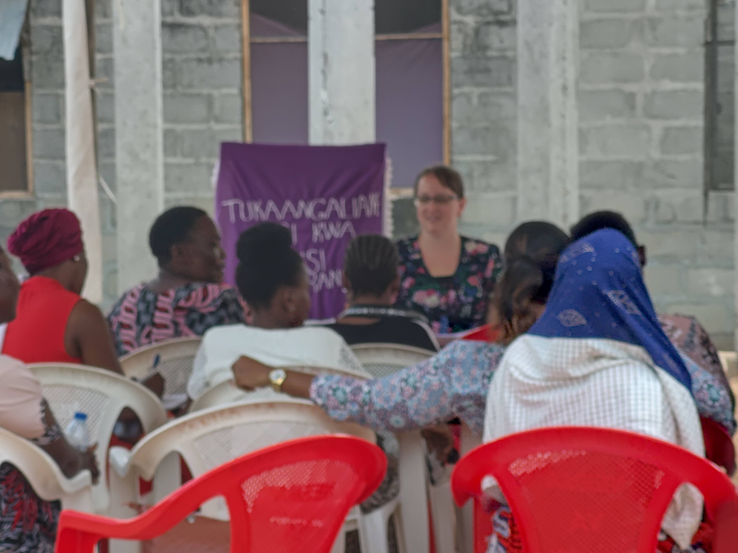
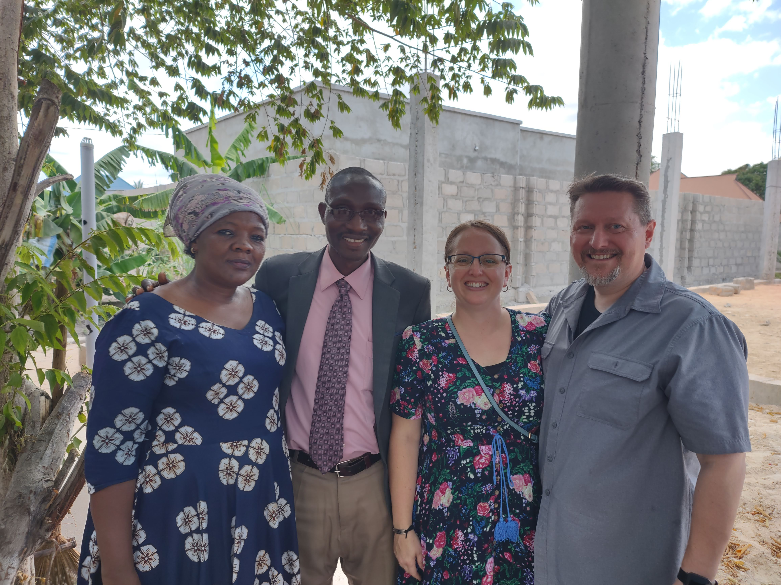
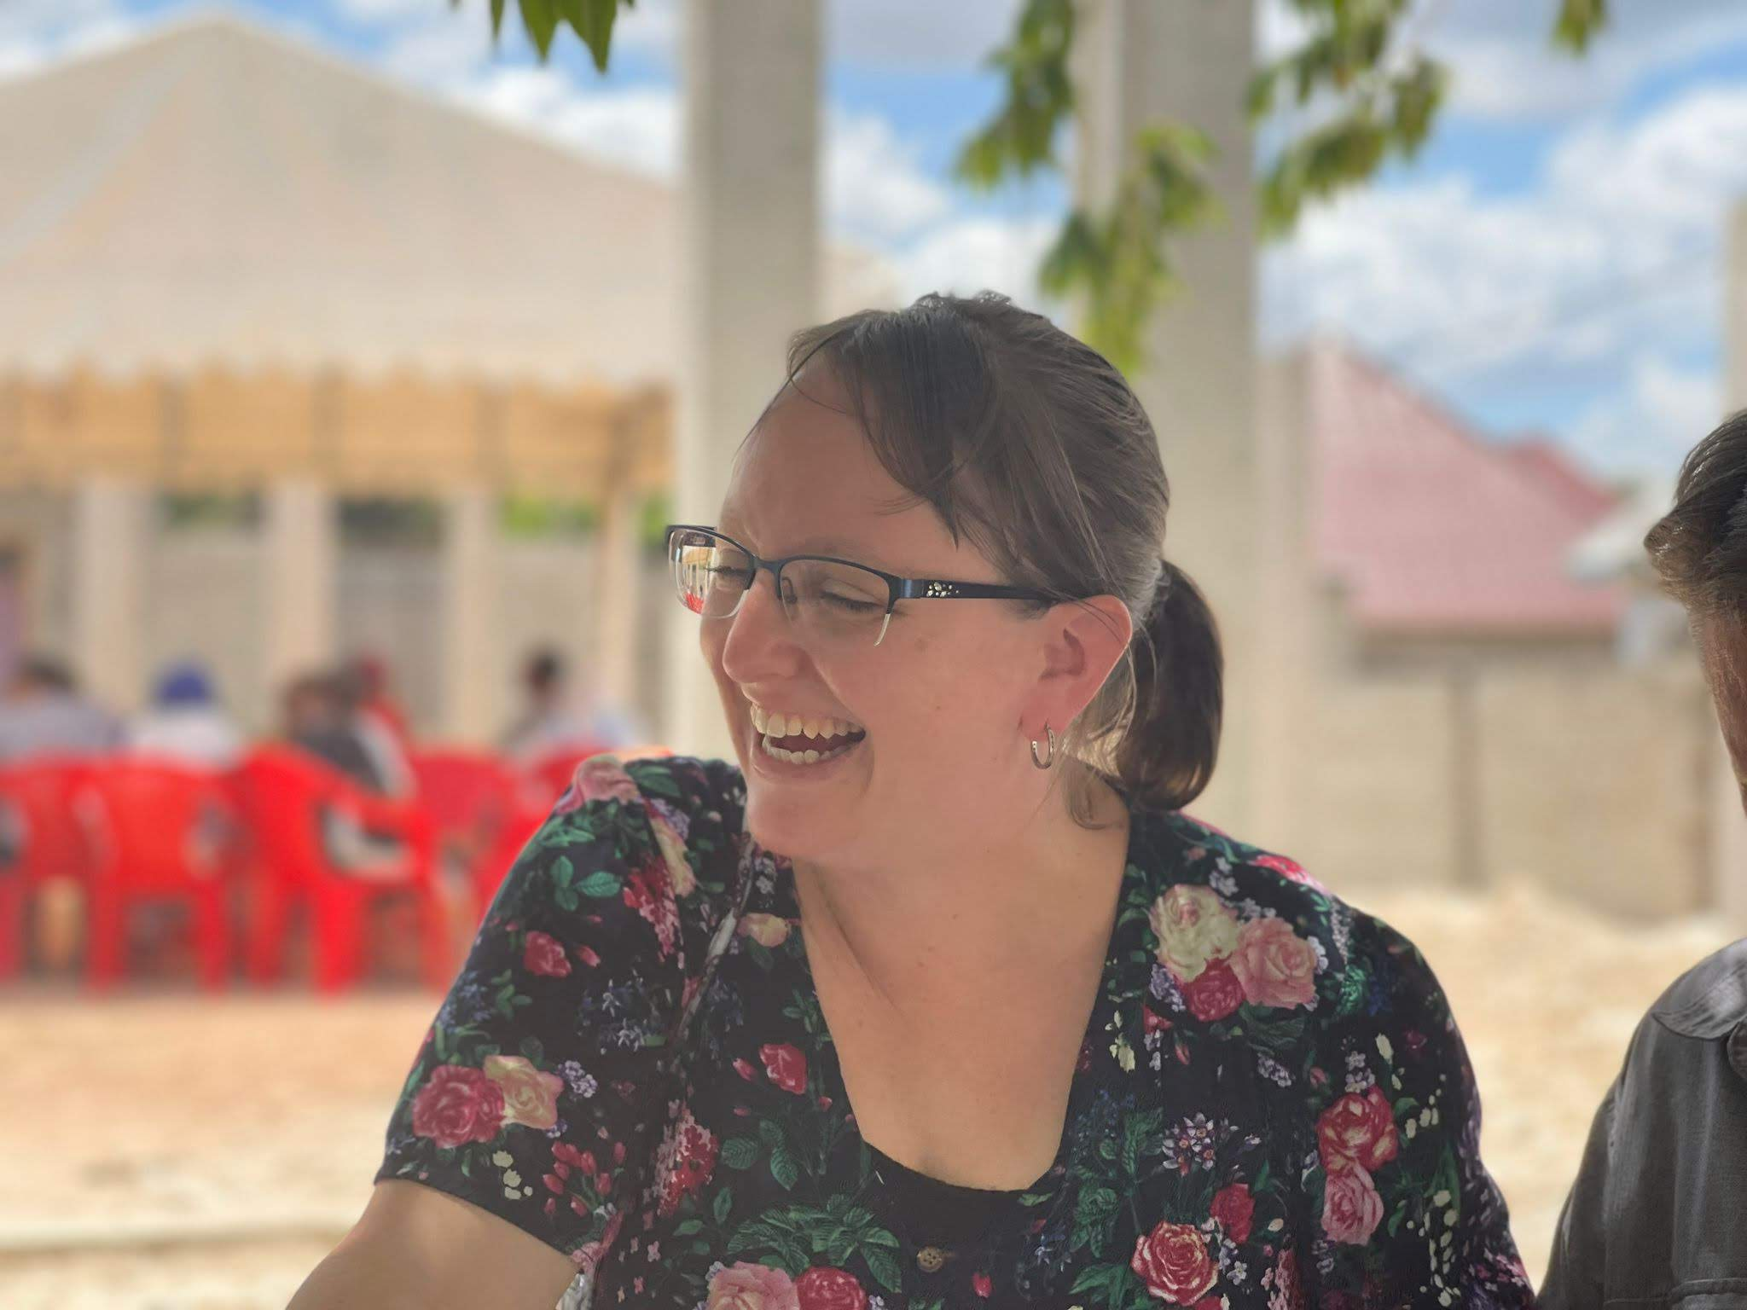
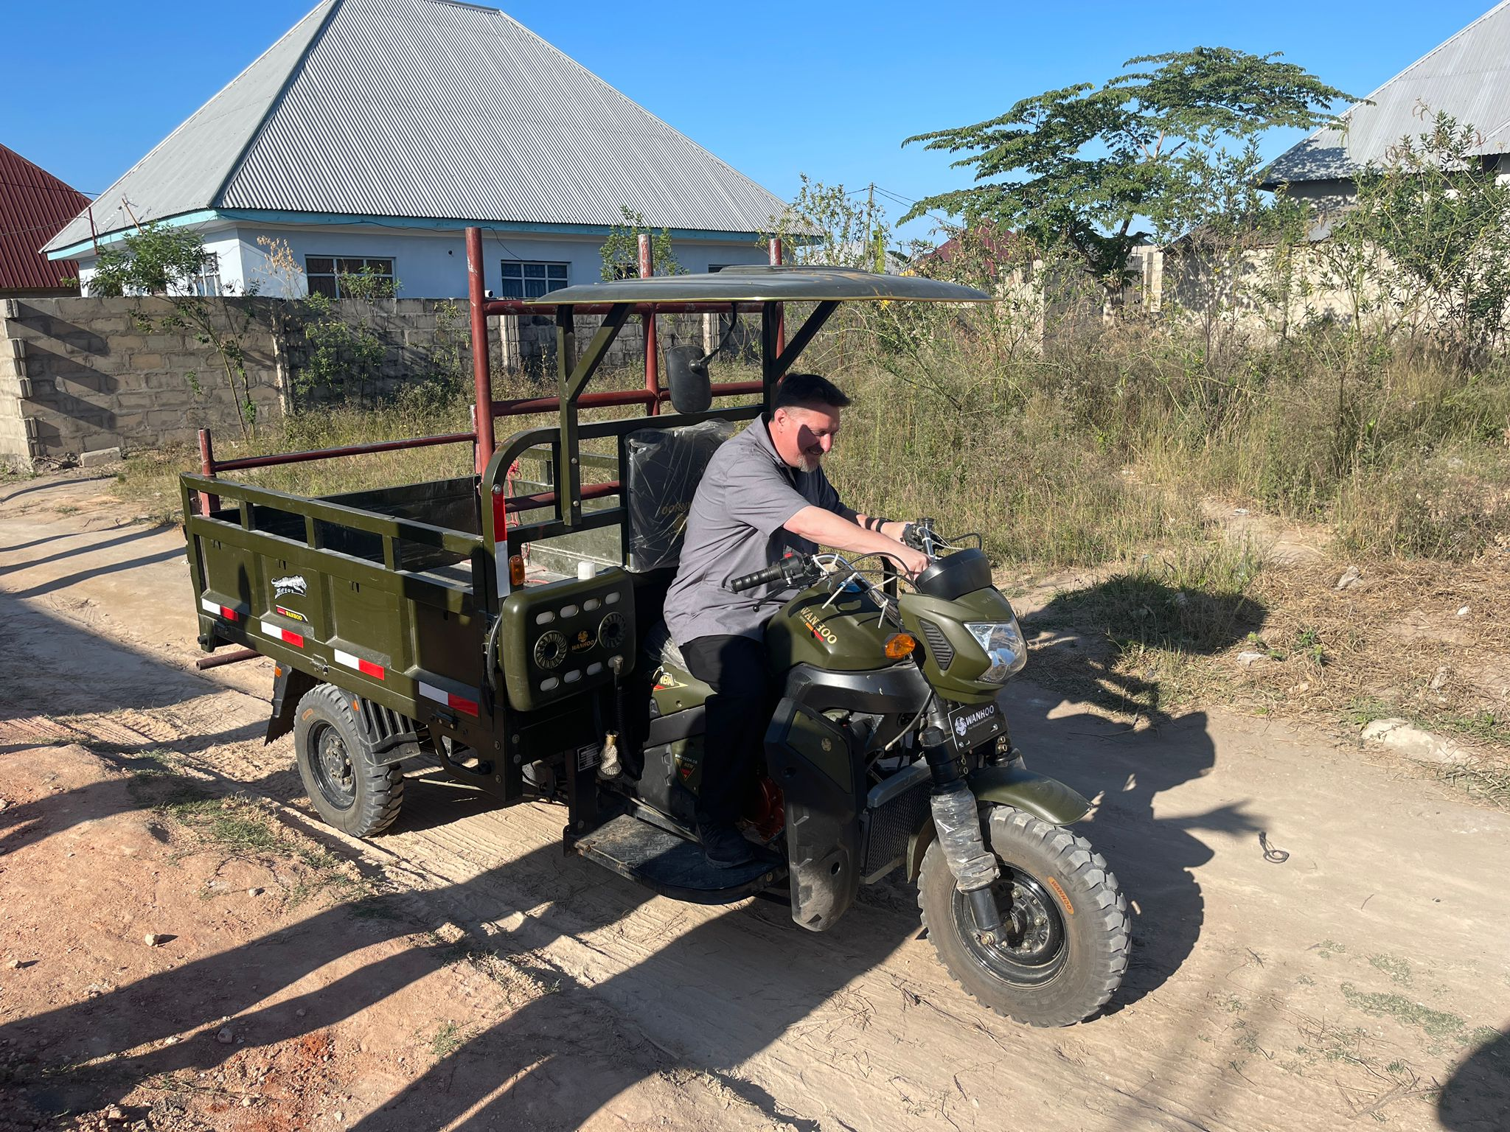
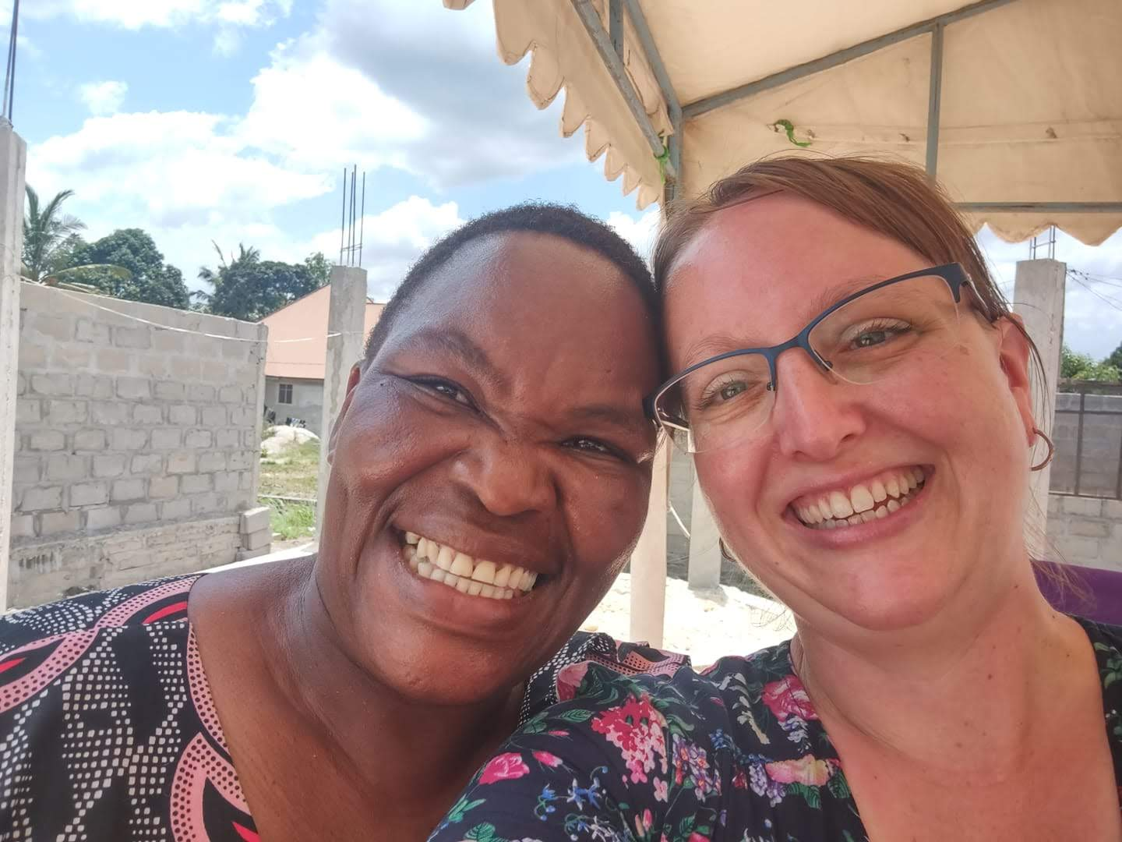
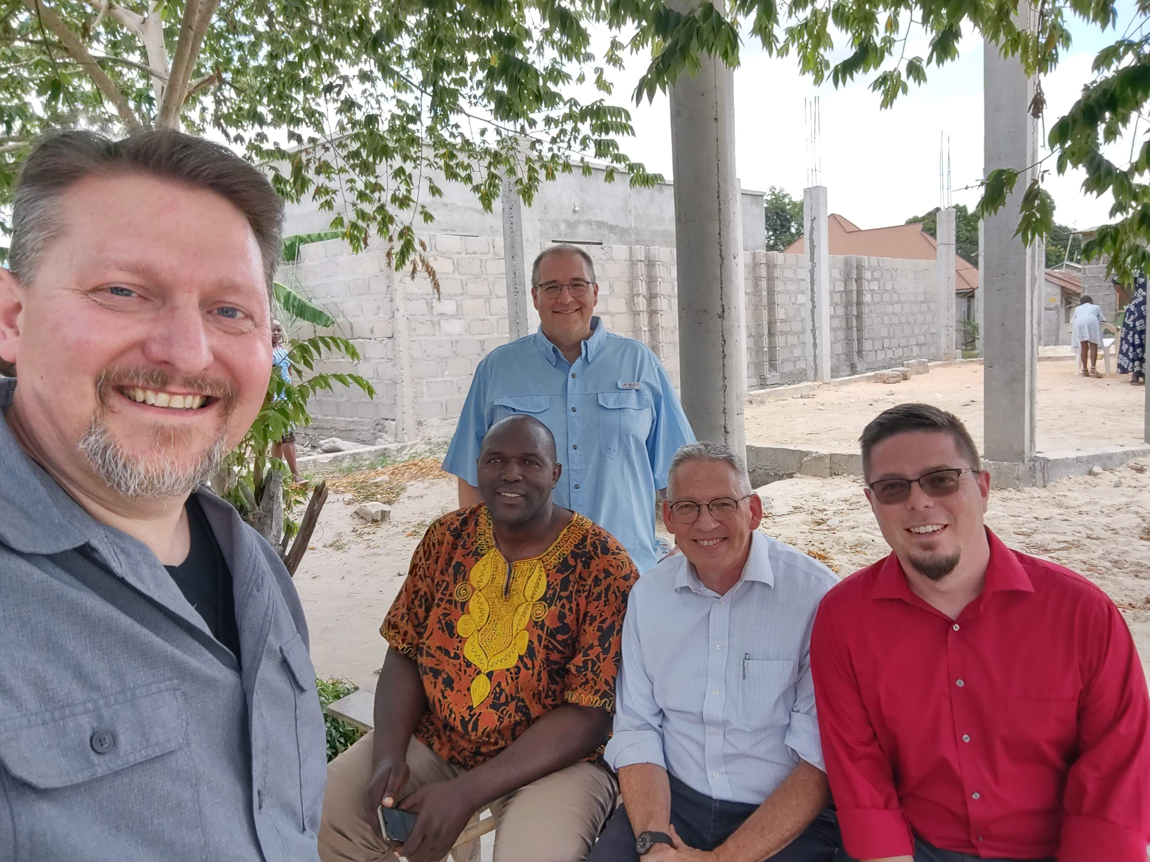
Highlights
Chanika!
Wanhoo
Notes:
Images: Clockwise from the top Left: Nate & Becky with the preacher at Chanika, Hansen and his wife Grace, Becky teaching the women, Becky laughing (taken by Chad), Becky with her Translator, Sherida Hongora, Nate, Zuberi, Andrew, Ed and Chad under the Mustard Tree just outside the building entrance.
Highlights:
Opposition: The City had removed the Chanika church of Christ sign from the road so we missed our turn by a lot and were late! (It was explained that it was a little persecution by the city government)
Seeing the brethren at Chanika again was a delight. We spent time with the preacher there, Hansen and his wife Grace.
It was good to see the progress they are making on building a new building.
Sitting under their Mustard Tree and seeing how it has grown was something I looked forward to!
A man drove up in his Wanhoo, a motorcycle attached to a trailer. I mentioned that it would be fun to just drive a Wanhoo a little ways. Zuberi asked the driver and he let me drive it several yards after showing me what to do. It was fun! There is video!

Slide 19
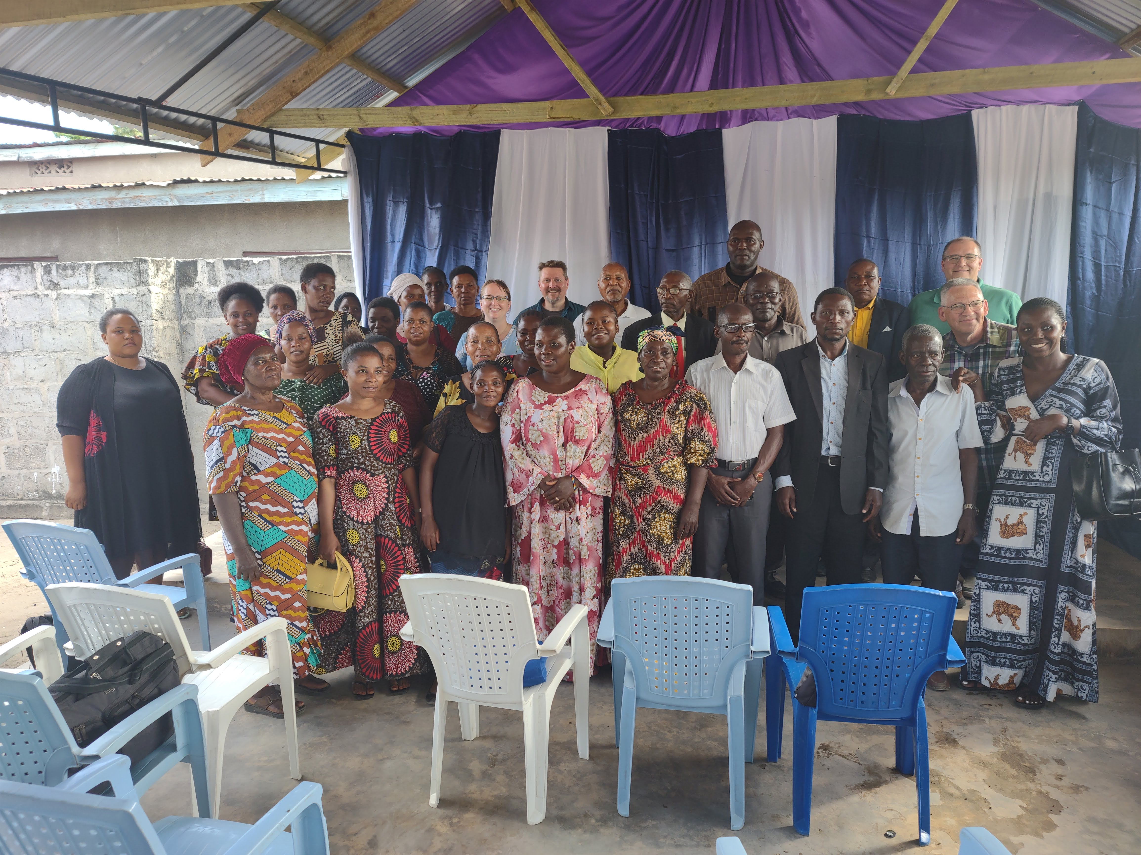
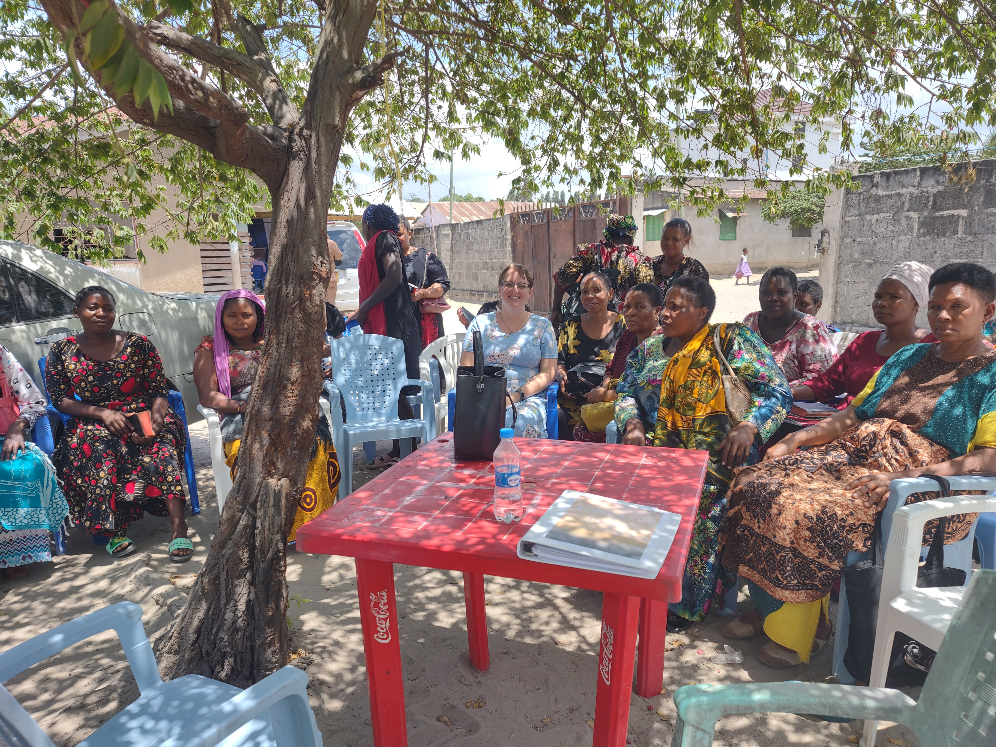
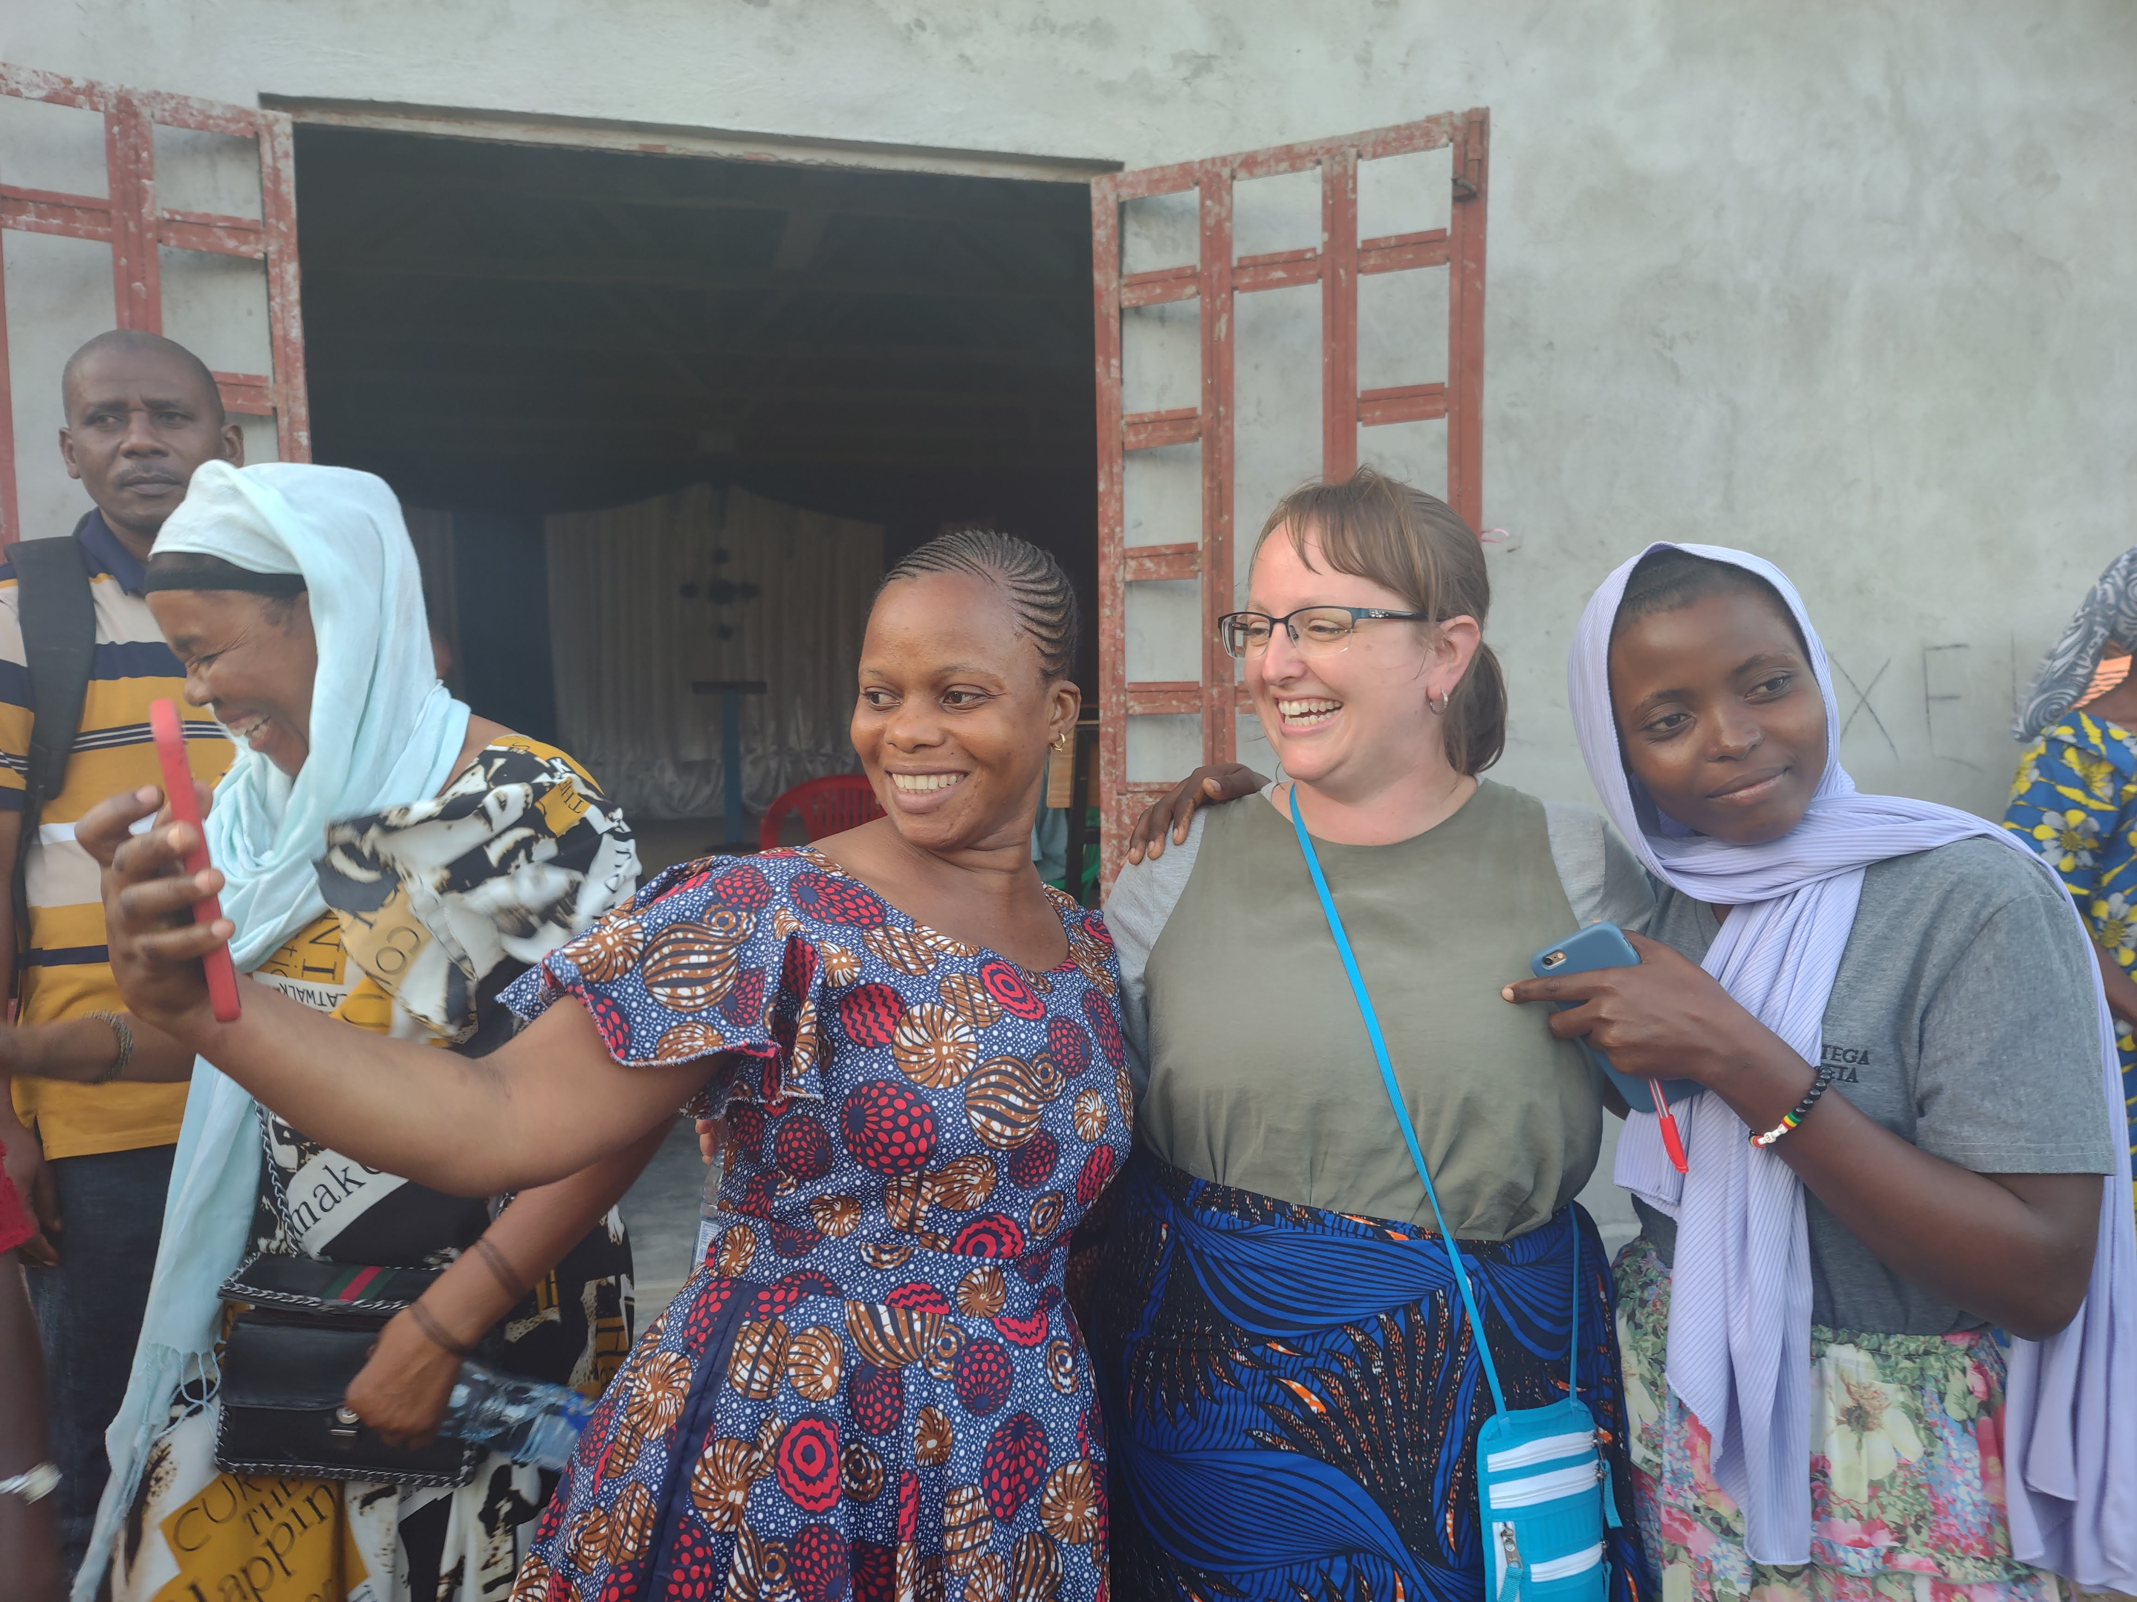
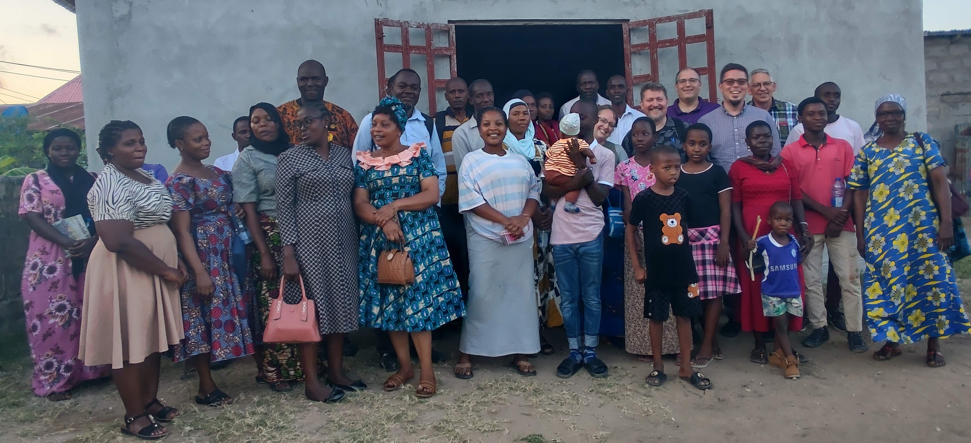
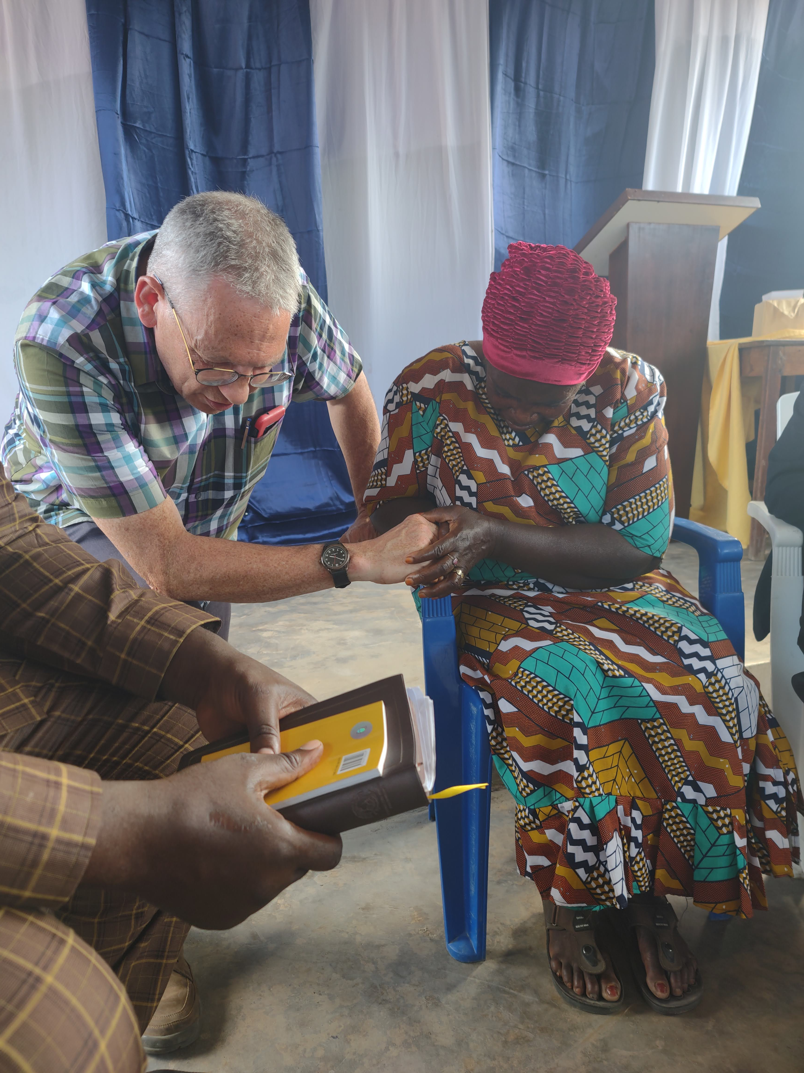
Highlights
Tabata!
Kingugi
Notes:
Images: Clockwise from the top Left: Group shot of the congregation at Tabata, Becky teaching the women, Ed praying with Mama Lucy Monyo; Group shot of the congregation at Kingugi, Becky getting selfies with some of the ladies.
Highlights:
We were invited to two congregations I haven’t been to before.
The first was a new congregation at Tabata, one that none of us had been to before.
Their preachers are Aiden and Albert and they invited us to preach on the work of the church. The ladies wanted Becky to teach them as well!
The property belongs to Mama Lucy Monyo. She lives there but gave a portion of it to the church so they can meet together. She is not a Christian. Yet!
Kingugi is a group that some of us had visited before but not me so it was all new to me and Becky.
Becky’s presence here was much appreciated by the women, even though there wasn’t a ladies’ class.

Slide 20
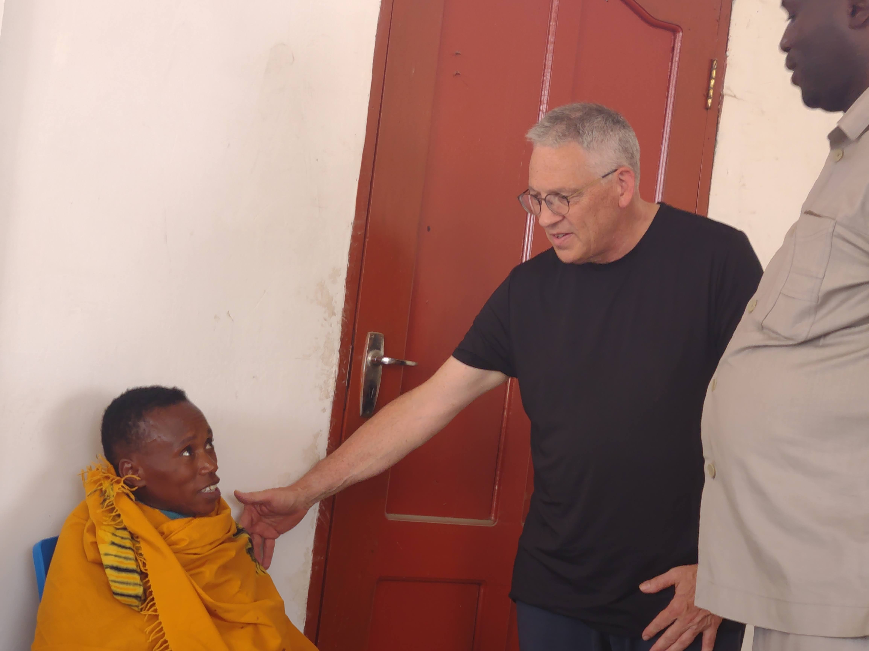
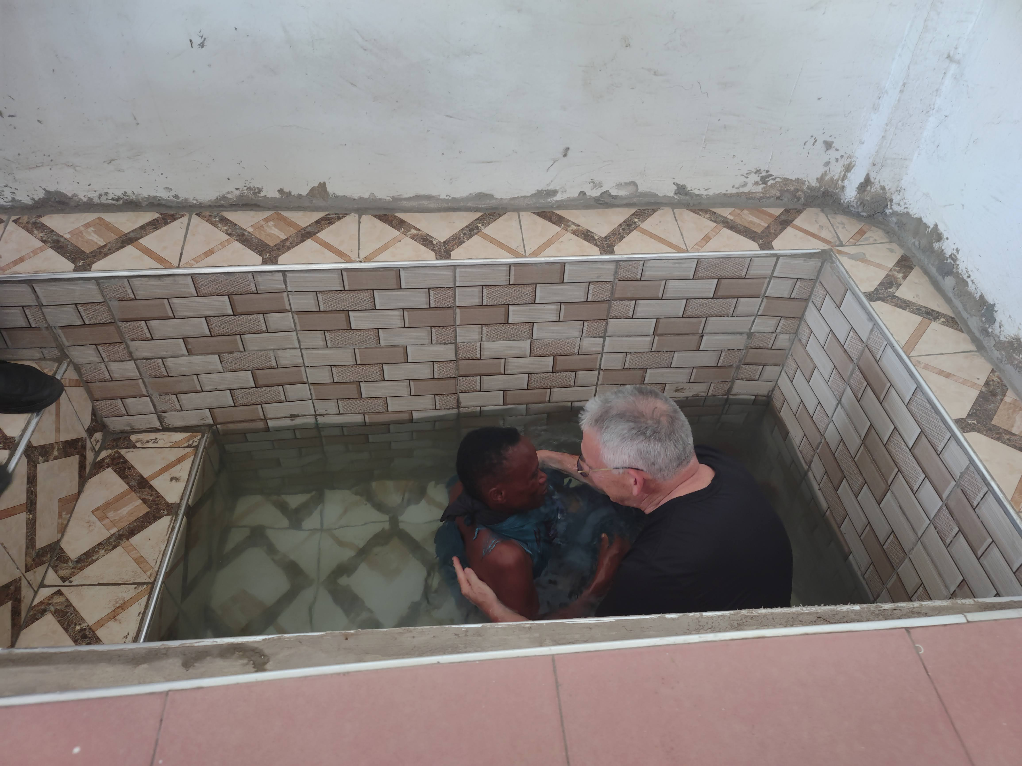
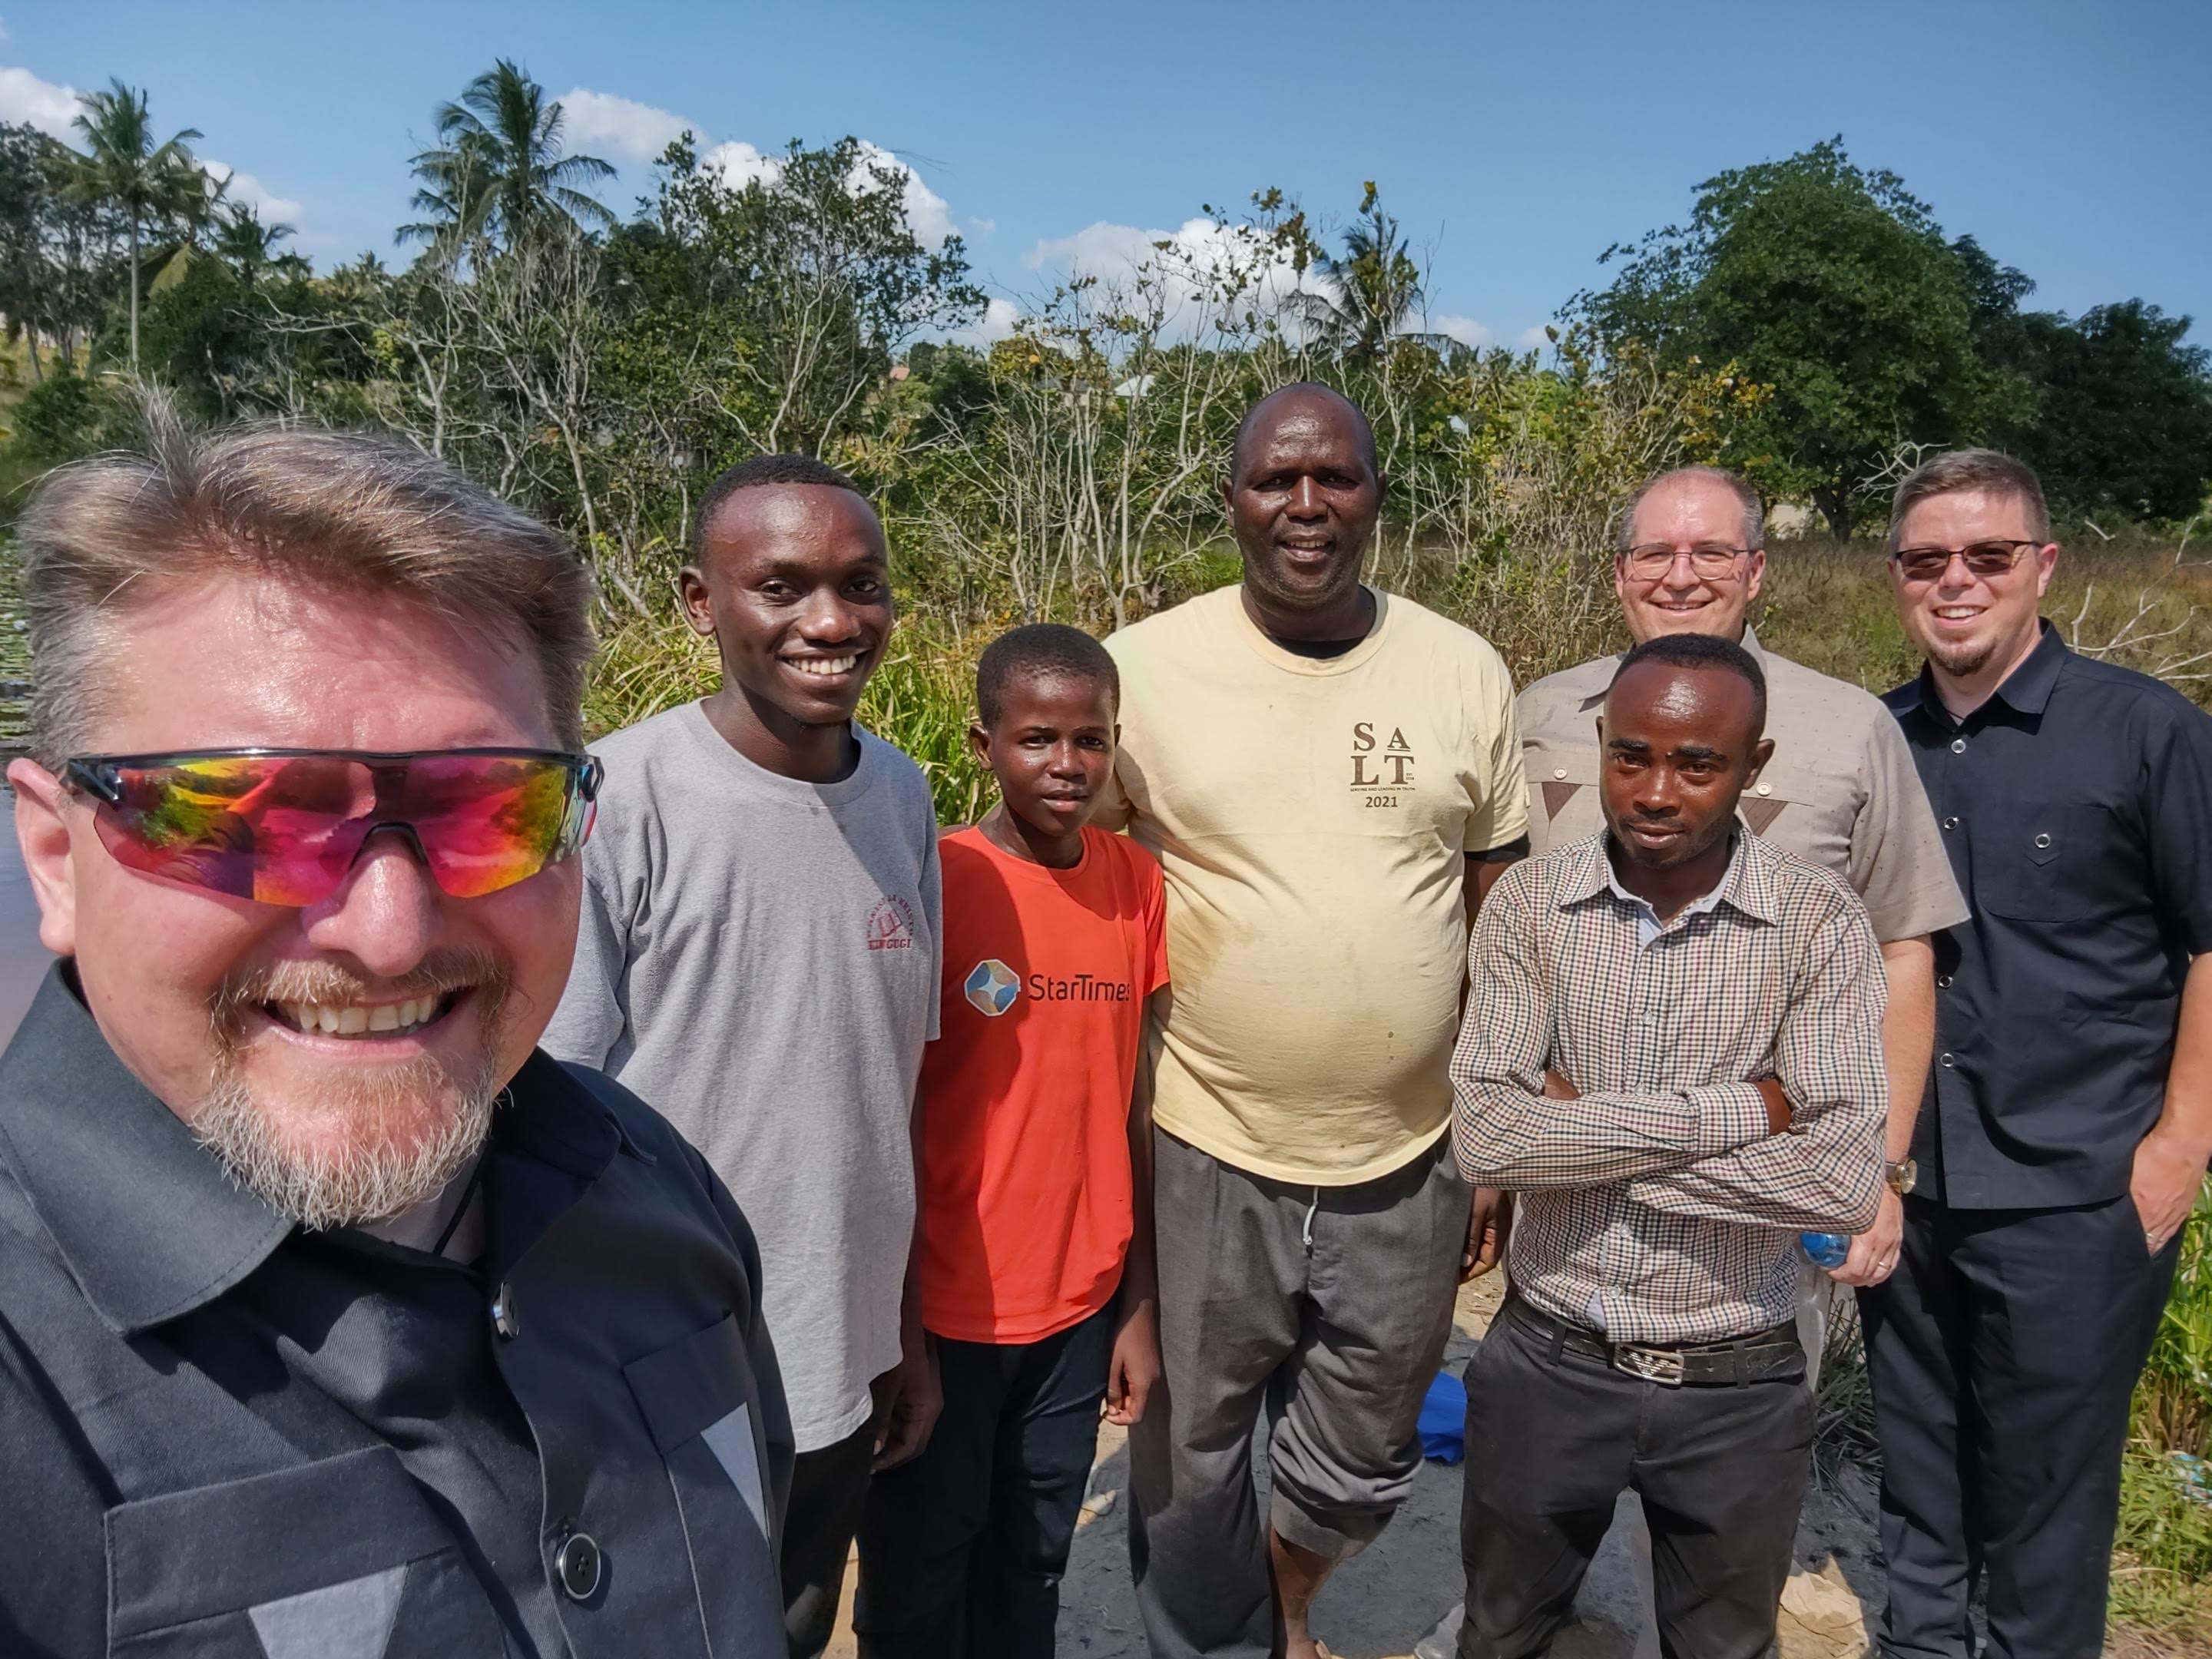
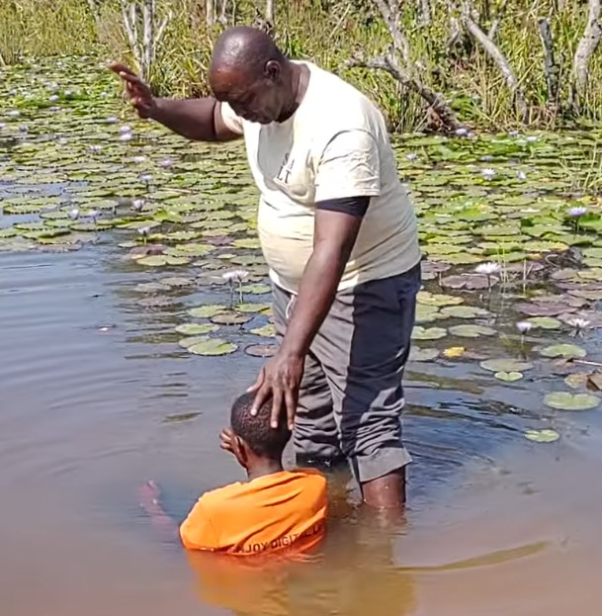
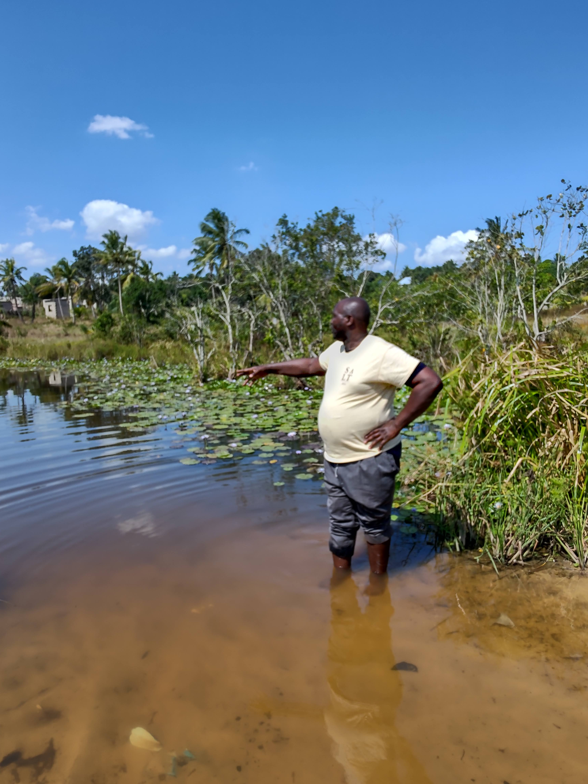
Highlights
Two Baptisms
Happiness Deusi
Ambwene Mwakyami
Angels rejoiced!
Notes:
Images: Clockwise from the top Left: At Kizuiani brother Ed was asked to baptize Happiness Deusi, a woman who had studied with brother Godwin Dihigo; At Mwanambya we walked almost an hour to a crocodile and snake infested river to baptize his son, Ambwene; Group shot of all of us who walked down to the river: Nate, Wendelin, Ambwene, Zuberi, Ihibata, Andrew & Chad
Highlights:
Baptism at Kizuiani: Ed baptized a woman, Happiness Deusi, who studied with brother Godwin. We rejoiced with the angels!
Then I was asked to preach something different than what I was previously asked to teach on. I had been teaching on personal work and after the baptism was asked to preach on beign like Jesus. I had just the lesson on me. I’m glad I was prepared!
Baptism at Mwanambya: Zuberi’s son Ambwene wanted to be baptized. After services a small group of us walked to the river. Zuberi told us on the way there it had crocodiles and snakes. He said he hit crocodiles for fun! We started calling him, “Zuberi, Crocodile Puncher!”
He said he would baptize his son because if one of us Mzungus went into the water the crocs and snakes would bite us and eat us!
He said they wouldn’t get him because he knows how to detect the crocs and touch the snakes.
One of the young men from a visiting congregation, Ihibata, who walked with us said, “I don’t think they’re racist. I think they would get him too!”
We didn’t see any crocs or snakes.

Slide 21
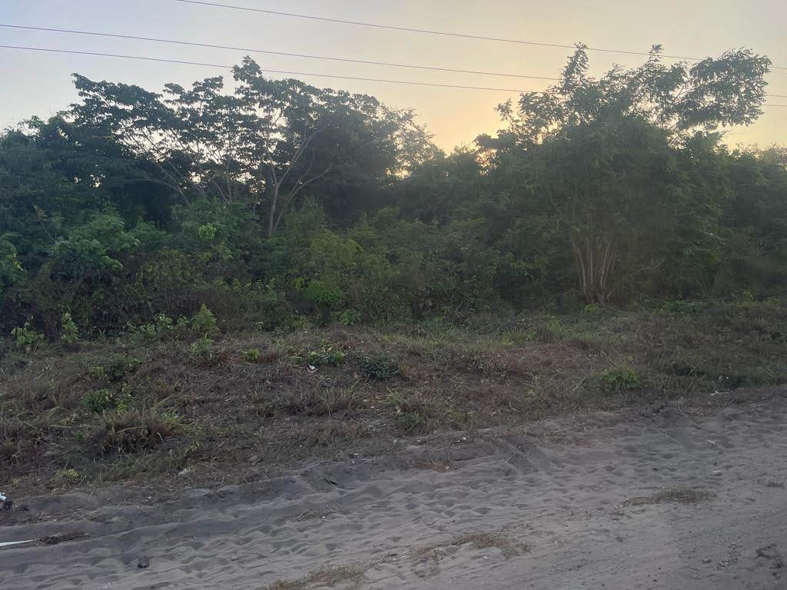
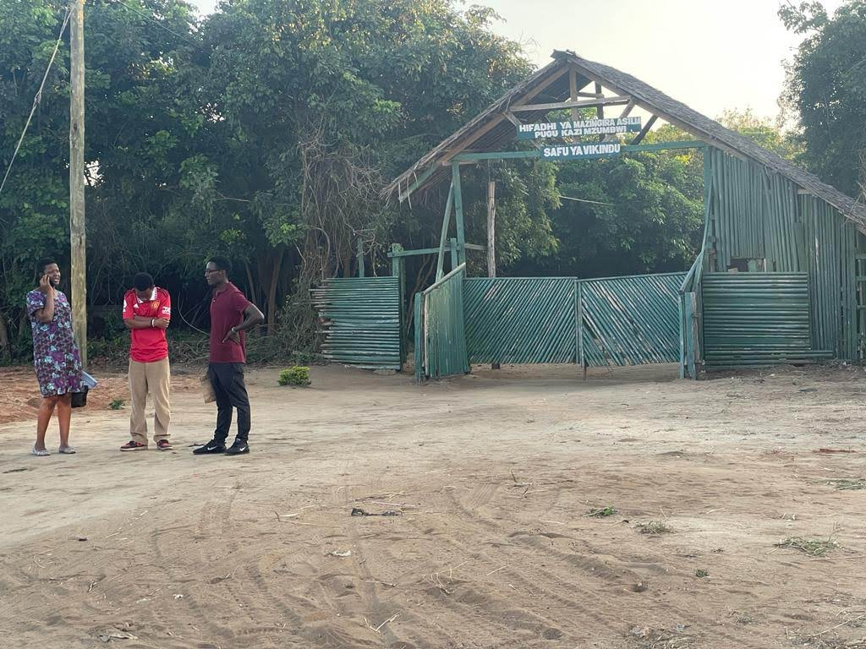
Highlights
“So many pythons”
Isis caused deforestation!
Notes:
Images: Clockwise from the top Right: Forested area where pythons are placed to deter Isis from returning, The gate to the nature preserve where you can see pythons.
Highlights:
On the way to the congregation in his home at Mwanambya, Zuberi pointed out that a forest that was there last year when we visited is now gone.
He explained it was due to Isis being in the forest. So, they cut it all down. Isis caused deforestation!
We saw a forest a little later on and asked if Isis was in there and he said No, there were pythons in there to deter Isis from coming back.
We asked, “There are pythons in there?” He said, “So many pythons.”
He said they will bite you and eat you. Don’t go in alone. But if you go into the forest with at least two people you should be safe.
He said if we wanted to, we could go through the gate and pay a fee to see pythons! We passed on that offer.
Earlier this year he had a python in his yard eating his chickens and he said he called and the government came and removed it and most likely moved it here, to this forest.

Slide 22
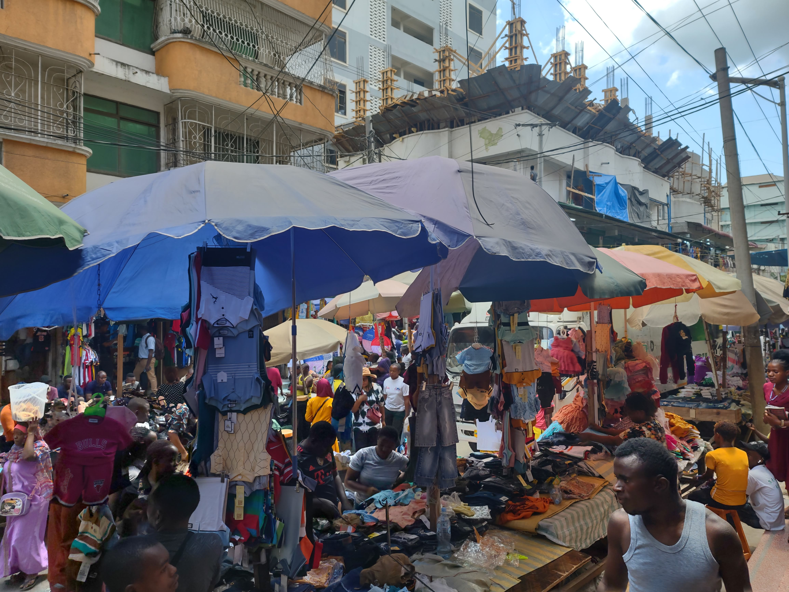
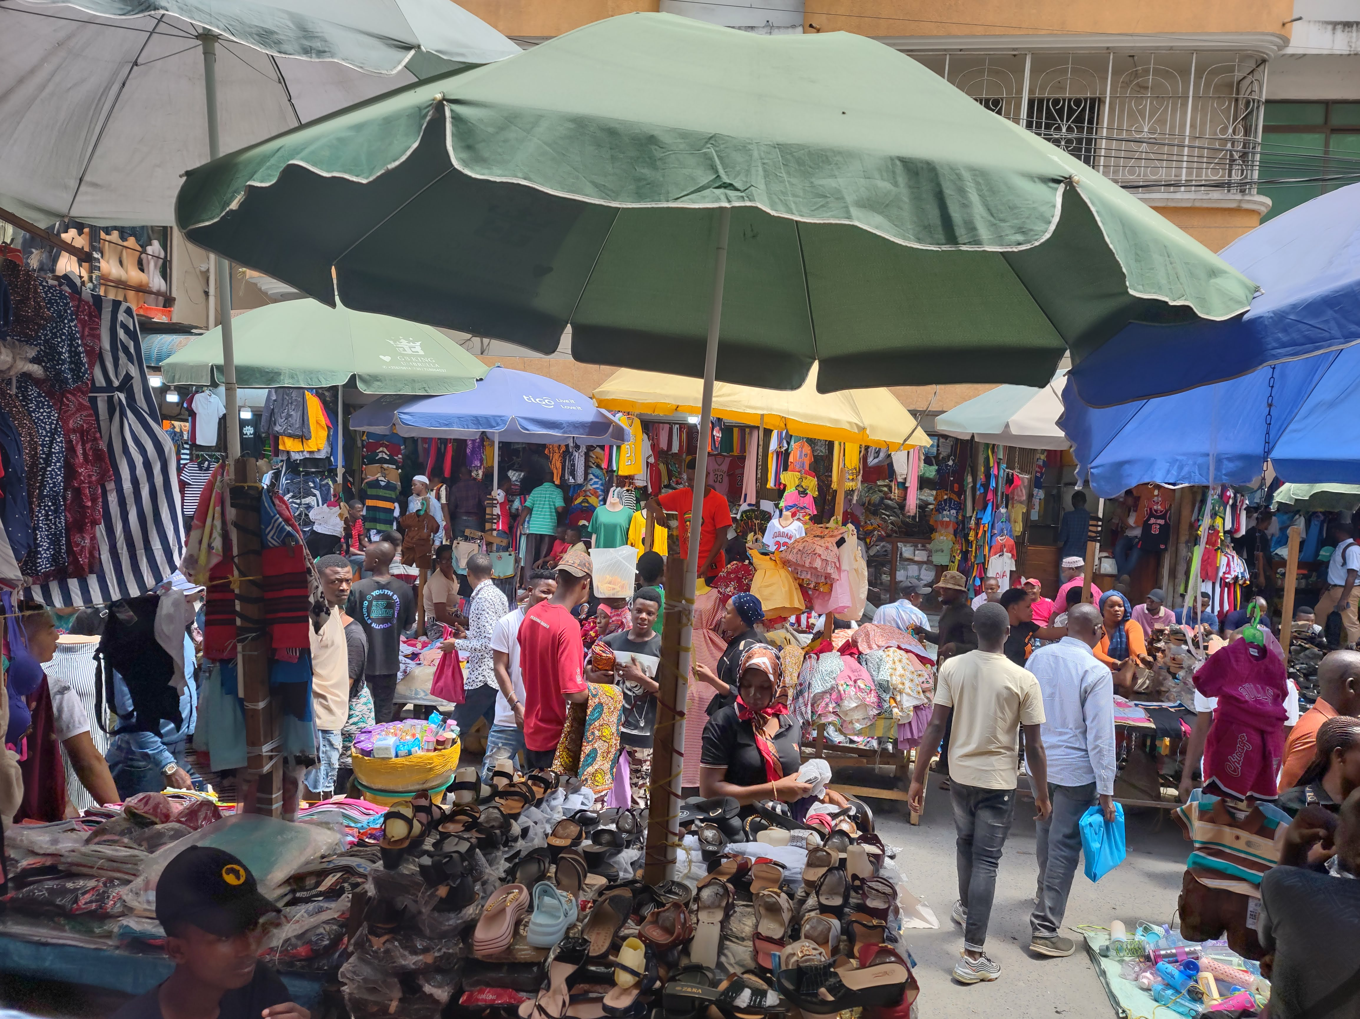
Highlights
The Markets
Street Vendors
Notes:
Images: Clockwise from the top Left: Two pictures of Kariakoo Market from the stall where Becky bought her kintege from (pictured next), Street Vendors selling boxers, shoes and shirts
Highlights:
Zuberi and Godfrey took us to the largest and busiest market in Tanzania: Kariakoo Market!
It was insane! An Introvert’s Nightmare!
Becky bought a kintege there though so that was a win!
When you are stuck in traffic there’s no telling what you will see street vendors selling: one lady was selling packages of boxers, a guy was selling shoes while another was selling shirts and jerseys.
We eventually made it to the market I wanted Zuberi to take us to, Slipway Market, where we found gifts for friends and family and Becky found the dress she really wanted and a skirt to match my new shirt!

Slide 23
Highlights
“China”
“Mr. Lee”
Notes:
Images: Clockwise from the top Left: Chad, “Mr. Lee” with Hansen at Chanika, Chad with Zuberi translating at Kizuiani, Nate, Andrew & Chad down by the river after Ambwene’s baptism, Chad at Chanika
Highlights:
“China”
“Mr. Lee”
While at Mwanambya on Sunday, walking down to the river to baptize Ambwene, a little girl called out to Chad, “China!”
He explained that everywhere he travels he gets mistaken for Chinese. It has happened to him every time he travels to South Africa and other places. He said this was consistent.
On Monday we ate lunch at the New Zakhem Ice Cream diner in Mbagala, Zuberi’s favorite place to eat at.
The lady that took our order looked at our group and said to Zuberi, “Three Mzungu and one China?” The “China” was aimed at Chad! Zuberi called him, Mr. Lee, his new nickname!
Zuberi told us that his neighbor told him he saw him with a Chinaman yesterday (on Sunday) and offered to sell 2 acres to him and wanted him to tell his “China” friend the neighbor’s offer!
China is buying up lots of land there. We couldn’t buy land there but Chad could!

Slide 24
Highlights
House Studies
Brother Godwin
Brother Moshe
Notes:
Images: Clockwise from the top Left: Brother Godwin’s house: Andrew and Chad sitting on his couch, Nate and brother Godwin at Tabata, Group shot at brother Godwin’s house; Group shot of our group with brother Innocent Moshe and his wife at their house.
Highlights:
We had been at brother Godwin’s house last year but he had a larger crowd waiting for us this time. There was a short devotional and then a Q&A period.
Brother Godwin is the preacher at Kizuiani and is well respected around the congregations of Dar.
Brother Moshe also invited us later that day. No one from our group had ever been to his house before.
He is an elder at the Mbagala congregation, which is one of the largest ones in Dar, and he is a tailor by trade and made our suits.
His congregation didn’t invite us this time and it may be because they are heavily influenced by the preaching schools and receive money from them.
One of the great things that came about from this trip was this invitation to his house.
At the end he extended an invitation to visit his congregation next time. They saw the difference between preachers and the missionaries they have been seeing.

Slide 25
Highlights
Spending time with Zuberi and his family
Riding his motorcycle
Notes:
Images: Clockwise from the top Left: Zuberi’s house at Mwanambya, His family: His wife Fina in the middle, daughters to her right, middle and left, Zuberi holding his 4 year old daughter, Abigail, Abigail with Chad: she said, “I want a picture with China,” Our group (minus Ed for he had left earlier that day) with Zuberi on the property the church bought to build a building on, Chad on Zuberi’s motorcycle with Andrew, Nate and Abigail
Highlights:
Wednesday September 20th was our last full day. The brethren in the area wanted us to have a day off so no classes were scheduled that day.
Ed left for his long journey home earlier that day. We said our farewells to Ed.
Zuberi took us to Slipway Market for shopping early that day and then we went to his house for the rest of the day.
We enjoyed spending time with him and his family.
He showed us the small plot the church purchased to eventually build a meeting place. He showed us the three plots around it that they are saving up to buy which would give them more room and a large parking lot. His congregation that he preaches for has grown to over 60 and they meet in his yard under tarps.
He let Chad ride his motorcycle.
Chad took me for a ride and as we got going he told me, “This will be fun, Nate. There aren’t any brakes!”
We went down the road and managed to slow down to turn around and come back. There are videos.
When we came back to the yard we wanted a picture that represented the amount of people we saw every day riding bikes so we posed on it: Andrew, Nate, and Abigail with Chad!
It was an encouraging day for Zuberi who worked hard as he translated for us the lion-share of the time during our last week there.

Slide 26
Shoutouts!
Romans 16:3-4
3. Greet Prisca and Aquila, my fellow workers in Christ Jesus,
4. who for my life risked their own necks, to whom not only do I give thanks, but also all the churches of the Gentiles;
Notes:
In his concluding part of his letter to the Romans, Paul gave a shoutout to Priscilla and Aquila for risking their necks to save his life.
We don’t know what the event or the danger was but Paul knew and thanked them.

Slide 27
Shoutouts
To Godfrey for saving our lives times without number!
To Godfrey and Zuberi for watching over us on the streets!
Notes:
Images: Clockwise from the top Left: Nate and Godfrey at Chanika, Godfrey, Zuberi, Andrew, Ed, Nate & Chad at Chanika under the Mustard Tree, Ed and Godfrey, our group shot saying “Farewell” to Ed on his last day with us.
Shoutouts:
Shoutout to the many times Godfrey saved our lives!
Traffic is scary: lines are guidelines, suggestions, and people drive as if they don’t exist and yet it works somehow. We only saw three accidents the whole time we were there.
Large trucks (lories), cars and SUV’s, motorcycles and bikes all on the road together and create tight spots.
In many places where it looked like a horrific accident was inevitable Godfrey, our driver, made it out safely.
We owed our lives to him innumerable times! We often would shout, “Nice job, Godfrey! Thank you”
He acted like it wasn’t a big deal, it’s just another day on the road. He is a professional driver by trade.
Shoutout to the many times Zuberi and Godfrey looked after us in busy markets and on the street!
So many times we were separated from the group by a sea of people and pressed in on all sides by a mass of humanity.
Zuberi or Godfrey would be there and guide us to where we needed to be or go.
They were invaluable to our safety on the streets!

Slide 28
Shoutouts!
Romans 16:5
5. also greet the church that is in their house. Greet Epaenetus, my beloved, who is the first convert to Christ from Asia.
Notes:
In his concluding part of his letter to the Romans, Paul gave a shoutout to Priscilla and Aquila for risking their necks to save his life, and then recognized the church that met in their house and told the Roman saints to greet them!

Slide 29
Shoutouts
Greet the Mwanambya church of Christ that meets at the home of Zuberi & Fina Mwakyami!
Notes:
Images: Clockwise from the top: Group shot of Chad, Andrew, Ed, Nate with the young people at Mwanambya, Nate & Becky with Irene & Abigail, The Mwakyami family with six of their eight children
Shoutouts:
Greet the Mwanambya church of Christ that meets at the home of Zuberi & Fina Mwakyami!

Slide 30
Conclusion
We will miss our working group and the people
We made connections
We hope we made a difference
Notes:
Images: Clockwise from the top: Group shot of our group saying farewell to Ed at our hotel, Becky with the hotel clerk who took our photo, Esther George, A group of children from Mbezi
Conclusion:
We will miss our working group and the people
We made connections
We hope we made a difference

Slide 31
Conclusion
There is still work to do
We go to strengthen them
We go to teach them to do the work
Your support meant everything to the people there and to us!
They send their Greetings & their thanks!
Thank you!
Notes:
Images: Clockwise from the top: Mbezi group, Kingugi group
Conclusion:
There is still work to do
We go to strengthen them
We go to teach them to do the work
Your support meant everything to the people there and to us!
They send their Greetings & their thanks!
Thank you!

Slide 32
Conclusion
Matthew 9:37-38
37. Then He said to His disciples, "The harvest is plentiful, but the workers are few.
38. "Therefore beseech the Lord of the harvest to send out workers into His harvest."
Notes:
Jesus said the harvest is plentiful but the workers are few.

Slide 33
Conclusion
The fields are white for harvest (John 4:35)
The need is great both abroad and here at home!
Look for opportunities to teach, and for ways to support the teaching of the gospel to a lost and dying world!
Notes:
Images: Clockwise from the top: Group shot of our group in Chanika
Conclusion:
While it is good to send preachers into foreign lands, let us recognize that there are a lot of teaching opportunities right here in our communities!
The need is great both abroad and here at home!
Look for opportunities to teach, and for ways to support the teaching of the gospel to a lost and dying world!

Slide 34
“What Must I Do To Be Saved?”
Hear The Gospel (John 5:24; Romans 10:17)
Believe In Christ (John 3:16-18; John 8:24)
Repent Of Sins (Luke 13:3-5; Acts 2:38)
Confess Christ (Matthew 10:32; Romans 10:10)
Be Baptized (Mark 16:16; Acts 22:16)
Remain Faithful (John 8:31; Revelation 2:10)
For The Erring Saint:
Repent (Acts 8:22), Confess (I John 1:9),
Pray (Acts 8:22)

