Slide 1
Know Your Enemy
Text:
John 8:44
Notes:
By Nathan L Morrison
All Scripture given is from NASB unless otherwise stated
For further study, or if questions, please Call: 804-277-1983 or Visit: www.courthousechurchofchrist.com
Adapted from a lesson by Ron Halbrook

Slide 2
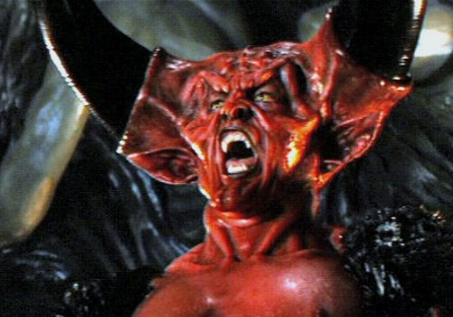
Intro
“The wise warrior knows the enemy as well as they know themselves” (J.R.R. Tolkien)!
The Scriptures tell us we have an enemy: Satan!
I Peter 5:8 (John 8:44)
8. Be of sober spirit, be on the alert. Your adversary, the devil, prowls around like a roaring lion, seeking someone to devour.
Many in the world look at their enemy as a myth, legend,
a made-up entity
“The biggest trick by Satan is
convincing the world he doesn’t exist!”
Notes:
Image: Tim Curry as Darkness (aka Satan) from the movie ‘Legend.’

Slide 3
Intro
Is Satan “The Morning Star?” (Lucifer)
Some say Satan can be found in the pages of Isaiah 14 and Ezekiel 28 described as a fallen angel called the morning star, translated in the KJV as “Lucifer”
In Isaiah 14:3-23, the passage is a prophecy against the King of Babylon (14:3-4).
In Ezekiel 28:12-19, the passage speaks of the lamentation against the King of Tyre (28:12) after prophesying doom for the “Leader of Tyre,” also called a “Prince” (NKJV) in 28:2.
A careful examination of the context reveals that these passages primarily address earthly kings and their downfall rather than Satan specifically!

Slide 4
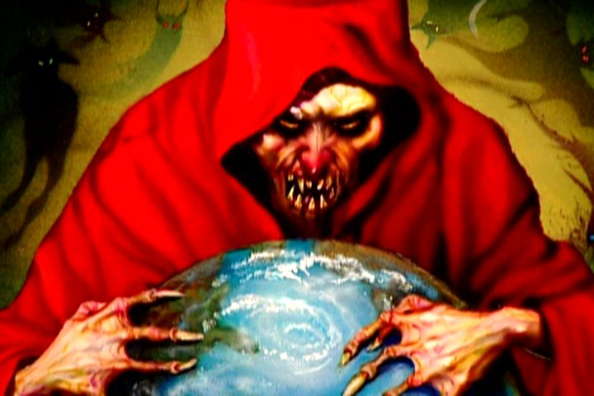
Intro
It is clear that whoever he is and wherever he came from, Satan is our archenemy!

Slide 5
Who is Satan from the Scriptures?
Leader of angels who sinned!
Matthew 25:41
41. "Then He will also say to those on His left, 'Depart from Me, accursed ones, into the eternal fire which has been prepared for the devil and his angels;
II Peter 2:4
4. For if God did not spare angels when they sinned, but cast them into hell and committed them to pits of darkness, reserved for judgment;

Slide 6
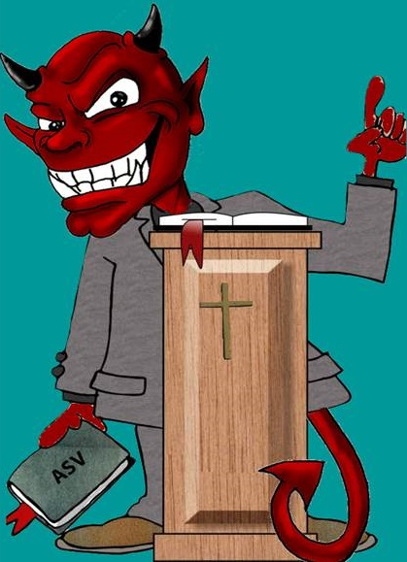
Who is Satan from the Scriptures?
These passages, among others, offer clearer and direct references to Satan's existence and character.
Satan wants your soul and your company with him for eternity (Matthew 25:41).
Satan’s character:
The Author of Sin – Gen. 3:1-6
Satan, Adversary, Enemy – Rev. 12:9
Devil, Accuser, Slanderer – Rev. 12:9
Beelzebub, Prince of Demons – Mt. 12:24
Prince of the Powers of the Air – Eph. 2:2; 6:12
The Great Dragon – Rev. 12:9
That Old Serpent – Rev. 12:9
The Father of Lies – Jn. 8:44
A Murderer – Jn. 8:44
The Wicked One – Mt. 13:38
Belial: Extremely Wicked, Stubborn, Destined for Ruin – II Cor. 6:15
The god of This World – II Cor. 4:4
Ruler or Prince Over This World’s Sin & Darkness – Jn. 12:31; Eph. 6:12
Deceives the Whole World – Rev. 12:9
The Tempter – I Thess. 3:5
The Enemy – Mt. 13:39
A Roaring Lion – I Pet. 5:8
Disguised as an “angel of light” – II Cor. 11:13-15

Slide 7
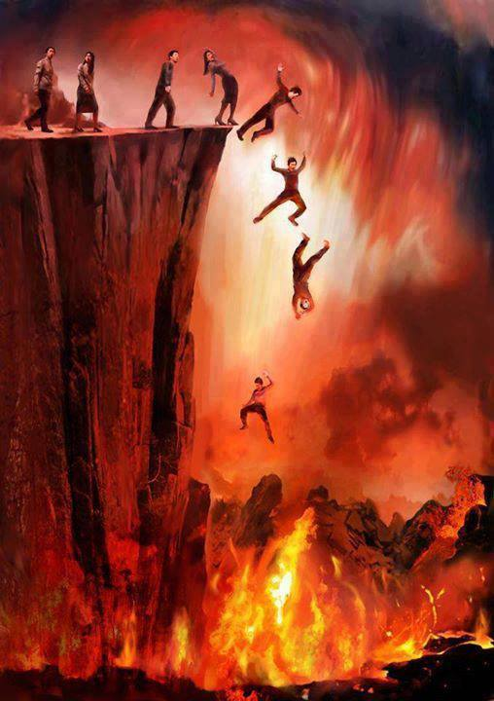
Who is Satan from the Scriptures?
The children of Satan are all who follow him in sin
John 8:38-47: Spiritual Genealogy & Lineage: Do you do the will of God OR of Satan?
Matthew 25:41: If you follow Satan, you will be cast into eternal fire with him!

Slide 8
Who Is Satan? Child of Satan and the Child of God
Child of Satan
Child of God
John 8:41-47
John 1:9-13
Matthew 6:24
Whose child are you?
Choose Jesus, the True Light of the world (John 1:1-10) who is the Bright Morning Star! (Revelation 22:16)

Slide 9
Contrast Satan and His Children to God and His Children
Trait | Father Satan | Satan’s Children | Trait | Father God | God’s Children
Liar, Deceiver
Jn. 8:44; Rev. 12:9
Jn. 8:44; Rev. 21:8
Honest
Titus 1:1-2; Heb. 6:18
Eph. 4:15, 25; Col. 3:9
Murderer
Jn. 8:44
Jn. 8:44; Rom. 1:29; Mt. 5:21-22
Saves Life
Jn. 3:16; 10:10;
I Pet. 3:9
II Cor. 5:11;
II Tim. 2:24-26
Rebel Against God
II Pet. 2:4; Gen. 3:1-6
Rom. 3:23; Acts 13:7-10
II Tim. 2:13; I Jn. 1:9
Faithful
Rev. 2:10; II Tim. 4:7-8
Destroyer
I Pet. 5:8
Mt. 18:6;
Jude 8
Edifier
Js. 4:8,10; Eph. 2:19-22
Eph. 4:29;
I Thess. 5:11
Thief
Mt. 13:19
I Cor. 6:9-10; I Pet. 4:15
Share
Jn. 10:10; Col. 1:12
Gal. 6:6; Eph. 4:28

Slide 10
Contrast Satan and His Children to God and His Children
Trait | Father Satan | Satan’s Children | Trait | Father God | God’s Children
Love Darkness & Sin
Jn. 3:19-21; Rom. 1:29-32
Love Light & Obedience
Js. 1:17; Phil. 2:8
Col. 1:13
Jn. 3:21; Mt. 5:16
Hate, Bitterness
Rom. 1:30; Gal. 5:19-21; Col. 3:8
Love, Forgiveness
Jn. 3:16; I Jn. 1:9
Jn. 13:35; Eph. 4:32; Col. 3:13
Jn. 8:44; I Pet. 5:8
II Cor. 11:13-15; Eph. 4:14
Sound Doctrine
Eph. 4:14-16; I Tim. 4:6; Titus 2:1
False Religion
II Cor. 11:14
Jn. 17:17; I Thess. 1:9-10
Bound
Rev. 1:18; 20:1-2
II Pet. 2:9, 19
Free
Acts 17:31;
I Pet. 4:4-6
Jn. 8:31;
Gal. 5:1, 13
Rev. 1:18; 20:10
Mt. 25:41; Rev. 21:8
Exalted
Ps. 57:5; Is. 57:15; Js. 1:17
Mt. 25:34; Js. 4:10;
I Pet. 5:6
Defeated

Slide 11
Conclusion
If one lives in sin then Satan, NOT God, is their father!
I John 3:4-10 (3:4, 7-8, 10)
4. Everyone who practices sin also practices lawlessness; and sin is lawlessness.
7. Little children, make sure no one deceives you; the one who practices righteousness is righteous, just as He is righteous;
8. the one who practices sin is of the devil; for the devil has sinned from the beginning. The Son of God appeared for this purpose, to destroy the works of the devil.
10. By this the children of God and the children of the devil are obvious: anyone who does not practice righteousness is not of God, nor the one who does not love his brother.

Slide 12
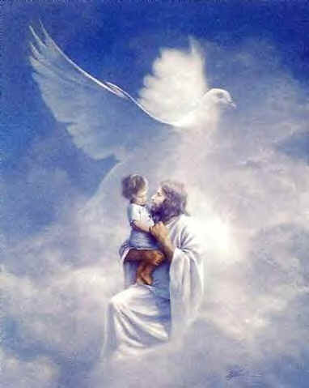
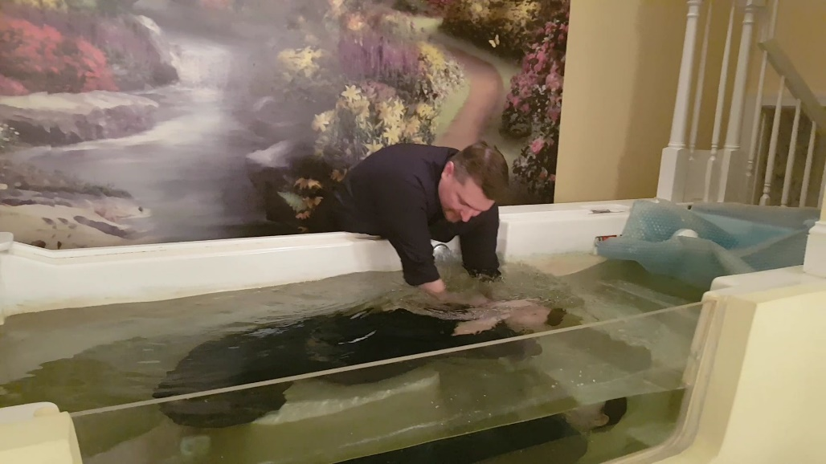
Conclusion
If one obeys the gospel they change their father from Satan to God!
Colossians 1:13
13. For He rescued us from the domain of darkness, and transferred us to the kingdom of His beloved Son,
Satan has already lost his power (Luke 10 17-18).
Jesus defeated Satan’s grip over man, the fear of death (Hebrews 2:14-15).

Slide 13
Conclusion
Child of Satan
Child of God
Matthew 25:41, 46
Matthew 25:34, 46
The child of Satan will inherit an eternal fire, which is eternal punishment (Mt. 25:41, 46), but the child of God inherits eternal rest (Mt. 25:34, 46)!

Slide 14
Conclusion
Are you a child of Satan OR a child of God?
Child of Satan
Child of God
Matthew 25:41, 46
Matthew 25:34, 46
Obedience!

Slide 15
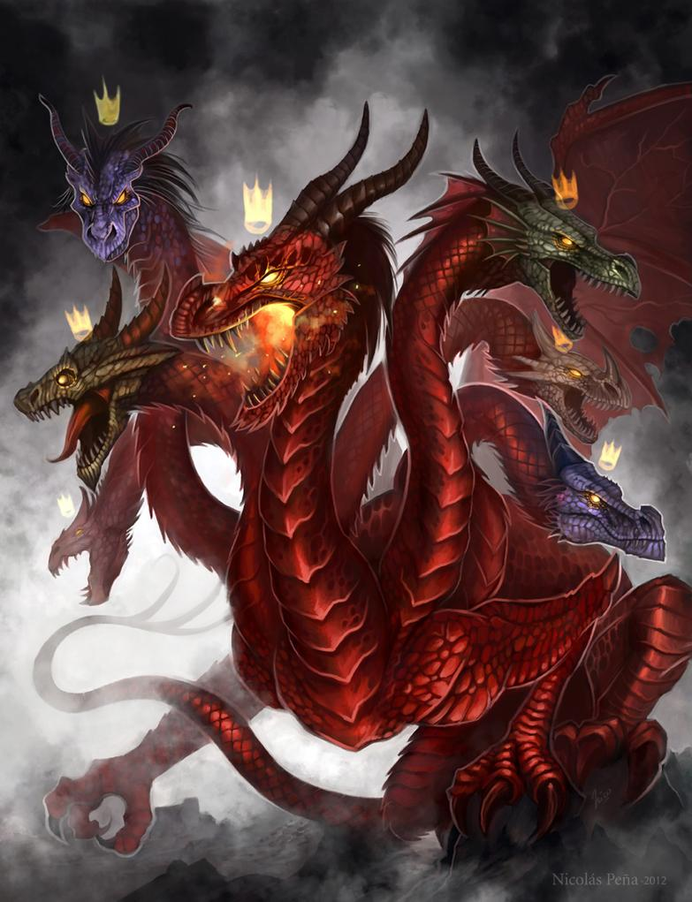
Conclusion
To be sober and alert we need to know we have an enemy and know our enemy!
(I Peter 5:8)

Slide 16
“What Must I Do To Be Saved?”
Hear The Gospel (Jn. 5:24; Rom. 10:17)
Believe In Christ (Jn. 3:16-18; Jn. 8:24)
Repent Of Sins (Lk. 13:3-5; Acts 2:38)
Confess Christ (Mt. 10:32; Rom. 10:10)
Be Baptized (Mk. 16:16; Acts 22:16)
Remain Faithful (Jn. 8:31; Rev. 2:10)
For The Erring Saint:
Repent (Acts 8:22), Confess (I Jn. 1:9),
Pray (Acts 8:22)

