Slide 1
Come Grow With Us! Text: John 15:1-10
Notes:
By Nathan L Morrison for Sunday May 28, 2023
All Scripture given is from NASB unless otherwise stated
For further study, or if questions, please Call: 804-277-1983 or Visit www.courthousechurchofchrist.com
The logo art was used by permission by www.vecteezy.com

Slide 2
Intro
John 15:1-5
1. "I am the true vine, and My Father is the vinedresser.
2. "Every branch in Me that does not bear fruit, He takes away; and every branch that bears fruit, He prunes it so that it may bear more fruit.
3. "You are already clean because of the word which I have spoken to you.
4. "Abide in Me, and I in you. As the branch cannot bear fruit of itself unless it abides in the vine, so neither can you unless you abide in Me.
5. "I am the vine, you are the branches; he who abides in Me and I in him, he bears much fruit, for apart from Me you can do nothing.

Slide 3
Intro
John 15:6-10
6. "If anyone does not abide in Me, he is thrown away as a branch and dries up; and they gather them, and cast them into the fire and they are burned.
7. "If you abide in Me, and My words abide in you, ask whatever you wish, and it will be done for you.
8. "My Father is glorified by this, that you bear much fruit, and so prove to be My disciples.
9. "Just as the Father has loved Me, I have also loved you; abide in My love.
10. "If you keep My commandments, you will abide in My love; just as I have kept My Father's commandments and abide in His love.
Notes:
John 15:1-10: Jesus said He was the True Vine and His disciples are branches.
The branches are required to grow and bear fruit.
A healthy vine will have many branches.
The apostle Peter wrote, “You therefore, beloved, knowing this beforehand, be on your guard so that you are not carried away by the error of unprincipled men and fall from your own steadfastness, but grow in the grace and knowledge of our Lord and Savior Jesus Christ. To Him be the glory, both now and to the day of eternity. Amen (II Peter 3:17-18).
The way to ensure the purity of the doctrine of Jesus is taught and maintained and no error creeps in is for every member (branch of the True Vine) to grow spiritually in Christ, Who is the Head of the body (Ephesians 4:14-16).

Slide 4
The Two-Invitation-Card Challenge!
Notes:
The logo art was used by permission by www.vecteezy.com
With summer about to be kicked off with this weekend, the Memorial Day Weekend, let us focus our efforts in inviting others to services or a Bible study.
The Two-Invitation-Card Challenge: Take two of our congregation’s invitation cards and invite at least two people each over this next month!
We invite all to “Come grow with us!”

Slide 5
Intro
One of the best ways to see what makes a congregation grow is to study the New Testament to see what made the early church grow in the times of apostles!
The Scriptures show us the church grew when…

Slide 6
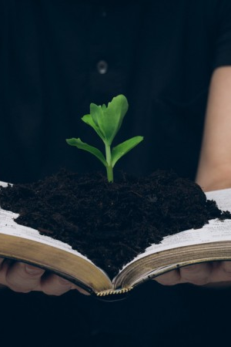
The Seed Was Put In The Soil
The Scriptures show us the church grew when…
For a church to grow people must hear the word, the gospel preached (Romans 10:14; Luke 8:4-15)
Some NT examples where the seed (word of God) was put in the hearts of men:
Acts 2:22-36: The first gospel sermon recorded
Results: Acts 2:41
Acts 8:5: Phillip preached Jesus in Samaria
Results: Acts 8:5
Notes:
The Scriptures show us the church grew when…
The Seed Was Put In The Soil
First, for a church to grow people must hear the word, the gospel preached!
Romans 10:14: How will they believe in Him whom they have not heard?
And how will they hear without a preacher?
Luke 8:4-15: The parable of the Sower teaches us that if there is to be harvest, the seed must be put in the right kind of soil.
Luke 8:11: The seed is the word of God.
It also teaches us to sow the seed to all soils, for the right soil will grow from it!
If the seed stays in the “barn” there will be no harvest!
Some NT examples where the seed (word of God) was put in the hearts of men.
Acts 2:22-36: The first gospel sermon recorded.
Notice the results: Acts 2:41: “So then, those who had received his word were baptized; and that day there were added about three thousand souls.”
Acts 8:5: Phillip preached Jesus in Samaria.
Notice the results: Acts 8:12: “But when they believed Philip preaching the good news about the kingdom of God and the name of Jesus Christ, they were being baptized, men and women alike.”
Saints are to preach the gospel of Jesus and plant the seed today!

Slide 7
The Seed Was Put In The Soil
Saints are to preach the gospel of Jesus and plant the seed today!

Slide 8
The Members Worked Together
The Scriptures show us the church grew when…
The church in Jerusalem had needy widows (Acts 6:1-6) and the members took care of it!
Results: How did this affect the church growing?
Acts 6:7: “The word of God kept on spreading; and the number of the disciples continued to increase greatly in Jerusalem, and a great many of the priests were becoming obedient to the faith!”
Notes:
The Scriptures show us the church grew when…
The Seed Was Put In The Soil
The Members Worked Together
The church in Jerusalem had needy widows.
Acts 6:1: There was so much growth that there were those who were getting overlooked.
Acts 6:2-6: Men of the local church were appointed “over this business.”
Acts 6:3: Members of the local church took care of their needy saints.
Results: How did this affect the church growing?
Acts 6:7: The church grew so much that even Jewish priests were converting!
“The word of God kept on spreading; and the number of the disciples continued to increase greatly in Jerusalem, and a great many of the priests were becoming obedient to the faith.”
A local church can grow when its members are willing to work together!

Slide 9
The Members Worked Together
A local church can grow when its members are willing to work together!

Slide 10
The Church Was At Peace
The Scriptures show us the church grew when…
The church had “peace” and was being “being built up” or edified (Acts 9:31)
Results: How did this affect the church growing?
Acts 9:31: “So the church throughout all Judea and Galilee and Samaria enjoyed peace, being built up; and going on in the fear of the Lord and in the comfort of the Holy Spirit, it continued to increase.”
Notes:
The Scriptures show us the church grew when…
The Seed Was Put In The Soil
The Members Worked Together
The Church Was At Peace
Acts 9:31: The church had “peace” and was being “being built up” or edified.
The text says they “continued to increase” (KJV: “Multiplied”).
Too many churches today are torn asunder by one thing or another and have no concept of what it means to be at peace.
Romans 12:18: As far as we can, be at peace with all people.
How do we achieve this peace today?
Unity: being of the same mind we can have peace (I Corinthians 1:10).
When there is harmony and peace within a local congregation there can be growth!

Slide 11
The Church Was At Peace
When there is harmony and peace within a local congregation there can be growth!

Slide 12
The Church Was Persecuted
The Scriptures show us the church grew when…
The early church had lots of problems and it kept them growing (Acts 5:17-18; 9:1-2; 12:1-5)
Results: How did this affect the church growing?
Acts 8:1; 8:3-4; 12:24; 11:19-24: “…considerable numbers were brought to the Lord” (11:22-24)
Notes:
The Scriptures show us the church grew when…
The Seed Was Put In The Soil
The Members Worked Together
The Church Was At Peace
The Church Was Persecuted
It’s easy to understand growth in times of peace, but what about persecution?
The thought behind persecution was to stamp Christianity out.
They thought they were getting rid of a problem, not making it bigger!
The early church had lots of problems and it kept them growing.
Acts 5:17-18: The church grew so much after the discipline of Ananias & Sapphira; the Jews became jealous and imprisoned the apostles! (The church can grow through discipline as well)
Acts 9:1-2: Saul imprisoned many Christians, men and women.
Acts 12:1-5: Herod beheaded James, the brother of John, and imprisoned Peter.
After such persecution, who would want to be part of the church?
Results: How did persecution affect the growth of the church?
Acts 8:1: Persecution caused the Christians to scatter all over from Jerusalem. To go in hiding?
Acts 8:3-4: Those scattered went on preaching the word! (Rest of Acts 8 tells of word spreading to Samaria and all the way to Caesarea)
Acts 12:24: “But the word of the Lord continued to grow and to be multiplied.” (This growth was despite Herod’s attempts to persecute)
Acts 11:19-24: The persecution that arose in connection with Stephen’s death (Acts 7:54-8:3) sent saints preaching the word from Jerusalem to Phoenicia and Cyprus and Antioch, to both Jews and Greeks, and the text says, “a large number who believed turned to the Lord” (Acts 11:21).
The church at Jerusalem heard of it and sent Barnabas to check it out. When he arrived he encouraged them “with resolute heart to remain true to the Lord” and “considerable numbers were brought to the Lord” (11:22-24).
Not what man would think of causing church growth!
When we are growing in our faith in Jesus, our circumstances don’t matter!
Saints need endurance (James 1:2-3) to keep growing into maturity and to set their minds on Christ no matter what the circumstances are!

Slide 13
The Church Was Persecuted
Saints need endurance (James 1:2-3) to keep growing into maturity and to set their minds on Christ!

Slide 14
God’s Word Was Kept
The Scriptures show us the church grew when…
Paul visited some churches he had worked with to see how they were doing (Acts 16:1-4)
Results: How did this affect the church growing?
Acts 16:5: “So the churches were being strengthened in the faith, and were increasing in number daily.”
Notes:
The Scriptures show us the church grew when…
The Seed Was Put In The Soil
The Members Worked Together
The Church Was At Peace
The Church Was Persecuted
God’s Word Was Kept
Acts 16: Paul visited some churches he had worked with to see how they were doing.
Acts 16:4: The delivering of the letter written in Acts 15 to strengthen and encourage non-Jewish converts.
Results: How did this affect the growth of the church?
Acts 16:5: “So the churches were being strengthened in the faith, and were increasing in number daily.”
Saints can grow when the word of God is kept, and they are strengthened and encouraged in its teachings!

Slide 15
God’s Word Was Kept
Saints can grow when the word of God is kept, and they are strengthened and encouraged in its teachings!

Slide 16
Conclusion
The church grew in times past when these things were done.
The Lord’s body of believers can still grow today and bear fruit when these things are done!
The Scriptures show us the church grew when…
The Seed Was Put In The Soil
The Members Worked Together
The Church Was At Peace
The Church Was Persecuted
God’s Word Was Kept
Notes:
Conclusion
The church grew in times past when these things were done.
The Lord’s body of believers can still grow today and bear fruit when these things are done!

Slide 17
Conclusion
Ephesians 4:14-16
14. As a result, we are no longer to be children, tossed here and there by waves and carried about by every wind of doctrine, by the trickery of men, by craftiness in deceitful scheming;
15. but speaking the truth in love, we are to grow up in all aspects into Him who is the head, even Christ,
16. from whom the whole body, being fitted and held together by what every joint supplies, according to the proper working of each individual part, causes the growth of the body for the building up of itself in love.
We need to grow individually in our faith and to grow together so that the body may be built up in love and faith!
We can grow today when every member brings to the body the talents and abilities they have from God and uses them to His glory!
Notes:
Conclusion
The church grew in times past when these things were done.
The Lord’s body of believers can still grow today and bear fruit when these things are done!
We need to grow individually in our faith and to grow together so that the body may be built up in love and faith!
We can grow today when every member brings to the body the talents and abilities they have from God and uses them to His glory!
Ephesians 4:14-16
As a result, we are no longer to be children, tossed here and there by waves and carried about by every wind of doctrine, by the trickery of men, by craftiness in deceitful scheming;
but speaking the truth in love, we are to grow up in all aspects into Him who is the head, even Christ,
from whom the whole body, being fitted and held together by what every joint supplies, according to the proper working of each individual part, causes the growth of the body for the building up of itself in love.

Slide 18
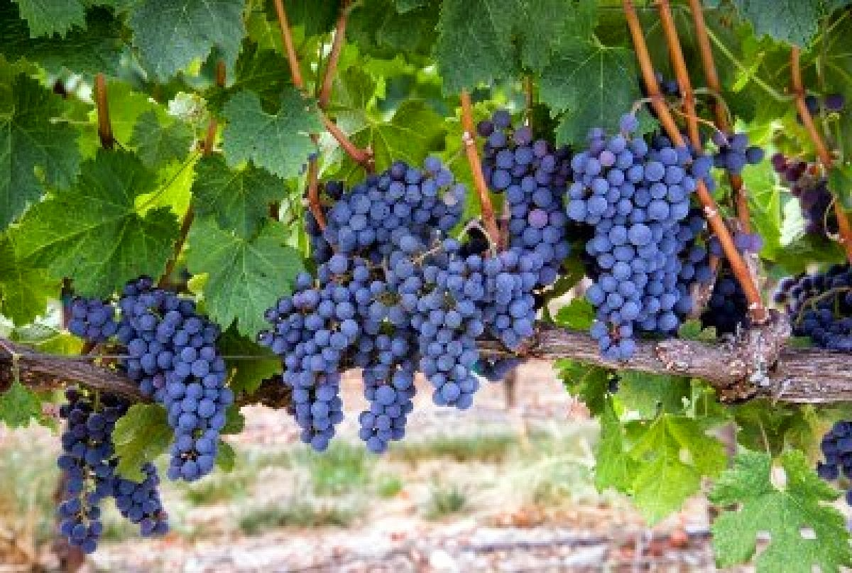
Let’s be the branches of the True Vine that grow together and bear fruit!
Come grow with us!
Notes:
The logo art was used by permission by www.vecteezy.com
Conclusion
IV. Let’s be the branches of the True Vine that grow together and bear fruit!
V. Come grow with us!

Slide 19
“What Must I Do To Be Saved?”
Hear The Gospel (Jn. 5:24; Rom. 10:17)
Believe In Christ (Jn. 3:16-18; Jn. 8:24)
Repent Of Sins (Lk. 13:3-5; Acts 2:38)
Confess Christ (Mt. 10:32; Rom. 10:10)
Be Baptized (Mk. 16:16; Acts 22:16)
Remain Faithful (Jn. 8:31; Rev. 2:10)
For The Erring Saint:
Repent (Acts 8:22), Confess (I Jn. 1:9),
Pray (Acts 8:22)

