Slide 1
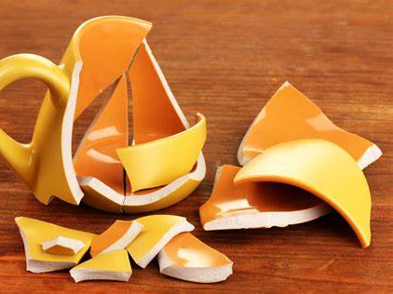
Broken Things Text: Psalm 51:17
Notes:
By Nathan L Morrison for Sunday April 30, 2023
All Scripture given is from NASB unless otherwise stated
For further study, or if questions, please Call: 804-277-1983 or Visit www.courthousechurchofchrist.com

Slide 2
Intro
Psalm 51:17
The sacrifices of God are a broken spirit; A broken and a contrite heart, O God, You will not despise.
Notes:
Psalm 51:17:
From King David’s pain and sin, he once wrote, “The sacrifices of God are a broken spirit; A broken and a contrite heart, O God, You will not despise.”
In II Samuel 11:2-5 King David committed adultery with Bathsheba, the wife of Uriah the Hittite, one of his friends and a Mighty Man who was completely loyal to him.
When she told him she was pregnant it began a cover up that would include the murder of Bathsheba’s husband, Uriah the Hittite.
David did it in secret and tried to cover it up but from that time throughout the Scriptures God doesn’t let people forget her 1st husband’s name, Uriah the Hittite (At least 12 times, including in reading the genealogy of Jesus in Matthew 1:6).
David was broken! (Psalm 51)

Slide 3
Intro
Like the Phoenix in mythology, something beautiful can come from the ashes; something beautiful comes from broken things!

Slide 4
The Beautiful from the Broken
The Earth from Without Form and Void to Beautiful
Clouds are broken to produce rain
Grains are broken to produce bread
The ground is broken to yield something new
5 loaves of broken bread fed over 5,000 people
A broken vial of very costly perfume anointed the head of Jesus
Notes:
The Beautiful from the Broken
The Earth from Without Form and Void to Beautiful
Genesis 1:2: The earth was without form, and void; and darkness was on the face of the deep. And the Spirit of God was hovering over the face of the waters.
Genesis 1:31: Then God saw everything that He had made, and indeed it was very good. So the evening and the morning were the sixth day.
Ecclesiastes 3:11: He has made everything beautiful in its time.
Broken Things Chorus (Hallal Music):
“Oh Lord who uses, broken things
Who through broken clouds, gives us sweet, sweet rain
Who gives us bread, from broken grains
Oh Lord make me stronger, through broken things”
Clouds are broken to produce rain! (I Samuel 12:18; Job 37:11)
Grains are broken to produce bread! (Isaiah 28:28)
The ground is broken to yield something new:
To “break ground” usually means to start something new (Isaiah 30:23-24).
A few weeks back Lego celebrated with a “breaking ground” ceremony for their new plant.
When something is “groundbreaking” it usually means it is new or unique, beautiful!
Broken things that yielded beauty
Matthew 14:19: Jesus broke 5 loaves of bread and fed over 5,000 people! (He did it again when He broke 7 loaves of bread and fed over 4,000 people in Matthew 15:36)
Mark 14:1-9: An unnamed woman came to Jesus two days before the Passover and broke a vial of very costly perfume and poured it over His head. Many thought it was a waste but Jesus said, “She has done what she could; she has anointed My body beforehand for the burial. Truly I say to you, wherever the gospel is preached in the whole world, what this woman has done will also be spoken of in memory of her” (Mark 14:8-9)
Beauty often comes from broken things!

Slide 5
The Beautiful from the Broken
Beauty often comes from broken things!

Slide 6
The Beautiful from David’s Broken Life of Sin
II Samuel 11:2-5 King David’s sin
II Samuel 12:13: David confessed and was forgiven
Psalm 51:1-4, 17: David repented; heart broken
I Chronicles 3:5; Matthew 1:6; Luke 3:31: Solomon & Nathan in line of Jesus
Notes:
The Beautiful from the Broken
The Beautiful from David’s Broken Life of Sin
II Samuel 11:2-5 King David committed adultery with Bathsheba, the wife of Uriah the Hittite, and then had him murdered to cover it up.
II Samuel 12:13: Then David said to Nathan, “I have sinned against the LORD.” And Nathan said to David, “The LORD also has taken away your sin; you shall not die
David owned his sin and confessed it and God forgave him.
Psalm 51:1-4, 17:
Psa 51:1 For the choir director. A Psalm of David, when Nathan the prophet came to him, after he had gone in to Bathsheba. Be gracious to me, O God, according to Your lovingkindness; According to the greatness of Your compassion blot out my transgressions. .
Psa 51:2 Wash me thoroughly from my iniquity And cleanse me from my sin.
Psa 51:3 For I know my transgressions, And my sin is ever before me.
Psa 51:4 Against You, You only, I have sinnd And done what is evil in Your sight, So that You are justified when You speak And blameless when You judge. !
Psa 51:17 The sacrifices of God are a broken spirit; A broken and a contrite heart, O God, You will not despise.
David repented of his sin to God. David’s heart was broken!
I Chronicles 3:5
“These were born to him in Jerusalem: Shimea, Shobab, Nathan and Solomon, four, by Bath-shua the daughter of Ammiel”
Two of Bathsheba’s four sons are in the lineage of Jesus!
Solomon and Nathan are in the line of Jesus
Matthew 1:6: Jesse was the father of David the king. David was the father of Solomon by Bathsheba who had been the wife of Uriah.
Luke 3:31: …the son of Melea, the son of Menna, the son of Mattatha, the son of Nathan, the son of David,
Matthew records the royal line of David through Solomon and establishes Jesus Christ’s right to rule.
Many think of Luke’s genealogy being Mary’s, who came from Nathan, David’s other son from Bathsheba.
Luke 2:10-11
Luke 2:10: But the angel said to them, “Do not be afraid; for behold, I bring you good news of great joy which will be for all the people;
Luke 2:11: for today in the city of David there has been born for you a Savior, who is Christ the Lord.
From the broken heart of David’s sin and the darkest hour of his life came the Shining Light of men, the Savior of the world, who is Jesus Christ the Lord!

Slide 7
The Beautiful from David’s Broken Life of Sin
Luke 2:10-11
But the angel said to them, “Do not be afraid; for behold, I bring you good news of great joy which will be for all the people;
for today in the city of David there has been born for you a Savior, who is Christ the Lord.

Slide 8
The Beautiful from David’s Broken Life of Sin
From the broken heart of David’s sin and the darkest hour of his life came the Shining Light of men, the Savior of the world, who is Jesus Christ the Lord!

Slide 9
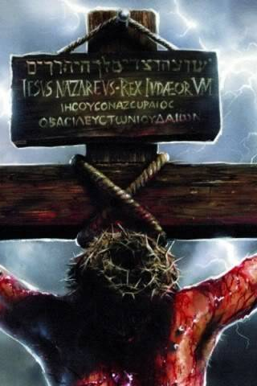
The Beautiful from the Broken Son of God on the Cross
Matthew 27:24-31: Jesus scourged & crucified
Luke 22:19: Like the bread at Passover, Jesus’ body was broken for us
Matthew 26:28: Like the fruit of the vine at Passover, Jesus’ blood was poured out for us
Romans 5:8: From mankind’s ugliest, most wicked moment came the Greatest Expression of Love!
Notes:
The Beautiful from the Broken
The Beautiful from David’s Broken Life of Sin
The Beautiful from the Broken Son of God on the Cross
Matthew 27:24-31
Mat 27:24 When Pilate saw that he was accomplishing nothing, but rather that a riot was starting, he took water and washed his hands in front of the crowd, saying, “I am innocent of this Man's blood; see to that yourselves.”
Mat 27:25 And all the people said, “His blood shall be on us and on our children!”
Mat 27:26 Then he released Barabbas for them; but after having Jesus scourged, he handed Him over to be crucified.
Mat 27:27 Then the soldiers of the governor took Jesus into the Praetorium and gathered the whole Roman cohort around Him.
Mat 27:28 They stripped Him and put a scarlet robe on Him.
Mat 27:29 And after twisting together a crown of thorns, they put it on His head, and a reed in His right hand; and they knelt down before Him and mocked Him, saying, “Hail, King of the Jews!”
Mat 27:30 They spat on Him, and took the reed and began to beat Him on the head.
Mat 27:31 After they had mocked Him, they took the scarlet robe off Him and put His own garments back on Him, and led Him away to crucify Him.
Jesus said His body was broken for mankind (Luke 22:19: He broke the bread and said it was given for us) and He was scourged.
Jesus said His blood was “poured out for many for forgiveness of sins” (Matthew 26:28) then He was scourged and crucified!
Romans 5:8: But God demonstrates His own love toward us, in that while we were yet sinners, Christ died for us.
From mankind’s ugliest, most wicked moment came the Greatest Expression of Love!
The love of God was poured out on the world through the broken form of Jesus on the cross – In His blood we have redemption from sin! (John 1:29; Ephesians 1:7)

Slide 10
The Beautiful from the Broken Son of God on the Cross
The love of God was poured out on the world through the broken form of Jesus on the cross – In His blood we have redemption from sin! (John 1:29; Ephesians 1:7)

Slide 11
Poem
Five broken loaves beside the sea and thousands fed
As Thy hand, Lord, in breaking, blessed the bread.
Men would the throng in emptiness have sent away
Whose need was met with broken bread that day.
A broken vase of priceless worth rich fragrance shed
In ointment poured in worship on Thy head.
A lovely thing all shattered thus – “What waste”, they thought.
But Mary’s deed of love Thy blessing brought.
A broken form upon the cross and souls set free.
Thy anguish there has paid the penalty –
Sin’s awful price in riven flesh and pain and blood –
Redemption’s cost, the broken Lamb of God.
Oh, break my life if need must be.
No longer mine, I give it Thee.
Oh, break my will’ the offering take.
For blessing comes when Thou dost break.
Broken Things
by Bob Jones, Jr.
Notes:
A Poem: Broken Things by Bob Jones, Jr.
Five broken loaves beside the sea and thousands fed
As Thy hand, Lord, in breaking, blessed the bread.
Men would the throng in emptiness have sent away
Whose need was met with broken bread that day.
A broken vase of priceless worth rich fragrance shed
In ointment poured in worship on Thy head.
A lovely thing all shattered thus – “What waste”, they thought.
But Mary’s deed of love Thy blessing brought.
A broken form upon the cross and souls set free.
Thy anguish there has paid the penalty –
Sin’s awful price in riven flesh and pain and blood –
Redemption’s cost, the broken Lamb of God.
Oh, break my life if need must be.
No longer mine, I give it Thee.
Oh, break my will’ the offering take.
For blessing comes when Thou dost break.

Slide 12
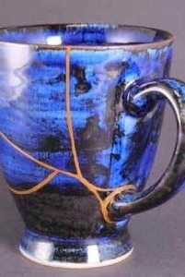
The Beautiful from a Sinner Dead in Sins
From the Chief of Sinners to the Apostle Paul
Acts 8:3
Acts 9:6
Acts 22:16
I Timothy 1:15-16
Notes:
The Beautiful from the Broken
The Beautiful from David’s Broken Life of Sin
The Beautiful from the Broken Son of God on the Cross
The Beautiful from a Sinner Dead in Sins
From the Chief of Sinners to the Apostle Paul
Acts 8:3: But Saul was trying to destroy the church; entering one house after another, he dragged off both men and women and put them in prison.
Acts 9:6: So he, trembling and astonished, said, “Lord, what do You want me to do?” Then the Lord said to him, “Arise and go into the city, and you will be told what you must do.” (NKJV)
Acts 22:16: 'Now why do you delay? Get up and be baptized, and wash away your sins, calling on His name.'
I Timothy 1:15-16: It is a trustworthy statement, deserving full acceptance, that Christ Jesus came into the world to save sinners, among whom I am foremost of all. Yet for this reason I found mercy, so that in me as the foremost, Jesus Christ might demonstrate His perfect patience as an example for those who would believe in Him for eternal life.
From a Sinner Dead in Sins to a Child of God
I Corinthians 6:9-11: Or do you not know that the unrighteous will not inherit the kingdom of God? Do not be deceived; neither fornicators, nor idolaters, nor adulterers, nor effeminate, nor homosexuals, nor thieves, nor the covetous, nor drunkards, nor revilers, nor swindlers, will inherit the kingdom of God. Such were some of you; but you were washed, but you were sanctified, but you were justified in the name of the Lord Jesus Christ and in the Spirit of our God.
Ephesians 2:1-10: Before coming to Christ we were dead in sin. But God’s great love made us alive together with Christ!
But God, being rich in mercy, because of His great love with which He loved us, even when we were dead in our transgressions, made us alive together with Christ (by grace you have been saved). (Ephesians 2:4-5)
Jeremiah 18:4-5; Romans 9:21-26: The Potter and the Clay.
God is the Potter. We are the clay.
When we are broken, through repentance and forgiveness we are made into something new! We can’t be like we once were, but we are made into something new and beautiful!
See the beauty in the broken!
Kintsugi: There is beauty in the broken. Kintsugi is a Japanese art that repairs broken pottery with gold, rendering a new piece that is more exquisite than it was before the break. It literally means “to join with gold.”
God doesn’t throw away broken people but reforms them into something beautiful and more valuable than before! A child of God! (I John 3:1-3)
I Peter 5:6-7: To be made into something new we must be humble!
Therefore humble yourselves under the mighty hand of God, that He may exalt you at the proper time, casting all your anxiety on Him, because He cares for you.
From the brokenness of a life of sin can come a beautiful life, one filled with the goodness of God as one reflects the Light of the Son of God in their life!

Slide 13
The Beautiful from a Sinner Dead in Sins
From a Sinner Dead in Sins to a Child of God
I Corinthians 6:9-11
Ephesians 2:1-10
Jeremiah 18:4-5; II Corinthians 4:7-10
See the beauty in the broken (Kintsugi – I John 3:1-3)
I Peter 5:6-7: To be made into something new & beautiful we must be humble!
Notes:
The Beautiful from the Broken
The Beautiful from David’s Broken Life of Sin
The Beautiful from the Broken Son of God on the Cross
The Beautiful from a Sinner Dead in Sins
From the Chief of Sinners to the Apostle Paul
Acts 8:3: But Saul was trying to destroy the church; entering one house after another, he dragged off both men and women and put them in prison.
Acts 9:6: So he, trembling and astonished, said, “Lord, what do You want me to do?” Then the Lord said to him, “Arise and go into the city, and you will be told what you must do.” (NKJV)
Acts 22:16: 'Now why do you delay? Get up and be baptized, and wash away your sins, calling on His name.'
I Timothy 1:15-16: It is a trustworthy statement, deserving full acceptance, that Christ Jesus came into the world to save sinners, among whom I am foremost of all. Yet for this reason I found mercy, so that in me as the foremost, Jesus Christ might demonstrate His perfect patience as an example for those who would believe in Him for eternal life.
From a Sinner Dead in Sins to a Child of God
I Corinthians 6:9-11: Or do you not know that the unrighteous will not inherit the kingdom of God? Do not be deceived; neither fornicators, nor idolaters, nor adulterers, nor effeminate, nor homosexuals, nor thieves, nor the covetous, nor drunkards, nor revilers, nor swindlers, will inherit the kingdom of God. Such were some of you; but you were washed, but you were sanctified, but you were justified in the name of the Lord Jesus Christ and in the Spirit of our God.
Ephesians 2:1-10: Before coming to Christ we were dead in sin. But God’s great love made us alive together with Christ!
But God, being rich in mercy, because of His great love with which He loved us, even when we were dead in our transgressions, made us alive together with Christ (by grace you have been saved). (Ephesians 2:4-5)
Jeremiah 18:4-5; II Corinthians 4:7-10: The Potter and the Clay.
God is the Potter. We are the clay.
When we are broken, through repentance and forgiveness we are made into something new! We can’t be like we once were, but we are made into something new and beautiful! Stronger!
See the beauty in the broken!
Kintsugi: There is beauty in the broken. Kintsugi is a Japanese art that repairs broken pottery with gold, rendering a new piece that is more exquisite than it was before the break. It literally means “to join with gold.”
God doesn’t throw away broken people but reforms them into something beautiful and more valuable than before! A child of God! (I John 3:1-3)
Through our reforming we are made stronger!
Excerpt from Kiss The Wave by Dave Furman: “The story of kintsugi—this style of pottery—may be the most perfect embodiment of all our trauma-shattered lives... Instead of throwing away the broken beloved pottery, we’ll fix it in a way that doesn’t pretend it hasn’t been broken but honors the breaking—and more so, the surviving—by highlighting those repaired seams with gold lacquer. Now the object is functional once again and dignified, not discarded. It’s stronger and even more valuable because of its reinforced, golden scars.”
I Peter 5:6-7: To be made into something new we must be humble!
Therefore humble yourselves under the mighty hand of God, that He may exalt you at the proper time, casting all your anxiety on Him, because He cares for you. (Be malleable clay to be shaped into something of value!)
Another excerpt from Kiss The Wave by Dave Furman: “Similar to the Japanese art of Kintsugi, our rough edges and cracks are filled in with gold to point to the greatness of God… We can embrace God in our trials with faith that God is doing a work in us beyond our comprehension. Our scars are not things to run from or to hide from others. Through them we exalt the one who is conforming us more and more into the image of Christ.” (https://www.vaneetha.com/journal/kintsugi-beauty-in-the-broken) – Romans 8:28-30
From the brokenness of a life of sin can come a beautiful life, one filled with the goodness of God as one reflects the Light of the Son of God in their life!

Slide 14
The Beautiful from a Sinner Dead in Sins
From the brokenness of a life of sin can come a beautiful life, one filled with the goodness of God as one reflects the Light of the Son of God in their life!

Slide 15
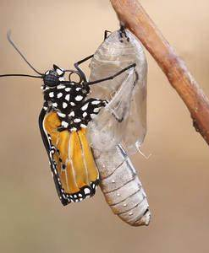
Conclusion
God values you and wants to use you for His service no matter how broken you think you are!
Jesus broke His body and spilled His blood on the cross for you; to make you beautiful and new!
Romans 12:1-2: Be transformed! (Like a caterpillar becoming a beautiful butterfly)
Broken things can become blessed things when you let God build it back up!

Slide 16
Conclusion
To overcome the brokenness of sin you must repent as David once did!
Psalm 51:17: The sacrifices of God are a broken spirit; A broken and a contrite heart, O God, You will not despise!

Slide 17
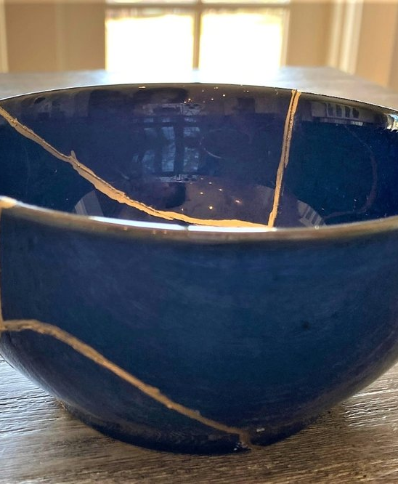
Conclusion
To be made beautiful and new in Christ you must obey the gospel and be washed!
Acts 22:16: 'Now why do you delay? Get up and be baptized, and wash away your sins, calling on His name’
Notes:
Image from: https://www.vaneetha.com/journal/kintsugi-beauty-in-the-broken

Slide 18
Conclusion
Are you broken hearted today?
Weighed down by sin and guilt?

Slide 19
Conclusion
God wants to make you beautiful and new!
You can be made new! Your sin and guilt can be removed!

Slide 20
Conclusion
Obey the gospel NOW and be Washed! Repent of your sins, be made new and be right before God!

Slide 21
“What Must I Do To Be Saved?”
Hear The Gospel (Jn. 5:24; Rom. 10:17)
Believe In Christ (Jn. 3:16-18; Jn. 8:24)
Repent Of Sins (Lk. 13:3-5; Acts 2:38)
Confess Christ (Mt. 10:32; Rom. 10:10)
Be Baptized (Mk. 16:16; Acts 22:16)
Remain Faithful (Jn. 8:31; Rev. 2:10)
For The Erring Saint:
Repent (Acts 8:22), Confess (I Jn. 1:9),
Pray (Acts 8:22)

