Slide 2
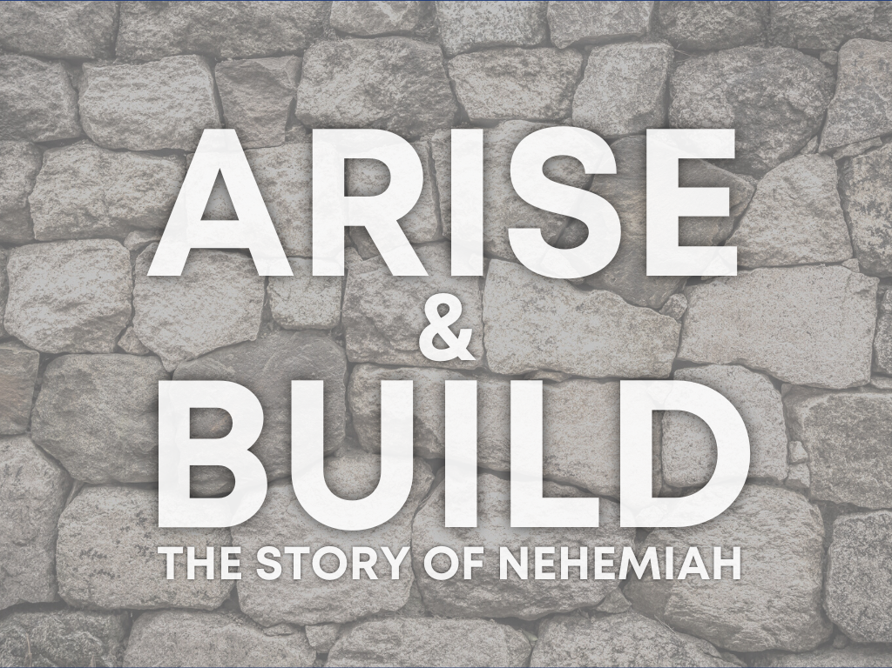

Slide 3
The Man: Nehemiah was a man of God.
  He was a man of prayer. He cared for others.
  He maintained his integrity in a foreign land.
  He was a man of action.
The Problem:
  His people were suffering.
  There was nothing physically he could do.
The Solution:
  God answered his prayers.
  Nehemiah encouraged the people to build!

Slide 4
The Rest of the Story.
The wall was rebuilt in 52-Days.
It required Nehemiah to be intentional.
  In his prayers, Nehemiah 4:1-6,9,14.
  What he wanted, Nehemiah 2:5.
  Time, Nehemiah 2:6.
  Accessing the problem, Nehemiah 2:11-16
  Being honest, Nehemiah 2:17.
  Trusting during obstacles, Nehemiah 4-5.

Slide 5

How has worry, fear, and doubt slowed you down? In what area of your life do you need to Arise and Build?

