Slide 1
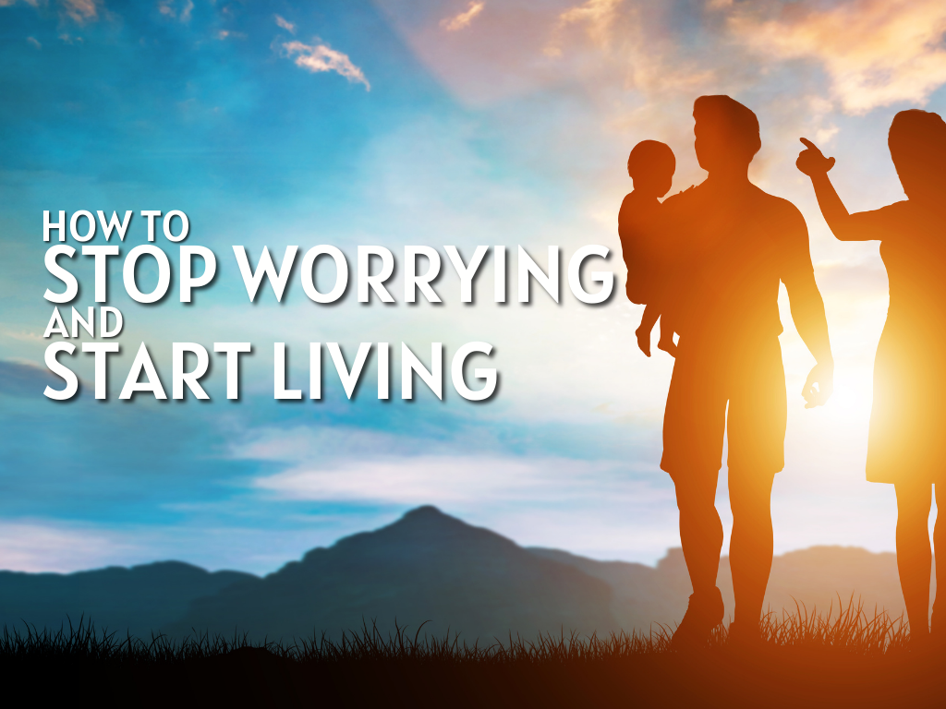

Slide 2
“And who of you by being worried can add a single hour to his life?”
Matthew 6:27

Slide 3
Worry: To be anxious, troubled with cares
Weighs a person down, Proverbs 12:25
Worry is the result of little faith, Matthew 6:30
Worry is one tormenting themselves with disturbing thoughts (dictionary.com)
People are described as being in a “state of worry.”
“Worry shuts God out of the equation because the person depends on themselves.”
Worry leads to negative actions.

Slide 4
“Anxiety is a meteor shower of what-ifs.”
“Anxiety and fear are cousins but not twins. Fear sees a threat. Anxiety imagines one.”
“Instead of being stars and stripes, we’re the country of Stress and Strife.”
“The presence of anxiety is unavoidable, but the prison of anxiety is optional.”

Slide 5
Concern
“The difference between the two is how we face the trouble. How you handle a situation and how you think about it is where the distinction can be made.”
Paul had concern for the churches, 2 Cor. 11:28. But he also prayed for them, Philippians 1:2-3; Colossians 1:9
We are to cast our anxieties to God, 1 Peter 5:7

Slide 6
How to stop worrying about the past
King David committed sin, 2 Samuel 12:7,13
He confessed and repented, Psalm 32:1-5, Psalm 38:18
David was forgiven by God, 2 Samuel 12:13
There were consequences, 2 Samuel 12:14
David moved forward, 2 Samuel 12:15-24
God is faithful and righteous to forgive, 1 John 1:9

Slide 7
How to stop worrying today
Pray and Cast, Matthew 6:9; 1 Peter 5:7
Today, Matthew 6:11.
Rejoice, Philippians 4:4
Act, Matthew 5:23-24
Observe, Matthew 6:28.
Meditate, Philippians 4:8.

Slide 8
How to stop worrying about tomorrow
Jesus said, “Do not worry about tomorrow.”
While we are not to worry, we can still plan for tomorrow. Our trust is in God, not in our riches.
With the understanding God is in control, James 4:13-16.
Accept the reality of death, Hebrews 9:27.
Prepare for death, Mark 16:16.

