Slide 1
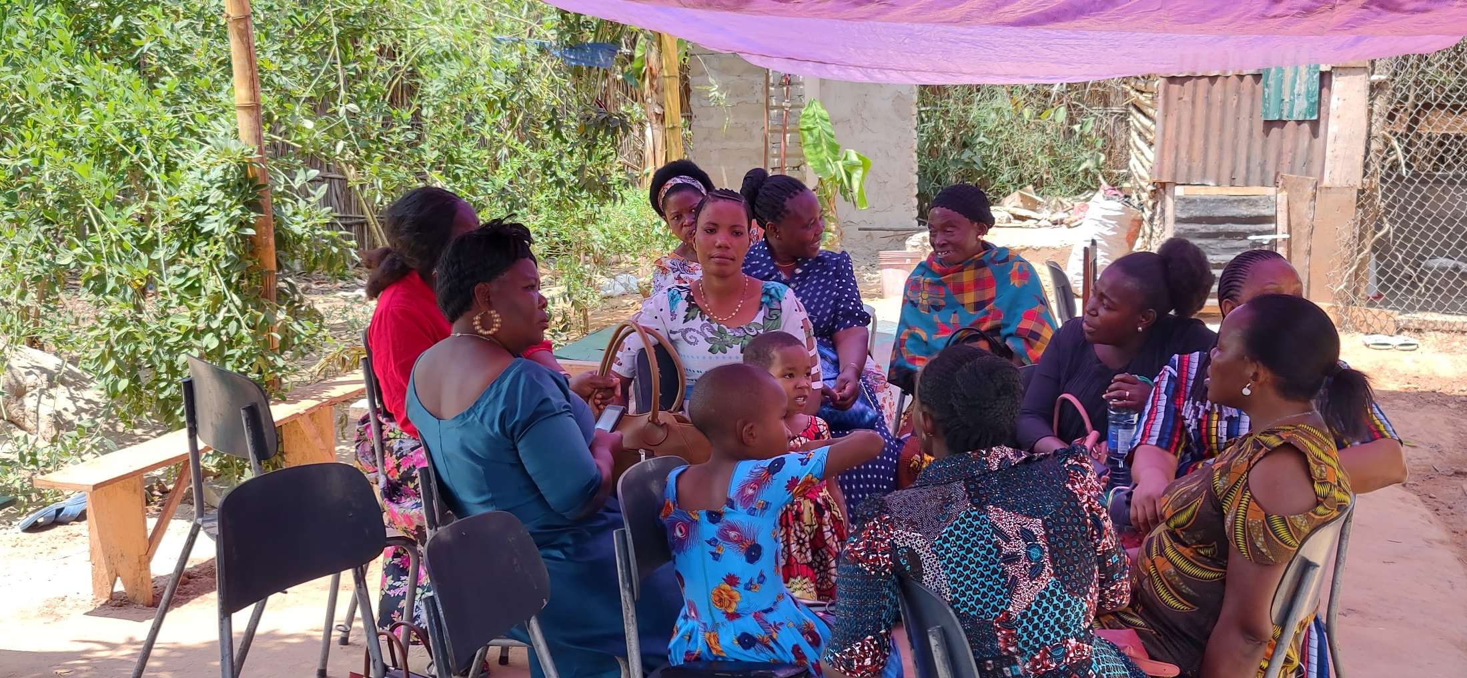
Helpers: The Role Of Godly Women In The Church
Text:
II Timothy 2:24-26
Notes:
By Nathan L Morrison for Sunday 09/18/2022
All Scripture given is from NASB unless otherwise stated
For further study, or if questions, please Call: 804-277-1983 or Visit: www.courthousechurchofchrist.com
Adapted from an article by Jonathan Rourke, https://www.9marks.org/article/seven-womens-ministries-in-the-new-testament/
Image: A ladies’ class at Mwanambaya church of Christ, Dar es Salaam, Tanzania

Slide 2
Intro
II Timothy 2:24-26
24. The Lord's bond-servant must not be quarrelsome, but be kind to all, able to teach, patient when wronged,
25. with gentleness correcting those who are in opposition, if perhaps God may grant them repentance leading to the knowledge of the truth,
26. and they may come to their senses and escape from the snare of the devil, having been held captive by him to do his will.
Notes:
2Ti 2:24 The Lord's bond-servant must not be quarrelsome, but be kind to all, able to teach, patient when wronged,
2Ti 2:25 with gentleness correcting those who are in opposition, if perhaps God may grant them repentance leading to the knowledge of the truth,
2Ti 2:26 and they may come to their senses and escape from the snare of the devil, having been held captive by him to do his will.

Slide 3
INTRO
Jesus
John 13:2-17
Women
II Timothy 2:24-26
Moses
Hebrews 3:5
The Scriptures say that as Christians, we are servants of the Lord (II Timothy 2:24-26)
To be great in the Lord’s kingdom, one must be a servant to God and to all saints!

Slide 4
Genesis 2:18-20
Women Are Helpers
God showed Adam that there was no one else created like him!
All the animals had mates but there was no “helper suitable for him”
From Adam God created woman (Genesis 2:23; I Corinthians 11:8-9)
The Hebrew word for “helper” is H5828 ezer (ay-zer): “help” or “one who helps”
Let’s notice how women in the OT and NT served God and others as a “Helper!”
Notes:
Women Are Helpers
Genesis 2:18-20: God showed Adam that there was no one else created like him! He saw all the animals had mates but there was no “helper suitable for him.”
God took care of that. From the first man God created woman (Genesis 2:23; I Corinthians 11:8-9).
From the beginning God ordained marriage for a husband and a wife (Genesis 2:24; Mark 10:6-9)
The Hebrew word for “helper” is H5828 ezer (ay-zer) and means: “help” or “one who helps.”
Sixteen out of twenty-one times in the OT it is used in reference to God as a Helper.
There is nothing passive, submissive, or domestic implied in the Hebrew word ezer (“helper”).
Let’s notice how women in the OT and NT served God and others as a “Helper!”

Slide 5
Edifying Teachers
7 Ways Women Can Serve in the Lord’s church
Miriam (Exodus 15:20-21)
Mary (Luke 1:46–55)
Anna (Luke 2:38)
Lois & Eunice (II Timothy 1:5; 3:15)
Priscilla (Acts 18:26)
Mature Women (Titus 2:3-5)
You (II Timothy 2:24-26)
Notes:
7 Ways Women Can Serve in the Lord’s church
Edifying Teachers
II Timothy 2:24-26: The bond-servant of the Lord (ALL Christians) are to be “able to teach.” That means the individual is “skillful in teaching” (Vines); “apt to teach,” “instructive” (G1317 didaktikos).
In order to be “skillful in teaching” or “able to teach” one must know what one is teaching.
To know what to teach, one must study (II Timothy 2:15).
Miriam:
Miriam, the prophetess, the sister of Moses and Aaron taught the women to sing of the deliverance of God and the victory over the Egyptian army when saved them by the parting of the Red Sea (Exodus 15:20-21).
Mary:
Mary sings a beautiful song in Luke 1:46–55 that has become a source of constant encouragement and teaching for the church.
She sings of God as her Savior, and refers to herself and all Israel as God’s servant.
Anna:
In Luke 2:38, Anna the prophetess, a widow, is introduced as a woman who served the Lord by staying in the temple and worshiping God.
She would also teach the people, and “to speak of Him to all who were waiting for the redemption of Jerusalem.”
Lois and Eunice:
Timothy received training from his godly grandmother Lois and his mother Eunice to have a sincere faith (II Timothy 1:5).
We know this at least meant instruction in “the sacred writings” which made him “wise for salvation through faith in Christ Jesus” (II Timothy 3:15).
Priscilla:
Priscilla, along with her husband Aquila, were servants of God and helped an influential preacher like Apollos by taking him aside privately and taught him “the way of God more accurately” (Acts 18:26).
Mature women:
Titus 2:3-5 says, “Older women likewise are to be reverent in their behavior, not malicious gossips nor enslaved to much wine, teaching what is good, so that they may encourage the young women to love their husbands, to love their children, to be sensible, pure, workers at home, kind, being subject to their own husbands, so that the word of God will not be dishonored.”
Older women are to be “teachers of what is good” and to teach younger women to love their husbands and children and be homemakers.
You:
Through study you can be teachers of children’s Bible classes and ladies’ classes!

Slide 6
Hard Workers
7 Ways Women Can Serve in the Lord’s church
Mary, Tryphaena (Troo'-fahee-nah), Tryphosa (Troo-fo'-sah), and Persis (Per-sece) (Romans 16:6, 12)
Priscilla (Acts 18:24-28)
Notes:
7 Ways Women Can Serve in the Lord’s church
Edifying Teachers
Hard Workers
Mary, Tryphaena (Troo'-fahee-nah), Tryphosa (Troo-fo'-sah), and Persis (Per-sece)
Several men worked diligently with Paul, but many women did too.
They are “workers in the Lord” such as Mary, Tryphaena, Tryphosa, and Persis “who has worked hard in the Lord” (Romans 16:6, 12).
Priscilla
Going a step further, Priscilla and Aquila were essential partners of Paul, left behind in Ephesus to maintain the church when Paul departed for a different city (Acts 18:18-19).
It was while they were there in Ephesus that they taught Apollos (Acts 18:24-28)

Slide 7
Teachers of the Gospel
7 Ways Women Can Serve in the Lord’s church
Euodia (Yoo-od-ee'-ah) and Syntyche (Soon-too'-khay) (Philippians 4:2-3)
The Woman at the Well and Lydia (John 4; Acts 16:14-15, 40)
Mary Magdalene (John 20:18)
You (I Corinthians 15:3-4)
Notes:
7 Ways Women Can Serve in the Lord’s church
Edifying Teachers
Hard Workers
Teachers of the Gospel (Teachers of the gospel: an evangelist is a Herald of Good News)
It is the role of every Christian to teach the gospel (II Timothy 2:24-26: to save the lost).
Euodia (Yoo-od-ee'-ah) and Syntyche (Soon-too'-khay)
Even though Philippians 4:2–3 is an admonition, Paul is clear that both Euodia and Syntyche “labored side by side with me in the gospel together with Clement and the rest of my fellow workers.”
This was an evangelistic (preaching) effort, and one that bore fruit through the faithfulness of these women!
He says their names, along with Clément’s “are in the book of life.”
The Woman at the Well and Lydia
The woman at the well who spoke to Jesus in John 4 and even Lydia (Acts 16:14-15, 40) are among the first to bring the gospel to their own family and towns!
Mary Magdalene
One of the most profound examples is Mary Magdalene, whom Jesus chose to be the first to witness his resurrection.
She was entrusted by Jesus Himself with bringing the good news (gospel) to the apostles that first day of the week when Jesus broke the power of the devil and sin and death by raising from the dead (John 20:18)!
You
You can teach the gospel (the good news of Jesus’ death, burial and resurrection) to your family and friends! (I Corinthians 15:3-4)

Slide 8
Generous Patrons
7 Ways Women Can Serve in the Lord’s church
The Shunammite Woman (II Kings 4:8-37)
Mary Magdalene, Joanna and Susanna & many others (Luke 8:1-3)
Phoebe (Romans 16:1-2)
Priscilla and Lydia (Romans 16:5; 14)
You (I Timothy 6:17-19)
Notes:
7 Ways Women Can Serve in the Lord’s church
Edifying Teachers
Hard Workers
Teachers of the Gospel (Teachers of the gospel: an evangelist is a Herald of Good News)
Generous Patrons
For centuries, wealthy people have sponsored artists so they can focus on their masterpiece instead of trying to pay the bills.
Godly women of means have been great support and help to godly men!
The Shunnamite Woman
In II Kings 4:8-37 we are introduced to an unnamed Shunammite woman who was a “prominent woman,” which means she was important to the city of Shunem.
As often as Elisha passed through the city she invited him in and showed him hospitality.
She even asked her husband and they built a little “upper chamber” for the prophet, a permanent dwelling place for Elisha and his servant to turn into to be refreshed every time he passed through Shunem.
Through the prophet Elisha she and her house were richly blessed!
Mary Magdalene, Joanna and Susanna & many others
In Luke 8:1–3, we learn that Jesus and His apostles had patrons (benefactors), and they were often wealthy women.
Luke tells us Mary Magdalene, Joanna and Susanna were among “many others” who “provided for them out of their private means” (Luke 8:3).
Phoebe
Similarly, Paul’s ministry was financed by women (Romans 16:1-2).
Phoebe, a servant of the church at Cenchrea is identified as Paul’s “helper” (NASU), “patron” (ESV), or “benefactor” (NIV), a term that literally means defender or protector.
She also used her money and influence to be a “helper of many.”
Priscilla and Lydia
Priscilla and her husband Aquila (Romans 16:5) and Lydia (Acts 16:14) volunteered their homes for the church to meet in!
These remarkable and brave sisters are rarely mentioned.
You
It’s clear that God entrusts wealth to women, and they can joyfully utilize it in support of the gospel (I Timothy 6:17-19: Use riches to share with others and to support the gospel)
Image: Asian Woman Hugging Dollar Bills, courtesy of DepositPhotos.com

Slide 9
Courageous Partners
7 Ways Women Can Serve in the Lord’s church
Priscilla (Romans 16:3-4)
Junia (Romans 16:7)
Preachers’, Deacons’ and Elders’ Wives (I Corinthians 9:5; I Timothy 3:11)
Notes:
7 Ways Women Can Serve in the Lord’s church
Edifying Teachers
Hard Workers
Teachers of the Gospel (Teachers of the gospel: an evangelist is a Herald of Good News)
Generous Patrons
Courageous Partners
Priscilla
Romans 16:3–4 mentions Priscilla and Aquila again, this time as “fellow workers” who “risked their necks” for the gospel.
Junia
This is followed by a commendation of Junia in Romans 16:7, who worked so closely with Paul that she suffered as a “fellow prisoner.”
That’s extreme commitment, and it proves that Paul didn’t mind having women at his side during a dangerous mission for the gospel.
He ends Romans with warm and personal greetings, deeply thankful for the service and sacrifice of the women who worked with him.
Preachers’, Deacons’ and Elders’ Wives
Paul said the wives of the apostles and the Lord’s brothers traveled with them as did Peter’s (Cephas) wife in I Corinthians 9:5.
Preachers’ wives are partners with their husbands in all that they do and what befalls them.
Deacons’ and Elders’ wives have certain characteristics that the brethren look at as well as their husbands in the appointment process in I Timothy 3:11.

Slide 10
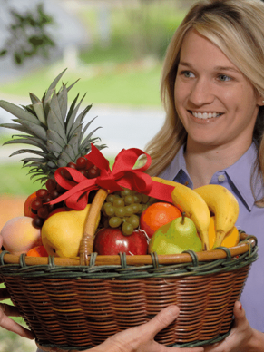
Good Works
7 Ways Women Can Serve in the Lord’s church
Mary Magdalene, Mary the mother of James the younger and of Joses, and Salome, others (Mark 15:40-41; 16; Romans 16:13)
Tabitha (Hebrew) / Dorcas (Greek) (Acts 9:36-43)
Notes:
7 Ways Women Can Serve in the Lord’s church
Edifying Teachers
Hard Workers
Teachers of the Gospel (Teachers of the gospel: an evangelist is a Herald of Good News)
Generous Patrons
Courageous Partners
Good Works
Mary Magdalene, Mary the mother of James the younger and of Joses, and Salome, others
Jesus was often in the company of women who “followed him and ministered to him” including Mary Magdalene, Mary the mother of James the younger and of Joses, and Salome (Mark 15:40–41).
Women comprised His ministry support structure.
Some of these women appear again in Mark 16 when they arrive to serve the Lord by anointing His body after the crucifixion.
At the end of Romans, we also read about Rufus, a man with a remarkable mother (and father, Simon the Cyrene since he was possibly the one who carried Jesus’ cross – Mark 15:21).
Paul says she was like his adoptive mother in the faith (Romans 16:13).
Tabitha (Hebrew) / Dorcas (Greek)
Tabitha in Acts 9:36-43 was the same kind of woman, “full of good works and acts of charity” (Acts 9:36).
When she died and they called for Peter to come to Joppa, the widows showed him all things she had made for them. He was moved with compassion and prayed to God and his prayer was answered and Tabitha was raised from the dead.
Her good works and resurrection caused many to become believers in Jesus!

Slide 11
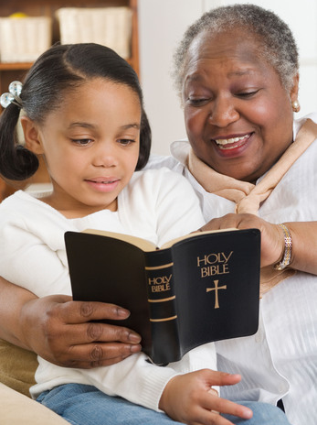
Worthy Examples
7 Ways Women Can Serve in the Lord’s church
Proverbs 31 Woman (Proverbs 31:10-31)
Widows (I Timothy 5:3-16)
You (Ephesians 2:10; I Timothy 2:10)
Notes:
7 Ways Women Can Serve in the Lord’s church
Edifying Teachers
Hard Workers
Teachers of the Gospel (Teachers of the gospel: an evangelist is a Herald of Good News)
Generous Patrons
Courageous Partners
Good Works
Worthy Examples
Proverbs 31 Woman
The godly woman from Proverbs 31 speaks of a woman, a wife, whose value is far above jewels.
She takes care of her family and servants, and through her influence her husband is highly respected and honored: he sits in the gate of the city (judgment).
Her husband and children praise her. He says, “Other women are OK, but, Baby, you’re the best!”
Widows
I Timothy 5:3-16 contains instructions for widows and the care of widows.
If a widow has been a faithful example of raising children and showing hospitality and doer of good works then the church can take care of her.
Widows are also charged with helping other widows, and perhaps to even teach and help younger widows to get married and be fruitful to their husbands and the church.
You
Teach girls and women how to prepare the Lord’s Supper
Teach girls and women how to teach children’s classes and ladies’ classes
Teach the unmarried how to become the godly wife of Proverbs 31
Teach them how to be a preacher’s wife (I Corinthians 9:5) and later, a deacon’s and an elder’s wife (I Timothy 3:11)
Mothers, teach your children! (Proverbs 1:8; II Timothy 1:5; 3:15)
Teach girls and women to look for ways to do “good works” (Ephesians 2:10; I Timothy 2:10)
Visit the sick or injured
Prepare meals for the sick and shut-in or for those who have been injured
Be greeters! Greet visitors at the door: You can make sure they feel welcome, have a bulletin, Visitor’s Card and pen.

Slide 12
Edifying Teachers
7 Ways Women Can Serve in the Lord’s church
Edifying Teachers
Hard Workers
Teachers of the Gospel
Generous Patrons
Courageous Partners
Good Works
Worthy Examples
The Lord’s church deliberately teaches the next generation, and women play an important role in that goal!
Women must never underestimate the value of demonstrating godly character!
Notes:
Women must never underestimate the value of demonstrating godly character.
The Lord’s church deliberately teaches the next generation, and women play an important role in that goal!
You have worth! You have value!

Slide 13
Conclusion
Both men and women are to be bond-servants of Jesus, that is to be owned by Jesus, but they have different roles and equal value!
(I Peter 3:7: Husbands and wives are “fellow heir[s] of the grace of life”)

Slide 14
Conclusion
God has always been glorified through the service of women. Women are of great value to the Lord’s church – Look for ways you can serve God and all the saints!

Slide 15
“What Must I Do To Be Saved?”
Hear The Gospel (Jn. 5:24; Rom. 10:17)
Believe In Christ (Jn. 3:16-18; Jn. 8:24)
Repent Of Sins (Lk. 13:3-5; Acts 2:38)
Confess Christ (Mt. 10:32; Rom. 10:10)
Be Baptized (Mk. 16:16; Acts 22:16)
Remain Faithful (Jn. 8:31; Rev. 2:10)
For The Erring Saint:
Repent (Acts 8:22), Confess (I Jn. 1:9),
Pray (Acts 8:22)

