Slide 1
Dead Flies In The Ointment
Text:
Ecclesiastes 10:1
Notes:
By Nathan L Morrison for Sunday August 21st, 2022
All Scripture given is from the NASB, unless otherwise stated
For further study, or if questions, please Call: 804-277-1983 or Visit www.courthousechurchofchrist.com
Adapted from an article by Matt Bassford

Slide 2
Ecclesiastes 10:1
Intro
Dead flies make a perfumer's oil stink, so a little foolishness is weightier than wisdom and honor.
Notes:
Ecclesiastes 10:1: Dead flies make a perfumer's oil stink, so a little foolishness is weightier than wisdom and honor.
King Solomon is saying you can do something that will blight the rest of your life!
In my teenage years I was often reminded by my father that one lapse of judgment could:
Ruin my reputation
Ruin the reputation of my parents
Cost me a job/career
Cause great pain or injury to myself or others
My teenage self had many “dead fly” moments and I needed to hear the warning from my dad often!

Slide 3
Ezekiel 18:24
Intro
But when a righteous man turns away from his righteousness, commits iniquity and does according to all the abominations that a wicked man does, will he live? All his righteous deeds which he has done will not be remembered for his treachery which he has committed and his sin which he has committed; for them he will die.
Notes:
Ezekiel 18:24: God, through the prophet Ezekiel, warned Israel that if they turn from their righteousness and commit sin, their previous righteous acts will not be remembered but they will be punished for their sin. He is saying they will be remembered for their sin!
It is possible to be remembered for your “dead fly” moments! (no matter how faithful you were in other circumstances!)
Sadly, it is not just the young that need to be reminded of this life-lesson:
No matter how young or old you are, your “dead fly” moment can stay with you the rest of your life!
You can learn from it, correct it, and move on (Ezekiel 18:21-22; Hebrews 8:12: If one turns from sin and practices righteousness, his sins will not be remembered!)

Slide 4
Intro
Walk in the paths of wisdom and your foolishness may not be remembered!

Slide 5
Dead Fly Moments
Noah
Drunkeness (Genesis 9:21-22)
Noah is listed as a hero of faith in Hebrews 11:7
Notes:
Noah (Genesis 9:21-22)
Noah, the man who found favor with God (Genesis 6:8) and who did “all that God had commanded him” concerning building the ark (Genesis 6:22), had a “dead fly” moment.
When most people think of Noah, they think of the ark and his righteousness (Genesis 7:1).
You can be 600 years old and still be foolish: Here in Genesis 9:21-22 we see Noah, patriarch, preacher of righteousness (II Peter 2:5), and Hebrews 11 hero of faith (11:7), planting a vineyard, getting drunk, and exposing himself to his youngest son, Ham.
Thousands of years later, the descendants of Noah do the same kind of foolish stuff when they get drunk!
Application:
Proverbs 20:1: Wine is a mocker, strong drink a brawler, And whoever is intoxicated by it is not wise.
I am ashamed to say in my early 20’s I was foolish and had a “dead fly” moment like this.
After a year of turning down co-workers’ offers to go to a bar after work, one night I went to an employee party at a co-workers house. I thought I was ten feet tall and bullet proof and could handle drinking a little (as I had in small doses earlier in my 20’s) but that night I pushed the boundary too far. I lucked out that a friend made sure I didn’t say/do/get photographed doing anything embarrassing or stupid and took care of me.
I ignored not only my dad’s advice but my mother’s as well and was guilty of Proverbs 1:8: “Hear, my son, your father's instruction And do not forsake your mother's teaching.”
When I turned 21 I used to tell my mom that I didn’t drink to get drunk and had never been drunk and ignored all her pleas.
My dead fly moment removed all that!
When word got out at the office about that weekend, it took months to gain any kind of credibility back!
I never did that again or went to another employee party at that company!
Noah is listed as a hero of faith in Hebrews 11:7 and so there is hope for those who turn their lives around after their dead fly moment!

Slide 6
Dead Fly Moments
Noah
Samson
The Ladies! (Judges 14-16)
Samson is listed as a hero of faith in Hebrews 11:32
Notes:
B. Samson (Judges 14-16)
Samson, a Nazirite, judge over Israel, and a Mighty man of weakness. His moral fiber was not as strong as his physique.
Samson spoiled his perfume because of several different women! He was a ladies’ man!
His love for and penchant for showing off for the ladies cost him everything!
Application:
Proverbs 7:4-5: Say to wisdom, “You are my sister,” And call understanding your intimate friend; That they may keep you from an adulteress, From the foreigner who flatters with her words.
Samson flirted with fire and pushed the lines to see how far he could go before being burned. His actions are defined by King Solomon as unwise!
Hebrews 13:4: Marriage is to be held in honor among all, and the marriage bed is to be undefiled; for fornicators and adulterers God will judge.
Many people today repeat Samson’s dead fly moment with sexual promiscuity & adultery.
Samson is listed as a hero of faith in Hebrews 11:32 and so there is hope for those who turn their lives around after their dead fly moment!

Slide 7
Dead Fly Moments
Noah
Samson
David
Adultery & Murder (II Samuel 11-12)
David is listed as a hero of faith in Hebrews 11:32
Notes:
C. David (II Samuel 11-12)
King David, the man after God’s heart (Acts 13:22), the champion of Israel (I Samuel 17), from whose line was promised a man to sit his throne forever (II Samuel 7:12-16), fulfilled in Jesus (Acts 13:23)!
Two things most people can remember about David: His defeat of the Philistine giant, Goliath, and his adultery with Bathsheba (which included the murder of her husband Uriah).
Sometimes, unlike with Noah, we manage disastrous foolishness when we are stone-cold sober: David did upon seeing one woman bathing on the top of her roof!
He inquired about her and knew who she was and that she was married before he invited her into his room! (II Samuel 11)
Application:
David didn't think he was signing up for anything more than a one-night stand. When he found out she was pregnant he tried to cover it up.
Proverbs 2:10-11: For wisdom will enter your heart And knowledge will be pleasant to your soul; Discretion will guard you, Understanding will watch over you,
Proverbs 2:16: To deliver you from the strange woman, From the adulteress who flatters with her words;
Proverbs 2:20: So you will walk in the way of good men And keep to the paths of the righteous.
Hebrews 13:4: Marriage is to be held in honor among all, and the marriage bed is to be undefiled; for fornicators and adulterers God will judge.
David is listed as a hero of faith in Hebrews 11:32 and so there is hope for those who turn their lives around after their dead fly moment!

Slide 8
Dead Fly Moments
Noah
Samson
David
Judas
Betrayal (Matthew 27:3-10)
Judas doesn’t have a redeeming part to his story
Notes:
D. Judas (Matthew 27:3-10)
Judas was handpicked by Jesus to be one of His 12 Apostles.
He was a friend of Jesus and to the others, and was a trusted member: He was their Treasurer! (John 12:6; 13:29)
Judas blew it over 30 pieces of silver!
Greed led to betrayal, and Judas’ dead fly moment is remembered for all time!
Application:
Judas thought he could make everything better by giving the money back to the chief priests and telling them that Jesus was innocent (Matthew 27:3-10)
Many people don't even think about Judas proclaiming the gospel, casting out demons, working miracles, and doing all the other things that apostles did.
He is only remembered for his impulsive treachery and subsequent suicide!
He felt and expressed remorse according to the world that produces death, but not godly sorrow, which produces repentance (II Corinthians 7:10)
He doesn’t even have a redeeming part to his story.

Slide 9
Dead Fly Moments
Noah
Samson
David
Judas
What about you? Will your dead fly moments define you or will you rise up and be remembered for your faithfulness?
Notes:
D. Judas (Matthew 27:3-10)
Judas was handpicked by Jesus to be one of His 12 Apostles.
He was a friend of Jesus and to the others, and was a trusted member: He was their Treasurer! (John 12:6; 13:29)
Judas blew it over 30 pieces of silver!
Greed led to betrayal, and Judas’ dead fly moment is remembered for all time!
Application:
Judas thought he could make everything better by giving the money back to the chief priests and telling them that Jesus was innocent (Matthew 27:3-10)
Many people don't even think about Judas proclaiming the gospel, casting out demons, working miracles, and doing all the other things that apostles did.
He is only remembered for his impulsive treachery and subsequent suicide!
He felt and expressed remorse according to the world that produces death, but not godly sorrow, which produces repentance (II Corinthians 7:10)
He doesn’t even have a redeeming part to his story.

Slide 10
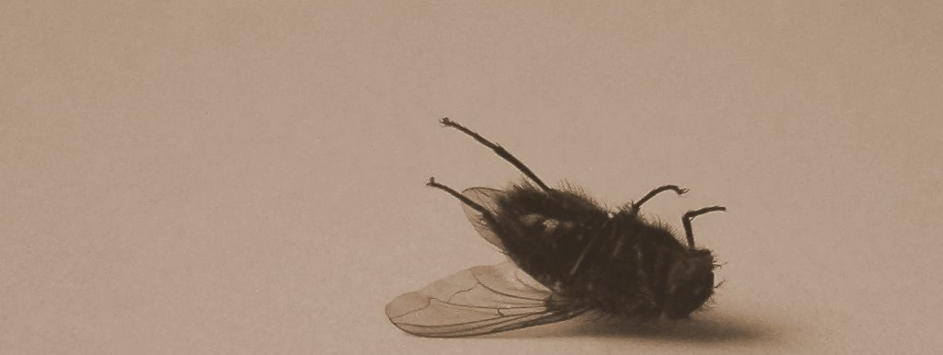
Conclusion
Christians today are not immune!
Faithful men and women of old have made mistakes that still today are talked about and remembered!

Slide 11
Conclusion
Our dead fly moments often are what stick in people's minds about us:
What of the devoted husband and father who cheats that one time and gets caught?
What of the gifted preacher who couldn't get along with the congregation or the elders?
What of the woman of God who couldn't control her temper with her sister or her sister in Christ?

Slide 12
Conclusion
When a little foolishness can be so powerful, the only solution for us is to avoid all foolishness!
Any of us can spoil the testimony of a godly life with only one ill-chosen act (Paul: I Corinthians 9:27)
When we are tempted then we must remember the stakes: The devil would love to number us with Noah and all the rest!
If we stick to the paths of wisdom, Satan will never get the chance!

Slide 13
Proverbs 4:10-15
Conclusion
10. Hear, my son, and accept my sayings And the years of your life will be many.
11. I have directed you in the way of wisdom; I have led you in upright paths.
12. When you walk, your steps will not be impeded; And if you run, you will not stumble.
13. Take hold of instruction; do not let go. Guard her, for she is your life.
14. Do not enter the path of the wicked And do not proceed in the way of evil men.
15. Avoid it, do not pass by it; Turn away from it and pass on.

Slide 14
Conclusion
Walk in the paths of wisdom and avoid dead fly moments!

Slide 15
“What Must I Do To Be Saved?”
Hear The Gospel (Jn. 5:24; Rom. 10:17)
Believe In Christ (Jn. 3:16-18; Jn. 8:24)
Repent Of Sins (Lk. 13:3-5; Acts 2:38)
Confess Christ (Mt. 10:32; Rom. 10:10)
Be Baptized (Mk. 16:16; Acts 22:16)
Remain Faithful (Jn. 8:31; Rev. 2:10)
For The Erring Saint:
Repent (Acts 8:22), Confess (I Jn. 1:9),
Pray (Acts 8:22)

