Slide 1
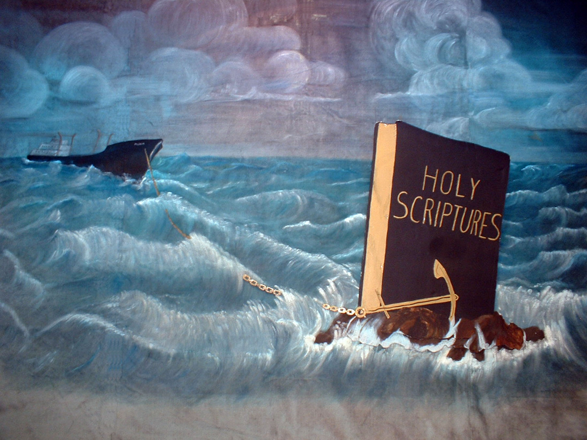
Faithful Saints
Text: Colossians 1:1-12
Notes:
By Nathan L Morrison for Sunday July 10th, 2022
All Scripture given is from NASB unless otherwise stated
For further study, or if questions, please Call: 804-277-1983; or Visit: www.courthousechurchofchrist.com

Slide 2
Intro
A “Sound church” indicates the relationship of the church with God
“Sound”: “Normal and healthy; not weak, diseased, or impaired; firm, safe, secure, based on truth or valid reasoning; accurate, reliable, sensible; morally strong; honest, honorable, loyal.” (Webster's)
“Sound”: hugiainō [hoog-ee-ah'ee-no] (G5198): “To have sound health, that is, be well (in body); figuratively to be uncorrupt (true in doctrine): be in health, (be safe and) sound, (be) whole (-some).” (Strong’s)

Slide 3
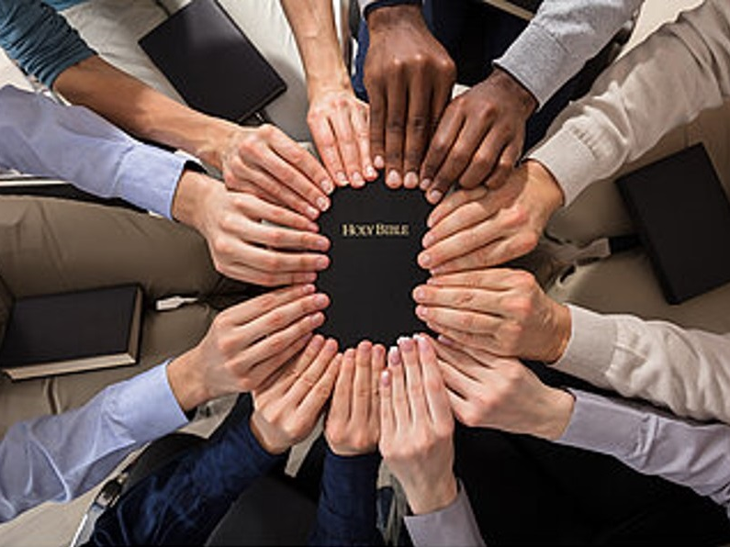
A sound church is one that:
The members know their abilities and use them – Eph. 4:16
Is NOT content –
Phil. 3:13-14
Teaches the “Doctrine of Christ” – II Jn. 9
Seeks Scriptural Organization –
Phil. 1:1
Demands sound preaching – II Tim. 4:2, 5
Is pure –
I Jn. 3:3
Is unified –
Phil. 2:1-2

Slide 4
Intro
A church (the “called out”) will only be as sound as its members (body of Christ – Col. 1:18):
Those “faithful unto death” will be rewarded – Rev. 2:10
What does it take to be counted as faithful?
The Letter to the Colossians says a lot about what it means to be sound/faithful (Colossians 1:1-12)
What were the characteristics of these faithful brethren?

Slide 5
Saints (Colossians 1:2)
Colossians 1:2
To the saints and faithful brethren in Christ who are at Colossae: Grace to you and peace from God our Father.

Slide 6
Saints (Colossians 1:2)
Old Testament concept, a word that means “set apart; sanctified; holy; saints” (G40 hagios)
God’s people have always been called to be separate
(II Cor. 6:17; I Pet. 1:14-16)
Saints to be dedicated to God & separated from the sin of this world!
Saints
Col. 3:5: Dead to sin
Eph. 5:3-5: Act in proper way for saints

Slide 7
Thirst for Knowledge (Colossians 1:9)
Colossians 1:9
For this reason also, since the day we heard of it, we have not ceased to pray for you and to ask that you may be filled with the knowledge of His will in all spiritual wisdom and understanding,

Slide 8
Thirst for Knowledge (Colossians 1:9)
Paul recognized their hunger and thirst after righteousness and prayed they would get it
"Blessed are those who hunger and thirst for righteousness, for they shall be satisfied” (Matthew 5:6)
Psalm 42:1-2: Soul pants & thirsts for God
Eph. 3:1-5: Those who do so can understand the gospel
Col. 2:2-3: Treasures of wisdom are hidden in Christ
Thirst for
Knowledge

Slide 9
Walk Worthy of the Lord (Colossians 1:10)
Colossians 1:10
so that you will walk in a manner worthy of the Lord, to please Him in all respects, bearing fruit in every good work and increasing in the knowledge of God;

Slide 10
Walk Worthy of the Lord (Colossians 1:10)
Be pleasing to the Lord:
Hebrews 11:5
Colossians 2:6
Hebrews 11:6
Bear Fruit:
“My Father is glorified by this, that you bear much fruit, and so prove to be My disciples” (John 15:8)
Increase in the knowledge of God:
II Pet. 3:17-18: Grow in His knowledge! (Eph. 4:14-16)
Heb. 5:12: Teach others!
Walk Worthy
of the Lord

Slide 11
Steadfast (Colossians 1:11)
Colossians 1:11
strengthened with all power, according to His glorious might, for the attaining of all steadfastness and patience; joyously

Slide 12
Steadfast (Colossians 1:11)
They have a knowledge of God that results in patience and longsuffering
Suffering with joy produces endurance (James 1:2-3)
Patience & steadfastness are traits of the faithful:
Col. 1:23; 2:7: Faith produces steadfastness
Col. 2:4-5: Faith grounded in Christ
I Cor. 15:1-2: “Hold fast”
I Cor. 15:58: Be immovable, steadfast!
Steadfast

Slide 13
Thankful (Colossians 1:12)
Colossians 1:12
…joyously (v.11)…
giving thanks to the Father, who has qualified us to share in the inheritance of the saints in Light.

Slide 14
Thankful (Colossians 1:11)
A Saint’s life is to be characterized by thankfulness
Col. 1:3: Paul gave thanks
Col. 1:12: Give thanks unto the Father
Col. 2:7: “Overflowing with gratitude”
Col. 3:15: Be thankful
Col. 3:17: In all that we do we are to give thanks to God through Jesus
Col. 4:2: Thankful prayers!
Thankful

Slide 15
Conclusion
II Corinthians 13:5
Test yourselves to see if you are in the faith; examine yourselves! Or do you not recognize this about yourselves, that Jesus Christ is in you—unless indeed you fail the test?

Slide 16
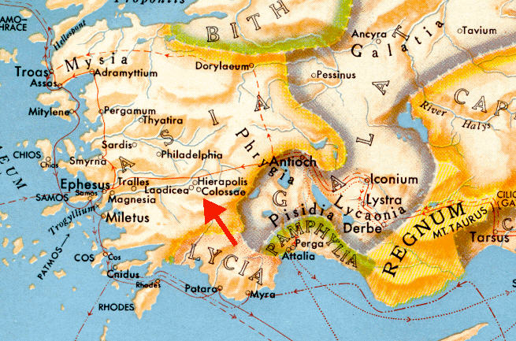
Conclusion
The saints at Colossae are a great example of what faithfulness looks like!

Slide 17
Conclusion
Are You…
A Saint? (Col. 1:2)
Walking in a manner worthy of the Lord? (Col. 1:10)
Thirsting for knowledge? (Col. 1:9)
Thankful? (Col. 1:12)
Steadfast in your faith? (Col. 1:11)

Slide 18
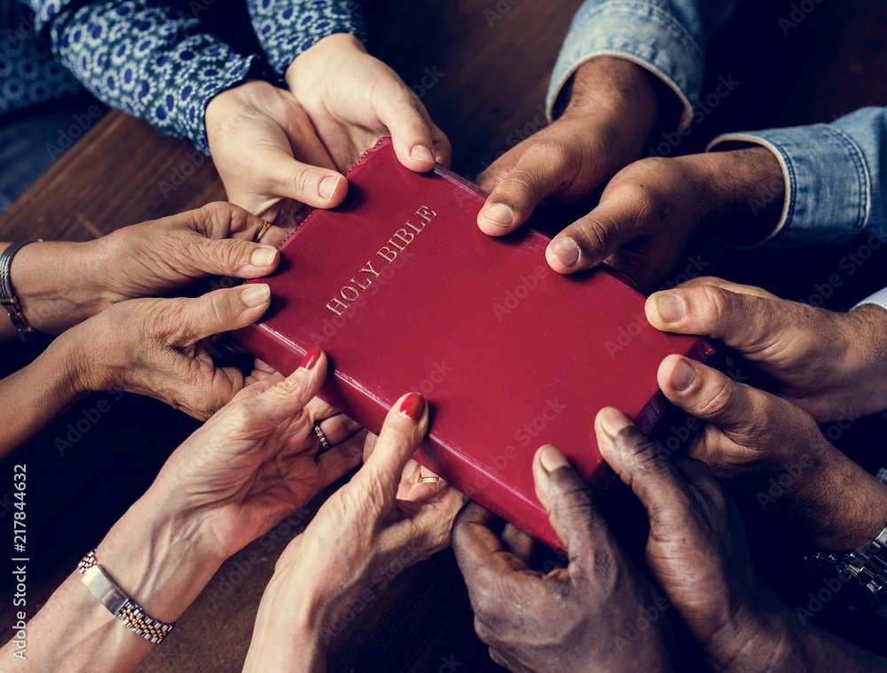
Conclusion
Are we the committed, dedicated people God wants us to be?!

Slide 19
“What Must I Do To Be Saved?”
Hear The Gospel (Jn. 5:24; Rom. 10:17)
Believe In Christ (Jn. 3:16-18; Jn. 8:24)
Repent Of Sins (Lk. 13:3-5; Acts 2:38)
Confess Christ (Mt. 10:32; Rom. 10:10)
Be Baptized (Mk. 16:16; Acts 22:16)
Remain Faithful (Jn. 8:31; Rev. 2:10)
For The Erring Saint:
Repent (Acts 8:22), Confess (I Jn. 1:9),
Pray (Acts 8:22)

