Slide 1
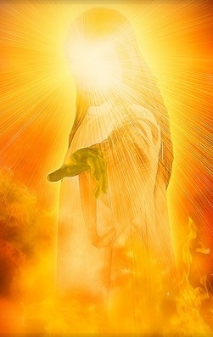
EXALTED
Text: Acts 2:21-36
Notes:
Prepared by Nathan L Morrison
All Scripture given is from NASB unless otherwise stated
For further study, or if questions, please Call: 804-277-1983 or Visit www.courthousechurchofchrist.com
Adapted from a lesson by Jeff Asher

Slide 2
Intro
Paul described the nature of Christ in Philippians 2:5-11 as:
Fully God (Phil. 2:6)
Fully man (Phil. 2:7-8)
Exalted (Phil. 2:9-11)

Slide 3
Intro
Peter preached Christ and salvation from Joel 2:28-32:
“Everyone who calls on the name of the Lord will be saved” (Acts 2:21)
“Jesus of Nazareth…” (Acts 2:22)
“Whom God raised up…” (Acts 2:24)
“Exalted to the right hand of God…” (Acts 2:33)
“Both Lord and Christ…” (Acts 2:36)

Slide 4
Intro
Peter shows that Jesus is the “Lord” whose name must be called on from Joel 2!
Peter proclaimed Jesus as the Exalted Lord and Christ!

Slide 5
Jesus, Lord & Christ: EXALTED
Jesus:
The Man
Acts 2:22-23, 30
He became flesh to:
Qualify Himself as man’s High Priest – Heb. 2:16-18; 4:15-16
Die to save man from sin – Jn. 1:29; Heb. 2:9; 9:28; 10:4, 11-12; Rev. 1:5
Deliver His people from death – Heb. 2:14-15
Destroy the works of the devil – I Jn. 3:8
Show us who God is – I Jn. 5:20

Slide 6
Jesus, Lord & Christ: EXALTED
Jesus:
The Man
Acts 2:22-23, 30
He died for the sins of the world:
God was not satisfied with animal sacrifices (Heb. 10:5-8)
Only the death of the Son of Man would satisfy God (Heb. 10:9-10)
Jesus offered that sacrifice for all time (Heb. 10:10-14)
Jesus:
The Crucified
Acts 2:23

Slide 7
Jesus, Lord & Christ: EXALTED
Jesus:
The Man
Acts 2:22-23, 30
Jesus:
The Crucified
Acts 2:23
Jesus raised Himself up from the dead:
Luke 24:4-7; John 2:18-22; 10:17-18
Jesus:
The Resurrected
Acts 2:24, 32

Slide 8
Jesus, Lord & Christ: EXALTED
Jesus:
The Man
Acts 2:22-23, 30
Importance of Jesus sitting at the right hand of God:
We will be like Him – I John 3:2
He are to be pure – I John 3:3
He is our help – Hebrews 4:15-16
Jesus:
The Crucified
Acts 2:23
Jesus:
The Exalted
Acts 2:33
Jesus:
The Resurrected
Acts 2:24, 32

Slide 9
Jesus, Lord & Christ: EXALTED
Fully God!
Joel 2:32; Acts 2:16-21, 36; John 8:57-58
Jesus:
The Man
Acts 2:22-23, 30
Jesus:
The Divine
Acts 2:34-36
Jesus:
The Crucified
Acts 2:23
Jesus:
The Exalted
Acts 2:33
Jesus:
The Resurrected
Acts 2:24, 32

Slide 10
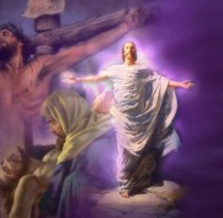
Conclusion
Isaiah 53:8-10
Death, Burial, Resurrection
O.T. passage that says what Peter (Acts 2:22-36) and Paul (I Cor. 15:1-8) preached concerning Jesus:
Death (53:8: “cut off from the land of the living,” 53:10: “putting Him to grief,” “guilt offering”)
Burial (53:9 “grave was assigned with wicked men, Yet He was with a rich man in His death”)
Resurrection (53:10: “He will see His offspring, He will prolong His days”)

Slide 11
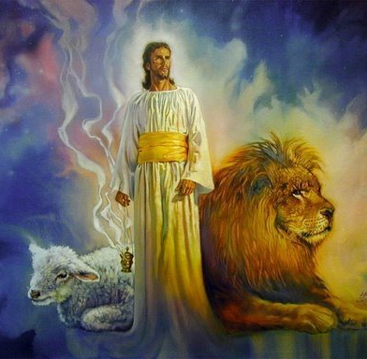
Conclusion
Peter preached Jesus as:
The Man
The Crucified
The Resurrected
The Exalted
The Divine

Slide 12
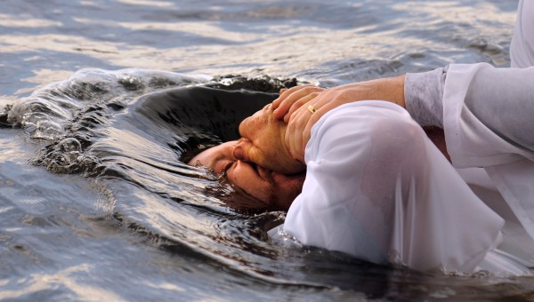
Conclusion
Those who put Him to death were pricked in their heart upon hearing Who it was they crucified!
(Acts 2:37)
Peter’s answer to their dilemma was to “Repent!” and “Be baptized in the name of Jesus for the forgiveness of their sins” and they would receive the “gift of the Holy Spirit (salvation, forgiveness of sins) – Acts 2:38

Slide 13
Conclusion
Have you believed in Jesus, the Exalted One, and obeyed Him to be saved?
(Acts 4:10-12; Hebrews 5:9)

Slide 14
“What Must I Do To Be Saved?”
Hear The Gospel (Jn. 5:24; Rom. 10:17)
Believe In Christ (Jn. 3:16-18; Jn. 8:24)
Repent Of Sins (Lk. 13:3-5; Acts 2:38)
Confess Christ (Mt. 10:32; Rom. 10:10)
Be Baptized (Mk. 16:16; Acts 22:16)
Remain Faithful (Jn. 8:31; Rev. 2:10)
For The Erring Saint:
Repent (Acts 8:22), Confess (I Jn. 1:9),
Pray (Acts 8:22)

Slide 15
Jesus: The Exalted

