Slide 1
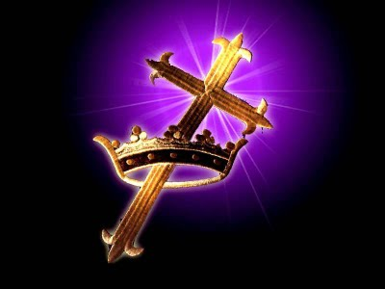
“More Than Conquerors” Text: Romans 8:31-39
Notes:
By Nathan L Morrison
All Scripture given is from NASB unless otherwise stated
For further study, or if questions, please Call: 804-277-1983 or Visit www.courthousechurchofchrist.com

Slide 2
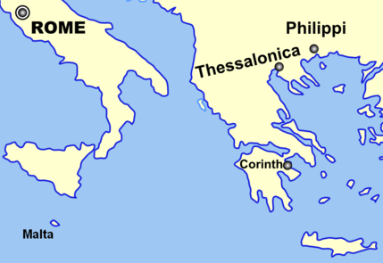
Intro
Letter from Paul written to saints in Rome (Romans 1:1-7):
The Scriptures don’t record the establishment of the church in Rome
Notes:
Distance from Rome to Corinth: http://www.mapcrow.info/Distance_between_Rome_IT_and_Corinth_GR.html

Slide 3
Intro
Paul commends Phoebe, “a servant of the church which is at Cenchrea” (Romans 16:1), which is a suburb of Corinth.
Paul is staying with “Gaius” (Romans 16:23). A Corinthian named Gaius was converted by Paul (I Corinthians 1:14).
A greeting is offered from “Erastus, the city treasurer” (Romans 16:23). Paul speaks of Erastus as being in Corinth in II Timothy 4:20
Many historians believe Paul wrote the letter from Corinth in A.D. 57 (615 miles away), before his final journey to Jerusalem (Acts 19:21)
Notes:
Distance from Rome to Corinth: http://www.mapcrow.info/Distance_between_Rome_IT_and_Corinth_GR.html

Slide 4
Intro
At the time of his writing a congregation in Rome existed:
Their faith was “proclaimed throughout the whole world” (1:8)
The “report” of their “obedience has reached to all” (16:19)
Paul “had for many years a longing to come” visit them (15:23)
Notes:
Distance from Rome to Corinth: http://www.mapcrow.info/Distance_between_Rome_IT_and_Corinth_GR.html

Slide 5
Intro
At the time of his writing a congregation in Rome existed:
Emperor Claudius “had commanded all the Jews to leave Rome” (Acts 18:2) in AD 52 (Seutonius’ Claudius, 25).
Aquila and Priscilla were affected by this and met Paul in Corinth (Acts 18:2)
By the time of this letter they had apparently moved back and hosted a congregation of saints in their home (Romans 16:3-5)
Notes:
Distance from Rome to Corinth: http://www.mapcrow.info/Distance_between_Rome_IT_and_Corinth_GR.html

Slide 6
Intro
Their existence may go back as far as the beginning of the church in Jerusalem:
on the Day of Pentecost in Jerusalem there were “visitors from Rome, both Jews and proselytes” (Acts 2:10)
Out of 3,000 saved that day it is possible many were from Rome and when these new converts went home, they took their new faith with them
Notes:
Distance from Rome to Corinth: http://www.mapcrow.info/Distance_between_Rome_IT_and_Corinth_GR.html

Slide 7
Intro
Roman citizens would have been very familiar with the Triumph Parade:
Conquered prisoners would be paraded through the streets of Rome to the shouts and applause of the populace.
Rose petals would be thrown before them in the streets to be crushed by the prisoners and soldiers alike.
To the soldiers and citizens it was a smell of victory.
To the prisoners it was the stench of death.
At the end of the parade the prisoners were publicly executed (usually by strangling) to the cheers and adoration of the citizens of Rome
Notes:
Distance from Rome to Corinth: http://www.mapcrow.info/Distance_between_Rome_IT_and_Corinth_GR.html

Slide 8
Intro
Paul describes a different triumph, an ultimate victory found in Jesus Christ:
II Corinthians 2:14-16: The ultimate triumph in Jesus – A smell of victory to those being saved, the fragrance of Christ to God, and the stench of death to those who are perishing!
Romans 8:31-39: Paul says in Christ we are more than conquerors (NKJV: 8:37)! Nothing can separate a saint from the love of Jesus Christ!
Notes:
Distance from Rome to Corinth: http://www.mapcrow.info/Distance_between_Rome_IT_and_Corinth_GR.html

Slide 9
Intro
Like the Roman saints, Christians today face all kinds of problems and difficulties
Dealing with life’s issues can lead some to discouragement.
Notes:
Distance from Rome to Corinth: http://www.mapcrow.info/Distance_between_Rome_IT_and_Corinth_GR.html

Slide 10
Intro
Unlike people in the world, who have to deal with discouragement without any real hope, saints have the true source of encouragement: the love of Jesus Christ!

Slide 11
More Than Conquerors
As Christians, we will have the ultimate victory, the triumph over all of our troubles, persecutions and problems, if we remain faithful to Him who loves us, Jesus Christ our Lord and Savior (8:37; Philippians 3:20)!
Romans 8:31-39

Slide 12
More Than Conquerors
Romans 8:31-32
31. What then shall we say to these things? If God is for us, who is against us?
32. He who did not spare His own Son, but delivered Him over for us all, how will He not also with Him freely give us all things?
Romans 8:31-32

Slide 13
More Than Conquerors
Who should we fear? “If God is for us, who can be against us?” (Mt. 10:28)
Instead of being fearful & anxious, we can be confident that God will bless us!
Romans 8:31-32

Slide 14
More Than Conquerors
Romans 8:33-34
33. Who will bring a charge against God's elect? God is the one who justifies;
34. who is the one who condemns? Christ Jesus is He who died, yes, rather who was raised, who is at the right hand of God, who also intercedes for us.
Romans 8:33-34

Slide 15
More Than Conquerors
Remember: It is not those in the world, but Jesus Christ Who will be our ultimate Judge (NOT the court of public opinion!)
Not only our Judge, but our Mediator as He lives to make intercession for saints (Hebrews 7:25) – No greater defense than the Lord & Creator
Romans 8:33-34

Slide 16
More Than Conquerors
Romans 8:35-37 (NKJV)
35. Who shall separate us from the love of Christ? Shall tribulation, or distress, or persecution, or famine, or nakedness, or peril, or sword?
36. As it is written: "FOR YOUR SAKE WE ARE KILLED ALL DAY LONG; WE ARE ACCOUNTED AS SHEEP FOR THE SLAUGHTER."
37. Yet in all these things we are more than conquerors through Him who loved us.
Romans 8:35-37
Notes:
NASB Romans 8:35-37
35. Who will separate us from the love of Christ? Will tribulation, or distress, or persecution, or famine, or nakedness, or peril, or sword?
36. Just as it is written, "FOR YOUR SAKE WE ARE BEING PUT TO DEATH ALL DAY LONG; WE WERE CONSIDERED AS SHEEP TO BE SLAUGHTERED."
37. But in all these things we overwhelmingly conquer through Him who loved us.

Slide 17
More Than Conquerors
Some may become so discouraged they may ask or wonder if they can be separated from the love of Christ.
Paul affirms that no matter the difficulty or trial, through Christ we can be victorious over any obstacle or hardship.
NKJV: “More than conquerors!”
Romans 8:35-37
Notes:
Quotes Psalm 44:22 in Romans 8:36

Slide 18
More Than Conquerors
Romans 8:38-39
38. For I am convinced that neither death, nor life, nor angels, nor principalities, nor things present, nor things to come, nor powers,
39. nor height, nor depth, nor any other created thing, will be able to separate us from the love of God, which is in Christ Jesus our Lord.
Romans 8:38-39

Slide 19
More Than Conquerors
No external power or persecution, no created thing or person on earth can separate us from God’s love!
SELF is not included in that list because we can fall away – – So many warnings!
Rocky & Thorny Soil – Luke 8:13-14
Example of Israel: Hebrews 2:1-4; 3:12-13
General warnings: I Timothy 4:1; II Peter 3:17
Romans 8:38-39

Slide 20
More Than Conquerors
If we remain faithful to Jesus, Who loved us, died for us, and intercedes for us (Romans 8:32, 34, 37) then there is NOTHING in this world that can separate us from the love of Jesus Christ and God the Father, or keep us from the benefits of God’s love!
Romans 8:38-39

Slide 21
More Than Conquerors
For Christians in any time period there is great encouragement and comfort in these words: Through Jesus Who loves us we are “more than conquerors!”
Romans 8:31-39

Slide 22
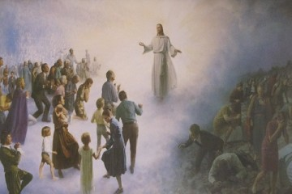
We can be victorious!
The Ultimate Victory is in Jesus Christ!
Conclusion
The Day of Judgment will be a Triumph Parade unlike anything ever seen!
(Matthew 25:31-46)
All people will be separated to the right & left of Jesus: Sheep to the right, goats to the left

Slide 23
We can be victorious!
The Ultimate Victory is in Jesus Christ!
Conclusion
righteous judged & eternally rewarded
wicked judged & eternally punished
The enemies of the Lamb of God & His saints will be eternally punished (II Thess. 1:7-9)
Ultimate Triumph Parade
(Matthew 25:31-46)

Slide 24
Conclusion
In this life and the life to come, a faithful child of God cannot be separated from the love of Jesus; however, the wicked will be eternally separated from God (II Thess. 1:9)
No matter what you are dealing with today, would you like to have the ultimate victory over your problems, persecutions, challenges, hardships, etc.?
“More Than Conquerors” (NKJV: Rom. 8:37)

Slide 25
In Jesus Christ we have the ultimate victory through our faith (I John 5:4) and in His love we are “more than conquerors!”

Slide 26
“What Must I Do To Be Saved?”
Hear The Gospel (Jn. 5:24; Rom. 10:17)
Believe In Christ (Jn. 3:16-18; Jn. 8:24)
Repent Of Sins (Lk. 13:3-5; Acts 2:38)
Confess Christ (Mt. 10:32; Rom. 10:10)
Be Baptized (Mk. 16:16; Acts 22:16)
Remain Faithful (Jn. 8:31; Rev. 2:10)
For The Erring Saint
Repent (Acts 8:22), Confess (I Jn. 1:9),
Pray (Acts 8:22)

