Slide 1
Standing Fearless
In
Fearful Times

Slide 2
How Did He Get To This Point?
Dan 6:10 Now when Daniel knew that the writing was signed, he went home. And in his upper room, with his windows open toward Jerusalem, he knelt down on his knees three times that day, and prayed and gave thanks before his God, as was his custom since early days.

Slide 3
Chapter 1: Daniel Taken Into Captivity

Slide 4
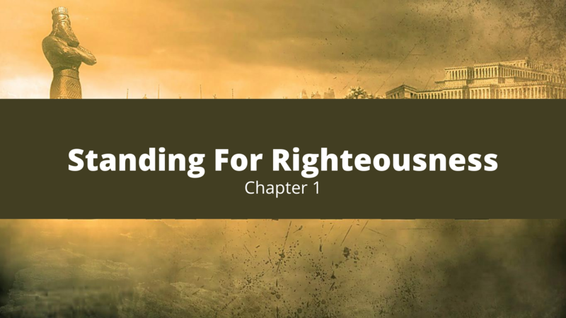
Daniel and His Friends selected to serve the king (vs 3-4)
³ Then the king instructed Ashpenaz, the master of his eunuchs, to bring some of the children of Israel and some of the king’s descendants and some of the nobles,
⁴ young men in whom there was no blemish, but good-looking, gifted in all wisdom, possessing knowledge and quick to understand, who had ability to serve in the king’s palace, and whom they might teach the language and literature of the Chaldeans.

Slide 5
The king attempts to manipulate Daniel and his friends (vs 5)
⁵ And the king appointed for them a daily provision of the king’s delicacies and of the wine which he drank, and three years of training for them, so that at the end of that time they might serve before the king.

Slide 6
Daniels and his friends given new names (vs 6-7)
⁷ To them the chief of the eunuchs gave names: he gave Daniel the name Belteshazzar; to Hananiah, Shadrach; to Mishael, Meshach; and to Azariah, Abed-Nego.

Slide 7
Daniel refuses to defile himself with the king’s goods (vs 8-9)
⁸ But Daniel purposed in his heart that he would not defile himself with the portion of the king’s delicacies, nor with the wine which he drank; therefore he requested of the chief of the eunuchs that he might not defile himself.
⁹ Now God had brought Daniel into the favor and goodwill of the chief of the eunuchs.

Slide 8
The fear and response of the chief of the eunuchs (vs 10)
¹⁰ And the chief of the eunuchs said to Daniel, “I fear my lord the king, who has appointed your food and drink. For why should he see your faces looking worse than the young men who are your age? Then you would endanger my head before the king.”

Slide 9
The request and challenge made to the steward (vs 11-13)
¹² “Please test your servants for ten days, and let them give us vegetables to eat and water to drink.
¹³ Then let our appearance be examined before you, and the appearance of the young men who eat the portion of the king’s delicacies; and as you see fit, so deal with your servants.”

Slide 10
The results of the challenge (vs 15-16)
¹⁵ And at the end of ten days their features appeared better and fatter in flesh than all the young men who ate the portion of the king’s delicacies.
¹⁶ Thus the steward took away their portion of delicacies and the wine that they were to drink, and gave them vegetables.

Slide 11
The blessings from God given to Daniel and his friends (17)
¹⁷ As for these four young men, God gave them knowledge and skill in all literature and wisdom; and Daniel had understanding in all visions and dreams.

Slide 12
The blessings from God given to Daniel and his friends (19-20)
¹⁹ Then the king interviewed them, and among them all none was found like Daniel, Hananiah, Mishael, and Azariah; therefore they served before the king.
²⁰ And in all matters of wisdom and understanding about which the king examined them, he found them ten times better than all the magicians and astrologers who were in all his realm.

Slide 13
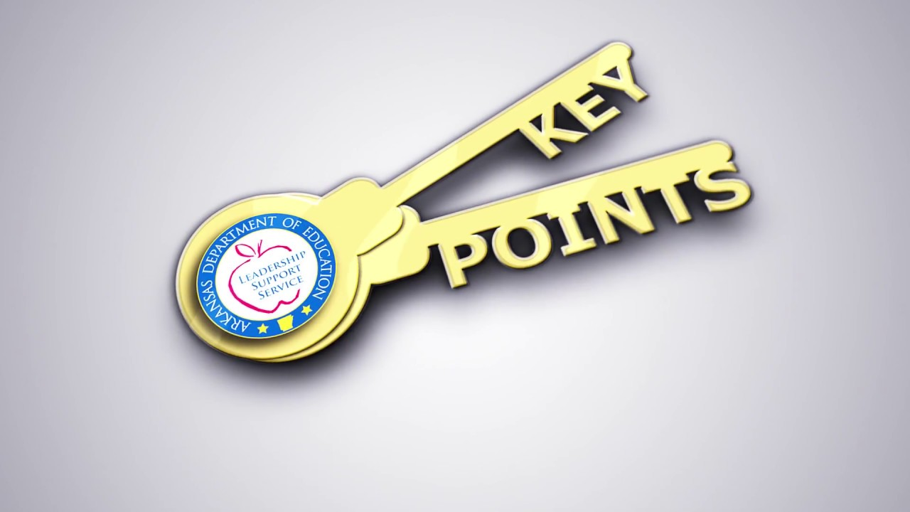
How Daniel is able to display fearlessness
Daniel remembered who he belonged to and where he came from
Daniel chose not to accept the king’s gifts but instead focus on and not forget his God
Daniel is rewarded and protected by God

Slide 14
Chapter 2: Nebuchadnezzar’s Dream

Slide 15
The King’s disturbing dream (vs 1-3)
² Then the king gave the command to call the magicians, the astrologers, the sorcerers, and the Chaldeans to tell the king his dreams. So they came and stood before the king.
³ And the king said to them, “I have had a dream, and my spirit is anxious to know the dream.”

Slide 16
The Chaldean’s tell the king they will interpret for him (vs 4)
⁴ Then the Chaldeans spoke to the king in Aramaic, “O king, live forever! Tell your servants the dream, and we will give the interpretation.”

Slide 17
The offer and warning from the king (vs 5-6)
⁵ The king answered and said to the Chaldeans, “My decision is firm: if you do not make known the dream to me, and its interpretation, you shall be cut in pieces, and your houses shall be made an ash heap.
⁶ However, if you tell the dream and its interpretation, you shall receive from me gifts, rewards, and great honor. Therefore tell me the dream and its interpretation.”

Slide 18
The king demands he be told the dream before its interpretation (vs 8-9)
⁹ if you do not make known the dream to me, there is only one decree for you! For you have agreed to speak lying and corrupt words before me till the time has changed. Therefore tell me the dream, and I shall know that you can give me its interpretation.”

Slide 19
The Chaldean’s response (vs 10-11)
¹⁰ The Chaldeans answered the king, and said, “There is not a man on earth who can tell the king’s matter; therefore no king, lord, or ruler has ever asked such things of any magician, astrologer, or Chaldean.
¹¹ It is a difficult thing that the king requests, and there is no other who can tell it to the king except the gods, whose dwelling is not with flesh.”

Slide 20
The anger of the king and his actions (vs 12-13)
¹² For this reason the king was angry and very furious, and gave the command to destroy all the wise men of Babylon.
¹³ So the decree went out, and they began killing the wise men; and they sought Daniel and his companions, to kill them.

Slide 21
Daniel receives news of the king’s orders (vs 14-15)
¹⁴ Then with counsel and wisdom Daniel answered Arioch, the captain of the king’s guard, who had gone out to kill the wise men of Babylon;
¹⁵ he answered and said to Arioch the king’s captain, “Why is the decree from the king so urgent?” Then Arioch made the decision known to Daniel.

Slide 22
Daniel asks the king for time to interpret the dream (vs 16)
¹⁶ So Daniel went in and asked the king to give him time, that he might tell the king the interpretation.

Slide 23
Daniel tells his friends he is going to interpret the dream and they should pray God spare their lives (vs 17-18)
¹⁷ Then Daniel went to his house, and made the decision known to Hananiah, Mishael, and Azariah, his companions,
¹⁸ that they might seek mercies from the God of heaven concerning this secret, so that Daniel and his companions might not perish with the rest of the wise men of Babylon.

Slide 24
Daniel praises God and thanks him for revealing the dream and its interpretation (vs 19-23)
¹⁹ Then the secret was revealed to Daniel in a night vision. So Daniel blessed the God of heaven….
²³ “I thank You and praise You, O God of my fathers; You have given me wisdom and might, And have now made known to me what we asked of You, For You have made known to us the king’s demand.”

Slide 25
Daniel reveals the dream to the king advising no man could have (vs 27-28)
²⁷ Daniel answered in the presence of the king, and said, “The secret which the king has demanded, the wise men, the astrologers, the magicians, and the soothsayers cannot declare to the king.
²⁸ But there is a God in heaven who reveals secrets, and He has made known to King Nebuchadnezzar what will be in the latter days. Your dream, and the visions of your head upon your bed, were these:

Slide 26
Daniel reveals the interpretation of the dream (vs 36-45)
³⁶ “This is the dream. Now we will tell the interpretation of it before the king…The dream is certain, and its interpretation is sure.”

Slide 27
The king honors the God of Daniel for revealing his dream and promotes Daniel (vs 47-48)
⁴⁷ The king answered Daniel, and said, “Truly your God is the God of gods, the Lord of kings, and a revealer of secrets, since you could reveal this secret.”
⁴⁸ Then the king promoted Daniel and gave him many great gifts; and he made him ruler over the whole province of Babylon, and chief administrator over all the wise men of Babylon

Slide 28
Daniel petitions the king on behalf of his friends (vs 49)
⁴⁹ Also Daniel petitioned the king, and he set Shadrach, Meshach, and Abed-Nego over the affairs of the province of Babylon; but Daniel sat in the gate of the king.

Slide 29
How Daniel is able to display fearlessness
Daniel allows God to work through him to answer the king
Daniel remembers and seeks benefits for his friends as well

Slide 30
Chapter 3: Daniel’s Faithful Friends

Slide 31
How Daniel is able to display fearlessness
Daniel chooses faithful friends

Slide 32
Chapter 4: Nebuchadnezzar’s Second Dream

Slide 33
Nebuchadnezzar Declares God’s works to the people (vs 1-3)
² I thought it good to declare the signs and wonders that the Most High God has worked for me.
³ How great are His signs, And how mighty His wonders! His kingdom is an everlasting kingdom, And His dominion is from generation to generation.

Slide 34
Nebuchadnezzar troubled by his dream (vs 4-18)
⁴ I, Nebuchadnezzar, was at rest in my house, and flourishing in my palace.
⁵ I saw a dream which made me afraid, and the thoughts on my bed and the visions of my head troubled me.

Slide 35
Nebuchadnezzar troubled by his dream (vs 4-18)
⁷ Then the magicians, the astrologers, the Chaldeans, and the soothsayers came in, and I told them the dream; but they did not make known to me its interpretation.
⁸ But at last Daniel came before me (his name is Belteshazzar, according to the name of my god; in him is the Spirit of the Holy God), and I told the dream before him, saying:
⁹ “Belteshazzar, chief of the magicians, because I know that the Spirit of the Holy God is in you, and no secret troubles you, explain to me the visions of my dream that I have seen, and its interpretation..

Slide 36
Nebuchadnezzar troubled by his dream (vs 4-18)
¹⁸ “This dream I, King Nebuchadnezzar, have seen. Now you, Belteshazzar, declare its interpretation, since all the wise men of my kingdom are not able to make known to me the interpretation; but you are able, for the Spirit of the Holy God is in you.”

Slide 37
Daniel interprets the dream (vs 19-27)
²⁶ “And inasmuch as they gave the command to leave the stump and roots of the tree, your kingdom shall be assured to you, after you come to know that Heaven rules.
²⁷ Therefore, O king, let my advice be acceptable to you; break off your sins by being righteous, and your iniquities by showing mercy to the poor. Perhaps there may be a lengthening of your prosperity.”

Slide 38
The vision becomes a reality (vs 28-33)
²⁸ All this came upon King Nebuchadnezzar.
²⁹ At the end of the twelve months he was walking about the royal palace of Babylon.
³⁰ The king spoke, saying, “Is not this great Babylon, that I have built for a royal dwelling by my mighty power and for the honor of my majesty?”

Slide 39
The vision becomes a reality (vs 28-33)
³³ That very hour the word was fulfilled concerning Nebuchadnezzar; he was driven from men and ate grass like oxen; his body was wet with the dew of heaven till his hair had grown like eagles’ feathers and his nails like birds’ claws.

Slide 40
Nebuchadnezzar praises God and is restored (vs 34-37)
³⁴ And at the end of the time I, Nebuchadnezzar, lifted my eyes to heaven, and my understanding returned to me; and I blessed the Most High and praised and honored Him who lives forever:…
³⁶ At the same time my reason returned to me, and for the glory of my kingdom, my honor and splendor returned to me. My counselors and nobles resorted to me, I was restored to my kingdom, and excellent majesty was added to me.
³⁷ Now I, Nebuchadnezzar, praise and extol and honor the King of heaven, all of whose works are truth, and His ways justice. And those who walk in pride He is able to put down.

Slide 41
Important reminders for us today
Pride and forgetting God leads to destruction
Be willing to offer Godly advice
God will do what He says He will do exactly how He says He will do it

Slide 42
Chapter 5: Belshazzar’s Feast

Slide 43
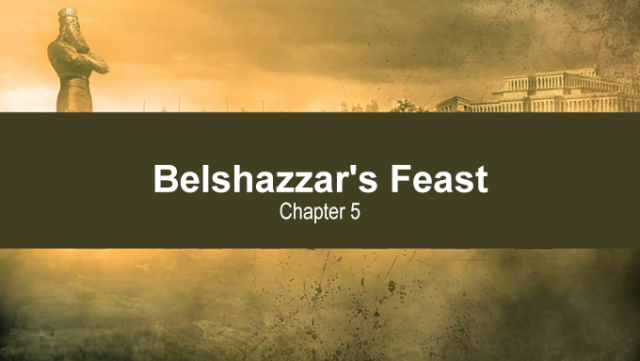
Belshazzar’s feast (vs 1-5)
5 Belshazzar the king made a great feast for a thousand of his lords, and drank wine in the presence of the thousand.
² While he tasted the wine, Belshazzar gave the command to bring the gold and silver vessels which his father Nebuchadnezzar had taken from the temple which had been in Jerusalem, that the king and his lords, his wives, and his concubines might drink from them.

Slide 44
Belshazzar’s feast (vs 1-5)
⁴ They drank wine, and praised the gods of gold and silver, bronze and iron, wood and stone.
⁵ In the same hour the fingers of a man’s hand appeared and wrote opposite the lampstand on the plaster of the wall of the king’s palace; and the king saw the part of the hand that wrote.

Slide 45
Belshazzar is troubled by the writing and no one is able to interpret it (vs 6-9)
⁶ Then the king’s countenance changed, and his thoughts troubled him, so that the joints of his hips were loosened and his knees knocked against each other.
⁷ The king cried ]aloud to bring in the astrologers, the Chaldeans, and the soothsayers. The king spoke, saying to the wise men of Babylon, “Whoever reads this writing, and tells me its interpretation, shall be clothed with purple and have a chain of gold around his neck; and he shall be the third ruler in the kingdom.”

Slide 46
Belshazzar is troubled by the writing and no one is able to interpret it (vs 6-9)
⁸ Now all the king’s wise men came, but they could not read the writing, or make known to the king its interpretation.
⁹ Then King Belshazzar was greatly troubled, his countenance was changed, and his lords were astonished.

Slide 47
The queen advises to send for Daniel (vs 10-12)
¹⁰ The queen, because of the words of the king and his lords, came to the banquet hall. The queen spoke, saying, “O king, live forever! Do not let your thoughts trouble you, nor let your countenance change.
¹² Inasmuch as an excellent spirit, knowledge, understanding, interpreting dreams, solving riddles, and explaining enigmas were found in this Daniel, whom the king named Belteshazzar, now let Daniel be called, and he will give the interpretation.”

Slide 48
The king calls for Daniel and offers a reward (vs 13-16)
¹³ Then Daniel was brought in before the king. The king spoke, and said to Daniel, “Are you that Daniel who is one of the captives from Judah, whom my father the king brought from Judah?
¹⁴ I have heard of you, that the Spirit of God is in you, and that light and understanding and excellent wisdom are found in you…
¹⁶ And I have heard of you, that you can give interpretations and explain enigmas. Now if you can read the writing and make known to me its interpretation, you shall be clothed with purple and have a chain of gold around your neck, and shall be the third ruler in the kingdom.”

Slide 49
Daniel interprets the writing (vs 17-29)
²⁶ This is the interpretation of each word. MENE: God has numbered your kingdom, and finished it;
²⁷ TEKEL: You have been weighed in the balances, and found wanting;
²⁸ PERES: Your kingdom has been divided, and given to the Medes and Persians.”

Slide 50
Belshazzar’s fall (vs 30-31)
³⁰ That very night Belshazzar, king of the Chaldeans, was slain.
³¹ And Darius the Mede received the kingdom, being about sixty-two years old.

Slide 51
How Daniel is able to display fearlessness
Daniel’s reputation was well-known
Daniel had enough faith in God to speak directly to the king

Slide 52
Chapter 6: The Plot Against Daniel

Slide 53
King Darius places Daniel in a very high position (vs 1-3)
6 It pleased Darius to set over the kingdom one hundred and twenty satraps, to be over the whole kingdom;
² and over these, three governors, of whom Daniel was one, that the satraps might give account to them, so that the king would suffer no loss.
³ Then this Daniel distinguished himself above the governors and satraps, because an excellent spirit was in him; and the king gave thought to setting him over the whole realm.

Slide 54
The jealousy of the governors and satraps (vs 4-5)
⁴ So the governors and satraps sought to find some charge against Daniel concerning the kingdom; but they could find no charge or fault, because he was faithful; nor was there any error or fault found in him.
⁵ Then these men said, “We shall not find any charge against this Daniel unless we find it against him concerning the law of his God.”

Slide 55
The deception by the governors and satraps (vs 6-7)
⁶ So these governors and satraps thronged before the king, and said thus to him: “King Darius, live forever!
⁷ All the governors of the kingdom, the administrators and satraps, the counselors and advisors, have consulted together to establish a royal statute and to make a firm decree, that whoever petitions any god or man for thirty days, except you, O king, shall be cast into the den of lions.

Slide 56
King Darius signs the decree (vs 8-9)
⁸ Now, O king, establish the decree and sign the writing, so that it cannot be changed, according to the law of the Medes and Persians, which does not alter.”
⁹ Therefore King Darius signed the written decree.

Slide 57
How Daniel is able to display fearlessness
A trap is set based on the others’ knowledge that he prays to God regularly
Daniel continues to follow his custom of prayer to God despite his knowledge of the decree

Slide 58
How Did He Get To This Point?
Dan 6:10 Now when Daniel knew that the writing was signed, he went home. And in his upper room, with his windows open toward Jerusalem, he knelt down on his knees three times that day, and prayed and gave thanks before his God, as was his custom since early days.

Slide 59
How Did He Get To This Point?
He remembered he was a child of God
He refused worldly pleasures (didn’t follow the crowd)
He put his faith in God and was rewarded
He understood God can do what man cannot and will do what He says He will do
He chose faithful friends
He had faith to speak boldly
He made prayer a part of his daily life (habit)

Slide 60
How Do We Get To This Point?
Learn from the example of Daniel and follow the godly life he modeled

