Slide 1
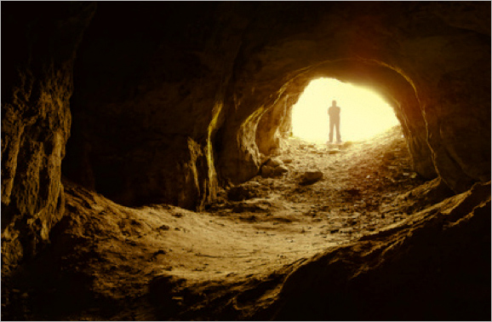
Alone! In A Cave
Text:
I Kings 19
Standing Fearless
In
Fearful Times
Notes:
Prepared by Nathan L Morrison
Standing Fearless In Fearful Times Local Preacher Themed Gospel Meeting, August 27-31, 2021, Hosted by Courthouse church of Christ
Presented at the Courthouse church of Christ, Sunday August 29, 2021
All Scripture given is from NASB unless otherwise stated
For further study, or if questions, please Call: 804-277-1983 or Visit: www.courthousechurchofchrist.com

Slide 2
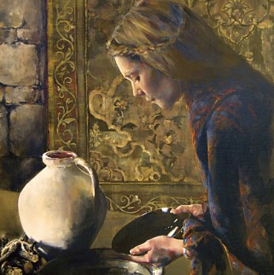
Elijah
I Kings 17
Elijah condemned wicked king Ahab for the sin of idolatry
Prayed for a famine
Miraculously fed by ravens
In the middle of a drought, he had a brook that gave him enough to drink
He was entrusted to a dying widow and her son in the homeland of the wicked queen (Jezebel) who sought his life
He saw oil and flour not run out
He prayed and saw somebody raised from the dead
Notes:
I Kings 17
Elijah came on the scene out of nowhere and condemned wicked king Ahab for the sin of idolatry
Then was miraculously fed by ravens (they brought him little cakes in the desert. In the middle of a drought, he had a brook that gave him enough to drink.
He was entrusted to a dying widow and her son in the homeland of the wicked queen (Jezebel) who sought his life: Zarephath in Phoenicia (Tyre & Sidon).
He saw oil and flour not run out: miraculously multiplied over and over and over again; God’s provision that’s unmistakable.
He prayed and saw somebody raised from the dead, because he prayed and laid down on the widow’s young boy and he came back to life.

Slide 3
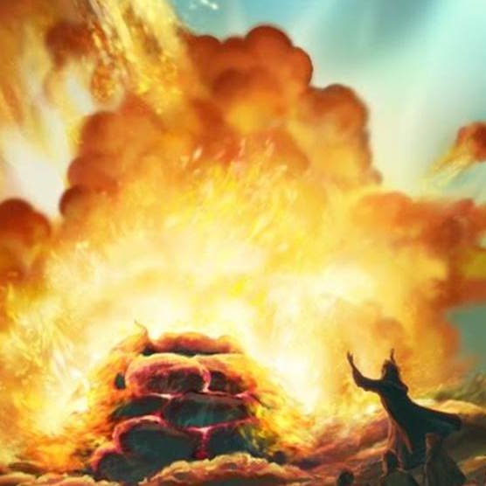
Elijah
I Kings 18
Then he stood on Mount Carmel in front of all Israel and King Ahab
Outnumbered; 850 false prophets of Baal and the Asherah to 1 prophet of God
He challenged the false prophets to a contest to see Who is God: YHWH or Baal?
He prayed and called down fire from heaven and it came down
He had the 850 false prophets put to death!
Prayed for the famine to end
Outran Ahab’s chariot
Notes:
I Kings 18
Then he stood on Mount Carmel in front of all Israel and King Ahab
Outnumbered; 850 false prophets of Baal and the Asherah to 1 prophet of God (450 prophets of Baal & 400 prophets of Asherah)
He challenged the false prophets to a contest to see Who is God: YHWH or Baal?
He prayed and called down fire from heaven and it came down.
He had the 850 false prophets put to death!
Prayed for the famine to end (after 3.5 years – Luke 4:25; James 5:17)
Outran Ahab’s chariot to get away from the coming storm
{Quick survey—How many of you have down ANY of those things?}

Slide 4
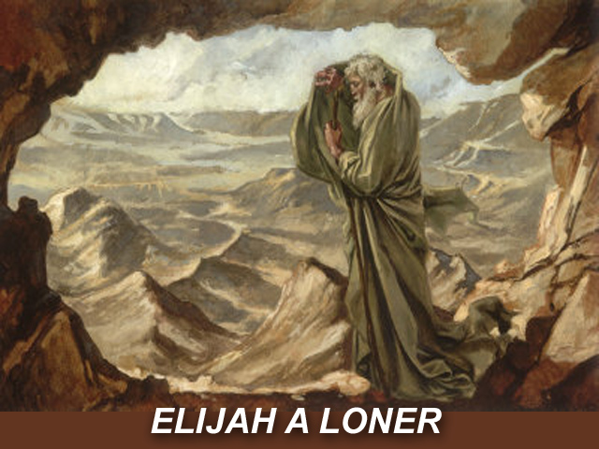
Intro
What do you do after that?
The scorched earth is still breathing up the remnant of the fire from Heaven, and you can still see the bodies of the prophets that are slaughtered on the mountain.
If you’re Elijah, you have people hoist you up on their shoulders and carry you down the mountain, right?
This is where you cue the confetti for the Super Bowl parade!
This is where there’s high fives and there’s no going back.
This is where you beat your chest and go, “That’s my God!”
Only that’s not what happened! As high as Elijah was on that mountain, he drops almost immediately to the valley!
Notes:
What do you do after that?
The scorched earth is still breathing up the remnant of that fire, and you can still see the bodies of the prophets that are slaughtered on the mountain.
This is when, if you’re Elijah, you have people hoist you up on their shoulders and carry you down the mountain, right?
This is where you cue the confetti for the Super Bowl parade!
This is where there’s high fives and there’s no going back.
This is where you beat your chest and go, “That’s my God!”
Only that’s not what happened! As high as Elijah was on that mountain, he drops almost immediately to the valley.
His “high” on Mt. Carmel is followed by a spiritual low—almost, as you’ll see, a kind of depression!

Slide 5
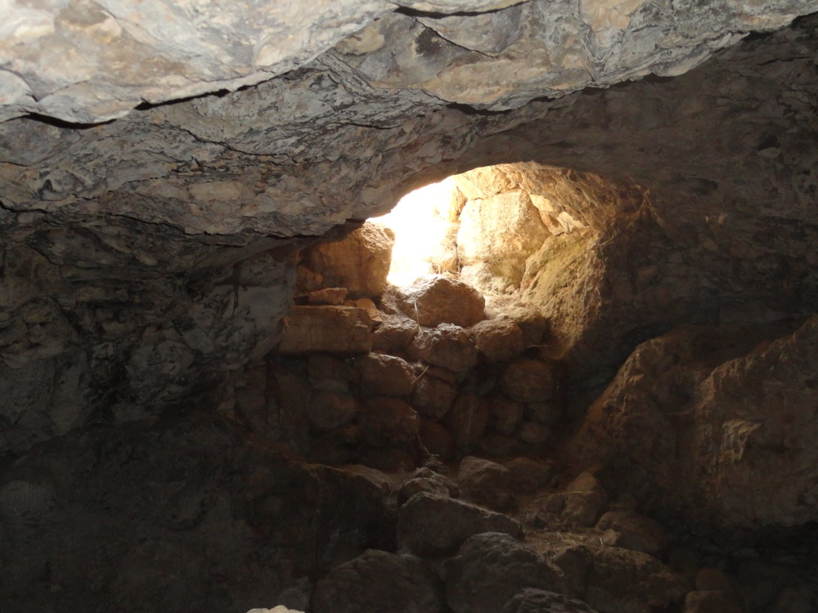
The Valley of Death
I Kings 19:1-4
1. Now Ahab told Jezebel all that Elijah had done, and how he had killed all the prophets with the sword.
2. Then Jezebel sent a messenger to Elijah, saying, "So may the gods do to me and even more, if I do not make your life as the life of one of them by tomorrow about this time."
3. And he was afraid and arose and ran for his life and came to Beersheba, which belongs to Judah, and left his servant there.
4. But he himself went a day's journey into the wilderness, and came and sat down under a juniper tree; and he requested for himself that he might die, and said, "It is enough; now, O LORD, take my life, for I am not better than my fathers."
Elijah’s fears caused depression and anxiety!
Notes:
I Kings 19
Verse 1
Now Ahab told Jezebel everything Elijah had done and how he had killed all the prophets with the sword. Jezebel is Ahab’s wicked wife. She’s a worshipper of Baal. She’s brought that worship to Israel, the Northern Kingdom. She’s killed many of the prophets of YHWH. She’s a blood-thirsty, vindictive, violent woman.
Verse 2
Jezebel sent a messenger to Elijah to say, “May the gods deal with me, be it ever so severely, if by this time tomorrow I do not make your life like that of one of them.”
Those gods that were silent, those gods that weren’t able to produce fire, those gods that YHWH was more powerful than, yeah, those gods.
No revolution. No deposition.
Jezebel hasn’t repented nor has she been deposed (even after her gods defeated) — far from that; she’s still on the throne barking out orders, ordering his death.
Then Elijah said, “Well, MY God raised the dead! MY God called down fire from heaven. MY God is with me. MY God is for me and you’re not going to tell me what to do because….I serve the Living God!
That’s what we expect and that’s what we hope for from one of the faithful prophets of Israel.
No, He goes back into hiding!
Verse 3
Elijah was afraid and ran for his life.
Wait! What??! You just saw God call down fire from heaven!
By the way, fear is exactly what he had just told the widow of Zerephath not to do.
Remember? When she was faced with famine, Elijah had said, “Do not fear” (I Kings 17:13)
Elijah, then, was doing exactly what he had just told someone else not to do.
Even preachers can get so caught up in a situation, even to the point where in a moment of weakness they fail to take their own advice.
As James says, “Elijah was a man with a nature like ours” (James 5:17)
The same man who had just called down fire from heaven, the same man who had just killed nearly a thousand false prophets, this man who made it rain after 3½ years of drought, is now overcome with fear.
Revelation 21:8: Those who are overcome with fear to the point they no longer fear God will meet their end in Hell as they fall into the category of the “Cowardly and Unbelievers.”
When he came to Beersheba in Judah, he left his servant there, while he himself went a day’s journey into the wilderness. For whatever reason he left the one person who knew him better than any mortal behind in order to be alone! (Ironically, later we see he fears being alone! See Verses 10 & 14)
Verse 4
He came to a Juniper tree, sat down under it and prayed that he might die.
“I have had enough, Lord,” he said. “Take my life; I am no better than my ancestors.” He was, in essence, saying, “I have been as ineffective as other prophets in turning Israel back to the Lord!”
“I’ve had enough!” Have you ever been in that place?
“Lord, I’ve had enough.” And yet, this is one of the prophets of Israel, this is one of the heroes of the faith.
One of the people we look to and go, “We should be more like Elijah.” What he says in this text is “I’d rather die.”
As much as he’s been on the mountain and he’s seen God work, now he’s in the valley of the shadow of death!
For some people, they seem to think if they just had enough faith they wouldn’t ever be scared, or they would never be depressed! (Matthew 6:25-33: Jesus says not to be anxious or depressed because it doesn’t help and in verse 27 He says it can’t add to your life! Most times, anxiety and depression make life harder! Trust in God – Matthew 6:33: God provided food and drink for Elijah, 1st by Ravens and the brook, and 2nd by an angel!)
Maybe they thought, “Faith is like the magic blue pill and when you take it, every one of your troubles goes away,” or someone told them that!
Some think or teach, “If you’re depressed, if you’re upset, well all that means is you’re just not trusting Jesus enough.”
I’m happy this chapter is here for it teaches us that there are frailties of being human, and that faith in God does not always keep the fears away!
We see people all throughout the Scriptures who see God move mightily, and then say, “God, I don’t even want to live anymore.”
Moses (Numbers 11:4-15)
David (II Samuel 12:15-23)
Jonah (Jonah 4:3)
Apostle Paul (II Cor. 1:8): After his ministry in Asia, he says: We were under great pressure, (life was so hard there) far beyond our ability to endure, so that we despaired of life itself.

Slide 6
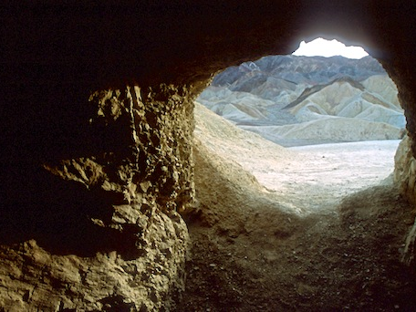
Fears of…
I Kings 19
I Kings 19:3
Health Fears: Life & Death!
Jezebel had killed other prophets and she promises to kill Elijah
Health
Notes:
Thanatophobia = Intense fear of death or dying
Elijah fears dying at the hands of Jezebel
Ironically, he asks God to take his life!
Perhaps, like David before him, he would rather the just wrath of God over the wrath of men (II Samuel 24:14)

Slide 7
Fears of…
I Kings 19
I Kings 18:7-14; 19:10, 14
Persecution Fears: Hunted down with the threat of death
Jezebel had hunted down and killed other prophets of God, and now she hunts for Elijah and intends to kill him
Health
Persecution
Notes:
Xenophobia = Fear or Hatred of Foreigners & Strangers. Often expressed by persecution of foreigners & strangers. Fear of the unknown!
Elijah is hunted by Jezebel (I Kings 18:7-14; 19:10, 14)
I Kings 18:10: Obadiah said to Elijah, “As the LORD your God lives, there is no nation or kingdom where my master has not sent to search for you; and when they said, 'He is not here,' he made the kingdom or nation swear that they could not find you.”
Obadiah helped hide the prophets, but he could not save them all!

Slide 8
Fears of…
I Kings 19
I Kings 18:22; 19:3, 10, 14
Loneliness Fears: Elijah was outnumbered on Mt. Carmel 850 to 1, and in the cave says, “I alone am left”
To feel alone or isolated can be discouraging, demoralizing, and can leave one with sense of dread or a sense of loss
Elijah was ready to quit!
Health
Persecution
Loneliness
Notes:
Monophobia = Fear being alone, isolated, or lonely
Also known as: Autophobia, Isolophobia, or Eremophobia
For fearing he is the only one left, which isn’t true (I Kings 19:18), he goes a long way to be alone! (I Kings 19:3-9)
From Jezreel, Elijah flees to Beersheba, which means he crossed the southern border into the Kingdom of Judah
Once there, he leaves his servant there
He flees into the wilderness alone for a day’s journey, and after a short time there, he moves on
He makes it all the way to Mt. Horeb, the “mountain of God” (Mt. Sinai, where the children of Israel received the law), a journey that lasted several weeks!
Once there he enters a cave and lodges there
At the beginning of Elijah’s life, he’s led by God into the wilderness for solitude and strengthening.
When Elijah’s fear and anxiety take over, he runs into the wilderness to get isolation.
Solitude and isolation are two very different things.
Solitude is usually something we desire for reflection and to be strengthened
Isolation is usually something we desire when we wish to cut ourselves off from other people
Have you ever been there? Afraid to be alone, but you cut off your loved ones, the very ones that can help and offer you love and support?
A story has been told that goes along those lines…
A man wouldn’t get out of bed one Sunday morning.
His wife tried and tried, begged and begged for him to get up.
He said, “I don’t want to go today!” This goes on and on, back and forth for some time
Finally, the wife says, “But you have to go to services today! You are the preacher!”
Sometimes life is like that. We just want to be alone, and yet, when it comes down to it, we don’t want to really feel alone.
Elijah went to extremes to be alone but didn’t want to be alone, and it led to him asking God to just end it, to take his life!

Slide 9
Fears of…
I Kings 19
The Solution to his Fears: God
What God doesn’t do:
Rebuke, argue, condemn
How God deals with Elijah:
Physically: He sends an angel of rest
Psychologically: God listens
Spiritually: God gives him a task
Health
Persecution
Loneliness
Notes:
What God doesn’t do in dealing with Elijah’s depression:
Rebuke or argue, condemn or judge
How God deals with Elijah’s depression:
Physically: He sends an angel of rest
I Kings 19:5-8: An angel is God’s messenger, and this one was sent to give Elijah comfort and aid in his time of need.
He doesn’t say, “You just need a little more faith!” He doesn’t say, “Hey, get it together!”
The angel touches him (that personal touch that we often need more than friend’s words)
The angel makes some nice, hot food for him
Elijah naps (He is exhausted! He ran about 20 miles from Mt. Carmel to Jezreel, outrunning Ahab’s chariot in I Kings 18:45-46, then heads south into Judah to Beersheba, then a day into the wilderness, and on to Mt. Horeb!) – Elijah needed rest.
Then the angel sends him in the strength of that food on a 40-day journey to Mt. Horeb (We could all use that energy food and drink!)
Sometimes you need some comfort food and a nap!
Psychologically: God listens
I Kings 19:9-14: God asked, “What are you doing here, Elijah?” He then listened to Elijah’s response.
Twice, in this passage, God asks Elijah why he is depressed, and twice Elijah answers with a mixture of truth and error:
“I have been zealous for you” – True
The Israelites rejected You” – True
They have killed Your prophets” – True
“I’m the only one left” – False (19:18)
Elijah may have felt ineffective as a prophet (“I am not better than my fathers” – 19:4): Ahab & Jezebel were still ruling Israel.
Rulers didn’t repent.
People didn’t repent.
No revolution, even after the people saw what God did on Mt. Carmel and they put the false prophets to death!
Idolatry still rampant!
Elijah had pushed away his servant in 19:2 – what NOT to do when dealing with depression.
He had forgotten about Obadiah and the hundred prophets he saved (I Kings 18:13)
He had forgotten about his own servant (I Kings 19:2)
He didn’t know about Shaphat and his wife, who had raised a godly son, Elisha, who would be a friend and successor to Elijah (I Kings 19:19-21; II Kings 2)
Here, in the cave on Mt. Horeb, God listens and is a friend to Elijah. He provides comfort.
When you are sorrowful, or depressed, it may help to talk it out, to express how you are feeling.
God’s comfort to Elijah is in contrast to when Moses and the Israelites were here at Mt. Sinai (Horeb):
Exodus 19:14-25: God descended upon Mt. Sinai in thunder & lightning, fire and earthquakes
I Kings 19:11-13: God was not in the strong wind. God was not in the earthquake. God was not in the fire.
After the gentle blowing, a voice asked Elijah what he was doing there.
These are all frequent images of God’s presence: Wind: Job; Acts 2; Fire: Exodus 3; Acts 2; Earthquake: Exodus 19; Matthew 27:51-54
God was not in those things that could destroy, but in the gentle blowing wind. God is the God of all comfort! – II Corinthians 1:3-4
2Co 1:3 Blessed be the God and Father of our Lord Jesus Christ, the Father of mercies and God of all comfort,
2Co 1:4 who comforts us in all our affliction so that we will be able to comfort those who are in any affliction with the comfort with which we ourselves are comforted by God.
Spiritually: God gives him an assignment
I Kings 19:15-18: God reveals to Elijah His plan. God gives Elijah his next assignment!
God’s voice in our lives doesn’t always come in the ways we expect.
Here, God reveals He is working in the life of a pagan king to bring judgment on the house of Ahab and Jezebel (King Hazael of Syria, the Arameans – I Kings 22; II Kings 8:8-15, 28-29; 9:14-15)
He is working in the life of Jehu, who would be king over Israel and completely judge the house of Ahab – II Kings 9-10
He is to anoint his own replacement, Elisha, who would be twice as powerful, and who would confront the evils of the house of Ahab head on – I Kings 19:19-21
Elijah is not alone for God reveals there are 7,000 people who have not knelt to Baal or kissed his image!
How wrong Elijah was! Not alone: 7,000, and then comes Elisha (perhaps the friend Elijah desperately needed), and ultimately Jesus, Who promises in Hebrews 13:5-6…
Heb 13:5 Make sure that your character is free from the love of money, being content with what you have; for He Himself has said, "I WILL NEVER DESERT YOU, NOR WILL I EVER FORSAKE YOU,"
Heb 13:6 so that we confidently say, "THE LORD IS MY HELPER, I WILL NOT BE AFRAID. WHAT WILL MAN DO TO ME?"
So often, we put God in a box and expect a certain outcome, and when it doesn’t happen we become despondent!
Trust in God!
He sees the big picture!

Slide 10
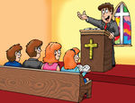
Conclusion When saints today face Fears of…
“What are you doing here?”
The Solution to our Fears: God
Turn to the God of all comfort
II Corinthians 1:3-4
Get back to work!
Galatians 6:9 (I Cor. 15:58)
II Thessalonians 3:13
Look to Jesus as example
Hebrews 12:1-3
You are not alone
Hebrews 13:5-6
I Peter 5:8-9
Health
Persecution
Loneliness
Notes:
God asks each of us in our despair, “What are you doing here?”
Turn to the God of all comfort!
2Co 1:3 Blessed be the God and Father of our Lord Jesus Christ, the Father of mercies and God of all comfort,
2Co 1:4 who comforts us in all our affliction so that we will be able to comfort those who are in any affliction with the comfort with which we ourselves are comforted by God.
Get back to work! Remember you have an assignment to be lights to the world!
Gal 6:9 Let us not lose heart in doing good, for in due time we will reap if we do not grow weary.
(1Cor 15:58 Therefore, my beloved brethren, be steadfast, immovable, always abounding in the work of the Lord, knowing that your toil is not in vain in the Lord.)
2Th 3:13 But as for you, brethren, do not grow weary of doing good.
Look to Jesus as our example in completing our tasks, even when the way is rough and discouraging
Heb 12:1 Therefore, since we have so great a cloud of witnesses surrounding us, let us also lay aside every encumbrance and the sin which so easily entangles us, and let us run with endurance the race that is set before us,
Heb 12:2 fixing our eyes on Jesus, the author and perfecter of faith, who for the joy set before Him endured the cross, despising the shame, and has sat down at the right hand of the throne of God.
Heb 12:3 For consider Him who has endured such hostility by sinners against Himself, so that you will not grow weary and lose heart.
You are not alone!
Heb 13:5 Make sure that your character is free from the love of money, being content with what you have; for He Himself has said, "I WILL NEVER DESERT YOU, NOR WILL I EVER FORSAKE YOU,"
Heb 13:6 so that we confidently say, "THE LORD IS MY HELPER, I WILL NOT BE AFRAID. WHAT WILL MAN DO TO ME?"
1Pe 5:8 Be of sober spirit, be on the alert. Your adversary, the devil, prowls around like a roaring lion, seeking someone to devour.
1Pe 5:9 But resist him, firm in your faith, knowing that the same experiences of suffering are being accomplished by your brethren who are in the world.
God recognizes that we need help.
We are not called to do the work all by ourselves.
Moses needed help and God gave him elders to help him lead and judge the people.
Elijah needed help and God appointed Elisha to work with him and be his eventual successor.
We must work together (Ephesians 4:14-16).
We can easily become discouraged in our spiritual walk, either as individuals or as a group. We need to lift one another up and carry the load so that the work does not fall on one individual (Galatians 6:2).

Slide 11
Conclusion When saints today face Fears of…
“What are you doing here?”
The Solution to our Fears: God
Turn to the God of all comfort
II Corinthians 1:3-4
Get back to work!
Galatians 6:9 (I Cor. 15:58)
II Thessalonians 3:13
Look to Jesus as example
Hebrews 12:1-3
You are not alone
Hebrews 13:5-6
I Peter 5:8-9
Health
Persecution
Loneliness
Notes:
God asks each of us in our despair, “What are you doing here?”
Turn to the God of all comfort!
2Co 1:3 Blessed be the God and Father of our Lord Jesus Christ, the Father of mercies and God of all comfort,
2Co 1:4 who comforts us in all our affliction so that we will be able to comfort those who are in any affliction with the comfort with which we ourselves are comforted by God.
Get back to work! Remember you have an assignment to be lights to the world!
Gal 6:9 Let us not lose heart in doing good, for in due time we will reap if we do not grow weary.
(1Cor 15:58 Therefore, my beloved brethren, be steadfast, immovable, always abounding in the work of the Lord, knowing that your toil is not in vain in the Lord.)
2Th 3:13 But as for you, brethren, do not grow weary of doing good.
Look to Jesus as our example in completing our tasks, even when the way is rough and discouraging
Heb 12:1 Therefore, since we have so great a cloud of witnesses surrounding us, let us also lay aside every encumbrance and the sin which so easily entangles us, and let us run with endurance the race that is set before us,
Heb 12:2 fixing our eyes on Jesus, the author and perfecter of faith, who for the joy set before Him endured the cross, despising the shame, and has sat down at the right hand of the throne of God.
Heb 12:3 For consider Him who has endured such hostility by sinners against Himself, so that you will not grow weary and lose heart.
You are not alone!
Heb 13:5 Make sure that your character is free from the love of money, being content with what you have; for He Himself has said, "I WILL NEVER DESERT YOU, NOR WILL I EVER FORSAKE YOU,"
Heb 13:6 so that we confidently say, "THE LORD IS MY HELPER, I WILL NOT BE AFRAID. WHAT WILL MAN DO TO ME?"
1Pe 5:8 Be of sober spirit, be on the alert. Your adversary, the devil, prowls around like a roaring lion, seeking someone to devour.
1Pe 5:9 But resist him, firm in your faith, knowing that the same experiences of suffering are being accomplished by your brethren who are in the world.
God recognizes that we need help.
We are not called to do the work all by ourselves.
Moses needed help and God gave him elders to help him lead and judge the people.
Elijah needed help and God appointed Elisha to work with him and be his eventual successor.
We must work together (Ephesians 4:14-16).
We can easily become discouraged in our spiritual walk, either as individuals or as a group. We need to lift one another up and carry the load so that the work does not fall on one individual (Galatians 6:2).

Slide 12
Conclusion
Elijah, a man with a nature like ours and an example of a righteous man’s prayer
James 5:16-18
16. Therefore, confess your sins to one another, and pray for one another so that you may be healed. The effective prayer of a righteous man can accomplish much.
17. Elijah was a man with a nature like ours, and he prayed earnestly that it would not rain, and it did not rain on the earth for three years and six months.
18. Then he prayed again, and the sky poured rain and the earth produced its fruit.
Notes:
Elijah, a man with a nature like ours and an example of a righteous man’s prayer
James 5:16-18
16. Therefore, confess your sins to one another, and pray for one another so that you may be healed. The effective prayer of a righteous man can accomplish much.
17. Elijah was a man with a nature like ours, and he prayed earnestly that it would not rain, and it did not rain on the earth for three years and six months.
18. Then he prayed again, and the sky poured rain and the earth produced its fruit.

Slide 13
Conclusion
Remember Elijah’s request to God in I Kings 19:4?
II Kings 2:1-14
God answered his prayer!
God did take his life, took him right up to Heaven in a whirlwind while Elisha and others stood watching, separated by a chariot of fire pulled by horses of fire!
Notes:
Remember Elijah’s request to God in I Kings 19:4?
1Ki 19:4 But he himself went a day's journey into the wilderness, and came and sat down under a juniper tree; and he requested for himself that he might die, and said, "It is enough; now, O LORD, take my life, for I am not better than my fathers."
He asked God to take his life.
God did answer Elijah’s prayer, just not in the way and timing Elijah thought!
II Kings 2:1-14: After calling Elisha to replace him as God commanded him to do, somehow Elijah knew his time was up.
God did take his life, took him right up to Heaven in a whirlwind while Elisha and others stood watching, separated by a chariot of fire pulled by horses of fire!
2Ki 2:11 As they were going along and talking, behold, there appeared a chariot of fire and horses of fire which separated the two of them. And Elijah went up by a whirlwind to heaven.
2Ki 2:12 Elisha saw it and cried out, "My father, my father, the chariots of Israel and its horsemen!" And he saw Elijah no more. Then he took hold of his own clothes and tore them in two pieces.
God’s timing is always best!

Slide 14
Conclusion
When you are in your Cave of Sorrow, or in the Valley of Death, seek out friends (don’t pull away), and remember to pray!
I Peter 5:6-7
6. Therefore humble yourselves under the mighty hand of God, that He may exalt you at the proper time,
7. casting all your anxiety on Him, because He cares for you.

Slide 15
“What Must I Do To Be Saved?”
Hear The Gospel (Jn. 5:24; Rom. 10:17)
Believe In Christ (Jn. 3:16-18; Jn. 8:24)
Repent Of Sins (Lk. 13:3-5; Acts 2:38)
Confess Christ (Mt. 10:32; Rom. 10:10)
Be Baptized (Mk. 16:16; Acts 22:16)
Remain Faithful (Jn. 8:31; Rev. 2:10)
For The Erring Saint:
Repent (Acts 8:22), Confess (I John 1:9),
Pray (Acts 8:22)

