Slide 1
((e^iπ/ gcd((2^57,885,161 - 1, 2^43,112,609 - 1))^2) + tan(π/4)
Or
1+1=2
Or
+
=

Slide 2
What Happened Next…

Slide 3
Putting It Together
The “Great Commission” given to the apostles

Slide 4
Go therefore and make disciples of all nations, baptizing them in the name of the Father and of the Son and of the Holy Spirit, teaching them to observe all that I have commanded you. – Matthew 28:19-20a
“Go into all the world and proclaim the gospel to the whole creation. Whoever believes and is baptized will be saved, but whoever does not believe will be condemned. – Mark 16:15-16a
And that repentance for the forgiveness of sins should be proclaimed in his name to all nations, beginning from Jerusalem. – Luke 24:47

Slide 5
Go therefore and make disciples of all nations, baptizing them in the name of the Father and of the Son and of the Holy Spirit, teaching them to observe all that I have commanded you. – Matthew 28:19-20a
“Go into all the world and proclaim the gospel to the whole creation. Whoever believes and is baptized will be saved, but whoever does not believe will be condemned. – Mark 16:15-16a
And that repentance for the forgiveness of sins should be proclaimed in his name to all nations, beginning from Jerusalem. – Luke 24:47

Slide 6
Putting It Together
The “Great Commission” given to the apostles
Preaching
Belief
Repentance
Baptism
God Has Taken The Complex And Taught It With Simplicity

Slide 7
Whoever believes and is baptized will be saved
+
=
persuaded
immersed
rescued
Sometimes We Need The Apples!

Slide 8
What Happened Next…
Jews on Pentecost

Slide 9
This Jesus God raised up, and of that we all are witnesses. Being therefore exalted at the right hand of God, and having received from the Father the promise of the Holy Spirit, he has poured out this that you yourselves are seeing and hearing. For David did not ascend into the heavens, but he himself says,
“‘The Lord said to my Lord, “Sit at my right hand, until I make your enemies your footstool.”’
Let all the house of Israel therefore know for certain that God has made him both Lord and Christ, this Jesus whom you crucified.” Now when they heard this they were cut to the heart, and said to Peter and the rest of the apostles, “Brothers, what shall we do?” And Peter said to them, “Repent and be baptized every one of you in the name of Jesus Christ for the forgiveness of your sins, and you will receive the gift of the Holy Spirit

Slide 10
This Jesus God raised up, and of that we all are witnesses. Being therefore exalted at the right hand of God, and having received from the Father the promise of the Holy Spirit, he has poured out this that you yourselves are seeing and hearing. For David did not ascend into the heavens, but he himself says,
“‘The Lord said to my Lord, “Sit at my right hand, until I make your enemies your footstool.”’
Let all the house of Israel therefore know for certain that God has made him both Lord and Christ, this Jesus whom you crucified.” Now when they heard this they were cut to the heart, and said to Peter and the rest of the apostles, “Brothers, what shall we do?” And Peter said to them, “Repent and be baptized every one of you in the name of Jesus Christ for the forgiveness of your sins, and you will receive the gift of the Holy Spirit

Slide 11
This Jesus God raised up, and of that we all are witnesses. Being therefore exalted at the right hand of God, and having received from the Father the promise of the Holy Spirit, he has poured out this that you yourselves are seeing and hearing. For David did not ascend into the heavens, but he himself says,
“‘The Lord said to my Lord, “Sit at my right hand, until I make your enemies your footstool.”’
Let all the house of Israel therefore know for certain that God has made him both Lord and Christ, this Jesus whom you crucified.” Now when they heard this they were cut to the heart, and said to Peter and the rest of the apostles, “Brothers, what shall we do?” And Peter said to them, “Repent and be baptized every one of you in the name of Jesus Christ for the forgiveness of your sins, and you will receive the gift of the Holy Spirit

Slide 12
What Happened Next…
Jews on Pentecost
Samaritans
Now those who were scattered went about preaching the word. Philip went down to the city of Samaria and proclaimed to them the Christ. And the crowds with one accord paid attention to what was being said by Philip, when they heard him and saw the signs that he did./But when they believed Philip as he preached good news about the kingdom of God and the name of Jesus Christ, they were baptized, both men and women. 8:4-6/12

Slide 13
What Happened Next…
Jews on Pentecost
Samaritans
Now those who were scattered went about preaching the word. Philip went down to the city of Samaria and proclaimed to them the Christ. And the crowds with one accord paid attention to what was being said by Philip, when they heard him and saw the signs that he did./But when they believed Philip as he preached good news about the kingdom of God and the name of Jesus Christ, they were baptized, both men and women. 8:4-6/12

Slide 14
What Happened Next…
Jews on Pentecost
Samaritans
Simon
Even Simon himself believed, and after being baptized he continued with Philip. And seeing signs and great miracles performed, he was amazed. – 8:13

Slide 15
What Happened Next…
Then Philip opened his mouth, and beginning with this Scripture he told him the good news about Jesus. And as they were going along the road they came to some water, and the eunuch said, “See, here is water! What prevents me from being baptized?” And he commanded the chariot to stop, and they both went down into the water, Philip and the eunuch, and he baptized him. 8:35-38
Jews on Pentecost
Samaritans
Simon
Eunuch

Slide 16
What Happened Next…
Then Philip opened his mouth, and beginning with this Scripture he told him the good news about Jesus. And as they were going along the road they came to some water, and the eunuch said, “See, here is water! What prevents me from being baptized?” And he commanded the chariot to stop, and they both went down into the water, Philip and the eunuch, and he baptized him. 8:35-38
Jews on Pentecost
Samaritans
Simon
Eunuch

Slide 17
What Happened Next…
And he said, ‘The God of our fathers appointed you to know his will, to see the Righteous One and to hear a voice from his mouth; for you will be a witness for him to everyone of what you have seen and heard./ And now why do you wait? Rise and be baptized and wash away your sins, calling on his name.’/ And immediately something like scales fell from his eyes, and he regained his sight. Then he rose and was baptized -- 9:18/22:14-16
Jews on Pentecost
Samaritans
Simon
Eunuch
Saul

Slide 18
What Happened Next…
And he said, ‘The God of our fathers appointed you to know his will, to see the Righteous One and to hear a voice from his mouth; for you will be a witness for him to everyone of what you have seen and heard./ And now why do you wait? Rise and be baptized and wash away your sins, calling on his name.’/ And immediately something like scales fell from his eyes, and he regained his sight. Then he rose and was baptized-- 9:18/22:14-16
Jews on Pentecost
Samaritans
Simon
Eunuch
Saul

Slide 19
What Happened Next…
Jews on Pentecost
Samaritans
Simon
Eunuch
Saul
Cornelius
When they heard these things they fell silent. And they glorified God, saying, “Then to the Gentiles also God has granted repentance that leads to life.”/And he commanded them to be baptized in the name of Jesus Christ. Then they asked him to remain for some days. 11:18;10:48

Slide 20
What Happened Next…
Jews on Pentecost
Samaritans
Simon
Eunuch
Saul
Cornelius
When they heard these things they fell silent. And they glorified God, saying, “Then to the Gentiles also God has granted repentance that leads to life.”/And he commanded them to be baptized in the name of Jesus Christ. Then they asked him to remain for some days. 11:18;10:48

Slide 21
What Happened Next…
Jews on Pentecost
Samaritans
Simon
Eunuch
Saul
Cornelius
Lydia
One who heard us was a woman named Lydia, from the city of Thyatira, a seller of purple goods, who was a worshiper of God. The Lord opened her heart to pay attention to what was said by Paul. And after she was baptized, and her household as well, she urged us, saying, “If you have judged me to be faithful to the Lord, come to my house and stay.” And she prevailed upon us.
-- 16:14-15

Slide 22
What Happened Next…
Jews on Pentecost
Samaritans
Simon
Eunuch
Saul
Cornelius
Lydia
One who heard us was a woman named Lydia, from the city of Thyatira, a seller of purple goods, who was a worshiper of God. The Lord opened her heart to pay attention to what was said by Paul. And after she was baptized, and her household as well, she urged us, saying, “If you have judged me to be faithful to the Lord, come to my house and stay.” And she prevailed upon us.
-- 16:14-15

Slide 23
What Happened Next…
And the jailer called for lights and rushed in, and trembling with fear he fell down before Paul and Silas. Then he brought them out and said, “Sirs, what must I do to be saved?” And they said, “Believe in the Lord Jesus, and you will be saved, you and your household.” And they spoke the word of the Lord to him and to all who were in his house. And he took them the same hour of the night and washed their wounds; and he was baptized at once, he and all his family. – 16:29-32
Jews on Pentecost
Samaritans
Simon
Eunuch
Saul
Cornelius
Lydia
Jailer

Slide 24
What Happened Next…
And the jailer called for lights and rushed in, and trembling with fear he fell down before Paul and Silas. Then he brought them out and said, “Sirs, what must I do to be saved?” And they said, “Believe in the Lord Jesus, and you will be saved, you and your household.” And they spoke the word of the Lord to him and to all who were in his house. And he took them the same hour of the night and washed their wounds; and he was baptized at once, he and all his family. – 16:29-32
Jews on Pentecost
Samaritans
Simon
Eunuch
Saul
Cornelius
Lydia
Jailer

Slide 25
Preacher
Belief
Repentance
Baptism
Jews
Peter
Implied
Yes
Yes
Samaritans
Philip
Yes
Implied
Yes
Simon
Philip
Yes
Implied
Yes
Eunuch
Philip
Implied
Implied
Yes
Saul
Ananias
Implied
Implied
Yes
Cornelius
Peter
Implied
Yes
Yes
Lydia
Paul
Implied
Implied
Yes
Jailer
Paul/Silas
Yes
Implied
Yes

Slide 26
To Titus, my true child in a common faith: Grace and peace from God the Father and Christ Jesus our Savior. – Titus 1:4
Beloved, although I was very eager to write to you about our common salvation, I found it necessary to write appealing to you to contend for the faith that was once for all delivered to the saints. – Jude 3

Slide 27
Clearing The Path
As I urged you when I was going to Macedonia, remain at Ephesus so that you may charge certain persons not to teach any different doctrine, nor to devote themselves to myths and endless genealogies, which promote speculations rather than the stewardship from God that is by faith. -- I Timothy 1:3-4

Slide 28
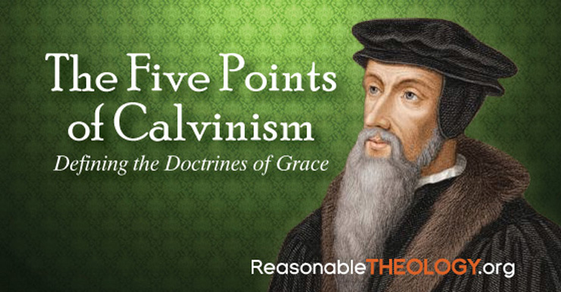
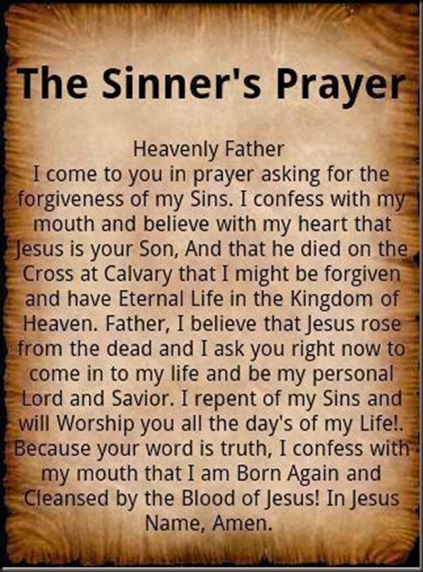
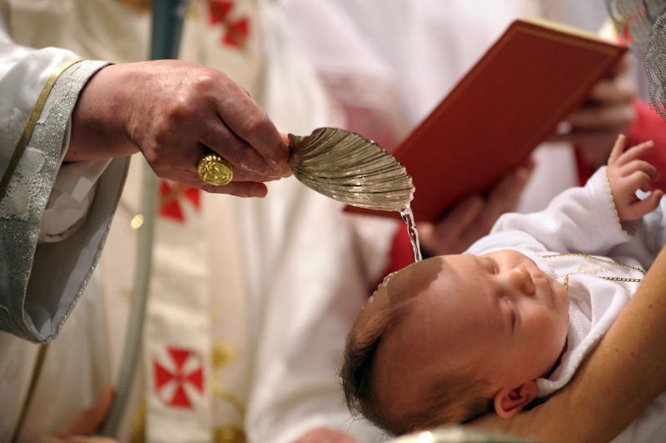
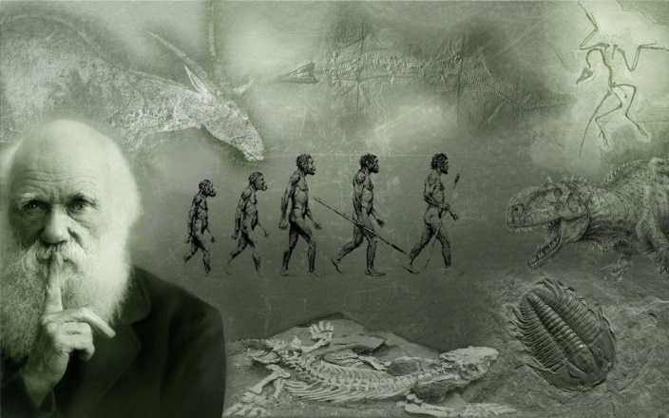

Slide 29
What Happens Next…
With Your Salvation?

