Slide 1
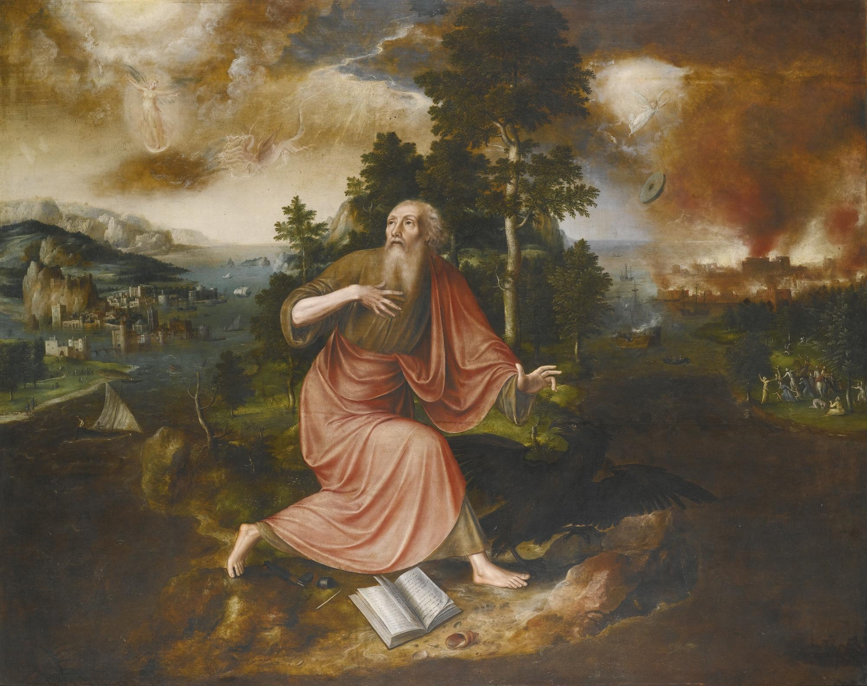
No Fear of the Apocalypse
Finding Hope in Apocalyptic literature
Notes:
=The last letter of John describes itself as “the revelation of Jesus Christ.” It is an apocalypse... or an unveiling... meaning that if God had not taken the initiative, the human mind could never have understood the real spiritual forces at work in the world…
-No one could have known how it would all turn out. The term “Apocalypse” or “revelation” is an indication of the nature and purpose of this last letter from John. Christ has something to reveal to us through John’s letter. In a way, the book of Revelation is the culmination of all the design patterns of the Hebrew Bible Prophets.
-READ Rev 1:1-3, This verse, v3, promises a blessing to those who hear “the words of this prophecy” (READ 22:7, 10). So… Has the revelation of Christ to John been a blessing to you? No? Why not? How then is this letter a blessing?
== !!The apocalypse of John is designed to shake us from our view of the world... like a dog shakes off water after a swim. But the Bible doesn’t only deconstruct the way we’ve always seen the world(deconstruction happens to be a popular buzzword now); the Bible replaces our frail paradigms with a new robust one, one that sees from God’s perspective. That’s what the apocalypse that John had was all about… seeing from God’s perspective. When we let the Bible become our lens for how we view our reality, we become free, and everything begins to look different. We get divine clarity.
=This last letter of John gives you, the reader, the task of going out and looking at your reality, in your time, through the lens of the design patterns presented in the letter.
=This is a lens of Hope though! Even if the writer is writing from the depths of despair, banished to a small remote island, near the end of his life. The resurrection of Jesus Christ gives us a reason for uniting ourselves and the ability to love other people more than ourselves, and an ultimate hope for victory over evil and death.
=...That last part is what I want to focus on today… hope of victory over evil and death.

Slide 2
Outline
Introduction
Context
Theopolitical setting
Revelation as a lens
Victim to Victor
Christ the Firstborn(of God, of man, of the dead 1:5)
Slain lamb imagery (slain but standing, no fear in death)
Chs 5-10=slain in Christ
Chs 21-22=slain vindicated
Polemic against the oppressor
Revelation as a lens of fear, and hope
For viewing ruling structures
Oppression, persecution, war
For viewing our behavior
Notes:
I don’t have time to give a detailed analysis of every view of revelation this morning. If you have a point that you disagree with, please approach me afterwards, I would love to discuss it then.
-This will be the basic outline for today’s lesson...

Slide 3
Introduction
Context
Author and date
“John” about 96-98AD
Theopolitical setting
Sacrifice to the gods or a pledge of allegiance to Caesar was the only way to success in Rome
Revelation as a lens
A letter “to the seven churches that are in Asia”
Notes:
First talk about: “Apocalyptic narrative” applies to a broad group of writings that flourished in the biblical world between 200 b.c. and a.d. 100 and to the basic concepts contained in those writings. The majority of scholars place the composition of the Apocalypse during the reign of Domitian (a.d. 81-96). And When we turn to Revelation itself, it is obvious that the context of the book is a conflict between the demands of a totalitarian secular power and allegiance to the Christian faith.
-The book of Revelation was written to seven churches as both encouragement and challenge. As an apocalyptic letter, it relies on visions, symbols, and Old Testament references to reveal the ultimate fulfillment of God's promise given to Abraham in Genesis. “All nations will be blessed”
-The author of the Apocalypse identifies himself simply as John. The introduction of 1:4 simply reads, “John, to the seven churches in the province of Asia.” Apparently it could be assumed that there could be no possibility of mistaken identity. Within the book itself, however, there is no specific indication as to who exactly this John was.
-It was widely accepted by the second-century church as the work of John the apostle. In fact there is no book of the entire New Testament whose external attestation can compare with that of Revelation. I think the wisest course of action is to accept as a reasonable hypothesis that the Apocalypse was written by John the apostle, son of Zebedee and disciple of Jesus.

Slide 4
Introduction
Context
Author and date
“John” about 96-98AD
Theopolitical setting
Sacrifice to the gods or a pledge of allegiance to Caesar was the only way to success in Rome
Revelation as a lens
A letter “to the seven churches that are in Asia”
Notes:
Revelation is also a theo-political text. It is “uncivil”. Revelation upsets the status quo because it calls out civil religion in all of its forms, and calls the church to live as an alternative polis in the midst of rampant idolatry, greed, and injustice (the true form and essence of the Empire’s civil religion). More worship of the emperor, meant more political favors that took advantage of more people, making you more wealthy.
The message of Revelation would have come across as strikingly political to the original audience.
=Efforts at understanding the book have been further complicated by traditions of treating Revelation as some sort of crystal ball that gives detailed geopolitical predictions about the time period we live in. This has led to all sorts of grotesque claims—Christians needing to support the modern nation of Israel in building a third Temple to hasten the return of Jesus... references in Revelation to the USSR, or the COVID-19 vaccine being the mark of the beast—all of these would have been absolutely inconceivable to John, the author of Revelation, or to the first-century Christians to whom john was writing.

Slide 5
Introduction
Context
Author and date
“John” about 96-98AD
Theopolitical setting
Sacrifice to the gods or a pledge of allegiance to Caesar was the only way to success in Rome
Revelation as a lens
A letter “to the seven churches that are in Asia”
Notes:
=The apocalyptic narrative of Revelation is challenging to us as modern readers, but it remains an understandable book if we seek to interpret it on its own terms.
-John is writing to seven congregations of Christians in Asia Minor about things that actually would have been relevant to them in their time and place. He peels back the curtain to allow his audience to see the spiritual realities that lay behind their daily experiences.
=Specifically, he addresses the pressure that Rome, the great beast under the influence of Satan, who is the great dragon), Rome is pressuring Christians **to deny their allegiance to King Jesus** and instead give in to the social, economic, and religious requirements of Rome.
-John encourages those faithfully resisting to hang onto the confidence that Jesus has already claimed the victory over Satan, and that His followers will be vindicated. John’s message to the ones who have given in is warning and judgment: they must repent before they are wiped out along with the rest of God’s enemies.
=So integrated was Roman government, Roman religion, military prowess, and society that it was impossible to be considered a good citizen or a good neighbor if one resisted sacrifice to the gods or a pledge of allegiance to Caesar above all else.
-It is in this context, John depicts Rome as a hideous beast under the influence of evil spiritual forces! This is a deeply political text.
=And so the question this morning is this: Have you denied your allegiance to King Jesus, and pledged allegiance to a political ideology, or a particular politician as the one who will save our nation? have you succumbed to the social, economic, and religious requirements of Rome. That is true application of the principles found in John’s apocalypse. That is… looking through Revelation tinted glasses.

Slide 6
Milestones in The Revelation
https://bibleproject.com/learn/revelation/
Seven Letters
John wrote the book of Revelations to encourage believers in seven churches to resist sin, remain faithful although persecuted, and anticipate Jesus's return as King. These churches are representative of all churches.
The Sacrificed Lamb
The Old Testament's promise of God's future victorious kingdom was inaugurated through Jesus, the crucified Passover Lamb and Messiah who alone was able to open the sealed scroll.
Seven Judgments
Three sets of seven divine judgments do not generate repentance in the nations. Instead, only God's mercy shown through Jesus and believers who die for enemies does.
Final Battle
Several symbols signify spiritual and earthly battles. The church can choose to resist Babylon and follow the Lamb or follow the beast and suffer defeat.
God's Kingdom
After the rebellion against God and the final battle, King Jesus returns to punish evil, vindicate His followers, and reign forever in the New Jerusalem.
Notes:
Let me give the Quickest overview of revelation ever… this is taken directly from the Bibleproject.com’s page on revelation.
=READ SLIDE
-Seven Judgments: breaking of the 7 seals, 7 trumpets, and 7 bowls.

Slide 7
Victim to Victor
Christ the Firstborn (of God, of creation, of the dead)
Psalm 89:27 “I also shall make him My firstborn, The highest of the kings of the earth.”
Colossians 1:15 “He is the image of the invisible God, the firstborn of all creation.”
Revelation 1:5 “the faithful witness, the firstborn of the dead, and the ruler of the kings of the earth.”
Slain lamb imagery (slain but standing, no fear of death)
Polemic against the oppressor
Notes:
Firstborn in Position, not chronological creation.
=Slaughtered political victim turned conquering warrior is a very different image to that which is often associated with Jesus as lamb. Biblical lambs are most often interpreted as sacrificial lambs who atone for sin, cute cuddly things with not a drop of blood in site!
=In portraying Christ as a conquering lamb, Revelation’s author reconfigures death. Death, particularly unjust death at the hand of an oppressor, is no longer a result of weakness but is portrayed instead as victory. Or more precisely, Jesus’ faithfulness to the point of death is what makes him a victor and model martyr. As Craig Koester in his revelation commentary writes, “it would appear that Jesus’ captors were victorious when they took his life, but in Revelation the opposite is true: Remaining loyal to God to the point of death is triumph.” The resurrection of the Lamb re-imagines the cross as victory, in a shocking reversal of power.
-Revelation continues to appeal to readers today precisely because it offers a framework for believing that the victim will ultimately become the victor.
=Revelation speaks to those who necessarily have a pessimistic outlook about the world’s power structures. It is written for those who are oppressed and have no recourse but hope in God’s justice… the ultimate representative of this being Christ himself.
=Jesus, if He was truth incarnate, had no option but to speak the truth about oppressive Jewish authorities. This would lead inevitably to his arrest and trial, his only recourse being destruction of the world at His command, or, trusting in the Father’s will.

Slide 8
Victim to Victor
Slain lamb imagery (slain but standing, no fear in death)
Chapters 5-18 = slain in Christ waiting
Chapters 21-22 = slain vindicated
Polemic against the oppressor
Notes:
Central to Revelation’s theology of hope and cosmic reversal of fortune is its particular and unusual portrayal of Christ as this slaughtered yet... standing lamb—the ultimate victim turned victor.
=We first see the lamb of Revelation in chapter five as part of a vision of the heavenly throne room. An angel tells John to look and “see, the Lion of the tribe of Judah” who has conquered (5:5). John turns to see this lion... but when he does, he sees a slaughtered lamb standing instead.
=This reversal of status(because dead sheep don’t stand!) is described as “vindication” in Revelation and Jesus’ embodiment of the lamb raises theological and ethical questions.
=As victor, the standing but slaughtered lamb is a potent symbol of the power of God to condemn injustice and vindicate those who have suffered for their faith in God. Jesus as lamb is therefore a martyr(A Greek word originally meant: witness) one whose death and ultimate vindication is a testimony and model for his follower’s ethical behavior.

Slide 9
Victim to Victor
Slain lamb imagery (slain but standing, no fear in death)
Chapters 5-18 = slain in Christ waiting
Chapters 21-22 = slain vindicated
Polemic against the oppressor
Notes:
=The symbolic work of the lamb metaphor takes us beyond the historical reality of Jesus as a victim of the Empire’s violent injustice and into the linguistic area of Passover. In the biblical tradition, the Passover Lamb is slaughtered, rather than offered as a sin sacrifice, and it serves as a means of remembrance of liberation from an oppressive regime.
=Revelation has inspired and continues to inspire Christians to hope for a better world. South African scholar Allan Boesak observes the cry of the martyrs in Revelation 6:10 and comments: “how long O Lord?” is a “cry of hope that God will prove to be the Mighty One […] it is a cry black South Africans who find their help in Yahweh have been uttering for a long time.” He wrote this in 1986. It would be another 7 long years before the practice of institutionalized racial segregation called Apartheid was abolished.
=Passover evokes the memory of the Hebrew people’s liberation from slavery, a reminder of a time when the blood of the lamb protected God’s people. The lamb’s blood in Revelation similarly acts to liberate the people (1:5)

Slide 10
Revelation as a Lens
A lens for viewing:
With a polarized filter (misuse)
“myth of persecution”
e.g. claiming to be a “Christian nation”… but not looking to God for answers
Ruling structures
Oppression, persecution, war
Our behavior
...of Fear
...of Hope
Notes:
=In light of this reality—the evil and corruption of the world around them, How are Christians supposed to live in a world that has Babylonian tendencies? Before we answer that question, we should first note what they are not encouraged to do:
-They are not encouraged to obsess over how beastly Rome is, and constantly rail against it because of this. After all we should expect that beasts will act in beastly ways. Rome is a beast, not the Bride of Christ!
-What is more is they are not encouraged to “Make Rome Great Again”, hearkening back to some fictitious history when the beast was somehow not a beast.
-On the other hand, neither are they encouraged to revolt against Rome or tear down all the pillars upon which society is built and work to create a utopian society where justice reigns.
=Instead, John encourages those to whom he is writing to remain faithful to Jesus, their Lord, at all costs.
-John is relying exclusively on the Hebrew scriptures for his imagery here. John has shown us that if we look from God’s perspective… all the back from the beginning, from babel to Babylon… Genesis 3 to 11 was about autonomy, human autonomy from God wanting to redefine good and evil. All political structures want to redefine good and evil… I mean that is why nations have laws, to define good and evil… and not a single nation today… or in John’s day lives by the standard of the God most high.

Slide 11
Revelation as a Lens
A lens for viewing:
With a polarized filter (misuse)
“myth of persecution”
e.g. claiming to be a “Christian nation”… but not looking to God for answers
Ruling structures
Oppression, persecution, war
Our behavior
...of Fear
...of Hope
Notes:
That’s what John wants us to see, even today… that every ruling structure, even in the first century is corrupt because it has fallible human beings at its head. The problem is that these humans though often claim to have a divine mandate for their behavior, whether it is Nebuchadnezzar, of Babylon, or Caesar of Rome, “one nation under God, with liberty for some and justice for a few”… over the last 275 years we have blurred the line between the truth of God’s word, and the “truth” that our Country stands for. This is known as syncretism. To the point where we can’t tell the God of the American Civil Religion from the actual God most high revealed in Jesus of Nazareth.
-Revelation is a lens that allows us to focus on the lamb, not the current political distress. It allows us to see the way God intended for His people to interact in a peaceful, benevolant, forgiving institution… and *spoiler alert* it isn’t America or Israel, or any other nation state.
=It’s the CHURCH. The church is supposed to be a multi-ethnic covenant people that are bound by their allegiance to Jesus and his love for them that causes them to live by a radically different value system as a response to Babylon.

Slide 12
Conclusion
Revelation is not a call to be a Christian empire
Revelation seeks to shape our worldview and foster hope
Notes:
Revelation is not a call to be a Christian empire. We need to adopt Jeremiah's philosophy, which was to live in the midst of Babylon and fully immerse yourself in the society, but only out of allegiance to a different ruler Jesus, and with a completely different value system. Which most of the time is going to create overlap in pursuit of the common good, but sometimes will create a conflict of allegiance. God's people are to obey God rather than man, as Peter puts it in Acts chapter 4 he will happily suffer whatever consequences that come, even if it means death. And here we hear echos of Daniel and Esther’s boldness. because depending on the particular moment in history, and what you're doing as the church, you're either being celebrated or you're a threat to national security.
The book is not a secret code that allows believers to decipher the timeline of Jesus's return. Instead, it shows that every human kingdom eventually becomes Babylon and must be resisted. Jesus, the slain Lamb who died for the sins of the world, will return one day as King with His followers to prompt repentance.

Slide 13
Conclusion
Revelation in practice
Hope in God’s reign manifests as ethical living:
Abstaining from worship of idols, the emperor… and the President
Non-participation + withdrawal from the economic injustices of Rome… and the USA
Notes:
READ SLIDE
-How are we supposed to think as a Christian about my relationship to the power institutions of the world? What is your answer? When someone asks what your political affiliation is, what is your answer? I’ll give you mine: “Jesus is Lord."
=So, when Caesar or Nebuchadnezzar or the President of the USA is on board with the common good as defined by Jesus(NOT MY POLITICAL PARTY), then we're happy neighbors… but none of those people will overcome the evil of the world.
==the only one who overcomes is the slaughtered, but standing Lamb. The one who overcame death by dying…. The Lamb brings his his multi-ethnic covenant people with Him through faith… in Him... And to the ones who overcome by faith in the lamb is made a spectacular promise… God will remove evil permanently and re-new all things.
=Read (Rev 21:1-6) are you thirsty? That promise motivates every generation of God's people to remain faithful in the midst of persecution until their King returns.
=Are you ready to commit your life to the king?

