Slide 1
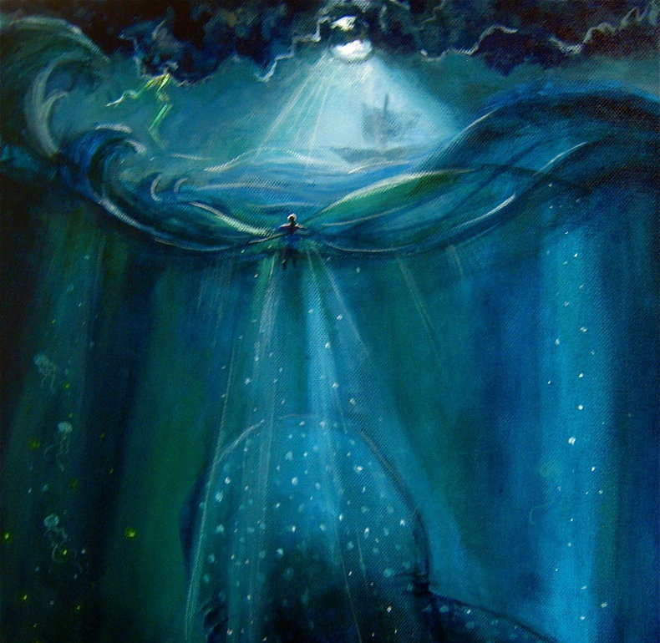
Jonah and the Ninevites
Book of Jonah, Part 2

Slide 2
Introducing the Book
Usually considered book of prophecy yet only has 5 words of prophecy
It is a “Great” book…except for Jonah
An upside-down book where the “good guy” is bad and pagans are good
Uniquely structured: Ch. 1 parallels 3; Ch. 2 parallels 4
Neither the fish nor Jonah is the main character

Slide 3
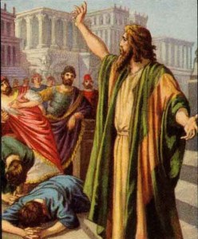
Recommissioned

Slide 4
Recommissioned
Chapters 1 & 3 begin in similar manner
Jonah preached a very short message (5 Hebrew words)
Amazingly, all in the pagan city believed
King repented of evil and violence
What brought about this great repentance?

Slide 5
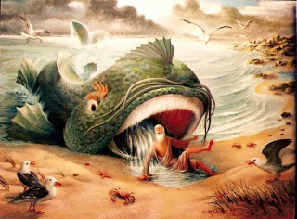
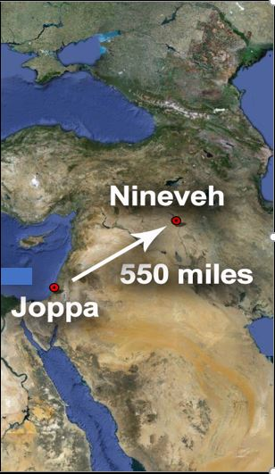
Did you hear about Jonah…
Yes, a fish!!!
And the Lord spoke to the fish, and it vomited Jonah out upon the dry land
Vomited him up 3 days later!!
When the crowds were increasing, he began to say, “This generation is an evil generation. It seeks for a sign, but no sign will be given to it except the sign of Jonah. For as Jonah became a sign to the people of Nineveh, so will the Son of Man be to this generation. – Luke 11:29-30

Slide 6
Recommissioned
An Important Lesson for Us
The men of Nineveh will rise up at the judgment with this generation and condemn it, for they repented at the preaching of Jonah, and behold, something greater than Jonah is here. – Luke 11:32
How much do we imitate the king of Nineveh?
One greater than Jonah spoke about evil and violence

Slide 7
Recommissioned
God relents
City was overthrown, but not in expected way
No foreign invaders; citizens defeated their own evil
Not everyone is happy (4:1)

Slide 8
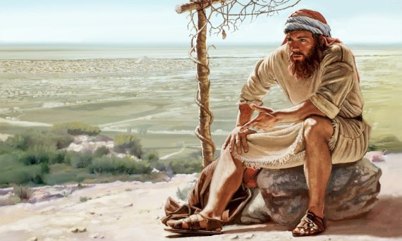
Bitter Prayers

Slide 9
Bitter Prayers
Chapters 2 & 4 detail Jonah’s prayers
Another unrecorded prayer (4:2)
Turned the Lord’s self-description against Him
The Lord passed before him and proclaimed, “The Lord, the Lord, a God merciful and gracious, slow to anger, and abounding in steadfast love and faithfulness, keeping steadfast love for thousands, forgiving iniquity and transgression and sin – Exodus 34:6-7a
“O Lord, is not this what I said when I was yet in my country? That is why I made haste to flee to Tarshish; for I knew that you are a gracious God and merciful, slow to anger and abounding in steadfast love, and relenting from disaster.

Slide 10
Bitter Prayers
Chapters 2 & 4 detail Jonah’s prayers
Another unrecorded prayer (4:2)
Turned the Lord’s self-description against Him
Another death wish
Ignored God’s question

Slide 11
Bitter Prayers
Jonah is the only one in the book who disobeys God!
A visual aid from God
Note use of the word “appoint”
Earlier, God appointed a fish
Appointed a plant for shade
Appointed a worm to destroy the plant
Appointed a hot east wind
Jonah asked for death after losing a plant
God’s point: “You pity a plant. Should I not pity Nineveh?”

Slide 12
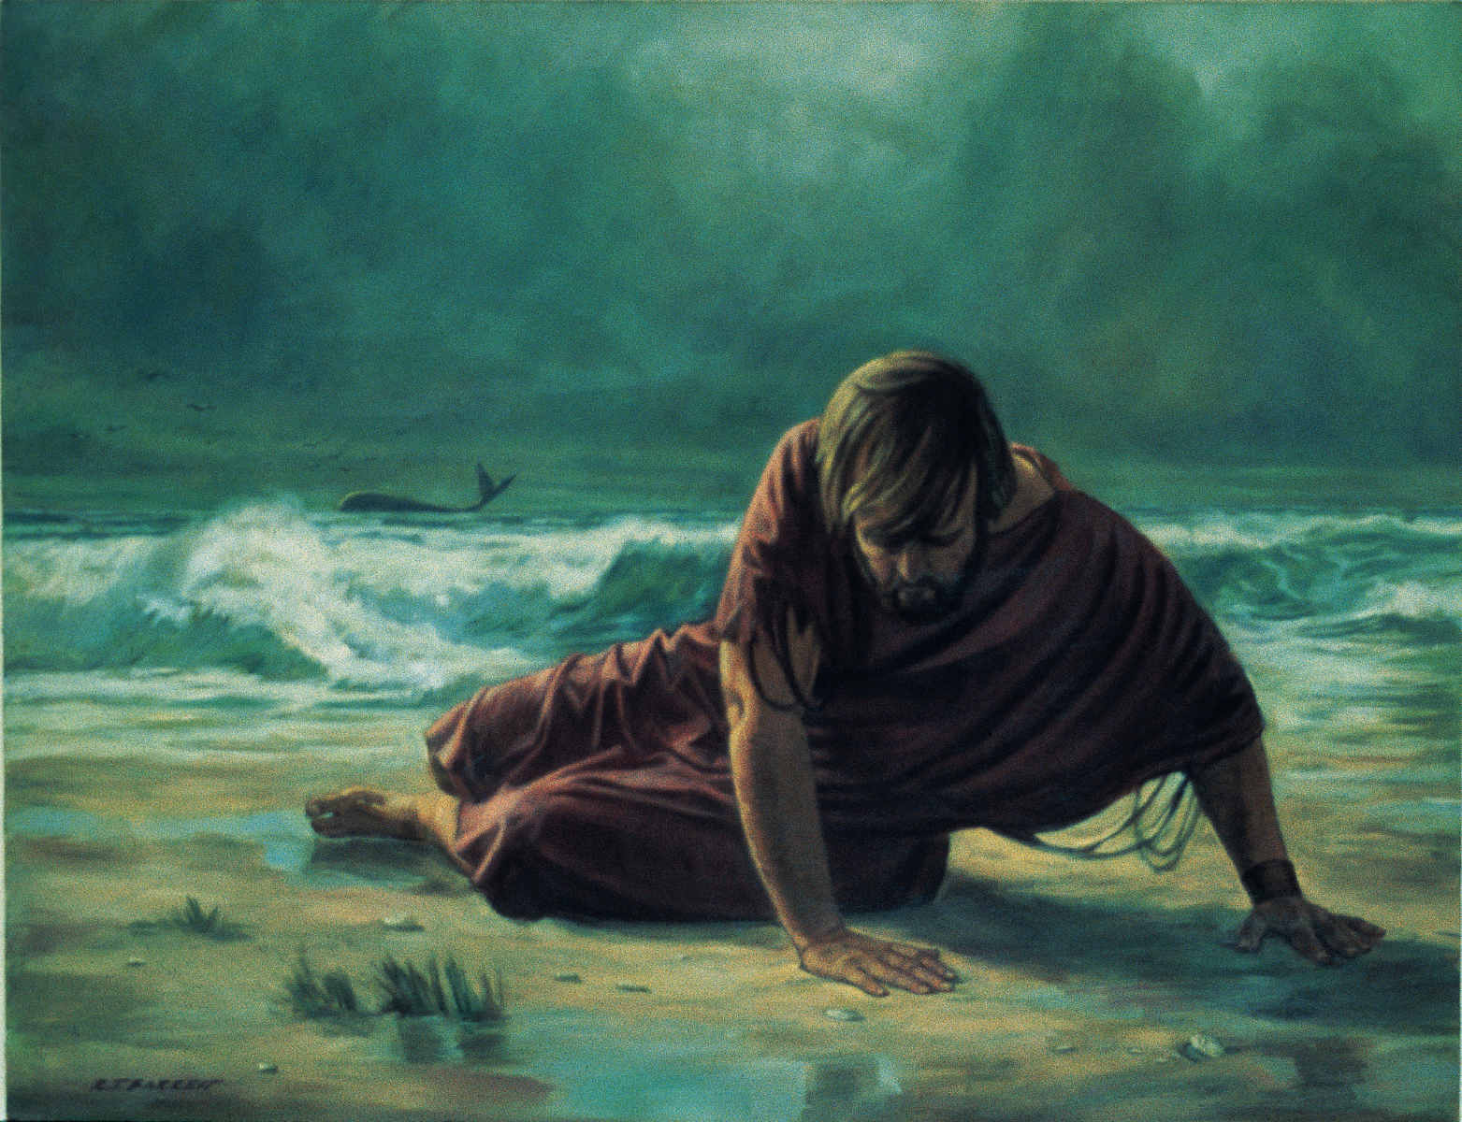
Important Lessons!

Slide 13
Important Lessons!
There is a danger in second chances
Continuation of failing practices shows lack of seriousness
True repentance requires a change of attitude
What we love and hate is a window into our soul
Illustrates how much we value self/devalue others
Pagans can teach important lessons
Sometimes “good people” have difficulty seeing their sins
Like the king, evil and violence must be put away

Slide 14
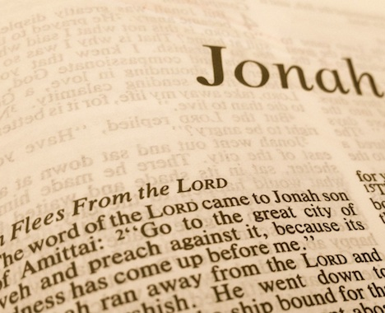
Am I More Like the Prophet or the Pagans?

