Slide 1
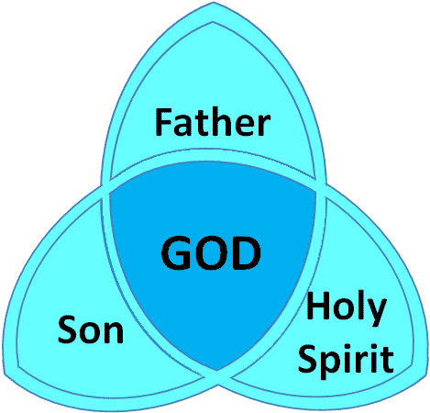
Understanding The Godhead
Text:
Genesis 1:26; Matthew 3:16-17
Notes:
By Nathan L Morrison
All Scripture given is from the NASB, unless otherwise stated
For further study, or if questions, please Call: 804-277-1983 or Visit: www.courthousechurchofchrist.com
Based on a lesson by Richie Thetford

Slide 2
Intro
Different beliefs people have concerning God or deity
Theism – belief in the existence of a god or gods.
Natural Theism – a study of existence, character, & God in light of nature and reason.
Deism – belief that God created the world, but denies His supernatural intervention (will not allow God to perform miracles).
Pantheism – belief that universe & God are the same (laws of nature & universe = God).
Atheism – a disbelief of the existence of deity - there is no deity (God, or gods).
Agnosticism – belief that the existence of God is unknown and probably unknowable.
Humanism – philosophy that usually rejects supernaturalism and elevates man.
Naturalism – the view which ascribes everything to natural causes (often called evolution, rationalism). It is always anti-supernatural.
Polytheism – belief in or worship of more than one God.
Monotheism – belief that there is but one God.

Slide 3
Intro
It is no wonder that the world today is confused in religious matters!
??
Christians in the 1st c. and today believe in an all-present, all-knowing, all-powerful God that has created all things and revealed Himself to man through His special divine revelation
Notes:
“Inspired by God” = theopneustos [theh-op'-nyoo-stos] (G2315): “God-breathed;” from theos (G2316: God) and pneo (G4154: to breathe).

Slide 4
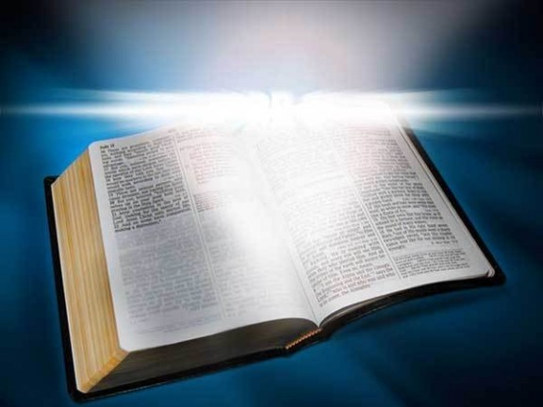
Intro
II Timothy 3:16
16. All Scripture is inspired by God and profitable for teaching, for reproof, for correction, for training in righteousness
2 Tim 3:16-17
“Inspired by God”(G2315): “God-breathed;” from theos (G2316: God) and pneo (G4154: to breathe).
All Scripture was breathed out from God.
God inspired the authors who wrote the Scriptures (II Peter 1:20-21: Through the Holy Spirit).

Slide 5
Intro
Saints need to know and understand
the GOD we serve!
Notes:
Emphasis in Scriptures mine!

Slide 6
Understanding the Godhead
There is One God, but a plurality of persons
Genesis 1:26
26. Then God said, "Let Us make man in Our image, according to Our likeness; and let them rule over the fish of the sea and over the birds of the sky and over the cattle and over all the earth, and over every creeping thing that creeps on the earth."
Elohim (H430) is the name used in the first verse of the Bible: “In the beginning God [Elohim] created the heavens and the earth” (Gen. 1:1).
Elohim is a plural form of the singular Eloah (H433: deity, god, or God).
They are both related to the more general form, El (H410: mighty, Almighty), and are the most common designations for deity in ancient Semitic languages.
Ephesians 4:4-6
4. There is one body and one Spirit, just as also you were called in one hope of your calling;
5. one Lord, one faith, one baptism,
6. one God and Father of all who is over all and through all and in all.
Notes:
Emphasis in Scriptures mine!

Slide 7
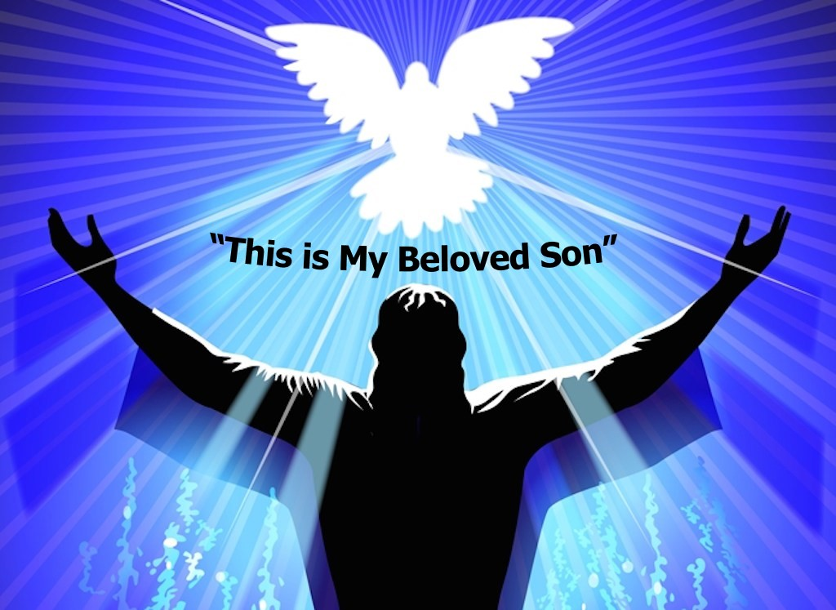
Understanding the Godhead
All were present at the baptism of Jesus!
Matthew 3:16-17 (Jn. 3:16; Eph. 1:7; II Pet. 1:20-21)
16. After being baptized, Jesus came up immediately from the water; and behold, the heavens were opened, and he saw the Spirit of God descending as a dove and lighting on Him,
17. and behold, a voice out of the heavens said, "This is My beloved Son, in whom I am well-pleased."
Notes:
Emphasis in Scriptures mine!

Slide 8
Understanding the Godhead
There is one GOD, but He is revealed to man in three
persons of the Godhead!
Notes:
Emphasis in Scriptures mine!

Slide 9
God:
The Father, The Son, The Holy Spirit
Jn. 20:17; I Pet. 1:3; I Jn. 1:3; II Jn. 3
Father
IS NOT
Son
Jn. 3:16; 8:42;
Mt. 6:9
Jn. 1:1,14; Heb. 1:8
Titus 2:13; Jn. 8:58;
Mt. 16:16
IS
IS
God
Jn. 14:16-17, 26
Rom. 8:16, 26
IS NOT
IS NOT
Jn. 15:26;
Acts 10:38
Acts
5:1-4
IS
Holy
Spirit

Slide 10
God: Father, Son, The Holy Spirit
These three never disagree!
John 10:30
"I and the Father are one."
Not the same person! “One” = “heis” (G1520): One; the neuter, not the masculine (one person). It implies unity of essence, not merely of will or of power.
They are one in purpose, one in all things....except in person. They are three persons making up One Godhood (Eph. 4:4-6)
Ephesians 4:4-6
4. There is one body and one Spirit, just as also you were called in one hope of your calling;
5. one Lord, one faith, one baptism,
6. one God and Father of all who is over all and through all and in all.
Notes:
Emphasis in Scriptures mine!

Slide 11
God: Father, Son, The Holy Spirit
How Can THREE Be ONE?
ONE
Board
ONE
Eldership
ONE
Body
8 Members
Plurality
of
Elders
Many Members
I Cor 12:12-20
X
X
X
X
X
X
X
X

Slide 12
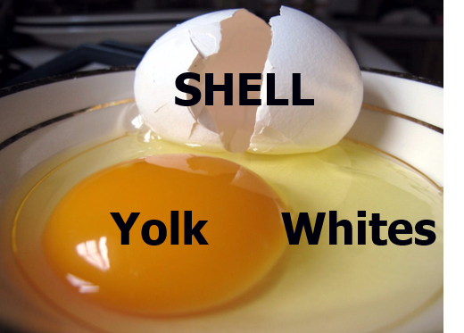
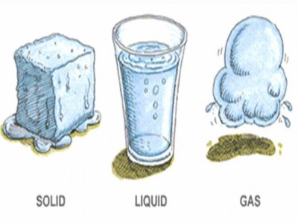
God: Father, Son, The Holy Spirit
How Can THREE Be ONE?
Egg
Water (H2O)

Slide 13
God: Father, Son, The Holy Spirit
GOD is three persons but One in purpose and mind!
Notes:
Emphasis in Scriptures mine!

Slide 14
God In Three Persons
Jn. 20:17; I Pet. 1:3; I Jn. 1:3; II Jn. 3
Father
IS NOT
Son
Jn. 3:16; 8:42
Mt. 6:9
Heb. 1:8-10; Mt. 22:43-44; Jn. 1:1,14;20:28
Titus 2:13
Elohim [H430],
Yahweh [H3068], Adonay [H136]
IS
IS
God
Jn. 14:16-17, 26
Rom. 8:16, 26
IS NOT
IS NOT
Jn. 15:26;
Acts 10:38
Acts
5:1-4
IS
Holy
Spirit

Slide 15
God In Three Persons
The three are united, working together as one,
and in that sense, they are one GOD!
Notes:
Emphasis in Scriptures mine!

Slide 16
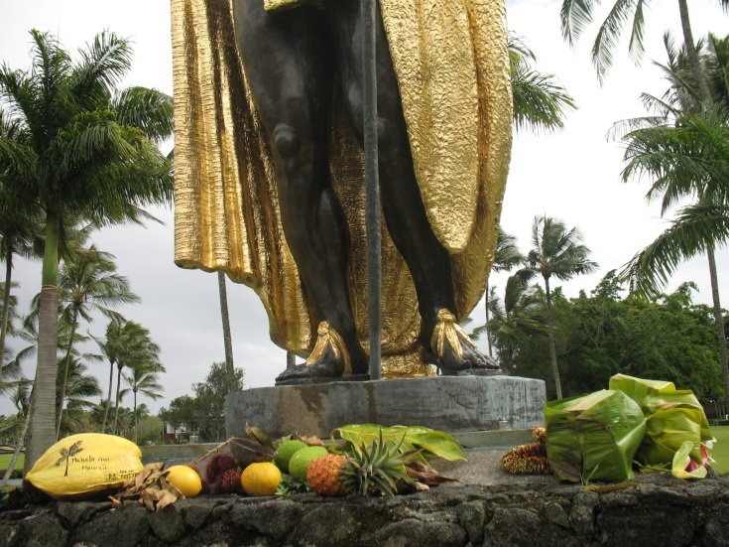
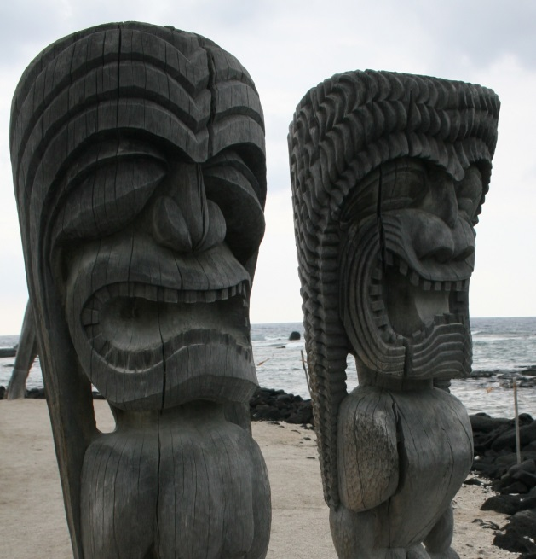
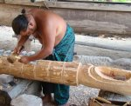
Conclusion
The world throughout time has worshiped many false deities and idols!
Ex. 20:3; Acts 14:11; 17:22-23; 19:26; Gal. 4:8; I Cor. 8:4-7; I Thess. 1:9

Slide 17
Conclusion
The Scriptures Teach that there is One God
Isaiah 43:10
Isaiah 45:6
Isaiah 45:18
I Corinthians 8:5-6

Slide 18
Conclusion
A proper understanding of the Godhead will make it easier for us to have the right attitude when we worship our God in spirit and truth (John 4:24)
We understand the truth because the Holy Spirit guided
the N.T. writers to reveal it to man for all time
(Jn. 16:13; II Pet. 1:3, 20-21), and grants us eternal salvation when we obey!
Have you obeyed GOD? (Jn. 12:48)

Slide 19

“What Must I Do To Be Saved?”
Hear The Gospel (Jn. 5:24; Rom. 10:17)
Believe In Christ (Jn. 3:16-18; Jn. 8:24)
Repent Of Sins (Lk. 13:3-5; Acts 2:38)
Confess Christ (Mt. 10:32; Rom. 10:10)
Be Baptized (Mk. 16:16; Acts 22:16)
Remain Faithful (Jn. 8:31; Rev. 2:10)
For The Erring Saint:
Repent (Acts 8:22), Confess (I Jn. 1:9),
Pray (Acts 8:22)

