Slide 1
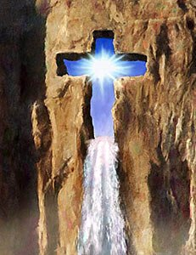
“Revive Us Again”
Text: Galatians 6:9-10
Notes:
By Nathan L Morrison
All Scripture given is from NASB unless otherwise stated
For further study or if questions, Call: 804-277-1983 or visit www.courthousechurchofcrist.com
From the hymn, “Revive Us Again,” by William Paton Mackay

Slide 2
Intro
Galatians 6:9-10
9. Let us not lose heart in doing good, for in due time we will reap if we do not grow weary.
10. So then, while we have opportunity, let us do good to all people, and especially to those who are of the household of the faith.
II Thessalonians 3:13
13. But as for you, brethren, do not grow weary of doing good.

Slide 3
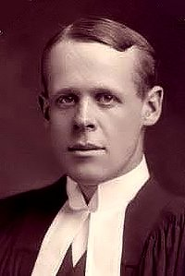
Intro
William P. Mackay (1839-1885)
“Revive Us Again” (1863)
He was born in Montrose, Scotland on May 13th, 1839.
He graduated from University of Edinburgh, and was a doctor for most of his life.
Was converted after finding a Bible in the personal effects of a patient who died.
The Bible was his, a gift from his mother still with his name in it, that he had sold years earlier!
He wrote “Revive Us Again” shortly after being reunited with his Bible. It was published under the original name, “O Lord, Revive Thy Work.”
Became a Presbyterian preacher in Hull, Scotland in 1868 till death on Aug. 22, 1885.
Notes:
Sources:
http://maranatha777.wordpress.com/2008/06/28/william-paton-mackays-testimony/
http://wordwisehymns.com/2010/05/13/today-in-1839-william-mackay-born/
http://www.cobblestoneroadministry.org/2007/SermonStory_William_P_Mackay_FaithfulnessOfGod.html
Then Sings My Soul by Robert J. Morgan, p. 147

Slide 4
Intro
This hymn reminds us that Jesus is the answer to not getting weary from the struggles with the world & temptations!
Matthew 11:28-30
28. "Come to Me, all who are weary and heavy-laden, and I will give you rest.
29. Take My yoke upon you and learn from Me, for I am gentle and humble in heart, and YOU WILL FIND REST FOR YOUR SOULS.”
30. "For My yoke is easy and My burden is light."
Hebrews 12:3
3. For consider Him who has endured such hostility by sinners against Himself, so that you will not grow weary and lose heart.
Notes:
Image: By Carlos S.

Slide 5
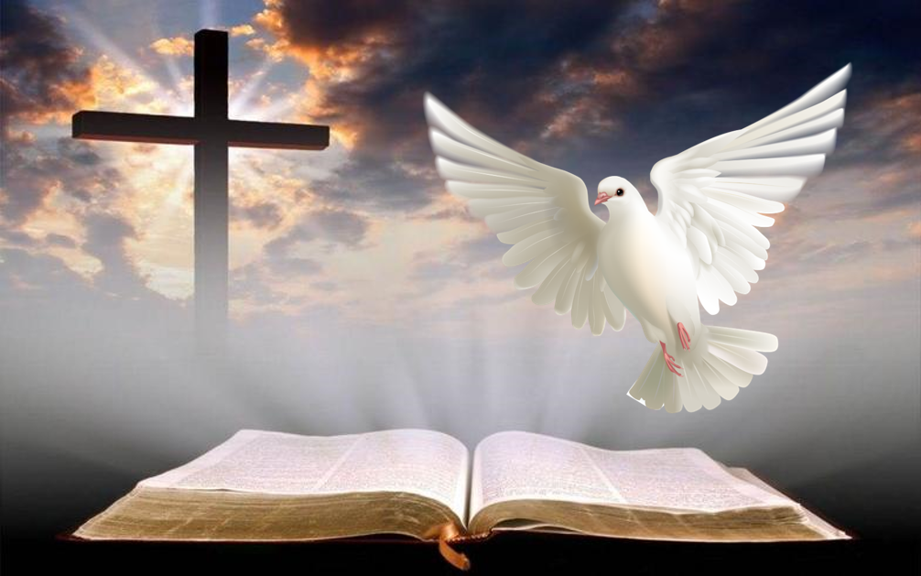
Intro
This hymn reminds us to be thankful and to praise God for Jesus and for the Holy Spirit!

Slide 6
Praise God For Sending Us The Savior
Stanza 1
“We praise Thee, O God, For the Son of Thy love, For Jesus who died, And is now gone above.”
Stanza 3
“All glory and praise To the Lamb that was slain, Who has borne all our sins And has cleansed every stain.”

Slide 7
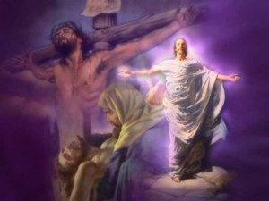
Praise God For Sending Us The Savior
Jesus Paid It All!
I Corinthians 15:3-4
Isaiah 53:4-5
Hebrews 4:15
I Corinthians 15:3-4
3. For I delivered to you as of first importance what I also received, that Christ died for our sins according to the Scriptures,
4. and that He was buried, and that He was raised on the third day according to the Scriptures,

Slide 8
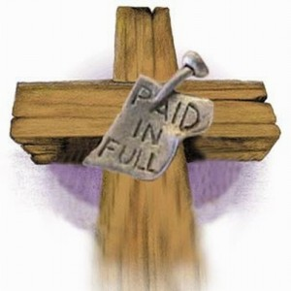
Praise God For Sending Us The Savior
Jesus was sent for 3 primary reasons!
To show us what God is like – Jn. 10:30; 14:6-10
To teach us how to live – Jn. 8:12, 31-32; I Pet. 2:21-23
To save us – Lk. 19:10; Jn. 1:29; 3:16; I Pet. 2:24-25
He has “cleansed every stain” because His blood was the purchase price of our redemption!
Eph. 1:7; I Pet. 1:18-19; Rev. 1:5
We show God our thanks and praise for His Son’s sacrifice through our obedience and faithfulness to the gospel!

Slide 9
Praise God For Sending Us The Holy Spirit
Stanza 2
“We praise Thee, O God, For Thy Spirit of light, Who has shown us our Savior, And scattered our night.”

Slide 10
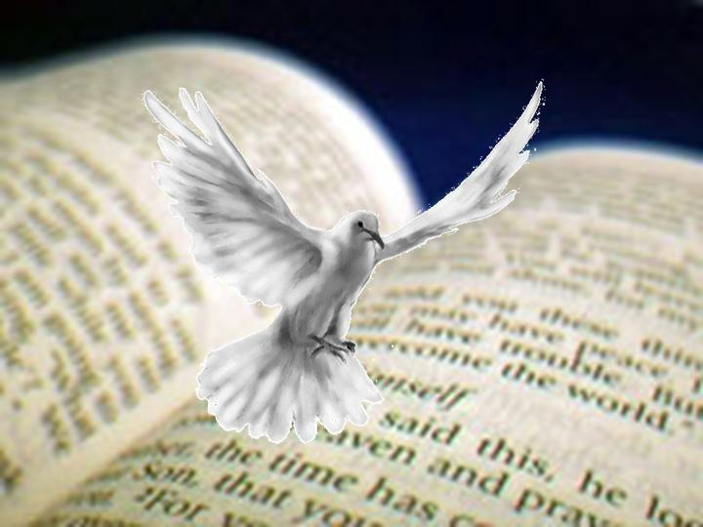
Praise God For Sending Us The Holy Spirit
Praise God and give thanks for sending the Holy Spirit!
John 14:26: The Spirit of Light is the Holy Spirit sent in Jesus’ name
John 15:26-27: The Spirit has shown us our Savior because He testified of Christ in the written word.
John 16:13: The Spirit has also “scattered our night” because He revealed to the apostles the light of “all the truth” in God’s word! (II Peter 1:20-21)
Romans 5:8: The Spirit convicts us of sin.
John 16:13
13. "But when He, the Spirit of truth, comes, He will guide you into all the truth; for He will not speak on His own initiative, but whatever He hears, He will speak; and He will disclose to you what is to come.

Slide 11
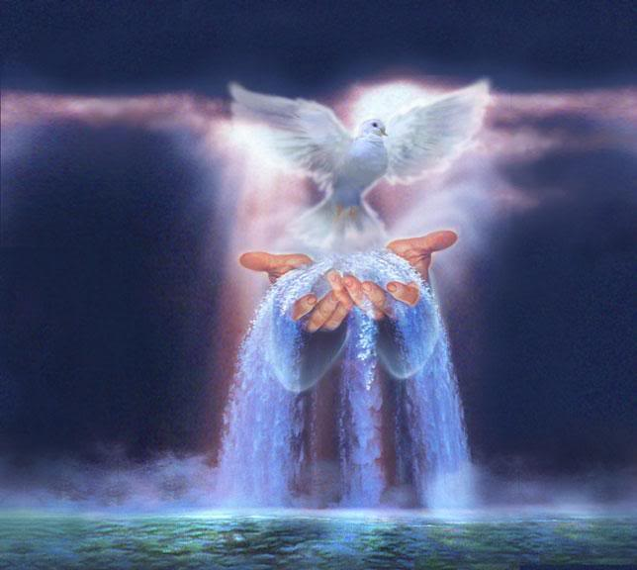
Praise God For Sending Us The Holy Spirit
He gives us comfort in sorrow—Through God’s word!
Reminding us of God’s presence and love despite life’s trials (II Cor. 1:3-7)
Providing strength to go on (Acts 9:31; II Thess. 2:16-17)
Reminding us of the Scriptures to lift our fallen and crushed spirits in time of need (Rom. 8:18, 28; I Thess. 4:16-18)
We show thanks to God for His word through study and application of it in our lives!

Slide 12
Praise God For Sending His Son Back One Day
Chorus
“Hallelujah! Thine the glory! Hallelujah! Amen! Hallelujah! Thine the glory! Revive us again!”

Slide 13
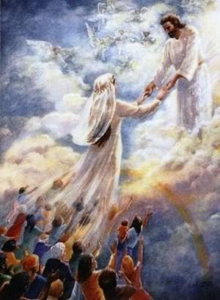
Praise God For Sending His Son Back One Day
Jesus has “now gone above” (Col. 3:1) and awaits the time for His return!
I Thessalonians 4:16-18
Hebrews 9:27-28
I Thessalonians 4:16-18
16. For the Lord Himself will descend from heaven with a shout, with the voice of the archangel and with the trumpet of God, and the dead in Christ will rise first.
17. Then we who are alive and remain will be caught up together with them in the clouds to meet the Lord in the air, and so we shall always be with the Lord.
18. Therefore comfort one another with these words.

Slide 14
Praise God For Sending His Son Back One Day
A complete contrast to the 1st time He came!
1st Time Jesus Came | 2nd Time Jesus Comes
He came as a lowly babe (Lk. 2:12) | He will come as a conquering King – Mt. 25:31-46; II Thess. 1:7-9
He came riding into Jerusalem on a donkey (Lk. 19:30-40) | He will come on a white horse – Rev. 19:11-16
He came as the sacrificial Lamb of God (Jn. 1:29; Acts 8:32) | He will come as the Lion of the tribe of Judah – Rev. 5:5
He had few friends (Is. 53:3; Mk. 14:50) | He will come with all the hosts of Heaven – II Thess. 1:7; Rev. 19:14
He came to suffer (Mt. 16:21; Lk. 24:24-26, 46-47) | He will come to bring judgment & salvation – Mt. 25:34, 41, 46; Heb. 9:27-28

Slide 15
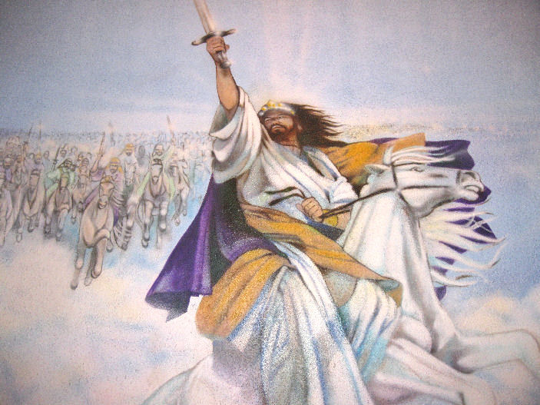
Praise God For Sending His Son Back One Day
We show thanks to God for the salvation to be revealed in living godly lives and being watchful and ready for Jesus’ Return! (II Pet. 3:10-12)

Slide 16
Conclusion
“Revive Us Again” reminds us to be grateful and praise God for:
God sending His Son to redeem us from our sins!
God sending the Holy Spirit to reveal His word and will for our lives!
May we ever give God the glory, praise, and
thanksgiving due Him for all He has done for us!
Psalm 96:1-3
1. Sing to the LORD a new song; Sing to the LORD, all the earth.
2. Sing to the LORD, bless His name; Proclaim good tidings of His salvation from day to day.
3. Tell of His glory among the nations, His wonderful deeds among all the peoples.

Slide 17
Conclusion
After a year that has wearied many souls, let us be reminded of this hymn as we go into the next year and be “Revived Again,” praising God for sending our Savior and the Holy Spirit, and for one day sending Jesus back for Salvation & Judgment!

Slide 18
“What Must I Do To Be Saved?”
Hear The Gospel (Jn. 5:24; Rom. 10:17)
Believe In Christ (Jn. 3:16-18; Jn. 8:24)
Repent Of Sins (Lk. 13:3-5; Acts 2:38)
Confess Christ (Mt. 10:32; Rom. 10:10)
Be Baptized (Mk. 16:16; Acts 22:16)
Remain Faithful (Jn. 8:31; Rev. 2:10)
For The Erring Saint:
Repent (Acts 8:22), Confess (I Jn. 1:9),
Pray (Acts 8:22)

