Slide 1
Barnabas!
Dare To Be Like…
Text:
Acts
4:36-37
Notes:
By Nathan L Morrison
All Scripture given is from NASB unless otherwise stated
For further study, or if questions, please Call: 804-277-1983 or Visit www.courthousechurchofchrist.com

Slide 2
intro
The world will try to discourage you
Christians are to encourage one another
I Thess. 5:11
I Thess. 5:14
Barnabas was a Christian, an encourager, and a gospel preacher of the first century!
Dare to be like Barnabas!
Heb. 3:13
Hebrews 3:13
But encourage one another day after day, as long as it is still called “Today,” so that none of you will be hardened by the deceitfulness of sin.

Slide 3
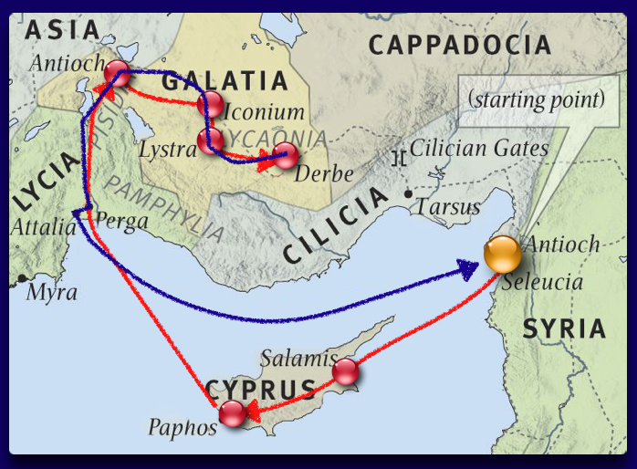
Barnabas, the Encourager
First introduced in Acts 4:32-37

Slide 4
Acts 4:32-37
Barnabas, the Encourager
32. And the congregation of those who believed were of one heart and soul; and not one of them claimed that anything belonging to him was his own, but all things were common property to them.
33. And with great power the apostles were giving testimony to the resurrection of the Lord Jesus, and abundant grace was upon them all.
34. For there was not a needy person among them, for all who were owners of land or houses would sell them and bring the proceeds of the sales
35. and lay them at the apostles' feet, and they would be distributed to each as any had need.
36. Now Joseph, a Levite of Cyprian birth, who was also called Barnabas by the apostles (which translated means Son of Encouragement),
37. and who owned a tract of land, sold it and brought the money and laid it at the apostles' feet.

Slide 5
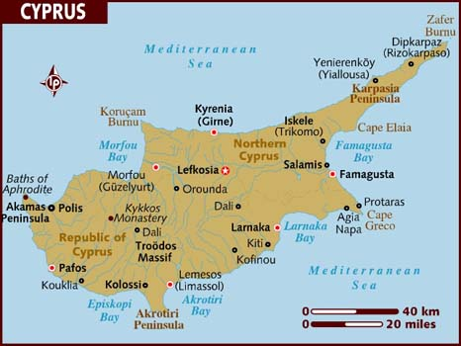
Barnabas, the Encourager
Acts 4:32-37
One of the earliest Christians: mentioned shortly after Pentecost
An apparently wealthy man – He sold land and laid the money at the apostles’ feet (Acts 4:36-37) – setting an example
A Jew and a Levite
Originally known as Joses (KJV/NKJV) or Joseph (NASB)
The Apostles called him Barnabas, which means “Son of Encouragement”
“Son of Consolation” (KJV)
“Son of Exhortation” (ASV)
Was from Cyprus (Acts 4:36), an island in the Mediterranean
Barnabas was bold and well respected (Acts 9:26-28)
He was a “Good Man” (Acts 11:22-24)

Slide 6
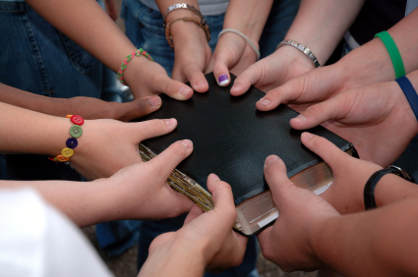
Application!
Barnabas, the Encourager
In good times (right after Pentecost in Acts 4:32-37) or in Bad times (right after the death of Stephen and persecution of the church in Acts 8:1-4 & 11:19-20, 23) we ought to encourage others!
There will always be the detractors who are ready and willing to discourage -- but YOU be the encourager! (Eph. 4:29; Col. 3:8)
Dare to be like Barnabas and encourage people through the good times and the bad!
Dare To Be Like Barnabas!

Slide 7
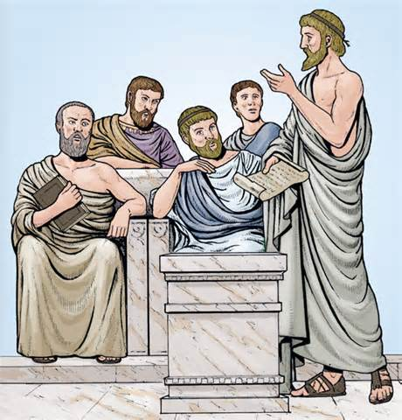
Barnabas, the Bold Teacher
When a congregation was established in Antioch among the Gentiles, Barnabas was sent by the church at Jerusalem to encourage the new congregation (Acts 11:19-24)

Slide 8
Acts 11:19-24
Barnabas, the Bold Teacher
19. So then those who were scattered because of the persecution that occurred in connection with Stephen made their way to Phoenicia and Cyprus and Antioch, speaking the word to no one except to Jews alone.
20. But there were some of them, men of Cyprus and Cyrene, who came to Antioch and began speaking to the Greeks also, preaching the Lord Jesus.
21. And the hand of the Lord was with them, and a large number who believed turned to the Lord.
22. The news about them reached the ears of the church at Jerusalem, and they sent Barnabas off to Antioch.
23. Then when he arrived and witnessed the grace of God, he rejoiced and began to encourage them all with resolute heart to remain true to the Lord;
24. for he was a good man, and full of the Holy Spirit and of faith. And considerable numbers were brought to the Lord.

Slide 9
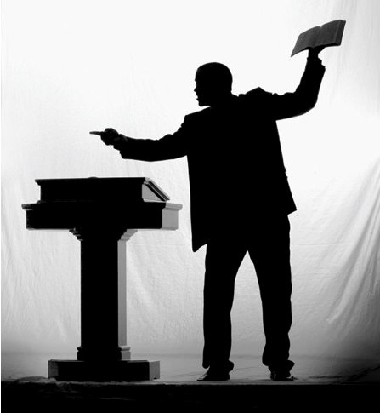
Barnabas, the Bold Teacher
Sent to Antioch by the church at Jerusalem to encourage the new congregation (Acts 11:19-24)
He encouraged them to remain true to the Lord, and “considerable numbers were brought to the Lord.”
Acts 11:25-26: While there, he went to Tarsus and found Paul, brought him back to Antioch and they worked together there for a year; they “taught considerable numbers.”
Disciples of Christ were first called Christians in Antioch! (Acts 11:26)
The Antioch congregation sent financial relief for saints in Judea by Barnabas & Paul (Acts 11:27-30)

Slide 10
Barnabas, the Bold Teacher
The Holy Spirit calls upon Barnabas and Paul for preaching work in the first missionary journey (Acts 13)
When Judaizing teachers attempted to bind circumcision on Christians, Barnabas speaks with Paul and Peter to correct this (Acts 15:12)
Paul and Barnabas split up after an argument
After preaching more in Antioch they got into a contention over Barnabas’ cousin, John Mark, who had started on the First Missionary Journey but quit at Pamphylia (Acts 15:36-41)
Paul goes on with Silas
Barnabas heads to Cyprus with John Mark

Slide 11
Application!
Barnabas, the Bold Teacher
Christians are called, the “Lord's bond-servant” and are told to be “able to teach” in II Timothy 2:24-26.
Even if you are not as good at it as some others you can still be an effective teacher with practice!
You can teach by your example and encourage others wherever you go!
Dare to be like Barnabas and boldly teach and encourage others!
Dare To Be Like Barnabas!

Slide 12
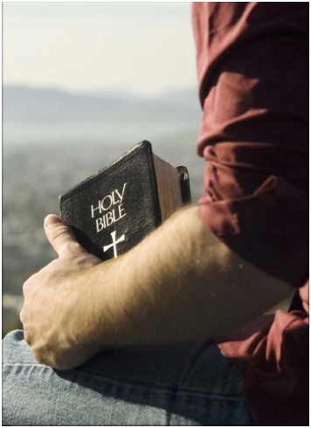
Barnabas, the Faithful Example
Generosity – Acts 4:36-37
Trusting – Acts 9:26-28
Humble – Acts 14:8-15
Was a teacher and preacher – Acts 11:22-24; 15:39
Was an encourager – Acts 4:36; 11:23

Slide 13
Application!
Barnabas, the Faithful Example
You can influence others by your faithful example!
Romans 12:4-8: Whatever skill or ability for the Lord you have, use it to the best of your ability and make use of opportunities!
You can serve, teach, encourage, be generous, be diligent and cheerfully show mercy! In all of this you can teach and encourage others by your example!
Dare to be like Barnabas in being an example of a faithful servant of God in using your gifts to the best of your ability!
Dare To Be Like Barnabas!

Slide 14
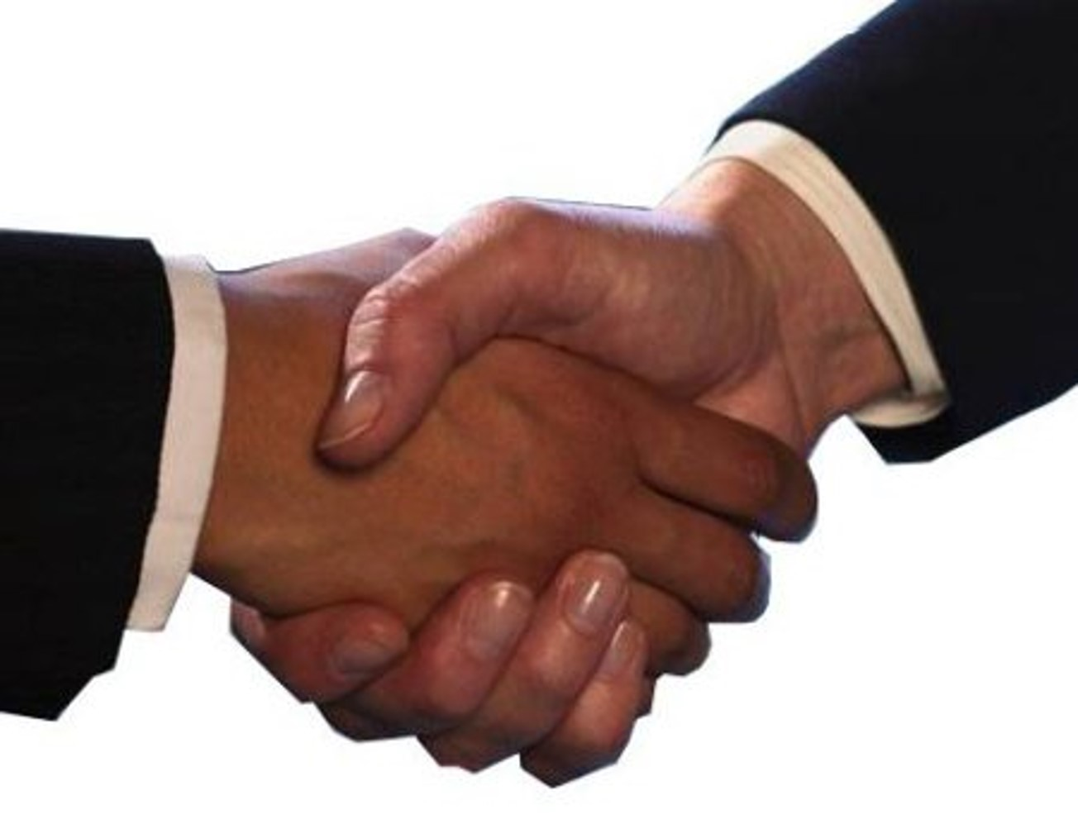
Conclusion
Let’s not overlook or forget about Barnabas, and the work he did for God and for Paul:
He used his abilities to build up and strengthen saints and Paul.
He stands for all time described as a “good man” by the Holy Spirit!

Slide 15
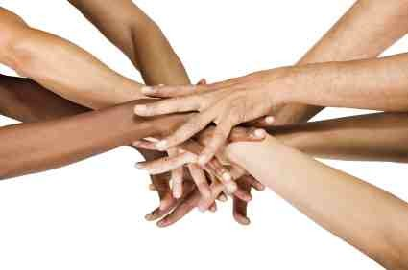
Conclusion
Barnabas fills the early part of the book of Acts and it was the apostles who changed his name to “Son of Encouragement!”
His role was one of teacher and preacher but he was known for his encouragement:
To the first Jewish converts
To the early Gentile converts
To the apostle Paul, with whom he was friends with, and closely worked!
He serves as a role model for all Christians, and he must have been a joy to have around!

Slide 16
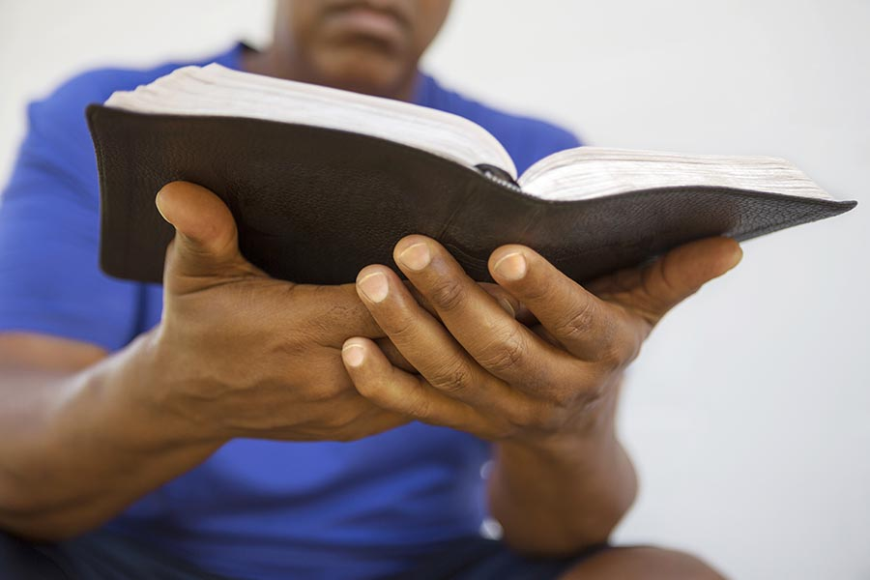
Conclusion
Do you use the talents God gave you to the best of your ability?
Be faithful, humble, generous, able to teach, and encourage others!
Dare to be like Barnabas and encourage others to remain true to Christ!

Slide 17
“What Must I Do To Be Saved?”
Hear The Gospel (Jn. 5:24; Rom. 10:17)
Believe In Christ (Jn. 3:16-18; Jn. 8:24)
Repent Of Sins (Lk. 13:3-5; Acts 2:38)
Confess Christ (Mt. 10:32; Rom. 10:10)
Be Baptized (Mk. 16:16; Acts 22:16)
Remain Faithful (Jn. 8:31; Rev. 2:10)
For The Erring Saint:
Repent (Acts 8:22), Confess (I Jn. 1:9),
Pray (Acts 8:22)

