Slide 1
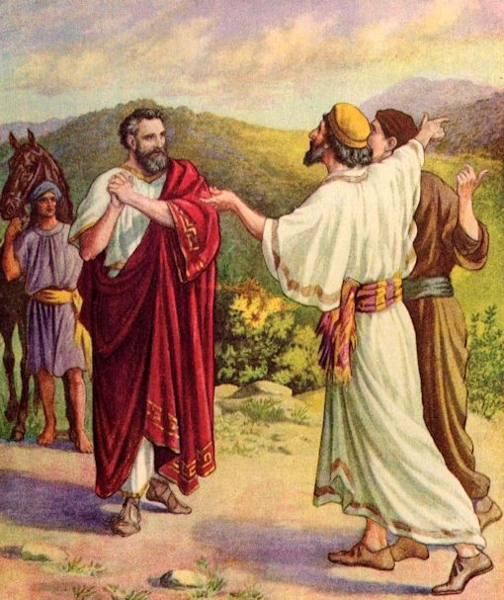
Andrew!
Dare To Be Like…
Text:
John 1:35-42
Notes:
By Nathan L Morrison
All Scripture given is from NASB unless otherwise stated
For further study, or if questions, please Call: 804-277-1983 or Visit www.courthousechurchofchrist.com

Slide 2
intro
Influence
Many times those that influence others take a back seat to the other’s abilities and deeds
There are those in life that lead and influence…
…and others that influence the leaders!
Dare to be like Andrew!
Andrew was an apostle and “Peter’s brother”
He knew Jesus first and brought Peter to Him!
Influence
“The capacity or power of persons or things to produce effects on others by intangible or indirect means” (Webster).

Slide 3
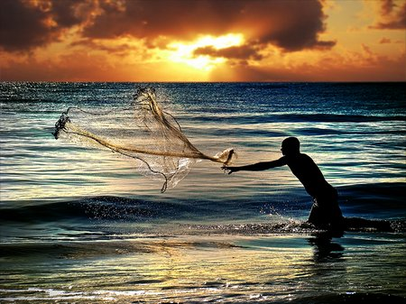
Andrew, the Brother of Peter
John 1:35-42: Andrew was a disciple of John the Baptist and then followed Jesus

Slide 4
John 1:35-42
Andrew, the Brother of Peter
35. Again the next day John was standing with two of his disciples,
36. and he looked at Jesus as He walked, and said, "Behold, the Lamb of God!"
37. The two disciples heard him speak, and they followed Jesus.
38. And Jesus turned and saw them following, and said to them, "What do you seek?" They said to Him, "Rabbi (which translated means Teacher), where are You staying?"
39. He said to them, "Come, and you will see." So they came and saw where He was staying; and they stayed with Him that day, for it was about the tenth hour.
40. One of the two who heard John speak and followed Him, was Andrew, Simon Peter's brother.
41. He found first his own brother Simon and said to him, "We have found the Messiah" (which translated means Christ).
42. He brought him to Jesus. Jesus looked at him and said, "You are Simon the son of John; you shall be called Cephas" (which is translated Peter).

Slide 5
Andrew, the Brother of Peter
John 1:35-42: Andrew was a disciple of John the Baptist and then followed Jesus
He brought his brother Peter to Jesus
Jn. 1:44: He was born in Bethsaida on the Sea of Galilee, “the city of Andrew and Peter”
Mt. 4:18: Andrew was Peter’s brother, and also a fisherman (Mk. 1:16)
Mk. 1:21, 29: He lived in a house with Peter’s family (wife and mother-in-law) in Capernaum
Mt. 10:2-4: Andrew was an apostle of Jesus, and is always listed with the first four
Acts 1:13; 2:1: Andrew was in the upper room and on the Day of Pentecost with the apostles

Slide 6
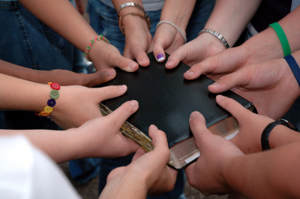
Application!
Andrew, the Brother of Peter
After coming to know Jesus is the Christ, the Son of God, and the Lamb of God Who died to wash away your sins, who is the first person you want to tell?
The Samaritan woman at the well told her whole village, and when they came out to meet Jesus, they came to know Him as the “Savior of the world” (John 4:28-30, 39-42)
Dare to be like Andrew, who had a strong faith and brought his brother to Jesus!
Dare To Be Like Andrew!

Slide 7
Andrew’s Conviction
John 1:35-39: Andrew heard John the Baptist call Jesus, “The Lamb of God!”

Slide 8
John 1:35-39
Andrew’s Conviction
35. Again the next day John was standing with two of his disciples,
36. and he looked at Jesus as He walked, and said, "Behold, the Lamb of God!"
37. The two disciples heard him speak, and they followed Jesus.
38. And Jesus turned and saw them following, and said to them, "What do you seek?" They said to Him, "Rabbi (which translated means Teacher), where are You staying?"
39. He said to them, "Come, and you will see." So they came and saw where He was staying; and they stayed with Him that day, for it was about the tenth hour.

Slide 9
Andrew’s Conviction
John 1:35-39: Andrew heard John the Baptist call Jesus, “The Lamb of God!”
Andrew and his unnamed companion believed John the Baptist and followed Jesus.
They asked to stay with Jesus and stayed with Him that day.
They believed Jesus was the “Lamb of God who takes away the sin of the world!” – Jn. 1:29
Jesus came to save the world from sin – Eph. 1:7
Andrew believed in and was not afraid to confess Him – Jn. 1:40-41; Jn. 12:42

Slide 10
Andrew’s Conviction
John 1:40-41: “We have found the Messiah!”
Before Peter’s confession of faith in Mt. 16:16 that Jesus is “the Christ,” Andrew declared to Peter that he had found the Messiah (Christ)!
The One whom Moses (Deut. 18:18-19) and the prophets foretold – cf. John 1:45: Philip’s similar declaration.
Isaiah called Him the Suffering Servant (Is. 53) and He would save the world.
Andrew believed in (Mt. 4:18) and confessed Jesus as the Christ and brought his brother Peter to Him

Slide 11
Application!
Andrew’s Conviction
Talk about Jesus; confess Him to your friends and family
Invite a family member to services or to a Bible study with you!
Use an Invitation Card or just a time and address to the next study opportunity!
Dare to be like Andrew and have strong convictions to follow Jesus and bring others to Him!
Dare To Be Like Andrew!

Slide 12
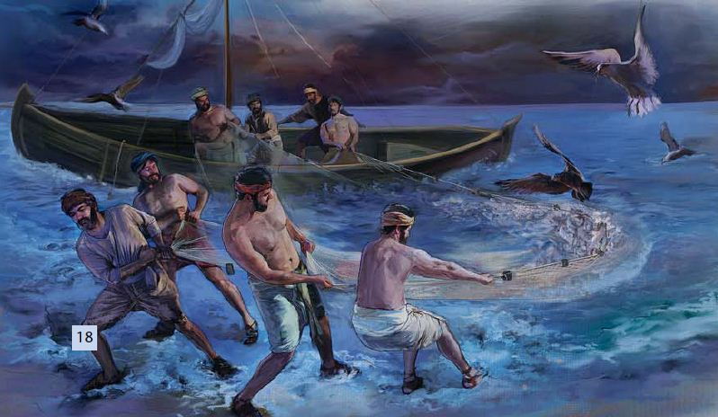
Andrew’s Conduct
John 1:40-42: He was convinced Jesus was the Christ so brought Peter to Him!

Slide 13
John 1:40-42
Andrew’s Conduct
40. One of the two who heard John speak and followed Him, was Andrew, Simon Peter's brother.
41. He found first his own brother Simon and said to him, "We have found the Messiah" (which translated means Christ).
42. He brought him to Jesus. Jesus looked at him and said, "You are Simon the son of John; you shall be called Cephas" (which is translated Peter).

Slide 14
Andrew’s Conduct
John 1:40-42: He was convinced Jesus was the Christ so brought Peter to Him!
Peter would become a “pillar” – Gal. 2:9
Peter given the “keys of the kingdom” – Mt. 16:17-19
Peter, with the 11, preached the first gospel sermon that saved 3,000 people on the Day of Pentecost – Acts 2
Peter opened the door of the kingdom to the Gentiles – Acts 10
Peter wrote two epistles
All because Andrew brought him to Jesus!

Slide 15
Andrew’s Conduct
Jn. 6:4-14: Andrew identified the lad who had the “five barley loaves and two fish”
Jn. 12:20-22: When Greeks came to see Jesus, it was Andrew who told Jesus
Acts 1:13; 2:1-4: He was numbered with the apostles on Pentecost

Slide 16
Application!
Andrew’s Conduct
Be excited to tell others about the foretold Messiah!
Bring others to know Jesus, the “Lamb of God who takes away the sin of the world!” (John 1:29)
Invite strangers to services or to a Bible study with you!
Use an Invitation Card or just a time and address to the next study opportunity!
Dare to be like Andrew and bring others to know Jesus Christ!
Dare To Be Like Andrew!

Slide 17
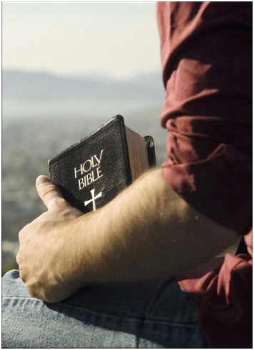
Conclusion
As little as we know of Andrew, his actions speak volumes about his service for Christ:
Every time we see him in the Gospels, he was bringing someone to Christ!
He was one that influenced others to serve Christ.
He brought men to Jesus, knowing He was the Messiah (Christ)!
He didn’t resent the second seat to Peter.

Slide 18
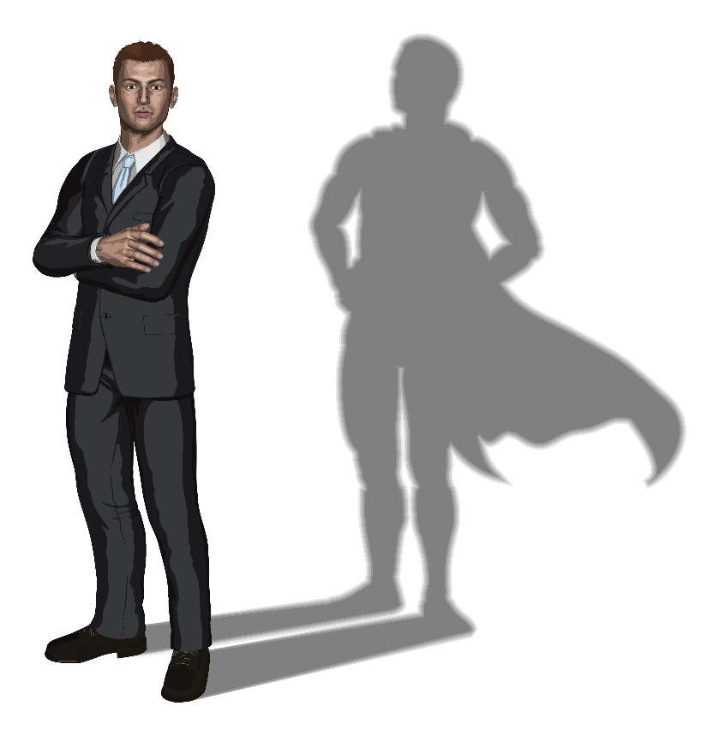
Conclusion
Like others he took a back seat to the leadership of those he influenced and didn’t complain
Think: Bette Midler’s 1988 Wind Beneath My Wings about the person in the shadows content to let the singer have the spotlight.
Joseph – Gen. 41:39-43
He was content to ride the “second chariot” – didn’t aspire to the #1 spot.
Benaiah – II Sam. 20:23; 23:20-23
He was a Mighty Man and was over David’s bodyguards, and although honored among the thirty, “he did not attain to the three.”
He was passed over as general, which went to Joab (not a Mighty Man).

Slide 19
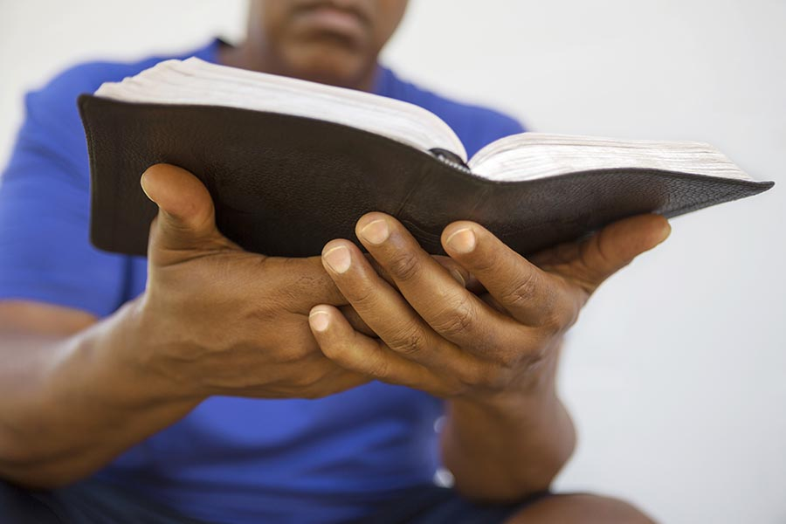
Conclusion
Andrew in many ways was honored among the apostles (listed in top four), but “he did not attain to the three” (Mark 13:3-4: In group of 4 that questioned Jesus privately)
Mt. 17:1-8: Jesus took Peter, James and John with Him at the Transfiguration
Mk. 5:37-43: Jesus took Peter, James and John with Him to raise Jairus’ daughter
Mk. 14:32-33: Jesus took Peter, James and John to the Garden of Gethsemane
Not told why Andrew was not invited to these occasions, but we don’t see any jealousy or complaint from Andrew, but he filled the role he was given!

Slide 20
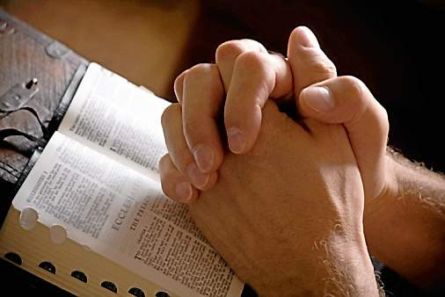
Conclusion
Secular writings record that he preached to Russia and other places (Eusebius, A.D. 260-340, Church History, Book III), and was crucified on an “X” shaped cross in Patras, Greece (John Foxe’s Book of Martyrs, A.D. 1563).
Notes:
Sources:
A. https://www.biblestudytools.com/history/foxs-book-of-martyrs/
B. https://www.documentacatholicaomnia.eu/03d/0265-0339,_Eusebius_Caesariensis,_Church_History,_EN.pdf
C. https://takingupspace.wordpress.com/2007/01/22/the-story-of-the-crucifixion-of-andrew-the-apostle-adapted-from-foxes-book-of-martyrs/
The “X”-shaped cross became known as “Andrew’s Cross” (also known as a “saltire”) and is the shape on the Scottish National Flag, as well as many others.

Slide 21
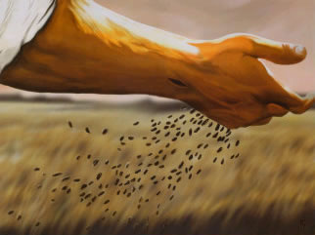
Conclusion
Andrew was a man that brought people to Christ!
(the positive influence behind their faith)
We may not know what great deeds someone will accomplish for Christ, but we need to introduce them! (Like the Sower, sow the seed: you don’t know their heart – Matthew 13:18-23)
Dare to be like Andrew and bring others to Christ!

Slide 22
“What Must I Do To Be Saved?”
Hear The Gospel (Jn. 5:24; Rom. 10:17)
Believe In Christ (Jn. 3:16-18; Jn. 8:24)
Repent Of Sins (Lk. 13:3-5; Acts 2:38)
Confess Christ (Mt. 10:32; Rom. 10:10)
Be Baptized (Mk. 16:16; Acts 22:16)
Remain Faithful (Jn. 8:31; Rev. 2:10)
For The Erring Saint:
Repent (Acts 8:22), Confess (I Jn. 1:9),
Pray (Acts 8:22)

