Slide 1
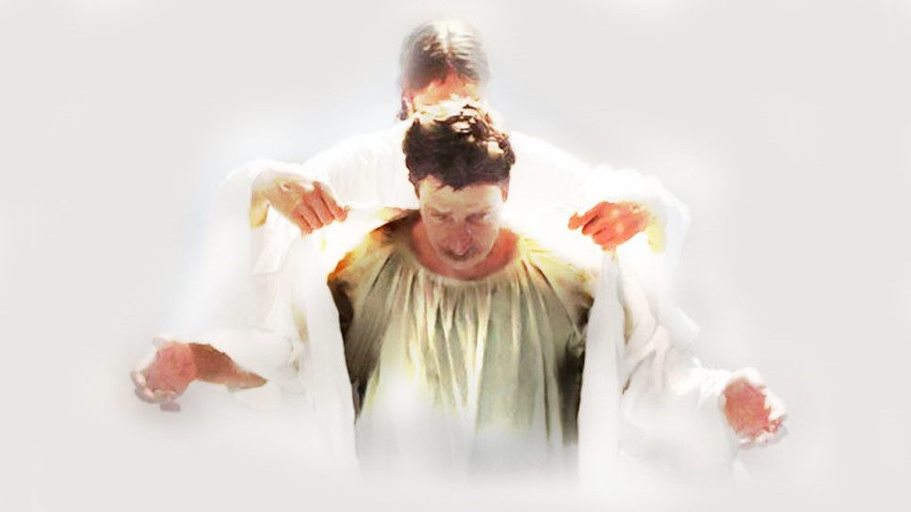
VSCO Christian
Text:
Colossians 3:12-14
Notes:
By Nathan L Morrison for Sunday August 2, 2020
All Scripture given is from NASB unless otherwise stated
For further study or if questions, Call: 804-277-1983, or Visit: www.courthousechurchofchrist.com

Slide 2
Intro
Have you heard of a VSCO Girl/Boy/Relationship?
It comes from taking pictures and using filters from the VSCO App
The term became a popular one around the end of 2017
It came to mean the “ideal” or “perfect” girl/boy, picture, or relationship regardless if they ever used the app!
They dress (look) and talk a certain way
In the last couple years it was also used sarcastically to mock & insult the people who dressed, talked, or filtered their pictures a certain way

Slide 3
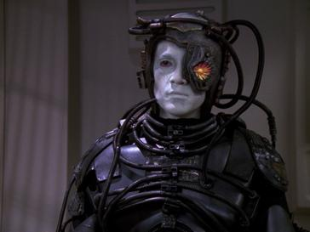
Intro
People have always striven for the “ideal” or what is “perfect” and that has always looked different from culture to culture, time period to time period, and generation to generation!
For Trekkies the ideal or what is perfect might call to mind The Borg!
“Resistance is Futile!”
Notes:
The Borg from Star Trek:
For Trekkies (fans of Star Trek) the ideal or what is perfect might call to mind The Borg! (a race of aliens that assimilated other races into a hive-mind collective, which was to them, “perfection”)

Slide 4
Intro
There are similarities between those labeled as VSCO (intentional or not) and Christians
Christians seek to become the “ideal” or “perfect” because we follow the only perfect man ever to walk the earth: Jesus Christ!
Saints look and talk a certain way
Sometimes the world uses “Christianity” as a sarcastic way to mock and insult saints for their choices in life, which make them different
Christians strive to be like Jesus Christ, to become the ideal and perfect child of God!

Slide 5
The Filter
The VSCO App started the VSCO movement
It is an App that allows you to filter your pictures to look as if they were taken by a film camera
The specific filtered look for VSCO is the 1990’s (fashion, etc.)

Slide 6
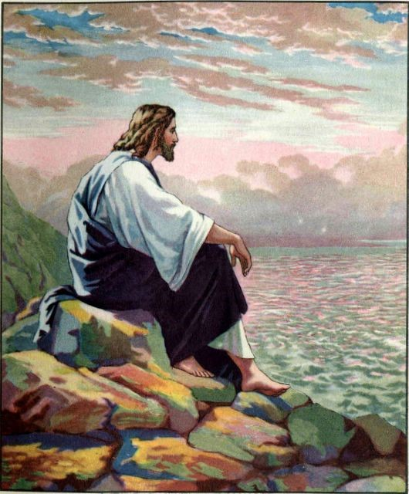
The Filter
Christians filter their perspectives and priorities through the lens of Jesus Christ
Jesus Christ was sinless (II Cor. 5:21; Heb. 4:15)
Jesus was perfect (Heb. 5:9)
Jesus left for us an example to follow (I Pet. 2:21-25)

Slide 7
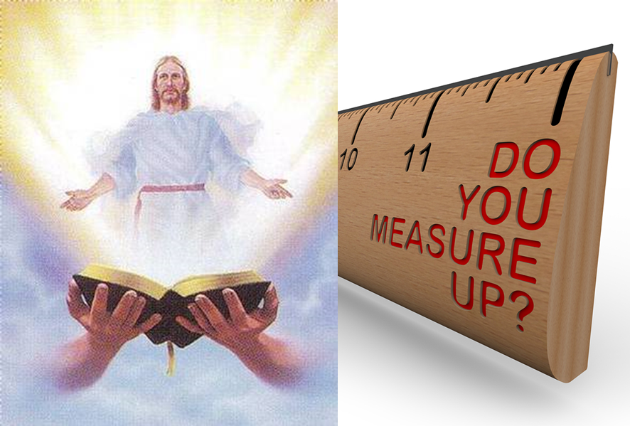
The Filter
Christians are called upon to imitate Jesus and conform to His image
Called to be “perfect,” that is mature, full grown (James 1:4)
Conform to the image of Jesus Christ (Rom. 8:29)
Imitate Jesus (I Cor. 11:1; Eph. 5:1)
James 1:4
4. And let endurance have its perfect result, so that you may be perfect and complete, lacking in nothing.
When we filter our lives through the perfect example of Jesus Christ we will look and sound different than the world around us!

Slide 8
The Look
Filtering through the VSCO App has caused a certain look by those who, either filter through it or by choice, wear the clothing and gear that makes for the VSCO image
Certain fashion choices and other apparel that reminds people of the ‘90’s!
Scrunchies, water bottles (called “hydro-flasks”), lip gloss, backpack purses, and “Save the Turtles” (???) apparel are all part of what accomplishes the look

Slide 9
The Look
Christians also have a look, a dress code (if you will) – Colossians 3:12-14
Colossians 3:12-14
12. So, as those who have been chosen of God, holy and beloved, put on a heart of compassion, kindness, humility, gentleness and patience;
13. bearing with one another, and forgiving each other, whoever has a complaint against anyone; just as the Lord forgave you, so also should you.
14. Beyond all these things put on love, which is the perfect bond of unity.

Slide 10
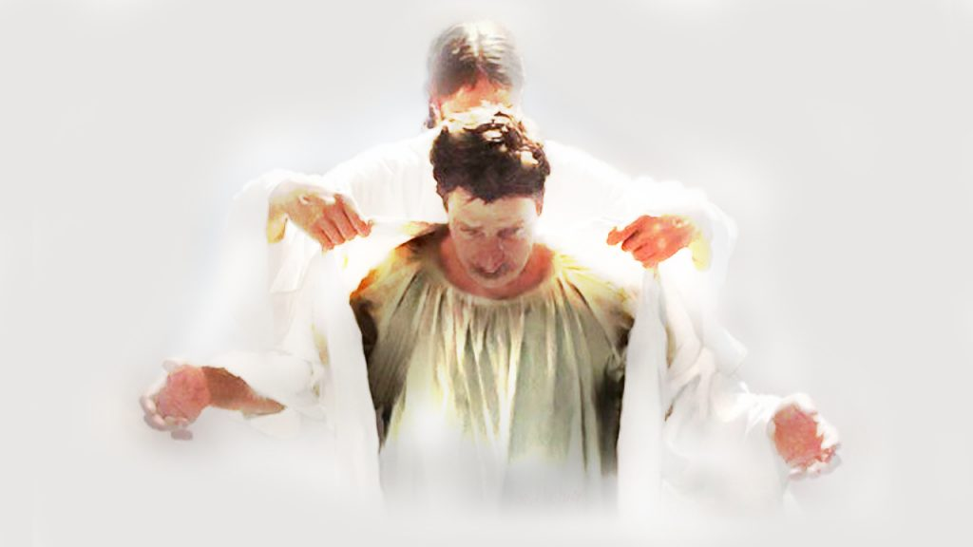
The Look
Colossians 3:12-14
Put on…
Compassion

Slide 11
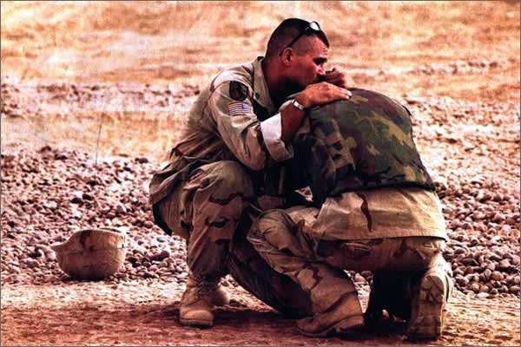
Put on Compassion (“Put on” means to “adorn,” “to clothe oneself”)
Jesus showed compassion
Mt. 9:36; 14:14; 15:32; 20:34; Mk. 1:41; 6:34; 8:2
Saints are to show compassion
Matthew 5:7: The one who shows mercy (compassion) will receive mercy (compassion)
Jude 1:21-23: We are to show mercy (compassion) to the lost and those weak in the faith

Slide 12
The Look
Colossians 3:12-14
Put on…
Compassion
Kindness

Slide 13
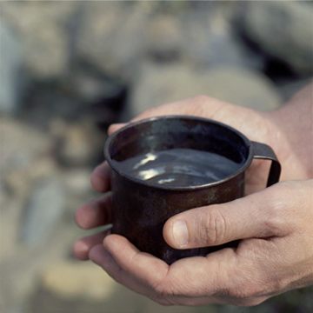
Put on Kindness
Jesus demonstrated kindness
God showed kindness to mankind through Jesus Christ!
In Jesus God’s kindness was extended to man in that we could be saved – Eph. 2:4-9; Titus 3:4-7
Saints are to show Kindness (A fruit of the Spirit – Gal. 5:22)
II Pet. 1:5-7: “brotherly kindness”
Eph. 4:32: We are to be kind, tenderhearted and forgiving to others

Slide 14
The Look
Colossians 3:12-14
Put on…
Compassion
Kindness
Humility

Slide 15
Put on Humility (Humility or meekness is “strength under control”)
Jesus humbled Himself (Mt. 11:29; 26:39; Phil. 2:5-11; Heb. 5:8)
Jn. 13:3-17: Washed His apostles’ feet
Jesus displayed such humility on the cross! (Jn. 10:18; Mt. 26:39, 53; Lk. 23:46)
Saints are to show humility to God and others
Phil. 2:3: “Humility of mind” will regard others as more important than oneself!
I Pet. 5:5: Must “clothe” ourselves in (“Put on…”) humility to each other and to God!

Slide 16
The Look
Colossians 3:12-14
Put on…
Compassion
Kindness
Humility
Gentleness

Slide 17
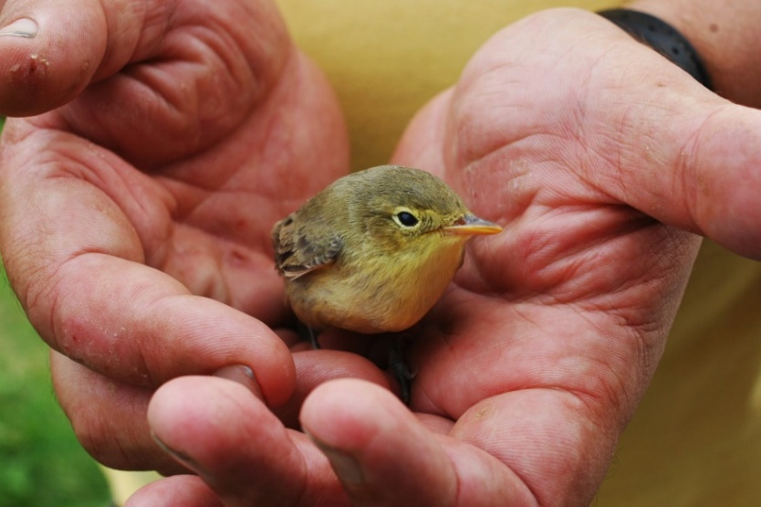
Put on Gentleness (The distinction between “gentleness, or meekness” and “patience” is slight)
Jesus was gentle and meek
(II Cor. 10:1)
Mt. 11:28-30: Jesus is “Gentle” and “Humble”
Mt. 21:1-5: A Gentle King! (Zech. 9:9)
Saints are to show gentleness! (A fruit of the Spirit – Gal. 5:23)
Eph. 4:1-2: Saints are called “to walk in a manner worthy of the calling” by walking “with all humility and gentleness, with patience, showing tolerance for one another in love”
Phil. 4:5: “Let your gentle spirit be known to all men. The Lord is near”

Slide 18
The Look
Colossians 3:12-14
Put on…
Compassion
Kindness
Humility
Gentleness
Patience

Slide 19
Put on Patience
Jesus is patient
II Pet. 3:9, 15: Not willing for any to perish but to come to repentance
Saints are to show Patience! (A fruit of the Spirit – Gal. 5:22)
Eph. 4:2; Col. 1:11; I Thess. 5:14: Saints are to be patient with each other, and all men!
II Tim. 2:24; 4:2: To even correct error “with great patience!”

Slide 20
The Look
Colossians 3:12-14
Put on…
Compassion
Kindness
Humility
Gentleness
Patience
Forgiveness

Slide 21
Put on Forgiveness
Jesus is forgiving
Eph. 1:7: “In Him we have redemption through His blood, the forgiveness of our trespasses, according to the riches of His grace”
Saints are to forgive as Jesus forgave us
We are to forgive each other as He forgave us! (Eph. 4:32; Col. 3:13)
Remember how much the Lord forgave (Mt. 18:32-34) us and do likewise!

Slide 22
The Look
Colossians 3:12-14
Put on…
Compassion
Kindness
Humility
Gentleness
Patience
Forgiveness
Love

Slide 23
Put on Love
Jesus is Love!
Jn. 13:34-35: Jesus set the standard in knowing and showing love: as He loved us!
Jn. 3:16; Rom. 5:8: Jesus displayed the love of God toward mankind on the cross
Saints are to show love! (A fruit of the Spirit – Gal. 5:22)
Mark 12:30-31: We are to love God, and our neighbor as our self!
Mt. 5:43-48; 22:39; Rom. 12:19-21: We are to love our neighbors and even our enemies!
I Pet. 2:17: “love the brotherhood!”
John 13:34-35: love as He loved us

Slide 24
The Look
Colossians 3:12-14
Put on…
Compassion
Kindness
Humility
Gentleness
Patience
Forgiveness
Love
When saints “put on” these traits of Jesus we clothe ourselves with Christ and share in attributes of God!

Slide 25
The Talk
VSCO Girls have their own language
To laugh you make this sound: “Sksksk”
When you make a mistake, are embarrassed, or nervous, you say, “And (an) I oop!”
Because to be VSCO means an ideal there seems to also be more, or better, communication in relationships, where both parties are encouraged to talk about their lives, goals, dreams, feelings, etc. (Good advice!)

Slide 26
The Talk
Christians also have a language and are to be known by their speech
I Tim. 4:12: “Let no one look down on your youthfulness, but rather in speech, conduct, love, faith and purity, show yourself an example of those who believe.”
Saints are not to use “abusive speech” (Col. 3:8)
Saints are to speak the truth in love (Eph. 4:15) – Remember in even correcting error saints are to be gentle (II Tim. 2:24-26)
Colossians 4:6
6. Let your speech always be with grace, as though seasoned with salt, so that you will know how you should respond to each person.
By our speech others ought to be able to see an example of believers and see Jesus in us!

Slide 27
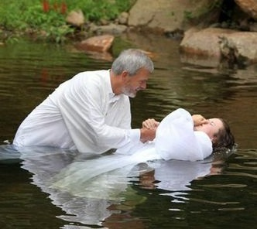
Conclusion
Before we can filter our lives through the lens of Jesus and look and sound different than the world around us, we must first put on Jesus!
Galatians 3:27
For all of you who were baptized into Christ have clothed yourselves with Christ.

Slide 28
Conclusion
Saints must continually make sure we are “putting on” the character of Christ! (Colossians 3:12-14)
Let us “put on” Christ by adorning our hearts in His character and in obedience to God!

Slide 29
“What Must I Do To Be Saved?”
Hear The Gospel (Jn. 5:24; Rom. 10:17)
Believe In Christ (Jn. 3:16-18; Jn. 8:24)
Repent Of Sins (Lk. 13:3-5; Acts 2:38)
Confess Christ (Mt. 10:32; Rom. 10:10)
Be Baptized (Mk. 16:16; Acts 22:16)
Remain Faithful (Jn. 8:31; Rev. 2:10)
For The Erring Saint:
Repent (Acts 8:22), Confess (I Jn. 1:9),
Pray (Acts 8:22)

Slide 31
Colossians 3:12-14
Compassion
Kindness
Humility
Gentleness
Patience
Forgiveness
Love

Slide 32
Colossians 3:12-14
Put on…
Compassion
Kindness
Humility
Gentleness
Patience
Forgiveness
Love
By Nathan L Morrison

