Slide 1
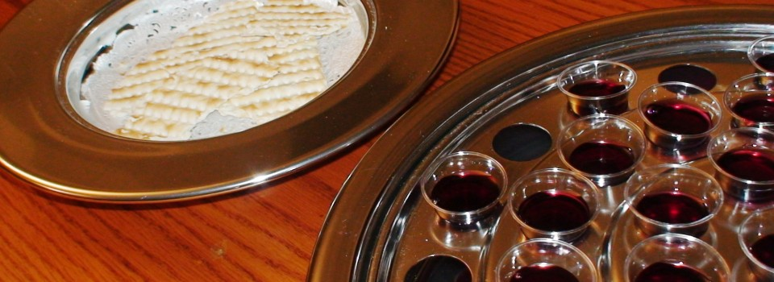
I Corinthians 10:16-17:
16. Is not the cup of blessing which we bless a sharing in the blood of Christ? Is not the bread which we break a sharing in the body of Christ?
17. Since there is one bread, we who are many are one body; for we all partake of the one bread.

Slide 2
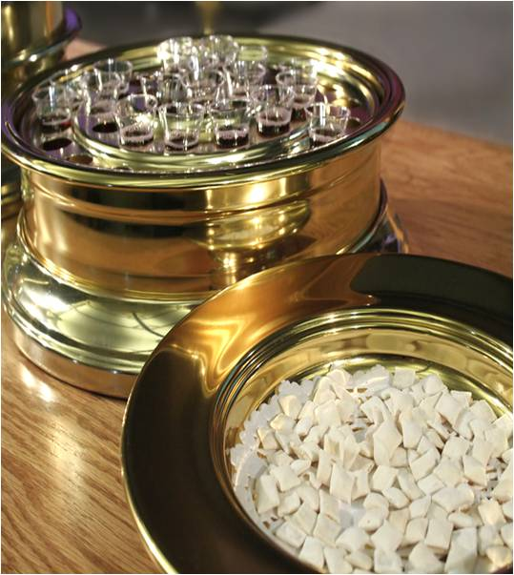
I Corinthians 10:16-17:
16. Is not the cup of blessing which we bless a sharing in the blood of Christ? Is not the bread which we break a sharing in the body of Christ?
17. Since there is one bread, we who are many are one body; for we all partake of the one bread.

