Slide 1
TREE OF LIFE
Text: Revelation 22:1-2
Notes:
By Nathan L Morrison
All Scripture is from NASB unless otherwise stated
For further study, or if questions, please Call: 804-277-1983 or Visit www.courthousechurchofchrist.com
Based on a lesson by Ron Halbrook

Slide 2
Intro
Revelation 22:1-5
1. Then he showed me a river of the water of life, clear as crystal, coming from the throne of God and of the Lamb,
2. in the middle of its street. On either side of the river was the tree of life, bearing twelve kinds of fruit, yielding its fruit every month; and the leaves of the tree were for the healing of the nations.
3. There will no longer be any curse; and the throne of God and of the Lamb will be in it, and His bond-servants will serve Him;
4. they will see His face, and His name will be on their foreheads.
5. And there will no longer be any night; and they will not have need of the light of a lamp nor the light of the sun, because the Lord God will illumine them; and they will reign forever and ever.

Slide 3
Intro
Rev. 22:1-2: The tree of life: lost at Eden, found in Heaven
The tree of life: In Heaven, the tree will abound, and all may freely partake of it (the emblem and pledge of immortal life) Different than in Eden – Gen. 3:22-23
Bearing twelve kinds of fruit: There were twelve fruit-harvests. The idea is that of abundance, not variety!
Yielding its fruit every month: It was not like a tree that bears but once a year, or in one season only, but it bore every month.
Were for the healing: Not a healing process in heaven, for that idea is expressly excluded in Rev. 21:4; but the meaning is, that the life and health of the heavenly inhabitants will have been imparted by partaking of that tree and made to live forever!
How was it lost and how do we find it?

Slide 4
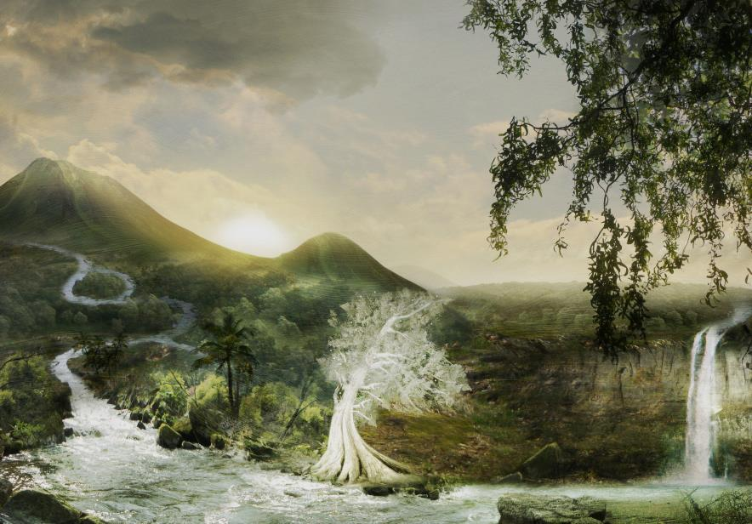
Eden Sustained Man in Fellowship with God
Man was created for fellowship with God
Gen. 1:27: Only man is made in God’s image! (Gen. 2:19-20)
God made man to live, not to die
Gen. 2:8-9: Man blessed by 3 kinds of trees: delicious food, tree of life (immortality – Gen. 3:22-23), and the tree of knowledge of good and evil
Eden means delight, bliss, pleasure, paradise
Gen. 2:10-14: River divided into
4 rivers & land filled with precious
metals & minerals
Gen. 2:18-25: Adam & Eve shared
Eden’s bliss & fellowship with God
The Garden of Eden with its
trees, rivers, and precious
metals was meant to sustain life!

Slide 5
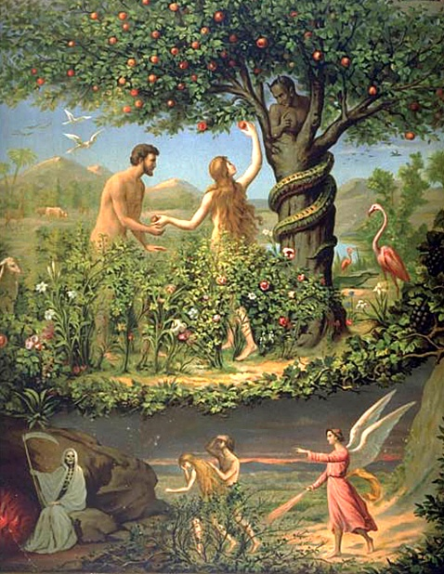
Sin Separated Man from God & the Tree of Life
Man has free will to love & obey or reject God
Gen. 2:16-17: God warned sin brings death
Satan presented sin as a blessing
Gen. 3:4-6: Eve & Adam chose the lie of Satan
Adam & Eve died spiritually
Gen. 3:8-10: The beautiful blissful fellowship was replaced with guilt, shame, & fear

Slide 6
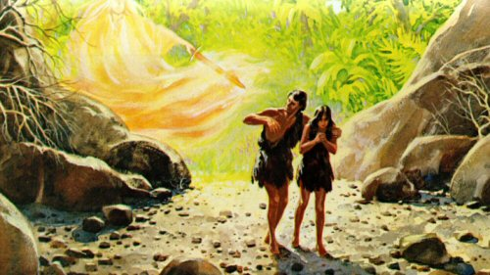
Sin Separated Man from God & the Tree of Life
Adam & Eve lost the right to the Tree of Life!
Gen. 3:19: The sentence of death pronounced (Rom. 5:12-14; I Cor. 15:21-22)
Gen. 3:22-24: Man could not return to the tree of life

Slide 7
Sin Separated Man from God & the Tree of Life
Gen. 3:19 (Rom. 5:12-14; I Cor. 15:21-22)
19. By the sweat of your face You will eat bread, Till you return to the ground, Because from it you were taken; For you are dust, And to dust you shall return."
Genesis 3:22-24
22. Then the LORD God said, "Behold, the man has become like one of Us, knowing good and evil; and now, he might stretch out his hand, and take also from the tree of life, and eat, and live forever"--
23. therefore the LORD God sent him out from the garden of Eden, to cultivate the ground from which he was taken.
24. So He drove the man out; and at the east of the garden of Eden He stationed the cherubim and the flaming sword which turned every direction to guard the way to the tree of life.

Slide 8
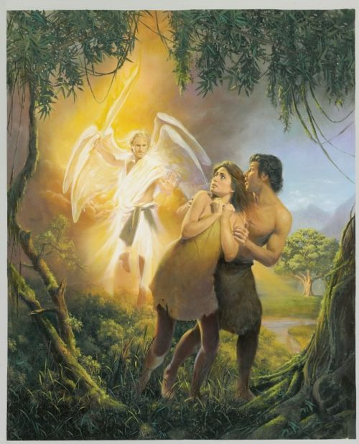
Sin Separated Man from God & the Tree of Life
Adam & Eve lost the right to the Tree of Life
Gen. 3:19: The sentence of death pronounced (Rom. 5:12-14; I Cor. 15:21-22)
Gen. 3:22-24: Man could not return to the tree of life
Sin resulted in spiritual death, and with the loss of the Tree of Life brought forth physical death!

Slide 9
God Revealed a Plan to Renew Our Fellowship
In the Patriarchal Age God promised a Savior
Gen. 3:15: Seed of woman will defeat Satan
Gen. 12:1-3: Seed of Abraham will bless men of all nations
Promise repeated to Abraham’s descendants: Isaac, Jacob, Judah, etc. (Deut. 1:8; 7:12; Gen. 49:8-10)
In the Mosaic Age God prepared to send a Savior
Judah’s family went to Egypt 400+ years, then Moses led the Jews to Canaan
Ex. 20:1-17: God gave Moses His covenant law for the nation of Israel, beginning with The Ten Commandments
Jer. 31:31-34: Moses’ Law was temporary, preparing the people for the New Law of Christ (Heb. 8:7-13)
God gave Israel kings: Saul, David, Solomon
II Sam. 7:12-16: David was promised a descendant to sit his throne forever!
Is. 9:6: Israel’s kings were temporary, preparing for Christ, the new perfect divine King

Slide 10
God Revealed a Plan to Renew Our Fellowship
God made Israel a great kingdom
Dan. 2:44: The kingdom of Israel was temporary, preparing for the new kingdom (which is the church of Christ) – “In the days of those kings…”)
God taught Israel to offer animal sacrifices
Is. 53:5-6: Animal sacrifices were temporary, preparing them for Christ, the perfect sacrifice for sin
God taught Israel to worship at the temple
Ezek. 47:12: Israel’s temple was temporary (Ezek. 40:1-5), preparing for the new temple (members of the church – I Cor. 6:19) with the river of life & the tree of life (Rev. 22:1-2)

Slide 11
God Revealed a Plan to Renew Our Fellowship
In the Gospel Age our Savior is here!
Mt. 1:21-23; Lk. 2:10-11: Angels said Jesus Christ is the Savior!
In Christ & His church, we find:
The seed of woman who defeats Satan (Rom. 16:20; Gal. 4:4-5; Heb. 2:14-15)
The seed of Abraham who blesses all men (Gal. 3:8-16)
Christ’s new covenant (Lk. 22:20: In Jesus’ blood)
Our new King (Mt. 1:1-17; I Tim. 6:13-16; Acts 2:30-32: Line of David)
The new spiritual kingdom of God (Mt. 21:43; Col. 1:13)
The perfect sacrifice for our sins (Heb. 9:24-28; 10:10-12, 14)
The new temple with the river & tree of life (Rev. 21:1-7; 22:1-5)
Mk. 16:15-16: The Savior built His church by sending His Apostles to proclaim salvation!
Mt. 28:18-20: The Savior calls all men to submit to the gospel & receive salvation!
God perfectly fulfilled His plan to save mankind:
The Gospel Age began in Acts 2!

Slide 12
We Find Eternal Fellowship with God in Heaven: The Tree of Life Awaits Us There!
Fellowship with God makes Heaven an eternity of bliss
(Paradise, a new Eden)
Rev. 2:7: To Ephesus: “To him who overcomes, I will grant to eat of the tree of life which is in the Paradise of God.”
Rev. 22:1-4, 14, 17: The water of life & the tree of life – Saints have the right to both!

Slide 13
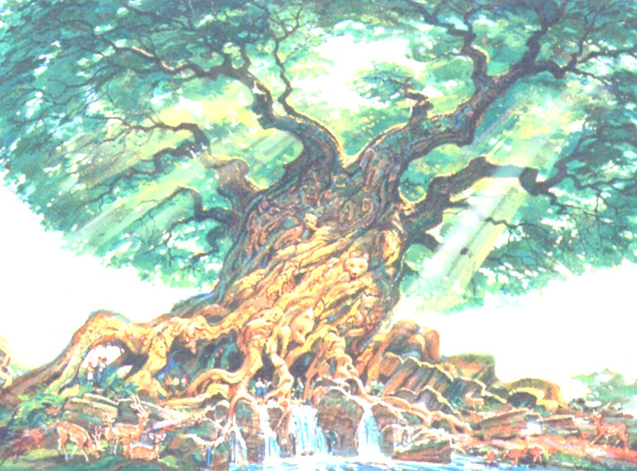
We Find Eternal Fellowship with God in Heaven: The Tree of Life Awaits Us There!
Revelation 22:1-4
1. Then he showed me a river of the water of life, clear as crystal, coming from the throne of God and of the Lamb,
2. in the middle of its street. On either side of the river was the tree of life, bearing twelve kinds of fruit, yielding its fruit every month; and the leaves of the tree were for the healing of the nations.
3. There will no longer be any curse; and the throne of God and of the Lamb will be in it, and His bond-servants will serve Him;
4. they will see His face, and His name will be on their foreheads.

Slide 14
We Find Eternal Fellowship with God in Heaven: The Tree of Life Awaits Us There!
Revelation 22:14, 17
14. Blessed are those who wash their robes, so that they may have the right to the tree of life, and may enter by the gates into the city.
17. The Spirit and the bride say, "Come." And let the one who hears say, "Come." And let the one who is thirsty come; let the one who wishes take the water of life without cost.

Slide 15
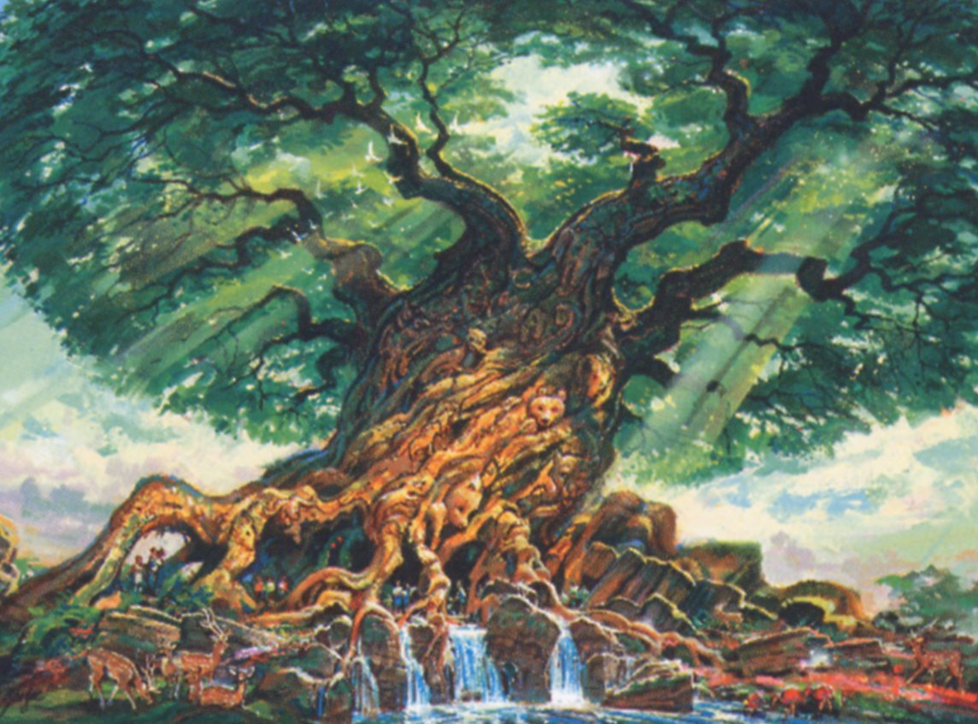
We Find Eternal Fellowship with God in Heaven: The Tree of Life Awaits Us There!
Fellowship with God makes Heaven an eternity of bliss
(Paradise, a new Eden
Rev. 2:7: To Ephesus: “To him who overcomes, I will grant to eat of the tree of life which is in the Paradise of God.”
Rev. 22:1-4, 14, 17: The water of life & the tree of life – Saints have the right to both!
Those who overcome and inherit Heaven have the right to the water and tree of life!

Slide 16
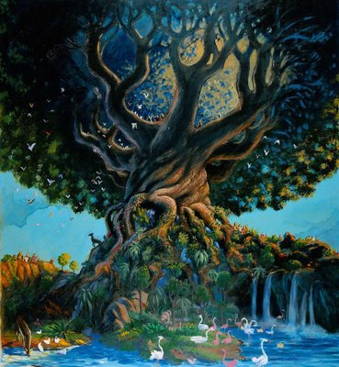
Conclusion
Rev. 22:1-2: The tree of life: lost at Eden, found in Heaven

Slide 17
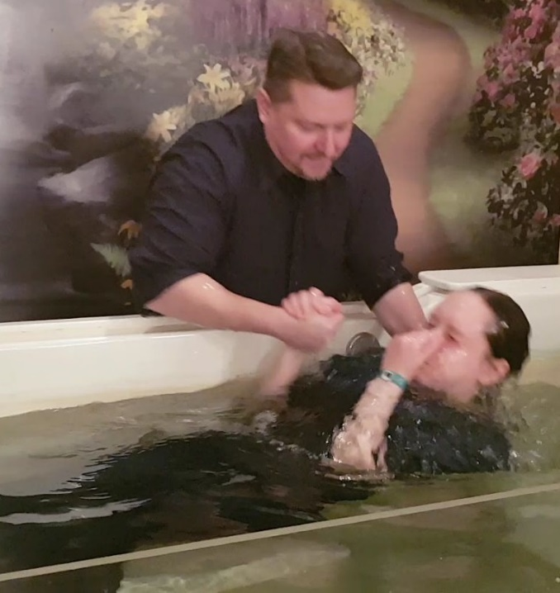
Conclusion
How was it lost and how do we find it?
Eden, with the tree of life in its midst, sustained man in fellowship with God
Sin separated man from God & the tree of life
God revealed a plan to renew our fellowship
We find eternal fellowship with God in heaven: the tree of life awaits us there!
We must choose: Satan offers lies, sin, & death
VS. Christ offers salvation & tree of life
II Thess. 1:7-9; Rev. 22:18-19: Those disobedient lose their right to the tree of life and their souls enter eternal punishment!
Mt. 28:19: Salvation for souls outside Christ (II Cor. 5:10-11)
James 5:16: Salvation for saints who fall into sin (I Jn. 1:9)

Slide 18
Conclusion
The Tree of Life was once lost to men but
can now be found!
Have you found it?!

Slide 19
“What Must I Do To Be Saved?”
Hear The Gospel (Jn. 5:24; Rom. 10:17)
Believe In Christ (Jn. 3:16-18; Jn. 8:24)
Repent Of Sins (Lk. 13:3-5; Acts 2:38)
Confess Christ (Mt. 10:32; Rom. 10:10)
Be Baptized (Mk. 16:16; Acts 22:16)
Remain Faithful (Jn. 8:31; Rev. 2:10)
For The Erring Saint:
Repent (Acts 8:22), Confess (I Jn. 1:9),
Pray (Acts 8:22)

