Slide 1
Putting The Cart Before The Horse
Text: Matthew 7:21-23
Notes:
Prepared by Nathan L Morrison
All Scripture given is from NASB unless otherwise stated!
For further study, or if questions, please Call: 804-277-1983 or Visit www.courthousechurchofchrist.com
Adapted from a lesson by Richie Thetford

Slide 2
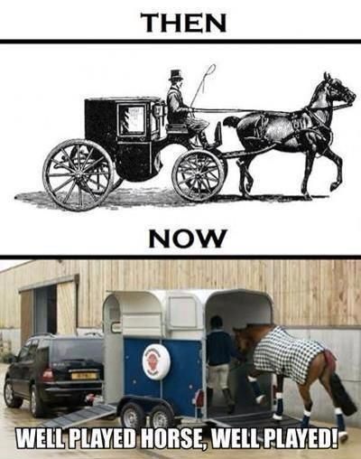
Intro
Old phrase: “Putting the cart before the horse”
Modern technology has changed the image!

Slide 3
Intro
Matthew 7:21-23
21. "Not everyone who says to Me, 'Lord, Lord,' will enter the kingdom of heaven, but he who does the will of My Father who is in heaven will enter.
22. "Many will say to Me on that day, 'Lord, Lord, did we not prophesy in Your name, and in Your name cast out demons, and in Your name perform many miracles?'
23. "And then I will declare to them, 'I never knew you; DEPART FROM ME, YOU WHO PRACTICE LAWLESSNESS.'
Many people put the cart before the horse in spiritual
matters and think God overlooks it!
Putting the cart before the horse physically, one will go nowhere.
Applying the same to the spiritual, one will not grow properly, and will go where they do not wish to go!
Many people put the cart before the horse by reversing
God’s order in trying to serve Him!

Slide 4
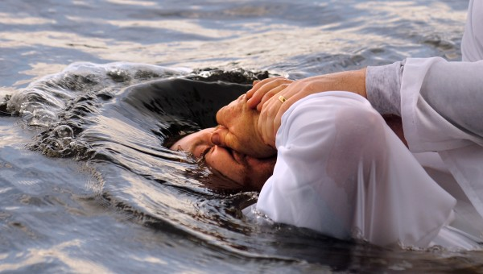
Ways Man Reverses God’s Order
Many teach one can be in Christ and in His church without baptism!
By believing they are IN Christ before baptism
Mk. 16:16: The one that “believes and is baptized” will be saved.
Gal. 3:26-27: The sons of God are those who were “baptized into Christ.”
I Cor. 12:13: To be in the church, one must be “baptized into one body.”

Slide 5

Ways Man Reverses God’s Order
Many teach forgiveness of sins can be had with a simple prayer, without baptism!
By believing they are forgiven of sins before baptism
Acts 2:38: To be forgiven of sins, one must “Repent and be baptized for the forgiveness of sins!”
Acts 22:16: To call on the name of the Lord, one must “be baptized, and wash away your sins.”

Slide 6
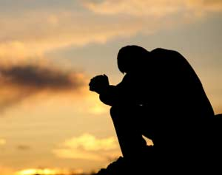
Ways Man Reverses God’s Order
Many teach one can be saved by praying for
salvation before obedience!
By believing God hears prayer before being saved
according to His will
I Pet. 3:12: God hears the prayers of the righteous, and turns his face against those who do evil.
Prov. 28:9: The one who does not obey God, even his prayers are an abomination!
Acts 10: Cornelius, a God fearing man, prayed to God. God answered him with what he needed to hear first before attending to his prayers.
  What he needed: to hear the gospel and obey it! (Acts 10:47-48)
I Jn. 5:14: God hears the one who prays according to His will.

Slide 7

Ways Man Reverses God’s Order
Many teach that one can just believe in God (believe there is a God) and be saved without ever really hearing His word! (Cornelius couldn’t)
By believing one can have faith before hearing God’s word
Acts 15:7: For the Gentiles to believe, they must first hear!
Acts 16:31-32: For the Philippian Jailer to “Believe in the Lord Jesus” they were taught “the word of the Lord.”
Rom. 10:17: “So faith comes from hearing, and hearing by the word of God.”

Slide 8

Ways Man Reverses God’s Order
Many teach one can live a good and “righteous” life apart from obedience to the gospel –
God’s word contains what man needs to know about righteousness!
By believing one can live a good life & expect to go to
Heaven before obeying the gospel
Gal. 2:20: To “live by faith” one must first be in the “faith!” (Eph. 4:5)
II Pet. 1:2-3: His word contains the knowledge of “life and godliness.”
Rom. 6:3-5, 17-18: To no longer be slaves of sin, one must be freed through obedience to become slaves of righteousness!

Slide 9
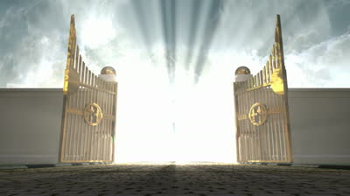
Ways Man Reverses God’s Order
Many believe that God could never send anyone to Hell, therefore it doesn’t really matter how one lives: Everyone is going to Heaven!
By believing in an inheritance in Heaven before following Jesus
I Pet. 1:3-5: Those who live by faith have that inheritance in Heaven!
Mt. 6:24: Jesus said one cannot serve two masters.
  One must choose to serve God – Rom. 6:16-18: By obedience!
Lk. 9:23: Must deny self and follow after Christ daily!
II Tim. 4:7-8: Paul said the reward comes to those who “have loved His appearing.”
  Jn. 14:15: Jesus said the one that loves Him is the one that obeys Him!

Slide 10
Ways Man Reverses God’s Order
By believing they are IN Christ before baptism
By believing they are forgiven of sins before baptism
By believing God hears prayer before being saved
according to His will
By believing one can have faith before hearing God’s word
By believing one can live a good life & expect to go to
Heaven before obeying the gospel
By believing in an inheritance in Heaven before following Jesus Christ
So many doctrines of men seek to serve God by
putting the cart before the horse!

Slide 11

We Must Respect God’s Order
Titus 2:11-14
11. For the grace of God has appeared, bringing salvation to all men,
12. instructing us to deny ungodliness and worldly desires and to live sensibly, righteously and godly in the present age,
13. looking for the blessed hope and the appearing of the glory of our great God and Savior, Christ Jesus,
14. who gave Himself for us to redeem us from every lawless deed, and to purify for Himself a people for His own possession, zealous for good deeds.
In order to receive salvation and an eternal rest we must respect God’s authority and do things His way – He redeemed us as His special people!

Slide 12
We Must Respect God’s Order
One must hear the word of God – Jn. 5:24 (Rom. 10:17)
Believe (have faith) – Jn. 3:16-18
Repent – Lk. 13:3-5
Confess Jesus as Lord – Mt. 10:32 (Acts 8:37)
Be baptized for the forgiveness of sins – Mk. 16:16
(Acts 2:38)
Remain obedient (faithful) till death – Jn. 8:31 (Rev. 2:10)
Pursue righteousness – II Tim. 2:22
The blessings of God fall upon those who do things
according to His plan!

Slide 13
Conclusion
Let us not be guilty of “putting the cart before the horse”
in our Christianity!
If we are guilty of that we need to repent of it and correct it!
I John 1:9
9. If we confess our sins, He is faithful and righteous to forgive us our sins and to cleanse us from all unrighteousness.

Slide 14

Conclusion
Our eternity in Heaven will be determined not by what we
think or believe to be right, or even by a majority poll, but
by our obedience to God!
II Thess. 1:7-9: Putting the cart before the horse religiously will cause us to be separated from God eternally!
Mt. 7:21: The ones that will be saved are the ones who do “the will of My Father in Heaven.”
It is not the will of God if it is against the word of God!
Don’t put the cart before the horse in
service to God but do as God has ordered
in His order to be saved!

Slide 15
“What Must I Do To Be Saved?”
Hear The Gospel (Jn. 5:24; Rom. 10:17)
Believe In Christ (Jn. 3:16-18; Jn. 8:24)
Repent Of Sins (Lk. 13:3-5; Acts 2:38)
Confess Christ (Mt. 10:32; Rom. 10:10)
Be Baptized (Mk. 16:16; Acts 22:16)
Remain Faithful (Jn. 8:31; Rev. 2:10)
For The Erring Saint:
Repent (Acts 8:22), Confess (I Jn. 1:9),
Pray (Acts 8:22)

