Slide 1


Not Deceived By Schemes
Of The Devil
Text:
II Corinthians 2:10-11
Notes:
By Nathan L Morrison
All Scripture given is from NASB unless otherwise stated
For further study, or if questions, please Call: 804-277-1983 or Visit www.courthousechurchofchrist.com

Slide 2
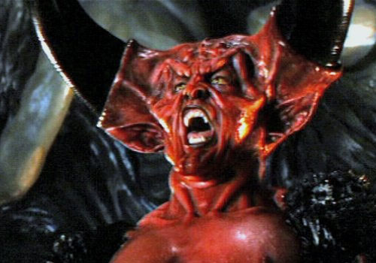

Intro
The Scriptures tell us we have an enemy in Satan!
I Pet. 5:8 (Jn. 8:44)
8. Be of sober spirit, be on the alert. Your adversary, the devil, prowls around like a roaring lion, seeking someone to devour.
Many in the world look at their enemy as a myth, legend,
a made up entity
“The biggest trick
by Satan is
convincing the
world he doesn’t
exist!”
Notes:
Image: Tim Curry as Darkness (aka Satan) from the movie ‘Legend.’

Slide 3

Intro
The armor of God is given to prepare the saint for battle
Eph. 6:10-13: The saint is to stand against the schemes of the devil!
II Tim. 2:24-26: The challenge or work of the Lord’s bond-servant is to recover/rescue those overtaken by the devil.
Notes:
Image of Satan with the World: By Jack-Chick

Slide 4

Intro
The Scriptures also tell us he has an agenda…
II Cor. 11:3 (To control the minds of man)
3. But I am afraid that, as the serpent deceived Eve by his craftiness, your minds will be led astray from the simplicity and purity of devotion to Christ.

Slide 5
Intro
The Scriptures also tell us he has an agenda…
II Cor. 11:13-15 (He works through agents)
13. For such men are false apostles, deceitful workers, disguising themselves as apostles of Christ.
14. No wonder, for even Satan disguises himself as an angel of light.
15. Therefore it is not surprising if his servants also disguise themselves as servants of righteousness, whose end will be according to their deeds.

Slide 6
Intro
The Scriptures also tell us he has an agenda…
Eph. 4:14 (His doctrines are to deceive men – II Tim. 3:5)
14. As a result, we are no longer to be children, tossed here and there by waves and carried about by every wind of doctrine, by the trickery of men, by craftiness in deceitful scheming;

Slide 7
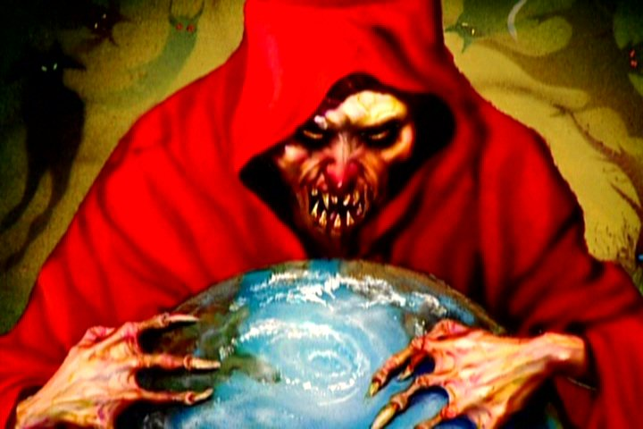
Intro
The Scriptures also tell us he has an agenda…
II Cor. 2:10-11 (He Schemes & blinds – II Cor. 4:4!)
10. But one whom you forgive anything, I forgive also; for indeed what I have forgiven, if I have forgiven anything, I did it for your sakes in the presence of Christ,
11. so that no advantage would be taken of us by Satan, for we are not ignorant of his schemes.;
Knowing his schemes
should help us
not be ignorant of or
deceived by them!

Slide 8

Subvert the Word of God
Gen. 3:1-19: Adam and Eve sinned because of deceit
Eve heard, believed, and obeyed a lie! (Gen. 3:6; II Cor. 11:3)
Adam listened to his wife and sinned (Gen. 3:17).
II Cor. 11:14-15: Satan, through his servants, perverts
God’s word
II Cor. 3:12-16; I Tim. 1:3-4: Mixing the gospel with the Law. (Acts 15)
Gal. 1:6-9: Perverting the gospel

Slide 9

Subvert the Word of God
Many problems today result from same kind of perversion
Plan of Salvation: (Thief on the cross; Sinner’s Prayer)
Acceptable worship: (Sabbath; Instrumental music; Communion on special events)
Identifying God’s people: (Premillennialism – Jews still God’s people; Mt. 21:43; Rom. 2:28-29; Gal. 3:27-29)
Giving to God: (Materialism – Bazaars to raise money, etc. – Lk. 12:15-21)
One church (Eph. 4:4-6: “One body”: “One church is as good as another”)

Slide 10
Subvert the Word of God
People think they are saved so why should they change? (Mt. 7:21-23)
The Truth is in Christ & His word – we must not only know it but practice it!
(Adam & Eve knew it, yet sinned!)

Slide 11

Set Mind on Things on Earth
Col. 3:2: Saints are not to set their minds on the things of
earth, but above to Heaven
II Cor. 4:3-4: Satan is called the “god of this world (age).”
He tempts saints to focus (set our minds) on the things of the earth! (Mt. 13:22; Lk. 8:14)

Slide 12

Set Mind on Things on Earth
The “World” is the present age
Heb. 11:24-25: Immediate fulfillment: Pleasure of sin
Lk. 12:15-21: Material things seem to offer so much security
Eph. 2:1-3: “Lusts” = uncontrolled desire

Slide 13

Set Mind on Things on Earth
God’s people live for present and future
II Peter 1:3; Heb. 6:9-20: Intend to obtain God’s promises.
II Tim. 4:7-8; Js. 1:12: The “Crown of life” waits.
Col. 3:1-3: Seek things above.
Those seeking immediate gratification in life (their reward now) will have the reward they seek but miss out on the eternal reward!

Slide 14

Seduce The Saints
Satan wants souls (YOU!)
I Pet. 5:8: “Someone to devour”
I Cor. 5:1-2: A Christian at Corinth involved in adultery
Lk. 22:3-6: An apostle of Christ (Judas) was seduced by his greed (material things).
Acts 5:3: A Christian was seduced to lie for the praise of men.
II Tim. 4:10: A Christian was seduced into forsaking Christ and Paul for the world.
Rev. 2:20-23: A Church of Christ in Thyatira tolerated members who were seduced into various acts of immorality by one of its members!

Slide 15
Seduce The Saints
Satan wants souls (YOU!)
I Pet. 5:8: “Someone to devour”
I Cor. 5:1-2: A Christian at Corinth involved in adultery
Lk. 22:3-6: An apostle of Christ (Judas) was seduced by his greed (material things).
Acts 5:3: A Christian was seduced to lie for the praise of men.
II Tim. 4:10: A Christian was seduced into forsaking Christ and Paul for the world.
Rev. 2:20-23: A Church of Christ in Thyatira tolerated members who were seduced into various acts of immorality by one of its members!
When you think it can’t happen to YOU, BEWARE!
Many Christians today become unfaithful to
Christ -- seduced by Satan!

Slide 16

Conclusion
Js. 4:7; I Pet. 5:9: Power to resist comes from God’s word! (Matthew 4: “It is written”)
I Peter 5:9
9. But resist him, firm in your faith, knowing that the same experiences of suffering are being accomplished by your brethren who are in the world.
James 4:7
7. Submit therefore to God. Resist the devil and he will flee from you.
Ephesians 6:13 (6:11)
13. Therefore, take up the full armor of God, so that you will be able to resist in the evil day, and having done everything, to stand firm.

Slide 17
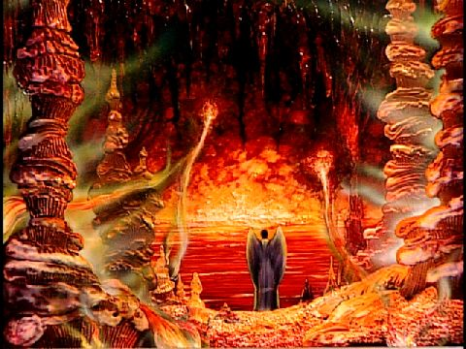
Conclusion
Matthew 25:41: Satan’s doom = Hell
Servants of Satan shall be doomed to Hell!
If serve Satan in this life, you will live with him eternally!
If serve God in this life, you will live with Him eternally! (Mt. 25:34)

Slide 18
Conclusion
Satan is strong, even powerful, but only as powerful as
you let him be in your life! (I Cor. 10:13; Js. 1:14-16)
Christ already defeated him!
Satan is strong, but not victorious!
Heb. 2:14-18
14. Therefore, since the children share in flesh and blood, He Himself likewise also partook of the same, that through death He might render powerless him who had the power of death, that is, the devil,
15. and might free those who through fear of death were subject to slavery all their lives.
16. For assuredly He does not give help to angels, but He gives help to the descendant of Abraham.
17. Therefore, He had to be made like His brethren in all things, so that He might become a merciful and faithful high priest in things pertaining to God, to make propitiation for the sins of the people.
18. For since He Himself was tempted in that which He has suffered, He is able to come to the aid of those who are tempted.

Slide 19

Conclusion
Don’t be deceived by Satan’s schemes but
“Resist him, firm in your faith!” (I Pet. 5:9)

Slide 20

“What Must I Do To Be Saved?”
Hear The Gospel (Jn. 5:24; Rom. 10:17)
Believe In Christ (Jn. 3:16-18; Jn. 8:24)
Repent Of Sins (Lk. 13:3-5; Acts 2:38)
Confess Christ (Mt. 10:32; Rom. 10:10)
Be Baptized (Mk. 16:16; Acts 22:16)
Remain Faithful (Jn. 8:31; Rev. 2:10)
For The Erring Saint:
Repent (Acts 8:22), Confess (I Jn. 1:9),
Pray (Acts 8:22)

