Slide 1
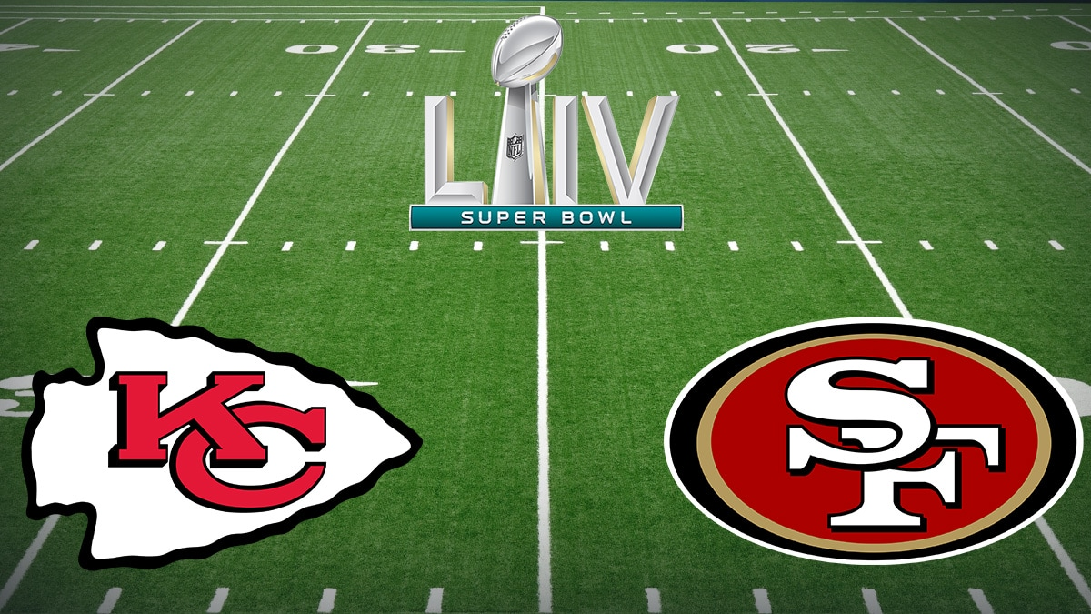
Happy 54th Super Bowl!

Slide 2
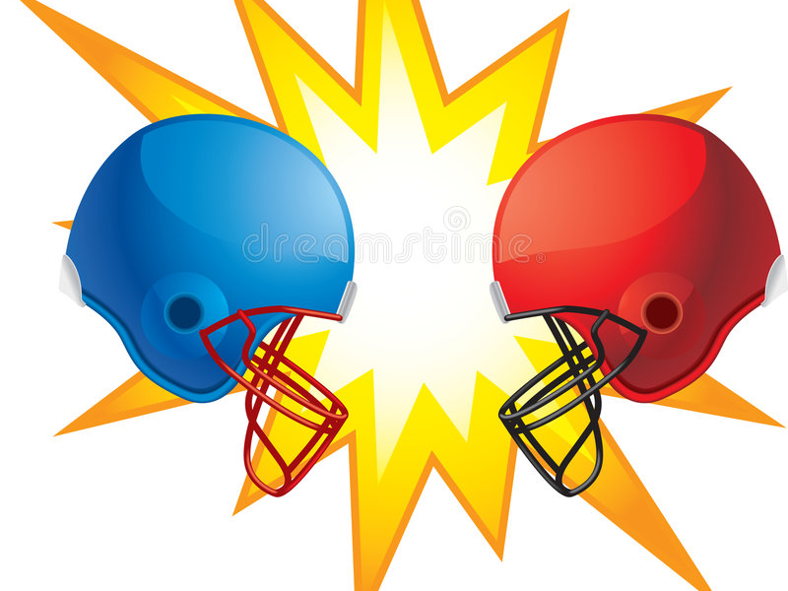
FIRE BOWL ON Mt. CARMEL
YHWH
Baal
TEAM: YHWH, God of Abraham, Isaac and Israel
VS.
TEAM: Baal, the Storm god of Tyre & Sidon

Slide 3
FIRE BOWL ON Mt. CARMEL
YHWH
Baal
The prize isn’t trophies, medals, money, or even the praise and adoration of men, but of life and death, the winning of hearts and minds and the saving of their souls!

Slide 4
Pre-Contest Background
I Kings 16:29-33
Jezebel imported the worship of Baal & Asherah
Ahab is king of Israel and is more evil than any king before him!
Jezebel was a princess of Phoenicia (Tyre & Sidon)
“…there was no one like Ahab who sold himself to do evil in the sight of the LORD, because Jezebel his wife incited him”
(I Kings 21:25-26)
Ahab may have intended to serve both Baal & YHWH from his sons’ names
Ahaziah = “The Lord sustains” (I Kings 22:40)
Joram = “The Lord is exalted” (II Kings 8:16)

Slide 5
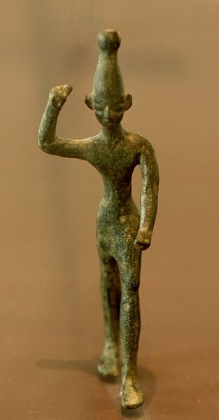
Pre-Contest Background
Baal (“Lord, Master”) was worshiped in Canaan
Worshiped in Babylon as Marduk, or Bel (or Bel-Marduk)
Worshiped in Phoenicia (Tyre & Sidon)
Worshiped in Assyria
Worshiped in Greece as Zeus
Worshiped in Rome as Jupiter
Worshiped by the Norse as Odin
Notes:
Image: Baal with raised right arm, as found in Ugarit ruins (Northern Syria), now at the Louvre
Sources:
Baal:
o https://en.wikipedia.org/wiki/Baal
o https://www.britannica.com/topic/Baal-ancient-deity
o http://www.mythencyclopedia.com/Ar-Be/Baal.html
o https://www.newworldencyclopedia.org/entry/baal

Slide 6
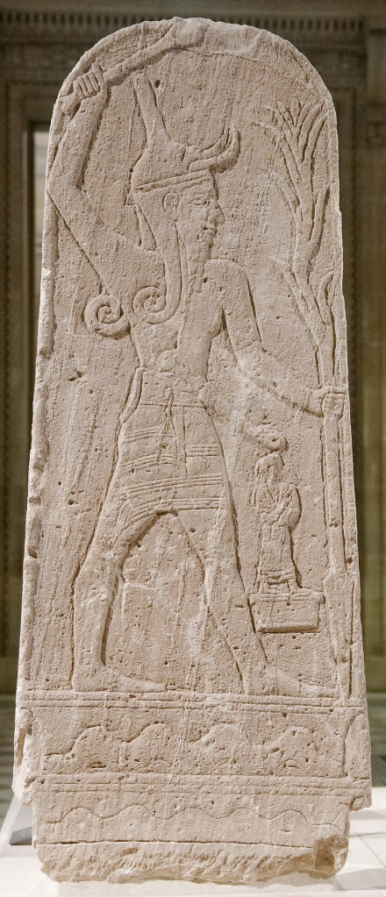
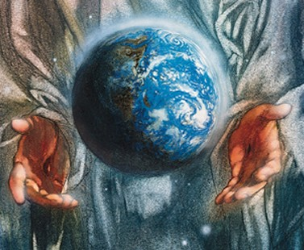
Pre-Contest Background
Similarities in visual perceptions of God and Baal:
YHWH, Lord God Almighty | Baal, the storm god
Said to ride the thunderstorm as His divine chariot (Psalm 104:3-4) | He who rides on the clouds, Lord of the heavens
Thunder is His voice (Psalm 29:3-9) | A god of thunder (as well as fertility)
Lightning, or fire, is His weapon (Psalm 18:14; 77:17; 144:6) | As a god of thunder, hurls lightning and fire
Notes:
Image: Public Domain, https://commons.wikimedia.org/w/index.php?curid=931147
The stele of Baal with Thunderbolt found in the ruins of Ugarit (Northern Syria)
Sources:
Baal:
o https://en.wikipedia.org/wiki/Baal
o https://www.britannica.com/topic/Baal-ancient-deity
o http://www.mythencyclopedia.com/Ar-Be/Baal.html
o https://www.newworldencyclopedia.org/entry/baal

Slide 7
Pre-Contest Background
I Kings 17:1-7
Elijah tells King Ahab about the wrath of God to come!
I Kings 18:1: Famine for 3.5 years (Luke 4:25-26; James 5:17)
I Kings 18:3-16: What has Ahab been up to?
Jezebel murdered prophets of God, and they scoured the land looking for Elijah!
Elijah sends Obadiah to fetch King Ahab for him and promises to be there when he returns with the king
Ahab looked to strengthen his military might in the midst of the famine!
Elijah is about to face the king of Israel again!
Notes:
The annals of Shalmaneser III, king of Assyria, tell us that Ahab had 2,000 chariots. That requires a lot of horses. Even in the midst of a famine over all the land, Ahab wants to preserve his military might. He put his trust in his own strength, rather than God’s.
Source: The annals of Shalmaneser III, king of Assyria:
o https://www.bible.ca/manuscripts/bible-archeology-Shalmaneser-III-Assyria-inscriptions-annals-Kurkh-monolith-Ahab-Israelite-battle-Qarqar-852BC.htm
o https://en.wikipedia.org/wiki/Kurkh_Monoliths

Slide 8
The Warm-Up
I Kings 18:17-19
When Ahab saw Elijah, Ahab said to him, "Is this you, you troubler of Israel?“
He said, "I have not troubled Israel, but you and your father's house have, because you have forsaken the commandments of the LORD and you have followed the Baals.
"Now then send and gather to me all Israel at Mount Carmel, together with 450 prophets of Baal and 400 prophets of the Asherah, who eat at Jezebel's table."

Slide 9
The Warm-Up
I Kings 18:20-22
So Ahab sent a message among all the sons of Israel and brought the prophets together at Mount Carmel.
Elijah came near to all the people and said, "How long will you hesitate between two opinions? If the LORD is God, follow Him; but if Baal, follow him." But the people did not answer him a word.
Then Elijah said to the people, "I alone am left a prophet of the LORD, but Baal's prophets are 450 men.

Slide 10
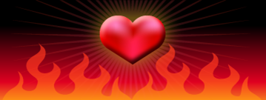
The Warm-Up
I Kings 18:23-24
23. "Now let them give us two oxen; and let them choose one ox for themselves and cut it up, and place it on the wood, but put no fire under it; and I will prepare the other ox and lay it on the wood, and I will not put a fire under it.
24. "Then you call on the name of your god, and I will call on the name of the LORD, and the God who answers by fire, He is God." And all the people said, "That is a good idea."
The contest for the hearts and minds of the people was about to begin!

Slide 11
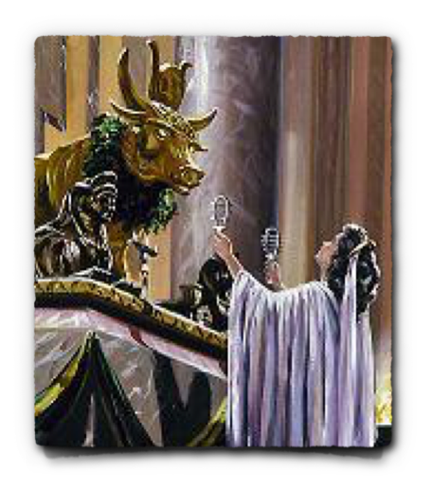
The Coin-Toss and Kickoff
Is this a real contest if Baal is a false god?
It’s a contest for the hearts & minds of the people who believed in the false god.
It’s a contest of heart & mind for the false prophets of Baal & Asherah and King Ahab to keep the people worshiping their creation.

Slide 12
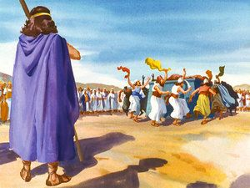
The Coin-Toss and Kickoff
The Coin Toss
Because of their number, Elijah lets the false prophets go first.
also for Elijah to go last and make a point by contrast.
I Kings 18:25
25. So Elijah said to the prophets of Baal, "Choose one ox for yourselves and prepare it first for you are many, and call on the name of your god, but put no fire under it."

Slide 13
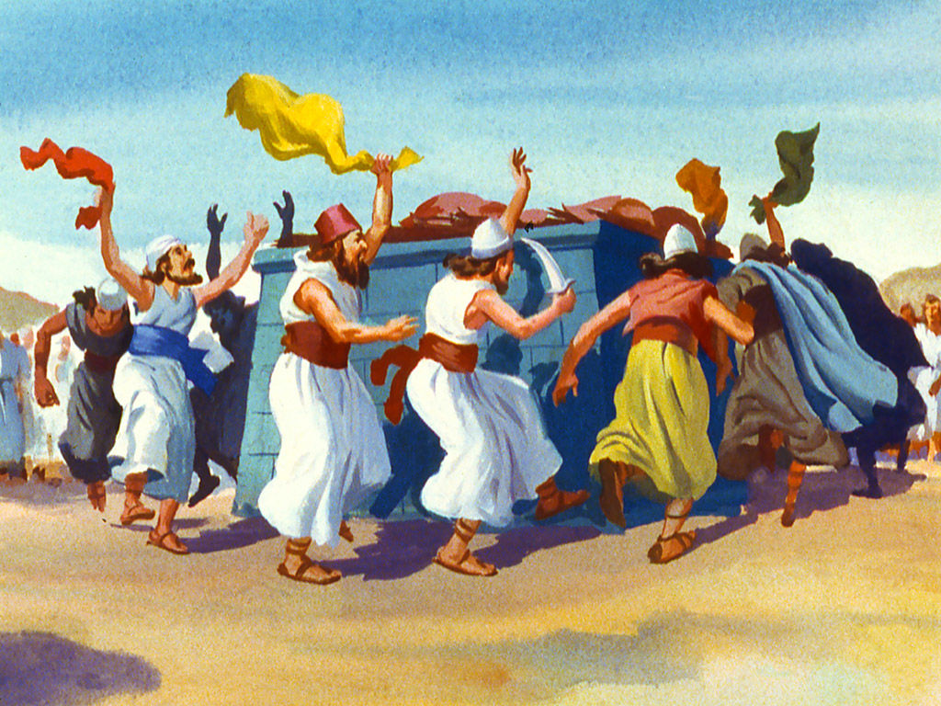
The Coin-Toss and Kickoff
The Kick-off
They called out to Baal from morning to noon
Silence
They leapt about the altar
Silence
About noon, Elijah mocked them with their own mythology (Vs. 27)
Louder shouts
Silence
I Kings 18:26-27
Then they took the ox which was given them and they prepared it and called on the name of Baal from morning until noon saying, "O Baal, answer us." But there was no voice and no one answered. And they leaped about the altar which they made.
It came about at noon, that Elijah mocked them and said, "Call out with a loud voice, for he is a god; either he is occupied or gone aside, or is on a journey, or perhaps he is asleep and needs to be awakened."

Slide 14
The Coin-Toss and Kickoff
The Kick-off
They called out to Baal from morning to noon
Silence
They leapt about the altar
Silence
About noon, Elijah mocked them with their own mythology (Vs. 27)
Louder shouts
Silence
The Fire Bowl has been under way for hours and no fire, and now it will take a bloody turn…

Slide 15
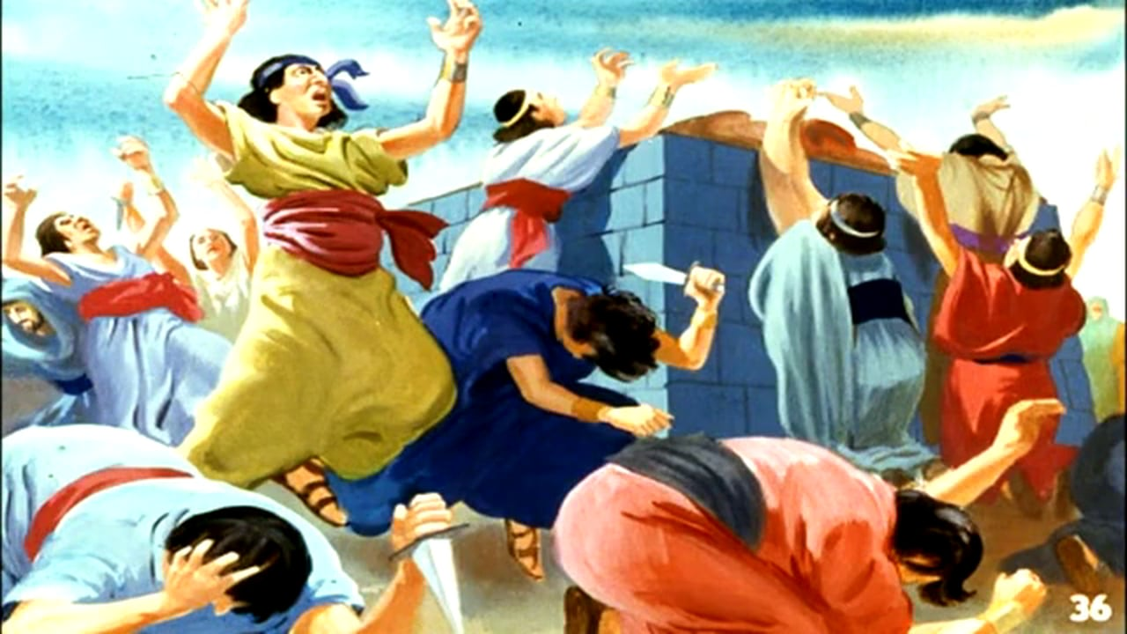
Half-Time
Mutilation
From noon onward, they began to mutilate themselves with swords and lances till their blood was gushing forth, raving all the while.
Silence
No fire from Heaven
Silence
I Kings 18:28-29
28. So they cried with a loud voice and cut themselves according to their custom with swords and lances until the blood gushed out on them.
29. When midday was past, they raved until the time of the offering of the evening sacrifice; but there was no voice, no one answered, and no one paid attention.

Slide 16
Half-Time
Mutilation
From noon onward, they began to mutilate themselves with swords and lances till their blood was gushing forth, raving all the while.
Silence
No fire from Heaven
Silence
From morning to noon, from noon to the evening the same result: Silence!

Slide 17
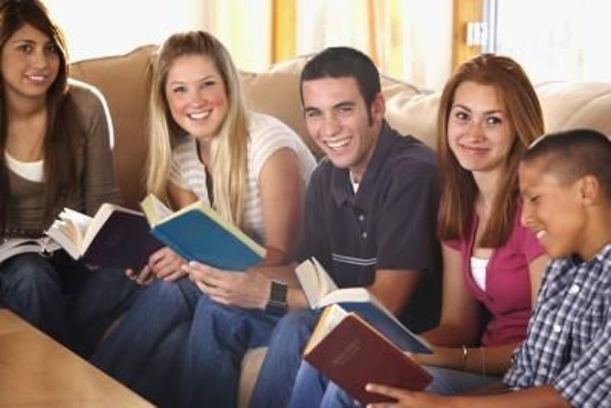
Teen/Young Adult Class
Hosted at Courthouse church of Christ
When: Friday, February 7th, 2020
Where: Courthouse church of Christ
8330 Double Creek Ct.
Chesterfield VA 23882
Time: 6:00 PM
Ages: A study for 12 years old and up!
A time to socialize afterwards at (Rides Available):
Morrison’s: 4512 Burgess House Ln,
N. Chesterfield, VA 23236
For more information contact Nathan L Morrison at 804-277-1983 or visit our Facebook Page at www.facebook.com/courthousecoc

Slide 18
The Winning Score
I Kings 18:30-32
Then Elijah said to all the people, "Come near to me." So all the people came near to him. And he repaired the altar of the LORD which had been torn down.
Elijah took twelve stones according to the number of the tribes of the sons of Jacob, to whom the word of the LORD had come, saying, "Israel shall be your name.“
So with the stones he built an altar in the name of the LORD, and he made a trench around the altar, large enough to hold two measures of seed.

Slide 19
The Winning Score
I Kings 18:33-35
Then he arranged the wood and cut the ox in pieces and laid it on the wood.
And he said, "Fill four pitchers with water and pour it on the burnt offering and on the wood." And he said, "Do it a second time," and they did it a second time. And he said, "Do it a third time," and they did it a third time.
The water flowed around the altar and he also filled the trench with water.

Slide 20
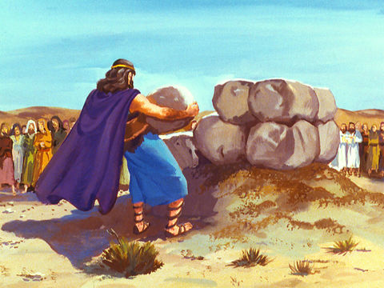
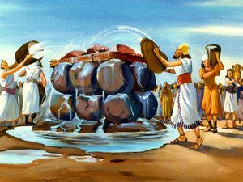
The Winning Score
Elijah’s Turn
He called the people to him
He repaired the altar of God
He built up the altar with 12 stones
He dug a trench around the altar
He orders 12 pitchers of water to not just wet the offering, but to drench it, and to fill the trench
What is the greatest commodity at this time?
WATER!

Slide 21
The Winning Score
I Kings 18:36-37
At the time of the offering of the evening sacrifice, Elijah the prophet came near and said, "O LORD, the God of Abraham, Isaac and Israel, today let it be known that You are God in Israel and that I am Your servant and I have done all these things at Your word.
"Answer me, O LORD, answer me, that this people may know that You, O LORD, are God, and that You have turned their heart back again."

Slide 22
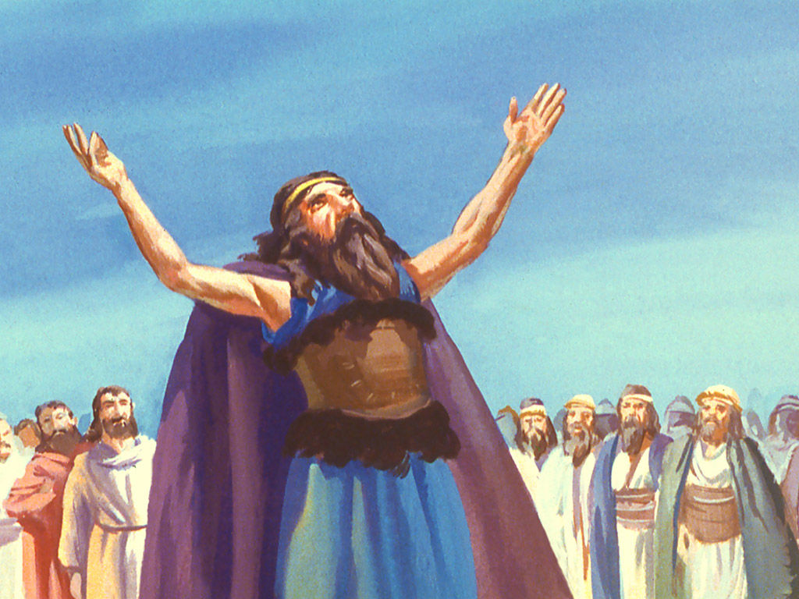
The Winning Score
Elijah’s Prayer
Contrast: The prophets of Baal had screamed for hours and received no answer
Elijah came near and “said”
Asks God to show Himself to the people as being the only true God
a lesson they had forgotten! (They promised to serve Him – Josh. 24:16-27)
"O LORD, the God of Abraham, Isaac and Israel, today let it be known that You are God in Israel and that I am Your servant and I have done all these things at Your word.
"Answer me, O LORD, answer me, that this people may know that You, O LORD, are God, and that You have turned their heart back again."

Slide 23
The Winning Score
I Kings 18:38-39
Then the fire of the LORD fell and consumed the burnt offering and the wood and the stones and the dust, and licked up the water that was in the trench.
When all the people saw it, they fell on their faces; and they said, "The LORD, He is God; the LORD, He is God."

Slide 24
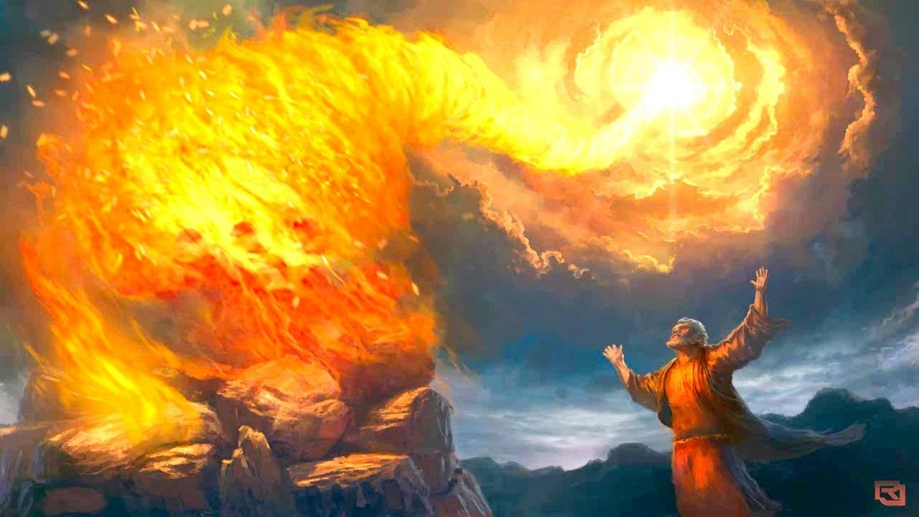
The Winning Score
Fire from Heaven
Fire from the Lord fell from heaven and consumed everything there, including the water!
The people know the difference from what they had witnessed all day long from the false prophets, and what they have seen here: They fall to their faces praising & worshiping God
YHWH wins the contest!

Slide 25
Post-Contest Activities
I Kings 18:40-46
God showed His awesome power to an idolatrous nation
Elijah orders all the false prophets killed!
Elijah warns Ahab that the famine is over and rain is coming!
Still applicable today:
There is only one God, and it is He we are to worship!
Isaiah 45:6
Isaiah 45:18-25
YHWH, Lord God Almighty, the God of Abraham, Isaac, and Jacob is the God Who created heaven and earth, and Who alone is worthy of our praise & worship!

Slide 26
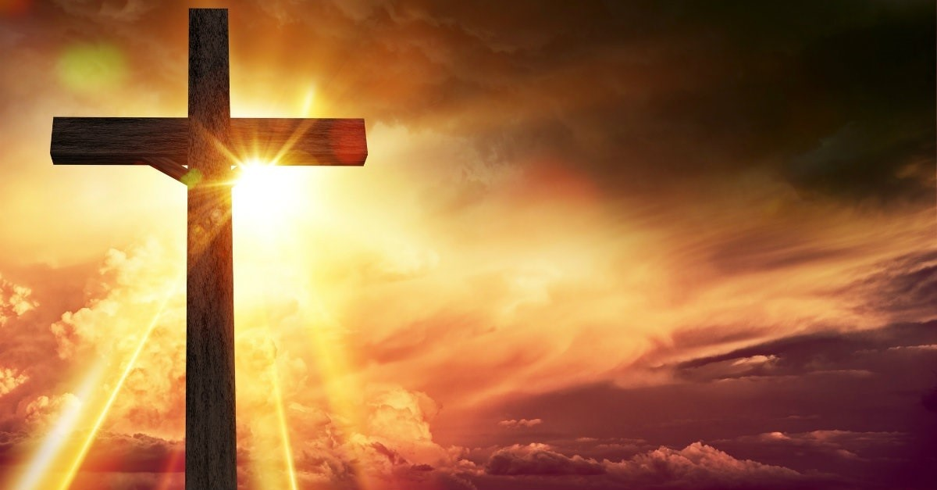
Conclusion
The contest didn’t end there on Mt. Carmel.
God’s true power was not fully displayed there!
During the time of the Romans, when Baal was worshipped as Jupiter, and in some parts of the world still as Zeus (Acts 14:12), when the Romans worshiped a pantheon of gods, God’s power would be displayed in a contest not just against false gods, but against death, and Satan himself, on the cross of Calvary.

Slide 27
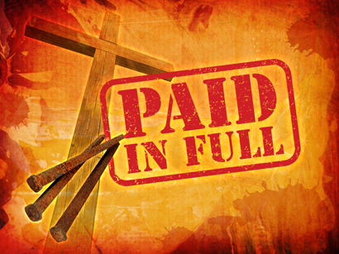
Conclusion
As the Son of God hung on a cross, crucified for the sins of the world, fulfilling the promise made to Abraham (Gen. 22:18), the power of God was fully displayed!
The power of God was made manifest in mercy, compassion, love, power and glory.
the veil and the rocks in the temple were torn in two; the earth shook, and the dead rose and walked into the city. A Roman centurion standing guard even said, “Truly this was the Son of God!” (Mt. 27:51-54)

Slide 28
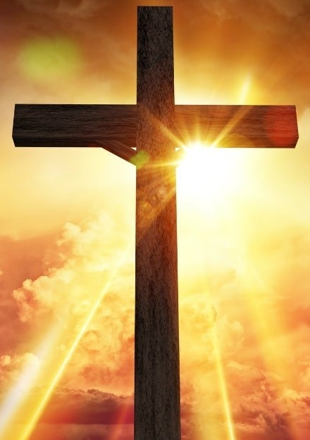
Jesus rose from the dead!
Fire Bowl On Mt. Carmel
Conclusion
Rom. 6:8-10
Heb. 2:14-15
II Tim. 1:10
I Cor. 15:50-57

Slide 29
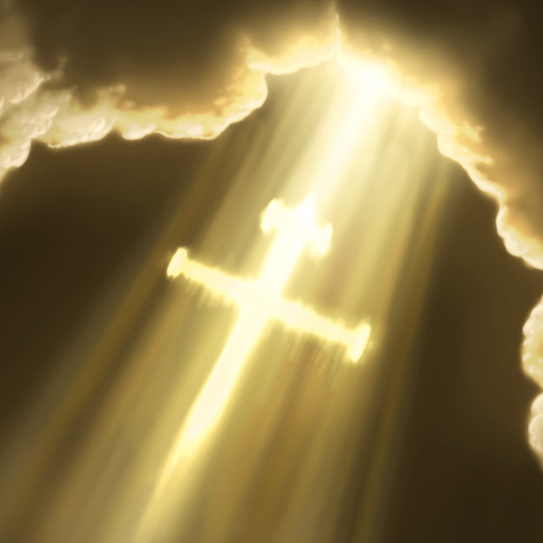
Conclusion
After the fall of Rome, Baal ceased to exist as he had for centuries before, but not what he stood for: An alternative; a substitute!
Jesus Christ lives, seated at the right hand of God (Rom. 8:34), waiting on those who recognize His sovereignty to come to Him to partake of the free gift of life (Rom. 6:23).
Heb. 13:8: “Jesus Christ is the same yesterday and today and forever.”
Acts 4:12: There is salvation in no one else, no other name than Christ’s!

Slide 30
In Jesus is the power of God – Every knee will bow (Phil. 2:10-11)
Fire Bowl On Mt. Carmel
Conclusion
We teach the gospel to change the hearts and minds of the people today that their souls may be saved! (II Cor. 5:9-11; James 1:21)

Slide 31
FIRE BOWL ON Mt. CARMEL
YHWH
Baal
Let us love and serve the One and only God, Creator of the heavens and the earth!

Slide 32
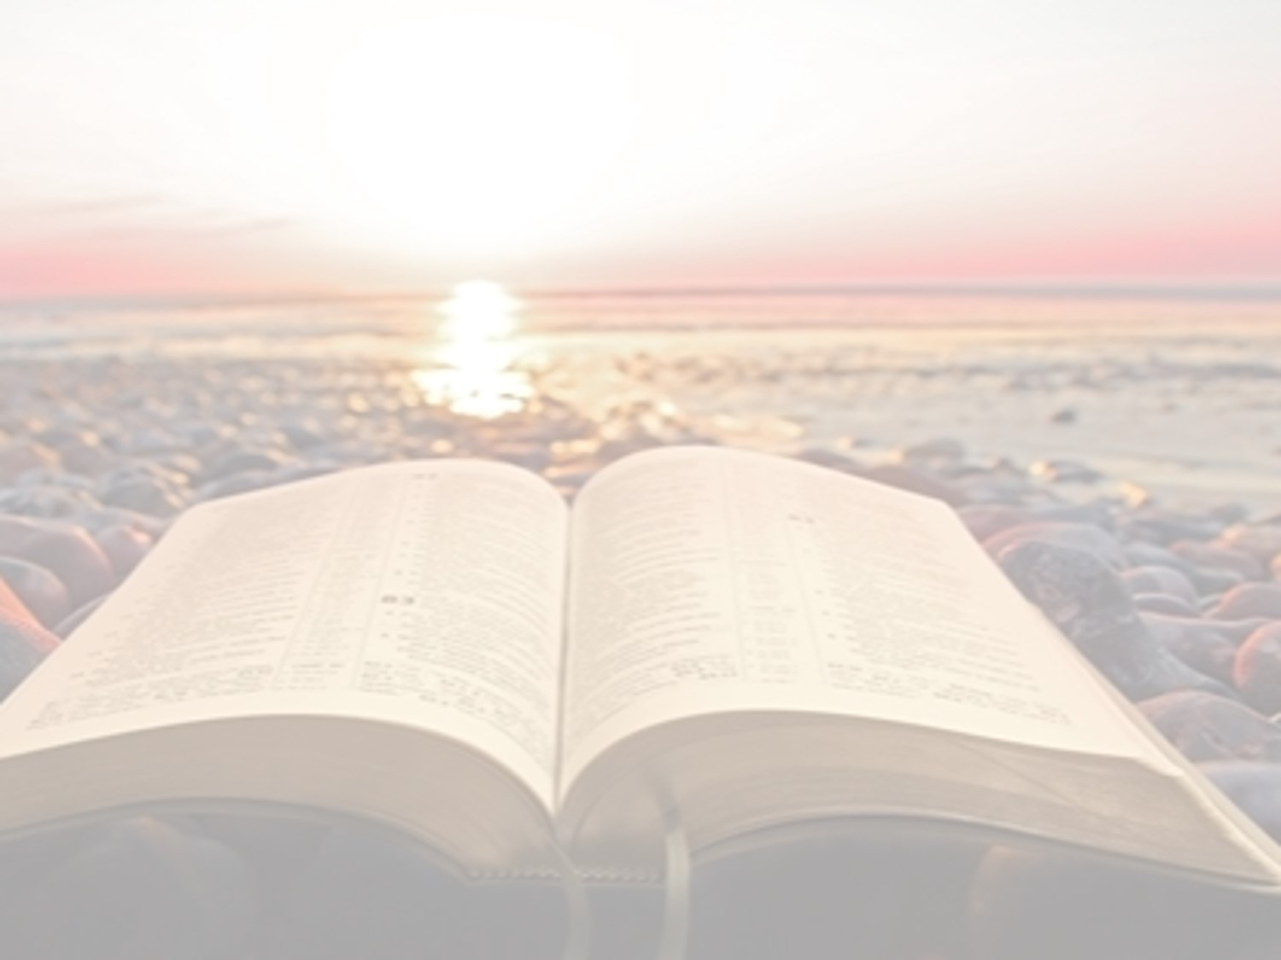
“What Must I Do To Be Saved?”
Hear The Gospel (Jn. 5:24; Rom. 10:17)
Believe In Christ (Jn. 3:16-18; Jn. 8:24)
Repent Of Sins (Lk. 13:3-5; Acts 2:38)
Confess Christ (Mt. 10:32; Rom. 10:10)
Be Baptized (Mk. 16:16; Acts 22:16)
Remain Faithful (Jn. 8:31; Rev. 2:10)
For The Erring Saint:
Repent (Acts 8:22), Confess (I Jn. 1:9),
Pray (Acts 8:22)

Slide 33
FIRE BOWL ON Mt. CARMEL
YHWH
Baal
TEAM: YHWH, God of Abraham, Isaac and Israel
VS.
TEAM: Baal, the Storm god of Tyre & Sidon

