Slide 1
God's Workmen: Lights In The Darkness
Text: I Timothy 4:12
Notes:
By Nathan L Morrison
All Scripture given is from the NASB, unless otherwise stated
For further study, or if questions, please Call: 804-277-1983 or Visit www.courthousechurchofchrist.com

Slide 2
Intro
We are creatures of imitation
“Like father like son”
Important who we choose to imitate!
I Cor. 11:1; Eph. 5:1: Must imitate God!
I Tim. 4:12
12. Let no one look down on your youthfulness, but rather in speech, conduct, love, faith and purity, show yourself an example of those who believe.
A bad example can ruin a reputation, along with one’s
credibility for teaching!
I Cor. 9:24-27; I Thess. 5:22
As God’s workmen (approved by God – II Tim. 2:15), we are to be the lights in the darkness!

Slide 3
Good Examples:
Faith At Work in Example
The power of example is very great!
Godliness: Noah (Gen. 6-7)
Faith: Abraham (Heb. 11:8-10)
Endurance: Moses (Heb. 11:23-27)
Patience: Job (Job 1-2)
Leadership: Joshua (Josh. 24:31)
Courage: Daniel (Dan. 6)
God's Workmen: Lights In The Darkness

Slide 4
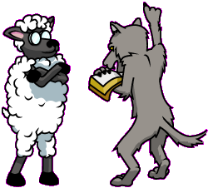
Bad Examples:
Faith At Work in Example
The power of example is very great!
Unbelief: The ten spies (Num. 13-14)
Rebellion: Korah (Num. 16)
Hypocrisy: The Pharisees (Mt. 6:2-8; 23:1-3)
God's Workmen: Lights In The Darkness

Slide 5
Faith at Work in Example
The Scriptures give us many examples to live by:
Rom. 15:4; I Cor. 10:6: Old Testament contains examples.
I Pet. 2:21-25: Jesus set before us the perfect example for us to follow.
The apostle Paul understood the importance of example:
He was aware of his own example (I Cor. 11:1; I Thess. 2:10-12)
He commanded others to set a proper example (Phil. 1:27; 2:14-16; Titus 2:7-8)
Paul knew his example could also discredit his preaching (I Cor. 9:26-27)
Our example is important: Our faith is seen at
work in our example – others see us!

Slide 6
Saints Are to Be Lights in the Darkness
Mt. 5:14-16
14. "You are the light of the world. A city set on a hill cannot be hidden;
15. nor does anyone light a lamp and put it under a basket, but on the lampstand, and it gives light to all who are in the house.
16. "Let your light shine before men in such a way that they may see your good works, and glorify your Father who is in heaven.
Notes:
Emphasis in Scripture mine!

Slide 7
Saints Are to Be Lights in the Darkness
Phil. 2:14-16
14. Do all things without grumbling or disputing;
15. so that you will prove yourselves to be blameless and innocent, children of God above reproach in the midst of a crooked and perverse generation, among whom you appear as lights in the world,
16. holding fast the word of life, so that in the day of Christ I will have reason to glory because I did not run in vain nor toil in vain.
Let your light shine!
Notes:
Emphasis in Scripture mine!

Slide 8
Lights in the Dark:
Faith At Work in Example
Speech
Conduct
Love
Faith
Purity
I Tim. 4:12
Let no one look down on your youthfulness, but rather in speech, conduct, love, faith and purity, show yourself an example of those who believe.
God's Workmen: Lights In The Darkness

Slide 9
Saints Are to Be Lights in the Darkness
Saints are to be examples of light to the world of darkness!

Slide 10
Power in Example
The power of example can have negative effects:
Peter – Gal. 2:11-13: Hypocrisy – Influenced others to sin
The power of example can have positive effects:
Tabitha (Dorcas) – Acts 9:36-42: Her example of kindness & love reached those in her community in a profound way
We often don’t know who will be affected by what we do
There is power in our examples and we must
be sure it is for the positive!

Slide 11
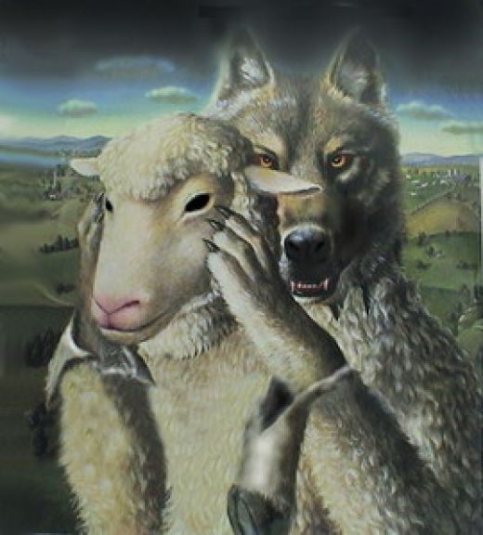
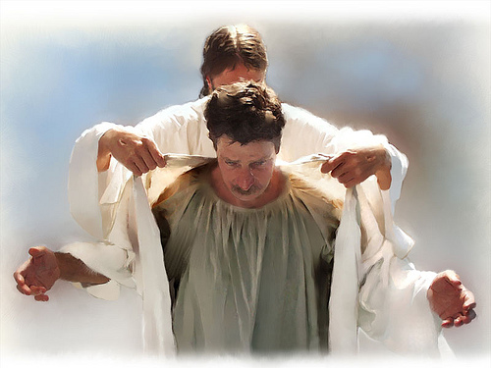
Conclusion
What is your example worth?
“A picture is worth a thousand words”
We may never know who exactly is observing and the
impact we have on that individual!
Matthew 7:15
Colossians 3:12-14

Slide 12
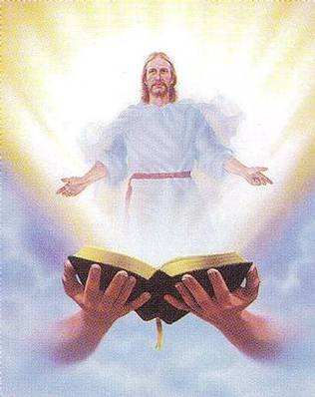
Conclusion
The working of our faith should be seen by a godly example in all that we say and do:
Col. 3:17: If all that we do is in accordance with Christ’s authority, we will set a good, godly example to those about us.
I Cor. 11:1; Eph. 5:1; Rom. 8:14-17: “Like Father, like son”

Slide 13
Conclusion
I Thess. 1:6-8
6. You also became imitators of us and of the Lord, having received the word in much tribulation with the joy of the Holy Spirit,
7. so that you became an example to all the believers in Macedonia and in Achaia.
8. For the word of the Lord has sounded forth from you, not only in Macedonia and Achaia, but also in every place your faith toward God has gone forth, so that we have no need to say anything.
As workmen of God, our light must shine in
the darkness around us!
Have you been the example
you should be?
Notes:
Emphasis in Scriptures mine!

Slide 14
“What Must I Do To Be Saved?”
Hear The Gospel (Jn. 5:24; Rom. 10:17)
Believe In Christ (Jn. 3:16-18; Jn. 8:24)
Repent Of Sins (Lk. 13:3-5; Acts 2:38)
Confess Christ (Mt. 10:32; Rom. 10:10)
Be Baptized (Mk. 16:16; Acts 22:16)
Remain Faithful (Jn. 8:31; Rev. 2:10)
For The Erring Saint:
Repent (Acts 8:22), Confess (I Jn. 1:9),
Pray (Acts 8:22)

