Slide 1
Determined To Serve God
Text: I Corinthians 2:1-5
Notes:
By Nathan L Morrison
All Scripture given is from the NASB, unless otherwise stated
For further study, or if questions, please Call: 804-277-1983 or Visit www.courthousechurchofchrist.com

Slide 2
Intro
As one year fades into the archives of history, many people turn their attention on the New Year
Many will make resolutions – most or all won’t be kept
Resolution: To declare one’s opinion, intent or purpose; determination (Webster’s)
While many resolutions are silly or in jest, there are resolutions that saints must keep if we are to spend eternity with God! (II Cor. 13:5)

Slide 3
Intro
There are many things that can be said of the apostle
Paul, but one that stands out is his determination…
Paul – Before Conversion (Acts 9:1-2)
He persecuted the church, “this Way to the death” (Acts 22:4-5; 26:9-12).
Was on the way to Damascus with full authority from the “chief priests.”
Paul – After Conversion (Acts 20:17-24; Phil. 3:13-14)
He “did not shrink” from teaching “repentance toward God and faith in our Lord Jesus Christ” to both Jew and Gentile!
He “forgot” his past and “pressed on” toward the prize of Christ.
Gal. 1:10-24: Paul once tried to destroy the church and now was determined to preach the gospel wherever he could go! God was glorified through his efforts

Slide 4
Intro
I Corinthians 2:1-5
And when I came to you, brethren, I did not come with superiority of speech or of wisdom, proclaiming to you the testimony of God.
For I determined to know nothing among you except Jesus Christ, and Him crucified.
I was with you in weakness and in fear and in much trembling,
and my message and my preaching were not in persuasive words of wisdom, but in demonstration of the Spirit and of power,
so that your faith would not rest on the wisdom of men, but on the power of God.
We can learn from Paul’s example and be determined to serve God!

Slide 5
Determined for Righteousness
Determination
“Decided, resolved; Firm, resolute.” (Webster 7th College Dictionary)
G2919 krino: To determine, resolve, decree; to be diligent.
Examples:
Joseph: Not to sin against God (Gen. 39)
Daniel: To worship God, despite consequences (Dan. 6)
Nehemiah: To rebuild the walls of Jerusalem at great odds (Neh. 2-4)
Paul:
II Cor. 11: Despite his storms of life Paul was determined to be right before God and men, and suffered for Christ’s sake.
His determination to do what was right (Phil. 3:9) led him to boldly declare to Timothy, “I have fought the good fight, I have finished the course, I have kept the faith” (II Tim. 4:6-8).
Like Paul (I Cor. 11:1), are you determined
to live righteously?

Slide 6
Determined to Do What Is Right
Many are determined, but not in the right thing:
To do as they please (Jud. 21:25: Israel)
To get their own way (I Kings 1:5-18: Adonijah)
To do evil – even though they know better (Acts 24:24-27: Felix & Drusilla)
To practice their own righteousness (Rom. 10:1-3)
To have prominence (III Jn. 9: Diotrephes)
To keep traditions (Mt. 15:3: Pharisees and scribes)
To do as they think is right (Acts 26:9; Gal. 1:12-13: Saul of Tarsus/Paul)
One’s Own Righteousness

Slide 7
Determined to Do What Is Right
Determination must be guided by the word of God:
Gal. 1:10: Paul was concerned about pleasing God, not men! (Jn. 15:18-19)
Gal. 1:23: Paul was determined to preach the gospel he once tried to destroy, despite the great personal loss! (Phil. 3:7-8; II Cor. 11)
I Pet. 4:12-19: Despite the circumstances or trials, saints must be those who entrust their souls to a “faithful Creator,” and “do what is right!”
II Pet. 1:5: We are to be diligent in attaining moral excellence.
Moral Excellence = Virtue (KJV, ESV): G703 arête [ar-et'-ay]: “properly, manliness (valor), i.e. excellence (intrinsic or attributed): praise, virtue.” (I Thess. 2:13; 4:1: Add knowledge to have virtue!)
Virtue = Determination to do what is right: “conformity of one’s life and conduct to moral and ethical principles; moral excellence, rectitude; chastity; manly excellence, valor.” (Webster, 7th)
Like Paul, are you determined to do the right thing?

Slide 8
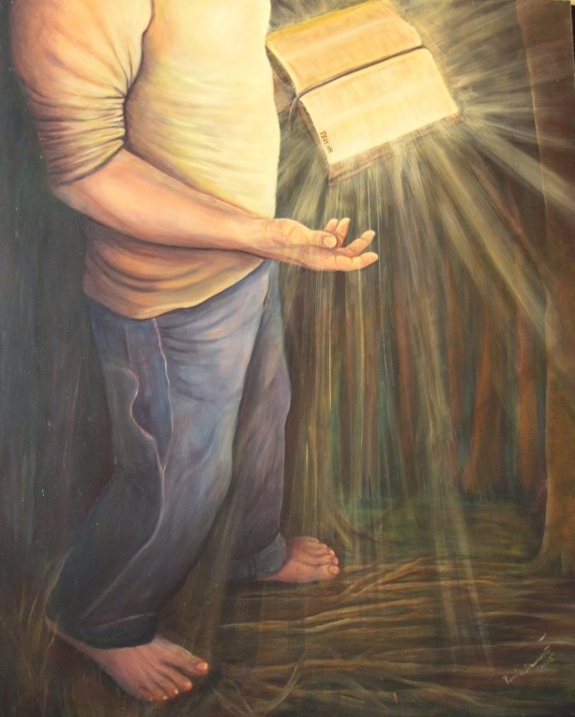
Determine to Serve God
Many people are determined to know many things!
Determine to know more of the word of God!
Heb. 2:1-4: There will be no excuse for ignorance.
Since it is our guide, we must be familiar with it:
Ps. 119:105: It is a lamp to our feet.
Ps. 119:104; Eph. 3:4-5: It gives understanding.
II Tim. 2:15; II Pet. 1:10: It makes one approved.

Slide 9
Determine to Serve God
Determine to grow as a Christian!
I Pet. 2:1-2; II Pet. 3:18: Two elements for growth: Food and Exercise.
I Cor. 16:13; Eph. 6:10: Love and stand for the truth!

Slide 10
Determine to Serve God
Determine to serve the Lord faithfully!
I Cor. 15:58: Be “always abounding in the work of the Lord…”
Gal. 6:9: Service to the Lord is an ongoing endeavor, not a one-time act.
II Tim. 4:6-8: “I have fought the good fight, I have finished the course, I have kept the faith” and was secure in his future with God!

Slide 11
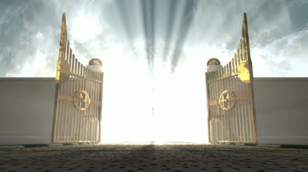
Determine to Serve God
Determine to get to Heaven!
Acts 20:24; Phil. 3:13-14: Our lives must be spent on getting to Heaven
I Pet. 1:3-5: For the faithful, there is a reservation in Heaven (II Tim. 4:8)
Like Paul, are you determined to serve God and reserve your crown in Heaven?

Slide 12
Conclusion
If one is determined to get to heaven, that person will
do all the things necessary to get there, despite the will
of Self! (Rev. 2:10)
We determine to do many things in life!
We ought to have Paul’s determination to do what is right no matter the cost!

Slide 13
Conclusion
Are you determined to serve God and get to Heaven?

Slide 14
“What Must I Do To Be Saved?”
Hear The Gospel (Jn. 5:24; Rom. 10:17)
Believe In Christ (Jn. 3:16-18; Jn. 8:24)
Repent Of Sins (Lk. 13:3-5; Acts 2:38)
Confess Christ (Mt. 10:32; Rom. 10:10)
Be Baptized (Mk. 16:16; Acts 22:16)
Remain Faithful (Jn. 8:31; Rev. 2:10)
For The Erring Child:
Repent (Acts 8:22), Confess (I Jn. 1:9),
Pray (Acts 8:22)

