Slide 1
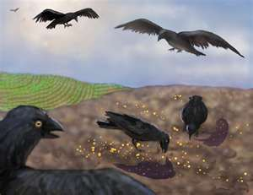
Wayside Soil Preachers
Text:
Mark 3:13-15
Notes:
By Nathan L Morrison
All Scripture given is from NASB unless otherwise stated
For further study, or if questions, please Call: 804-277-1983 or Visit www.courthousechurchofchrist.com
Adapted from a lesson by Edwin Crozier

Slide 2
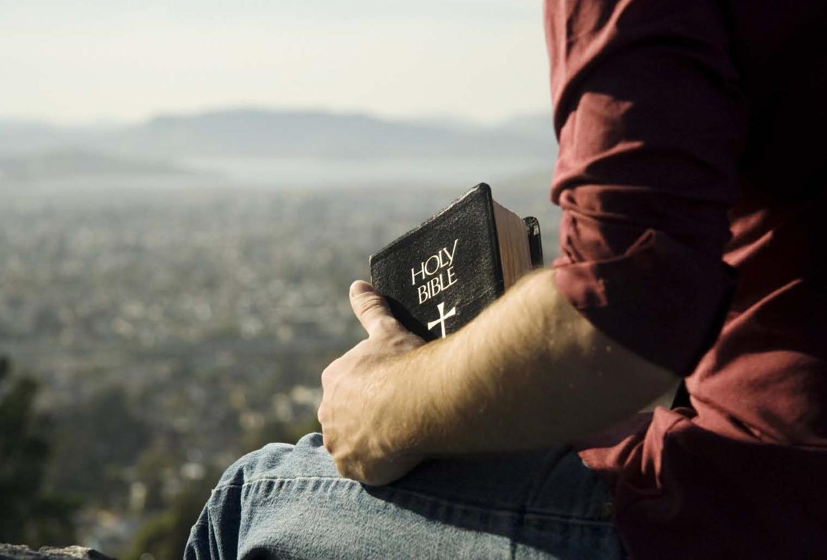
Intro
Gospel of Mark:
“The preaching gospel”
Begins and ends with preaching (proclaiming)
Mark 1:1-4: John the Immerser preaching (Isaiah 40:3)
Mark 1:7: John preaches Jesus is coming
Mark 1:14-15: Jesus preaches

Slide 3
Intro
Mark 3:13-15
And He went up on the mountain and summoned those whom He Himself wanted, and they came to Him.
And He appointed twelve, so that they would be with Him and that He could send them out to preach,
and to have authority to cast out the demons.

Slide 4
Intro
Gospel of Mark:
“The preaching gospel”
Begins and ends with preaching (proclaiming)
Mark 3:13-15: Jesus chose 12 preachers
Mark 16:15: The 12 to preach to the whole world!
Mark 16:20: They preach everywhere

Slide 5
Intro
Mark (shortest gospel) speaks on preaching more than the other gospels
Preach = kerysso [kay-roos-so] (G2784): to herald, to preach, proclaim, publish.
New Testament: 61 times
Matthew: 9 times (56% longer than Mark)
Mark: 14 times (23% of the uses in the NT are in the gospel of Mark!)
Luke: 9 times (71% longer than Mark)
John: 0 times! (not at all!)

Slide 6
Intro
At the heart of preaching:
There’s a new King in town and all need to repent!
(Mark 1:4, 15; 6:12-13)

Slide 7
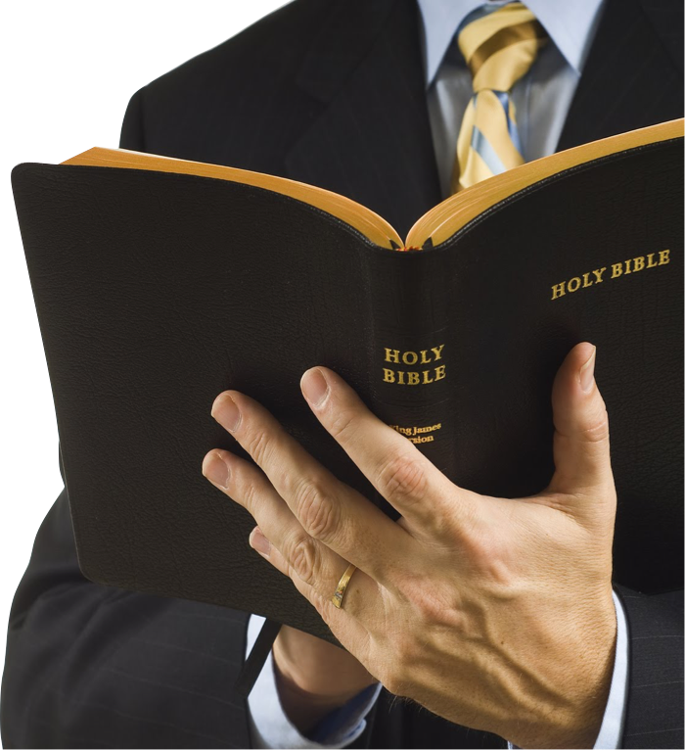
The Preachers Jesus Chose
The apostles may be on pedestals or superhero-like status in our minds!
Peter messed up
Thomas doubted
Judas fell away
Overall we may think of them as the best of the best
That’s why Jesus chose them!
Jesus didn’t choose them because they were perfect, but because He knew what they would become!

Slide 8
Mark 4:1-20: The Parable of the Sower
Wayside Soil – Seed sown on the wayside
The birds pick it up and eat it – describes hearts that Satan takes the word away from so they won’t believe and be saved! (Mark 4:15; Luke 8:12)
Mark 1:35-39: Apostles Didn’t understand!
Outsiders & Wayside People

Slide 9
Mark 3:13-15: The 12 to be like Jesus
Preach & cast out demons
Mark 4:11-13: outsiders have eyes and ears but don’t see or understand (Isaiah 6:9-10)
Apostles: heard but didn’t understand
Outsiders & Wayside People

Slide 10
Mark 6:30-44: Jesus feeds 5,000
Apostles: Doubt & disbelief
Mark 6:45-52: Jesus walks on water
Apostles: Didn’t understand, unbelief & hardened hearts!
Mark 8:1-10: Jesus feeds 4,000
Apostles: Doubt
Mark 8:11-21: Jesus teaches about leaven of Pharisees & Herod
Apostles: Didn’t understand, hearts hardened, eyes and ears but don’t see or hear (Is. 6:9-10)!
Outsiders & Wayside People

Slide 11
Lack of understanding and hard hearts – traits of outsiders and wayside people!
Outsiders & Wayside People
Wayside Soil Preachers
If the apostles were filled with doubt, unbelief and hard hearts, what hope did the rest of the world have?

Slide 12
Mark 1:39; 3:13-19
Be like Jesus: Preach & cast out demons
Mark 6:7-13: Jesus sends the 12 2x2 to preach and cast out demons
They fulfill their commission!
Failure of Their Commission

Slide 13
Mark 8:27-30: Peter confesses Jesus is the Christ
Christ & Son of God (Mt. 16:16)
Mark 9:2-9: Jesus transfigured on the mount with Moses & Elijah
Peter suggests 3 tabernacles, one for Jesus, Moses, and Elijah!
God tells him to listen to Jesus!
Failure of Their Commission

Slide 14
Mark 9:14-29: down the mountain, Jesus (like Moses) found trouble
Disciples couldn’t cast out a demon from a boy
caused doubt in the father
Apostles: “Faithless” (NKJV)
Mark 9:33-37: Apostles fight over who is greatest
Mark 9:38-41: Someone casts out demons in Jesus’ name, and is not one of the 12!
Apostles: try to stop him!
There are others who seem to do their job better than them–Wow!
Failure of Their Commission

Slide 15
Mark 8:27-30: Peter confesses Jesus is the Christ
Shining moment!
Mark 1:24-25, 32-34: Remember what the demon confessed?
“Holy One of God” (James 2:19)
Mark 8:31-33: Peter rebukes Jesus
Jesus calls him, “Satan!”
Peter was a mouthpiece for Satan
Mark 4:15: It is Satan who takes away the word of God from the hearts of men (Wayside Soil)
Failure of Their Commission

Slide 16
Satan takes away the word from the hardened heart of the wayside soil person!
Failure of Their Commission
Wayside Soil Preachers
The preachers Jesus chose have failed at their commission up to this point!

Slide 17
Mark 14:26-31: Jesus warns the 12 they will all fall away
Zechariah 13:7 as warning
Peter will deny Jesus 3 times
When Jesus rises from the dead they are to meet Him in Galilee
They all said they would die 1st before falling away
Did they all flee or not?
Mark 14:50-52: They all fled!
Calls to mind Amos 2:16
Peter denied Jesus 3 times and went out weeping (Mark 14:66-72)
Falling Away

Slide 18
Mark 14:28: Jesus tells them to meet Him in Galilee (after His resurrection)
Apostles: Did not do what Jesus told them to do
Mark 16:7, 11: An angel told the women to remind the 11 to meet in Galilee
Apostles: Did not believe!
Mark 16:12-13: 2 Disciples tell the others they saw Jesus
Apostles: Did not believe!
Mark 16:14: Jesus rebukes them
Apostles: Unbelief and hardness of heart!
Falling Away

Slide 19
Falling Away
Wayside Soil Preachers
Six verses away from the end of Mark’s gospel and he has depicted the preachers Jesus chose as stubborn, faithless, hard-hearted, ignorant, outsiders, wayside soil people, and worthy of judgment like everyone else Jesus encountered!

Slide 20
Conclusion
If Mark’s gospel concluded with this, one may think that Jesus’ all-night prayer prior to choosing His preachers was in vain! (Luke 6:12-13)

Slide 21
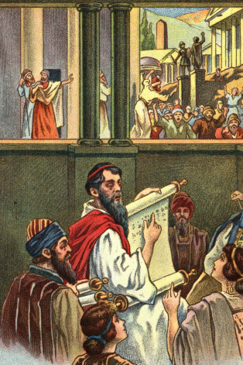
Conclusion
Jesus says His apostles will stand head and shoulders above the outsiders and will teach the wayside people!
Mark 10:39: They will drink His cup (Mt. 26:39, 42; Acts 5:40-42).
They were faithful till death! (James – Acts 12:1-2)
Mark 13:9-13: They will bear witness before governors and kings, will be put on trial, and put to death for Jesus’ sake.
Peter, once the mouthpiece for Satan (Mark 8:31-33), will become the mouthpiece for the Holy Spirit (Acts 2:4, 14; 4:8)

Slide 22
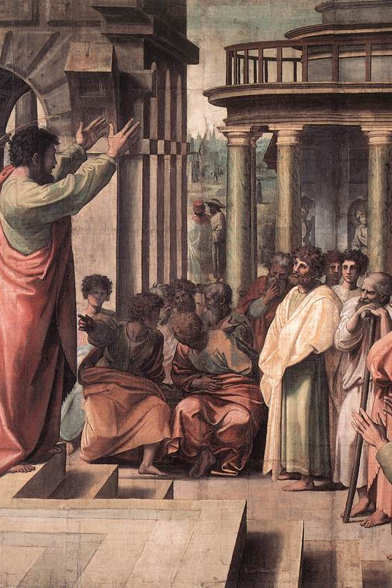
Conclusion
Mark 16:15-16: Preach to the whole world!
Mark 16:20: “They went out and preached everywhere”
Acts 1:8: Jesus said they would be His witnesses to the “remotest parts of the earth.”
The apostles step up and do exactly what they were commissioned to do!

Slide 23
Conclusion
When you struggle with your faith and wrestle with doubts and unbelief, remember the preachers Jesus chose: They were in the same boat as everyone else!
They overcame their doubts, fears, and unbelief, and became the preachers Jesus chose them to be! Good Soil! (Mark 4:20)

Slide 24
Conclusion
Mark 9: Jesus said there was a kind of demon that can only be cast out by prayer
DON’T FORGET TO PRAY!
What were the apostles doing in the ten days after the ascension and before the descension of the Holy Spirit? (Mark 16:19; Acts 1:9; 2:1-4)
They were together and “devoting themselves to prayer!” (Acts 1:14)

Slide 25
Conclusion
If God can use such stubborn, struggling men as the 12, He can use us!
He can use you!
He can transform your Wayside Soil heart into the Good Soil heart!

Slide 26
“What Must I Do To Be Saved?”
Hear The Gospel (Jn. 5:24; Rom. 10:17)
Believe In Christ (Jn. 3:16-18; Jn. 8:24)
Repent Of Sins (Lk. 13:3-5; Acts 2:38)
Confess Christ (Mt. 10:32; Rom. 10:10)
Be Baptized (Mk. 16:16; Acts 22:16)
Remain Faithful (Jn. 8:31; Rev. 2:10)
For The Erring Saint:
Repent (Acts 8:22), Confess (I Jn. 1:9),
Pray (Acts 8:22)

