Slide 1
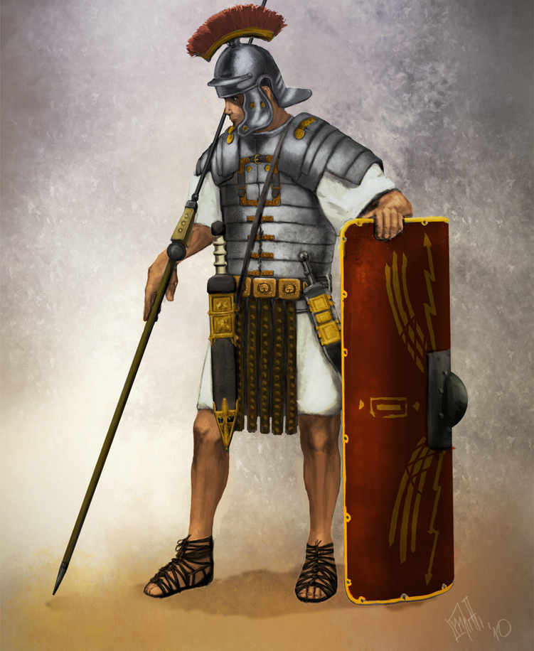
“Stand Up For Jesus”
Text:
Ephesians 6:10-14
Notes:
By Nathan L Morrison
All Scripture given is from NASB unless otherwise stated
For further study, or if questions, please Call: 804-277-1983 or Visit www.courthousechurchofchrist.com
“Stand Up, Stand Up for Jesus!” by George Duffield, Jr. (Inspired by the last words of Dudley Tyng)

Slide 2
Last Words!
“Stand Up For Jesus”
Intro
“It is finished!” – Jesus (John 19:30)
“To the strongest!” – Alexander the Great (Daniel 8)
“Are you guys ready? Let’s roll!” – Todd Beamer, 09/11/01
Notes:
Last words can often affect more people and lives than those in the lifetime of the speaker.
On the cross, Jesus said, “It is finished” before He died – Jn. 19:30
Those words were not only recorded and preserved in written form but they echo throughout time that God’s eternal purpose of providing man with the means of salvation was accomplished for all time! (Heb. 7:27; 9:12; 10:10)
Before dying, Alexander the Great was asked who would succeed him, to which he responded, “To the strongest!”
His four generals then reshaped the known world in their quest for dominance and to be “the strongest,” just as God foretold through Daniel (Dan. 8).
In modern times, on 09/11/01 aboard Flight 93 when the intent of the hijackers became known, Todd Beamer ended his cell phone call with his wife saying, “Are you guys ready? Let’s roll!”
He and others rushed the cockpit to retake the plane. The plane crashed in Shanksville, PA, killing all on board, but was not used as a weapon. “Let’s roll!” was used as a rallying cry and was seen on banners across the country and in military recruiting centers!

Slide 3
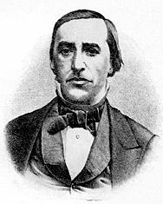
Intro
George Duffield, Jr. (1818-1888):
“Stand Up, Stand Up For Jesus!”
Presbyterian minister.
Friends with Dudley Tyng (1829-1858), who was an Episcopalian minister.
He attended a lecture at the YMCA to hear Dudley Tyng speak on Mar. 30th, 1858.
Two weeks later, Dudley was in his family’s barn watching the corn-thrasher (sheller) and petting a horse. He got too close; his sleeve was caught and his arm was shredded. Infection set in and they had to amputate his arm at the shoulder. He was too weak to survive the surgery, and died 5 days later.
He said to his father, “Stand up for Jesus, father, and tell my brethren of the ministry to stand up for Jesus.”
George Duffield, Jr. was there to hear and see his friend die.
The following Sunday he preached a lesson from Eph. 6:14 and read a poem he wrote inspired by his friend’s last words. It found its way into hymnals shortly after.
We will give account to God one day on how we
“Stand up for Jesus” in this life!
Notes:
Sources:
http://homeschoolblogger.com/hymnstudies/611845/
Then Sings My Soul, pg. 135, by Robert J. Morgan

Slide 4
“Stand Up For Jesus”
Ephesians 6:10-14
I Corinthians 16:13
I Peter 3:15 (Phil. 2:9-10; Rom. 14:12; Mt. 10:32-33)
Stand Firm
Stanza 1 reminds us that we are soldiers of the cross
Eph. 6:10-11
10. Finally, be strong in the Lord and in the strength of His might.
11. Put on the full armor of God, so that you will be able to stand firm against the schemes of the devil.
Saints are to be prepared for battle & “be strong in the
Lord and in the strength of His might!”

Slide 5
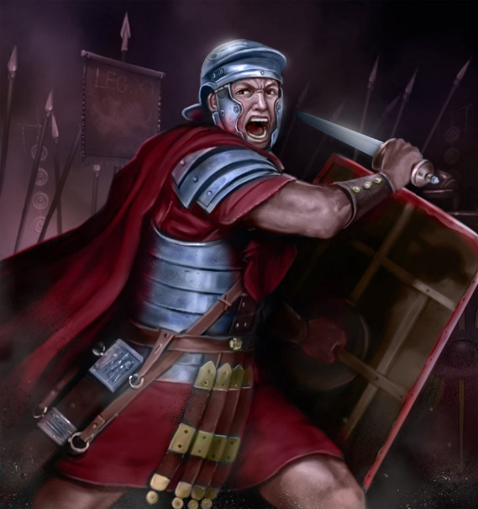
“Stand Up For Jesus”
Ephesians 6:18 (Phil. 4:6-7)
II Corinthians 10:3-6
Eph. 6:17; II Tim. 2:15; Heb. 4:12
Ephesians 6:10-18 (II Tim. 2:1-3; 4:5)
Stand Firm
Soldier’s Courage
Stanzas 2 & 3 remind the soldier of Christ to wear the armor of God and be of courage
Eph. 6:18
18. With all prayer and petition pray at all times in the Spirit, and with this in view, be on the alert with all perseverance and petition for all the saints,
Though not a physical battle, we must possess a soldier’s courage to press on till death!

Slide 6
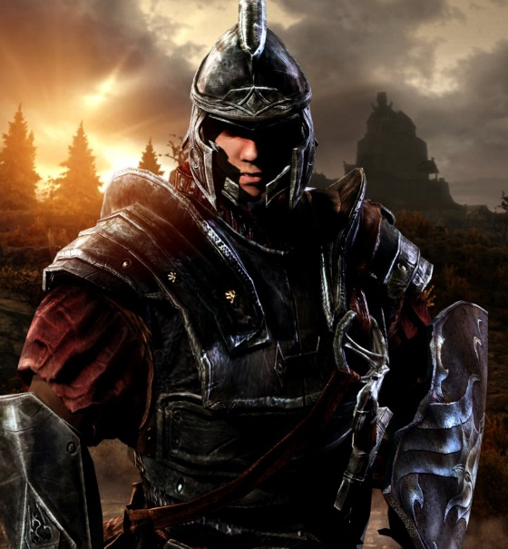
“Stand Up For Jesus”
I John 5:4
Revelation 2:10
Revelation 21:7; 22:3-5
II Timothy 4:6-8
Stand Firm
Soldier’s Courage
Victor’s Song
Stanzas 4 & 5 teaches that the soldier who overcomes will gain a crown of life
I John 5:4
4. For whatever is born of God overcomes the world; and this is the victory that has overcome the world--our faith.
The victor’s song will be sung by those who “stand firm” and remain “faithful till death!”
Notes:
Image: Imperial Legionnaire from the video game Skyrim

Slide 7
Conclusion
The hymn makes it plain that the Christian’s life is a
spiritual fight with evil within and without, and that Jesus
Christ is our leader!
To gain the crown of life we must, as the song & Scriptures teach, “Stand Up for Jesus!”
“We are not of those who shrink back to destruction, but of those who have faith to the preserving of the soul!” (Hebrews 10:39)

Slide 8
“What Must I Do To Be Saved?”
Hear The Gospel (Jn. 5:24; Rom. 10:17)
Believe In Christ (Jn. 3:16-18; Jn. 8:24)
Repent Of Sins (Lk. 13:3-5; Acts 2:38)
Confess Christ (Mt. 10:32; Rom. 10:10)
Be Baptized (Mk. 16:16; Acts 22:16)
Remain Faithful (Jn. 8:31; Rev. 2:10)
For The Erring Saint:
Repent (Acts 8:22), Confess (I Jn. 1:9),
Pray (Acts 8:22)

