Slide 1
The Prayer of Psalm 8
Notes:
THE PRAYER OF PSALM 8
PSALM 8
INTRODUCTION:
To the Chief Musician. On the Instrument of Gath. A Psalm of David. O LORD, our Lord, How excellent is Your name in all the earth, Who have set Your glory above the heavens! Out of the mouth of babes and nursing infants You have ordained strength, Because of Your enemies, That You may silence the enemy and the avenger. - (Psa 8:1-2 NKJV)
DO WE FEAR GOD? DO WE RESPECT GOD? ARE WE IN AWE OF GOD?
PEOPLE TODAY WANT TO TELL GOD HOW THE WORLD SHOULD BE.
TELL GOD HE MADE A MISTAKE OR WE HAVE A BETTER IDEA!
EVEN BRETHREN WANT TO HELP GOD OUT!
TO ARGUE WITH HIM, HELP HIM, EXPLAIN THE WAY THINGS “OUGHT TO BE”!

Slide 2
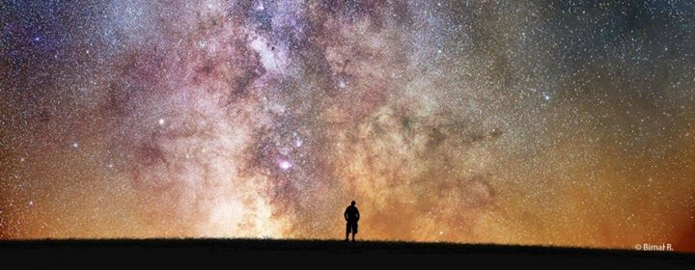
When I Consider the Heavens
z
z
Notes:
WHEN I CONSIDER YOUR HEAVENS, THE WORK OF YOUR FINGERS, THE MOON AND THE STARS, WHICH YOU HAVE ORDAINED, - (PSA 8:3 NKJV)
9,096 STARS VISIBLE WITH THE NAKED EYE.
IMAGINE YOUNG SHEPHERD DAVID SITTING ON A JUDEAN HILL GAZING AT THE STARS ON A MOONLESS NIGHT!
DO YOU THINK DAVID UNDERSTOOD THESE STARS WERE SUNS, MOST, LARGER THAN OUR OWN? THAT MANY HAD WORLDS ORBITTING THEM?
NOOOO! BUT HE DID KNOW THEY WERE …
THE WORK OF YOUR FINGERS… Psa_19:1 – The heavens declare the glory of God and the firmament shows His handiwork – (discuss YOUR handiwork)
WHICH YOU HAVE ORDAINED… Psa_33:6 – By the word of the Lord the heavens were made, and all the host of them by the breath of His mouth!
E NEED TO SPEND SOME TIME “LOOKING AT THE SKY”

Slide 3
The Milky Way Galaxy
z
z
Notes:
THE MILKY WAY GALAXY
Night sky photographer Amit Ashok Kamble captured this amazing panorama of the Milky Way over Pakiri Beach, New Zealand by stitching 10 images together into a complete mosaic. Image submitted May 5, 2014.
100,000 million stars in the milky way galaxy
HOWEVER, It is puny compared to Galaxy M87, an elliptical galaxy 980,000 light years in diameter. The Milky Way is only100,000 light years in diameter, OR Hercules A, which is 1.5 million light years across. Apr 4, 2013
GENESIS 1:16 – HE MADE THE STARS ALSO. THEY ARE BARELY MERIT A MENTION!
THIS SHOULD IMPRESS UPON US THE UTTER POWER OF GOD – ROMANS 1:18-20

Slide 4
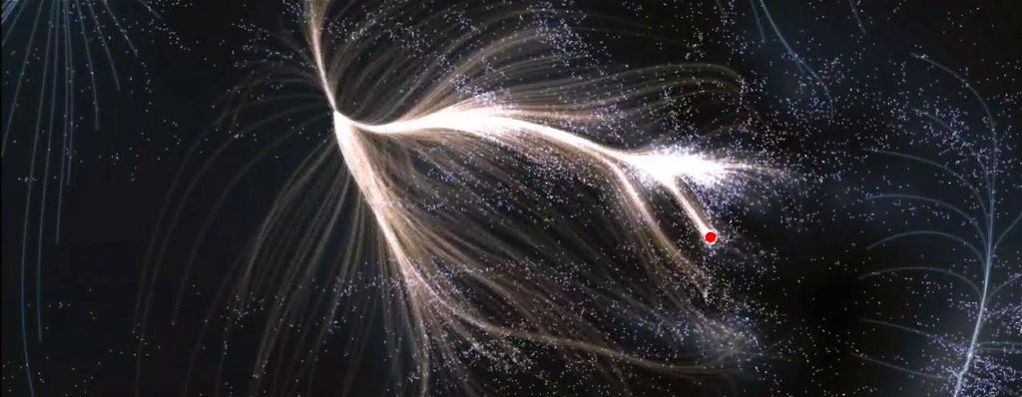
This Is The Most Detailed Map Of The Universe To Date
z
z
Notes:
MAP OF THE UNIVERRSE
One light year = 5.88 trillion miles
588,000,000,000,000 miles
This map of the universe spans more than 500 million light-years and contains more than 100,000 galaxies.
GALAXIES, EACH ONE CONTAINING BILLIONS, EVEN TRILLIONS OF STARS!
… HE … MADE … THE … STARS… ALSO!!

Slide 5
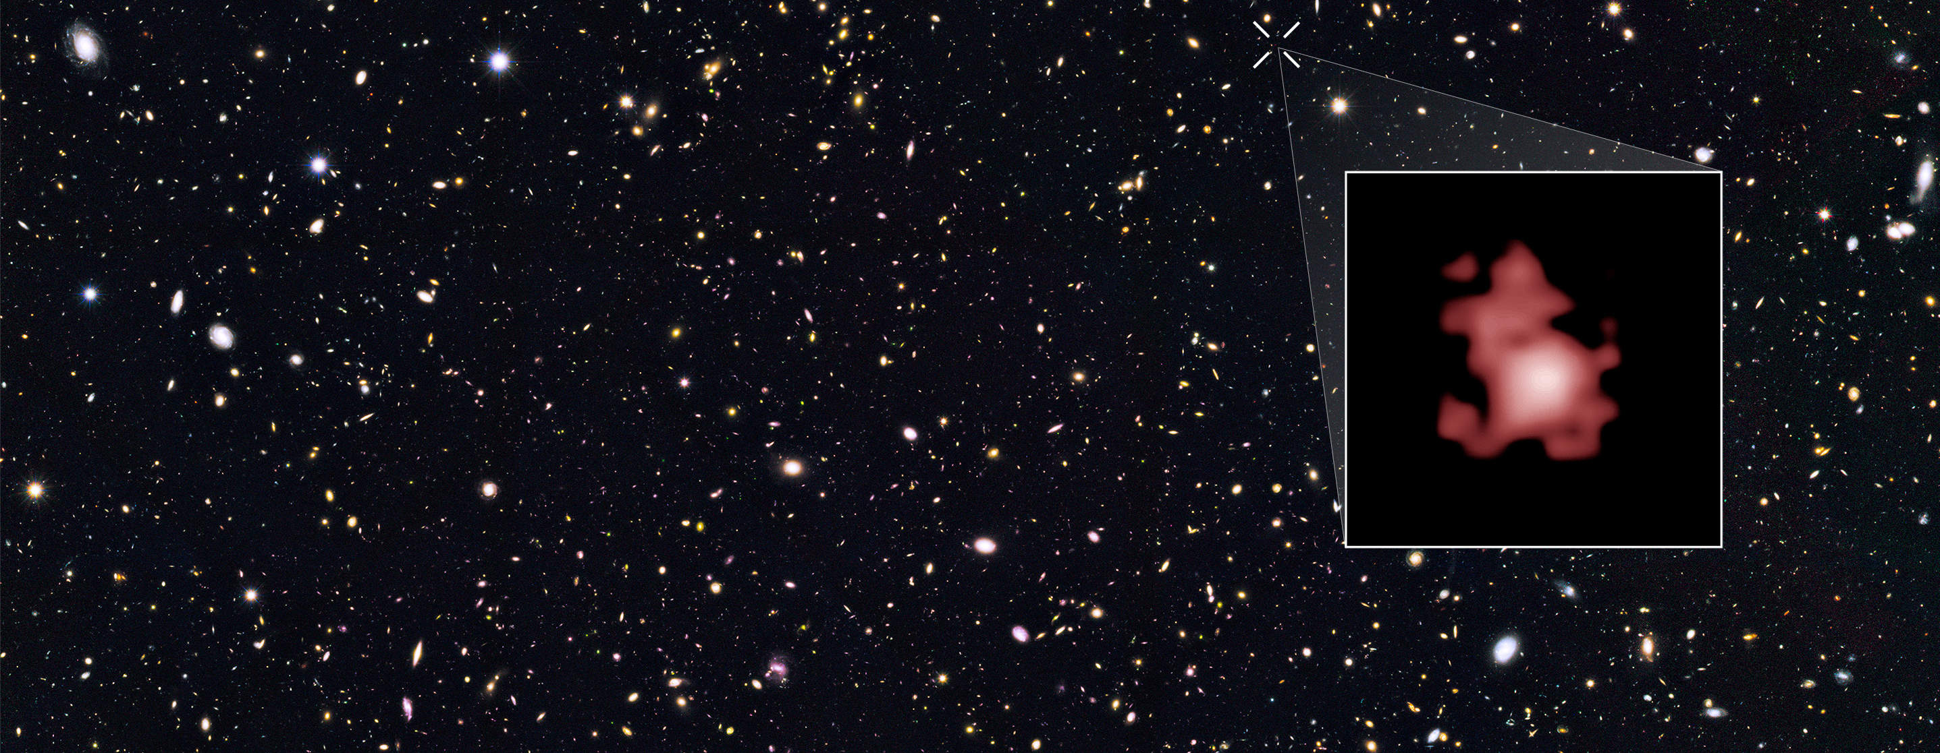
This is the Most Distant Known Object in Our Universe
z
z
588,000,000,000,000,000,000,000,000,000,000,000,000,000,000,000,000,000,000,000,000,000,000,000,000,000,000,000,000,000,000,000,000,000,000,000,000,000,000,000,000,000,000,000,000
Notes:
MOST DISTANT OBJECT
Farthest Known Galaxy in the Universe Discovered. The galaxy MACS0647-JD (inset) appears very young and is only a fraction of the size of our own Milky Way. The galaxy is about 13.3 billion light-years from Earth, the farthest galaxy yet known, and formed 420 million years after the Big Bang. Nov 15, 2012
5.8 TRILLION ----MILES ----TIMES----13.3 ----BILLION
HONESTLY, CAN YOU EVEN COMPREHEND THOSE KIND OF NUMBERS… AND THIS IS ONLY WHAT IS KNOWN… TODAY!!
AND WE WANT TO TELL GOD HOW THINGS SHOULD BE?!

Slide 6
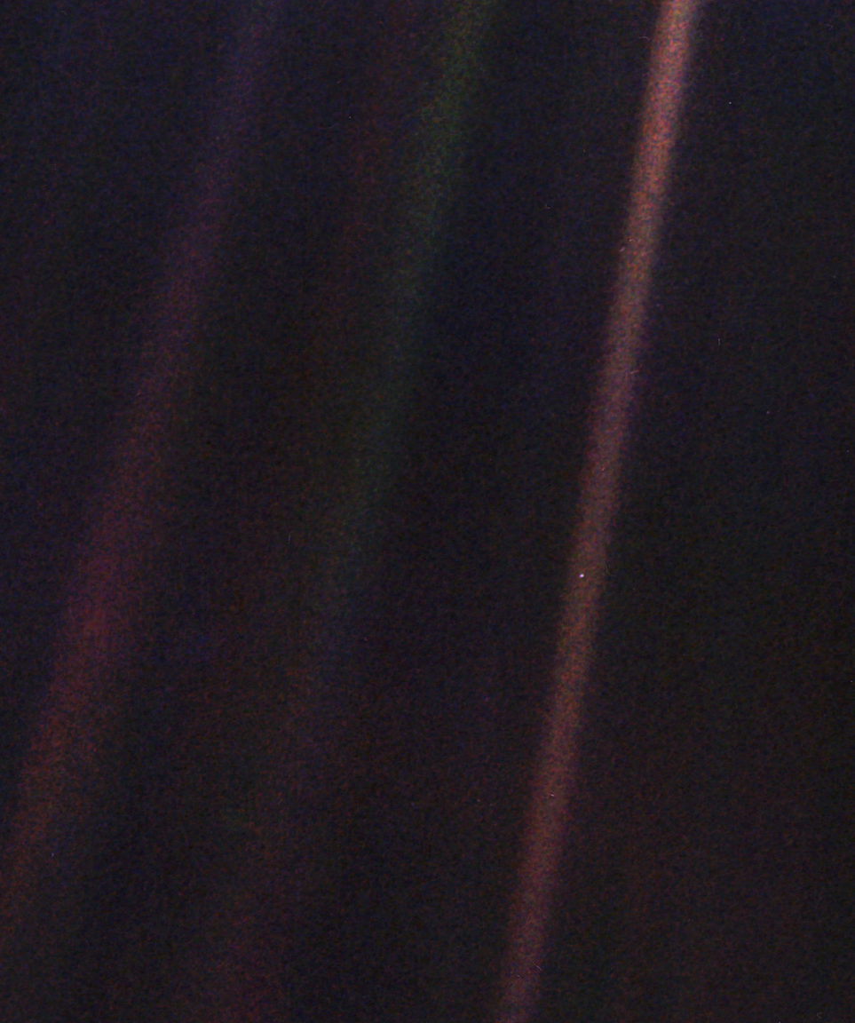
What is Man That You Are Mindful of Him
z
Notes:
WHAT IS MAN THAT YOU ARE MINDFUL
Valentine's Day is special for NASA's Voyager mission. It was on Feb. 14, 1990, that the Voyager 1 spacecraft looked back at our solar system and snapped the first-ever pictures of the planets from its perch at that time beyond Neptune.
Sagan wrote in his "Pale Blue Dot" book: "That's here. That's home. That's us. On it everyone you love, everyone you know, everyone you ever heard of, every human being who ever was, lived out their lives. … There is perhaps no better demonstration of the folly of human conceits than this distant image of our tiny world.“
POPULATION ABOUT 8 BILLION

Slide 7
The Blue Marble
z
z
Notes:
THE BLUE MARBLE
NORTH AND PART OF CENTRAL AMERICA
327 MILLION IN U.S. ALONE!
4% WORLD POPULATION

Slide 8
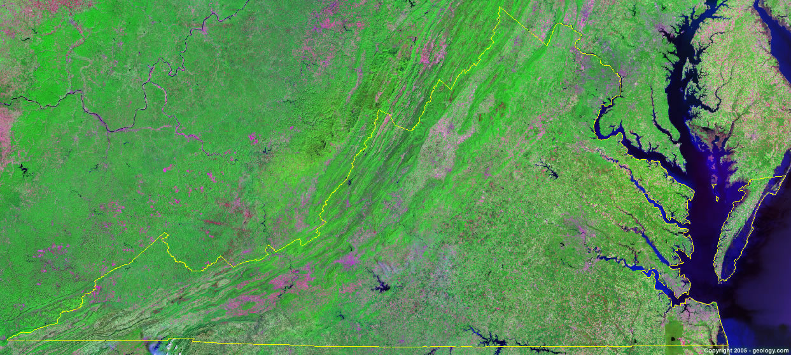
The State of Virginia
z
z
Notes:
STATE OF VIRGINIA
8.2 MILLION
.001 % WORLD POPULATION

Slide 9
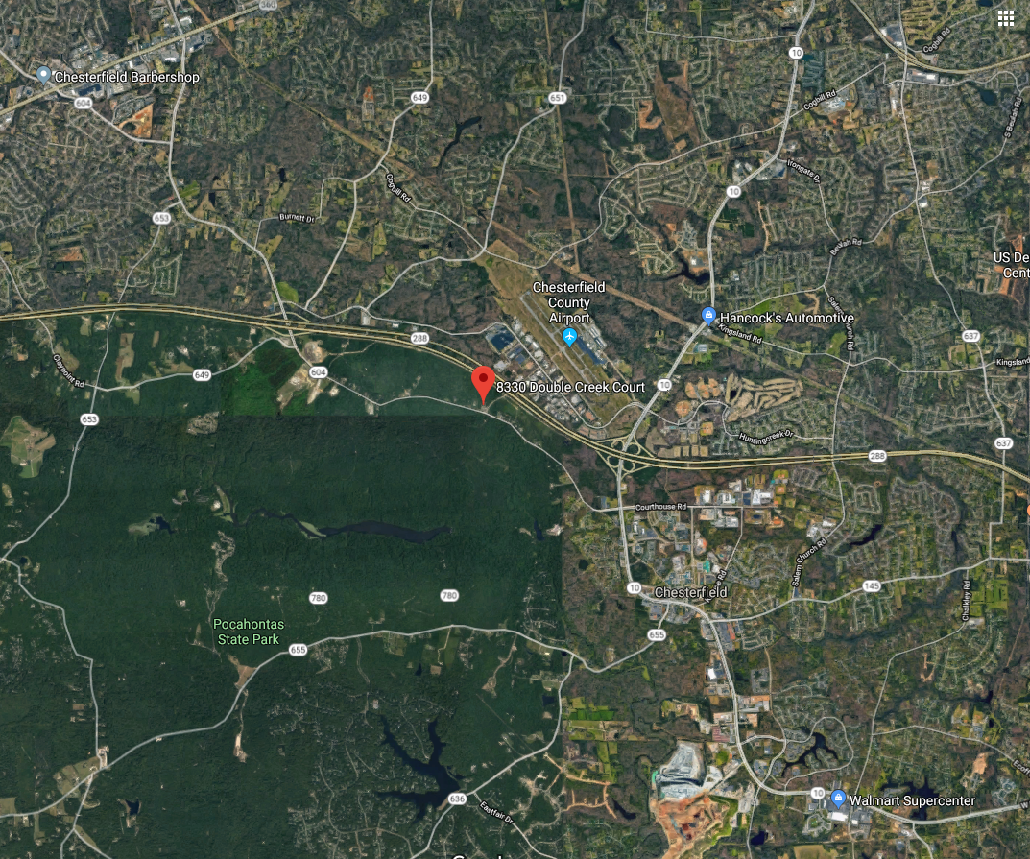
Notes:
CHESTERFIELD COUNTY
POPULATION 343,000
.0000429 OF WORLD POPULATION

Slide 10
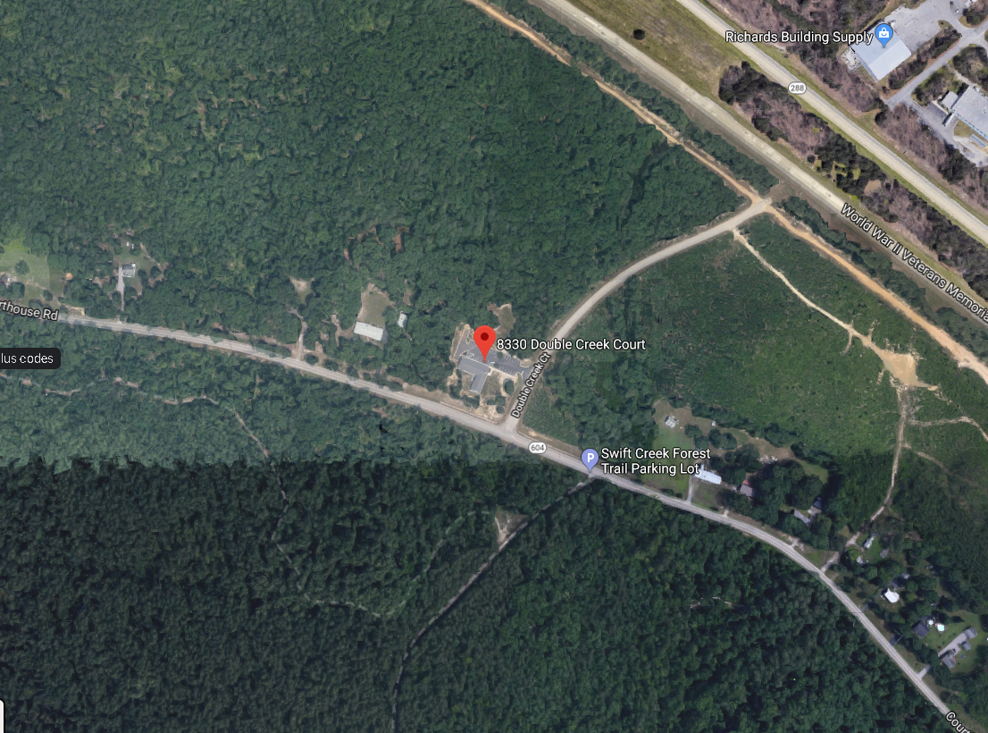
Notes:
DOUBLE CREEK COURT

Slide 11
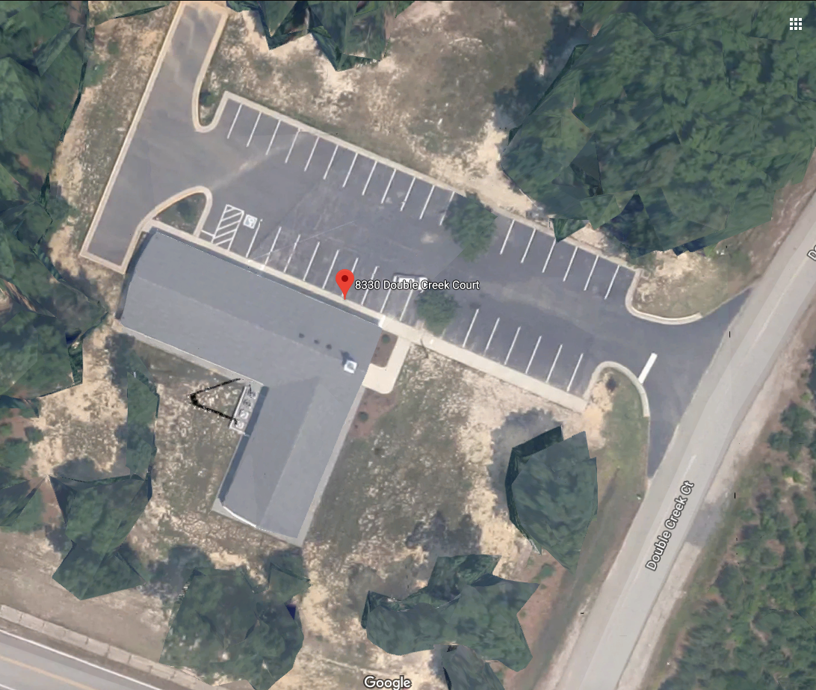
Notes:
COURTHOUSE ROAD MEETING HOUSE
ATTENDANCE OF COURTHOUSE RD. =

Slide 12
What is Man That YOU Are Mindful of Him?
You Have Made Him a Little Lower Than the Angels (Isaiah 37:36)
Angels Aid Man – Hebrews 1:13,14
Man Given Dominion – Genesis 1:26-28
Man Given Gospel – 2 Corinthians 4:7; Mark 16:15,16
Notes:
WHAT IS MAN THAT YOU ARE MINDFUL OF HIM?
You have made him a little lower than the angels. – Isaiah 37:36
Then the angel of the LORD went out, and killed in the camp of the Assyrians one hundred and eighty-five thousand; and when people arose early in the morning, there were the corpses—all dead. - (Isaiah 37:36 NKJV)
Angels Aid Man - But to which of the angels has He ever said: "SIT AT MY RIGHT HAND, TILL I MAKE YOUR ENEMIES YOUR FOOTSTOOL"? Are they not all ministering spirits sent forth to minister for those who will inherit salvation? - (Hebrews 1:13-14 NKJV)
Man was given dominion over the all creatures – Genesis 1:26-28
Man Given the Gospel – 2 Corinthians 4:7; Mark 16:15,16

Slide 13
How Excellent is Your Name
False gods and Their Legacy - Isaiah 44:9-20
How Excellent is Your Name! (Genesis 1:11-13)
Besides Me There Is No god! - Isaiah 44:6-8
Notes:
HOW EXCELLENT IS YOUR NAME
FALSE GODS AND THEIR LEGACY 44:6-20
HOW EXCELLENT IS YOUR NAME! – GENESIS 1:11-13
Why worship the wood?
Worship Him who made the tree, and the ax, and the fire, and the oven!
Worship Him who made man, and angels, and sent His Son to die for your sins!
Worship the Father who is above all, and through all and in you all! (Ephesians 4:6)
Praise the Son who died, and furthermore is also risen, who is even at the right hand of God! (Romans 8:32)
Praise the Spirit who makes intercession for the saints according to the will of God! (Romans 8:27)
BESIDES ME THERE IS NO GOD!

Slide 14
The Prayer of Psalm 8
O Lord, Our Lord, How Excellent is Your Name
When I Consider Your Heavens the Work of Your Fingers
What is Man That You are Mindful of Him
Notes:
CONCLUSION:
WHAT IS MAN? HE IS THE CREATION OF GOD!
WOULD YOU CORRECT GOD?
WOULD YOU INSTRUCT HIM?
GOD HAS SENT HIS SON TO DIE FOR MAN… FOR YOU!
CONSIDERTING WHAT GREAT CONSIDERATION HAS BEEN GIVEN TO YOU…WILL YOU NEGLECT IT?
WILL YOU PLEASE RESPOND TO THE INVITATION THIS MORNING?

Slide 15
Image Credits
Map of the Universe - https://futurism.com/wp-content/uploads/2016/01/2ca8fb67ad95ca31249e5062571772ba-600x315.jpg
Man Looking at Stars - http://astronoteen.org/wp-content/uploads/2014/08/Man-looking-at-the-stars.jpg

