Slide 1
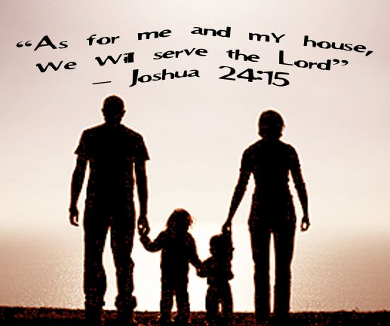
“As For Me And My House…”
Text:
Joshua 24:15
Notes:
By Nathan L Morrison
All Scripture given is from NASB unless otherwise stated
For further study, or if questions, please Call: 804-277-1983 or Visit www.courthousechurchofchrist.com

Slide 2
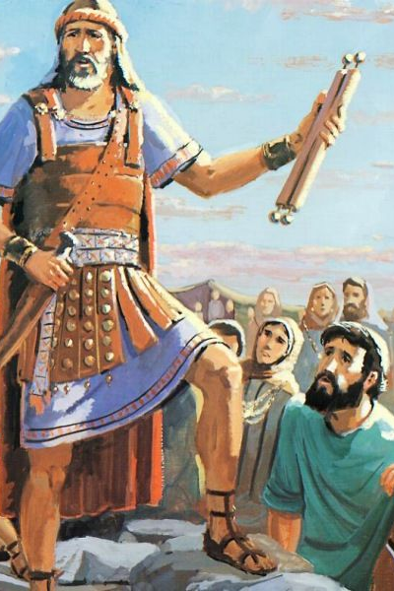
Intro
Remember What God Has Done For You
(Joshua 24:1-13)
Before Moses died, he gathered the Israelites (Deuteronomy)
Joshua became the leader of Israel
Joshua was a man of great faithfulness and obedience
In Joshua 24 Joshua also gathers the nation of Israel before he dies

Slide 3
Intro
Joshua reminds them what God had done for them
God fulfilled His promise to Abraham in bringing them out of Egypt
God was with them on the way to Canaan
They are living in the Promised Land intact, fields, cities, houses they did not build
God had given all these things to His people and fulfilled His promises to them!

Slide 4
Intro
Joshua’s Challenge
(Joshua 24:15)
"If it is disagreeable in your sight to serve the LORD, choose for yourselves today whom you will serve: whether the gods which your fathers served which were beyond the River, or the gods of the Amorites in whose land you are living; but as for me and my house, we will serve the LORD."
A challenge issued to God’s people, and a choice we must constantly make amidst a dark world filled with sin and opposition to God!

Slide 5
Joshua 24:14-15: “…as for me and my house, we will serve the Lord”
Serving God in sincerity and faithfulness is not that easy
If they did not want to serve the true and living God, then which god would they serve?
Joshua doesn’t just speak for himself! (“As for me and my house…”)
Joshua’s Challenge (Joshua 24:15)

Slide 6
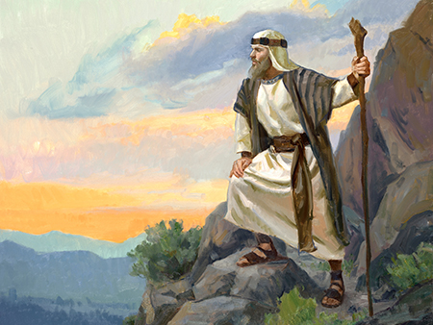
Application!
“As For Me And My House…”
Joshua’s Challenge
God requires separation from the world – II Cor. 6:14-18
God requires full dedication – Mark 12:30

Slide 7
“Who are you going to serve?”
“We will serve the Lord!”
Would we not all desire to hear these words from every person that we teach the gospel?
Joshua’s Challenge (Joshua 24:15)
Response of the People (Joshua 24:16-18)

Slide 8
Application!
“As For Me And My House…”
Response of the People
Our confession to serve God must be proved through our faith – James 1:21-22
God requires more than words from His people! – James 2:14-26

Slide 9
Joshua tells the people that they are not able to serve the Lord!
God is holy
God is jealous
Joshua says that they cannot serve the Lord because the people are unwilling to make the life changes necessary to serve the Lord!
Joshua’s Challenge (Joshua 24:15)
Response of the People (Joshua 24:16-18)
Joshua’s Rebuttal (Joshua 24:19-20)

Slide 10
Application!
“As For Me And My House…”
Joshua’s REbuttal
God is holy and he expects His people to be holy – I Peter 1:14-16
God is jealous and requires separation from the world – Romans 12:1-2

Slide 11
Joshua’s Challenge (Joshua 24:15)
Response of the People (Joshua 24:16-18)
Joshua’s Rebuttal (Joshua 24:19-20)
Monument to God (Joshua 24:21-28)
The people of Israel respond that they really will serve the Lord!
“Then put away the foreign gods that are among you, and incline your heart to the Lord, the God of Israel.”
Joshua made a monument (large stone) to remind the people of their commitment to serve God
Joshua says, “Remember your promise to God” then dismisses the people!

Slide 12
Application!
“As For Me And My House…”
Monument to God
Remember your promise to God!
Baptism – II Pet. 1:9
Lord’s Supper – I Cor. 11:26
Walk as children of God – Phil. 2:15-16

Slide 13
Conclusion
The world around Christians is full of sin, with differing priorities – Always has been!
The choice to serve God or other gods has always been before mankind!
The choice was before God’s people in times past.
The choice is before God’s people today!

Slide 14
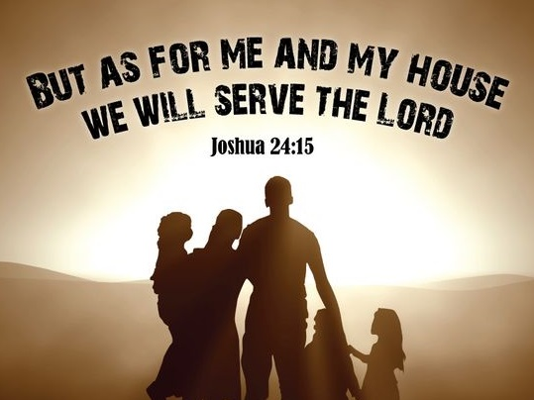
Conclusion
No matter what others are doing, let us, like Joshua, say, “But as for me and my house, we will serve the Lord!

Slide 15
“What Must I Do To Be Saved?”
Hear The Gospel (Jn. 5:24; Rom. 10:17)
Believe In Christ (Jn. 3:16-18; Jn. 8:24)
Repent Of Sins (Lk. 13:3-5; Acts 2:38)
Confess Christ (Mt. 10:32; Rom. 10:10)
Be Baptized (Mk. 16:16; Acts 22:16)
Remain Faithful (Jn. 8:31; Rev. 2:10)
For The Erring Saint:
Repent (Acts 8:22), Confess (I Jn. 1:9),
Pray (Acts 8:22)

