Slide 1
I Barabbas!
I Barabbas!
Text:
I Peter 3:18 (Romans 5:6-10)
Notes:
By Nathan L Morrison
All Scripture given is from NASB unless otherwise stated
For further study, or if questions, please Call: 804-277-1983 or Visit www.courthousechurchofchrist.com

Slide 2
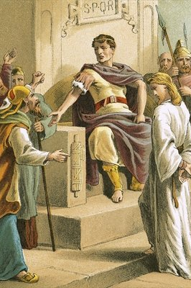
Intro
I Peter 3:18
18. For Christ also died for sins once for all, the just for the unjust, so that He might bring us to God, having been put to death in the flesh, but made alive in the spirit;
I Barabbas!

Slide 3
Intro
At Jesus’ Trial, Pilate gave the people a choice: Release Barabbas or Jesus
Barabbas = “son of a/the father”
Jesus is Son of the Father
Matthew 27:15-18
Mark 15:6-8
Luke 23:17-19
John 18:39-40
At the Passover, Pilate had a custom where he would release any prisoner the people wanted freed!
I Barabbas!

Slide 4
Intro
At Jesus’ Trial, Pilate gave the people a choice: Release Barabbas or Jesus
Matthew 27:20-26
Mark 15:11-15
Luke 23:20-25
John 18:39-40; 19:15
The people chose Barabbas!
I Barabbas!

Slide 5
Intro
I Peter 3:18
18. For Christ also died for sins once for all, the just for the unjust, so that He might bring us to God, having been put to death in the flesh, but made alive in the spirit;
Jesus, the Just, died for the unjust!
I Barabbas!

Slide 6
Barabbas
Notorious/Infamous – Matthew 27:16
Murderer – Mark 15:7; Luke 23:18-19, 25; Acts 3:14
Insurrectionist/ Rebel/Traitor – Mark 15:7; Luke 23:18-19, 25
Robber – John 18:40
Barabbas is guilty, his trial is over, he is on death row awaiting execution – deserves death!
“Whoever sheds man's blood, By man his blood shall be shed, For in the image of God He made man” (Gen. 9:6)
I Barabbas!
Notes:
Excerpt from We Are Barabbas by Dave Furman, March 29, 2018…
I have often wondered what Barabbas was thinking at that point. He was sitting on death row in a Roman prison and certainly aware that he could be killed any day. There was not a clear or straightforward process of parole or further appeals for him to count on. Prisoners didn’t have any rights. It was over for him. There was no hope. He was a murderer who deserved death, and deep down he probably knew it. Each passing day was one day closer to certain death. He may have been imagining it—the flogging, mocking, and eventual death. It was coming.
And then the day comes. He can hear the shouts ringing throughout the courtyard: “Crucify him, crucify him!” Perhaps he was thinking to himself, “They are coming for me.” The guards open the door to his cell and drag him outside. But then an astonishing thing happens. Everyone is celebrating his new freedom. His chains are released, and he is set free. The murderer is set free.
Put yourself in his sandals for a minute. You are walking to your death in chains and then all of a sudden, when you least expect it, you are a free man. Then you hear the words begin again: “Crucify him, crucify him.” And you see another walking by. Those chants are not for you. The guards are dragging another man to his death—Jesus of Nazareth. He’s beaten and flogged and is forced to carry his cross to his death. It’s the very cross you had imagined yourself carrying only moments earlier. You think to yourself, that’s my death he’s dying. Barabbas is the one person in history who could say that Jesus literally carried his cross. Jesus took his death, and Barabbas was given the freedom Jesus deserved. Jesus bore the guilt and shame and curse and disgrace and death that Barabbas deserved. Barabbas received the release, the freedom, and the life that Jesus deserved. It was an incredible scene.

Slide 7
Barabbas
Unjust
Guilty
Enemy
Free Man!
Jesus the innocent is delivered over to the punishment of death; while the guilty, deserving of death, is released and thus given new life!
I Barabbas!

Slide 8
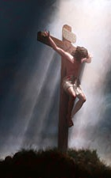
Jesus
What did He do?
Matthew 11:2-5 (From Isaiah 35:4-6; Mt. 15:30-31)
Healed the Blind!
Healed the Lame!
Healed Lepers/Diseased!
Healed the deaf!
Healed the Mute!
Healed the Crippled!
Raised the Dead!
Preached the good news of the Kingdom!
Luke 23:14
14. and said to them, "You brought this man to me as one who incites the people to rebellion, and behold, having examined Him before you, I have found no guilt in this man regarding the charges which you make against Him.
I Barabbas!
Notes:
Luke 23:14: The Jews accused Jesus of rebellion/insurrection, the very charge Barabbas was guilty of and they wanted him released!

Slide 9
Jesus
The Just! (I Peter 3:18)
Innocent! (Luke 23)
V.4: “I find no guilt in this man”
V.14: “I have found no guilt in this man”
V.15: “No, nor has Herod…nothing deserving death has been done by Him”
V.22: “I have found in Him no guilt demanding death”
V.41: The Thief…” This man has done nothing wrong”
V.47: The Centurion… ”Certainly this man was innocent”
I Barabbas!
Notes:
Luke 23:14: The Jews accused Jesus of rebellion/insurrection, the very charge Barabbas was guilty of and they wanted him released!

Slide 10
Jesus
Condemned as a sinner!
Condemned to die!
Scourged!
Carried His Cross!
Crucified with criminals!
Died for the sins of the world!
Mt. 27:26; Mk. 15:15; Lk. 23:24-26, 32-33; Jn. 19:14-18
Luke 23:25
25. And he released the man they were asking for who had been thrown into prison for insurrection and murder, but he delivered Jesus to their will.
I Barabbas!

Slide 11
Jesus
I Peter 3:18
18. For Christ also died for sins once for all, the just for the unjust, so that He might bring us to God, having been put to death in the flesh, but made alive in the spirit;
Jesus, the Just, died for the unjust!
I Barabbas!

Slide 12
We Are Like Barabbas!
Romans 5:6-10
6. For while we were still helpless, at the right time Christ died for the ungodly.
7. For one will hardly die for a righteous man; though perhaps for the good man someone would dare even to die.
8. But God demonstrates His own love toward us, in that while we were yet sinners, Christ died for us.
9. Much more then, having now been justified by His blood, we shall be saved from the wrath of God through Him.
10. For if while we were enemies we were reconciled to God through the death of His Son, much more, having been reconciled, we shall be saved by His life.
If Barabbas wasn’t set free, what hope would I have?
Helpless! (Romans 5:6-10)
Ungodly!
Sinner!
Deserving Wrath!
Enemies!
Dead in Sin! (Eph. 2:1-3)
Rebellion to God!
Sons of Disobedience!
Living According to Lust!
Children of Wrath!
I Barabbas!

Slide 13
We Are Like Barabbas!
Ephesians 2:4-7
4. But God, being rich in mercy, because of His great love with which He loved us,
5. even when we were dead in our transgressions, made us alive together with Christ (by grace you have been saved),
6. and raised us up with Him, and seated us with Him in the heavenly places in Christ Jesus,
7. so that in the ages to come He might show the surpassing riches of His grace in kindness toward us in Christ Jesus.
Unjust
Guilty
Enemy (Rom. 5:10)
Set Free!
Made Alive!
Jesus the innocent is delivered over to the punishment of death; while the guilty, deserving of death, is released and thus given new life!
I Barabbas!
I Barabbas!

Slide 14
Conclusion
Jesus went to His death, and Barabbas was given the freedom Jesus deserved!
Jesus went to his death, and I was given the freedom Jesus deserved!
I am the one so clearly guilty and deserving of condemnation (Is. 53:8) but set free because of the willing substitution of the Son of God in my place!
“And hearing this, Jesus said to them, "It is not those who are healthy who need a physician, but those who are sick; I did not come to call the righteous, but sinners"
(Mark 2:17)
I Barabbas!
Notes:
Isaiah 53:8: “By oppression and judgment He was taken away; And as for His generation, who considered That He was cut off out of the land of the living For the transgression of my people, to whom the stroke was due?”

Slide 15
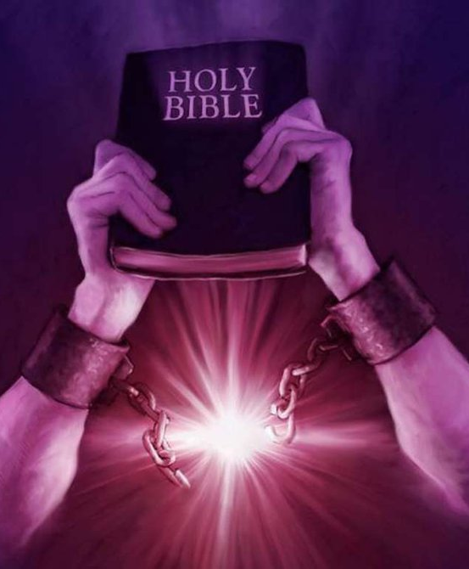
Conclusion
O Sacred Head (Paul Gerhardt, AD 1350), org. 2nd stanza
What thou, my Lord, hast suffered was all for sinners’ gain;
Mine, mine was the transgression, but thine the deadly pain.
Lo, here I fall, my Savior! ’Tis I deserve thy place;
Look on me with thy favor, and grant to me thy grace.
I Barabbas!

Slide 16
Conclusion
The message of the gospel:
A sinner goes free!
An innocent man dies!
(I Peter 2:21-24)
I Barabbas!

Slide 17
Conclusion
Trust God!
Run to the cross and lay hold of Jesus who loved you and died for you.
Jesus or Barabbas?
The choice is yours!
I Barabbas!

Slide 18
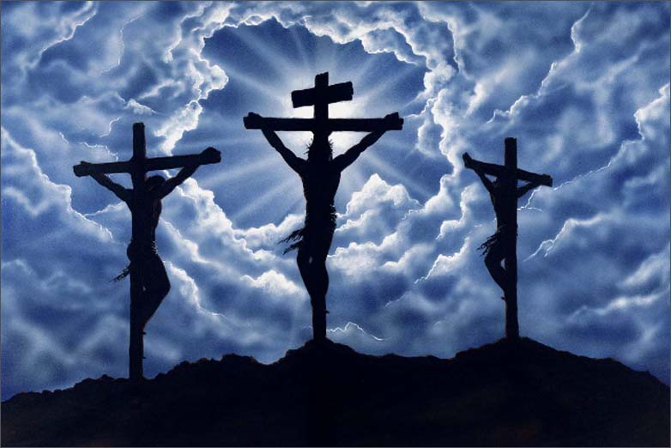
Conclusion
Will you choose to remain guilty and deserving of death or take the freedom found in Christ?
Obey the gospel NOW!
I Barabbas!

Slide 19
“What Must I Do To Be Saved?”
Hear The Gospel (Jn. 5:24; Rom. 10:17)
Believe In Christ (Jn. 3:16-18; Jn. 8:24)
Repent Of Sins (Lk. 13:3-5; Acts 2:38)
Confess Christ (Mt. 10:32; Rom. 10:10)
Be Baptized (Mk. 16:16; Acts 22:16)
Remain Faithful (Jn. 8:31; Rev. 2:10)
For The Erring Saint:
Repent (Acts 8:22), Confess (I Jn. 1:9),
Pray (Acts 8:22)

Slide 20
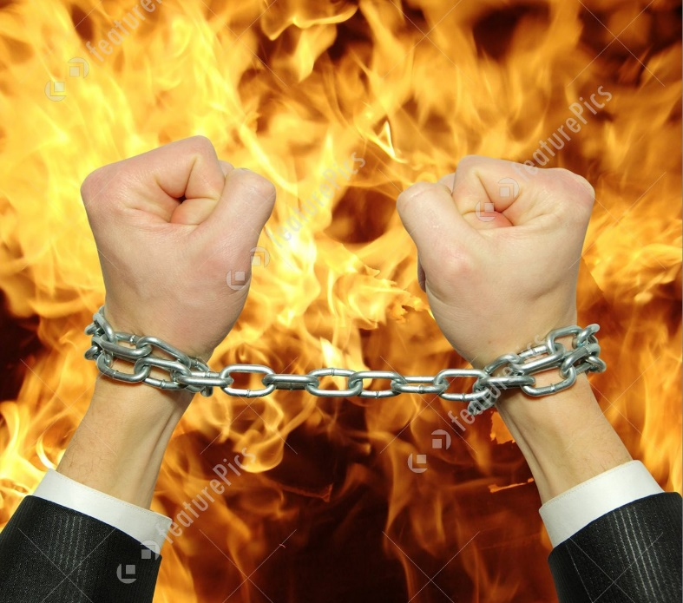
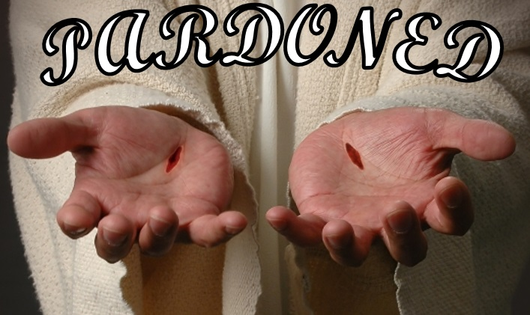
Conclusion
Will you choose to remain guilty and deserving of death or take the freedom found in Christ?
Obey the gospel NOW!
I Barabbas!

Slide 21
I Peter 3:18 (NASB)
“For Christ also died for sins once for all, the just for the unjust, so that He might bring us to God, having been put to death in the flesh, but made alive in the spirit”
by Nathan L Morrison @ www.courthousechurchofchrist.com

