Slide 1
…the Truth is like…
Mathew 13

Slide 2
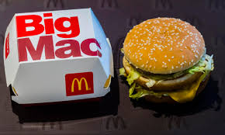

Slide 3
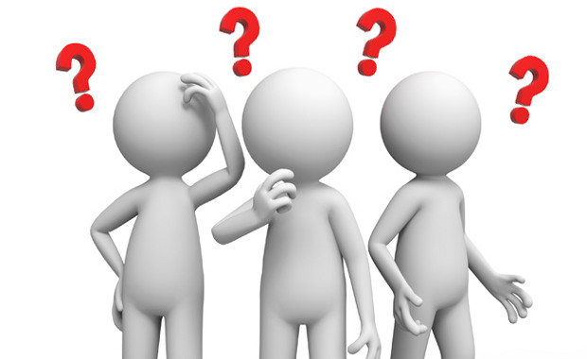
Introduction You’re probably thinking…

Slide 4
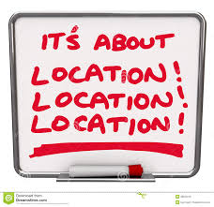
Where can I Find Big Mac???
It’s not something I can just go pick up at the store
It’s not available at just any restaurant
It’s not something available in my own home or a friend’s house

Slide 5
Where can I Find Big Mac???
It’s only found at McDonalds Restaurants
This is where it was created and this is where it belongs
If you’re looking for a Big Mac, you’re looking for a McDonalds

Slide 6
What does this have to do with the Truth

Slide 7
Food can be found at a restaurant
Truth can be found at a church
Just like you won’t find a Bic Mac in just any restaurant serving food, you won’t find the Truth in just any church building
If you want a Big Mac you must go to where it is served… if you want the Truth you must go where it is served

Slide 8
Jn 14:6 “⁶ Jesus said to him, “I am the way, the truth, and the life. No one comes to the Father except through Me.”
Jn 17:17 “¹⁷ Sanctify them by Your truth. Your word is truth.”
If I want to find the Truth I must go where Jesus and His word are taught

Slide 9
If you want a Big Mac you have to go to the right place and ask for it
“I want a Big Mac”
Try asking for it by name at Burger King or Wendy’s and see what happens

Slide 10
If you want to know the Truth you must go to the right place and ask for it
Mt 7:7 “⁷ “Ask, and it will be given to you; seek, and you will find; knock, and it will be opened to you.”
Jn 8:31-32 “³¹ Then Jesus said to those Jews who believed Him, “If you abide in My word, you are My disciples indeed. ³² And you shall know the truth, and the truth shall make you free.”

Slide 11
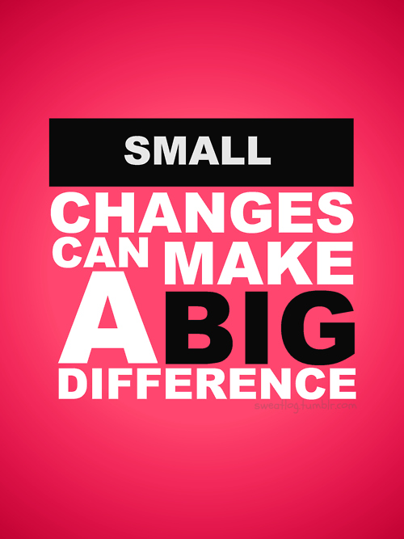
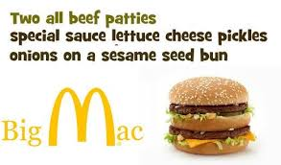
Some people will order a Big Mac and then ask if they can add something to it or take something off of it
We all know the ingredients of a Big Mac

Slide 13
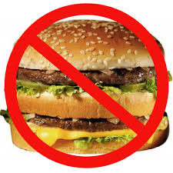
Some people just don’t like Big Macs
No matter how hard you try, you are not going to convince them to change their mind
Not only do they not like it, but they tell others they don’t like it and why

Slide 14
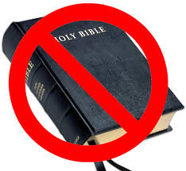
Just like there are people who do not like Big Macs there are people who do not like the Truth
No matter how hard you try you can not convince them to change
Not only do they not like it, but they tell others they don’t like it and why

Slide 15
In order to acquire a Big Mac you must be willing to give up a portion of your money
The question one must ask… Are the benefits I am receiving worth what I am giving up
Are the benefits of this Big Mac worth the money

Slide 16
In order to acquire the benefits promised in the Truth there are things we must give up
The question one must ask… Are the benefits I am receiving worth what I am giving up
Are the benefits found in the Truth worth giving up other things

Slide 17
Mk 10:17 “¹⁷ Now as He was going out on the road, one came running, knelt before Him, and asked Him, “Good Teacher, what shall I do that I may inherit eternal life?”
Mk 10:18 “¹⁸ So Jesus said to him, “Why do you call Me good? No one is good but One, that is, God.
Mk 10:19 “You know the commandments: ‘Do not commit adultery,’ ‘Do not murder,’ ‘Do not steal,’ ‘Do not bear false witness,’ ‘Do not defraud,’ ‘Honor your father and your mother.’ ”

Slide 18
Mk 10:20 “²⁰ And he answered and said to Him, “Teacher, all these things I have kept from my youth.”
Mk 10:21 “²¹ Then Jesus, looking at him, loved him, and said to him, “One thing you lack: Go your way, sell whatever you have and give to the poor, and you will have treasure in heaven; and come, take up the cross, and follow Me.”

Slide 19
Mk 10:22 “²² But he was sad at this word, and went away sorrowful, for he had great possessions.”
Now consider what Paul says
Phil 3:8 “⁸ Yet indeed I also count all things loss for the excellence of the knowledge of Christ Jesus my Lord, for whom I have suffered the loss of all things, and count them as rubbish, that I may gain Christ”

Slide 20
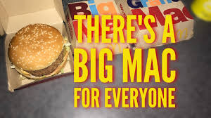
Big Macs are available to everyone but come with certain conditions
It doesn’t matter who you are, where you live, what you have done, if you are willing to come into a McDonalds and ask for one while agreeing to all the rules to receive it, you can receive it
If you refuse to do all McDonalds requires of you to receive it… you won’t get it even though it’s available to you

Slide 21
The Truth and its benefits are available to everyone but come with certain conditions
It doesn’t matter who you are, where you live, what you have done, if you are willing to come God and seek His forgiveness and are willing to follow His conditions you can receive the benefits of His Truth
If you refuse to do all God requires of you to receive it… you won’t get it even though it’s available to you

Slide 22
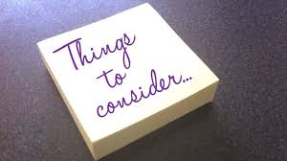
Conclusion
Teaching others about the truth is as easy as teaching them about something they already understand
We can draw parallels in our teaching, so that they can understand the basic points.
These points are easy to comprehend and the Truth can easily be understood through comparison
Are we doing our part to teach others while “Imitating Christ?”

