Slide 1
Walk in a Worthy Manner
Therefore I, the prisoner of the Lord, implore you to walk in a manner worthy of the calling with which you have been called
Eph. 4:1
‘walk’ = ‘live’

Slide 2
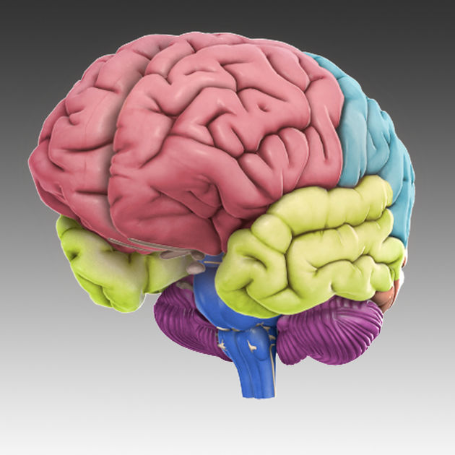
Renew Your Mind
Notes:
The PROBLEM – the ‘heart’ – the MIND –
OUT of the heart –
18 “But the things that proceed out of the mouth come from the heart, and those defile the man.
19 “For out of the heart come evil thoughts, murders, adulteries, fornications, thefts, false witness, slanders.
20 “These are the things which defile the man; but to eat with unwashed hands does not defile the man.”

Slide 3
24 occurrences; AV translates as “mind” 21 times, and “understanding” three times.
1 the mind, comprising alike the faculties of perceiving and understanding and those of feeling, judging, determining.
1a the intellectual faculty, the understanding.
1b reason in the narrower sense, as the capacity for spiritual truth, the higher powers of the soul, the faculty of perceiving divine things, of recognising goodness and of hating evil.
1c the power of considering and judging soberly, calmly and impartially.
2 a particular mode of thinking and judging, i.e thoughts, feelings, purposes, desires.
Notes:
Enhanced Strongs Lexicon – ‘nous’ -
24 occurrences; AV translates as “mind” 21 times, and “understanding” three times.
1 the mind, comprising alike the faculties of perceiving and understanding and those of feeling, judging, determining.
1a the intellectual faculty, the understanding.
1b reason in the narrower sense, as the capacity for spiritual truth, the higher powers of the soul, the faculty of perceiving divine things, of recognising goodness and of hating evil.
1c the power of considering and judging soberly, calmly and impartially.
2 a particular mode of thinking and judging, i.e thoughts, feelings, purposes, desires.

Slide 4
Renew Your Mind
18 “But the things that proceed out of the mouth come from the heart, and those defile the man.
19 “For out of the heart come evil thoughts, murders, adulteries, fornications, thefts, false witness, slanders.
20 “These are the things which defile the man; but to eat with unwashed hands does not defile the man.”
Notes:
The PROBLEM – the ‘heart’ – the MIND –
OUT of the heart –
18 “But the things that proceed out of the mouth come from the heart, and those defile the man.
19 “For out of the heart come evil thoughts, murders, adulteries, fornications, thefts, false witness, slanders.
20 “These are the things which defile the man; but to eat with unwashed hands does not defile the man.”

Slide 5
Renew your MIND
CHANGE:
How / What you THINK

Slide 6
Changing Your Mind/heart
Read
Listen to
Watch
Allow self to think!
Notes:
Changing your MIND / heart / thinking
Read
Listen to
Watch
Allow self to think!

Slide 7
Renew your MIND
CHANGE:
How / What you THINK
What you DESIRE
Notes:
Illustrate – diet –
Stock refrig with blue bell ice cream
Stock cupboard with chocolate chip cookies..
THEN PRACTICE WILL POWER???

Slide 8
Renew Your Mind
The NEED
Before –
Futility
Darkened in understanding
Excluded from life of God
Ignorance
Hardness of heart
Callous
Sensuality / impurity / Greed
Notes:
The NEED
Before –
Futility
Darkened in understanding
Excluded from life of God
Ignorance
Hardness of heart
Callous
Sensuality / impurity / Greed

Slide 9
Renew Your Mind
The NEED
After –
Righteousness
Holiness
Truth
Notes:
The NEED
After –
Righteousness
Holiness
Truth

Slide 10
Renew the Spirit of Your Mind
Learned Christ
Heard
Taught
Truth
… make disciples of all the nations, baptizing them in the name of the Father and the Son and the Holy Spirit, teaching them to observe all that I commanded you; Matt. 28:19-20
Notes:
Learned Christ
Heard
Taught
Truth

Slide 11
Renew the Spirit of Your Mind
¹⁸ And do not get drunk with wine, for that is dissipation, but be filled with the Spirit, ¹⁹ speaking to one another in psalms and hymns and spiritual songs, singing and making melody with your heart to the Lord; ²⁰ always giving thanks for all things in the name of our Lord Jesus Christ to God, even the Father;
Notes:
Eph. 5:18-20
¹⁸ And do not get drunk with wine, for that is dissipation, but be filled with the Spirit, ¹⁹ speaking to one another in psalms and hymns and spiritual songs, singing and making melody with your heart to the Lord; ²⁰ always giving thanks for all things in the name of our Lord Jesus Christ to God, even the Father;
Dissipation? - behavior which shows lack of concern or thought for the consequences of an action—‘senseless deeds, reckless deeds, recklessness. Louw Nida see prodigal in Luke 15:13
the Greek text actually has only two imperatives—“Do not get drunk” and “Be filled with the Spirit”—and five participles:
Speaking to each other with psalms, hymns, and spiritual songs
Singing
Making music
Giving thanks
Submitting to each other in fear of Christ.

Slide 12
Put off → Put on
Lying → Truth
Anger/sin → Self-control
Stealing → Generosity
Unwholesome Speech → Edifying
Grieve Holy Spirit → Obedience
Bitterness, wrath → Kindness, tender,
forgiving
Notes:
Lying → Truth
Anger/sin → Self-control
Stealing → Generosity
Unwholesome Speech → Edifying
Grieve Holy Spirit → Obedience
Bitterness, wrath → Kindness, tender, forgiving
Grieve HS - Is 63:10; In all their affliction He was afflicted,
And the angel of His presence saved them;
In His love and in His mercy He redeemed them,
And He lifted them and carried them all the days of old.
10 But they rebelled And grieved His Holy Spirit;
Therefore He turned Himself to become their enemy,
He fought against them.

Slide 13
Imitators of God
Walk in Love - 2
Walk in Purity - 3f
Walk in Light - 6f
Walk in Knowledge - 14f
Notes:
Walk in Love - 2
Walk in Purity - 3f
Walk in Light - 6f
Walk in Knowledge - 14f
→ Godly Relationships

Slide 14
Godly Relationships
Husband – Wife (5:22-33)
Father – (6:4)
Children – (6:1-3)
Slave – (6:5-8)
Master – (6:9)
Notes:
Godly Relationships – if NOT practice the teaching of Jesus towards those whom we have to deal with MOST of our time, then most of our time we are not practicing the teaching of Jesus!
Husband – Wife 5:22-33
Father – 6:4
Children – 6:1-3
Slave – 6:5-8
Master - 6:9

