Slide 1
Prayer Part 4: “What Do I Pray For?”
Text:
John 14:13-15; 15:7
Notes:
By Nathan L Morrison
All Scripture given is from NASB unless otherwise stated
For further study, or if questions, please Call: 804-277-1983 or Visit www.courthousechurchofchrist.com

Slide 2
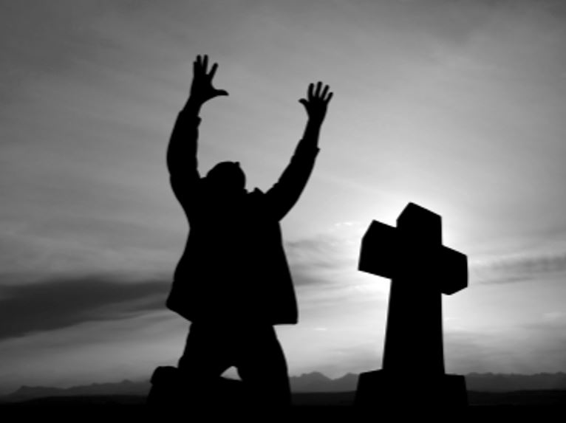
Intro
“What do I pray for?”

Slide 3
Intro
John 14:13-15
13. "Whatever you ask in My name, that will I do, so that the Father may be glorified in the Son.
14. "If you ask Me anything in My name, I will do it.
15. "If you love Me, you will keep My commandments.
John 15:7
"If you abide in Me, and My words abide in you, ask whatever you wish, and it will be done for you.
I John 3:21-22
21. Beloved, if our heart does not condemn us, we have confidence before God;
22. and whatever we ask we receive from Him, because we keep His commandments and do the things that are pleasing in His sight.

Slide 4
Intro
God answers prayer according to His will (I Jn. 5:14-15; Js. 4:13-15):
Withholds answers (Mt. 26:39-44; Job 30:20)
Delays answers (Lk. 18:7)
Exceeds request (Acts 12:15-16; Eph. 3:20)
Does not grant request (Mt. 26:39; II Cor. 12:8-9)
The Holy Spirit intercedes for us in our prayers (Rom. 8:26-27)
The Scriptures provide examples of things for which we are to pray!

Slide 5
“What Do I Pray For?”
Forgiveness of sins
I John 1:9
Matthew 6:12; Luke 11:4
Acts 8:22

Slide 6
“What Do I Pray For?”
Forgiveness of sins
Wisdom
James 1:5

Slide 7
“What Do I Pray For?”
Forgiveness of sins
Wisdom
Daily Necessities
Matthew 6:11
Luke 11:3
Matthew 6:25-34

Slide 8
“What Do I Pray For?”
Forgiveness of sins
Wisdom
Daily Necessities
The Sick
James 5:13
James 5:14
II Corinthians 12:7-10

Slide 9
“What Do I Pray For?”
Forgiveness of sins
Wisdom
Daily Necessities
The Sick
Avoid Temptation
Matthew 6:13
Matthew 26:41; Luke 22:40, 46
I Corinthians 10:13

Slide 10
“What Do I Pray For?”
Deliverance from evil
Matthew 6:13
II Timothy 2:22

Slide 11
“What Do I Pray For?”
Deliverance from evil
Daily Living
Hebrews 4:15-16
Acts 12:5
Matthew 24:20
James 5:13
I Peter 5:7

Slide 12
“What Do I Pray For?”
Deliverance from evil
Daily Living
Other People
I Timothy 2:1-2
Matthew 5:44
Romans 10:1
Ephesians 6:18
John 17:6-12
John 17:20

Slide 13
“What Do I Pray For?”
Deliverance from evil
Daily Living
Other People
Effective Working of the Word of God
Colossians 4:2-4
Ephesians 6:19
Luke 10:2
II Thessalonians 3:1-3

Slide 14
“What Do I Pray For?”
We must still teach and take opportunities as they arise! (Col. 4:2-4; I Pet. 3:15)
Forgiveness of sins
Wisdom
Daily Necessities
The Sick
Avoid Temptation
Deliverance from evil
Daily Living
Other People
Effective Working of the Word of God

Slide 15
Conclusion
Philippians 4:6
Be anxious for nothing, but in everything by prayer and supplication with thanksgiving let your requests be made known to God.

Slide 16
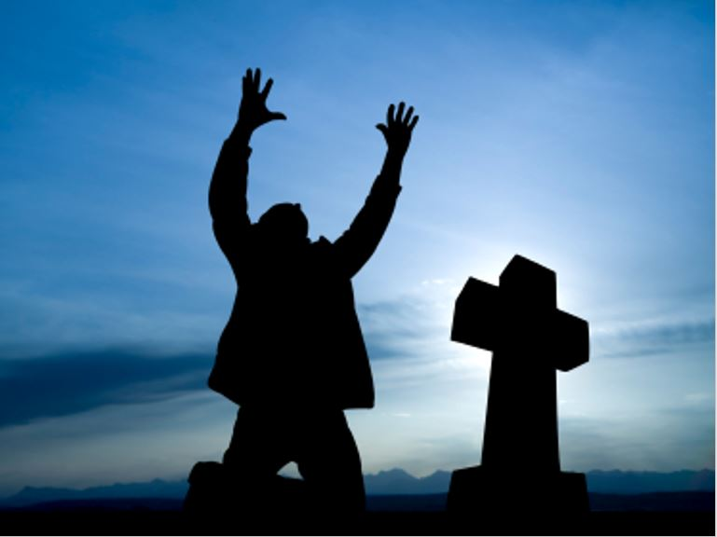
Conclusion
Let us pray often and let us make our requests before God with an attitude of thanksgiving!

Slide 17
“What Must I Do To Be Saved?”
Hear The Gospel (Jn. 5:24; Rom. 10:17)
Believe In Christ (Jn. 3:16-18; Jn. 8:24)
Repent Of Sins (Lk. 13:3-5; Acts 2:38)
Confess Christ (Mt. 10:32; Rom. 10:10)
Be Baptized (Mk. 16:16; Acts 22:16)
Remain Faithful (Jn. 8:31; Rev. 2:10)
For The Erring Saint:
Repent (Acts 8:22), Confess (I Jn. 1:9),
Pray (Acts 8:22)

