Slide 1
NO Reason To Be Baptized… UNLESS… Text: I Cor. 12:13-14
Notes:
By Nathan L Morrison
All Scripture given is from NASB unless otherwise stated
For further study, or if questions, please Call: 804-277-1983 or Visit www.courthousechurchofchrist.com
Based on a lesson by Richard Thetford

Slide 2
Intro
Mankind was created free moral agents and do not have
to do anything we don’t want to do
God is not forcing us to be obedient, or to even serve Him
Deut. 30:19: Moses told Israel they had to choose: life or death; blessing or curse (Joshua too – Joshua 24:15).
God never used the method of force to get one to serve
Him
Ps. 110:3: “Your people will volunteer freely in the day of Your power.”
Rom. 12:1: “Therefore I urge you…” (urging is to strongly suggest, not force).
I Tim. 2:4; II Pet. 3:9: God wants all men to be saved!

Slide 3
Intro
Jesus encourages us to come to Him (not force – pleads)
Mt. 11:28-30: Jesus says come to Him if you want rest for your souls.
This was true of Adam and Eve in the beauty of paradise: God admonished; but He did not force. (They made the wrong choice – Gen. 3:1-6)
This was true in the days that Christ walked upon the earth. He did not force, but instead pleaded with wayward Israel (Mt. 23:37-39). (They made the wrong choice – Mt. 21:43)
The same is true today: We are still free moral agents!
There are still consequences for our actions, both good and bad (Mt. 7:13-14; 25:46)
Like Israel of old, do we choose life or death? (Deut. 30:19; Josh. 24:15)
Are we making the right choices?
There is NO reason to be baptized…UNLESS…

Slide 4
You don’t have to be baptized…UNLESS…
…you want to accept the word of God

Slide 5
UNLESS you want to accept the word of God
You don’t have to be baptized…UNLESS…
Mt. 28:18-20
18. And Jesus came up and spoke to them, saying, "All authority has been given to Me in heaven and on earth.
19. "Go therefore and make disciples of all the nations, baptizing them in the name of the Father and the Son and the Holy Spirit,
20. teaching them to observe all that I commanded you; and lo, I am with you always, even to the end of the age."
Notes:
Emphasis in Scriptures mine!

Slide 6
UNLESS you want to accept the word of God
You don’t have to be baptized…UNLESS…
Acts 16:30-34
30. and after he brought them out, he said, "Sirs, what must I do to be saved?"
31. They said, "Believe in the Lord Jesus, and you will be saved, you and your household."
32. And they spoke the word of the Lord to him together with all who were in his house.
33. And he took them that very hour of the night and washed their wounds, and immediately he was baptized, he and all his household.
34. And he brought them into his house and set food before them, and rejoiced greatly, having believed in God with his whole household.
If you don’t choose to follow the word of God,
there is no reason to be baptized!
Notes:
Emphasis in Scriptures mine!

Slide 7
You don’t have to be baptized…UNLESS…
…you want to accept the word of God
…you want to accept Christ’s blood

Slide 8
UNLESS you want to accept Christ’s blood
You don’t have to be baptized…UNLESS…
Lev. 17:11: “For the life of the flesh is in the blood.”
I Cor. 15:1-4
1. Now I make known to you, brethren, the gospel which I preached to you, which also you received, in which also you stand,
2. by which also you are saved, if you hold fast the word which I preached to you, unless you believed in vain.
3. For I delivered to you as of first importance what I also received, that Christ died for our sins according to the Scriptures,
4. and that He was buried, and that He was raised on the third day according to the Scriptures,
Notes:
Emphasis in Scriptures mine!

Slide 9
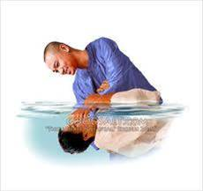
UNLESS you want to accept Christ’s blood
You don’t have to be baptized…UNLESS…
Rom. 6:3-5, 16-17
3. Or do you not know that all of us who have been baptized into Christ Jesus have been baptized into His death?
4. Therefore we have been buried with Him through baptism into death, so that as Christ was raised from the dead through the glory of the Father, so we too might walk in newness of life.
5. For if we have become united with Him in the likeness of His death, certainly we shall also be in the likeness of His resurrection,
16. Do you not know that when you present yourselves to someone as slaves for obedience, you are slaves of the one whom you obey, either of sin resulting in death, or of obedience resulting in righteousness?
17. But thanks be to God that though you were slaves of sin, you became obedient from the heart to that form of teaching to which you were committed,
Notes:
Emphasis in Scriptures mine!

Slide 10
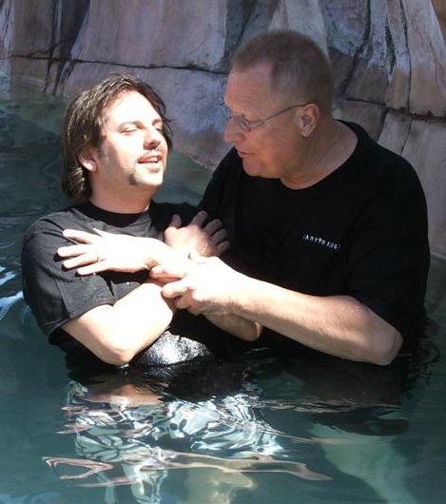
UNLESS you want to accept Christ’s blood
You don’t have to be baptized…UNLESS…
I Jn. 1:7: His blood cleanses us from our sins! (Eph. 1:7)
Acts 22:16
16. 'Now why do you delay? Get up and be baptized, and wash away your sins, calling on His name.'
If you don’t want to be cleansed from sin, then there is no reason
to be baptized!
Notes:
Emphasis in Scriptures mine!

Slide 11
You don’t have to be baptized…UNLESS…
…you want to accept the word of God
…you want to accept Christ’s blood
…you want to enter the body/church of Christ

Slide 12
UNLESS you want to enter the body of Christ
You don’t have to be baptized…UNLESS…
I Cor. 12:13-14 (Eph. 1:22-23; Col. 1:18)
13. For by one Spirit we were all baptized into one body, whether Jews or Greeks, whether slaves or free, and we were all made to drink of one Spirit.
14. For the body is not one member, but many.
Eph. 4:4-6 (Acts 2:41, 47)
4. There is one body and one Spirit, just as also you were called in one hope of your calling;
5. one Lord, one faith, one baptism,
6. one God and Father of all who is over all and through all and in all.
Eph. 5:23
23. For the husband is the head of the wife, as Christ also is the head of the church, He Himself being the Savior of the body.
Notes:
Emphasis in Scriptures mine!

Slide 13
UNLESS you want to enter the body of Christ
You don’t have to be baptized…UNLESS…
Gal. 3:26-28
26. For you are all sons of God through faith in Christ Jesus.
27. For all of you who were baptized into Christ have clothed yourselves with Christ.
28. There is neither Jew nor Greek, there is neither slave nor free man, there is neither male nor female; for you are all one in Christ Jesus.
If you don’t want to be “in Christ,” or saved in “the body,” or to be a part of the church Jesus died for (Acts 20:28), there is no reason to be baptized!
Notes:
Emphasis in Scriptures mine!

Slide 14
You don’t have to be baptized…UNLESS…
…you want to accept the word of God
…you want to accept Christ’s blood
…you want to enter the body/church of Christ
…you want forgiveness of sins

Slide 15
UNLESS you want forgiveness of sins
You don’t have to be baptized…UNLESS…
Acts 2:36-41 (Joel 2:32; Acts 2:16-21; Rom. 10:13)
36. "Therefore let all the house of Israel know for certain that God has made Him both Lord and Christ--this Jesus whom you crucified."
37. Now when they heard this, they were pierced to the heart, and said to Peter and the rest of the apostles, "Brethren, what shall we do?"
38. Peter said to them, "Repent, and each of you be baptized in the name of Jesus Christ for the forgiveness of your sins; and you will receive the gift of the Holy Spirit.
39. "For the promise is for you and your children and for all who are far off, as many as the Lord our God will call to Himself."
40. And with many other words he solemnly testified and kept on exhorting them, saying, "Be saved from this perverse generation!"
41. So then, those who had received his word were baptized; and that day there were added about three thousand souls.
Notes:
Emphasis in Scriptures mine!

Slide 16
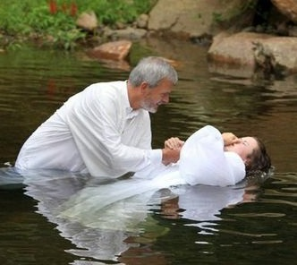
UNLESS you want forgiveness of sins
You don’t have to be baptized…UNLESS…
Acts 22:16 (“Calling on His name”--Joel 2:32; Rom. 10:13)
16. 'Now why do you delay? Get up and be baptized, and wash away your sins, calling on His name.'
If you don’t want to be forgiven,
then there is no reason to be baptized!
Notes:
Emphasis in Scriptures mine!

Slide 17
You don’t have to be baptized…UNLESS…
…you want to accept the word of God
…you want to accept Christ’s blood
…you want to enter the body/church of Christ
…you want forgiveness of sins
…you want to be saved

Slide 18
UNLESS you want to be saved
You don’t have to be baptized…UNLESS…
Mk. 16:16
16. "He who has believed and has been baptized shall be saved; but he who has disbelieved shall be condemned.
I Pet. 1:22-23
22. Since you have in obedience to the truth purified your souls for a sincere love of the brethren, fervently love one another from the heart,
23. for you have been born again not of seed which is perishable but imperishable, that is, through the living and enduring word of God.
I Pet. 3:21
21. Corresponding to that, baptism now saves you--not the removal of dirt from the flesh, but an appeal to God for a good conscience--through the resurrection of Jesus Christ,
If you don’t want to be saved from the wrath of God,
there is no reason to be baptized!
Notes:
Emphasis in Scriptures mine!

Slide 19
You don’t have to be baptized…UNLESS…
…you want to accept the word of God
…you want to accept Christ’s blood
…you want to enter the body/church of Christ
…you want forgiveness of sins
…you want to be saved
…you want to go to Heaven

Slide 20
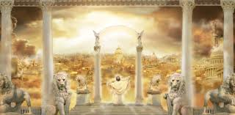
UNLESS you want to go to Heaven
You don’t have to be baptized…UNLESS…
Rev. 2:7, 10 (Mt. 11:28-30: Rest)
7. 'He who has an ear, let him hear what the Spirit says to the churches. To him who overcomes, I will grant to eat of the tree of life which is in the Paradise of God.'
10. 'Do not fear what you are about to suffer. Behold, the devil is about to cast some of you into prison, so that you will be tested, and you will have tribulation for ten days. Be faithful until death, and I will give you the crown of life.
Notes:
Emphasis in Scriptures mine!

Slide 21
UNLESS you want to go to Heaven
You don’t have to be baptized…UNLESS…
Rev. 21:3-7: Those who overcome inherit Heaven and all its bliss! (Rev. 14:13: Those who die in the Lord have rest)
Mt. 7:21: The one who does the will of God will enter Heaven!
(Mk. 16:16; Acts 22:16)
If you don’t want to be there, then there is
no reason to be baptized!

Slide 22
You don’t have to be baptized…UNLESS…
…you want to accept the word of God
…you want to accept Christ’s blood
…you want to enter the body/church of Christ
…you want forgiveness of sins
…you want to be saved
…you want to go to Heaven
Other than those reasons…YOU DON’T HAVE TO BE
BAPTIZED!

Slide 23
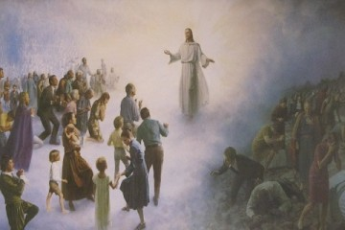
Conclusion
You can choose to do nothing or even choose to hold to a
form of godliness and go to the alternative…
Mt. 7:21-23; 25:31-34, 41, 46:
We choose to be on the right or the left of Jesus!

Slide 24
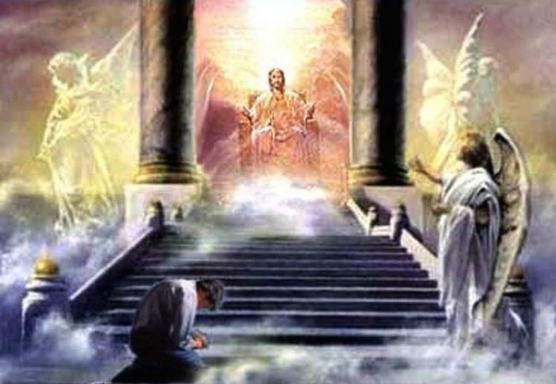
Conclusion
You don’t have to do one thing in obedience to God, but if you don’t do God’s will, then you will be parted to Jesus’ left on the Day of Judgment to eternal punishment! (II Cor. 5:10; Mt. 25:41)
In choosing the paths we each take we also accept the consequences or rewards that come with those decisions!
(Mt. 7:13-14; Mt. 25:31-46:
Eternal life or eternal punishment!)

Slide 25
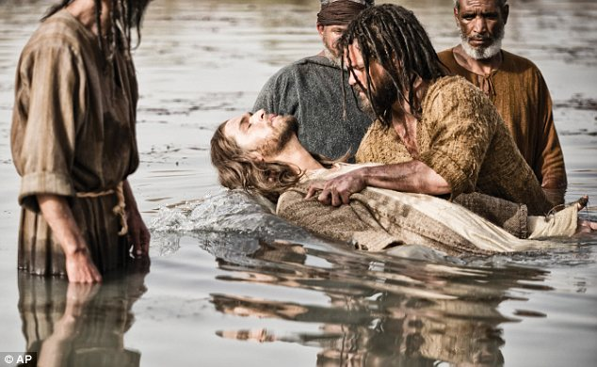
Conclusion
If you do want to be saved and inherit
Heaven, then choose to obey the
gospel and live faithfully to God!

Slide 26
“What Must I Do To Be Saved?”
Hear The Gospel (Jn. 5:24; Rom. 10:17)
Believe In Christ (Jn. 3:16-18; Jn. 8:24)
Repent Of Sins (Lk. 13:3-5; Acts 2:38)
Confess Christ (Mt. 10:32; Rom. 10:10)
Be Baptized (Mk. 16:16; Acts 22:16)
Remain Faithful (Jn. 8:31; Rev. 2:10)
For The Erring Child:
Repent (Acts 8:22), Confess (I Jn. 1:9),
Pray (Acts 8:22)

