Slide 1
“Such Were Some Of You…”
Text:
I Cor. 6:9-11
Notes:
By Nathan L Morrison
All Scripture given is from NASB unless otherwise stated
For further study, or if questions, please Call: 804-277-1983 or Visit www.courthousechurchofchrist.com

Slide 2
Intro
Paul uses the word “knowledge” 6 times in I Corinthians 6
We need to know: Those who practice unrighteousness shall NOT inherit the kingdom of God!
Knowledge of God’s word is necessary!
Jesus said knowledge of the truth can set one free – Jn. 8:32
Knowledge of the truth is required to be saved – I Tim. 2:4
Lack of knowledge leads to sin & destruction – Eph. 4:17-20; Hos. 4:6
God does not approve those who have religious zeal apart from knowledge of His will – Rom. 10:1-3
We need to know: People CAN change and turn from unrighteousness to righteousness!
Notes:
Paul uses the word “knowledge” 6 times in I Corinthians 6 (6:2, 3, 9, 15, 16, 19).

Slide 3
The Kingdom of God CAN Be Inherited
I Cor. 6:9 (Mt. 25:41: If not Heaven, then Hell)
9. Or do you not know that the unrighteous will not inherit the kingdom of God? Do not be deceived; neither fornicators, nor idolaters, nor adulterers, nor effeminate, nor homosexuals,
The Kingdom
Gr. basileia (Str. 932): “From G935; properly royalty, (abstractly) rule, or (concretely) a realm (literally or figuratively): kingdom, reign.”
Physical kingdom now (the church): Mk. 9:1; Col. 1:13-14
Eternal kingdom later (Heaven): II Tim. 4:18; I Pet. 1:11
The church can be inherited now, so the context here is
for Heaven, the eternal kingdom of God!
Notes:
Emphasis in Scripture mine

Slide 4
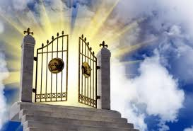
The Kingdom of God CAN Be Inherited
The kingdom is something we CAN inherit
We cannot buy our way into the kingdom.
We cannot be so morally good that God is required to give us the kingdom.
By obedience to the gospel and living righteously we become children of God, fellow heirs of Christ, & inherit Heaven – Rom. 8:17; I Pet. 1:4; II Pet. 1:5-11
Mt. 25:34
34. "Then the King will say to those on His right, 'Come, you who are blessed of My Father, inherit the kingdom prepared for you from the foundation of the world.
We must know that the kingdom of God CAN be inherited!
Notes:
Emphasis in Scripture mine

Slide 5
The Unrighteous Will NOT Inherit the Kingdom
I Cor. 6:9-10
9. Or do you not know that the unrighteous will not inherit the kingdom of God? Do not be deceived; neither fornicators, nor idolaters, nor adulterers, nor effeminate, nor homosexuals,
10. nor thieves, nor the covetous, nor drunkards, nor revilers, nor swindlers, will inherit the kingdom of God.
Satan would like to deceive people and he uses spiritual
ignorance to deceive and “blind” people to the truth!
II Cor. 4:4; 11:3; Eph. 4:17-19 (Titus 3:3)
Satan uses false doctrine to further deceive people!
II Cor. 11:15; Eph. 4:14
Notes:
Emphasis in Scripture mine

Slide 6
The Unrighteous Will NOT Inherit the Kingdom
I Cor. 6:9-10 (I John 3:4, 7-8)
9. Or do you not know that the unrighteous will not inherit the kingdom of God? Do not be deceived; neither fornicators, nor idolaters, nor adulterers, nor effeminate, nor homosexuals,
10. nor thieves, nor the covetous, nor drunkards, nor revilers, nor swindlers, will inherit the kingdom of God.
Notes:
Emphasis in Scripture mine

Slide 7
The Unrighteous Will NOT Inherit the Kingdom
Sins involving the abuse or misuse of the body (sexual immorality):
Fornication & Adultery
Gal. 5:19 (NKJ); Heb. 13:4: Deeds of the flesh & God will judge
Flee immorality! (I Cor. 6:13, 18: The body is not for immorality!)
Homosexuality & Effeminate

Slide 8
The Unrighteous Will NOT Inherit the Kingdom
Democratic presidential hopeful and current mayor of South Bend, Indiana, Pete Buttigieg (openly homosexual) to Vice President Mike Pence…
“My marriage to Chasten has made me a better man and yes, Mr. Vice President, it has moved me closer to God…I can tell you, that if me being gay was a choice, it was a choice that was made far, far above my pay grade…And that's the thing I wish the Mike Pence's of the world could understand, that if you have a problem with who I am, your problem is not with me. Your quarrel, sir, is with my creator.”
Notes:
Source:
https://www.cnn.com/2019/04/08/politics/pete-buttigieg-mike-pence/index.html
Image:
Democratic presidential hopeful and current mayor of South Bend, Indiana, Pete Buttigieg

Slide 9
The Unrighteous Will NOT Inherit the Kingdom
Mayor Pete Buttigieg
Your quarrel, sir, is with my creator.”
What do we find when we consult Mayor Pete's Creator on such matters as these?
Notes:
Source:
https://www.cnn.com/2019/04/08/politics/pete-buttigieg-mike-pence/index.html
Image:
Democratic presidential hopeful and current mayor of South Bend, Indiana, Pete Buttigieg

Slide 10
The Unrighteous Will NOT Inherit the Kingdom
Sins involving the abuse or misuse of the body (sexual immorality):
Fornication & Adultery
Gal. 5:19 (NKJ); Heb. 13:4: Deeds of the flesh & God will judge
Flee immorality! (I Cor. 6:13, 18: The body is not for immorality!)
Homosexuality & Effeminate
Rom. 1:26: Described as being “degrading” (NKJ: “vile”) and “unnatural” (NKJ: “against nature”)
Rom. 1:27: Described as “indecent acts” (NKJ: “shameful”) and “error”
Rom. 1:28: Described as being “not proper” (NKJ: “not fitting”)
Romans 1 describes same-sex practices as conduct that results from rejecting the Creator! (Rom. 1:25)

Slide 11
The Unrighteous Will NOT Inherit the Kingdom
Sins involving the abuse or misuse of the body (sexual immorality):
Fornication & Adultery
Gal. 5:19 (NKJ); Heb. 13:4: Deeds of the flesh & God will judge
Flee immorality! (I Cor. 6:13, 18: The body is not for immorality!)
Homosexuality & Effeminate
The Creator inspired the apostle Paul to write disapprovingly of same-sex situations (Effeminate is “soft” & used in a bad sense)
Thayer on “effeminate,” Gr. malakos (G3120): “Soft, soft to the touch, a boy or a man that submits to homosexual acts, male prostitute.”
Vine on “effeminate,” Gr. malakos (G3120): “Not simply of a male who practices forms of lewdness, but persons in general, who are guilty of addiction to sins of the flesh.”

Slide 12
The Unrighteous Will NOT Inherit the Kingdom
Mayor Pete Buttigieg
Your quarrel, sir, is with my creator.”
What do we find when we consult Mayor Pete's Creator on such matters as these?
God has decreed that the homosexual lifestyle is sinful – Romans 1:26-28
The one who argues in favor of homosexuality is the one who is quarreling with his Creator; it is a practice that will keep one from entering Heaven! (I Cor. 6:9)
Notes:
Source:
https://www.cnn.com/2019/04/08/politics/pete-buttigieg-mike-pence/index.html
Image:
Democratic presidential hopeful and current mayor of South Bend, Indiana, Pete Buttigieg

Slide 13
The Unrighteous Will NOT Inherit the Kingdom
Sins involving the abuse or misuse of things:
Idolatry, stealing (robbing & swindling), and covetousness/greed
Col. 3:5: Saints are to “put to death” these evil things in their lives

Slide 14
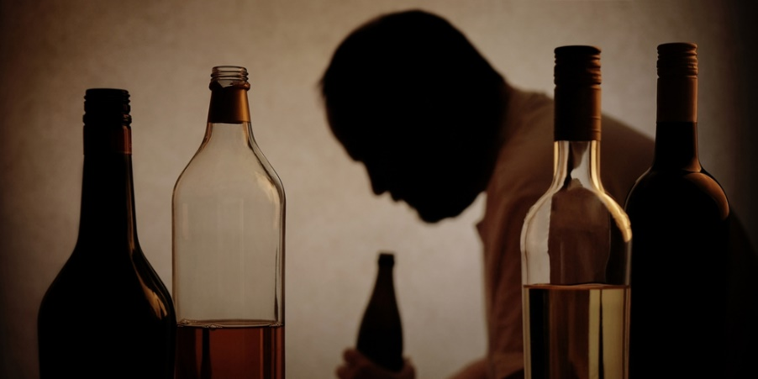
The Unrighteous Will NOT Inherit the Kingdom
Sins of lack of self-control:
Drunkenness
I Pet. 4:3-5: Saints not to engage in such behavior: drunkenness, carousing (that is late-night drinking in the streets), and drinking parties!

Slide 15
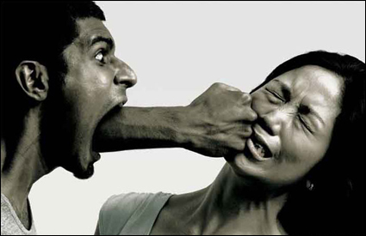
The Unrighteous Will NOT Inherit the Kingdom
Sins of lack of self-control:
Revilers
Verbal abuse at others or blasphemy against God (Gal. 5:20: Outbursts of anger listed as a deed of the flesh!)

Slide 16
The Unrighteous Will NOT Inherit the Kingdom
Gal. 5:19-21: “Now the deeds of the flesh are evident”
The deeds of the flesh and unrighteous acts CAN be known!
The world has been deceived and they teach these things are not only acceptable, but should be practiced with impunity! (Rom. 2:6-9: The unrighteous will be punished)
We must know there are some who will NOT inherit the kingdom of God!

Slide 17
“Such WERE Some of You…”
I Cor. 6:9-10
9. Or do you not know that the unrighteous will not inherit the kingdom of God? Do not be deceived; neither fornicators, nor idolaters, nor adulterers, nor effeminate, nor homosexuals,
10. nor thieves, nor the covetous, nor drunkards, nor revilers, nor swindlers, will inherit the kingdom of God.
The world teaches many of these practices are inherent (born with) and cannot be changed from!
Notes:
Emphasis in Scripture mine

Slide 18
“Such WERE Some of You…”
I Cor. 6:11
11. Such were some of you; but you were washed, but you were sanctified, but you were justified in the name of the Lord Jesus Christ and in the Spirit of our God.
Some of the Corinthians had been unrighteous, but became righteous
When Paul went to Corinth, he met people with the lowest morals.
Yet the power of Jesus Christ had changed them (Rom. 1:16-17)!
Some of the Corinthian brethren came out of these unrighteous backgrounds – we can know that we CAN change our lifestyles!
Notes:
Emphasis in Scripture mine

Slide 19
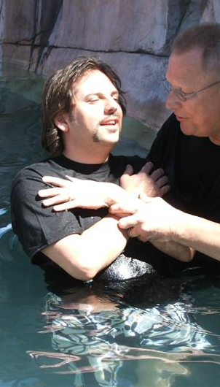
“Such WERE Some of You…”
The Corinthians had been “washed”
Acts 18:8; 22:16; Rev. 1:5 (NKJV)
The Corinthians had been “sanctified”
I Cor. 1:2
The Corinthians had been “justified”
“Justified by His grace” (Rom. 3:24; Titus 3:7)
“Justified by faith” (Rom. 5:1; Gal. 2:16)
”Justified by His blood” (Rom. 5:9)

Slide 20
“Such WERE Some of You…”
“Washed”
“Sanctified”
“Justified”
Obedience to the gospel washes, sanctifies,
and justifies us!
We must know that we CAN change from unrighteous lives to righteous lives for God!

Slide 21
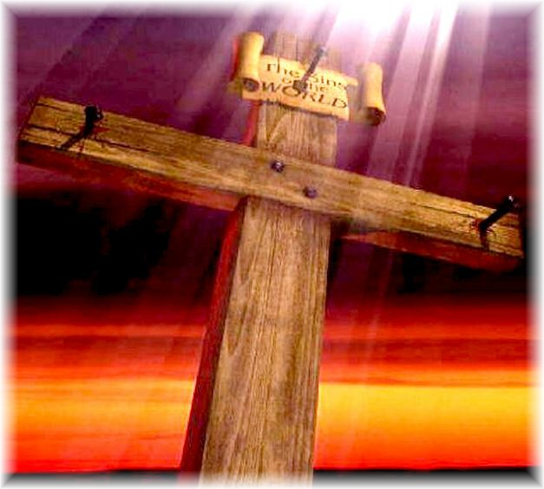
Conclusion
Paul had indeed preached a saving gospel message in
Corinth – I Cor. 15:1-3!
People who were involved in all kinds of sins, with no
hope of heaven, could now become heirs of the kingdom!
(Eph. 2:13: Those far off brought near to God by the blood of Christ)

Slide 22
Conclusion
We, like the Corinthians, must know…
One CAN inherit the kingdom of God (Col. 1:13)
One CANNOT inherit the kingdom of God while enslaved to sin (Rom. 6:16, 20, 23).
One CAN change and be washed, sanctified, and justified through the blood of Jesus in obedience to the gospel (Rom. 6:17-18, 22-23).

Slide 23
Conclusion
The gospel is the power of God (Rom. 1:16) to convert hell-bound people and make them citizens of God’s eternal kingdom!
Romans 1:16
For I am not ashamed of the gospel, for it is the power of God for salvation to everyone who believes, to the Jew first and also to the Greek.
Have you heard and obeyed the gospel?

Slide 24
“What Must I Do To Be Saved?”
Hear The Gospel (Jn. 5:24; Rom. 10:17)
Believe In Christ (Jn. 3:16-18; Jn. 8:24)
Repent Of Sins (Lk. 13:3-5; Acts 2:38)
Confess Christ (Mt. 10:32; Rom. 10:10)
Be Baptized (Mk. 16:16; Acts 22:16)
Remain Faithful (Jn. 8:31; Rev. 2:10)
For The Erring Saint:
Repent (Acts 8:22), Confess (I Jn. 1:9),
Pray (Acts 8:22)

