Slide 1
God Created Them Male & Female (Or, “The Emperor’s New Clothes” – A Cautionary Tale On Gender Confusion) Text: Gen. 1:27
God created man in His own image, in the image of God He created him; male and female He Created them.
(Gen. 1:27)
Notes:
By Nathan L Morrison
All Scripture given is from NASB unless otherwise stated
For further study or if questions, Call: 804-277-1983, or Visit: www.courthousechurchofchrist.com
Based on a lesson by Ron Halbrook

Slide 2
Intro
God created man in
His own image, in the
image of God He
created him; MALE and FEMALE He
Created them.
(Gen. 1:27)
IN THE BEGINNING!
(Mt. 19:4; Mk. 10:6)
God gives life clarity, sin brings darkness (Jn. 3:19-20)
Selfish, stubborn men question God & His word
Impact on morals: fornication, adultery, incest, polygamy, & homosexual sin

Slide 3
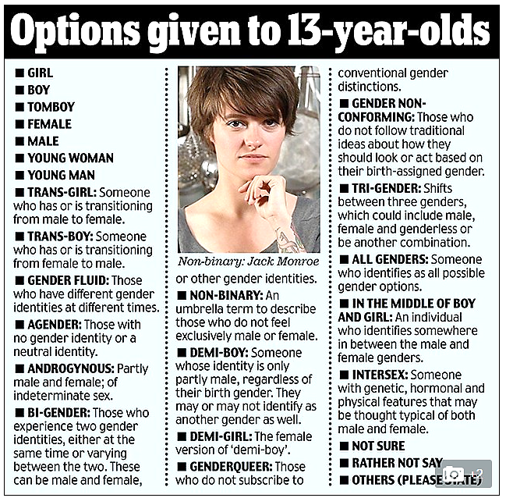
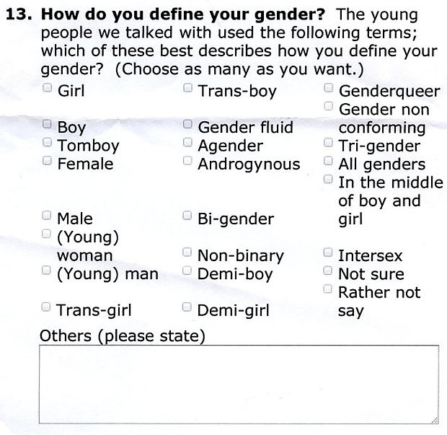
Gender Confusion
Darkness (Jn. 3:19-20) has fallen on gender identity &
roles and continues to do so!
British Children’s Commission survey for ages 13-18 offers 25 gender identities…
Notes:
Source:
British Children’s Commission Survey
(http://www.telegraph.co.uk/news/uknews/12127280/Government-asks-schoolchildren-to-define-their-gender-and-gives-them-24-options-to-choose-from.html)

Slide 4
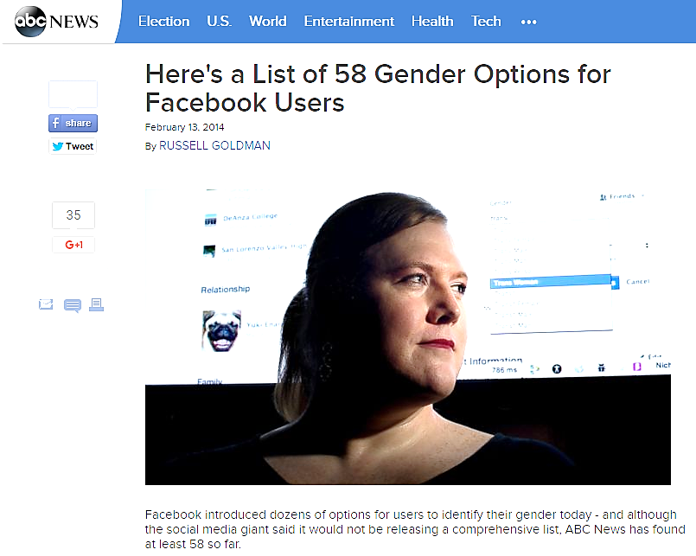
Gender Confusion
Darkness (Jn. 3:19-20) has fallen on gender identity &
roles and continues to do so!
“Here’s a List of 58
Gender Options for
Facebook Users…”
Notes:
Source:
List of 58 Gender Options for Facebook Users (http://abcnews.go.com/blogs/headlines/2014/02/heres-a-list-of-58-gender-options-for-facebook-users/)

Slide 5
Gender Confusion
Darkness (Jn. 3:19-20) has fallen on gender identity &
roles and continues to do so!
New bathroom signs reflect gender confusion!
Gender based on feelings, not biology!

Slide 6
Gender Confusion
Darkness (Jn. 3:19-20) has fallen on gender identity &
roles and continues to do so!
Many states, businesses and schools allow people to “identify” as one gender or another and use the bathroom accordingly (causes dangerous outcomes!)
Multiple stories of abuse and arrests resulting from this gender confusion!
Notes:
Sources:
Target’s Transgender Restroom Policy has Already led to Cases of ‘Peeping Toms’ (Problems since 2014) (http://www.youngcons.com/targets-transgender-restroom-policy-has-already-led-to-cases-of-peeping-toms/)
20 Stories of abuse due to Gender-Neutral Restroom Policies (http://www.breitbart.com/big-government/2016/04/23/twenty-stories-proving-targets-pro-transgender-bathroom-policy-danger-women-children/)
Man choked 8-year-old girl in women’s restroom at a Chicago restaurant (http://www.washingtontimes.com/news/2016/may/14/man-who-choked-girl-in-womens-restroom-stokes-alar/)
5 Times Transgendered men abused women and children (http://www.dailywire.com/news/5190/5-times-transgender-men-abused-women-and-children-amanda-prestigiacomo)
a. A Seattle man, citing transgender bathrooms laws, was able to gain access to a women’s locker-room at a public recreational center while little girls were changing for swim practice. (http://www.dailywire.com/news/3466/heres-infuriating-example-why-those-gender-amanda-prestigiacomo)
b. A Toronto man claiming to be transgender was arrested and sentenced to jail for sexually assaulting several women in a women’s shelter after he gained access to the shelter and its shower facilities as “Jessica.” (http://linkis.com/www.lifesitenews.com/12D80)
c. A Virginia man was caught and arrested for peeping on and filming two women and a 5-year-old child in a women’s restroom after receiving entry by dressing in drag. (http://www.dailywire.com/news/4844/transgender-advocates-say-men-dressed-women-will-amanda-prestigiacomo)
d. A Los Angeles man dressed in drag, entered a Macy’s department store bathroom and videotaped women under bathroom stalls. (http://www.dailywire.com/news/4522/man-drag-caught-macys-womens-restroom-secretly-amanda-prestigiacomo)
e. Two male students were caught at the University of Toronto exploiting “gender-neutral” facilities to peep on women in the shower with their cellphone cameras – Caused the University to “temporarily” shut down it’s policies! (http://www.dailywire.com/news/330/university-toronto-dumps-transgender-bathrooms-pardes-seleh)

Slide 7
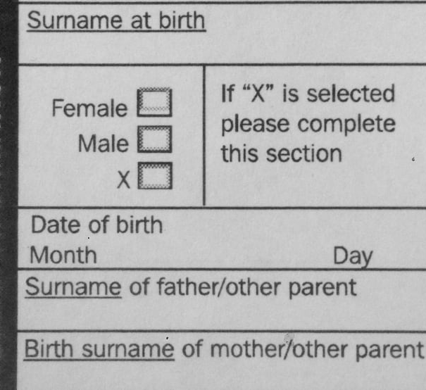
Gender Confusion
God Created Them Male & Female
Darkness (Jn. 3:19-20) has fallen on gender identity & roles and continues to do so!
Governor Jerry Brown of CA signed into law allowing birth certificates to reflect the individual’s gender-feeling as well as let doctor’s wait to identify the baby’s gender, becoming the 1st state to allow Gender-neutral Birth Certificates, Oct. 2017
As of Feb. 2019, 11 states allow Gender-neutral Birth Certificates!
Notes:
Sources:
California becomes first state to issue “Gender-neutral Birth Certificates. Gov. Jerry Brown signed bill into law, 10/17/2017: https://www.ajc.com/news/national/gender-neutral-birth-certificate-approved-california/usSoEReRk1vFa8qIRa39iI/
As of Feb. 2019, 11 states allow Gender-neutral Birth Certificates: https://www.weforum.org/agenda/2019/02/nonbinary-intersex-11-u-s-states-issuing-third-gender-ids/

Slide 8
Gender Confusion
God Created Them Male & Female
Darkness falls on gender identity & roles and causes confusion!
Alaska’s Girls’ Track All-State Honors is… a BOY! (Thailand teen boy identifies as a girl) – 2017
Same thing happening now in Connecticut schools! Girls speaking out against two male athletes always taking the top two spots in competition are being silenced and vilified!
Notes:
Sources:
Alaska’s Girls’ Track All-State Honors is a Boy (http://dailycaller.com/2016/06/03/high-school-boy-wins-all-state-honors-in-girls-track-and-field/) (http://www.dailywire.com/news/6319/dude-just-won-all-state-honors-female-track-and-amanda-prestigiacomo) (http://www.adn.com/sports/2016/05/27/at-alaska-state-track-meet-a-transgender-athlete-makes-her-mark/)
Connecticut Girl’s Track & Field: Athletes speak out against two transgender students who dominate the top two spots: https://youtu.be/NIlq85dL0C4

Slide 9
Intro
“The Emperor’s New Clothes” by Hans Christian Andersen
Vain Emperor cares about nothing except wearing & displaying clothes.
Hires two weavers (charlatans) who promise him the finest, best suit of clothes from a fabric invisible to anyone who is unfit for his position or “hopelessly stupid.”
Advisors cannot see the clothes themselves, but pretend that they can for fear of appearing unfit for their positions and the Emperor does the same.
Finally the weavers mime dressing him and the Emperor marches in procession before his subjects.
The townsfolk play along with the pretense, not wanting to appear unfit for their positions or stupid.
Then a child in the crowd, too young to understand the desirability of keeping up the pretense, blurts out that the Emperor is wearing nothing at all and the cry is taken up by others.
The Emperor suspects the assertion is true, but continues the procession.
Idiom: Something widely accepted or professed as true
due to an unwillingness of the general population to
criticize it or be seen as going against popular opinion
Notes:
Source:
The Emperor’s New Clothes by Hans Christian Andersen (1837) (HTTP://WWW.ANDERSEN.SDU.DK/VAERK/HERSHOLT/THEEMPERORSNEWCLOTHES_E.HTML)

Slide 10
Intro
The politically-correct world continues to watch and
praise the “Emperor’s New Clothes!” rather tell the truth
to people who have been allowed to be confused over
who they are!

Slide 11
God Made Gender with a Purpose
Genesis 1-2 Explains Gender Identity & Roles
Male & female: perfect plan perpetuates life (Gen. 1:27-28, 31)
No confusion: male is male, female is female (Biology matters!)
Gen. 2:18-25: Unique genders for
unique companionship (marriage)
Male designed to lead & to provide (Gen. 3:17-19; I Tim. 5:8)
Female designed to support as care-giver & mother (Titus 2:4-5)
Not male & animal! (Gen. 2:19-20)
Not female & animal! (Gen. 2:20, 24; 3:16; Lev. 18:23)
Not male & male! (Lev. 18:22; 20:13; Rom. 1:18-32)
Not female & female! (Rom. 1:18-32)
"As for you, be fruitful
and multiply;
Populate the earth
abundantly and
multiply in it"
(Gen. 9:7)
God created male
and female for each
other and to multiply
the earth!

Slide 12
Defying Gender Roles Defies God’s Purpose
Eve Defied God & Led Adam to Sin
Gen. 3:6: Eve took role of leader
Gen. 3:14-19: God punished them & emphasized their proper roles
Sodom & Gomorrah Defied God
Gen. 19:5: Burned with homosexual lust (Jude 7: “…indulged in gross immorality and went after strange flesh…”)
Gen. 19:24-25: God’s wrath burned (II Pet. 2:6: “…an example to those who would live ungodly lives thereafter”)
Law of Moses Warned against Defying God
Lev. 18:22-27: Jews warned of pagan sins & to avoid them!
Sumarian goddess Ninhursag created humans with bisexual or asexual anatomy: reflected rampant sexual perversion of sexual identity & roles
Deut. 22:5: Pagan cross-dressing sins (An Abomination to God!)
Notes:
Source:
Ninhursag, Sumerian goddess (https://en.wikipedia.org/wiki/Ninhursag) (http://oracc.museum.upenn.edu/amgg/listofdeities/mothergoddess/)

Slide 13
Defying Gender Roles Defies God’s Purpose
New Testament Issues Similar Warnings
Rom 1:26-27, 32
26. For this reason God gave them over to degrading passions; for their women exchanged the natural function for that which is unnatural,
27. and in the same way also the men abandoned the natural function of the woman and burned in their desire toward one another, men with men committing indecent acts and receiving in their own persons the due penalty of their error.
32. and although they know the ordinance of God, that those who practice such things are worthy of death, they not only do the same, but also give hearty approval to those who practice them.

Slide 14
Defying Gender Roles Defies God’s Purpose
New Testament Issues Similar Warnings
Unrighteous = Homosexuals (G733 sodomites)
I Cor. 6:9
9. Or do you not know that the unrighteous will not inherit the kingdom of God? Do not be deceived; neither fornicators, nor idolaters, nor adulterers, nor effeminate, nor homosexuals,
Unrighteous = Effeminate (G3120 “soft;” “catamite”)
CAN change – I Cor. 6:11!
God’s word on gender has been consistent in
any time period!

Slide 15
Gender Perversion Is Moral Perversion
Men Defy the Truth about God
Ps. 14:1
For the choir director.
A Psalm of David.
The fool has said in his heart, "There is no God." They are corrupt, they have committed abominable deeds; There is no one who does good.
Titus 1:16
16. They profess to know God, but by their deeds they deny Him, being detestable and disobedient and worthless for any good deed.
Notes:
Image: Gender-Neutral Birth-Certificate celebration in NY

Slide 16
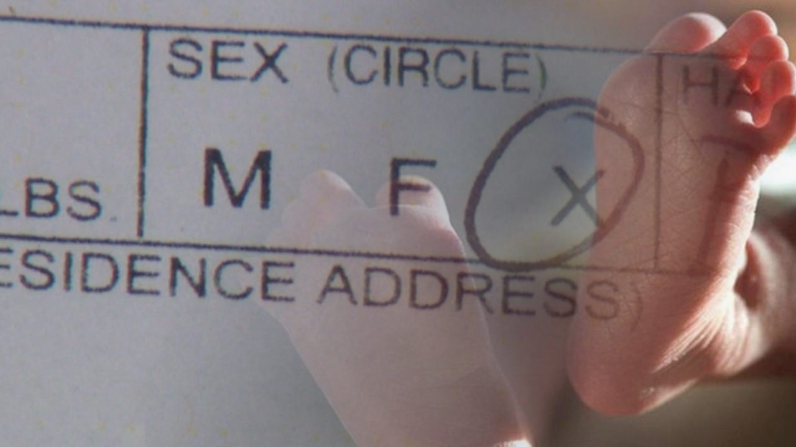
Gender Perversion Is Moral Perversion
Mankind today claim God made them deviant & accepts it
(lie of pseudo-science)
God does not make men alcoholics, adulterers, or sexual deviants – they choose to sin (Js. 1:13-15) – does not make mistakes with gender either!
IE: A woman’s brain in a man’s body, or vice versa!
Birth defects: hermaphrodite or intersex (Always comes up when talking about whether homosexuals are “born that way”) – born with characteristics of both sexes but only one reproductive capacity (biological gender!) – Rare! (Some sources say 1.7% of births!)
Solved by surgery & counseling (Has worked in times past)
Emotional imbalance: gender dysphoria or gender identity disorder – identify oneself with sex opposite to birth & anatomy (biological gender!)
Solved by counseling (Has worked in times past)

Slide 17
Gender Perversion Is Moral Perversion
Men Pervert the Truth about Love
I Jn. 5:2
By this we know that we
love the children of God,
when we love God and
observe His
commandments.
Society today claims freedom to love anyone
(or anything!)
Can love anyone as a friend: not the same as sexual love in marriage
(Heb. 13:4; cf. Mt. 19:4-5)

Slide 18
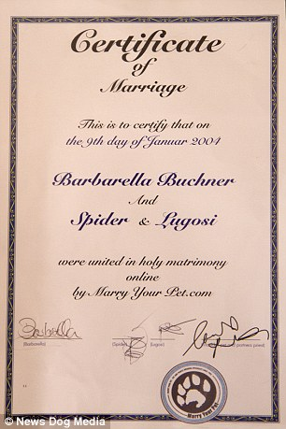
Gender Perversion Is Moral Perversion
Society today claims freedom to love anyone
(or anything!)
Can love animals: perversion to marry them like Barbarella Buchner (DailyMail.com 01/06/2015: Married two cats in 2004)
Notes:
Source:
Barbarella Buchner marries her two cats (http://www.dailymail.co.uk/femail/article-2898715/Woman-celebrating-decade-marriage-two-pet-CATS-says-never-happier-no-plans-human-husband.html)

Slide 19
Gender Perversion Is Moral Perversion
Society today claims freedom to love anyone
(or anything!)
Can love bridges: perversion to marry them like Jodi Rose (Australia) (HuffingtonPostWeirdNews 07/05/2013: Marries bridge in France)
Notes:
Source:
Jodi Rose of Australia marries 14th century bridge in France (http://www.dailymail.co.uk/news/article-2356774/Australian-woman-Jodi-Rose-marries-bridge-France--gets-mayors-blessing.html)

Slide 20
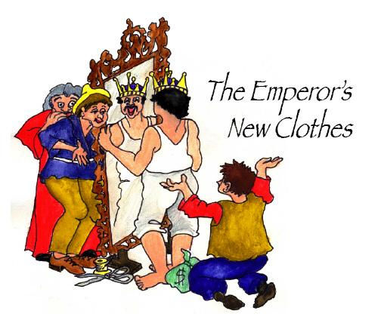
Gender Perversion Is Moral Perversion
Rather than help the confused the world stands by
applauding the delusional, as in Andersen’s
“The Emperor’s New Clothes,” and scoffs at those
who cry, “It’s not real!”

Slide 21
The Gospel Reinforces True Gender Roles
Christ Offers Salvation to All People
Gal. 3:26-28: One Savior & gospel for all (I Cor. 16:13: “Be manly” saints)
Gender Roles Serve God’s Purpose in the Home
Mt. 19:4-6: “From the beginning” God joins 1 man to 1 woman in marriage.
Eph. 5:22-23: Husband leads, wife submits (Children blessed – Eph. 6:4; Titus 2:4)
Gender Roles Serve God’s Purpose in the Church
I Tim. 2:8-15: Men lead in work & worship of church, women serve God in other ways (Rom. 16:1: Phoebe was a “servant of the church”).
I Tim. 3:1-5: Men lead as elders supported by godly wives – no female elders!
I Tim. 3:11-12: Men serve as deacons supported by godly wives – no deaconesses!

Slide 22
The Gospel Reinforces True Gender Roles
God offers clarity on gender and gender roles in His word!

Slide 23
Conclusion
IN THE BEGINNING!
(Mark 10:6)
Gen. 1:27
God created man in His own image,
in the image of God He created him;
MALE and FEMALE He created them.
Notes:
Image: Princess Bride Promo

Slide 24
Conclusion
Darkness falls on gender identity & roles and causes confusion!
The Remedy for Confusion:
Preach the gospel of Light to the Darkness! (II Cor. 4:5-6)
II Cor. 4:5-6 (I Thess. 2:4)
5. For we do not preach ourselves but Christ Jesus as Lord, and ourselves as your bond-servants for Jesus' sake.
6. For God, who said, "Light shall shine out of darkness," is the One who has shone in our hearts to give the Light of the knowledge of the glory of God in the face of Christ.

Slide 25
Conclusion
Darkness falls on gender identity & roles and causes confusion!
The Remedy for Confusion:
Obey the gospel & begin a new life in Christ with moral clarity!
Acts 22:16
'Now why do you
delay? Get up and be
baptized, and wash
away your sins,
calling on His name.'

Slide 26
“What Must I Do To Be Saved?”
Hear The Gospel (Jn. 5:24; Rom. 10:17)
Believe In Christ (Jn. 3:16-18; Jn. 8:24)
Repent Of Sins (Lk. 13:3-5; Acts 2:38)
Confess Christ (Mt. 10:32; Rom. 10:10)
Be Baptized (Mk. 16:16; Acts 22:16)
Remain Faithful (Jn. 8:31; Rev. 2:10)
For The Erring Child of God:
Repent (Acts 8:22), Confess (I Jn. 1:9),
Pray (Acts 8:22)

