Slide 1
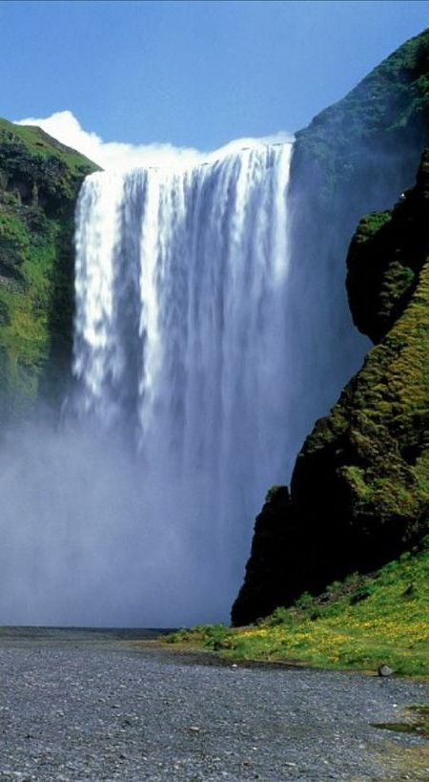
God’s Dividing Line: Water
Text: Mk. 16:16
Notes:
By Nathan L Morrison
All Scripture given is from NASB unless otherwise stated
For further study, or if questions, please Call: 804-277-1983 or Visit www.courthousechurchofchrist.com
Based on a lesson by Richard Thetford

Slide 2
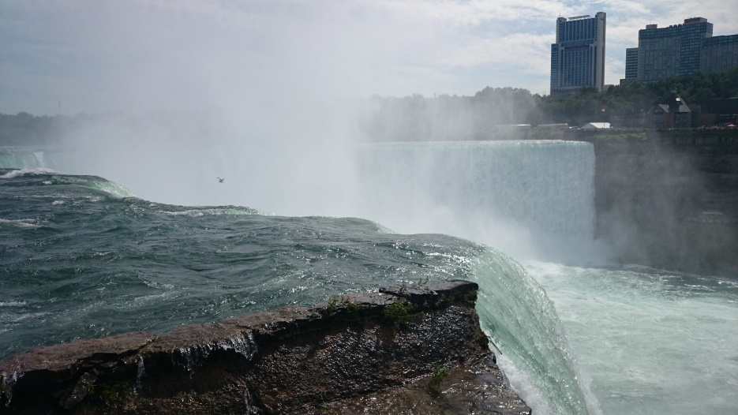
Intro
A dividing line is something that separates between two
or more things
Drawing lines in the sand:
168 BC – Roman Consul Gaius Popillius Laenas drew a line circle around King Antiochus IV (Epiphanes) of the Seleucid Empire and implied it would be war with Rome if he didn’t agree to withdraw from Egypt before stepping out of it. He agreed to withdraw!
1836 AD – Alamo: Col. Travis drew a line in the sand to see which volunteers would stay and fight to the death! All but one stepped over!
Many rivers are dividing lines:
The Niagara River is a dividing line between the USA and Canada (NY & Ontario).
The Mississippi River is the dividing line between many states.
Oceans and seas are dividing lines between nations (countries).
Notes:
Drawing A Line in the Sand: https://en.wikipedia.org/wiki/Line_in_the_sand_(phrase)
Image: Niagara River at Niagara Falls separating the US from Canada

Slide 3
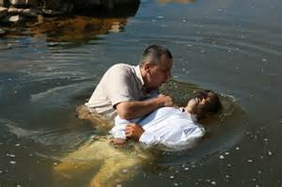
Intro
Water – Many teach that water does not have a part in
God’s redemptive plan:
Physically has been and still is used as a dividing line today!
Religiously has been the dividing line many times and still is today!
Many people will be divided from God by water,
while water also unites people with God!

Slide 4
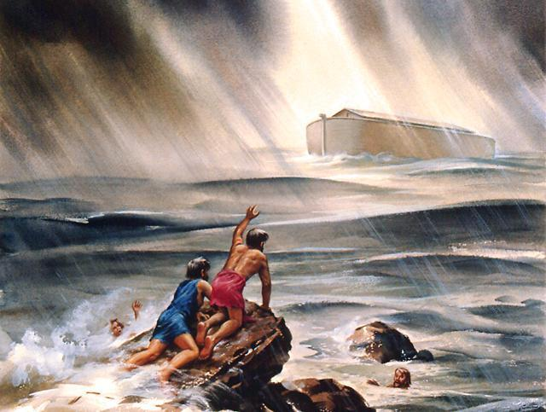
Noah – Gen. 6
Gen. 6:8: But Noah found favor in the eyes of the LORD
The old world was in bad (and sad) condition – sin reigned everywhere! (6:5-7)
God gave directions to Noah to build an ark – for a flood would destroy the world! (6:17)
NKJ: Heb. 11:7 (Gen. 6:22)
7. By faith Noah, being divinely warned of things not yet seen, moved with godly fear, prepared an ark for the saving of his household, by which he condemned the world and became heir of the righteousness which is according to faith.
Water was the dividing line between salvation and the wrath of God!
I Pet. 3:20-21

Slide 5
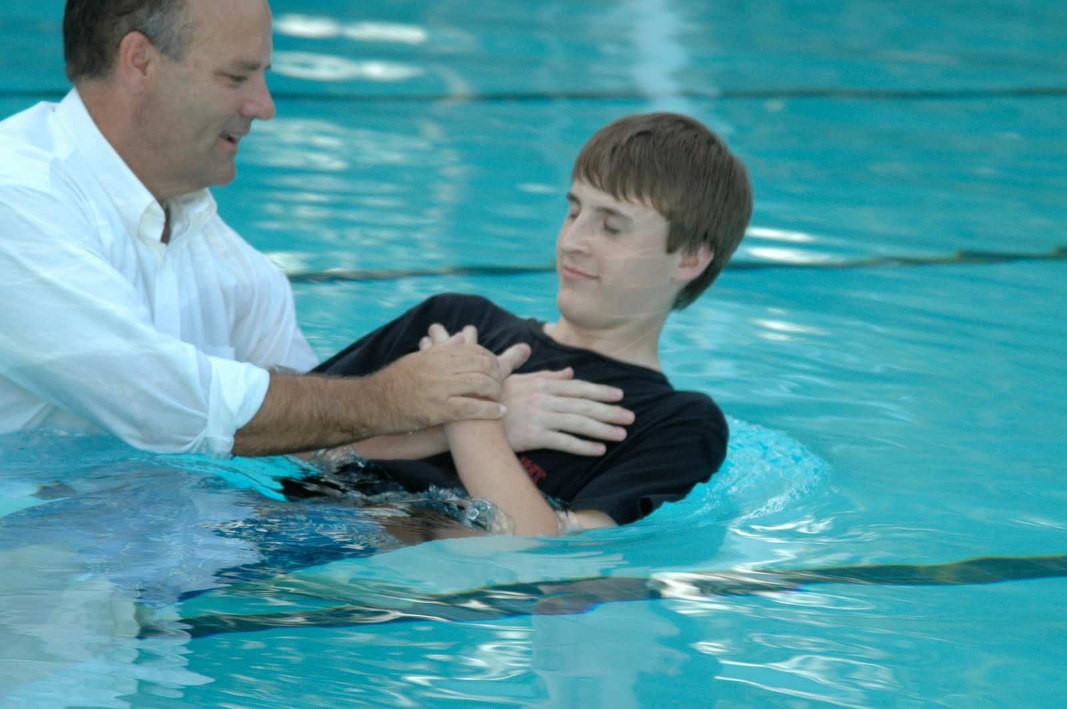
Noah – Gen. 6
Today
Saints, by obedience, die to sin & are buried with Christ & raised up to walk in newness of life in the kingdom of God’s beloved Son (Rom. 6:3-7; Col. 1:13; I Pet. 3:21)
Those obedient are rescued from the wrath of God (Rom. 5:9)!
Obediently crossing the dividing line of water rescues
the godly from the wrath of God!

Slide 6
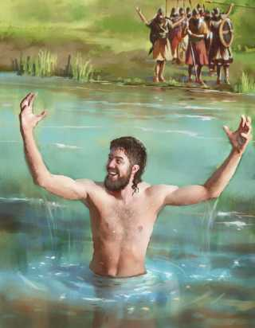
Naaman – II Kings 5
II Kings 5:10: Elisha sent a messenger to him, saying, "Go and wash in the
Jordan seven times, and your flesh will be restored to you and
you will be clean."
Naaman was the commander of the Syrian army, the enemy of Israel, but was a leper! (Incurable disease)
Commanded to dip in the Jordan River seven times to be healed
II Kings 5:14
14. So he went down and dipped himself seven times in the Jordan, according to the word of the man of God; and his flesh was restored like the flesh of a little child and he was clean.
Water was the dividing line between a
miraculous cure and remaining a leper!
II Kings 5:10, 14

Slide 7
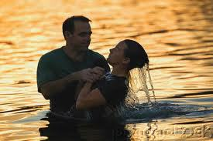
Naaman – II Kings 5
Today
Water is the dividing line between God & sin (children of Satan & the children of God)!
Sin is like leprosy; both have no cure!
Obedience to the gospel cleanses (forgives) us of sin and we rise a new creature in Christ! (Acts 22:16; Rom. 6:4; II Cor. 5:17; Col. 3:9-10).
Obediently crossing the dividing line of water cleanses
man from the lost state of sin!

Slide 8
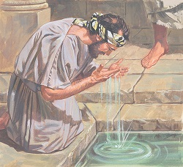
The Blind Man – Jn. 9:1-12
Jn. 9:25: He then answered, "Whether He is a sinner, I do not know; one
thing I do know, that though I was blind, now I see.
He received his sight, not when he received the clay mixture on his eyes, but when he went and washed in the Pool of Siloam as Jesus commanded him! (9:7)
Jn. 9:7
7. and said to him, "Go, wash in the pool of Siloam" (which is translated, Sent). So he went away and washed, and came back seeing.
Water was the dividing line between sight and remaining
blind! (Darkness and light!)
Jn. 9:7

Slide 9
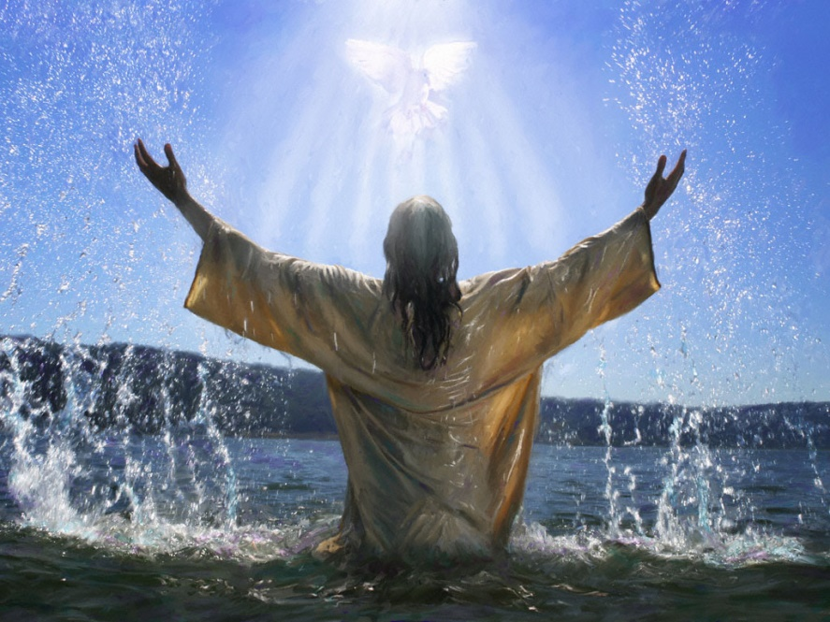
The Blind Man – Jn. 9:1-12
Today
We were once groping in darkness, but are now children of light when we respond to and obey the gospel of Christ! (Eph. 5:8-11).
Water is the dividing line between darkness and light! (Jn. 3:19; 8:12)
Obedience to the gospel puts one in the light, out of the darkness of the world (I Pet. 2:9).
Obediently crossing the dividing line of water grants light to those dwelling in darkness!

Slide 10
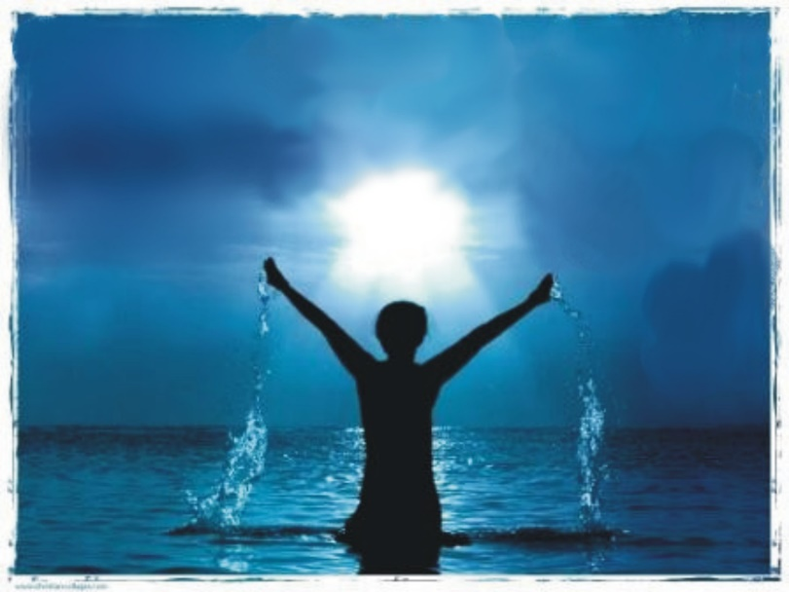
Every Sinner – Mk. 16:16
Mk. 16:16: "He who has believed and has been baptized shall be saved; but
he who has disbelieved shall be condemned.
To be saved, all men need to cross the dividing line of water from the kingdom of darkness to the kingdom of God’s Son into marvelous light (Col. 1:13; I Pet. 2:9)
Water is the dividing
line between being a
child of God and
remaining a child of
Satan!
It wasn’t the water
that cured Naaman or
the blind man but their
obedience:
Washing in any other body of water than what God said wouldn’t have done it!

Slide 11
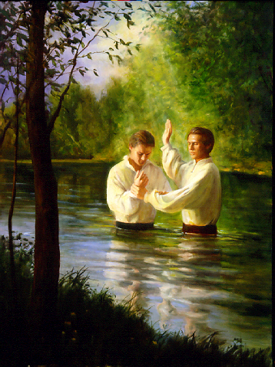
Every Sinner – Mk. 16:16
Today
The waters of baptism serve as a dividing line between the saved and lost!
Eph. 1:7
7. In Him we have redemption through His blood, the forgiveness of our trespasses, according to the riches of His grace
HOW?
Obedience to the
Gospel!
Mk. 16:16
Acts 2:38; 22:16
Rom. 6:3
Gal. 3:27
To be saved one must:
Hear (Rom. 10:17)
Believe (Heb. 11:6)
Repent (Acts 2:38)
Confess Christ (Acts 8:37)
Be baptized (Acts 22:16)
Obediently crossing the dividing line of water saves
one’s soul from an eternity in Hell!

Slide 12
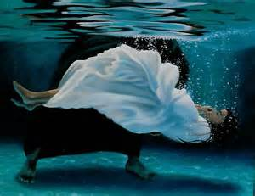
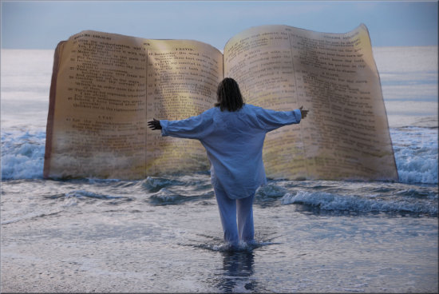
Conclusion
Many people may say that baptism isn’t important, that it
does not save us from our sins!
God’s word shows water has been used as a dividing line
before, and is still a dividing line today!
One must cross the watery dividing line in obedience to God’s word to be saved!

Slide 13
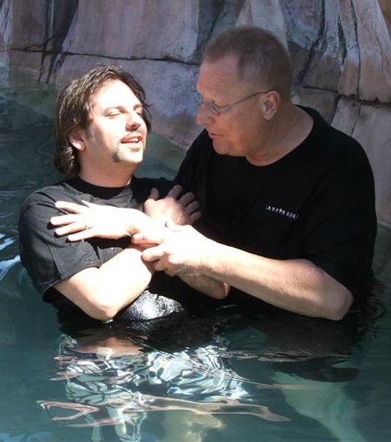
Conclusion
Mt. 11:28-30 (Mk. 16:16)
28. "Come to Me, all who are weary and heavy-laden, and I will give you rest.
29. "Take My yoke upon you and learn from Me, for I am gentle and humble in heart, and YOU WILL FIND REST FOR YOUR SOULS.
30. "For My yoke is easy and My burden is light."
Baptism is God’s dividing
line between being saved
and remaining lost –
Have you crossed over?

Slide 14
“What Must I Do To Be Saved?”
Hear The Gospel (Jn. 5:24; Rom. 10:17)
Believe In Christ (Jn. 3:16-18; Jn. 8:24)
Repent Of Sins (Lk. 13:35; Acts 2:38)
Confess Christ (Mt. 10:32; Rom. 10:10)
Be Baptized (Mk. 16:16; Acts 22:16)
Remain Faithful (Jn. 8:31; Rev. 2:10)
For The Erring Child of God:
Repent (Acts 8:22), Confess (I Jn. 1:9),
Pray (Acts 8:22)

