Slide 1
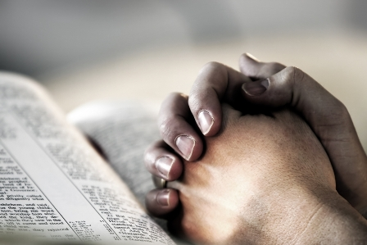
True Disciples Of Jesus
Text: Luke 9:23; 14:27; John 8:31-32
Notes:
By Nathan L Morrison
All Scripture given is from NASB unless otherwise stated
For further study, or if questions, please Call: 804-277-1983 or Visit www.courthousechurchofchrist.com
From A Christian Is… Workbook by Mike Willis & Portraits of Discipleship by Heath Rogers

Slide 2
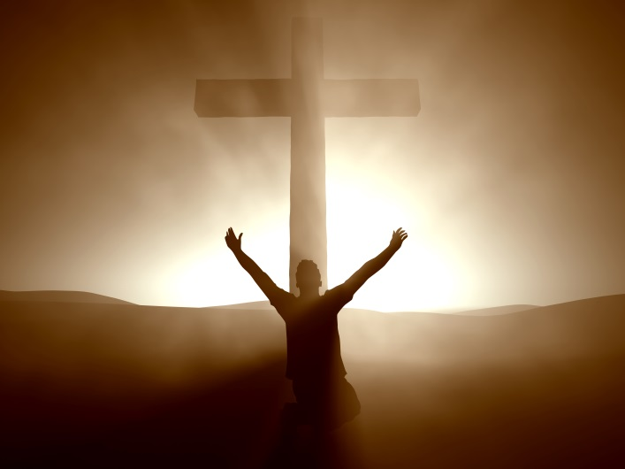
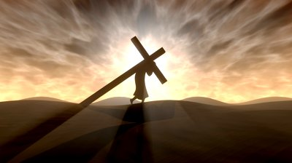
Intro
Christians (“Followers of Christ”)
are Disciples!
Lk. 9:23
23. And He was saying to them all, "If anyone wishes to come after Me, he must deny himself, and take up his cross daily and follow Me.
Lk. 14:27
27. "Whoever does not carry his own cross and come after Me cannot be My disciple.

Slide 3
Intro
What is a “Disciple?”
“Disciple”: Greek word mathetes [math-ay-tes' ] (Strong’s G3101): “a learner or pupil.”
“From manthano (G3129), ‘to learn,’ from a root math —, indicating thought accompanied by endeavor. A ‘disciple’ was not only a pupil, but an adherent; hence they are spoken of as imitators of their teacher; Jn. 8:31; Jn. 15:8” (Vine’s NT).
The disciple accepts the views of his teacher and adopts his teacher’s way of life (Mt. 10:24-25; I Cor. 11:1; Eph. 5:1)
Jesus is not the only person in the Bible who had disciples
John the Baptist had disciples (Mt. 9:14; 11:2-3)
The Pharisees had disciples (Mt. 22:16)
Some of the Jews claimed to be disciples of Moses (Jn. 9:28)
As Christians, we need to be sure that we are
disciples of Jesus Christ!

Slide 4
Conditions of Discipleship
Jesus has many followers, but He makes it clear that not
everyone who follows Him is a true disciple…
Lk. 14:26, 33 (Acts 4:34-37)
26. "If anyone comes to Me, and does not hate his own father and mother and wife and children and brothers and sisters, yes, and even his own life, he cannot be My disciple.
33. "So then, none of you can be My disciple who does not give up all his own possessions.
Jn. 8:31-32
31. So Jesus was saying to those Jews who had believed Him, "If you continue in My word, then you are truly disciples of Mine;
32. and you will know the truth, and the truth will make you free."

Slide 5
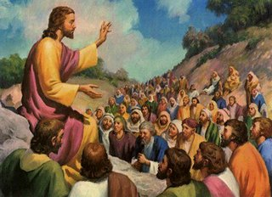
Conditions of Discipleship
Only those who meet certain conditions or requirements
are recognized by the Lord as being His true disciples
What are these conditions?
How can we know if we are truly disciples of Jesus?

Slide 6
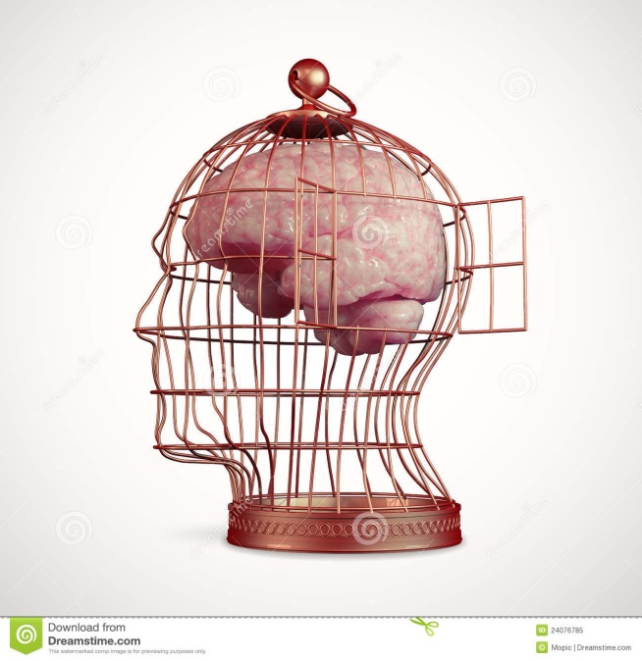
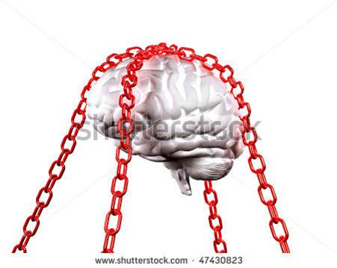
What are the Demands of Discipleship?
Lk. 9:23
23. And He was saying to them all, "If anyone wishes to come after Me, he must deny himself, and take up his cross daily and follow Me.
We Must Deny Self
Gal. 5:22-23; II Pet. 1:6: Self-denial is an important quality to have!
Denying self is accomplished when we put the will of Christ in the place of self (Gal. 2:20).
II Cor. 5:9: To be a true disciple of Christ, one must always choose to do those things that please Him, not ourselves.
Lk. 14:26-27; Mt. 10:37: No one is to come between us and our loyalty to Christ, including ourselves!
Notes:
Images courtesy of: Shutterstock.com

Slide 7
What are the Demands of Discipleship?
Lk. 9:23
23. And He was saying to them all, "If anyone wishes to come after Me, he must deny himself, and take up his cross daily and follow Me.
We Must Be Willing To Suffer For Christ
Many people have shown their misunderstanding of this statement by carrying around large, wooden crosses!
This is not what the Lord meant by this statement!
The cross was not a religious symbol when Jesus spoke these words – but a feared instrument of death!
Jesus was up front with those who desired to be His disciples (Mt. 10:22) – a path that led to persecution and death!
Unless we are willing to walk the path He walked, and bear the suffering that comes with it (II Tim. 3:12), we
cannot be His disciples!

Slide 8
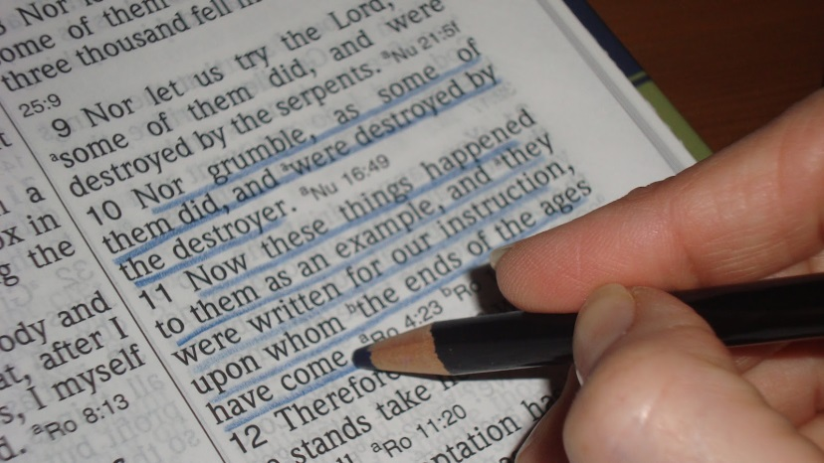
What are the Demands of Discipleship?
Mt. 11:29
29. "Take My yoke upon you and LEARN FROM ME, for I am gentle and humble in heart, and YOU WILL FIND REST FOR YOUR SOULS.
We Must Learn From Christ
Continue/Abide in His word! (Jn. 8:31; II Tim. 2:15)
Mt. 28:19-20: Jesus sent His apostles out to “make disciples of all the nations…teaching them…”
Lk. 6:46: Jesus said, “Why do you call Me, 'Lord, Lord,' and do not do what I say?”
The way we follow Christ today is by following His teachings!
To truly be a disciple of Christ one must follow His word!

Slide 9
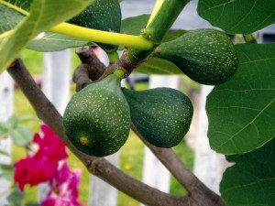
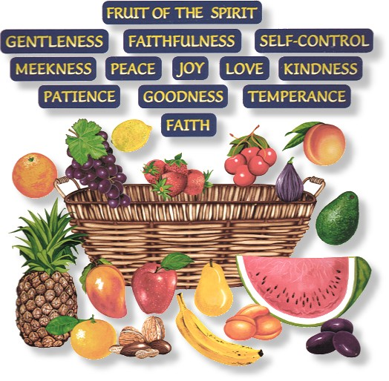
What are the Demands of Discipleship?
Jn. 15:8
8. "My Father is glorified by this, that you bear much fruit, and so prove to be My disciples.
We Must Bear Fruit
The production of this fruit is proof we are the Lord’s disciples. Without the fruit, there is no proof of discipleship and the Lord removes us and burns us in the fire! – Jn. 15:4-6)
What is this fruit we are to produce?
Continued spiritual growth (II Pet. 1:5-8; 3:18), good deeds (Mt. 25:34-46, Eph. 2:10), and living godly lives (Gal. 5:22-23; Phil. 2:15; Titus 2:11-14).

Slide 10
What are the Demands of Discipleship?
Jn. 13:34-35
34. "A new commandment I give to you, that you love one another, even as I have loved you, that you also love one another.
35. "By this all men will know that you are My disciples, if you have love for one another."
We Must Love Our Brethren
John 13:34-35; 15:12: Love as Jesus loved (Selflessly, sacrificially!)
Col. 3:12-14: Disciples of Jesus are to “put on” His traits (character attributes) of love & forgiveness!
I Jn. 4:12, 20-21; I Pet. 1:22; 4:8-9: “Fervently” love one another!
Gal. 5:14-15: Hard to love fervently if biting and devouring one another!

Slide 11
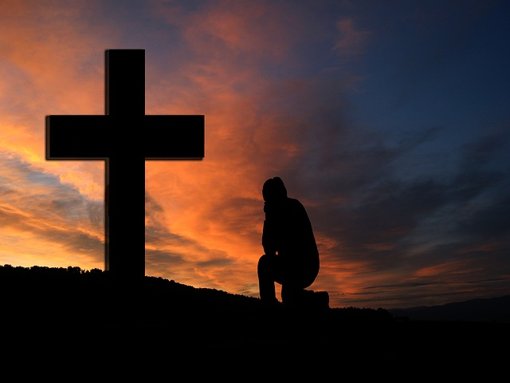
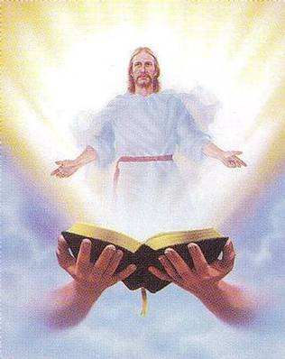
What are the Demands of Discipleship?
Lk. 9:23 (Lk. 14:27)
23. And He was saying to them all, "If anyone wishes to come after Me, he must deny himself, and take up his cross daily and follow Me.
We Must Be Committed To Following Christ
“Follow Me” is a daily commitment!
Being a disciple is not something we do once and it is taken care of for the rest of our life.
We are to count the cost before becoming a disciple (Luke 14:28).
Once we have made this decision, we are not to look back, but keep moving forward (Lk. 9:62)!
It is a lifetime commitment to be “Christ-like!” (Mt. 10:25; I Cor. 11:1)

Slide 12
What are the Demands of Discipleship?
We Must Deny Self
We Must Be Willing To Suffer For Christ
We Must Learn From Christ
We Must Bear Fruit
We Must Love Our Brethren
We Must Be Committed To
Following Christ
There are responsibilities in being a disciple of Christ!

Slide 13
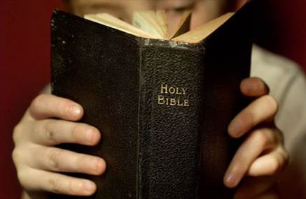
Conclusion
Are we really disciples of Jesus?
Have we put Him first in our lives, and committed
ourselves to following His teachings until the end?
II Tim. 4:6-8; Rev. 2:10: The finish line for our faith is death! (or His return – I Thess. 4:16-18)
The commitment is great, the hours long, and the
persecution can make one weary, but the reward is great
(outweighs any sacrifice one must make - Rom. 8:18)
Mt. 10:42; Lk. 6:23, 35; Col. 3:23-24; Heb. 10:35; II Jn. 1:8; Rev. 11:18; 22:12: No matter what we suffer in this life, if we are faithful, we will receive the great reward of eternal life in Heaven! (Rev. 2:10)

Slide 14
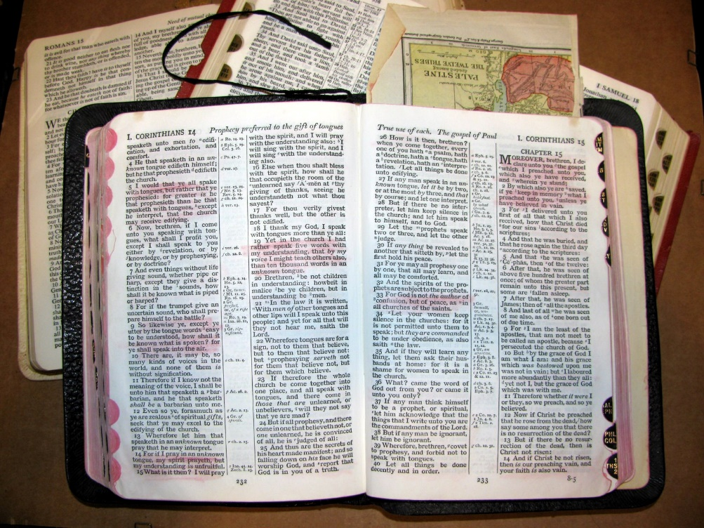
Conclusion
Let us be true disciples of Jesus
and take up our crosses
daily and follow Him!

Slide 15
“What Must I Do To Be Saved?”
Hear The Gospel (Jn. 5:24; Rom. 10:17)
Believe In Christ (Jn. 3:16-18; Jn. 8:24)
Repent Of Sins (Lk. 13:35; Acts 2:38)
Confess Christ (Mt. 10:32; Rom. 10:10)
Be Baptized (Mk. 16:16; Acts 22:16)
Remain Faithful (Jn. 8:31; Rev. 2:10)
For The Erring Child:
Repent (Acts 8:22), Confess (I Jn. 1:9),
Pray (Acts 8:22)

