Slide 1
Good News!
Text: I Cor. 15:1-11
Notes:
By Nathan L Morrison
All Scripture given is from NASB unless otherwise stated
For further study, or if questions, please Call: 804-277-1983 or Visit www.courthousechurchofchrist.com

Slide 2
Intro
I Cor. 15:1-11 (vss. 1-6)
1. Now I make known to you, brethren, the gospel which I preached to you, which also you received, in which also you stand,
2. by which also you are saved, if you hold fast the word which I preached to you, unless you believed in vain.
3. For I delivered to you as of first importance what I also received, that Christ died for our sins according to the Scriptures,
4. and that He was buried, and that He was raised on the third day according to the Scriptures,
5. and that He appeared to Cephas, then to the twelve.
6. After that He appeared to more than five hundred brethren at one time, most of whom remain until now, but some have fallen asleep;
Luke 24:13-27: Jesus is Alive!

Slide 3
Intro
I Cor. 15:1-11 (vss. 7-11)
7. then He appeared to James, then to all the apostles;
8. and last of all, as to one untimely born, He appeared to me also.
9. For I am the least of the apostles, and not fit to be called an apostle, because I persecuted the church of God.
10. But by the grace of God I am what I am, and His grace toward me did not prove vain; but I labored even more than all of them, yet not I, but the grace of God with me.
11. Whether then it was I or they, so we preach and so you believed.
Luke 24:13-27: Jesus is Alive!

Slide 4
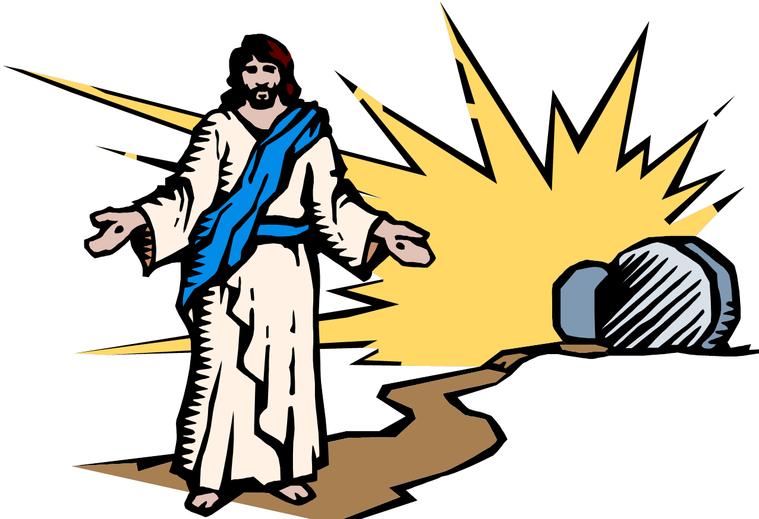
Intro
I Cor. 15:13-19
13. But if there is no resurrection of the dead, not even Christ has been raised;
14. and if Christ has not been raised, then our preaching is vain, your faith also is vain.
15. Moreover we are even found to be false witnesses of God, because we testified against God that He raised Christ, whom He did not raise, if in fact the dead are not raised.
16. For if the dead are not raised, not even Christ has been raised;
17. and if Christ has not been raised, your faith is worthless; you are still in your sins.
18. Then those also who have fallen asleep in Christ have perished.
19. If we have hoped in Christ in this life only, we are of all men most to be pitied.
Christ died and then arose!
The good news that brings salvation to all men!

Slide 5
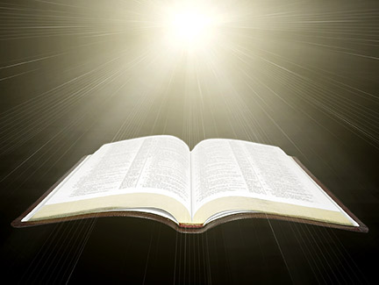
I Cor. 15:1
I Cor. 15:1: Now I make known to you, brethren, the gospel which I preached to you, which
also you received, in which also you stand,
15:1
Paul reminds them they heard the gospel from him and they stand in it!
Gal. 1:11-12
11. For I would have you know, brethren, that the gospel which was preached by me is not according to man.
12. For I neither received it from man, nor was I taught it, but I received it through a revelation of Jesus Christ.

Slide 6
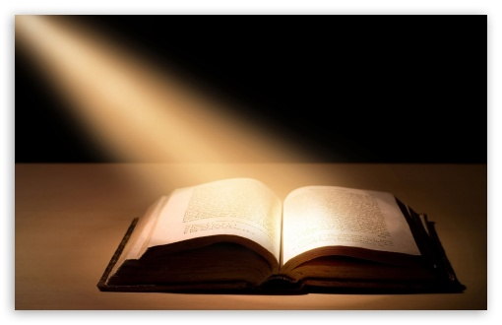
I Cor. 15:2
I Cor. 15:2: by which also you are saved, if you hold fast the word which I preached to you,
unless you believed in vain.
15:2
The gospel saves! (Rom. 1:16; I Pet. 1:23)
Jesus said, “I am the way, the truth, and the life. No one comes to the Father except through Me.” (Jn. 14:6)
One must hold fast the word of God – if not, then faith is in vain.
Paul was getting the Corinthians to agree that:
They had believed the gospel preached to them (15:1).
They were standing firm in their faith (15:1).
They were saved by it, IF they held fast!

Slide 7
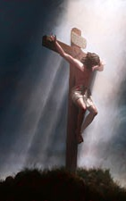
I Cor. 15:3
I Cor. 15:3: For I delivered to you as of first importance what I also received, that Christ died for
our sins according to the Scriptures,
15:3
Christ died for our sins ACCORDING to the Scriptures (Not by accident – Acts 2:23)
Paul explains the difference of the gospel from the Jewish expectation:
The Jews expected (wanted) the Messiah to establish an earthly, physical kingdom. (Acts 1:6; Jn. 18:36)
The Scriptures never taught that, instead they taught a “suffering Savior.” (Is. 53:11-12; Acts 3:18)
Jesus and the apostles taught that the Scriptures pointed to His death
(Lk. 24:44-46; I Pet. 1:10-12)

Slide 8
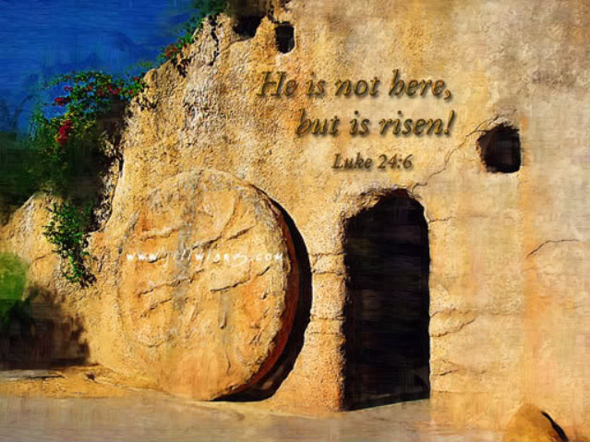
I Cor. 15:4
I Cor. 15:4: and that He was buried, and that He was raised on the third day according to the
Scriptures,
15:4
He was buried and rose on the third day ACCORDING to the Scriptures.
Ps. 16:10; Mt. 12:40; Lk. 24:4-7, 44-46
Paul is strengthening their faith by stating these events were foretold in the Scriptures, and were revealed to him by Christ (I Cor. 15:3; Gal. 1:12).
“Death cannot keep his prey”: The tomb was found empty! Christ Arose!
(Heb. 2:14-15)

Slide 9
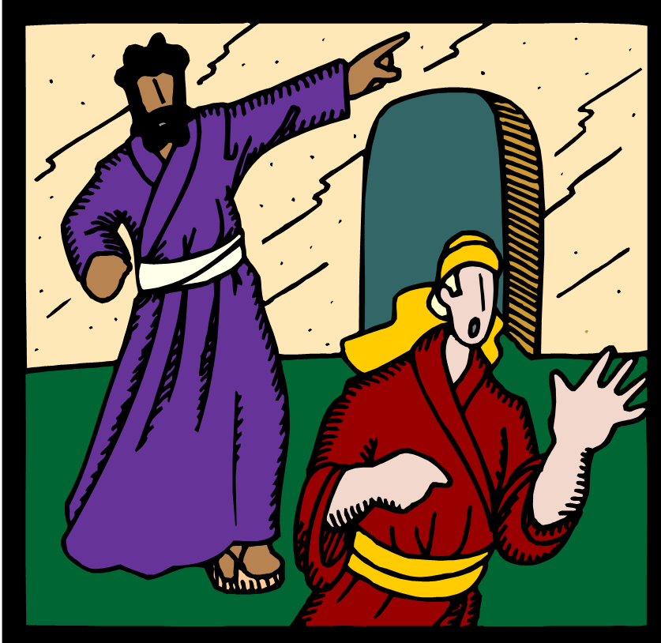
I Cor. 15:5
I Cor. 15:5: and that He appeared to Cephas, then to the twelve.
15:5
Seen by Cephas (Peter) and the twelve – Lk. 24:34-40.
Mt. 28:7-10: An angel told the women to tell the disciples He was raised from the dead, and will meet them in Galilee.
Mt. 28:16: Jesus met the apostles in Galilee just as he had instructed them to go.
Acts 1:3: Jesus appeared to them over a period of 40 days!

Slide 10
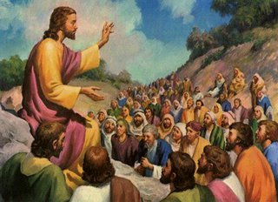
I Cor. 15:6
I Cor. 15:6: After that He appeared to more than five hundred brethren at one time, most of
whom remain until now, but some have fallen asleep;
15:6
He was seen by over five hundred brethren at once!
At the time of Paul’s writing, many of them were still alive
(could be verified)!

Slide 11
I Cor. 15:7
I Cor. 15:7: then He appeared to James, then to all the apostles;
15:7
This is James, the Lord’s brother – Gal. 1:18-19
Before His suffering and death, His brothers didn’t believe in Him – Jn. 7:5
Acts 1:12-14
12. Then they returned to Jerusalem from the mount called Olivet, which is near Jerusalem, a Sabbath day's journey away.
13. When they had entered the city, they went up to the upper room where they were staying; that is, Peter and John and James and Andrew, Philip and Thomas, Bartholomew and Matthew, James the son of Alphaeus, and Simon the Zealot, and Judas the son of James.
14. These all with one mind were continually devoting themselves to prayer, along with the women, and Mary the mother of Jesus, and with His brothers.
James was a strong believer and pillar in the church at Jerusalem (Acts 15; Gal. 2:9) & wrote the book of James, and his brother Jude (Mt. 13:55) wrote Jude.
Notes:
Emphasis in Scripture mine

Slide 12
I Cor. 15:8-9
8. and last of all, as to one untimely born, He appeared to me also.
For I am the least of the apostles, and not fit to be called an apostle, because I persecuted
the church of God.
15:8-9
Seen by the apostle Paul (Acts 9:3-6)
“The least of the apostles.”
Because he persecuted the church (Acts 22:4).
He was comparing his past with the other apostles.
The other apostles had been with Jesus during His ministry and witnessed many miracles! (Acts 1:21-22)
Paul had done what he could to destroy Christianity:
Held garments of those stoning Stephen (Acts 7:58).
Consented Stephen’s execution (Acts 8:1).
Imprisoned saints and voted for them to be put to death (Acts 26:10).
Persecuted them to foreign cities & forced them to blaspheme (Acts 26:11).
I Tim. 1:15 (Gospel saved him – Gal. 1:22-24)
15. It is a trustworthy statement, deserving full acceptance, that Christ Jesus came into the world to save sinners, among whom I am foremost of all.

Slide 13
I Cor. 15:10-11
10. But by the grace of God I am what I am, and His grace toward me did not prove vain; but I labored even more than all of them, yet not I, but the grace of God with me.
11. Whether then it was I or they, so we preach and so you believed.
15:10-11
God’s grace was NOT in vain!
He recognized where he had been and, by the grace of God and the saving power of the gospel, where he wanted to be!
II Tim. 4:6-8
6. For I am already being poured out as a drink offering, and the time of my departure has come.
7. I have fought the good fight, I have finished the course, I have kept the faith;
8. in the future there is laid up for me the crown of righteousness, which the Lord, the righteous Judge, will award to me on that day; and not only to me, but also to all who have loved His appearing.

Slide 14
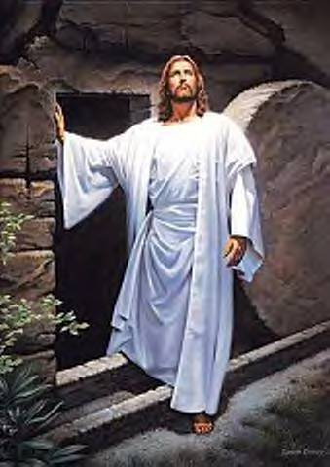
I Cor. 15:1-11
Our faith can be strengthened by the
message the Corinthians heard:
Christ has risen for you and for me!

Slide 15
Conclusion
Paul was trying to get the Corinthians to see that the
bodily resurrection of Jesus was the foundation of the
gospel – it IS the good news!
(I Cor. 15:20: Christ has risen! – Simplicity of the gospel: II Cor. 11:3)
He rose from the dead to break its power so you and I
might have life eternal!
Rom. 6:8-10: Christ overcame death and lives forever with God.
What should this prompt us to do in return?
Rom. 6:11-12: Die to sin and live for Christ!

Slide 16
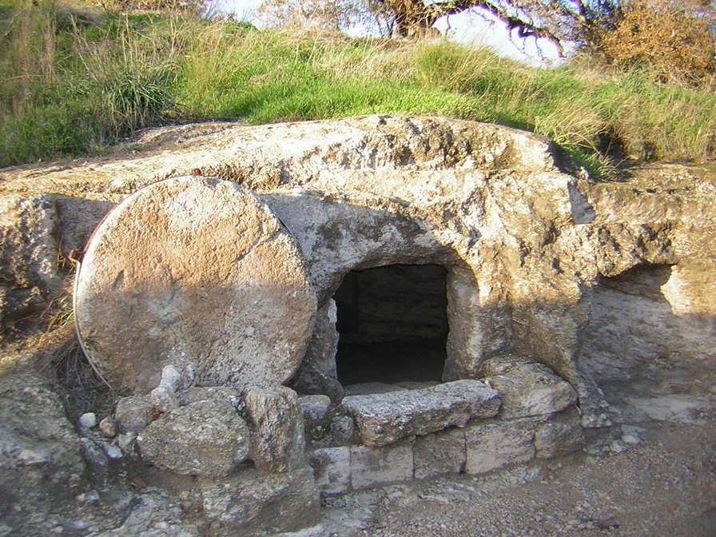
Conclusion
Like Paul let us labor for the goal, so that God’s grace is
not in vain in our lives! (I Cor. 15:10; II Tim. 4:6-8)
The good news of the gospel is that Christ arose!
That gospel cornerstone should strengthen our faith and
resolve to obey Him!

Slide 17
“What Must I Do To Be Saved?”
Hear The Gospel (Jn. 5:24; Rom. 10:17)
Believe In Christ (Jn. 3:16-18; Jn. 8:24)
Repent Of Sins (Lk. 13:35; Acts 2:38)
Confess Christ (Mt. 10:32; Rom. 10:10)
Be Baptized (Mk. 16:16; Acts 22:16)
Remain Faithful (Jn. 8:31; Rev. 2:10)
For The Erring Child of God:
Repent (Acts 8:22), Confess (I Jn. 1:9),
Pray (Acts 8:22)

