Slide 1
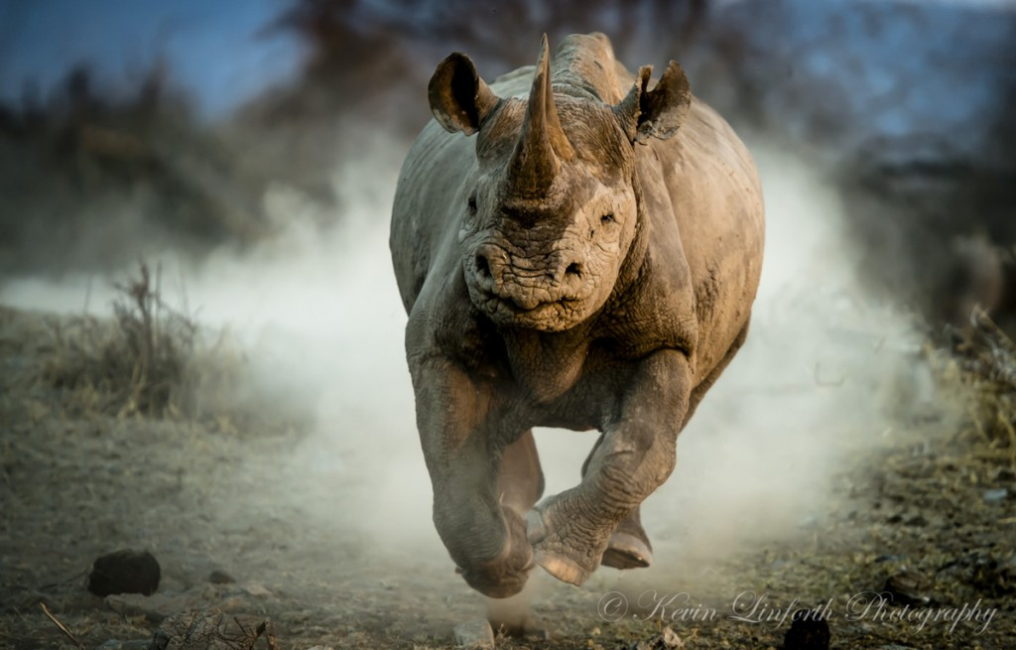
Rhino Christians!
Text: Hebrews 10:35-39
Notes:
By Nathan L Morrison
All Scripture given is from NASB unless otherwise stated
For further study, or if questions, please Call: 804-277-1983 or Visit www.courthousechurchofchrist.com
Hymn, “Stepping In The Light” By Eliza Edmunds Hewitt

Slide 2
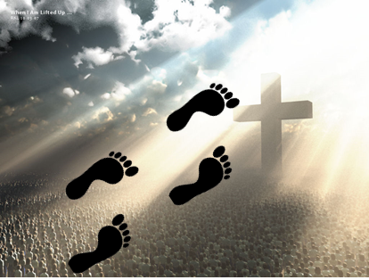
Intro
Becoming Christians, we take on the name of Christ, and
are to “put on the Lord!”
Gal. 3:27; Rom. 13:14: Once baptized into Christ, need to be clothed with Christ!
I Pet. 2:21; I Jn. 1:6-7: Once a child of God, must “walk in the light,” that is to walk in the steps of the Savior, Who is our perfect example.
I John 1:6-7
6. If we say that we have fellowship with Him and yet walk in the darkness, we lie and do not practice the truth;
7. but if we walk in the Light as He Himself is in the Light, we have fellowship with one another, and the blood of Jesus His Son cleanses us from all sin.
To “walk in the steps of the Savior,”
is to be “led in paths of light!”
Notes:
(From Hymn, Stepping In The Light, 1890, by Eliza E. Hewitt, 1851-1920)

Slide 3
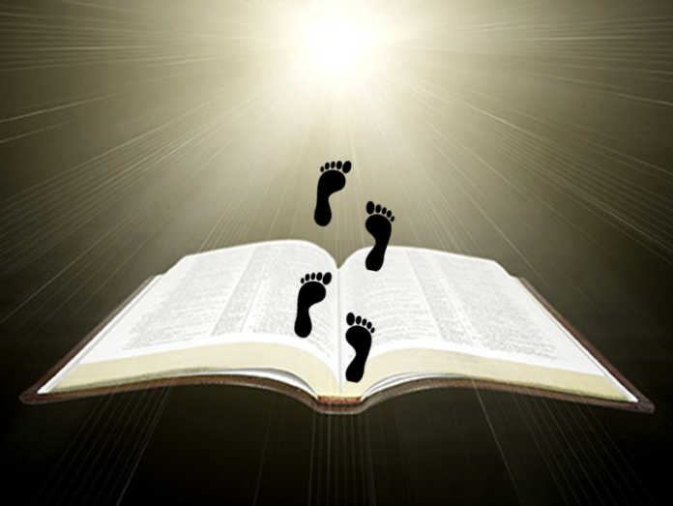
Knowledge of God’s Word
Titus 2:9-10
9. Urge bondslaves to be subject to their own masters in everything, to be well-pleasing, not argumentative,
10. not pilfering, but showing all good faith so that they will adorn the doctrine of God our Savior in every respect.
Jesus knew the word of God! (Lk. 2:41-52)
Mt. 4:1-10: The Battle of Lions: Lion of Judah (Rev. 5:5) vs. The Roaring Lion (I Pet. 5:8)
We must know the Scriptures well to battle Satan
II Tim. 2:15: (KJV) “Study to show yourself approved to God…”
Ps. 119:105: God’s word a path of light!
To overcome temptations (I Cor. 10:13)
we must know God’s word and
draw from its strength!

Slide 4
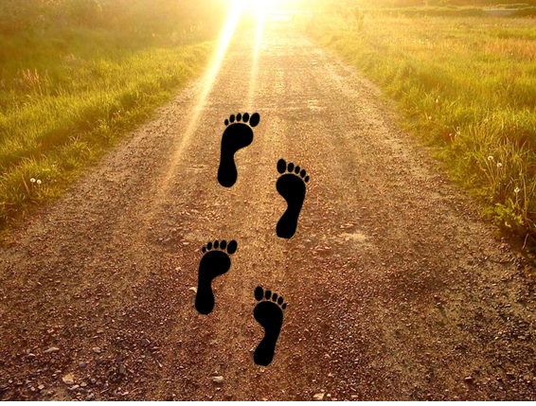
Humility
I Peter 5:5
5. You younger men, likewise, be subject to your elders; and all of you, clothe yourselves with humility toward one another, for GOD IS OPPOSED TO THE PROUD, BUT GIVES GRACE TO THE HUMBLE.
Jesus spoke of the Father’s will to be done, not His own
Mt. 26:39, 42: He prayed, “…not My will, but Yours be done.”
Jn. 6:38-40: Jesus came to earth to do His Father’s will.
Phil. 2:5-11: His humility led to obedience, which led to His exaltation!
Saints must be humble! (I Pet. 5:5)
Col. 1:18: Christ is the Head of the church (Eph. 5:22-33).
Christ is our example (Jn. 13:16: The slave is not greater than the master).
We are to seek after God’s will above
our own! (Mt. 6:33)

Slide 5
Loved Others
Colossians 3:12
12. So, as those who have been chosen of God, holy and beloved, put on a heart of compassion, kindness, humility, gentleness and patience;
Christ had a compassionate heart
Mt. 20:30-34: Moved by compassion to give sight to two blind men.
Jn. 11:30-44: Moved by compassion to weep and grieve for Lazarus.
Jn. 3:16: God so loved the world He gave His Son for the sins of the world
We are to have the love & compassion of Christ
(Col. 3:12-15)
Jn. 13:34-35: By our love we are to be known as His followers.
Jn. 15:12-13: “Greater love has no one than this, that he lay down his life for his friends.”
The world is to know us by our love & forgiveness for each other!

Slide 6
Corrected Error
II Timothy 2:25
25. with gentleness correcting those who are in opposition, if perhaps God may grant them repentance leading to the knowledge of the truth,
Jesus was angry but did not sin (Eph. 4:26-27)
Jn. 2:13-17: Jesus cleansed the Temple of the moneychangers and sellers of doves
Mt. 15:1-11: Jesus corrected the Pharisees often (Matthew 23)
Saints must confront error
Jn. 8:31-59: Jesus told the Pharisees their father is the devil.
Mt. 23: The whole chapter is full of “Woes” to the Pharisees
II Tim. 2:24-26: We are to oppose and correct error, so we might bring the erring to God!
We are not just to study, but accurately
handle the word of truth in correcting
error! (II Tim. 2:15)

Slide 7
Endurance
Jesus wasn’t offended at personal insults
Mt. 27:11-44; Heb. 12:1-3: Endurance. Thick-skinned.
Hebrews 12:1-3
1. Therefore, since we have so great a cloud of witnesses surrounding us, let us also lay aside every encumbrance and the sin which so easily entangles us, and let us run with endurance the race that is set before us,
2. fixing our eyes on Jesus, the author and perfecter of faith, who for the joy set before Him endured the cross, despising the shame, and has sat down at the right hand of the throne of God.
3. For consider Him who has endured such hostility by sinners against Himself, so that you will not grow weary and lose heart.
Saints need to be “Rhino Christians!”
(II Tim. 3:12: Persecutions will happen to the godly)

Slide 8
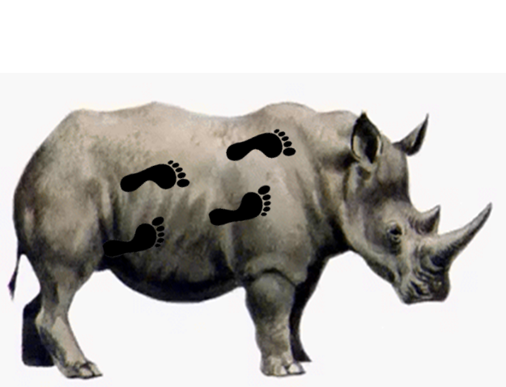
Endurance
Rhino Christians
Rhinos: Big ears, sharp hearing!
Saints: Quick to hear, slow to speak – James 1:19-20
James 1:19-20
19. This you know, my beloved brethren. But everyone must be quick to hear, slow to speak and slow to anger;
20. for the anger of man does not achieve the righteousness of God.

Slide 9
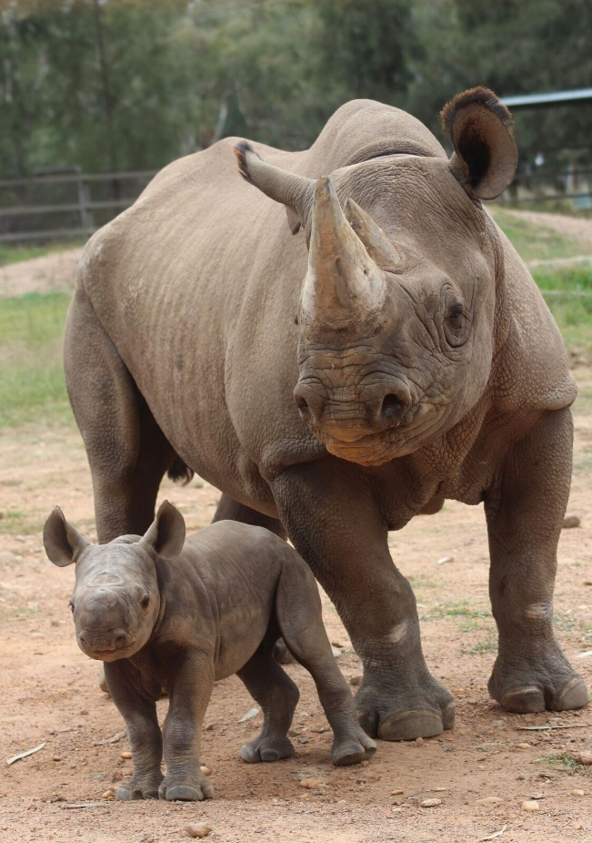
Endurance
Rhino Christians
Rhinos: Protective of young and family!
Saints: Love others, put others first – John 13:34-35
John 13:34-35
34. "A new commandment I give to you, that you love one another, even as I have loved you, that you also love one another.
35. "By this all men will know that you are My disciples, if you have love for one another."

Slide 10
Endurance
Rhino Christians
Rhinos: Long horn for offense & defense!
Saints: Offense & defense—the Sword of the Spirit, word of God – Ephesians 6:17
Ephesians 6:17
17. And take THE HELMET OF SALVATION, and the sword of the Spirit, which is the word of God.

Slide 11
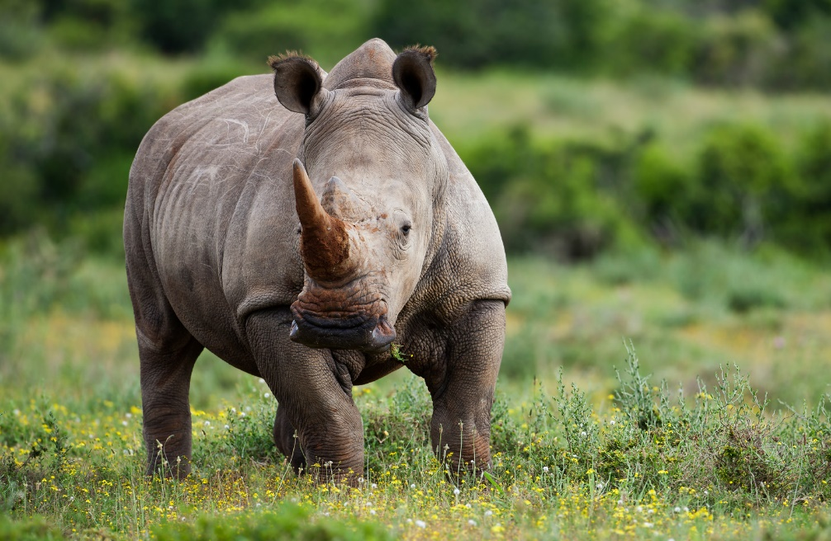
Endurance
Rhino Christians
Hebrews 10:35-39
35. Therefore, do not throw away your confidence, which has a great reward.
36. For you have need of endurance, so that when you have done the will of God, you may receive what was promised.
37. FOR YET IN A VERY LITTLE WHILE, HE WHO IS COMING WILL COME, AND WILL NOT DELAY.
38. BUT MY RIGHTEOUS ONE SHALL LIVE BY FAITH; AND IF HE SHRINKS BACK, MY SOUL HAS NO PLEASURE IN HIM.
39. But we are not of those who shrink back to destruction, but of those who have faith to the preserving of the soul.
Rhinos: Thick-skinned!
Saints: Need to have endurance – Heb. 10:35-39; Js. 1:2-4; 5:7-11
Saints: Faith as a shield – Eph. 6:16; Heb. 10:35-39; I Jn. 5:4

Slide 12
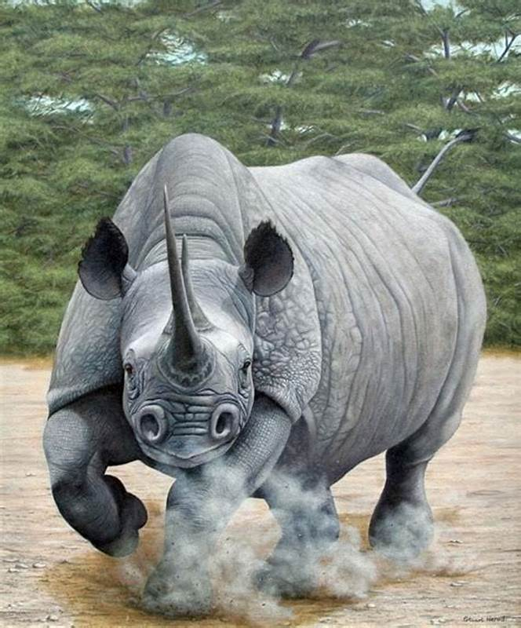
Endurance
Quick to hear, slow to speak!
Love & forgive others!
Take the sword of the Spirit!
Thick-skinned to endure!
We need to have the many traits of Jesus and of rhinos! We must endure, knowing the Lord rewards those who remain faithful!

Slide 13
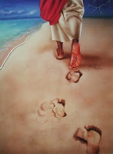
Conclusion
Saints must not only “put on Christ” in baptism (just the
beginning), but must continually “walk in the light” by
“walking in the steps of the Savior”
I Jn. 1:6-7: Follow Jesus to be “led in paths of light!”
I Jn. 1:6-7
6. If we say that we have fellowship with Him and yet walk in the darkness, we lie and do not practice the truth;
7. but if we walk in the Light as He Himself is in the Light, we have fellowship with one another, and the blood of Jesus His Son cleanses us from all sin.
Are you walking in the steps of the Savior?
Notes:
(From Hymn, Stepping In The Light, 1890, by Eliza E. Hewitt, 1851-1920)

Slide 14
“What Must I Do To Be Saved?”
Hear The Gospel (Jn. 5:24; Rom. 10:17)
Believe In Christ (Jn. 3:16-18; Jn. 8:24)
Repent Of Sins (Lk. 13:35; Acts 2:38)
Confess Christ (Mt. 10:32; Rom. 10:10)
Be Baptized (Mk. 16:16; Acts 22:16)
Remain Faithful (Jn. 8:31; Rev. 2:10)
For The Erring Child:
Repent (Acts 8:22), Confess (I Jn. 1:9),
Pray (Acts 8:22)

